Slide 1
Software Project Management
Laxmi Prasad Yadav

Slide 2
Outline
Software Engineering Problem
Introduction/Management Activities
Project Planning
Project Scheduling
Risk Management

Slide 3
Software Engineering Problem
Rapid technology advancement
Increasing customer demands
Time limitations
Limited infrastructure/resources
Conflicts with software testing teams
Software as a product (SaaP, also programming product, software product) — is a product, software, which is made to be sold to users, and users pay for licence which allows them to use it, in contrast to SaaS, where users buy subscription and where the software is centrally hosted.

Slide 4
Software Project Management Framework
The software project management framework provides structure and direction to a project. However, unlike software project management methodologies it is neither too detailed nor too rigid. Frameworks guide projects to their goal while being flexible enough to adapt to evolving conditions.

Slide 5
Framework and Methodology
Framework | Methodology
Gives an overview of how guidelines can be implemented | Offers rigid rules and practices for completing a project
Offers space for creative adaptation | Is pretty rigid and prescriptive
Preferred by experts | Preferred by beginners
Makes it hard to develop and implement performance metrics | Spells out all performance guidelines in granular detail
Leaves room to include other practices and tools | Cannot be embedded with other practices and tools

Slide 6
Introduction.
Software project management is aimed to ensure that the software is delivered on time, within budget and schedule constraints, and satisfies the requirements of the client
Management of software projects is different from other types of management because:
  Software is not tangible
  Software processes are relatively new and still “under trial”
  Larger software projects are usually “one-off” projects
  Computer technology evolves very rapidly

Slide 7
.Introduction
Management activities:
  Writing proposals
  Planning the project
  Scheduling the project
  Estimating the cost of the project
  Monitoring and reviewing the project’s progress
  Selecting, hiring, and evaluating personnel
  Writing reports and giving presentations

Slide 8
Project Planning…
A project plan should be drawn at the start of the project. This plan drives the project and needs to be continuously adjusted
The role of the project manager is to anticipate possible problems and be prepared with solutions for these problems
Other plans that need be developed:
  Quality plan
  Validation and verification plan
  Configuration management plan
  Maintenance plan
  Staff development plan

Slide 9
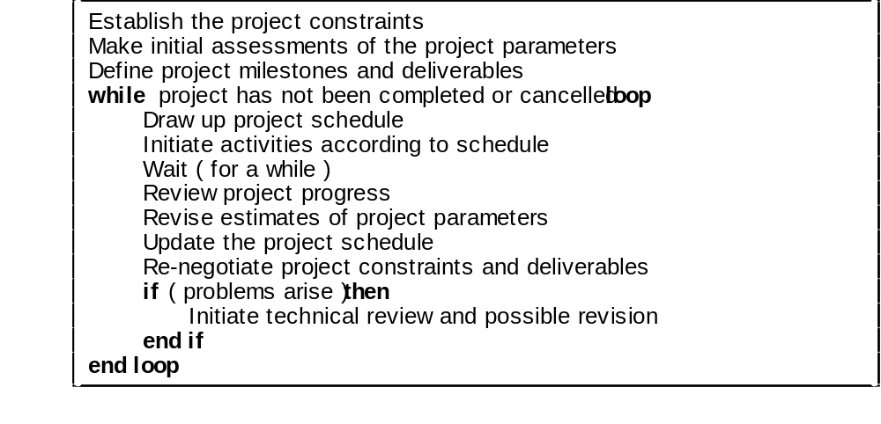
.Project Planning..
The planning process

Slide 10
..Project Planning.
The structure of the project plan:
  Introduction (objectives, constraints)
  Project organization (team structure, personnel involved, roles)
  Risk analysis (types of risk, probabilities, solutions to prevent or reduce the risk)
  Hardware and software resources needed (prices, delivery schedule)
  Work breakdown (activities, milestones, deliverables)
  Project schedule (dependencies between activities/tasks, work assignments, time allocated per task)
  Monitoring and reporting mechanisms (reports, dates)

Slide 11
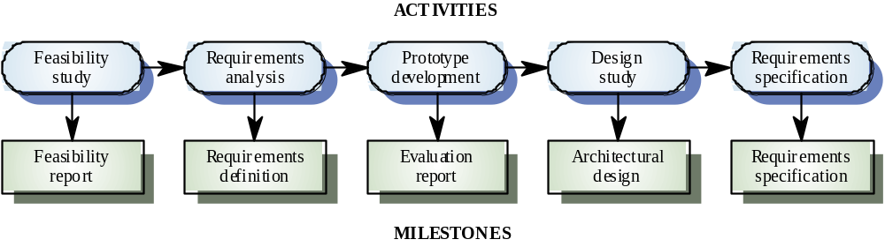
…Project Planning
Milestone = end-point of a specific, distinct software process activity or task (for each milestone a report should be presented to the management)
Deliverable = project result delivered to the client
In order to establish milestones the phases of the software process need be divided in basic activities/tasks. Example for requirements engineering

Slide 12
Project Scheduling……
Software managers:
  Divide the project in activities/tasks
  Estimate time and resources needed to finish the project
  Allocate resources to tasks
  Try to employ efficiently all the project personnel
  Minimize dependencies between tasks and teams
  Prepare contingency plans
  Rely on experience and intuition

Slide 13
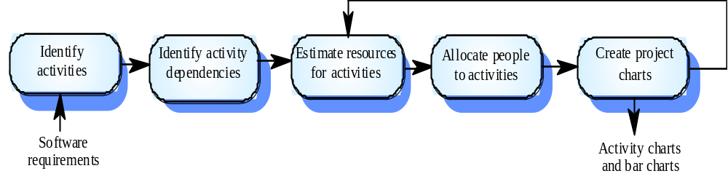
.Project Scheduling…..
The scheduling process]

Slide 14
..Project Scheduling….
Graphical notations used in software project scheduling:
  Tables: summary description of tasks
  Bar charts: show schedule against the time
  Activity charts: graphs that depict dependencies between tasks and indicate the critical path (the longest path in the activity graph)

Slide 15
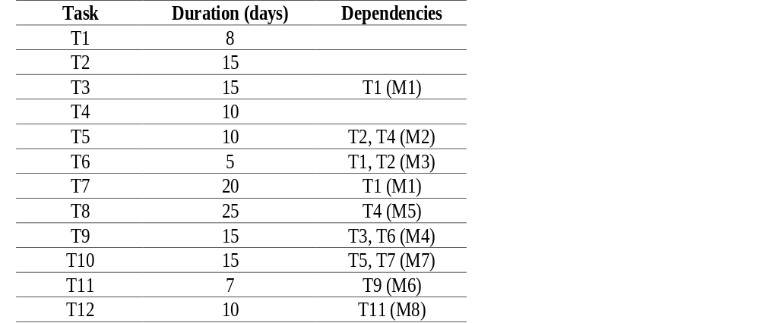
…Project Scheduling…
Example of tabular description :

Slide 16
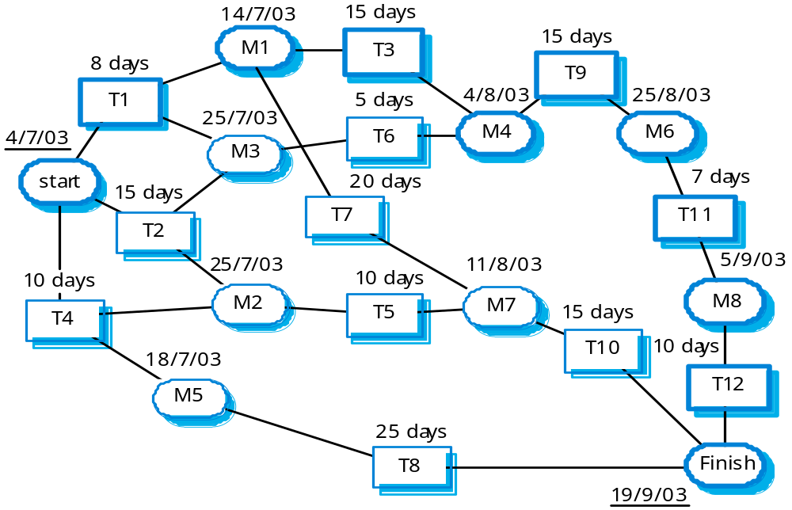
….Project Scheduling..
Example of activity chart

Slide 17
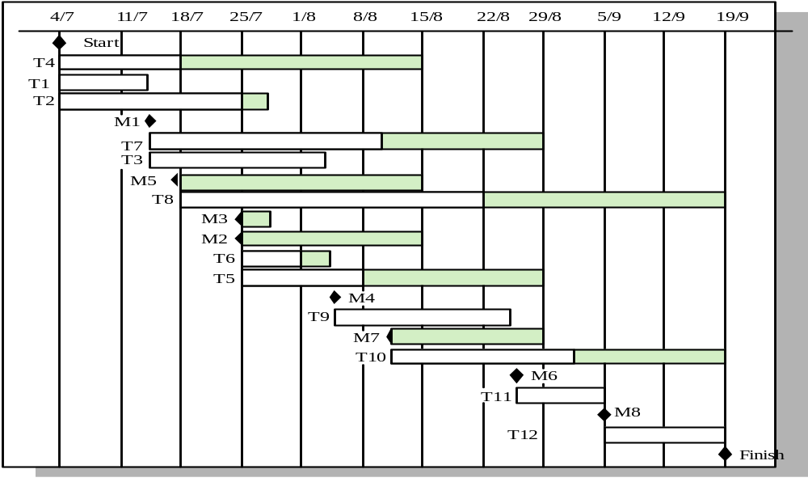
…..Project Scheduling.
Example of bar chart

Slide 18
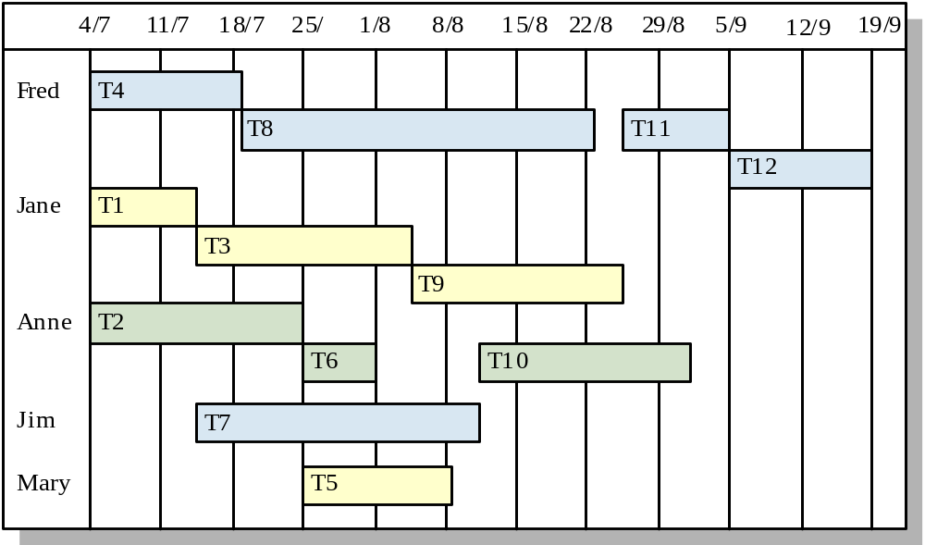
……Project Scheduling
Staff allocation chart

Slide 19
Risk Management…….
Risk = some adverse circumstance that may happen and affect negatively the project, the product, and/or the business
Categories of risk:
  Project risks
  Product risks
  Business risks
Risk management means anticipating risks and preparing plans to reduce their effect

Slide 20
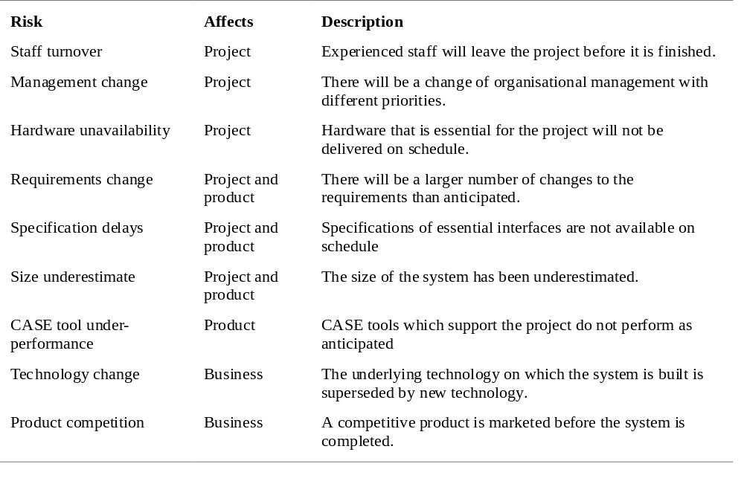
.Risk Management……
Examples of risks in the software process

Slide 21
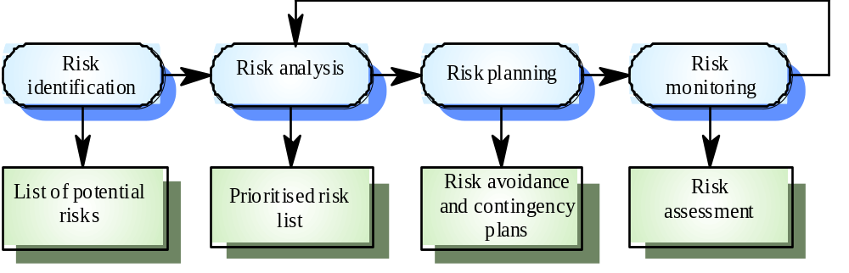
..Risk Management…..
The risk management activities

Slide 22
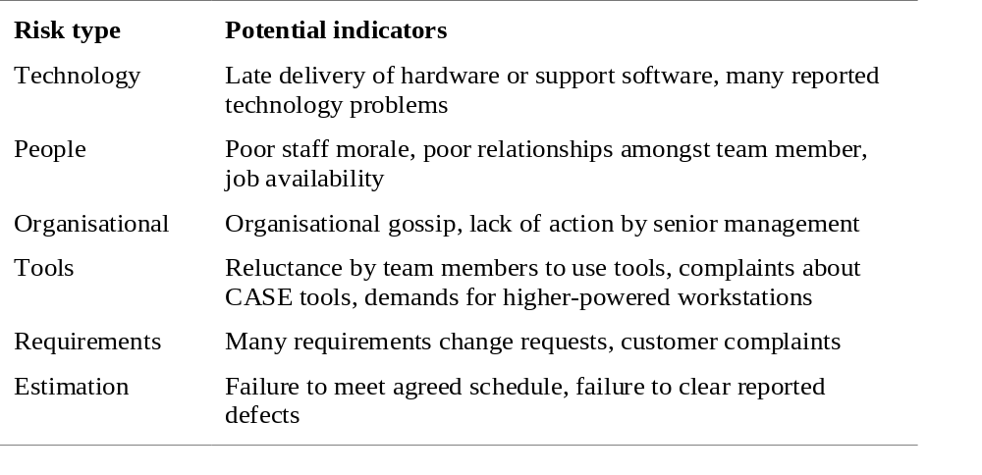
…Risk Management….
Types of risk in risk identification

Slide 23
….Risk Management…
Risk analysis:
  Estimate risk probability:
    Very low (< 10%)
    Low (10-25%)
    Moderate (25-50%)
    High (50-75%)
    Very high (> 75%)
  Establish risk seriousness:
    Insignificant
    Tolerable
    Serious
    Catastrophic

Slide 24
…..Risk Management..
Risk planning means preparing a strategy to deal with each of the risks identified
Classes of strategies:
  Avoidance strategies: the probability of the risk will be diminished
  Minimization strategies: the effect of the risk will be reduced
  Contingency strategies: plans for the worst case scenarios

Slide 25
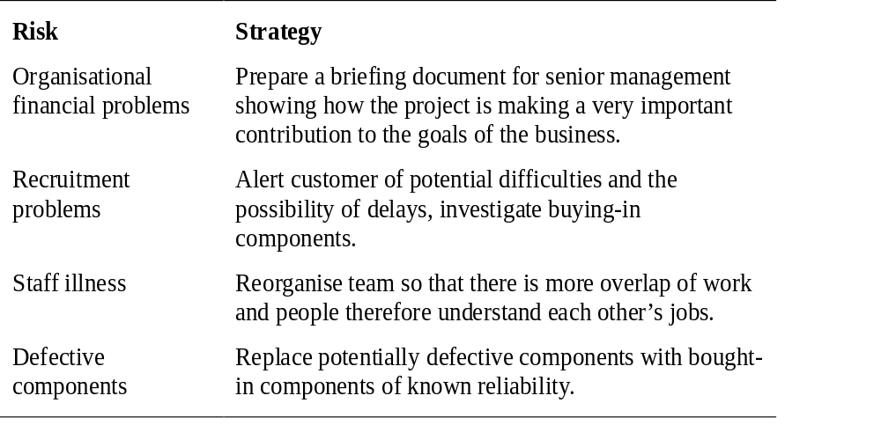
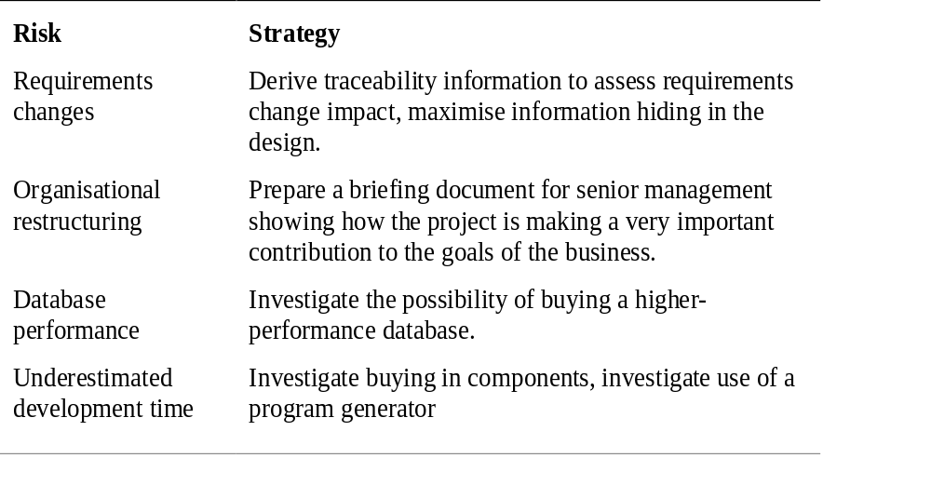
……Risk Management.
Examples of risk management strategies]

Slide 26
…….Risk Management
Risk monitoring:
  Frequently re-assess the risks
    Changes in risk probability?
    Changes in risk gravity?
  Take into consideration risk factors
  Discuss key risks at each management project progress meeting

