Slide 1
Software Testing Verification and Validation

Slide 2
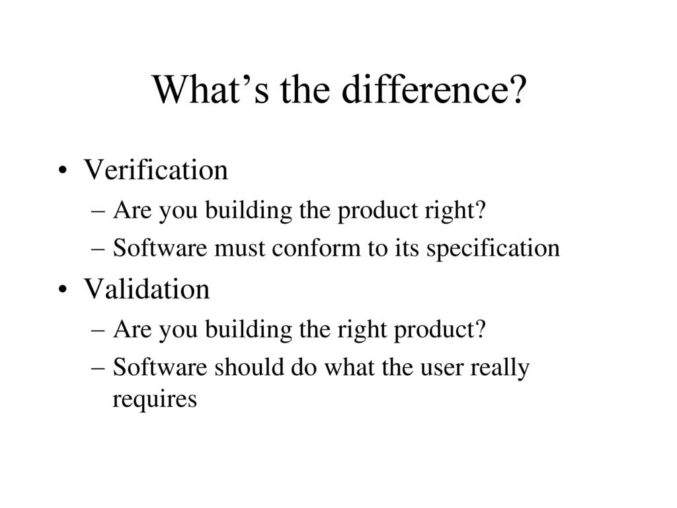

Slide 3
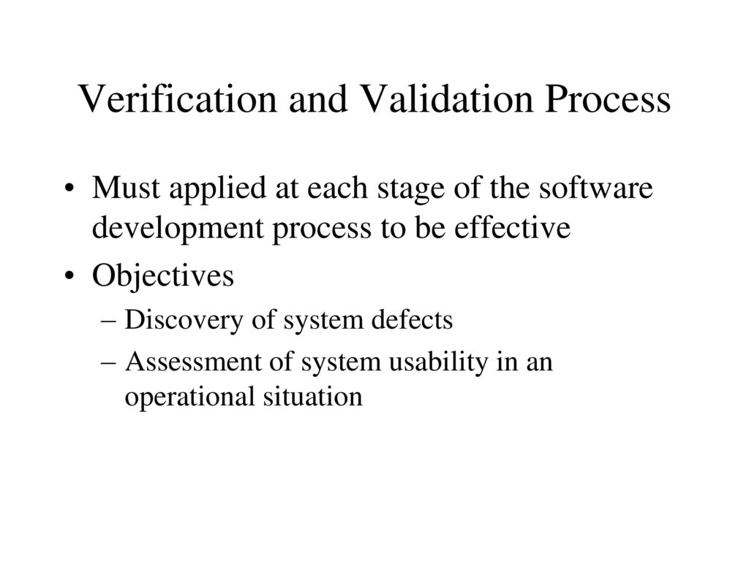

Slide 4
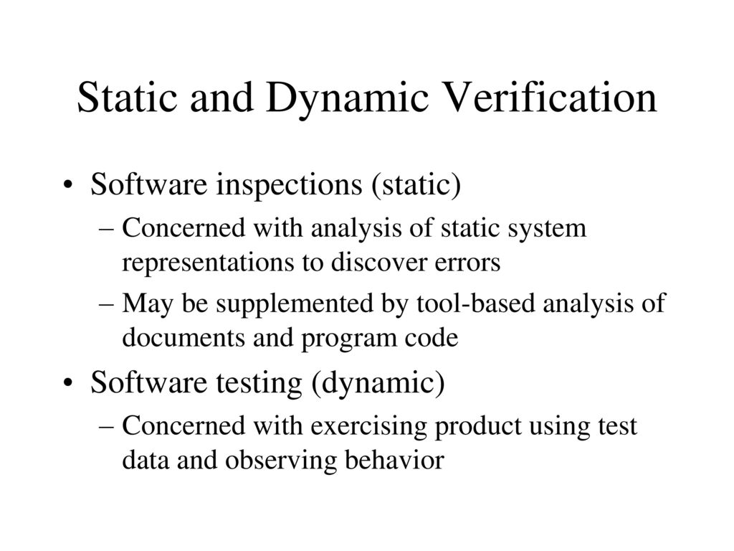

Slide 5
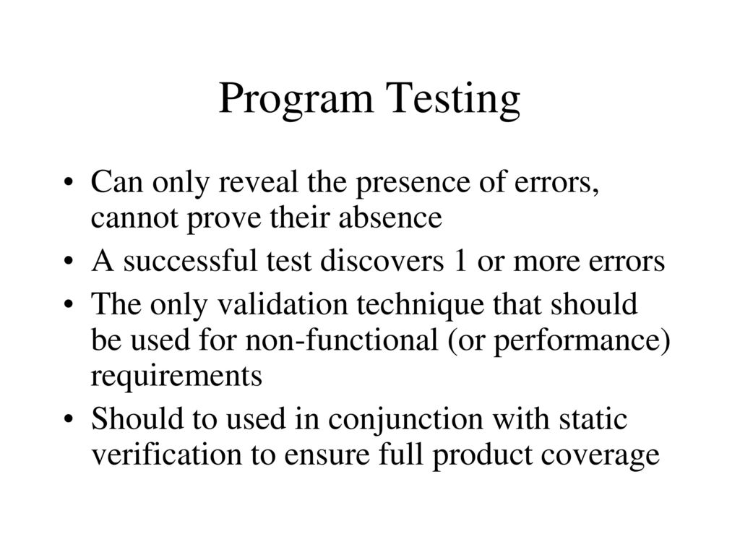

Slide 6
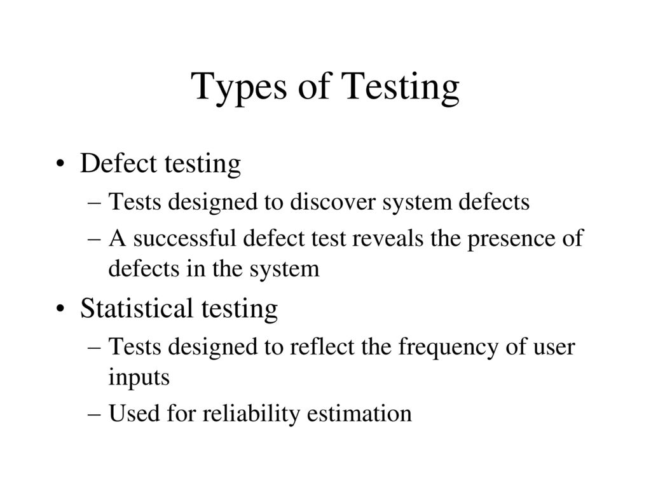

Slide 7
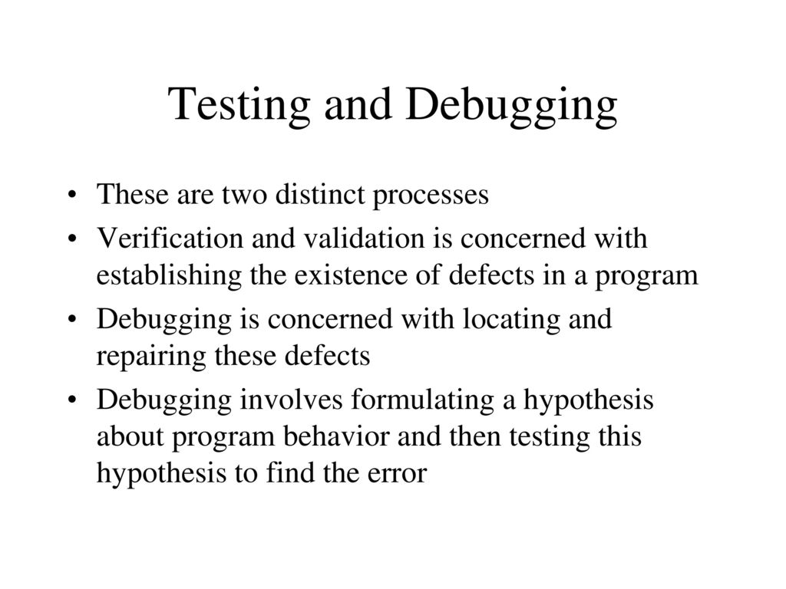

Slide 8
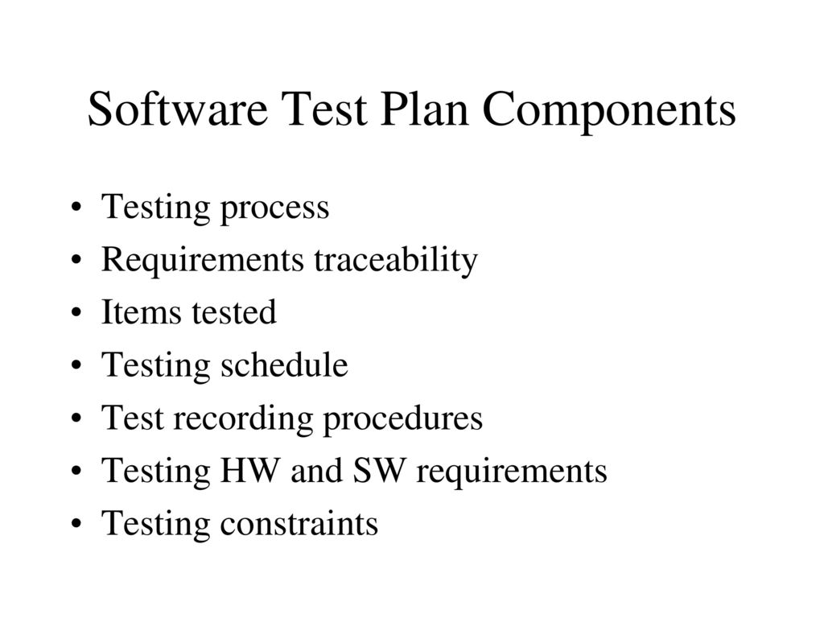

Slide 9
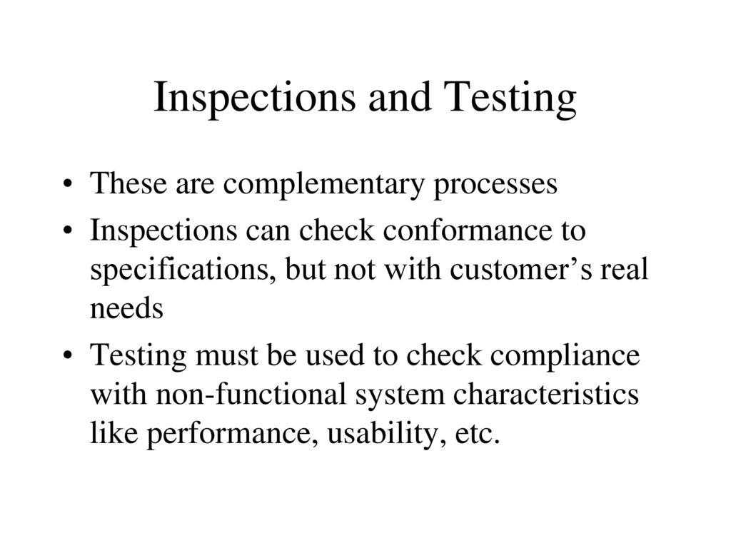

Slide 10
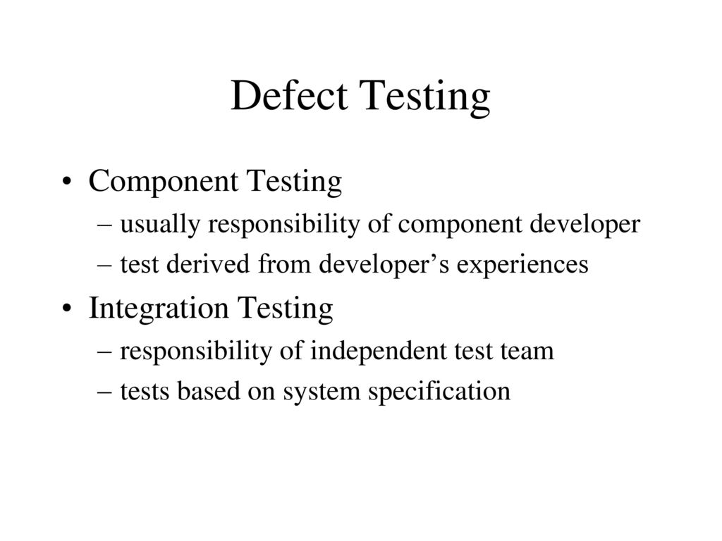

Slide 11
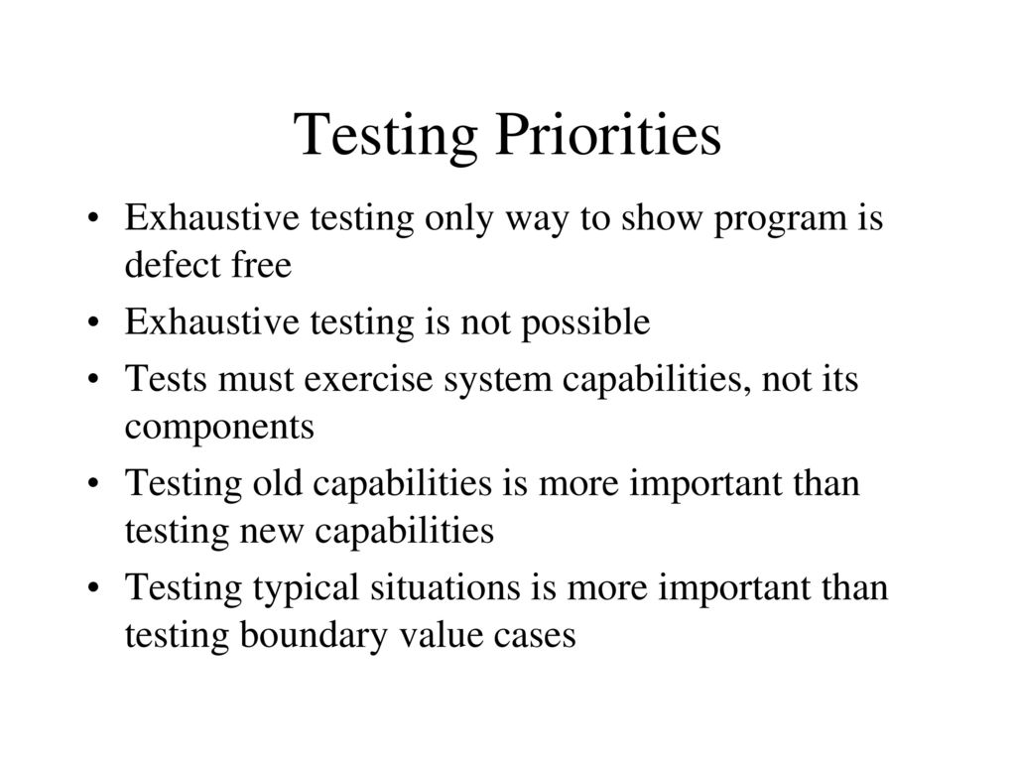

Slide 12
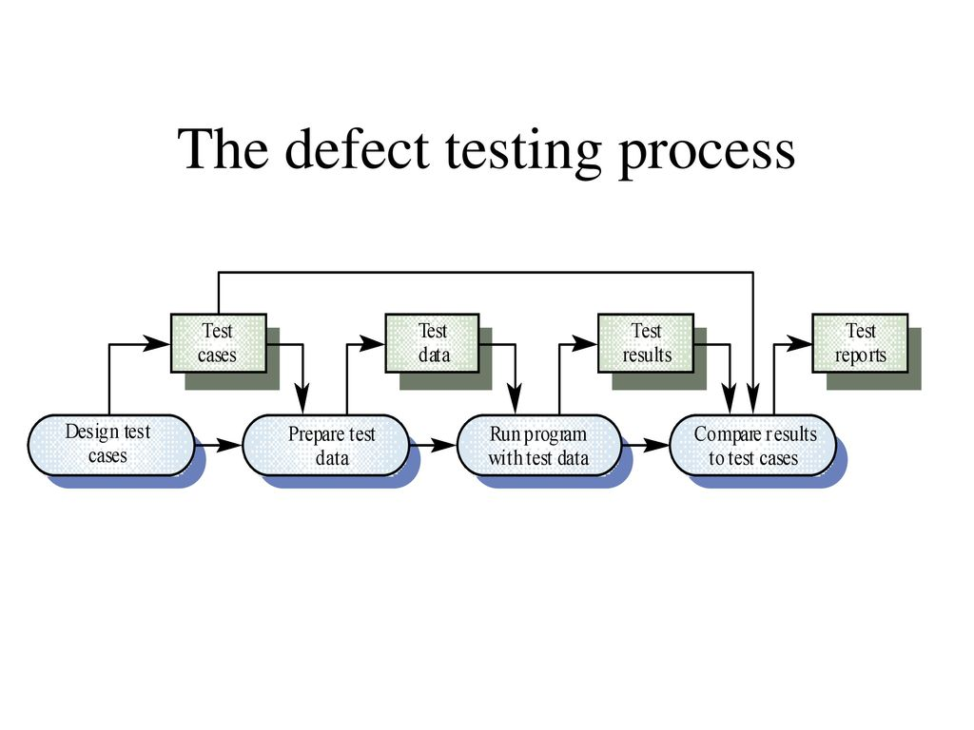

Slide 13
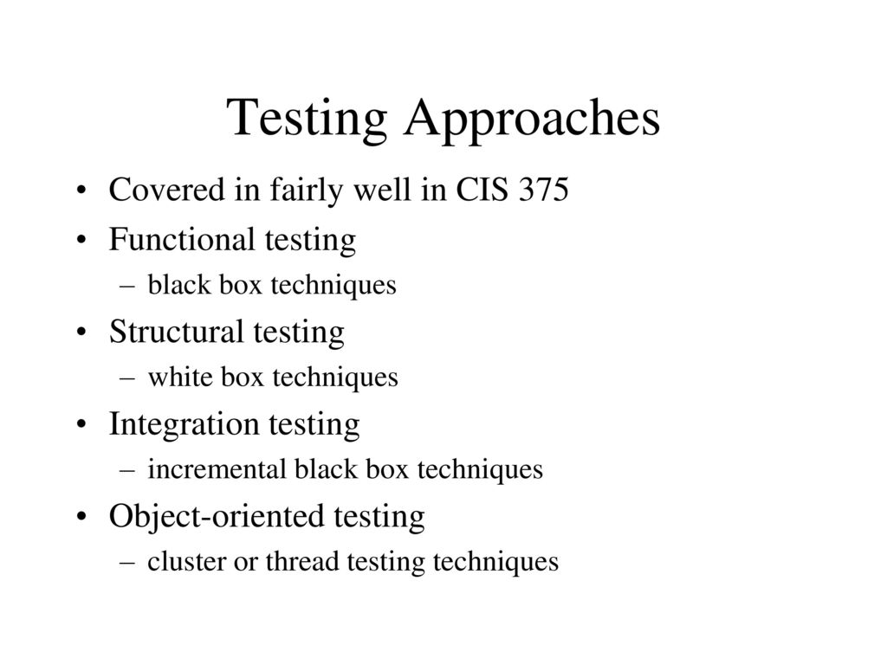

Slide 14
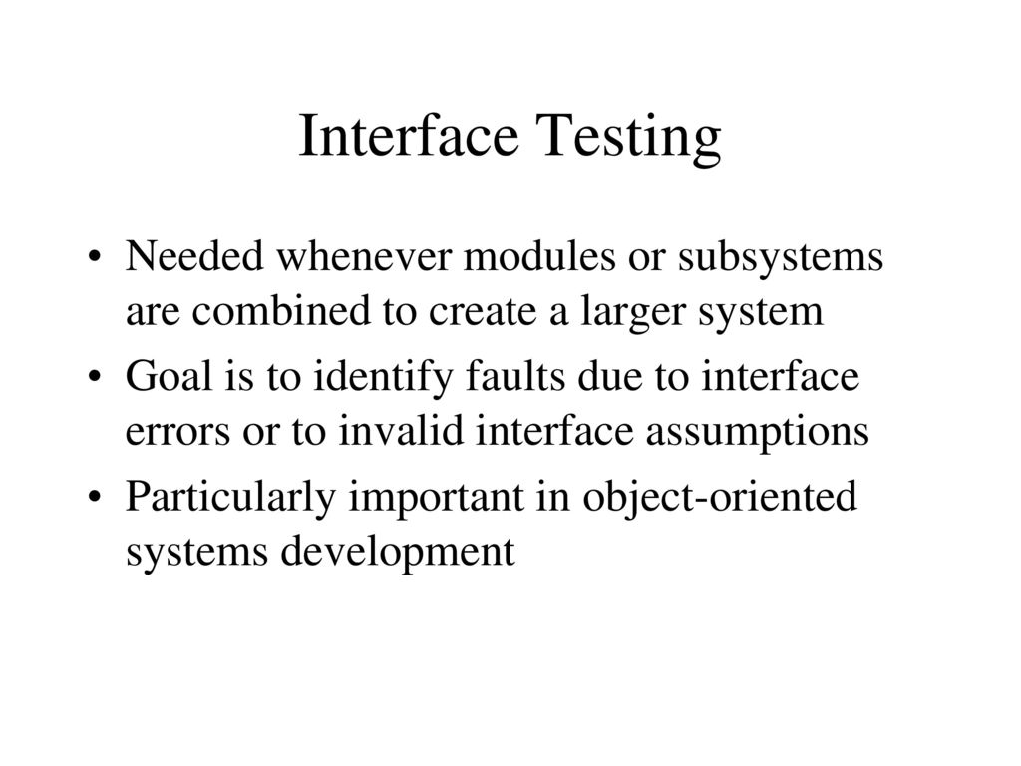

Slide 15


Slide 16
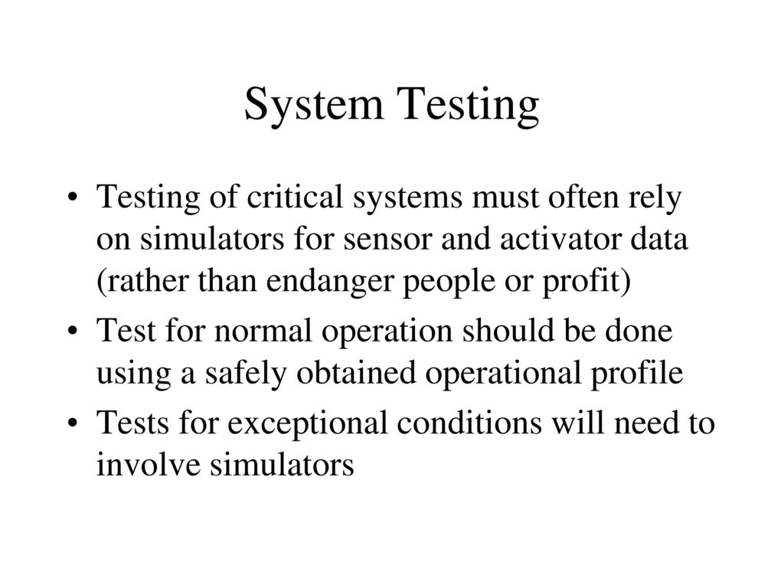

Slide 17


Slide 18


Slide 19


Slide 20


Slide 21
Importance of Software testing in SDLC
Its helps to verify that all the software requirements are implemented correctly or not.
Identifying defects and ensuring they are addressed before software deployment. Because if any defect will found after deployment and force to fixed it, than the correction cost will much higher than the cost of it fixed it at earlier stage of development.
Effective testing is demonstrates that software-testing function appear to be working according to specification, that behavioral and performance requirement appear to have been met.
Whenever any system is developed in different components, its helps to verify the proper integration/interaction of each component to rest of the system.
Data collection as testing is conducted provide a good indication of software reliability and some indication of software quality as a whole

Slide 22
Different Types of Testing
Dynamic v/s static testing.
Development v/s independent testing.
Black v/s white box testing.
Behavioral v/s structural testing.
Automated v/s manual testing.
Sanity, acceptance and smoke testing .
Regression testing.
Exploratory and monkey testing.
Debugging v/s be bugging.

Slide 23
Dynamic v/s static
Static Testing: This testing refers to testing something that’s not running-Examining and reviewing it.
Dynamic Testing: This you would normally think of as testing-running and using the software.

Slide 24
Development v/s independent testing
Development testing denotes the aspects of test design and implementation
Most appropriate for the team of developers to undertake. This is in contrast to Independent Testing. In most cases, test execution initially occurs with the developer testing group who designed and implemented the test, but it is a good practice for the developers to create their tests in such a way so as to make them available to independent testing groups for execution.
Independent testing denotes the test design and implementation most appropriately performed by someone who is independent from the team of developers. You can consider this distinction a superset, which includes Independent Verification & Validation. In most cases, test execution initially occurs with the independent testing group that designed and implemented the test, but the independent testers should create their tests to make them available to the developer testing groups for execution

Slide 25
Black v/s white box testing
The purpose of a black-box test is to verify the unit's specified function and observable behavior without knowledge of how the unit implements the function and behavior. Black-box tests focus and rely upon the unit's input and output.
A white-box test approach should be taken to verify a unit's internal structure. Theoretically, you should test every possible path through the code, but that is possible only in very simple units. At the very least you should exercise every decision-to-decision path (DD-path) at least once because you are then executing all statements at least once. A decision is typically an if-statement, and a DD-path is a path between two decisions.

Slide 26
Behavioral v/s structural testing
Behavioral Testing: This is another name commonly given to Black Box Testing as you are testing the behavior of the software when it’s used without knowing the internal logics how they are implemented.
Structural Testing: This is another name commonly used for white Box testing in which you can see and use the underlying structure of the code to design and run your tests.

Slide 27
Automated v/s manual
Automated Testing: Software testing assisted with software tools that require no operator input, analysis, or evaluation.
Manual Testing : That part of software testing that requires human input, analysis, or evaluation.

Slide 28
Sanity, Acceptance and Smoke testing
Sanity Testing: Sanity testing is a cursory testing; it is performed whenever a cursory testing is sufficient to prove the application is functioning according to specifications. It normally includes a set of core tests of basic GUI functionality to demonstrate connectivity to the database, application servers, printers, etc.
Acceptance testing: Acceptance testing is the final test action before deploying the software. The goal of acceptance testing is to verify that the software is ready and can be used by your end users to perform those functions and tasks for which the software was built.
Smoke Testing: Smoke testing is non-exhaustive software testing, ascertaining that the most crucial functions of a program work, but not bothering with finer details.

Slide 29
Regression testing
The selective retesting of a software system that has been modified to ensure that any bugs have been fixed and that no other previously working functions have failed as a result of the modifications and that newly added features have not created problems with previous versions of the software.
Regression testing is initiated after a programmer has attempted to fix a recognized problem or has added source code to a program that may have inadvertently introduced errors. It is a quality control measure to ensure that the newly modified code still complies with its specified requirements and that unmodified code has not been affected by the maintenance activity.

Slide 30
Exploratory and monkey testing
Exploratory testing involves simultaneously learning, planning, running tests, and reporting / troubleshooting results.
Monkey testing- This is another name for &quot; Ad Hoc Testing&quot;; it comes from the joke that if you put 100 monkeys in a room with 100 typewriters, randomly punching keys, sooner or later they will type out a Shakespearean sonnet. So every time one of your ad hoc testers finds a new bug, you can toss him a banana. The use of monkey testing is to simulate how your customers will use your software in real time.

Slide 31
Debugging v/s Bebugging
Debugging : The process of finding and removing the causes of failures in software. The role is performed by a programmer.
Bebugging: The process of intentionally adding known faults to those already in a computer program for the purpose of monitoring the rate of detection and removal, and estimating the number of faults remaining in the program

