Slide 1

Nonlinear Adaptive Pulse Coded Modulation-based Compression and
Code Reproduction
BoChen SHEN, Tian ZHANG
ESIGELEC

Slide 2
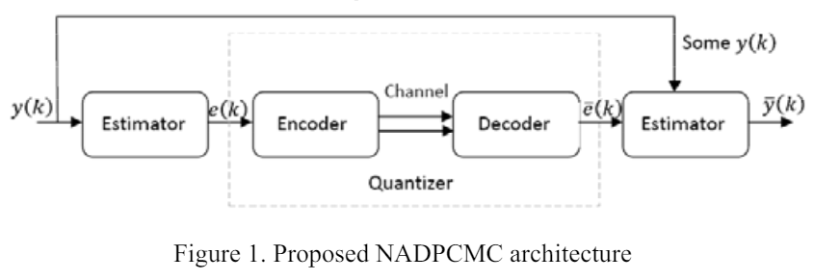

Slide 3

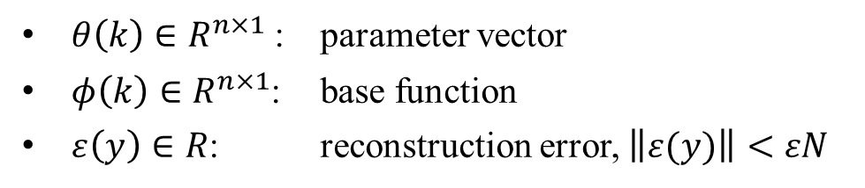
Nonlinear AutoRegressive Moving Average sequence
$θ\left(k\right)$ $∈R^{n×1}$: parameter vector
$φ\left(k\right)∈R^{n×1}$: base function
$ε\left(y\right)∈R$: reconstruction error, $\left\|ε(y)\right\|<εN$

Slide 4

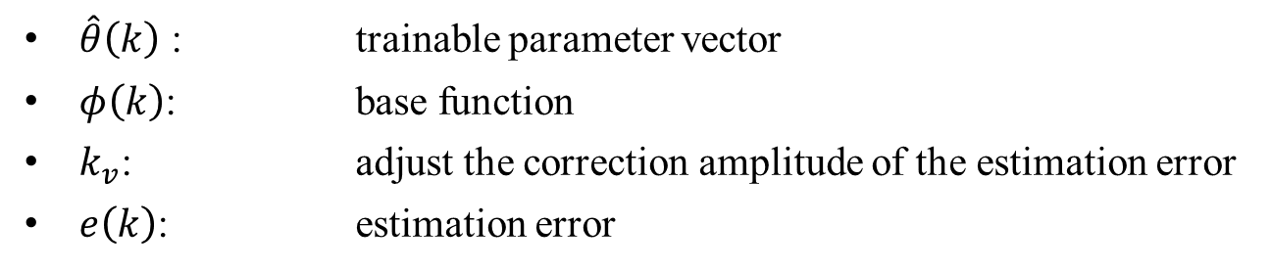
Nonlinear AutoRegressive Moving Average sequence
$\hat{θ}\left(k\right)$ : trainable parameter vector
$φ\left(k\right)$: base function
$k_{v}$: adjust the correction amplitude of the estimation error
$e\left(k\right)$: estimation error

Slide 5
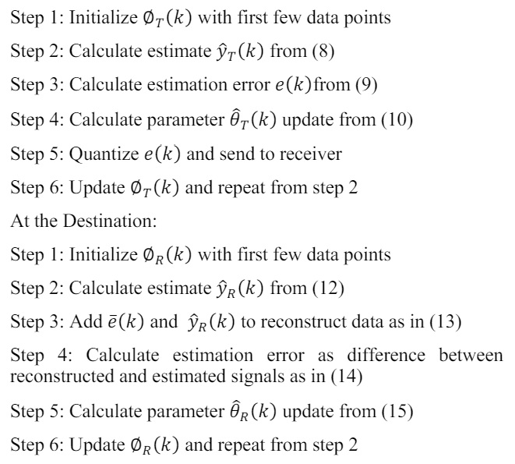
Step

Slide 6
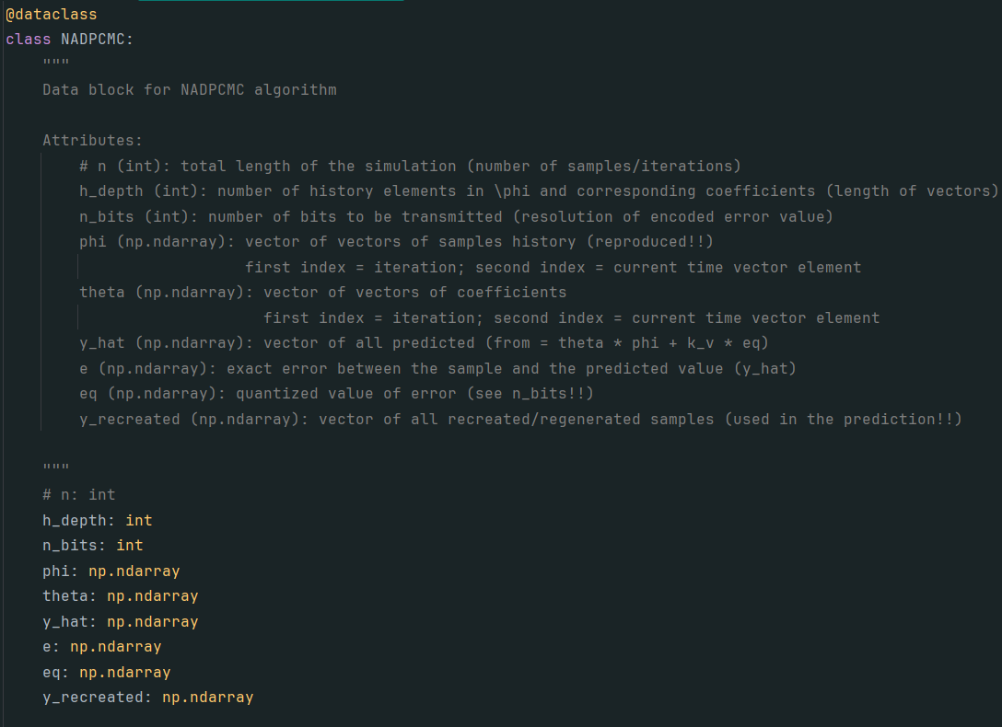
Key Code

Slide 7
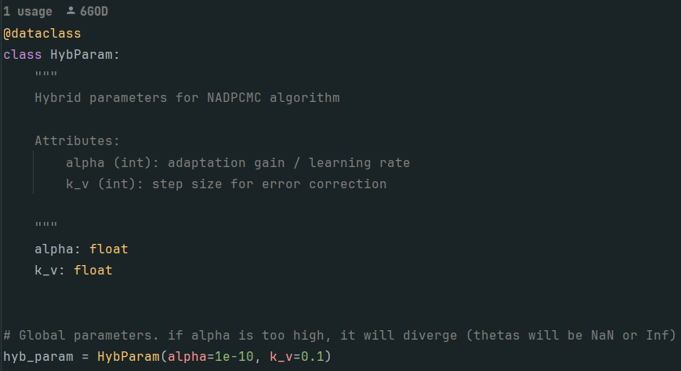
Key Code

Slide 8
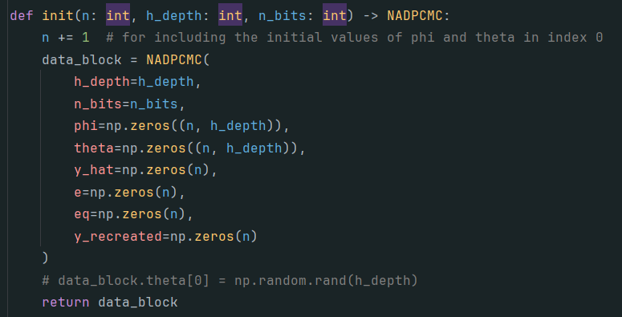
Key Code

Slide 9
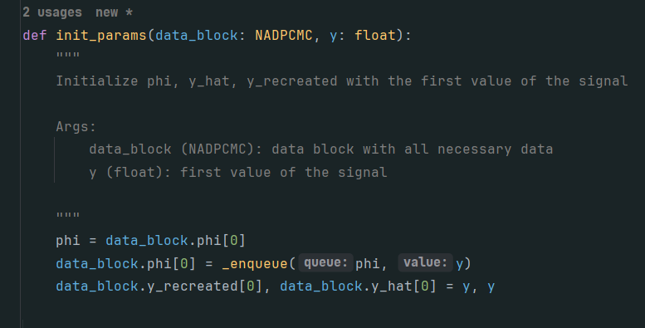
Key Code

Slide 10
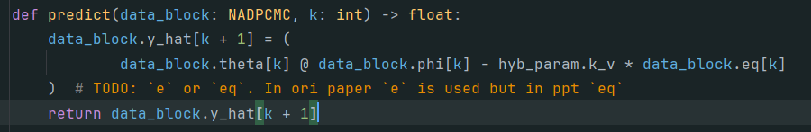
Key Code

Slide 11
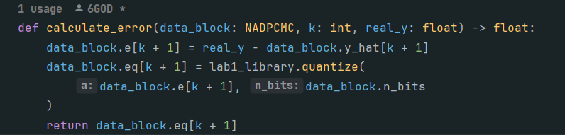
Key Code

Slide 12
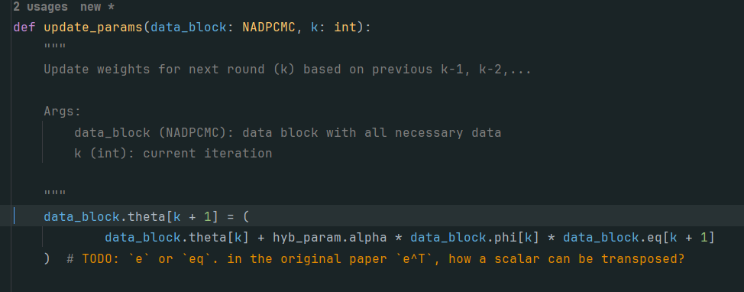
Key Code

Slide 13
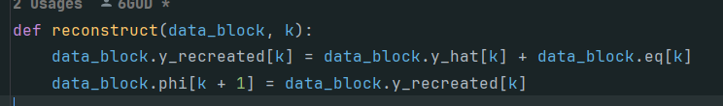
Key Code

Slide 14
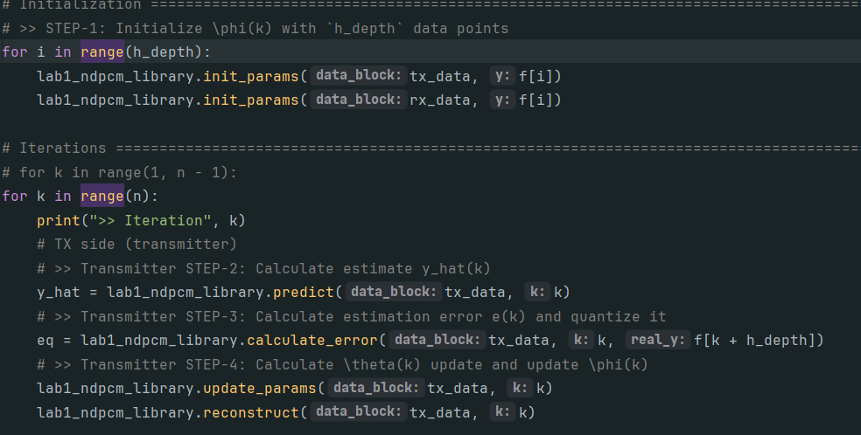
Key Code

Slide 15
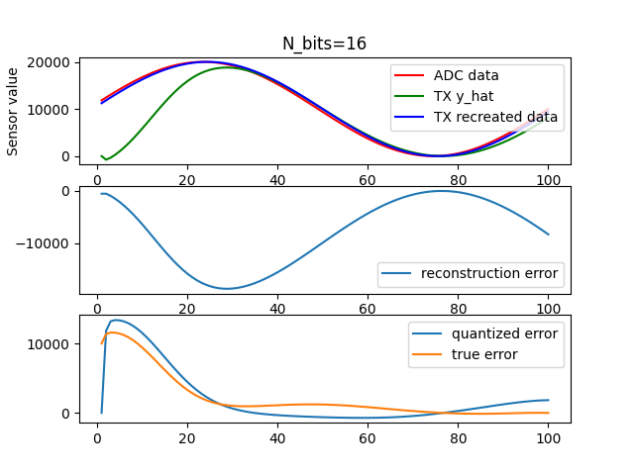
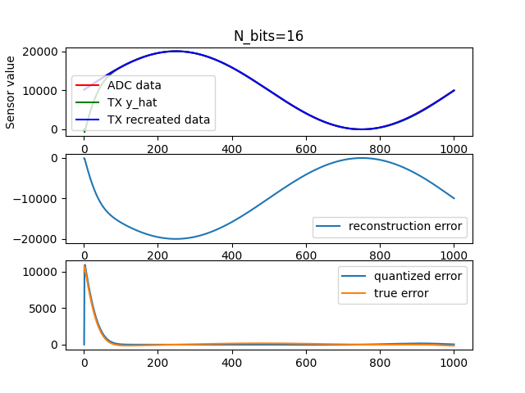

Result
Base Function: $φ\left(k\right)=y\left(k\right)$
$$n_{iter}=100$$
$$n_{iter}=1000$$

Slide 16
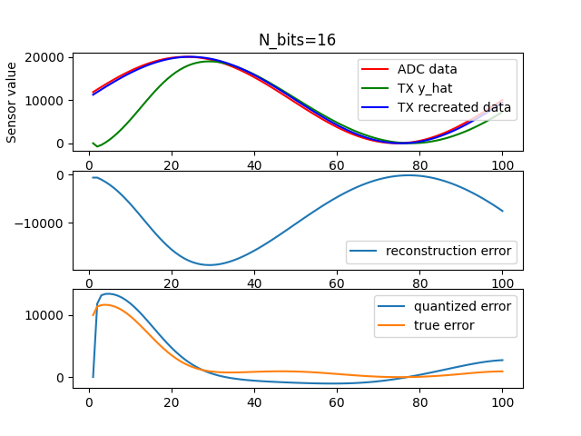
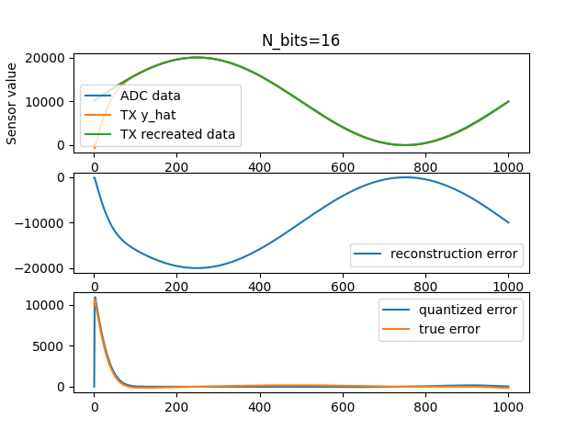

Result
Base Function: $φ\left(k\right)=recreate\left(y\left(k\right)\right)$
$$n_{iter}=100$$
$$n_{iter}=1000$$

Slide 17
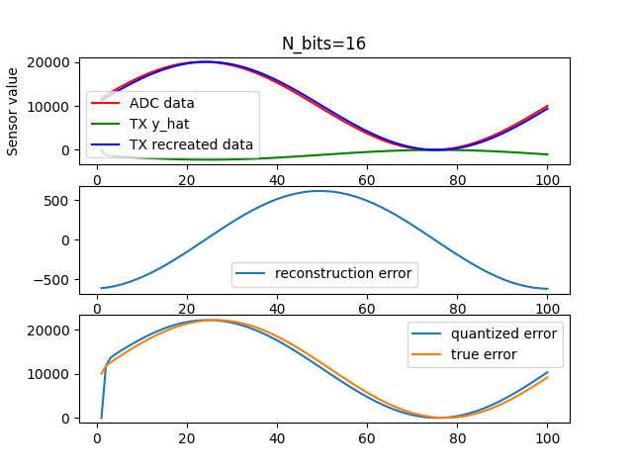
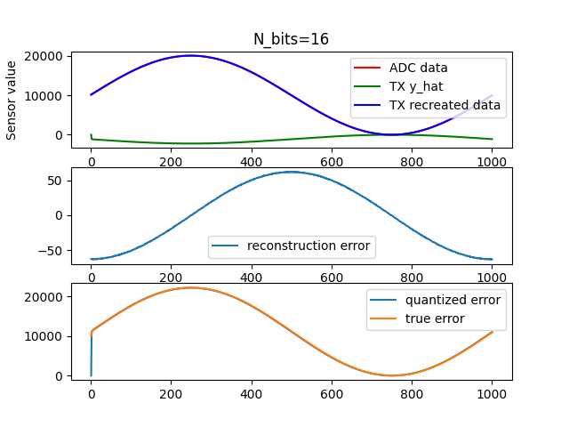
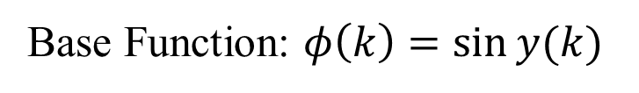
Result
Base Function: $φ\left(k\right)=\sin{y(k)}$
$$n_{iter}=100$$
$$n_{iter}=1000$$

Slide 18
CONCLUSION
Question Acquire Outlook
BoChen SHEN, Tian ZHANG
ESIGELEC

