Slide 1

EMPLOYEE SALARY PREDICTION USING REGRESSION MODEL
Leveraging Machine Learning for Data-Driven Compensation Analysis
Professional Data Science Presentation

Slide 2

SALARY PREDICTION OPTIMIZES TALENT RETENTION AND BUDGETING
Introduction
Problem Statement
Salary prediction leverages historical data to estimate future earnings based on specific employee attributes.
Manual salary estimation is often prone to unconscious bias and inconsistency across departments.
It ensures fair compensation, competitive hiring, and accurate financial forecasting for modern organizations.
Organizations struggle to align pay with market standards and individual performance metrics effectively.
Objective: To build a robust Linear Regression model that predicts salary based on Experience, Education, and Age.

Slide 3

LINEAR REGRESSION PROVIDES A TRANSPARENT AND SCALABLE SOLUTION
01
02
03
EXPERIENCE
EDUCATION
AGE
Total years in the industry; the primary predictor of salary growth.
Level of degree (Bachelor's, Master's, PhD) as a categorical factor.
Demographic factor influencing career progression and seniority.
Technical Approach
Mathematical Model
Algorithm: Multiple Linear Regression via Scikit-learn.
•
Y = β₀ + β₁X₁ + β₂X₂ + ... + ε
Process: 80/20 Train-Test split with feature scaling.
•

Slide 4

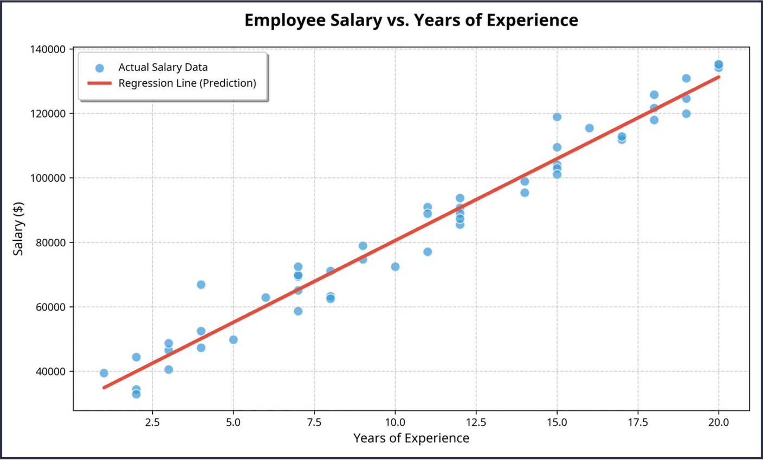
HIGH MODEL ACCURACY CONFIRMS EXPERIENCE AS A KEY SALARY DRIVER
0.94
R² SCORE
94% of salary variance is explained by the regression model.
Low
MSE
Mean Squared Error minimized through iterative training.
Figure 1: Linear Regression Line vs. Actual Employee Salary Data

Slide 5

DATA-DRIVEN INSIGHTS PAVE THE WAY FOR AUTOMATED HR SYSTEMS
01
02
03
KEY TAKEAWAYS
LIMITATIONS
FUTURE SCOPE
Regression models provide a scientific basis for salary benchmarking.
•
Model does not account for soft skills or leadership qualities.
•
Integrating Random Forest for higher non-linear accuracy.
•
Experience remains the most significant factor in salary determination.
•
Geographic location and company size are not yet integrated.
•
Adding real-time market data via API for dynamic adjustments.
•
END OF PRESENTATION • SALARY PREDICTION MODEL 2026

