Slide 1


GEODE
(gee-ohh’d)
Remote Pig Tracking Platform
Stop chasing boxes. Start seeing your pipeline.
SCISSORTAIL
SCISSORTAIL
TECHNOLOGIES
Sales Overview | Confidential — Pigtracks & Scissortail Instruments © 2026

Slide 2



THE COST OF RUNNING BLIND
What a Failed Pig Run Actually Costs
$15K–$100K
Every Pig Run, You Gamble On:
Cost of a failed ILI run including remobilization.
Operator frustration, fuel, labor, overages.
Are all 20+ AGMs still powered on?
Did that last rainstorm or an animal shift any units?
Is the SD card even recording?
4–8 hours+
Will you know the pig passed — or missed?
Wasted driving to check on AGMs that were dead on arrival. Missed data for innaccurate location correlation
When will you find out a device failed?
The current solution is to throw time and manpower at the problem.
The Geode RTD eliminates every one of these risks, making teams more effective and able to do more jobs.

Slide 3



THE SCISSORTAIL GEODE
One Compact Device. Every Detection Method.
Low Frequency Transmitter (22Hz)
Acoustic Accelerometer
+ Traditional Geophone
Magnetic Passage
Scissortail’s compact custom coil picks up 15–35Hz pig transmitter pulses through soil and steel. Software configurable detection frequency.
3-axis magnetometer detects ILI pig magnets. Exact waveform pattern matching with zero-crossing gives the most precise passage timestamp.
Combining new and proven technology. Acoustic weld-strike counting for pig velocity calculation. Works on every pig, with or without a transmitter.
Exact timestamp precision · 4 simultaneous sensor channels · 24-bit resolution

Slide 4










CHANGE OF MINDSET
Above Ground Monitor Remote Tracking Device
Capability | Legacy AGM | Geode RTD
Real-time data | No. SD card only | Yes. View live data over LTE
Remote fleet visibility | None | Full dashboard + alerts
Detection methods | 1 (coil only) | 4 (coil, geophone, mag, accel)
Timestamp precision | Varies (clock drift) | ±100ms (NTP-synced RTC)
Remote state control | No | Yes. Azure IOT Hub Managed
Deployment confirmation | Walk up and check LED | GPS + health on phone
Data format | CSV post-retrieval | Live stream + local archive
Power management | Fixed on/off | Intelligent power saving modes

Slide 5

THE REAL DIFFERENCE
You See Everything in Real Time.
BEFORE: Legacy AGM
NOW: GEODE RTD
✕
Deploy 2+ boxes per AGM and hope they work
Deploy and confirm live from your truck
✕
Drive to each unit to check status
Fleet dashboard shows every device's health
✕
Review SD cards days after the run
Watch live passage streams in real time
✕
Manually review CSVs for passage times
Integrates with Pigtracks to mark passages
✕
Discover dead units after it's too late
Pre-deploy days ahead of run and Remote Track.

Slide 6
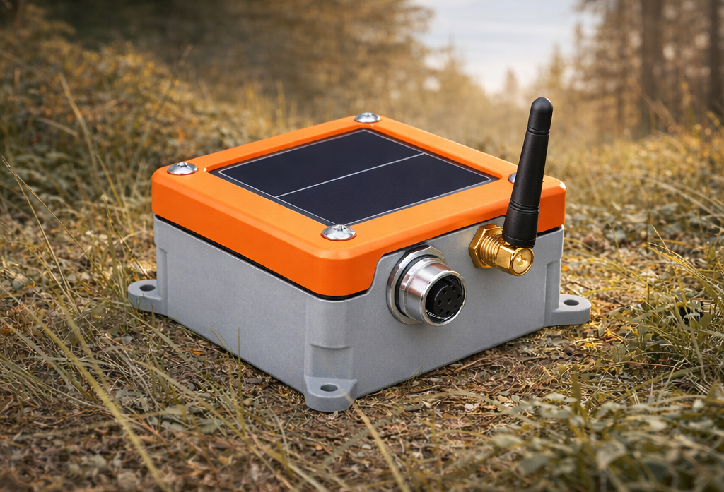





FIELD DEPLOYMENT
Deploy 20 Units Before Lunch
Watch them all from the truck
1
2
2
3
4
Power On
Place & Confirm
Walk Away
Monitor Remotely
Press power button.
Place at survey location.
WiFi appears in seconds.
Operator connects to Wi-Fi for device status:
battery, GPS, network
and sensor check.
Device reports to cloud.
Battery Mode Management
Pigging Project ready.
Live dashboard.
Charts and Data.
Passage alerts.
Battery status.
Solar-charged Li-Ion Battery
Days of runtime
LTE-M cellular
Always connected
Built-in GNSS
Auto-reports its own position
Outdoor ruggedized
Water, Rain, mud, UV

Slide 7


MOVE-ON-YOUR-FEET INTELLIGENCE
Monitor pig tracking equipment from anywhere
Live Health Dashboard
Remote Control
Battery level, last check-in, LTE signal strength, sensor status, and GPS position for every unit in your fleet on one screen.
Switch any device between standby, active streaming, and sleep modes from Pigtracks. No truck roll.
Automatic Alerts
Project-Based Organization
Low battery, LTE failure, enclosure breach, or silent device. If there is an issue, you know immediately, not days later.
Group devices by pipeline, project, or customer. Query fleet by battery, state, or location.
Generate Pigtracks Reports.
Powered by Azure IoT Hub · Enterprise-grade security

Slide 8

PARTNERSHIP MODEL
Your Brand. Our Hardware.
White-Label Ready
Bundle Into Projects
Replace Legacy Fleets
Geode hardware can be made under your brand. Your logo, your packaging, your customer relationship. We stay behind the curtain.
Include RTD monitoring as a line item in your ILI project bids. Differentiate on data quality. Command premium pricing.
Swap aging CDI / IRED AGM inventory for Geode RTDs. No retraining — same field workflow, improved outcomes, dramatically better data.
Scissortail handles firmware updates, cloud infrastructure, and hardware support. You focus on your customers.

Slide 9


Strike Gold with Geode
Let's Talk.
Request a demo. See Remote Tracking in action on your next pig run.
Solution Demo
Technical Deep-Dive
Partnership Discussion
Your team meets ours. We discuss sensor specs, real-life deployment scenarios, integration points, API access.
White-label terms, volume pricing, fleet migration planning.
We demonstrate our survey, deployment, monitoring and cloud applications. We service and deploy RTD’s on a real pig run. You see real data, real time.
SCISSORTAIL
Scissortail | scistail.com | Built for the Field.

