Slide 1
ADVANCED MOTORSPORT SIMULATION & VEHICLE DYNAMICS
Effect of Rear-Wing Angle on F1 Car Performance
Project Scope & Methodology
• An analytical simulation of a representative Formula 1-style vehicle.
• Rear-wing sweep: 0–30° on three synthetic circuit archetypes.
• Corrected force-feasible lap solver and full-bound active-aero search.
• Verified numerical results; not CFD, measured telemetry, or a team setup.
Project Code | ME3106 Motorsport Sim
Model Version | 1.0.0
Run ID | 9b1c3a7968173ace
Angle Sweep | 0.0° to 30.0° (1° step)
Circuits | Low-DF, Balanced, High-DF
Classification | Representative Educational
Representative Educational Model · Run ID: 9b1c3a7968173ace · Seed 3106
Notes:
Introduce the project as a comparative engineering experiment, not an exact F1 digital twin. The central question is whether added downforce compensates for drag over a complete lap.

Slide 2
ME3106 · RESEARCH QUESTION
Research Question and Objectives
• How does rear-wing incidence affect aerodynamic forces and minimum lap time?
• Quantify the trade-off between straight-line resistance and cornering grip.
• Compare low-downforce, balanced, and high-downforce circuit geometries.
• Compare a fixed wing with ideal and actuator-limited two-state strategies.
Key Metrics & Specifications
Independent variable | Rear-wing angle
Main objective | Minimum feasible lap time
Secondary outputs | Speed and tractive energy
Comparison | Same car; different tracks
Representative Educational Model · Run ID: 9b1c3a7968173ace · Slide 2 of 18
Notes:
Explain that a wing with maximum lift-to-drag ratio is not necessarily the fastest setup. All comparisons use identical vehicle inputs and track meshes.

Slide 3
ME3106 · ASSUMPTIONS
Study Scope and Modeling Assumptions
• Quasi-steady point-mass motion with front/rear axle load resolution.
• Analytical rear-wing polar combined with a fixed baseline full-car map.
• Load-sensitive tyres, combined grip, longitudinal load transfer, torque and gearing.
• No tyre-temperature dynamics, suspension transients, driver telemetry, or CFD.
Key Metrics & Specifications
Model scale | Full-car forces
Track spacing | No more than 5 m
Vehicle mass | 798 kg
Wheelbase | 3.60 m
Representative Educational Model · Run ID: 9b1c3a7968173ace · Slide 3 of 18
Notes:
State the scope before discussing results. Axle forces are resolved, but yaw handling and transient suspension behavior are not modeled. Circuit labels describe synthetic geometry, not real venues.

Slide 4
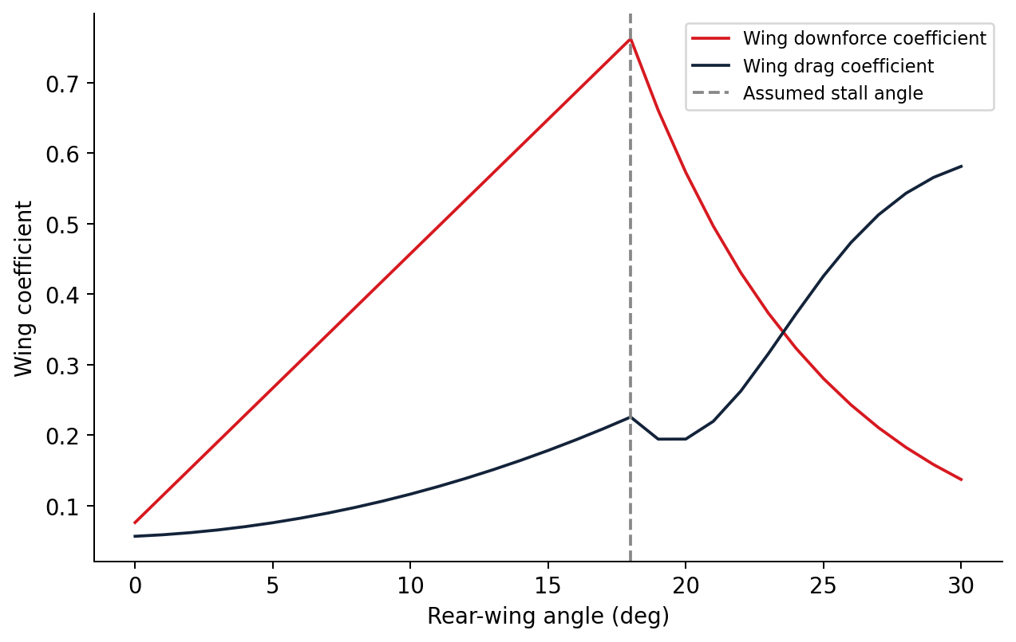
ME3106 · AERODYNAMICS
Aerodynamic Model: Lift, Drag and Stall
• Finite-wing slope: a = a0 / [1 + a0 / (pi e AR)].
• Wing drag includes profile, induced and assumed post-stall terms.
• Pre-stall lift rises linearly; post-stall lift decays exponentially.
• The join is continuous, but its slope can kink at the assumed stall angle.
Angle bounds | 0–30°
Assumed stall | 18°
Aspect ratio | Span squared / wing area
Corrected model output; representative educational vehicle.
Representative Educational Model · Run ID: 9b1c3a7968173ace · Slide 4 of 18
Notes:
Explain why finite span reduces the ideal two-dimensional lift slope. The stall angle is an assumed model parameter, not an experimentally measured property of a real F1 wing.

Slide 5
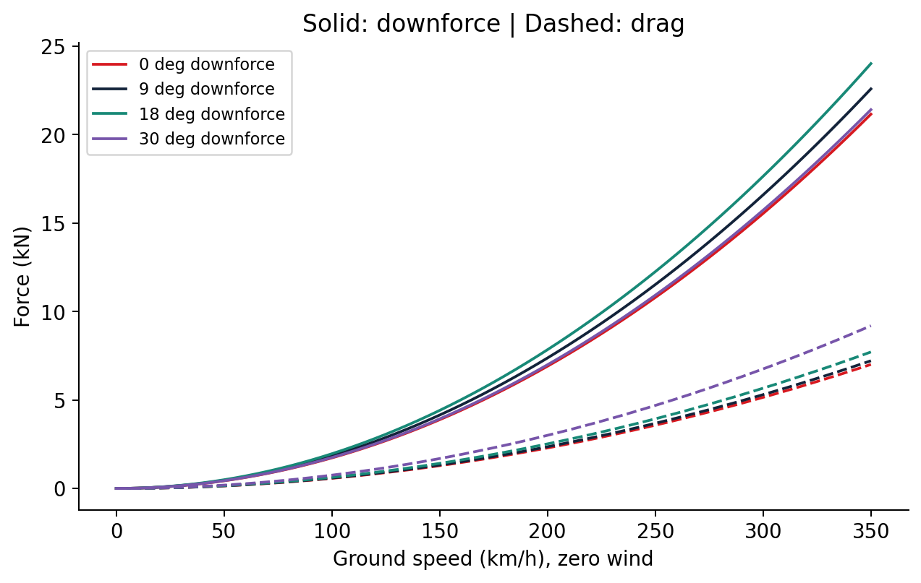
ME3106 · AERODYNAMIC FORCES
Speed-Dependent Downforce and Drag
• Dynamic pressure: q = 0.5 rho V_air squared.
• Downforce = q A CL,total; drag = q A CD,total.
• Relative air speed matters when wind is present.
• Added rear-wing force changes axle loading and the available tyre grip.
Air density | 1.225 kg/m3 nominal
Reference area | 1.50 m2
Comparison angles | 0°, 9°, 18°, 30°
Corrected model output; representative educational vehicle.
Representative Educational Model · Run ID: 9b1c3a7968173ace · Slide 5 of 18
Notes:
Show that force rises with air speed squared for unchanged coefficients. Distinguish the wing coefficients from the area-scaled full-car coefficients. Downforce is positive downward in this project.

Slide 6
ME3106 · VEHICLE DYNAMICS
Tyre Grip and Longitudinal Load Transfer
• Load sensitivity: mu = mu_ref (Fz / Fz_ref)^(-n).
• Combined demand: (Fx/Fx,max)^p + (Fy/Fy,max)^p <= 1.
• Lateral demand is normalized by lateral friction, not longitudinal friction.
• Actual acceleration shifts axle normal loads and alters traction/braking capacity.
Key Metrics & Specifications
Tyre exponent n | 0.08
Ellipse exponent p | 2
Nominal mu_x / mu_y | 1.85 / 1.95
Load resolution | Front and rear axles
Representative Educational Model · Run ID: 9b1c3a7968173ace · Slide 6 of 18
Notes:
Describe the corrected friction-ellipse normalization. An axle already using most lateral grip cannot independently provide its full longitudinal force. Load transfer must use the achieved acceleration.

Slide 7
ME3106 · LONGITUDINAL PERFORMANCE
Powertrain and Force Balance
• Available wheel thrust follows the interpolated engine torque curve and eight gears.
• Resistance combines aerodynamic drag, rolling resistance and track gradient.
• Each segment must satisfy thrust - brake - resistance = mass x acceleration.
• Constant-speed cornering must reserve enough longitudinal grip to overcome drag.
Key Metrics & Specifications
Gear count | 8
Driveline efficiency | 0.94
Redline | 15,000 rpm
Energy metric | Positive wheel tractive work
Representative Educational Model · Run ID: 9b1c3a7968173ace · Slide 7 of 18
Notes:
Explain the main physics correction: a purely lateral speed limit can permit unsustainable speed if no tyre force remains to overcome drag. The corrected solver rejects that state. No battery or hybrid deployment is modeled.

Slide 8
ME3106 · SIMULATION METHOD
Closed-Track Lap Simulation Workflow
• Load validated car configuration and discretize the track at <=5 m.
• Construct a sustainable local speed envelope for the commanded wing profile.
• Apply forward acceleration and backward braking passes until convergence.
• Include the closing segment, then check achieved acceleration and force closure.
Key Metrics & Specifications
Speed convergence | <=0.001 m/s
Iteration ceiling | 200
Force feasibility guard | >= -5 N
Force closure guard | <=0.000001 N
Representative Educational Model · Run ID: 9b1c3a7968173ace · Slide 8 of 18
Notes:
Walk through the distance-domain solver. The start/finish cell is part of the physics, not a special unchecked edge. Numerical guards establish feasibility within the model, not experimental accuracy.

Slide 9
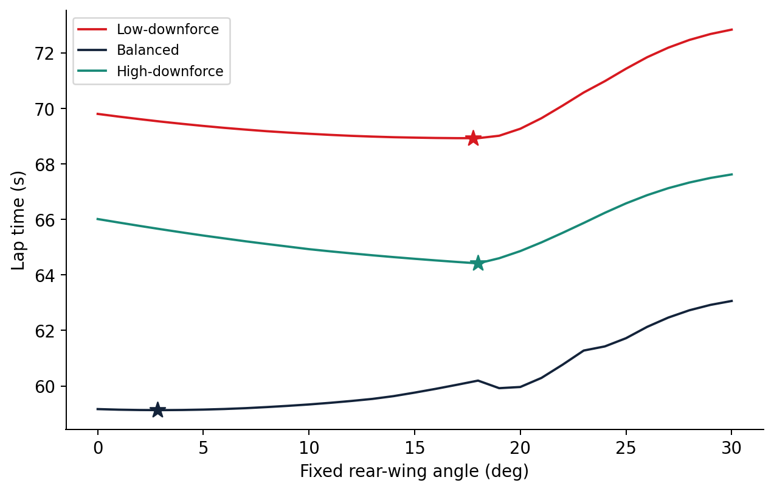
ME3106 · CORRECTED RESULTS
Fixed-Wing Sweep Across Three Circuits
• 93 physical laps: 31 integer angles x three synthetic circuits.
• Every case checked for convergence, force feasibility and closed-segment integration.
• All angle cases retain the original 5 m track discretization.
• The best wing setting depends on this car model and the circuit geometry.
Grid cases | 93 / 93 checked
Wing sweep | 0°, 1°, ... 30°
Track types | Low-DF / Balanced / High-DF
Corrected model output; representative educational vehicle.
Representative Educational Model · Run ID: 9b1c3a7968173ace · Slide 9 of 18
Notes:
Use the fresh fixed-lap sweep plot, not the legacy result bundle. Discuss how curve minima differ across circuits. Do not rename the synthetic circuits as real tracks.

Slide 10
ME3106 · FIXED OPTIMIZATION
Continuously Refined Fixed-Wing Optima
• Physical lap solves refine candidate basins around the integer sweep.
• Bounds and neighboring integer points remain part of the search.
• Balanced-track optimum is near 2.819°; the other two are near 18°.
• These are nominal model optima, not uncertainty confidence intervals.
Low-DF fixed | 17.752° / 68.927 s
Balanced fixed | 2.819° / 59.130 s
High-DF fixed | 18.000° / 64.418 s
Corrected model output; representative educational vehicle.
Representative Educational Model · Run ID: 9b1c3a7968173ace · Slide 10 of 18
Notes:
Report the refined optima to three decimals, then explain that more digits do not imply experimentally calibrated accuracy. The high-downforce optimum falls at the assumed stall angle.

Slide 11
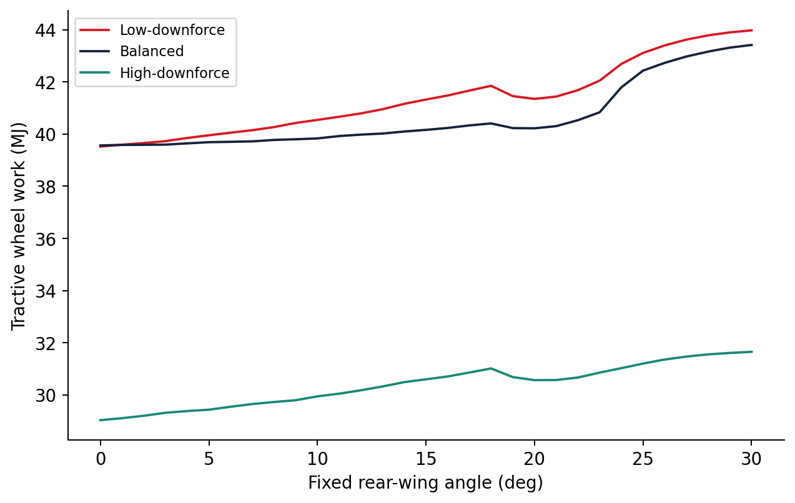
ME3106 · FIXED-WING DIAGNOSTICS
Speed and Energy: Secondary Performance Metrics
• Record maximum speed and positive tractive wheel work for every fixed lap.
• Energy is integrated from achieved tractive force over distance.
• Minimum lap time and minimum tractive energy are different objectives.
• Wheel tractive work is not fuel consumption or battery-energy demand.
Source | Fresh 93-case fixed audit
Energy unit | MJ per modeled lap
Speed unit | km/h
Corrected model output; representative educational vehicle.
Representative Educational Model · Run ID: 9b1c3a7968173ace · Slide 11 of 18
Notes:
Explain what the energy metric means. Avoid interpreting a tractive-work difference as a fuel-saving percentage; engine efficiency and hybrid energy flows are outside scope.

Slide 12
ME3106 · CONTROL STRATEGY
Two-State Active Aerodynamics
• Use an open, lower-angle state on eligible straight sections.
• Use a closed, higher-angle state under the modeled switching conditions.
• Search every unique integer pair within 0–30°, with >=1° separation.
• Compare ideal state changes against finite-rate, delayed actuator behavior.
Key Metrics & Specifications
Pairs per search | 465
Actuator limit | 90°/s
Activation delay | 0.2 s
Deactivation delay | 0.1 s
Representative Educational Model · Run ID: 9b1c3a7968173ace · Slide 12 of 18
Notes:
The active strategy is an educational control policy, not an exact FIA implementation. The ideal mode is a model comparison; the limited mode includes actuator timing. Grid-resolved optimality is not continuous-global optimality.

Slide 13
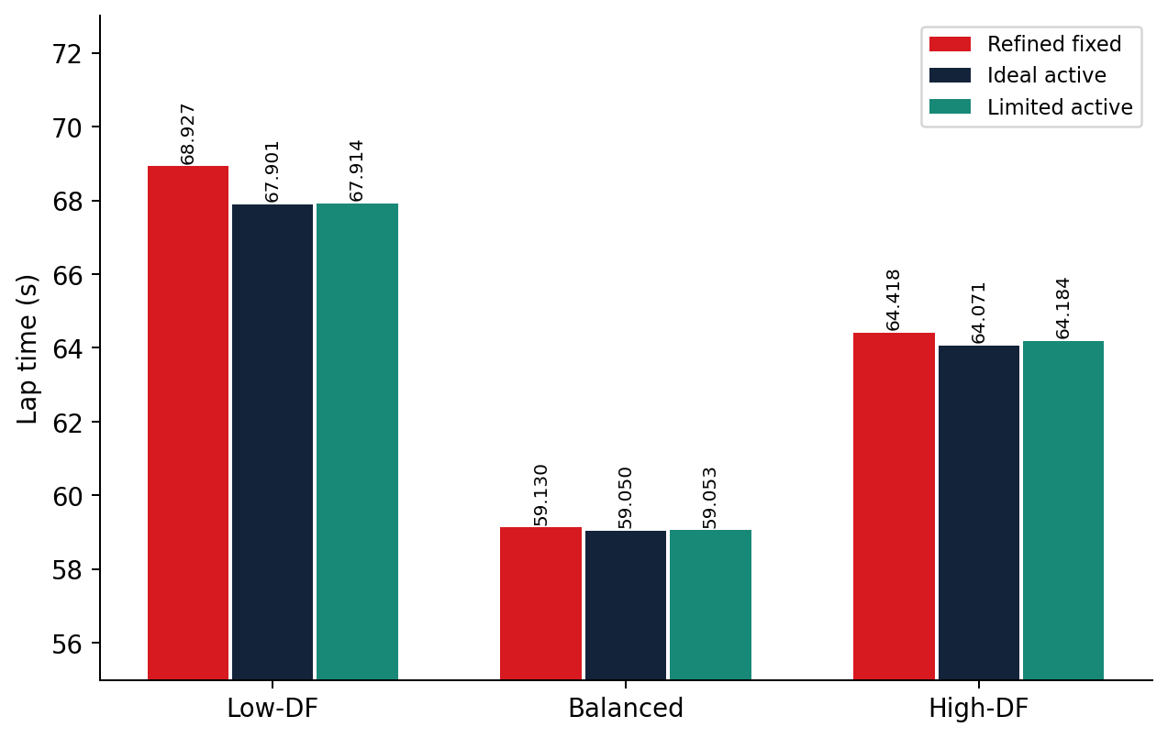
ME3106 · ACTIVE-AERO RESULTS
Fixed Versus Ideal and Limited Active Aero
• Compare optimized strategies using the same car and original track meshes.
• Active search evaluates actual physical laps, not a coarsened surrogate.
• All completed cases must satisfy force, convergence and actuator checks.
• Interpret small differences relative to model assumptions and numerical resolution.
Low-DF limited | 67.914 s
Balanced limited | 59.053 s
High-DF limited | 64.184 s
Corrected model output; representative educational vehicle.
Representative Educational Model · Run ID: 9b1c3a7968173ace · Slide 13 of 18
Notes:
Read the corrected three-strategy comparison. Report the gain in seconds from the fixed optimum to the limited strategy. These nominal gains are not guaranteed real-world performance improvements.

Slide 14
ME3106 · NUMERICAL AUDIT
Validation and Reproducibility Evidence
• Fixed sweep: 93 checked laps, including force, time and energy closure.
• Active searches: 465 unique pairs per circuit and actuator mode.
• Scalar force checks include the track closing segment and achieved acceleration.
• Source hashes, input hashes, runtime versions and completion receipts preserve identity.
Key Metrics & Specifications
Active scope | 3 circuits x 2 modes
Active cases | 2,790 total
Audit type | Numerical feasibility
Empirical validation | Not performed
Representative Educational Model · Run ID: 9b1c3a7968173ace · Slide 14 of 18
Notes:
Distinguish the six active grids: the balanced ideal grid completed earlier, while the five monitored grids contribute 2,325 cases. Passing these guards does not make the whole software suite or native implementation complete.

Slide 15
ME3106 · NATIVE TOOLCHAIN
MATLAB and Simulink Implementation
• MATLAB source includes configuration, aero, dynamics and fixed-wing lap analysis.
• Simulink model/builder is supplied for a speed-dependent aero/actuator demonstration.
• The aero block chain is: speed and angle -> coefficients -> forces -> scopes.
• Full native active/uncertainty/sensitivity execution and strict runtime parity remain unverified.
Key Metrics & Specifications
MATLAB entry point | matlab/run_project.m
Parity tolerance | 1e-4 required
Simulink scope | Aero/actuator demonstration
Runtime status | Full native validation pending
Representative Educational Model · Run ID: 9b1c3a7968173ace · Slide 15 of 18
Notes:
Show the actual source/model files if demonstrating the project. Do not say all results were produced by MATLAB: the corrected numerical evidence here comes from Python. MATLAB startup failed in this environment, and full native scope is incomplete.

Slide 16
ME3106 · RESEARCH LIMITATIONS
Uncertainty and Sensitivity: What Remains
• A validated >=1,000-sample, nine-parameter uncertainty study is still required.
• The tested uncertainty surrogate failed independent validation and was rejected.
• Direct full-physics Monte Carlo is selected, but not yet implemented or executed.
• No confidence intervals or sensitivity rankings are claimed in this presentation.
Key Metrics & Specifications
Planned random seed | 3106
Planned samples | >=1,000 per circuit
Accepted uncertainty | None yet
Legacy MC figures | Excluded
Representative Educational Model · Run ID: 9b1c3a7968173ace · Slide 16 of 18
Notes:
Be direct: uncertainty results are unfinished. Explain the planned sample-angle physical simulations, but do not present the proposal as completed work. This transparency is stronger than displaying invalid confidence intervals.

Slide 17
ME3106 · CONCLUSIONS
Main Findings and Engineering Interpretation
• There is no universal wing angle: optimize for the complete circuit, not one aerodynamic metric.
• Correct force balance changes the accepted lap speeds, optima and strategy comparisons.
• Two-state active aero provides a nominal model benefit when feasible switching is allowed.
• Final empirical calibration, native parity and validated uncertainty are necessary next steps.
Key Metrics & Specifications
Nominal fixed optimum | Circuit dependent
Control takeaway | Respect actuator limits
Model takeaway | Reserve grip for resistance
Claim boundary | Educational simulation
Representative Educational Model · Run ID: 9b1c3a7968173ace · Slide 17 of 18
Notes:
Conclude with the engineering trade-off and the corrected feasibility requirement. Explain that the deliverable is a defensible presentation of verified nominal results, not a declaration that every original project requirement is satisfied.

Slide 18
ME3106 · REFERENCES & HANDOFF
Evidence, Source Files and Questions
• Inputs: config/project.json and tracks/*.json define assumptions and geometry.
• Physics: src/f1wing/aero.py, dynamics.py, lap.py and strategies.py.
• Corrected results: docs/verification/*-20261005.csv and matching JSON audit receipts.
• Native files: matlab/ and results/simulink/; incomplete runtime scope is disclosed.
Key Metrics & Specifications
Presentation | Editable PowerPoint + PDF
Speaker support | Notes and slide-by-slide guide
Numerical source | Corrected audit receipts
Questions | Model, methods, trade-offs
Representative Educational Model · Run ID: 9b1c3a7968173ace · Slide 18 of 18
Notes:
Invite questions about the equations, numerical guards, optimization and limits. If asked about a real F1 setup or robust optimum, say that calibrated aerodynamic/tyre data and validated uncertainty are still needed.

