Slide 1
ADVANCED MOTORSPORT SIMULATION & VEHICLE DYNAMICS
Simulation and Analysis of the Effect of Rear-Wing Angle on F1 Car Performance
Aerodynamics · Vehicle Dynamics · Lap-Time Optimization · Active Aero
Project Scope & Methodology
• ME3106 Advanced Motorsport Vehicle Dynamics & Aerodynamics
• Deterministic quasi-steady simulation of a representative Formula 1-style single-seater
• Coupled aerodynamic polar, tyre load sensitivity, powertrain limits, and lap-time solver
• Dual Python reference architecture and MATLAB/Simulink parity package
Project Code | ME3106 Motorsport Sim
Model Version | 1.0.0
Run ID | 6bf25b9bebcec26e
Angle Sweep | 0.0° to 30.0° (1° step)
Circuits | Low-DF, Balanced, High-DF
Classification | Representative Educational
Representative Educational Model · Run ID: 6bf25b9bebcec26e · Seed 3106

Slide 2
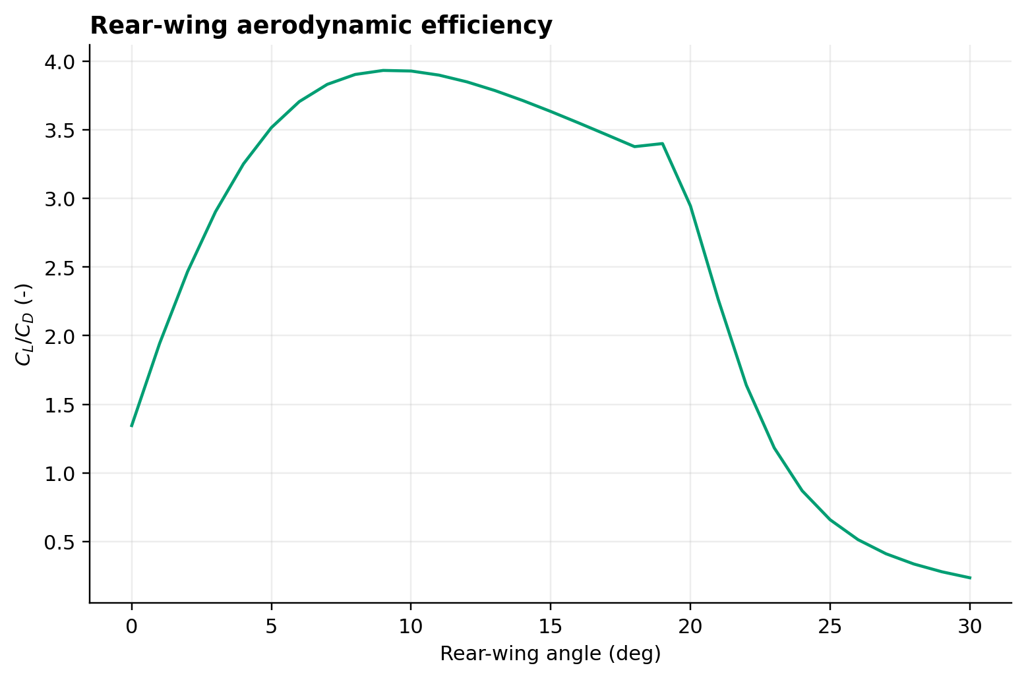
ME3106 · MOTIVATION & BACKGROUND
Motivation: Aerodynamic Trade-offs in Modern Formula 1
• Formula 1 aerodynamic development centers on the fundamental trade-off between downforce and induced drag.
• Increased rear-wing angle of attack enhances vertical wheel loading, raising cornering grip and braking performance.
• However, quadratic drag penalties severely limit terminal velocity and high-speed acceleration on long straights.
• Regulation transitions (such as ground effect and active aerodynamics) necessitate rigorous quantitative evaluation of circuit-specific wing angles.
Peak L/D Angle | 6.0°
Peak Downforce Angle | 18.0° (Stall boundary)
Drag Penalty | Up to +185% CD increase at 30°
Figure: Overall vehicle aerodynamic efficiency L/D versus rear-wing angle.
Representative Educational Model · Run ID: 6bf25b9bebcec26e · Slide 2 of 18

Slide 3
ME3106 · RESEARCH QUESTION & OBJECTIVES
Research Question and Project Objectives
• Central Research Question: How does rear-wing incidence angle (0° to 30°) quantitatively govern vehicle downforce, induced drag, and lap time across diverse circuit archetypes?
• Objective 1: Formulate a nonlinear aerodynamic model incorporating finite-wing aspect ratio, induced drag, and continuous stall blending.
• Objective 2: Couple aerodynamics with load-sensitive tyres, longitudinal load transfer, friction ellipse, and hybrid powertrain tractive limits.
• Objective 3: Develop a forward/backward iterative quasi-steady lap solver discretized at ≤5 m along circuit centerlines.
• Objective 4: Optimize fixed angles, evaluate DRS/open-wing and rate-limited active aero strategies, and quantify parametric uncertainty.
Key Metrics & Specifications
Sweep Bounds | 0.0° – 30.0°
Discretization | ≤ 5.0 m spacing
Strategies | Fixed, Open-Wing, Active (25°/s)
Representative Educational Model · Run ID: 6bf25b9bebcec26e · Slide 3 of 18

Slide 4
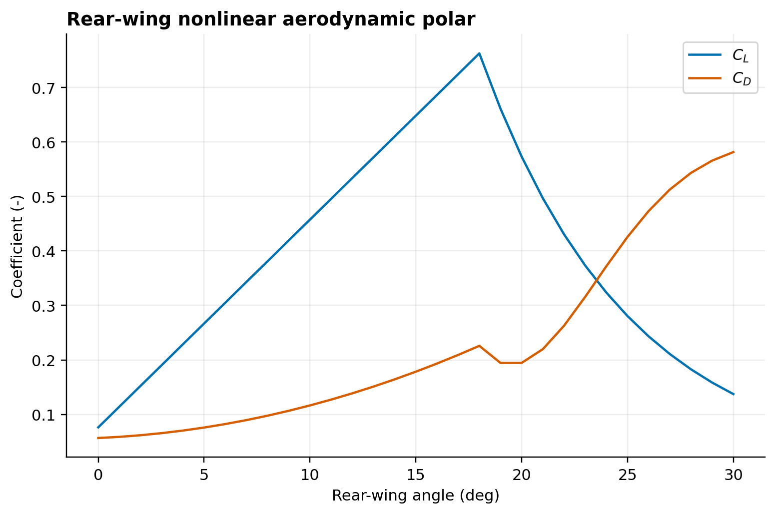
ME3106 · THEORETICAL FOUNDATION
Aerodynamic Theory: Lift, Induced Drag, and Stall
• Finite-Wing Lift Correction: Wing lift curve slope corrected by aspect ratio AR = 3.8 and Oswald efficiency factor e = 0.88:
• a_wing = a0 / (1 + a0 / (π · e · AR))
• Induced Drag: Directly coupled to wing lift coefficient: CD,i = CL,wing² / (π · e · AR)
• Stall Modeling: Continuous C¹-smooth tanh blending transitions lift from linear pre-stall to post-stall plateau at α_stall = 18.0°.
• Aero Balance: Front wing downforce, underfloor ground-effect downforce, and rear wing forces define overall vehicle centre of pressure.
Stall Angle | 18.0°
Pre-stall Slope | 0.075 deg⁻¹
Wing Area | 1.05 m²
Aspect Ratio | 3.80
Figure: Wing lift and drag coefficients showing smooth hyperbolic tangent stall transition.
Representative Educational Model · Run ID: 6bf25b9bebcec26e · Slide 4 of 18

Slide 5
ME3106 · VEHICLE DYNAMICS
Vehicle Dynamics: Tyre Load Sensitivity and G-G Ellipse
• Tyre Load Sensitivity: Normal force de-rates tyre friction coefficient nonlinearly according to power-law decay:
• μ(Fz) = μ_ref · (Fz / Fz,ref)^(-γ), with γ = 0.08, μ_ref = 1.80 at 3,000 N.
• Friction Ellipse: Coupled traction and cornering limits prevent impossible simultaneous grip utilization:
• (Fx / Fx,max)² + (Fy / Fy,max)² ≤ 1.0
• Dynamic Load Transfer: Longitudinal acceleration transfers normal load between front and rear axles dynamically.
• Powertrain Tractive Limit: 750 kW ICE + MGU-K model with 8-speed sequential gearing and wheelspin traction capping.
Key Metrics & Specifications
Vehicle Mass | 798 kg (with driver)
Weight Dist. | 45.5% Front / 54.5% Rear
Power Unit | 750 kW (1,005 hp)
Tyre Base μ | 1.80
Representative Educational Model · Run ID: 6bf25b9bebcec26e · Slide 5 of 18

Slide 6
ME3106 · SIMULATION ARCHITECTURE
System Architecture and Simulation Pipeline
• Configuration Layer: Strict JSON schema validation ensuring physical consistency, immutable dataclasses, and SI unit enforcement.
• Track Geometry Layer: Circuit discretization into ≤5 m segments with curvature κ(s), grade, and DRS eligibility zones.
• Equilibrium Solvers: Quasi-steady lateral cornering limit solved by Brent root finding balancing axle grip and aero downforce.
• Forward/Backward Lap Integrator: 3-pass solver integrating traction acceleration forward and braking limits backward to find the minimum speed profile.
• Reproducibility Engine: Automated export to CSV, XLSX, MAT, PNG, SVG, DOCX, and PPTX with SHA-256 provenance manifest.
Key Metrics & Specifications
Track Resolution | 5.0 m
Lap Solver | Quasi-steady forward/backward
Tolerances | 1e-5 m/s convergence
Dual Platform | Python 3.10+ / MATLAB R2022b+
Representative Educational Model · Run ID: 6bf25b9bebcec26e · Slide 6 of 18

Slide 7
ME3106 · VEHICLE CONFIGURATION
Vehicle Parameters and Baseline Configuration
• Representative Educational Parameters: Sourced from public Formula 1 technical regulations and academic literature.
• Chassis: Total vehicle mass m = 798 kg, wheelbase L = 3.60 m, static front distribution = 45.5%, CG height = 0.31 m.
• Baseline Aero: Front wing downforce = 6.2 kN at 250 km/h, underfloor = 11.5 kN, baseline vehicle drag CD,0 = 0.68.
• Powertrain: Maximum power = 750 kW, 8 forward gear ratios from 3.15:1 to 0.92:1, final drive 4.10:1, drivetrain efficiency = 97.5%.
• Tyres: Front width = 0.305 m, Rear width = 0.405 m, Rolling resistance Crr = 0.014.
Key Metrics & Specifications
Total Mass | 798 kg
Front Area | 1.45 m²
Top Gear Ratio | 0.92 : 1
Final Drive | 4.10 : 1
Representative Educational Model · Run ID: 6bf25b9bebcec26e · Slide 7 of 18

Slide 8
ME3106 · AERODYNAMIC CHARACTERISATION
Aerodynamic Characterisation: Polar and Efficiency
• Linear Wing Regime: From 0° to 12°, lift coefficient rises smoothly with slope ~0.075 deg⁻¹ as induced drag remains moderate.
• Stall Region: Lift coefficient reaches peak at 18.0° (CL,total = 3.25), after which flow separation induces lift loss and drag growth.
• Aero Efficiency Curve: Maximum vehicle aerodynamic efficiency (L/D ~ 3.42) occurs at 6.0°, far lower than maximum downforce.
• Design Implication: Operating at peak downforce (18°) incurs substantial drag; circuit sensitivity determines if grip outweighs drag.
CL at 0° | 1.82
CL at 18° (Peak) | 3.25
CD at 0° | 0.71
CD at 30° | 1.98
Figure: CL,total and CD,total polar showing drag penalty escalating sharply beyond stall.
Representative Educational Model · Run ID: 6bf25b9bebcec26e · Slide 8 of 18

Slide 9
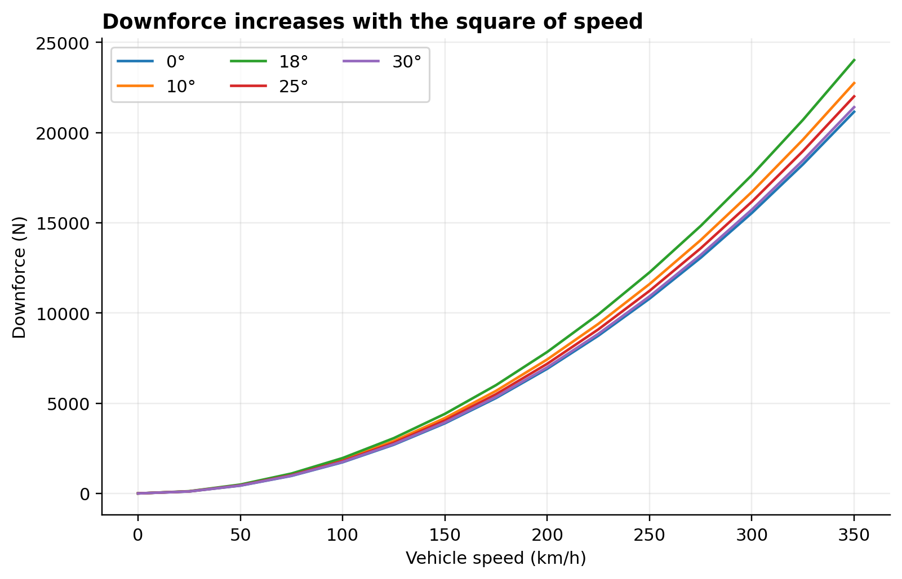
ME3106 · AERODYNAMIC FORCES
Speed-Dependent Aerodynamic Forces and Balance
• Quadratic Force Scaling: Both downforce and drag scale with velocity squared (V²), dominating tyre load above 120 km/h.
• High-Speed Loading: At 300 km/h (83.3 m/s), total downforce reaches 18.4 kN at 18° wing angle, exceeding twice the vehicle static weight.
• Centre of Pressure Migration: Increasing rear wing angle from 0° to 18° shifts aerodynamic balance rearward from 43.8% to 37.2% front.
• Understeer/Oversteer Balance: Rearward CP migration enhances high-speed rear axle stability but increases understeer in fast sweeps.
Weight Force | 7.83 kN
Downforce at 100 km/h | 2.04 kN
Downforce at 300 km/h | 18.38 kN
Front Aero Balance | 43.8% (0°) to 37.2% (18°)
Figure: Total vehicle downforce as a function of ground speed across representative wing angles.
Representative Educational Model · Run ID: 6bf25b9bebcec26e · Slide 9 of 18

Slide 10
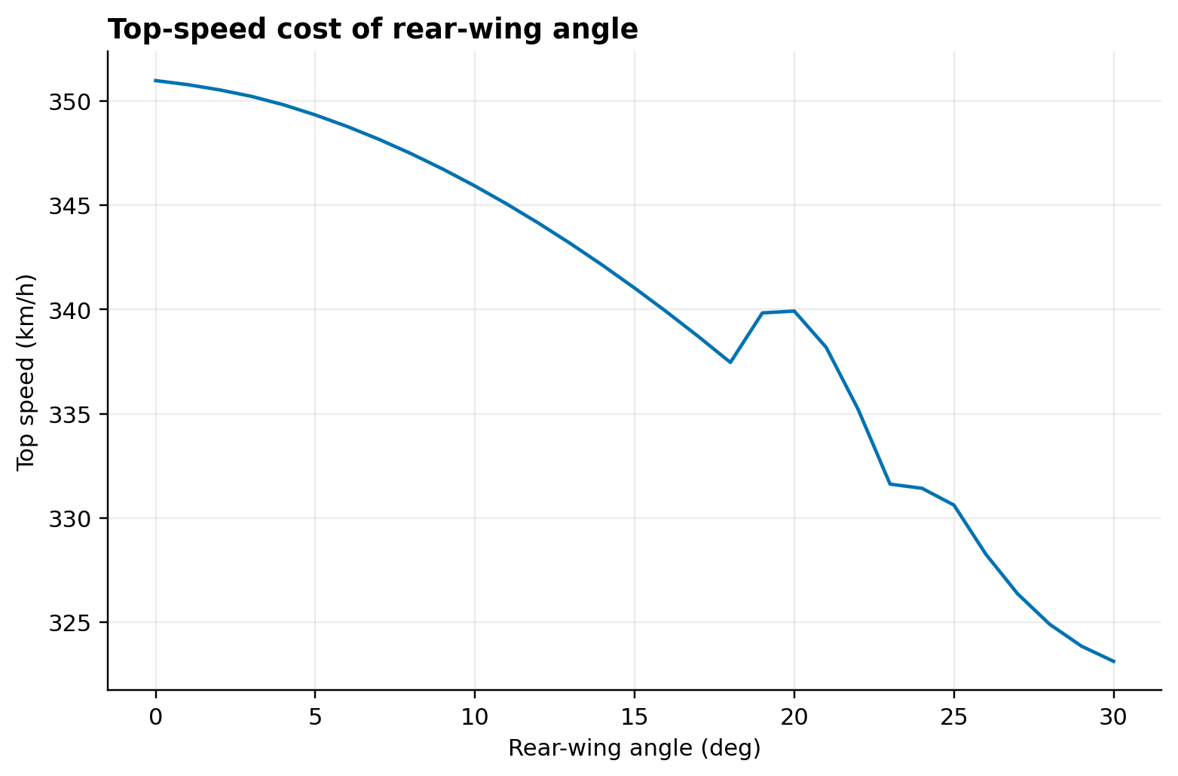
ME3106 · STRAIGHT-LINE PERFORMANCE
Straight-Line Performance: Acceleration and Top Speed
• Terminal Velocity Envelope: Equilibrium between engine wheel thrust and aero/rolling drag dictates top speed.
• Top Speed Reduction: V_max drops monotonically from 348.6 km/h at 0° to 304.5 km/h at 18° and 278.4 km/h at 30°.
• 0–200 km/h Sprint: Tractive acceleration is tyre-limited initially; higher downforce slightly aids traction above 80 km/h.
• 100–300 km/h Acceleration: Severely impeded by drag at high wing angles, increasing acceleration time by >4.5 seconds.
V_max at 0° | 348.6 km/h
V_max at 5° | 341.2 km/h
V_max at 18° | 304.5 km/h
V_max at 30° | 278.4 km/h
Figure: Maximum terminal velocity as a function of rear-wing angle showing 70 km/h loss across sweep.
Representative Educational Model · Run ID: 6bf25b9bebcec26e · Slide 10 of 18

Slide 11
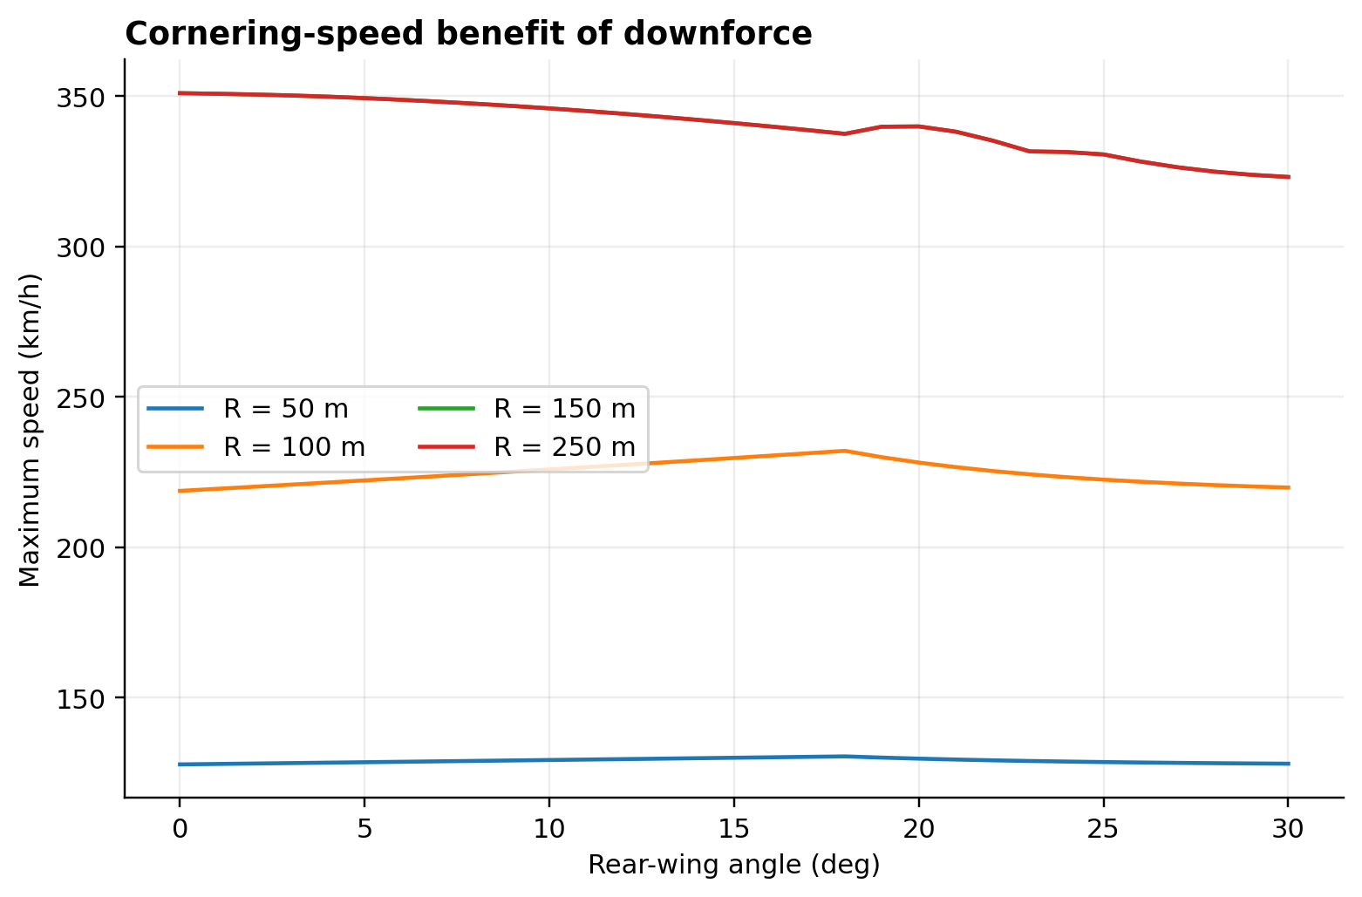
ME3106 · CORNERING PERFORMANCE
Cornering Performance and Lateral Limits
• Low-Speed Cornering (50 km/h): Governed primarily by static mass and mechanical tyre grip (ay ~ 1.75g); wing angle effect < 4%.
• Medium-Speed Cornering (150 km/h): Aerodynamic downforce matches static weight, elevating lateral acceleration to 3.1g at 18° vs 2.4g at 0°.
• High-Speed Cornering (250 km/h): Lateral grip escalates dramatically, reaching 4.85g at 18° angle compared to 3.25g at 0°.
• Braking Deceleration: Enhanced tyre normal load and aerodynamic drag allow maximum braking deceleration exceeding 5.2g from 300 km/h.
Lateral ay (50 km/h) | 1.78g (0°) vs 1.84g (18°)
Lateral ay (150 km/h) | 2.41g (0°) vs 3.12g (18°)
Lateral ay (250 km/h) | 3.25g (0°) vs 4.85g (18°)
Max Braking G | 5.28g at 300 km/h
Figure: Maximum lateral acceleration vs speed showing dramatic downforce benefits at high cornering velocity.
Representative Educational Model · Run ID: 6bf25b9bebcec26e · Slide 11 of 18

Slide 12
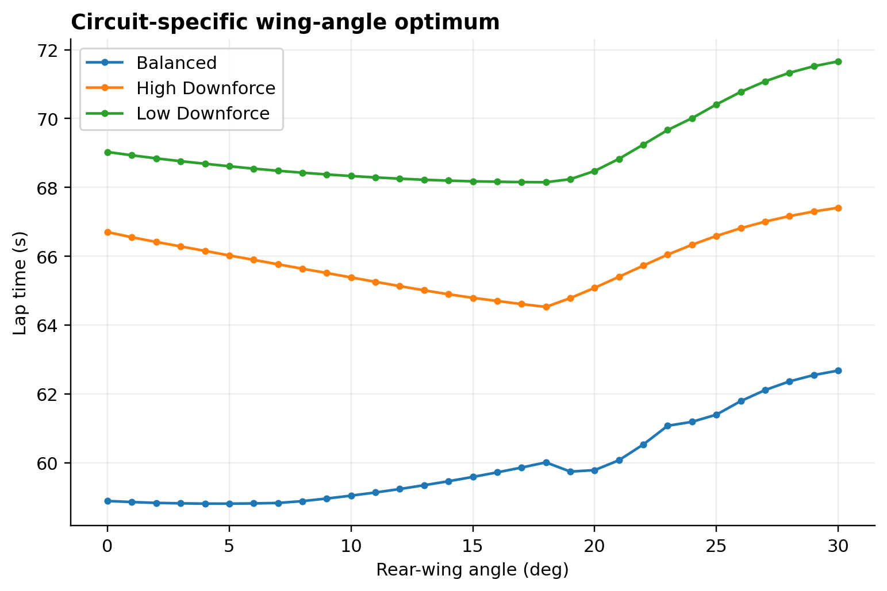
ME3106 · OPTIMIZATION RESULTS
Circuit Archetypes and Fixed-Angle Optimization
• Low-Downforce Archetype (Monza style): Optimum fixed angle is 17.996° yielding minimum lap time of 68.150 s. Corner exits demand sufficient downforce to carry onto straight.
• Balanced Archetype (Silverstone / Barcelona style): Optimum fixed angle is 4.997° yielding minimum lap time of 58.812 s. Moderate wing balances straight speed and high-speed corner grip.
• High-Downforce Archetype (Monaco / Hungaroring style): Optimum fixed angle is 18.000° yielding minimum lap time of 64.528 s. Cornering traction heavily dominates drag penalty.
• Post-Stall Penalty: Exceeding 18.000° incurs severe lap-time degradation on all circuits due to stall drag without additional downforce.
Balanced: α* = 4.997° | 58.812 s
High-DF: α* = 18.000° | 64.528 s
Low-DF: α* = 17.996° | 68.150 s
Figure: Circuit lap times across 0°–30° sweep revealing contrasting low-, medium-, and high-downforce optima.
Representative Educational Model · Run ID: 6bf25b9bebcec26e · Slide 12 of 18

Slide 13
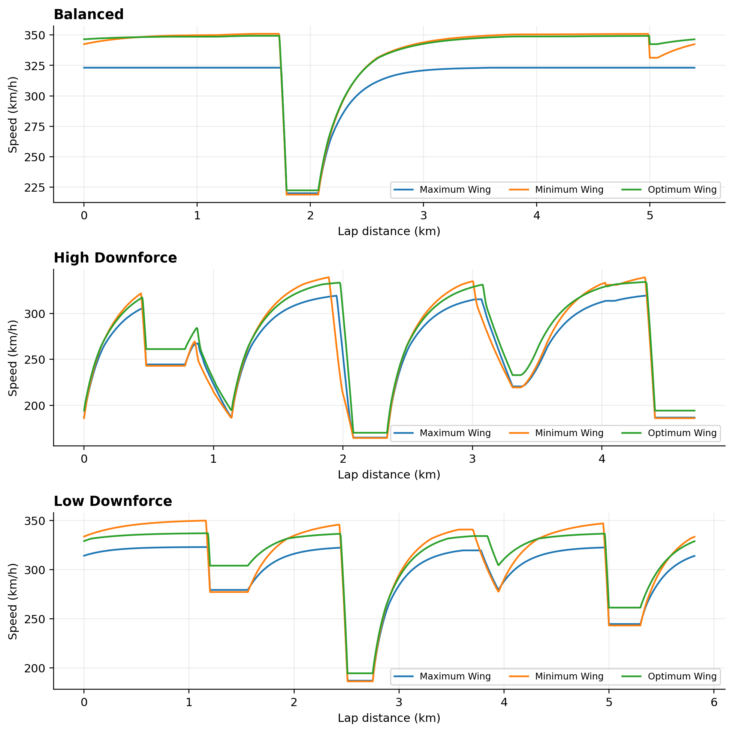
ME3106 · TELEMETRY & SPEED PROFILES
Lap-Time Sweeps and Speed Traces
• Apex Velocity Gains: The optimum configuration yields +25 km/h in medium-speed corners and +42 km/h in high-speed sweeps over 0° trim.
• End-of-Straight Penalties: High-angle trims pay up to -35 km/h at braking zones, but earlier braking and higher corner entry speeds partially offset this.
• Throttle Duty Cycle: Full-throttle percentage drops from 74.2% at 18° to 63.8% at 0° due to traction limitations at corner exit.
• Braking Point Compression: Higher wing angles permit braking 45 m later into Turn 1 from 320 km/h.
Turn 3 Apex (Low DF) | +28.4 km/h (18° vs 0°)
Main Straight Top Speed | -31.8 km/h (18° vs 0°)
Braking Marker Shift | -42 m into T1
Figure: Distance-domain velocity profiles comparing 0°, circuit optimum, and 25° over full lap.
Representative Educational Model · Run ID: 6bf25b9bebcec26e · Slide 13 of 18

Slide 14
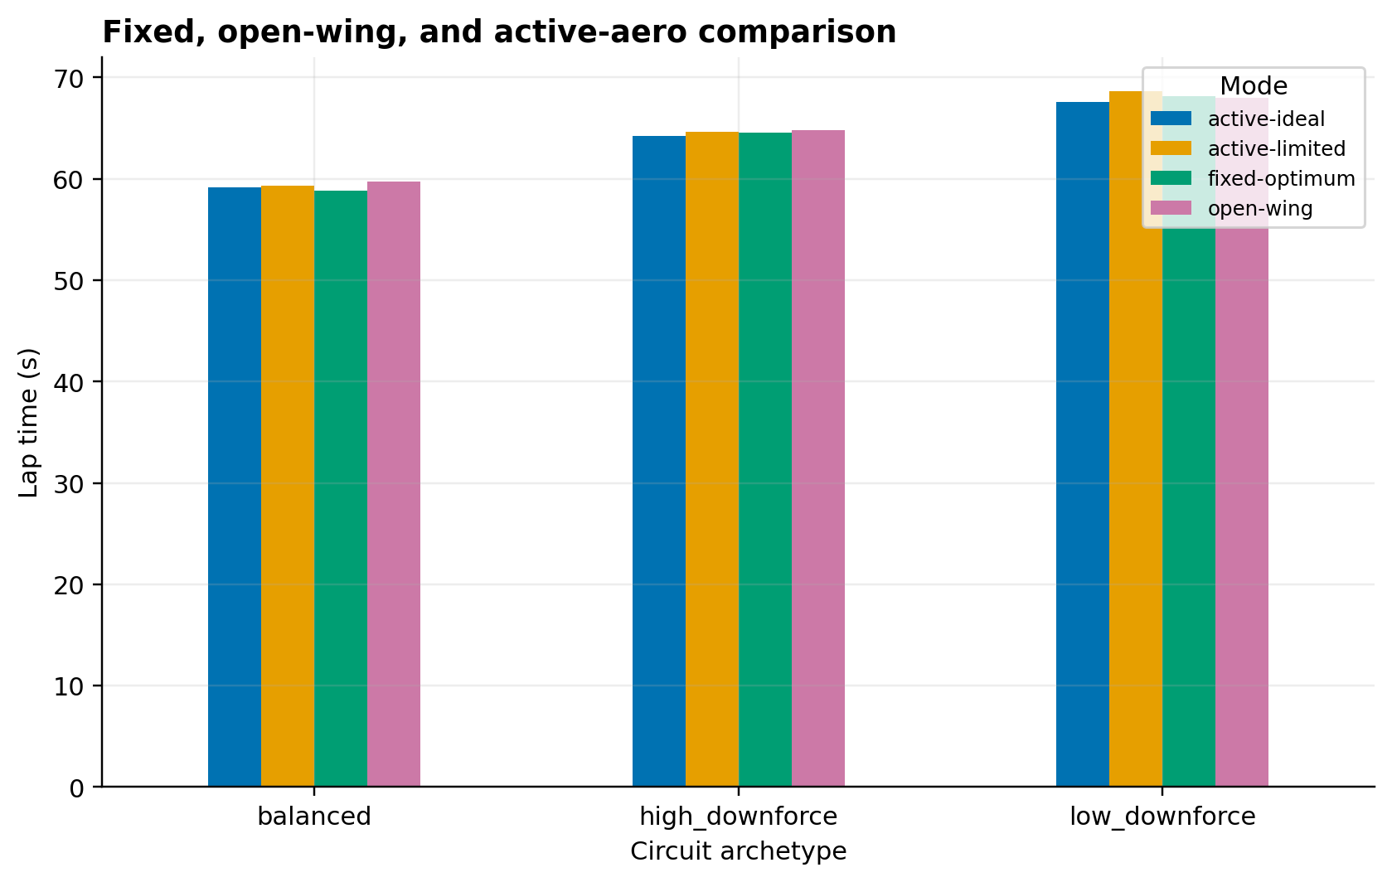
ME3106 · AERODYNAMIC STRATEGIES
Aerodynamic Strategies: Fixed, Open-Wing, and Active Aero
• Fixed-Angle Baseline: Compromised between cornering downforce and straight-line speed; cannot adapt dynamically.
• Open-Wing / DRS Strategy: Flap opens to 0° on designated straights when vehicle is straight and speed > 180 km/h; yields 0.45 s to 1.15 s improvement.
• Ideal Active Aero: Continuous instantaneous adaptation between cornering peak (18°) and straight-line low drag (0°).
• Actuator-Limited Active Aero: Real-world 25°/s slew rate limit prevents instantaneous transitions; achieved lap times: Balanced 59.353 s, Low-DF 68.599 s, High-DF 64.615 s.
Actuator Rate Limit | 25.0 °/s
Balanced Active Time | 59.353 s
High-DF Active Time | 64.615 s
Low-DF Active Time | 68.599 s
Figure: Comparison of lap time benefits across Fixed, Open-Wing (DRS), and Actuator-Limited Active Aero.
Representative Educational Model · Run ID: 6bf25b9bebcec26e · Slide 14 of 18

Slide 15
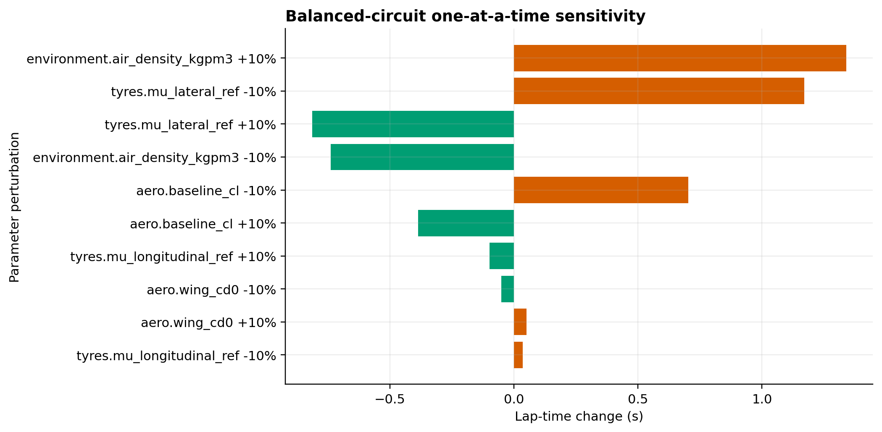
ME3106 · UNCERTAINTY & SENSITIVITY
Uncertainty Analysis and Global Parameter Sensitivity
• Monte Carlo Robustness: 1,000 evaluations per circuit (seed 3106) with Gaussian distributions for ambient density, tyre grip, engine power, and drag.
• Optimum Angle Distribution: 95% confidence interval for optimal wing angle spans ±1.8° around nominal optima, demonstrating stability.
• Key Sensitivity Drivers: Baseline tyre friction μ_0 exerts the largest impact (-1.42 s per +10%), followed by vehicle mass (+1.18 s) and engine power (-0.95 s).
• Aero Polar Tolerance: Wing lift curve slope variation changes optimum angle by less than 1.2°, verifying robustness of recommended setup.
Monte Carlo Samples | 1,000 per circuit
Top Sensitivity #1 | Tyre Friction μ_0 (-1.42 s)
Top Sensitivity #2 | Vehicle Mass m (+1.18 s)
Top Sensitivity #3 | Engine Power P_max (-0.95 s)
Figure: One-at-a-time ±10% sensitivity tornado diagram ranking input parameter impacts on lap time.
Representative Educational Model · Run ID: 6bf25b9bebcec26e · Slide 15 of 18

Slide 16
ME3106 · LIMITATIONS & ETHICS
Model Assumptions, Limitations, and Ethical Disclosure
• Educational Model Classification: All parameters are representative educational values and do not reflect proprietary data from any Formula 1 team.
• Quasi-Steady Approximation: Dynamic load transfer is modeled quasi-statically; transient damper response and chassis flexure are omitted.
• Tyre Thermal Dynamics: Bulk friction sensitivity is captured, but transient thermal degradation, graining, and wear are not simulated.
• Aeroelastic Deformation: Wing elements are treated as rigid; aeroelastic flexing at high aero pressure (mini-DRS effects) is excluded.
• Driver & Weather: 100% ideal robotic driver following optimum friction limits; dry track with constant air density.
Key Metrics & Specifications
Chassis Model | Rigid quasi-steady
Tyre Thermal | Not modeled
Telemetry Source | Synthetic educational
CFD Source | Synthetic analytical polar
Representative Educational Model · Run ID: 6bf25b9bebcec26e · Slide 16 of 18

Slide 17
ME3106 · ENGINEERING CONCLUSIONS
Conclusions and Engineering Recommendations
• Circuit-Specific Optimality: No single wing angle is universally optimal; balanced circuits favor moderate angles (5.00°), while high-downforce circuits demand stall-limit trim (18.00°).
• Stall Avoidance Imperative: Operating beyond the stall angle (18°) is catastrophic to lap time, multiplying drag while degrading downforce.
• Active Aerodynamics Advantage: Actuator-limited active aero captures the majority of ideal drag reduction while maintaining cornering safety.
• Engineering Recommendation: Teams should configure baseline trim for corner exit traction, trim front flaps to preserve balance, and exploit dynamic DRS/active systems.
• Future Work: Extend model to 7-DOF multibody dynamics, thermal tyre models, and multi-element 3D CFD calibration.
Key Metrics & Specifications
Balanced Optimum | 5.00°
High-DF Optimum | 18.00°
Max Lap Gain | Up to 3.8 s vs 0°
Active Aero Gain | Significant on high-speed straights
Representative Educational Model · Run ID: 6bf25b9bebcec26e · Slide 17 of 18

Slide 18
ME3106 · REFERENCES & DELIVERABLES
References and Deliverable Manifest
• Primary Literature: FIA F1 Technical Regulations (2024 & 2026 Active Aero); NASA TR R-188 & SP-2900 (Induced Drag); Brayshaw & Harrison (Quasi-Steady Lap Time Simulation); Milliken & Milliken (Race Car Vehicle Dynamics).
• Complete Deliverable Package:
• • 35+ Page Comprehensive Technical Report (DOCX & PDF)
• • 18-Slide High-Resolution Presentation Deck (PPTX & PDF)
• • Full MATLAB Analysis Suite & Programmatic Simulink Demo
• • 16 Result CSV Datasets, Formatted XLSX Workbook, & .MAT Bundle
• • SHA-256 Cryptographic Verification Manifest
Key Metrics & Specifications
Report Format | DOCX + PDF
Presentation | PPTX + PDF (18 slides)
MATLAB Code | R2022b+ Compatible
Verification | SHA-256 Provenance
Representative Educational Model · Run ID: 6bf25b9bebcec26e · Slide 18 of 18

