Slide 1
Tessera
TECHNICAL DECK · AI STUDY GROUP · 2026
A multi-agent LLM research desk for long-term
investing.
How we built it: data ingestion · feature computation · persona spec design · LLM pipeline · risk gateway · brokerage integration · compliance.
github.com/6ummy/Tessera

Slide 2
AGENDA
Eight things to walk through.
01
02
03
04
System architecture
Stack
Data ingestion
Hallucination defense
Three planes: data, agents, decision/execution. Why this split.
Vercel · Firebase · Cloud Run · Neon · Anthropic · Alpaca. Why each.
EOD prices, fundamentals, macro, news. APIs, frequency, storage shape.
The single most important design choice: LLMs never compute numbers.
05
06
07
08
Persona spec design
Same data, four readings
LLM call pipeline
Execution + compliance
Anatomy of a system prompt. What goes in, what's forbidden.
How four personas interpret one earnings release differently.
Haiku screen → Sonnet thesis → Pydantic validate → citation check.
Alpaca OAuth, paper/live flag, kill switch, US regulatory posture.
Tessera · technical deck
02 / 17

Slide 3
01 · SYSTEM ARCHITECTURE
Three planes. Strict one-way flow.
DATA PLANE
· Alpaca WS / Coinbase WS (EOD)
· FMP, SEC EDGAR (fundamentals, filings)
Ingest · normalize · store · embed
· FRED (macro)
· NewsAPI, Reddit, X (text)
AGENT PLANE
· Warren · Cathie · Ray · Peter (Anthropic Claude)
· Haiku 4.5 first pass → Sonnet 4.6 thesis
Read features · write theses · in parallel
· Pydantic schema validation
· pgvector recall of prior theses
DECISION + EXECUTION PLANE
· Quant validator (ticker exists, schema valid)
· Risk gateway (deterministic Python, caps + VaR)
Validate · enforce risk · execute
· Paper engine (default) / Alpaca live (flagged)
· Ledger writes + Firestore fan-out to UI
Data only flows downward. Each plane reads the one above, writes to its own store. No backward calls — keeps failures isolated and pipeline replayable.
03 / 17

Slide 4
02 · STACK
Boring choices on purpose.
FRONTEND
AUTH + REALTIME
AGENTS + BATCH
Next.js 14 App Router
Firebase Auth
Google Cloud Run Jobs
RSC + server actions + streaming
Google/Apple SSO, no custom auth code
Scale-to-zero, 60-min jobs, same GCP as Firebase
Vercel
Firestore
LangGraph (LangChain)
Zero-config deploy, US region, free tier
Client subscriptions for fan-out to UI
Agent state machine + retries
Tailwind + Radix
FCM
Anthropic Claude API
Claude-design palette, primitives only
Push alerts on rebalance / new portfolio
Haiku 4.5 · Sonnet 4.6 · Opus 4.7
Recharts
Deterministic charts, React-native
DATA + STATE
BROKERAGE
OPS
Neon Postgres
Alpaca
Sentry
Serverless, Vercel-friendly branching
US stocks + crypto, single API, paper/live flag
Errors + LLM call traces
TimescaleDB extension
OAuth flow only
Grafana Cloud free
OHLCV hypertables, continuous aggregates
We never touch user broker credentials
LLM cost dashboard, ingestor health
pgvector
Persona memory recall (embedding similarity)
Tessera · technical deck
04 / 17

Slide 5
03 · DATA INGESTION
Long-term means fundamentals dominate.
SOURCE
API
WHAT WE PULL
FREQ
STORE
Alpaca
alpaca.markets/v2/stocks/bars
EOD OHLCV, US equities + ETFs
daily
ohlcv_1d
Coinbase
api.exchange.coinbase.com
EOD candles, BTC/ETH/major alts
daily
ohlcv_1d
Financial Modeling Prep
fmp.api/financials
Income / balance / cash flow, 5 yrs
quarterly
fundamentals
SEC EDGAR
data.sec.gov/submissions
10-K, 10-Q, 8-K full text
as filed
filings + GCS
FRED
stlouisfed.org/api
Yields, CPI, employment, ~20 series
as released
macro_series
NewsAPI
newsapi.org/v2
Ticker-tagged headlines + bodies
hourly batch
news + embedding
Reddit (PRAW)
reddit.com/r/{stocks,wallstreetbets}
Top posts per ticker for sentiment
hourly batch
social + embedding
All raw rows preserved. Pre-computed features (returns, RSI, FCF yield, PEG, regime probabilities) live in a separate ticker_features table that the LLM reads instead.
Tessera · technical deck
05 / 17

Slide 6
04 · HALLUCINATION DEFENSE
LLMs write theses. Code computes numbers.
✗ NAIVE PATTERN
✓ TESSERA PATTERN
LLM reads raw data, computes signals, decides weights.
Python computes the numbers. LLM only interprets.
prompt = f"Here is AAPL's last 30 days:\n{ohlcv_csv}\n\n
What is its momentum? Allocate 0–20% if bullish."
→ model invents ret_30d = +12% (actual: −3%)
→ recommends 18% AAPL on hallucinated signal
features = compute_features("AAPL") # pandas
# {ret_30d: -0.031, rsi: 42, fcf_yield: 0.041,
# peg: 1.8, pe_fwd: 28.2, ...}
prompt = f"{persona_spec}\nFeatures: {features}\n
Write thesis. Output JSON per schema."
Risks: invented numbers, wrong tickers, fabricated citations, weights that violate risk policy — all reach production.
LLM gets pre-validated numbers. Its only freedom is the *narrative*. Wrong tickers and fake citations are rejected downstream.
Tessera · technical deck
06 / 17

Slide 7
05 · PERSONA SPEC DESIGN
Each persona = a tightly-specified prompt.
IDENTITY
Name, archetype, background, lens
# warren.system.md (excerpt)
VOICE:
- Plainspoken Midwestern. Period-heavy.
- Banned: "asymmetric", "disruptive", "TAM",
"compelling", "narrative", emojis.
HARD RULES:
- Every proposal MUST include
`what_would_make_me_wrong`.
- No 5-year hold case → no position.
- single_name_weight <= 0.18
OUTPUT (Pydantic):
class Proposal(BaseModel):
ticker: str # must exist in universe
target_weight: float = Field(ge=0, le=0.18)
horizon_days: int = Field(ge=1825)
cited_news_ids: list[UUID]
what_would_make_me_wrong: list[str]
MENTAL MODEL
The deterministic framework the persona applies (e.g. Warren's 4-question filter)
INPUTS
Schema of pre-computed features the persona will receive
VOICE RULES
Required style, banned words, formatting constraints
HARD RULES
Behaviors that can never be violated (e.g. 'never propose without `what_would_make_me_wrong`')
OUTPUT SCHEMA
Pydantic-validated JSON shape, every field typed
Full specs (~600 lines each) live in personalities.md and are versioned with the codebase.
07 / 17

Slide 8


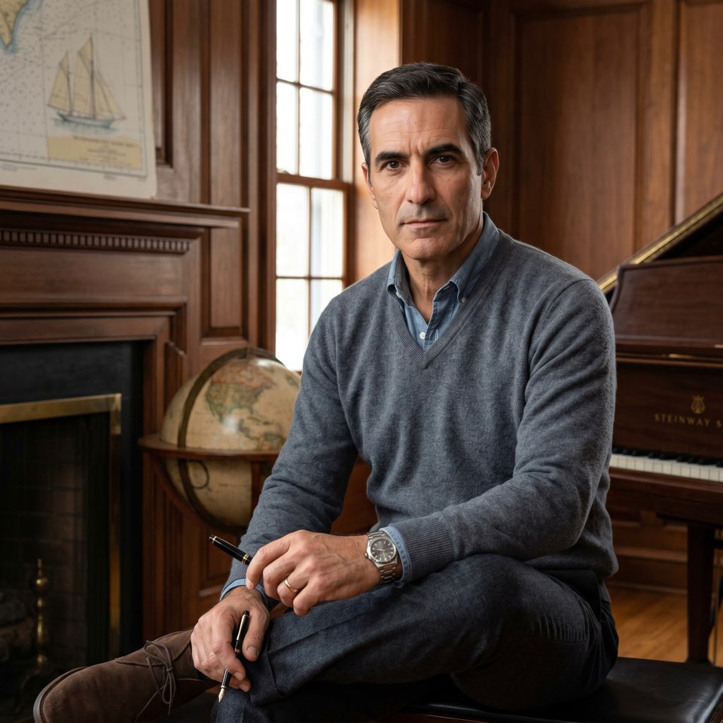

06 · THE FOUR LENSES
Same market data. Four different filters.
Warren
Cathie
Ray
Peter
Value · 67
Disruptive · 32
Macro · 58
GARP · 44
KEY METRIC
FCF yield > 6%
Bear/base/bull on 2030 P&L
Regime probabilities
PEG < 1.2 + EPS CAGR 15–25%
HOLDING
7–12 names, < 15% TO
15–25 names, 60–90% TO
8–14 ETFs, 25–40% TO
12–20 names, 25–40% TO
HORIZON
5+ years
3–5 years
Continuous rebalance
2–4 years
TIME-FRAME LLM SEES
5y financials
5y growth + scenarios
Real yields + macro factors
3y EPS + observability
IGNORES
Macro, momentum, IPOs
Trailing P/E, gross margin
Single stocks, sentiment
Turnarounds, story stocks
MAX SINGLE NAME
18%
16%
35% (broad equity)
13%
Tessera · technical deck
08 / 17

Slide 9
06b · CONCRETE EXAMPLE
NVDA Q3 2026 release: the desk reads it.
# Feature snapshot sent to all four personas (identical):
{ ticker: "NVDA", price: 1240, ret_30d: +0.082, ret_1y: +0.34, fcf_yield: 0.018,
pe_fwd: 38, eps_cagr_3y: +0.42, gross_margin_yoy: -0.03, dc_revenue_yoy: +0.41,
inference_share_yoy: +0.55, capex_intensity: 0.21, peg: 0.9, news_sentiment_7d: +0.41 }
Warren
Cathie
Ray
Peter
HOLD · 0%
ADD · 14%
N/A
HOLD · 7%
FCF yield 1.8% is half my bar. I can't underwrite a 5-year hold at this multiple. Watching only. Re-enter at FCF yield ≥ 5% or a 35%+ drawdown.
Inference share +55% YoY validates the bull. Bear (sovereign capex pause) loses 30%; base earns 2.5x; bull 4x. Sizing to the asymmetry — adding 200bps.
Single names aren't my desk. I'll note that AI capex strength keeps growth-quadrant probability elevated (+3pp this week), supporting equity tilt.
PEG of 0.9 looks GARP-ish but the gross margin yoy is decelerating. Add trigger: stable margin + EPS revision up next quarter. Trim trigger: two qtrs of margin contraction.
Tessera · technical deck
09 / 17

Slide 10
07 · LLM CALL PIPELINE
Per persona, one batch per session.
1. Universe screen
2. Thesis writeup
3. Schema validate
4. Citation check
5. Risk gateway
Haiku 4.5
Sonnet 4.6
Pydantic
Python
Python
~500 tickers → top ~30 per persona
Deep analysis on shortlist
Type + range checks, 1 retry
Each cited news_id must resolve
Weight caps, sector, VaR budget
cost/call: $0.005
cost/call: $0.045
cost/call: free
cost/call: free
cost/call: free
DAILY MATH
4 personas × 1 batch/day × (1 Haiku screen + ~20 Sonnet calls) ≈ 80 LLM calls/day
• ~$1.20/day per persona thesis batch · ~$1.50/day all-in including chat baseline
• Prompt caching: persona spec (~3K tokens) cached at 0.1× cost across all calls within 5-min window
Tessera · technical deck
10 / 17

Slide 11
08 · SURFACING TO USER
Validated outputs stream to UI.
Cloud Run
batch job
INSERT INTO
analyst_reports
(Neon Postgres)
Trigger fn
pushes to
Firestore
Firestore
realtime
client sub
Browser re-renders
portfolio cards
(no refresh)
WHAT USER SEES IMMEDIATELY
WHAT USER CAN DO
• 4 portfolios side-by-side on /proposals
• Hover any position → which analyst, what conviction
• Push notification on rebalance via FCM
• Follow a portfolio on paper (no money committed)
• Open chat with any analyst — discuss reasoning
• Phase F: opt-in live trading via Alpaca OAuth
Tessera · technical deck
11 / 17

Slide 12
07b · CHAT WITH ANALYST
System prompt assembled per turn.
SYSTEM PROMPT ASSEMBLY
reply = anthropic.messages.create(
model="claude-sonnet-4-6",
system=[
{"type":"text","text":persona_spec,
"cache_control":{"type":"ephemeral"}},
{"type":"text","text":book_+_reports},
],
messages=conversation_history + [
{"role":"user","content":user_msg}
],
max_tokens=600,
)
PERSONA SPEC
~3K tok
Loaded from personalities.md (cached)
CURRENT BOOK
~600 tok
JSON of persona's holdings (today)
RECENT REPORTS
~1K tok
Last 3 thesis snippets, summarized
RELEVANT FEATURES
~400 tok
Pre-computed numbers for any ticker mentioned
CONVERSATION HISTORY
~1.5K tok
Last N turns
USER MESSAGE
PER MESSAGE
Current turn
~50 tok
~$0.012 with caching (persona spec at 0.1× rate). Heavy chat user (50 msgs/day) ≈ $0.60/day.
Tessera · technical deck
12 / 17

Slide 13
08 · TRADING EXECUTION
Adapter pattern. Paper today, live by flag.
OAUTH FLOW (USER → ALPACA)
# tessera/execution/adapter.py
class ExecutionAdapter(Protocol):
def place(self, user_id, order: Order) -> Fill:
...
class PaperEngine(ExecutionAdapter): # default
"""Marks-to-market in Neon ledger table."""
class AlpacaLiveAdapter(ExecutionAdapter): # flagged
"""Routes via user's Alpaca OAuth token."""
adapter = (AlpacaLiveAdapter() if flag(user_id, "live")
else PaperEngine())
1. User clicks 'Connect Alpaca'
2. Redirect → Alpaca authorize URL
3. User logs in on Alpaca's domain
4. Callback returns short-lived code
5. Backend exchanges code → access_token
6. Token stored encrypted in Firestore
7. Every order: user confirms in UI first
INVARIANTS
✓ No custody — we never receive funds. ✓ Every order: explicit user confirm in UI.
✓ Kill switch: 1 click → queue close-all positions (paper or live) via Temporal workflow.
✓ Same code path for paper/live — only the adapter changes.
Tessera · technical deck
13 / 17

Slide 14
09 · RISK + COMPLIANCE
Two backstops: code, then law.
# tessera/risk/gateway.py
def validate(portfolio, persona) -> Result:
fail = []
for pos in portfolio.positions:
if pos.ticker not in UNIVERSE:
fail += ["hallucinated_ticker"]
if pos.weight > persona.MAX_NAME:
fail += ["single_name_cap_exceeded"]
for sec, w in sector_weights(portfolio):
if w > persona.MAX_SECTOR: fail += [...]
if portfolio_var(portfolio) > VAR_BUDGET:
fail += ["var_budget_exceeded"]
return Result(ok=not fail, reasons=fail)
US REGULATORY POSTURE
Paper only, all users
OK
Research/educational — no SEC filing
Self trading own capital
OK
No advisor relationship triggered
Friends/family live
REVIEW
Securities lawyer consult first (~$300)
Public users live
BLOCKED
Requires SEC RIA + state Blue Sky filings
INVARIANTS WE NEVER BREAK
No custody · No personalized advice · No hallucinated tickers · No skipping paper-trading phase · No live orders without explicit user confirmation
Tessera · technical deck
14 / 17

Slide 15
OPERATIONAL ECONOMICS
$60–325/mo at pilot. Knobs we can turn.
WHERE THE MONEY GOES
LEVERS TO REDUCE COST
LLM — Haiku screens
$15–40
Daily → weekly batch
−60% LLM
LLM — Sonnet thesis
$30–180
Long-term holdings don't need daily updates
4 personas → 2 personas
−50% LLM
LLM — Chat (user-driven)
$10–50
MVP can run with Warren + Cathie only
LLM — Opus weekly review
$5–20
Sonnet → Haiku for thesis
−70% LLM
Voice quality drops, valid trade-off
Cloud Run + Neon + Firebase free tier
$0–5
Prompt caching always-on
−40% LLM
Market data (Alpaca + FMP optional)
$0–30
Cached persona spec (5-min TTL)
TOTAL
$60–325
Skip the Opus weekly review
−$15
Replace with simple performance table
Cost is independent of user count. Persona analysis is shared across all subscribers.
15 / 17

Slide 16
STATUS · PLAN
Where we are. Where we're going.
BUILT TODAY
PATH TO PRODUCTION
Frontend MVP, demo-ready
6-week pilot, paper-first
Next.js 14 + Tailwind + Recharts, Vercel-ready
A
Data backbone
wk 1
4 personas with photos, bios, system prompts
Ingestors, feature builder, Neon schema
Marketplace + proposals + dashboard + how-it-works
B
Real LLM theses
wks 2–3
Haiku screen + Sonnet thesis, Pydantic validate
Slide-over detail with Thesis ↔ Chat toggle
C
Paper execution
wks 4–5
Chat UI with streaming (mock backend)
Risk gateway, paper engine, real P&L attribution
personalities.md (~600 lines/persona) ready for LLM
D
User auth + follow
wk 6
Firebase Auth, 3 F&F users on paper
PENDING
E
Compliance review
wk 6 (parallel)
Backend · real LLM · data ingestion · paper engine · auth · broker
Securities lawyer consult, written advice
F
Live trading (opt)
wk 7+
Alpaca OAuth, self first, F&F only if E clears
MVP done when: 4 personas writing real theses daily · 30+ days paper P&L · 3 F&F users active · lawyer advice on file · cost stable < $200/mo
16 / 17

Slide 17
TESSERA · TECHNICAL DECK
Questions. Comments. Forks.
Repo
Architecture
Persona specs
github.com/6ummy/Tessera
architecture.md
personalities.md
Thanks.

