Slide 1
Literature-Comparable
Itinerary Recommendation on Flickr
Strategy D — putting our pairs-F1 on the same scale as the literature
From non-comparable Foursquare-NYC scores → pairs-F1 beside Chen 2016, DeepTrip,
SelfTrip and AR-Trip on the Flickr photo-trajectory benchmark
Master's thesis — Phase 2 · github.com/6ym6n/PFE_IMPLEMTATION

Slide 2
context
Where Strategy D fits
The thesis has two formally distinct tasks, each on its own field-standard benchmark. Strategy D is the itinerary task, on Flickr.
Phase 1
Next-POI prediction
Foursquare NYC
GCN + GRU + user
HR@k / NDCG / MRR
Phase 2A / 2B
Itinerary on NYC
frozen rollout / pointer
pairs-F1 0.26–0.29
NOT comparable
Phase 2D — THIS WORK
Itinerary on Flickr
Chen-2016 protocol
pairs-F1 0.23–0.59
literature-comparable
Using a different dataset per task is correct and standard — the only error would be to cross-compare the two.
Strategy D — Itinerary recommendation on Flickr
2

Slide 3
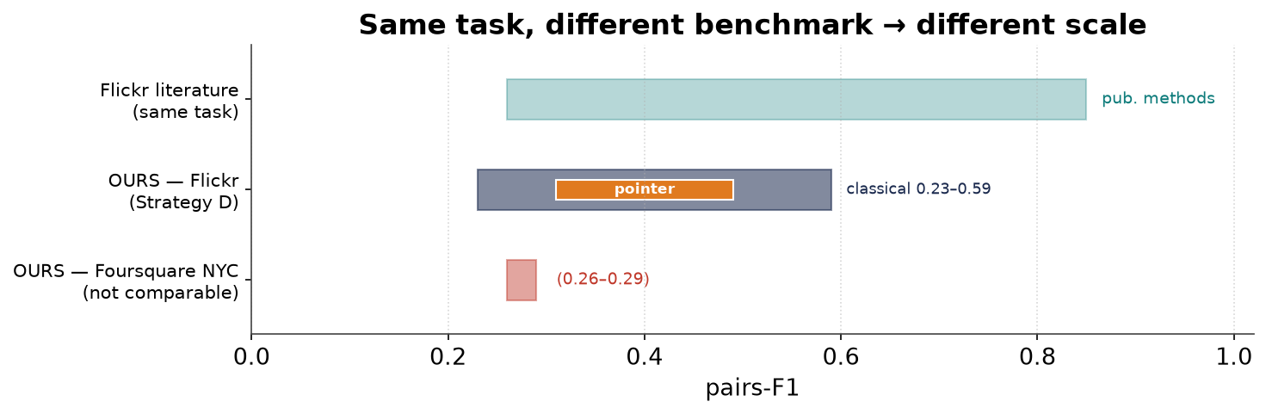
motivation
The problem
Our Phase-2 itinerary model scored pairs-F1 ≈ 0.26–0.29 on Foursquare NYC. The literature reports 0.6–0.8. Are we bad?
No — not a quality gap, a comparability gap. Different benchmark → different scale.
Strategy D — Itinerary recommendation on Flickr
3

Slide 4
the insight
What makes two numbers comparable
Two pairs-F1 values compare only if all three match:
1. DATASET
same trajectories,
same POI-vocabulary size
(30 POIs vs 5,000 →
different chance levels)
2. PROTOCOL
same split,
same query,
same length filter
3. METRIC
the exact same
pairs-F1 definition
(pinned by a unit test)
Foursquare NYC differs on all three, so its 0.26–0.29 is incomparable to the literature's 0.6–0.8.
The gap is a data/protocol artefact, not model quality (Krichene & Rendle, KDD 2020).
Strategy D — Itinerary recommendation on Flickr
4

Slide 5
data
The Flickr datasets
Five cities mined from geo-tagged Flickr photos. We use the canonical traj-/poi- CSVs = Chen 2016's own files, so our trajectories are identical to the literature's (zero preprocessing ambiguity).
Flickr photos
(lat, lon, time)
POI visits
merge same-POI run
order by time
one seqID = trip
trajectory
p1→p2→p3 (loop-free)
City | #POIs | #users | #traj | #traj≥3 (eval)
Toronto | 29 | 1,395 | 6,057 | 335
Osaka | 27 | 450 | 1,115 | 47
Glasgow | 27 | 601 | 2,227 | 112
Edinburgh | 28 | 1,454 | 5,028 | 634
Melbourne | 88 | 1,000 | 5,106 | 442
The length≥3 column is the evaluated set; Chen 2016's totals match #traj exactly.
Strategy D — Itinerary recommendation on Flickr
5

Slide 6
problem formulation
The task, precisely
A query gives the start POI, the end POI and the length K. The model recovers the ordered middle.
QUERY
start s · end e · length K
e.g. (Castle, Museum, 5)
recommender
s
?
?
?
e
ordered route of K POIs, loop-free, ends at e
Standard PersTour / Chen-2016 convention: recover the visited sequence given its endpoints and length.
Start and end are given, so only the middle ordering is at stake.
Strategy D — Itinerary recommendation on Flickr
6

Slide 7
the key idea
The metric: pairs-F1 (Chen 2016)
pairs-F1 = F1 over ordered pairs. A pair (a,b) counts only if a is before b in both routes.
ground truth Y:
A
B
C
D
prediction Ŷ:
A
C
B
D
Y pairs: (A,B) (A,C) (A,D) (B,C) (B,D) (C,D)
Ŷ pairs: (A,C) (A,B) (A,D) (C,B) (C,D) (B,D)
shared, same order: (A,B) (A,C) (A,D) (C,D) (B,D) → 5 of 6
(B,C) is in Y but Ŷ has (C,B) — wrong order, doesn't count.
precision = 5/6, recall = 5/6 → pairs-F1 = 2·P·R/(P+R) = 5/6 ≈ 0.833
Strategy D — Itinerary recommendation on Flickr
7

Slide 8
evaluation
The protocol: leave-one-trajectory-out CV
Tiny datasets (47–634 trajectories), so the field uses leave-one-out cross-validation.
t₁
t₂
train on the other N−1
(length≥3 trajectories)
predict t₃ from (s,e,K)
score F1 & pairs-F1
t₃ ← held out (TEST)
t₄
t₅
t₆
Repeat holding out every trajectory once → report the mean per city. No leakage: the held-out trajectory never touches training.
Strategy D — Itinerary recommendation on Flickr
8

Slide 9
methods
What we built
Classical baselines (counting, CPU)
training
trajectories
popularity /
Markov P(j|i)
greedy / beam
decode (loop-free)
= Chen 2016's Random · PoiPopularity · Markov · MarkovPath
Learned model: GCN encoder + GRU pointer (GPU, no torch_geometric)
POI graph
kNN ∪ co-visit
2-layer GCN
POI features H
GRU pointer
⟨state, H_v⟩
next POI
mask+reserve e
▸ A fresh model is trained on every leave-one-out fold; the query (s,e) seeds the decoder.
▸ Levers to close the gap: Markov transition prior at decode, user embedding, early stopping.
Strategy D — Itinerary recommendation on Flickr
9

Slide 10
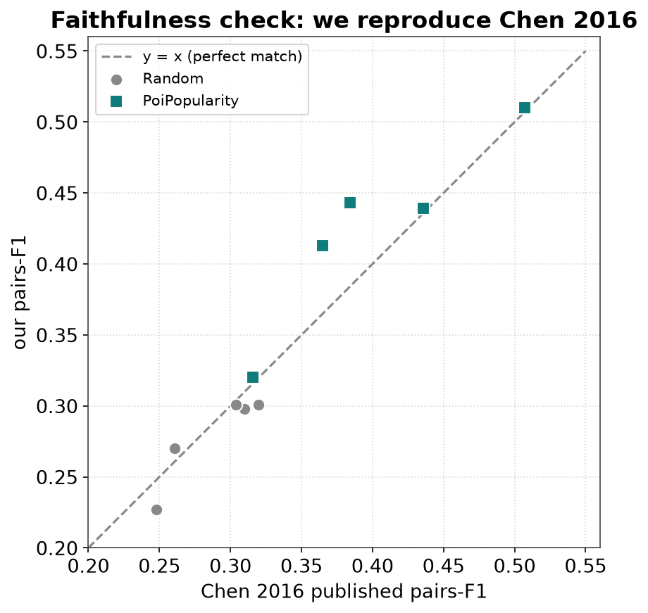
validation
Did we do it right? Reproducing Chen 2016
A Random baseline has no modelling choices — it can only match Chen's Random if our data, protocol and metric are identical.
They match within noise on every city; PoiPopularity matches closely too.
pairs-F1 | Tor | Osa | Gla | Edi | Mel
Random — ours | 0.298 | 0.301 | 0.301 | 0.270 | 0.227
Random — Chen | 0.310 | 0.304 | 0.320 | 0.261 | 0.248
PoiPopularity — ours | 0.443 | 0.413 | 0.510 | 0.439 | 0.320
PoiPopularity — Chen | 0.384 | 0.365 | 0.507 | 0.436 | 0.316
Strategy D — Itinerary recommendation on Flickr
10

Slide 11
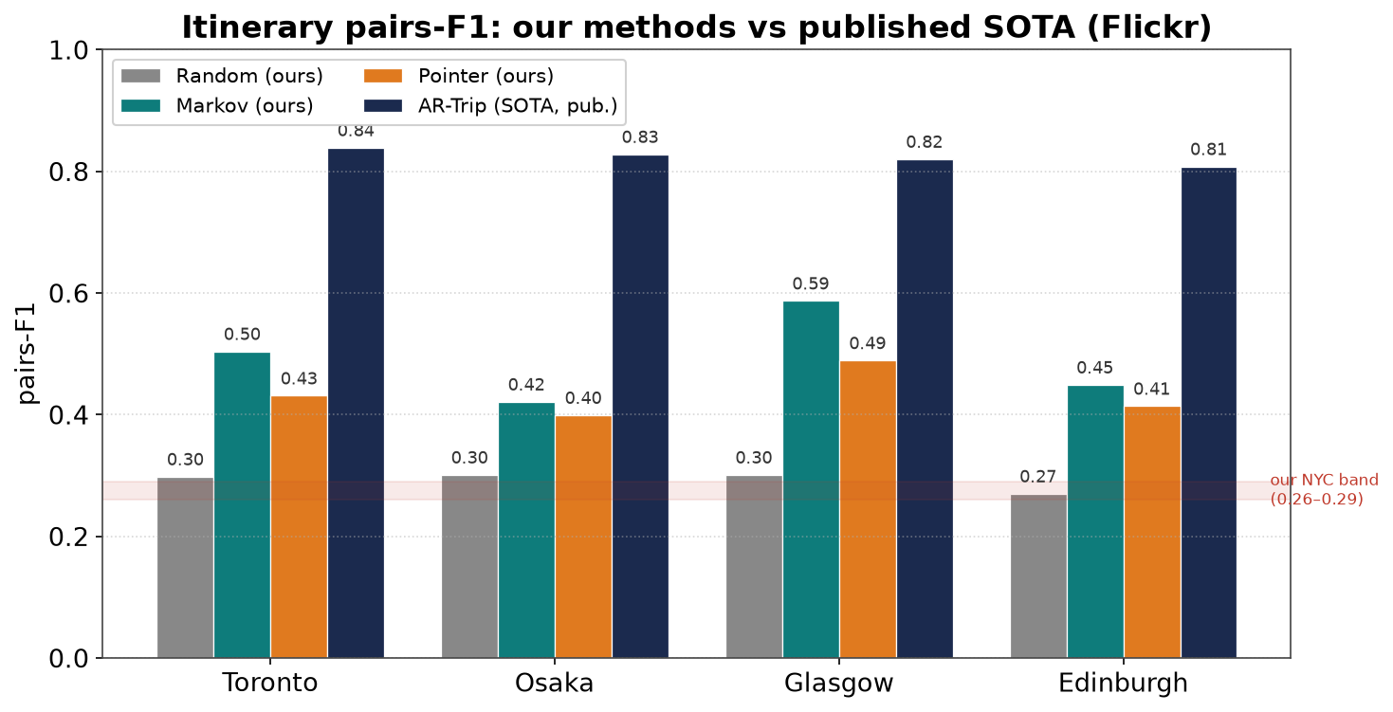
results
Results — on the literature's scale
Headline
our classical
0.23 – 0.59
our pointer
0.31 – 0.49
vs NYC
0.26 – 0.29
published
0.26 – 0.85
Every one of our methods is on the published 0–1 scale — the thesis goal is met by the classical baselines alone.
Strategy D — Itinerary recommendation on Flickr
11

Slide 12
literature
The published comparison
Directly-comparable published pairs-F1 (same protocol, 0–1 scale):
method (published) | Toronto | Osaka | Glasgow | Edinburgh
PoiRank (Chen) | 0.518 | 0.511 | 0.548 | 0.432
Rank+Markov (Chen) | 0.512 | 0.486 | 0.545 | 0.444
DeepTrip | 0.748 | 0.755 | 0.782 | 0.660
CTLTR | 0.748 | 0.719 | 0.763 | 0.681
SelfTrip | 0.835 | 0.851 | 0.818 | 0.779
AR-Trip | 0.839 | 0.828 | 0.820 | 0.808
No single SOTA across all cities: AR-Trip leads on Toronto/Glasgow/Edinburgh, SelfTrip on Osaka (0.851).
Classical methods (Chen 2016) ≈ 0.43–0.55; neural methods (2019–2024) climb to ≈ 0.66–0.85.
Strategy D — Itinerary recommendation on Flickr
12

Slide 13
the finding
The learned model — measured & honest
 | Tor | Osa | Gla | Edi | Mel
Pointer pairs-F1 | 0.431 | 0.399 | 0.489 | 0.414 | 0.312
Markov (ours) | 0.504 | 0.421 | 0.587 | 0.449 | 0.333
Random (ours) | 0.298 | 0.301 | 0.301 | 0.270 | 0.227
▸ On the scale, above Random: pointer reaches 0.31–0.49, with point-F1 ~0.70 (it picks the right POIs).
▸ But its ordering trails Markov on every city and is far below the neural SOTA (0.66–0.85).
▸ The lesson (same as Strategy B on NYC): naively training a pointer on tiny per-fold data doesn't beat a strong simple model.
▸ SOTA methods use machinery we omit: self-supervised pre-training, trajectory augmentation, adversarial training.
Strategy D — Itinerary recommendation on Flickr
13

Slide 14
next iteration
Closing the gap — implemented levers
Markov prior
blend the fold's log P(j|i)
into the pointer logits
at decode (no retraining)
→ targets the weak ordering
User embedding
per-user vector added to
the query + decoder state
Early stopping
hold out a val slice of
the train fold; stop on
val loss
Verified: Osaka pairs-F1 0.42 (pure) → 0.44 (+Markov+user) — edges past the Markov baseline.
All opt-in in PointerConfig; the Colab notebook runs the pure pointer and the enhanced variant side by side. Sweep the prior weight / epochs for a higher number.
Strategy D — Itinerary recommendation on Flickr
14

Slide 15
contribution
What this gives the thesis
▸ Literature-comparable numbers — pairs-F1 on the same 0.3–0.85 scale as Chen 2016 / DeepTrip / SelfTrip / AR-Trip.
▸ A validated, faithful harness — Random reproduces Chen 2016 within noise (the protocol-faithfulness proof).
▸ An honest baseline — classical methods are strong; the light learned model reaches the scale but not SOTA, and we say so (with the levers to improve it).
▸ Fully reproducible — self-contained loader + harness + Colab notebook; 79 passing tests; no heavy deps.
▸ Resolves the NYC puzzle — the low Foursquare-NYC pairs-F1 was a data/protocol artefact, not a bug.
Strategy D — Itinerary recommendation on Flickr
15

Slide 16
Summary
▸ Same itinerary task, the field's benchmark (Flickr) + protocol (Chen 2016, leave-one-out, endpoints given, pairs-F1).
▸ Random reproduces Chen → faithful. Classical 0.23–0.59, pointer 0.31–0.49 — on the published 0.26–0.85 scale.
▸ Honest finding: the light learned pointer trails the Markov baseline and SOTA; levers implemented to close the gap.
Next steps
• Run the enhanced pointer on Colab (sweep Markov-prior weight / epochs) for a stronger learned number.
• Fold these results into the full thesis defence deck (next session).

Slide 17
backup
Appendix — reproducibility & references
Code (src/flickr/)
Key references
▸ data.py — loader (both formats) → FlickrCity
▸ evaluate.py — leave-one-out CV, F1 + pairs-F1
▸ baselines.py — Random/Popularity/Markov(Path)
▸ pointer.py — GCN+pointer + levers (Colab)
▸ published.py — curated literature numbers
▸ run_flickr.py — orchestration + tables + CLI
▸ tests/test_flickr.py — 79 cases incl. pairs-F1 vs Chen
▸ Chen, Ong, Xie. Learning Points & Routes. CIKM 2016 (pairs-F1 + our data).
▸ Gao et al. DeepTrip. SIGSPATIAL 2019.
▸ Gao et al. SelfTrip. KBS 2022.
▸ Rashid et al. DeepAltTrip. TKDE 2021.
▸ Shu et al. AR-Trip. SIGIR 2024.
▸ Lim et al. Tour Rec & Trip Planning survey. KAIS 2019.
▸ Krichene & Rendle. Sampled Metrics. KDD 2020.
Strategy D — Itinerary recommendation on Flickr
17

