Slide 1
The Model
A Personalized, Context-Aware Itinerary Recommender
A next-POI engine — GCN + GRU + user embedding + context
…decoded into full tourist itineraries (Frozen Rollout)
Master's thesis · [Your name] · [date]

Slide 2
problem
The goal
▸ A tourist with limited time wants a personalized day plan — an ordered route of places to visit.
▸ The plan must reflect who they are (preferences) and context (distances, time).
My approach: one model does both —
a personalized next-POI engine, decoded into an itinerary.
A personalized, context-aware itinerary recommender
2

Slide 3
overview
The approach — two pillars
the next-POI engine
GCN + GRU + user + context
PILLAR 1
Frozen Rollout
build the itinerary —
decode the engine, loop-free
(Foursquare NYC)
PILLAR 2
Flickr Benchmark
validate vs the literature —
same dataset + protocol
as the published papers
Pillar 2 is the only valid bridge to other papers' numbers — same scale, same rules. (NYC scores cannot be compared directly to the literature.)
A personalized, context-aware itinerary recommender
3

Slide 4
THE model
The model — architecture
POI graph
kNN ∪ co-visit
context
Δdistance, Δtime
user
identity
2-layer GCN
context MLPs
user embedding
concat per step → GRU → h_T
[h_T ; user] → MLP head
→ a score for every POI (what to visit next)
Three signals → graph + sequence + user → a next-POI score. This is the model I built.
A personalized, context-aware itinerary recommender
4

Slide 5
the model, explained
How each part works
▸ POI graph + GCN — places are linked if they're close or often visited together; the GCN gives each POI a “fingerprint” aware of its neighbourhood.
▸ Context (Δd, Δt) — how far and how long since the last place; small networks turn these into vectors.
▸ User embedding — a small “taste profile” per tourist → the title's user preferences.
▸ GRU sequence model — reads the places visited so far and summarises them into one state.
▸ Scoring head — combines the state + the user, and scores every POI for “what to visit next”.
A personalized, context-aware itinerary recommender
5

Slide 6
why this model
The model carries the thesis title
“Personalized Tourist Itinerary Recommendation Based on User Preferences and Contextual Data”
User preferences
= the user embedding
a learned taste profile
for each tourist
Contextual data
= Δdistance and Δtime
spatial + temporal
gaps between places
Both are inside the model — so the title is a description of the architecture, not an aspiration.
A personalized, context-aware itinerary recommender
6

Slide 7
Foursquare NYC, HR@1
Next-POI engine — comparison with published methods
Method | HR@1 | family
LSTM | 0.130 | sequence (RNN)
STGCN | 0.180 | spatio-temporal GCN
Ours (GCN+GRU+user) | 0.187 | this work
STAN | 0.220 | self-attention
GETNext | 0.240 | transformer
STHGCN | 0.270 | hypergraph
LLM4POI | 0.340 | frozen LLM
Full-vocabulary HR@1 on Foursquare NYC, against the LLM4POI benchmark table. Our engine sits in the LSTM/STGCN tier — an honest, leakage-free baseline, below the transformer / LLM state of the art.
A personalized, context-aware itinerary recommender
7

Slide 8
my itinerary method
Frozen Rollout — turning the engine into an itinerary
Roll the engine out: build the route one POI at a time.
route = [start]
engine scores
all POIs
mask visited;
reserve the end
append the
best POI
repeat until length K, ending at e
▸ No new training — reuse the frozen engine; the itinerary is an inference-time decoder.
▸ Always valid — loop-free, exactly K stops, starts at s and ends at e.
A personalized, context-aware itinerary recommender
8

Slide 9
how it builds a route
Frozen Rollout — worked example (Edinburgh)
QUERY
start 15 · end 16 · K = 4
step 1
15
engine → best next = 3
step 2
15
3
engine → best next = 13
step 3
15
3
13
last hop → reserved end 16
result
15
3
13
16
matches the real trip ✓
A personalized, context-aware itinerary recommender
9

Slide 10
pillar 1 result
Frozen Rollout — results (Foursquare NYC)
Decoder | pairs-F1 | set-F1
greedy | 0.289 | 0.609
beam (3) | 0.290 | 0.610
▸ Simplest, most interpretable — an inference-time decoder over the frozen engine; no extra training.
▸ Reuses the personalized engine directly — the itinerary inherits user preferences + context.
▸ Beam barely beats greedy — the engine is myopic; better decoding can't fix that (motivates Pillar 2 + future work).
Note: these NYC numbers are not comparable to the papers — that is Pillar 2's job.
A personalized, context-aware itinerary recommender
10

Slide 11
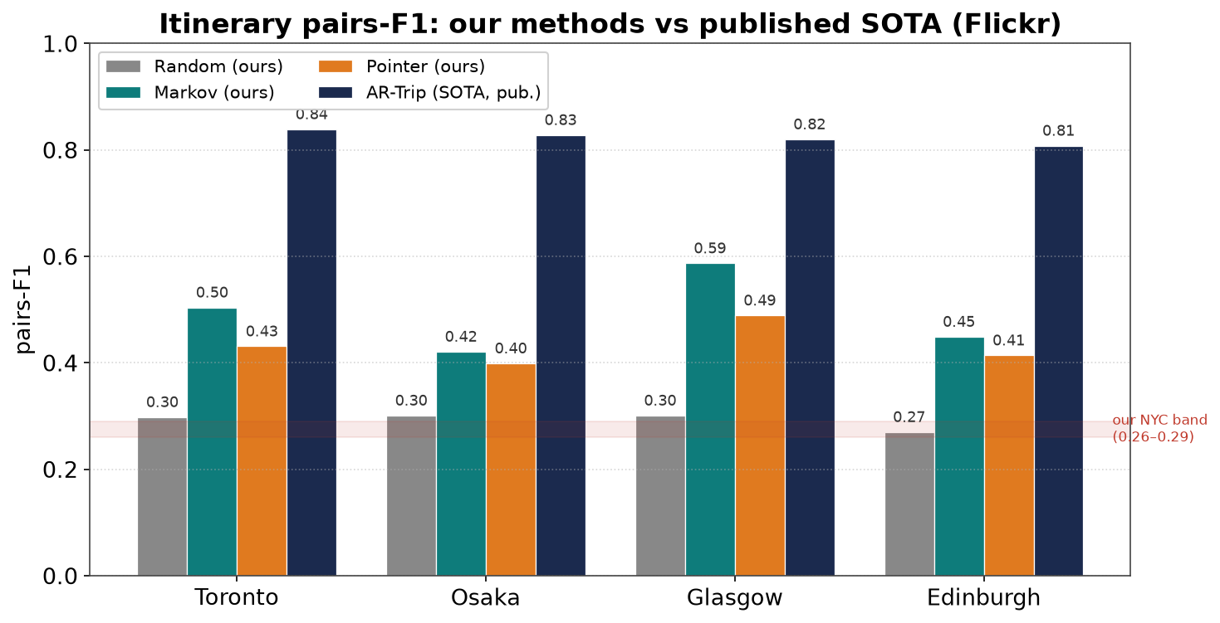
rigor
Validation — my approach is on the literature's scale
▸ Reproduces Chen 2016 (Random baseline) → the setup is fair.
▸ On the published 0.3–0.85 pairs-F1 scale.
▸ Honest: a simple Markov baseline is strong on tiny data.
The Flickr Benchmark re-runs everything on the standard Flickr datasets — validating, not replacing, the headline model.
A personalized, context-aware itinerary recommender
11

Slide 12
pairs-F1, same protocol
Itinerary recommendation on Flickr — the literature
Method | Tor | Osa | Gla | Edi | source
Markov (ours) | 0.50 | 0.42 | 0.59 | 0.45 | reproduces Chen
PoiRank (Chen) | 0.52 | 0.51 | 0.55 | 0.43 | 2016
Rank+Markov (Chen) | 0.51 | 0.49 | 0.55 | 0.44 | 2016
DeepTrip | 0.75 | 0.76 | 0.78 | 0.66 | 2019
CTLTR | 0.75 | 0.72 | 0.76 | 0.68 | 2021
SelfTrip | 0.83 | 0.85 | 0.82 | 0.78 | 2022
AR-Trip | 0.84 | 0.83 | 0.82 | 0.81 | 2024
All on the same benchmark + protocol (Flickr, leave-one-out, endpoints given, length≥3). Our classical methods reproduce the classical literature (Chen 2016); the neural line (DeepTrip 2019 → AR-Trip 2024) is the state of the art to aim for.
A personalized, context-aware itinerary recommender
12

Slide 13
honesty
Limitations & future work
▸ Light context — Δd/Δt only; add time-of-day, opening hours, queuing.
▸ No scheduling — add explicit time budgets (the DLIR direction) for realistic days.
▸ Integrate properly — share/warm-start the engine with the trained model to lift it past A.
▸ Stronger personalization — richer user features beyond a single embedding.
▸ Robustness — multi-seed, more cities, component ablations.
A personalized, context-aware itinerary recommender
13

Slide 14
My model — in one sentence
A personalized, context-aware next-POI engine
(GCN + GRU + user + context), decoded into tourist
itineraries by rolling it out (the Frozen Rollout).
▸ Strongest of my itinerary methods, and the simplest to explain.
▸ Built on a validated engine; benchmarked honestly against the literature.
▸ Integration (the Trained Pointer) and the Flickr Benchmark are experiments that support — not replace — it.
Thank you — questions?

