Slide 1
Smart Visit Module for Personalized
Tourist Itinerary Recommendation
Based on User Preferences and Contextual Data
A personalized, context-aware next-POI engine, decoded and trained into full
itineraries, and benchmarked against the trip-recommendation literature
Master's thesis · [Your name] · Supervisor: [name] · [date]

Slide 2
the problem
Motivation
▸ A tourist with limited time faces hundreds of POIs and wants a personalized day plan — an ordered route of places to visit, not just a single suggestion.
▸ A good plan depends on who they are (preferences) and context (where they are, how far apart places are, time of day).
▸ This is itinerary recommendation — a different problem from predicting the single next place (next-POI).
Goal: a “Smart Visit Module” that recommends a personalized, context-aware itinerary —
the right places, in the right order, for this user.
Smart Visit Module — Personalized Tourist Itinerary Recommendation
2

Slide 3
background
Two sub-problems — and the gap
Next-POI prediction
predict the single NEXT place
(a building block)
Itinerary recommendation
produce the WHOLE ordered route
(the actual goal)
The field's question (Halder 2024 survey; DLIR 2025):
should POI scoring and itinerary construction be SEPARATE steps, or INTEGRATED?
DLIR argues separate → sub-optimal; integration helps. We test this directly.
Smart Visit Module — Personalized Tourist Itinerary Recommendation
3

Slide 4
scope
Research questions
▸ RQ1 — Can a personalized, context-aware next-POI model (graph + sequence + user) reach a competitive tier on a standard check-in benchmark?
▸ RQ2 — Can that model be decoded into coherent, loop-free itineraries without dedicated itinerary training? (the decoupled approach)
▸ RQ3 — Does an integrated, end-to-end itinerary model improve over the decoupled decoding — i.e. does the integration hypothesis hold on our data?
▸ RQ4 — Where do our itinerary models stand against the published literature, under the exact comparable protocol?
Smart Visit Module — Personalized Tourist Itinerary Recommendation
4

Slide 5
what's new
Contributions
▸ A reproducible, honest personalized context-aware next-POI engine (graph + spatio-temporal context + user embedding) on Foursquare NYC.
▸ Two itinerary strategies and a controlled decoupled-vs-integrated comparison (Strategy A: decode the frozen engine; Strategy B: train an integrated pointer).
▸ A literature-comparable Flickr benchmark (Strategy D) with a pairs-F1 harness validated by reproducing Chen 2016.
▸ An honest analysis of where simple baselines suffice and where integration/personalization help — and a clear path toward a full DLIR-style module.
Smart Visit Module — Personalized Tourist Itinerary Recommendation
5

Slide 6
next-POI model
Phase 1 — the personalized, context-aware engine
A next-POI model fuses three signals into a score over all POIs:
POI graph
kNN ∪ co-visit
context
Δdistance, Δtime
user
embedding
2-layer GCN → POI features
context MLPs
user vector
concat per step → GRU sequence model → h_T
[h_T ; user] → MLP head
→ score over all POIs
This single model carries the thesis's “user preferences” (the user embedding) and “contextual data” (spatial Δd and temporal Δt). It is the engine the itinerary models reuse.
Smart Visit Module — Personalized Tourist Itinerary Recommendation
6

Slide 7
RQ1
Phase 1 — results (Foursquare NYC, full vocab)
Metric | Value
HR@1 | 0.187
HR@5 | 0.476
HR@10 | 0.588
NDCG@10 | 0.375
MRR | 0.316
Model | HR@1
LSTM | 0.130
STGCN | 0.180
Ours (GCN+GRU+user) | 0.187
STAN | 0.220
GETNext | 0.240
STHGCN | 0.270
LLM4POI | 0.340
HR@1 = 0.187 sits in the LSTM / STGCN tier of the LLM4POI benchmark — an honest baseline, below the transformer/LLM SOTA but a strong, leakage-free engine.
(RQ1: yes — a competitive personalized engine.)
Smart Visit Module — Personalized Tourist Itinerary Recommendation
7

Slide 8
RQ2 / RQ3
From engine to itinerary — two strategies
the next-POI engine
(Phase 1)
Strategy A — DECOUPLED
decode the FROZEN engine
roll it out: mask visited,
reserve the end POI
(no itinerary training)
Strategy B — INTEGRATED
TRAIN a pointer end-to-end
on whole trajectories
(GCN + GRU + pointer)
v1 no context, v2 + context
A = Halder's “separate problems” baseline; B = the “integrated” model. Comparing them tests the integration hypothesis directly.
Smart Visit Module — Personalized Tourist Itinerary Recommendation
8

Slide 9
RQ3 — an honest result
The integration experiment — A vs B (NYC, len≥3)
Method | pairs-F1 | kind
A — frozen rollout (greedy) | 0.289 | decoupled
A — frozen rollout (beam 3) | 0.290 | decoupled
B-v1 — pointer (no context) | 0.259 | integrated
B-v2 — pointer (+ context) | 0.261 | integrated
Finding
the INTEGRATED model
did NOT beat the
decoupled rollout
on NYC.
Contrary to the integration hypothesis, the trained pointer (B) trailed the frozen rollout (A) by ~0.03 pairs-F1.
Why: the next-POI engine was trained on ~75k prefix→next examples; the integrated pointer saw only ~10k whole trajectories.
Lesson: integration does not automatically win — supervision density matters. This nuances Halder/DLIR rather than contradicting it.
Smart Visit Module — Personalized Tourist Itinerary Recommendation
9

Slide 10
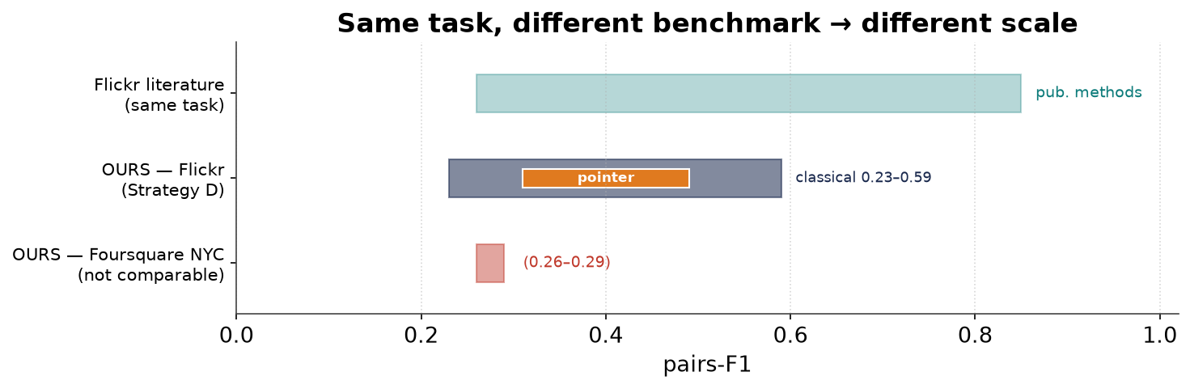
the catch
But are these numbers comparable?
Our NYC itinerary pairs-F1 (~0.29) looks far below the literature's ~0.6–0.8 — but it's a different benchmark.
Comparable needs the same dataset + protocol + metric. The literature uses the small Flickr datasets → Strategy D.
Smart Visit Module — Personalized Tourist Itinerary Recommendation
10

Slide 11
RQ4
Strategy D — the literature-comparable benchmark
▸ Data: 5 Flickr photo-trajectory cities (27–88 POIs), Chen 2016's own files → trajectories identical to the literature's.
▸ Protocol: leave-one-trajectory-out CV, first + last POI given, length ≥ 3.
▸ Metric: point-F1 and order-aware pairs-F1 (Chen 2016).
▸ Methods: classical baselines (Random / Popularity / Markov) + the GCN-pointer.
City | #POIs | #traj≥3
Toronto | 29 | 335
Osaka | 27 | 47
Glasgow | 27 | 112
Edinburgh | 28 | 634
Melbourne | 88 | 442
Small vocabularies → pairs-F1 can reach 0.5–0.85 here, vs ~0.29 on NYC's ~5,000 POIs (the “easier exam”).
Smart Visit Module — Personalized Tourist Itinerary Recommendation
11

Slide 12
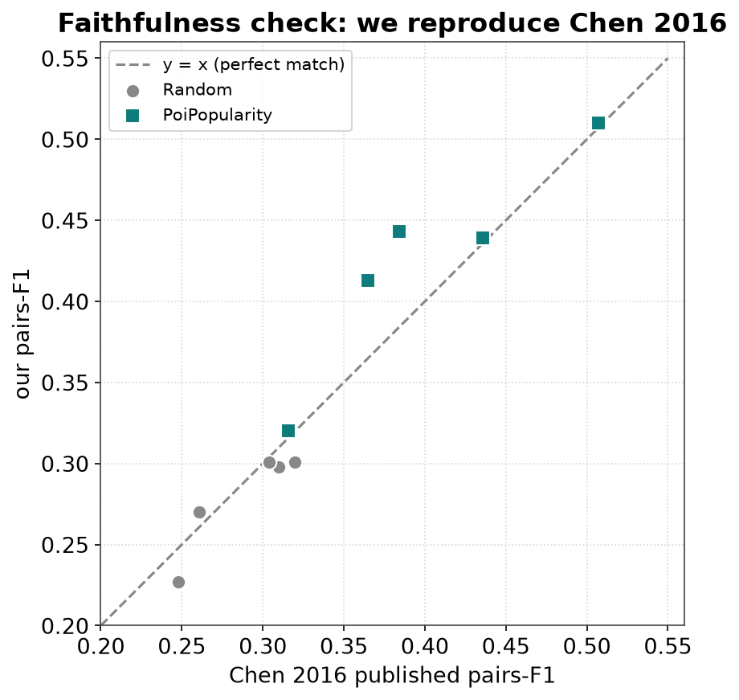
is the comparison fair?
Validation — we reproduce Chen 2016
A Random baseline has no modelling choices — it can only match Chen 2016 if our data, protocol and metric are identical. They match within noise.
pairs-F1 | Tor | Osa | Gla | Edi | Mel
Random ours | 0.298 | 0.301 | 0.301 | 0.270 | 0.227
Random Chen | 0.310 | 0.304 | 0.320 | 0.261 | 0.248
PoiPopularity ours | 0.443 | 0.413 | 0.510 | 0.439 | 0.320
PoiPopularity Chen | 0.384 | 0.365 | 0.507 | 0.436 | 0.316
Smart Visit Module — Personalized Tourist Itinerary Recommendation
12

Slide 13
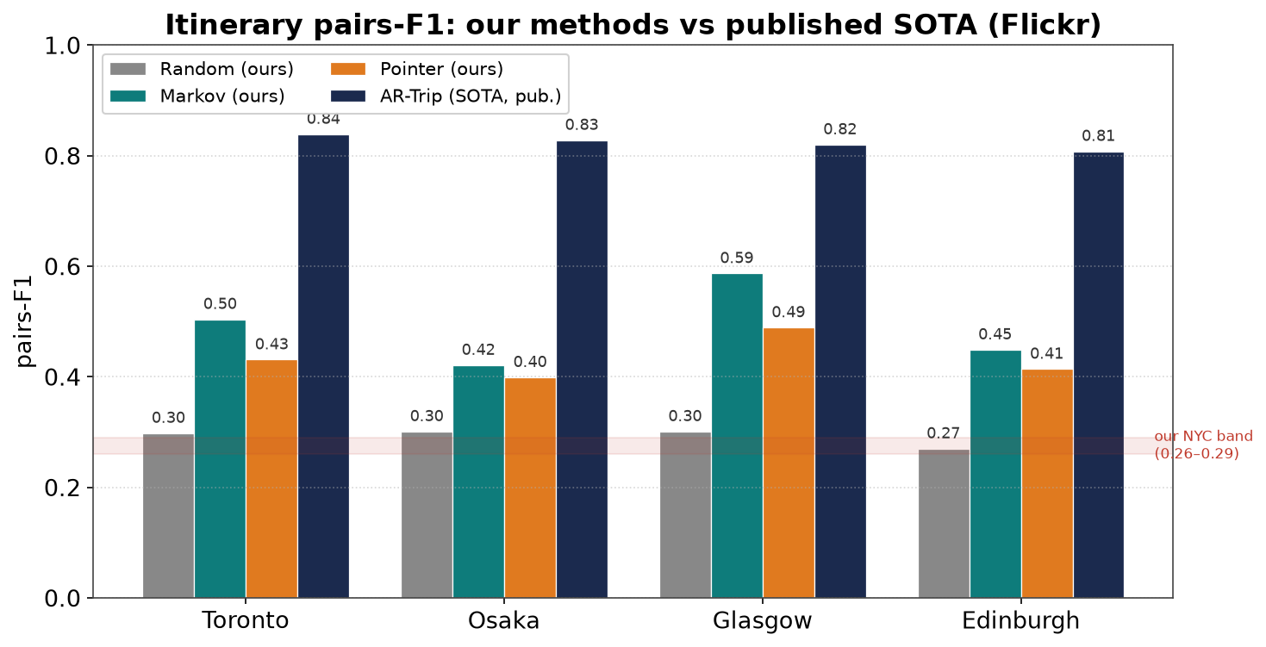
RQ4
Strategy D — results on the literature's scale
Headline
classical
0.23 – 0.59
pointer
0.31 – 0.49
vs NYC
0.26 – 0.29
published
0.26 – 0.85
On the standard benchmark our methods are on the published scale; the simple Markov baseline is strong and the learned pointer reaches the scale but doesn't beat it.
Smart Visit Module — Personalized Tourist Itinerary Recommendation
13

Slide 14
engaging the field
Positioning vs Halder / DLIR (2024–2025)
Halder / DLIR
integrate POI scoring + itinerary
+ dynamic temporal interest
+ queuing time + time budget
(Transformer + co-visit GCN)
This thesis
tests decoupled (A) vs integrated (B)
user embedding + Δd/Δt context
validated pairs-F1 on Flickr
(GCN + GRU pointer)
▸ We engage Halder's central claim directly — and find integration did not automatically win on our data (a nuance, not a contradiction).
▸ We deliberately scope smaller: we do not yet model queuing, explicit time budgets, or dynamic time-of-day interest.
Smart Visit Module — Personalized Tourist Itinerary Recommendation
14

Slide 15
self-critique
Honest findings & limitations
▸ Integration didn't beat decoupling on NYC — driven by supervision density, not a refutation of the idea.
▸ Personalization is uneven — strong on Foursquare (user embedding), weak in the comparable Flickr results.
▸ Context is light — spatial Δd + temporal Δt only; no time-of-day dynamics, queuing, or budgets (cf. DLIR).
▸ Markov is a hard baseline — on tiny data, a simple transition model beats the neural pointer.
▸ Single seed; NYC only for Phase 1 — multi-seed and TKY runs are planned.
Smart Visit Module — Personalized Tourist Itinerary Recommendation
15

Slide 16
next
Future work — toward the full Smart Visit Module
▸ Integrate properly — warm-start / share the engine with the pointer; emit prefix sub-trajectories to match supervision density.
▸ Turn on personalization in the itinerary — the pointer's user-embedding lever; report personalized-vs-not pairs-F1.
▸ Richer context — time-of-day / day-of-week dynamic interest, opening hours.
▸ Add scheduling — explicit time budget + queuing time (the DLIR direction) for realistic day plans.
▸ Robustness — multi-seed, more cities, ablations of each component.
Smart Visit Module — Personalized Tourist Itinerary Recommendation
16

Slide 17
Conclusion
▸ A personalized, context-aware next-POI engine (RQ1) — honest LSTM/STGCN tier on Foursquare NYC.
▸ Two ways to turn it into itineraries (RQ2/RQ3): decoupled decoding vs an integrated pointer — and integration did not automatically win.
▸ A validated, literature-comparable Flickr benchmark (RQ4): Random reproduces Chen 2016; our methods land on the published 0.3–0.85 scale.
▸ Positioned against Halder/DLIR: we test the integration claim and chart the path to a full scheduling-aware module.
Thank you — questions?

Slide 18
backup
Key references
▸ Halder, Lim, Chan, Zhang. Deep Learning of Dynamic POI Generation & Optimisation for Itinerary Rec (DLIR). ACM TORS 2025.
▸ Halder et al. A survey on personalized itinerary recommendation: from optimisation to deep learning. ASOC 2024.
▸ Chen, Ong, Xie. Learning Points and Routes to Recommend Trajectories. CIKM 2016 — pairs-F1 + our Flickr data.
▸ Gao et al. DeepTrip (SIGSPATIAL 2019); SelfTrip (KBS 2022). · Shu et al. AR-Trip (SIGIR 2024).
▸ Yang et al. GETNext (SIGIR 2022); Li et al. LLM4POI (SIGIR 2024) — next-POI tier we compare to.
▸ Krichene & Rendle. On Sampled Metrics for Item Recommendation. KDD 2020 — no cross-protocol comparison.
Smart Visit Module — Personalized Tourist Itinerary Recommendation
18

