Slide 1
The Model
A Personalized, Context-Aware Itinerary Recommender
A next-POI engine — GCN + GRU + user embedding + context
…decoded into full tourist itineraries (Frozen Rollout)
Master's thesis · [Your name] · [date]

Slide 2
problem
The goal
▸ A tourist with limited time wants a personalized day plan — an ordered route of places to visit.
▸ The plan must reflect who they are (preferences) and context (distances, time).
My approach: one model does both —
a personalized next-POI engine, decoded into an itinerary.
A personalized, context-aware itinerary recommender
2

Slide 3
overview
The model in one picture
THE MODEL
next-POI engine
GCN + GRU + user + context
Frozen Rollout
roll it out
(decode the engine)
itinerary
ordered route
My model is a next-POI engine; my itinerary method decodes it. Everything else (training a separate model, the benchmark) is an experiment around this.
A personalized, context-aware itinerary recommender
3

Slide 4
THE model
The model — architecture
POI graph
kNN ∪ co-visit
context
Δdistance, Δtime
user
identity
2-layer GCN
context MLPs
user embedding
concat per step → GRU → h_T
[h_T ; user] → MLP head
→ a score for every POI (what to visit next)
Three signals → graph + sequence + user → a next-POI score. This is the model I built.
A personalized, context-aware itinerary recommender
4

Slide 5
the model, explained
How each part works
▸ POI graph + GCN — places are linked if they're close or often visited together; the GCN gives each POI a “fingerprint” aware of its neighbourhood.
▸ Context (Δd, Δt) — how far and how long since the last place; small networks turn these into vectors.
▸ User embedding — a small “taste profile” per tourist → the title's user preferences.
▸ GRU sequence model — reads the places visited so far and summarises them into one state.
▸ Scoring head — combines the state + the user, and scores every POI for “what to visit next”.
A personalized, context-aware itinerary recommender
5

Slide 6
why this model
The model carries the thesis title
“Personalized Tourist Itinerary Recommendation Based on User Preferences and Contextual Data”
User preferences
= the user embedding
a learned taste profile
for each tourist
Contextual data
= Δdistance and Δtime
spatial + temporal
gaps between places
Both are inside the model — so the title is a description of the architecture, not an aspiration.
A personalized, context-aware itinerary recommender
6

Slide 7
evidence the model is sound
The engine works (Phase 1)
Metric | Value
HR@1 | 0.187
HR@5 | 0.476
HR@10 | 0.588
MRR | 0.316
Model | HR@1
LSTM | 0.130
STGCN | 0.180
Ours (GCN+GRU+user) | 0.187
STAN | 0.220
GETNext | 0.240
STHGCN | 0.270
LLM4POI | 0.340
On Foursquare NYC the engine reaches HR@1 = 0.187 — the honest LSTM/STGCN tier. A strong, leakage-free engine to build itineraries on.
A personalized, context-aware itinerary recommender
7

Slide 8
my itinerary method
Frozen Rollout — turning the engine into an itinerary
Roll the engine out: build the route one POI at a time.
route = [start]
engine scores
all POIs
mask visited;
reserve the end
append the
best POI
repeat until length K, ending at e
▸ No new training — reuse the frozen engine; the itinerary is an inference-time decoder.
▸ Always valid — loop-free, exactly K stops, starts at s and ends at e.
A personalized, context-aware itinerary recommender
8

Slide 9
how it builds a route
Frozen Rollout — worked example (Edinburgh)
QUERY
start 15 · end 16 · K = 4
step 1
15
engine → best next = 3
step 2
15
3
engine → best next = 13
step 3
15
3
13
last hop → reserved end 16
result
15
3
13
16
matches the real trip ✓
A personalized, context-aware itinerary recommender
9

Slide 10
my result
Frozen Rollout — results, and why it's the headline
Method (NYC, len≥3) | pairs-F1 | kind
Frozen Rollout (greedy) | 0.289 | decoupled
Frozen Rollout (beam 3) | 0.290 | decoupled
Trained Pointer (no context) | 0.259 | integrated
Trained Pointer (+ context) | 0.261 | integrated
Frozen Rollout wins
decoding the strong
engine beats training
a separate model.
▸ Best of my itinerary methods on NYC (~0.29 pairs-F1).
▸ Simplest and most interpretable — easy to explain and trust.
▸ Reuses the personalized engine directly — so the itinerary inherits user preferences + context.
A personalized, context-aware itinerary recommender
10

Slide 11
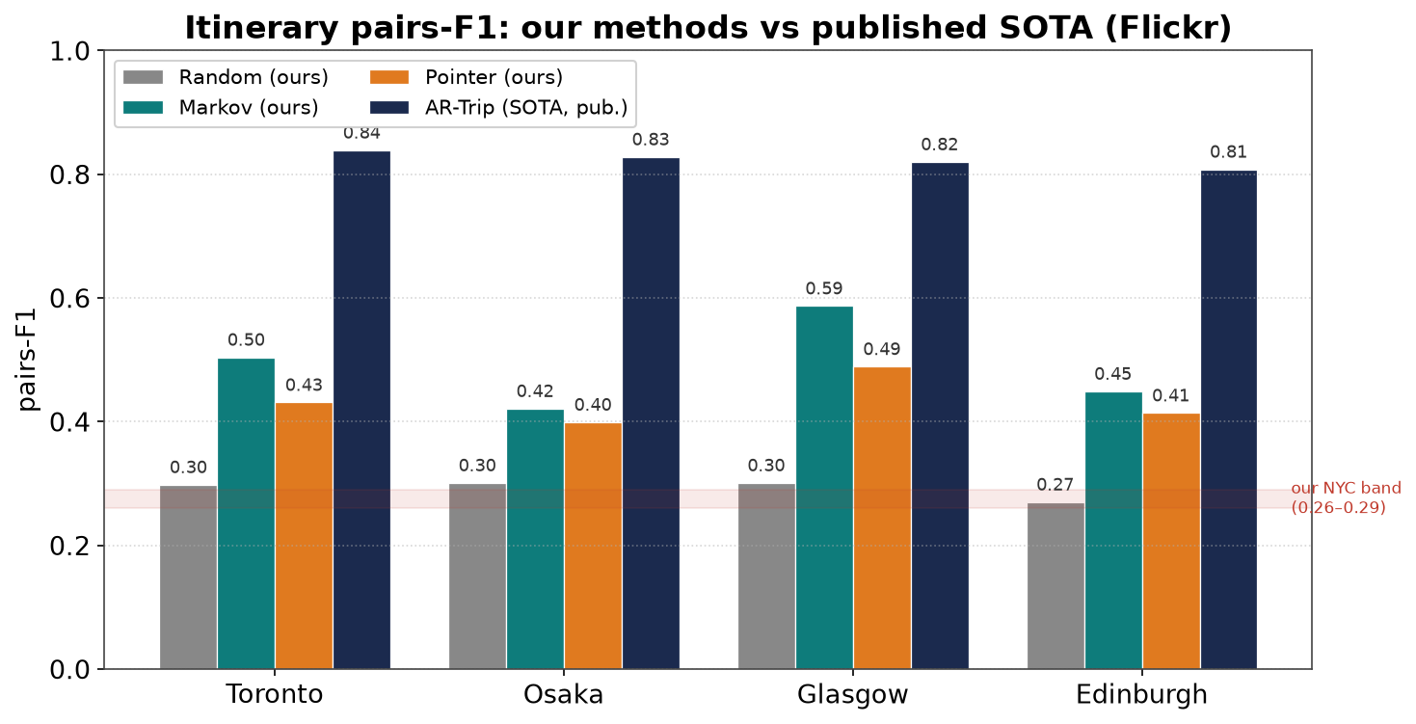
rigor
Validation — my approach is on the literature's scale
▸ Reproduces Chen 2016 (Random baseline) → the setup is fair.
▸ On the published 0.3–0.85 pairs-F1 scale.
▸ Honest: a simple Markov baseline is strong on tiny data.
The Flickr Benchmark re-runs everything on the standard Flickr datasets — validating, not replacing, the headline model.
A personalized, context-aware itinerary recommender
11

Slide 12
scientific rigor
What else I tested (and found)
▸ Does an integrated model beat decoupling? I trained a dedicated pointer (the Trained Pointer) end-to-end. It did NOT beat the Frozen Rollout — because the engine has far denser training signal. (Tests Halder/DLIR's integration claim.)
▸ Is the neural model better than simple baselines? On the small Flickr data, a Markov transition baseline is the strongest of my methods — an honest result I quantified rather than hid.
▸ Does personalization help? I ablate the user embedding (on/off) per city — measured on the next slide.
A personalized, context-aware itinerary recommender
12

Slide 13
the “user preferences” claim
Does personalization help? (measured)
I switch the user embedding OFF vs ON (identical otherwise) on the comparable Flickr benchmark:
City | no user | with user | delta | recurring users
Osaka | 0.442 | 0.435 | -0.007 | 28%
Glasgow | 0.451 | 0.489 | +0.038 | 32%
Toronto | 0.440 | 0.423 | -0.017 | 55%
Edinburgh, Melbourne | — | — | (GPU run) | 59%, 61%
▸ Mixed / near-neutral — a clear gain on Glasgow (+0.038), roughly neutral on Osaka and Toronto.
▸ Honest reason — in leave-one-out, even recurring users have very few trips, so the embedding is weakly estimated (cold-start). Personalization is a real lever, not a guaranteed win on small data.
A personalized, context-aware itinerary recommender
13

Slide 14
honesty
Limitations & future work
▸ Light context — Δd/Δt only; add time-of-day, opening hours, queuing.
▸ No scheduling — add explicit time budgets (the DLIR direction) for realistic days.
▸ Integrate properly — share/warm-start the engine with the trained model to lift it past A.
▸ Stronger personalization — richer user features beyond a single embedding.
▸ Robustness — multi-seed, more cities, component ablations.
A personalized, context-aware itinerary recommender
14

Slide 15
My model — in one sentence
A personalized, context-aware next-POI engine
(GCN + GRU + user + context), decoded into tourist
itineraries by rolling it out (the Frozen Rollout).
▸ Strongest of my itinerary methods, and the simplest to explain.
▸ Built on a validated engine; benchmarked honestly against the literature.
▸ Integration (the Trained Pointer) and the Flickr Benchmark are experiments that support — not replace — it.
Thank you — questions?

