Slide 1

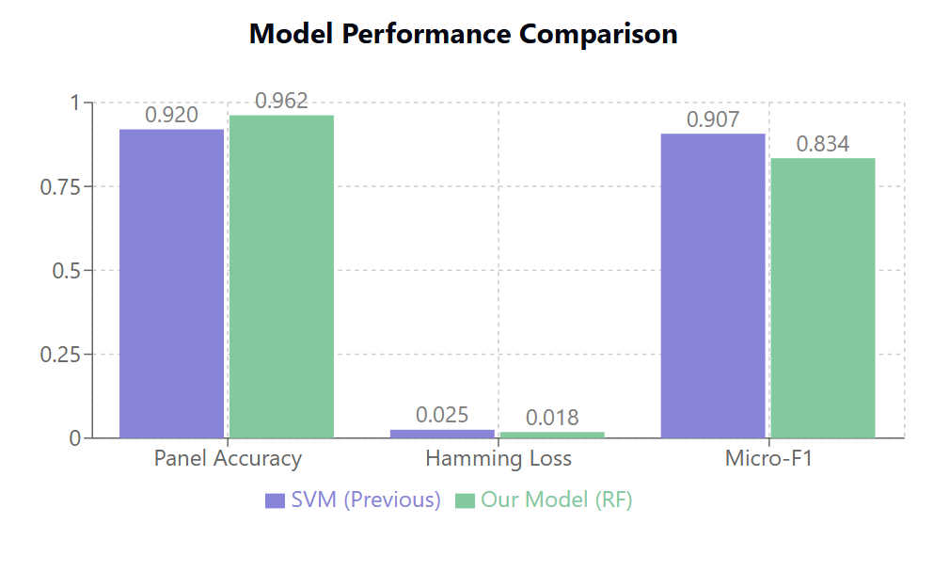
Automated Classification of Research Projects Using Machine Learning
Ankur Gupta(2201028)
Abstract
This research develops an ML system for automated technical project classification using NLP. We implement a multi-output Random Forest classifier trained on project descriptions, achieving 96.2% panel accuracy and 0.018 Hamming loss for research areas. The system streamlines project categorization, reducing manual effort while ensuring precise multi-label classification for academic management.
Research Question
How can TF-IDF features and ensemble learning be optimized to accurately and efficiently perform multi-output classification of technical projects, while addressing class imbalance?
Objective
This project aims to build an ML-based system that automatically classifies technical projects into expert panels and research areas using multi-output learning.
Methods/Approach
We analyzed 407 technical projects (≈125 KB) with titles, keywords, panel assignments, and multi-label research areas, sourced from Dr. Angshuman Jana. The text preprocessing combined titles and keywords, followed by TF-IDF vectorization (500 features, 1–2 word n-grams). Panels were encoded via LabelEncoder, while research areas used MultiLabelBinarizer.
For modeling, we implemented a MultiOutputClassifier with RandomForest (class-weighted for imbalance) and optimized hyperparameters (n_estimators, max_depth) via RandomizedSearchCV (3-fold CV). Evaluation used a custom weighted metric (30% panel accuracy, 70% research micro-F1) alongside Hamming loss. The final pipeline was serialized with joblib for deployment.
Results
The hyperparameter-optimized Random Forest achieved 96.2% panel accuracy (vs 92% previously) with a research area Hamming Loss of 0.018 (improved from 0.025), demonstrating superior generalization. The micro-F1 score (0.834) highlights strong overall performance, while the higher macro-F1 (0.907) indicates persistent class imbalance. Compared to the earlier SVM model, this approach offers greater efficiency with competitive predictive accuracy.
Conclusion
The system automates research project classification with high accuracy.

