Slide 1
AGENTIC AI • COMPILED GRAPHS
The Real LangGraph Outputs
Router · SQL Analyst · ETL Analyst — auto-generated directly from the running code
Agentic AI Data Agent — LangGraph Outputs
1

Slide 2
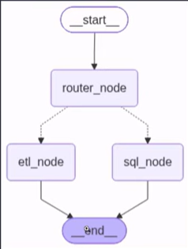
01 — DATA_AGENT.PY
Router Graph
Classifies the request, then branches to the matching specialist agent
start → router_node → (etl_node | sql_node) → end
Agentic AI Data Agent — LangGraph Outputs
2

Slide 3
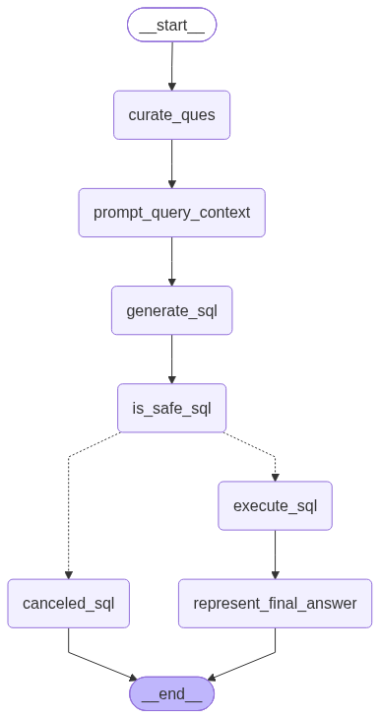
02 — SQL_ANALYST.PY
SQL Analyst Graph
A fixed, guarded pipeline — one branch, gated by an independent safety check
curate_ques → prompt_query_context → generate_sql → is_safe_sql → (execute_sql | canceled_sql) → end
Agentic AI Data Agent — LangGraph Outputs
3

Slide 4
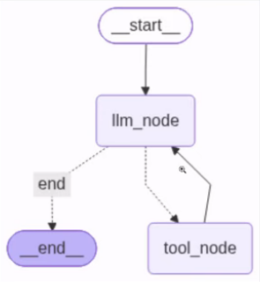
03 — ETL_ANALYST.PY
ETL Analyst Graph
An autonomous loop — the LLM decides when to call a tool, and when to stop
start → llm_node ⇄ tool_node → end (loops until no further tool calls)
Agentic AI Data Agent — LangGraph Outputs
4

