Slide 1
Electronic Resale MarketPlace

Slide 2

Technologies Used
1. ReactJS
2. NodeJS
3. MongoDB

Slide 3
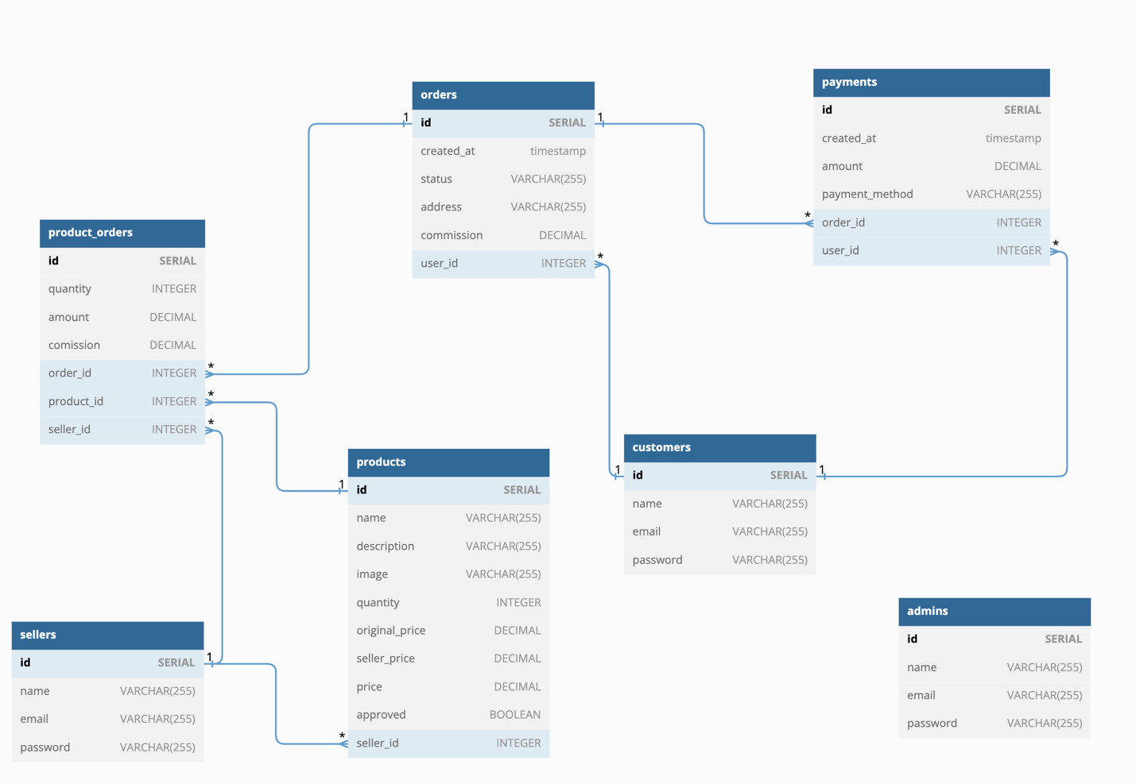
Collections

Slide 4
Roles
1. Admin
2. Sellers
3. Customers

Slide 5

Admin
1. Can add the sellers.
2. Should approve the seller’s request to add an electronic item. Will get commission on approval.

Slide 6

Sellers
1. Can add an electronic item by sending request to the admin.
2. Responsible for the shipment of the electronic item.

Slide 7
Customers
1. Can view and buy the electronic items.
2. Can view the payment history.

Slide 8
Features
Product Proposals: Sellers can propose new electronic items to the admin for listing.
Admin's Decision: Admin checks and approves electronic item proposals for adding them to the store.
Admin Commission: When an electronic item proposal gets approved, the admin receives a bonus commission.
Delivery Duty: Sellers handle shipping for the electronic items that customers purchase.
Admin Supervision: Admins have the authority to approve, cancel, and assign orders to maintain efficient management.
Smooth Payments: Customers can handle their payments and keep an eye on transaction history within the app. Order Placement: Customers can conveniently place orders with options for delivery or pickup.

