Slide 1
Handwritten Text to Digital Text Conversion
 |  | Bhavyasri Maddineni | 700748499
 |  | Shiny sherly | 700744314
 |  | Kusuma Sneha | 700745374

Slide 2
ROLES AND RESPONSIBILITES
Bhavyasri Maddineni: working on random forest in order to work on various algorithms, convolution neural network.
Shiny Sherly Katuru : working on Recurrent Neural Network to get better accuracy on different datasets, and decision tree.
Sneha Latha Kusuma: working on the support vector machine to get better accuracy, multinomial logistic regression.

Slide 3
INTRODUCTION
Handwritten Text Recognition (HTR) also known as Handwriting Recognition (HWR) is the detection and interpretation of handwritten text images by the computer.
Handwritten text from various sources such as notebooks, documents, forms, photographs, and other devices can be given to the computer to predict and convert into the Computerized / Digital Text.

Slide 4
MOTIVATION
In this transformation manually write Text Recognition (HTR) or Handwriting Recognition (HWR) undertakes a significant part of identifying transcripts from information inspection images and converting them into high-level designs. The input comes from various devices, including notebooks, documents, forms, and photographs.
There are two kinds of recognition:
1. Recognition Offline
2. Online Recognition

Slide 5
OBJECTIVE
• Centered on an AI approach with familiar elements.
• Utilization of Convolutional Neural Networks for feature extraction.
• Utilization of Recurrent Neural Networks for multiple windows of the text image that overlap.

Slide 6
RELATED WORK
Several OCR systems have been developed and each of them varies based on the image processing, feature extraction, classification techniques used.
It is used as an input device for pre - printed documents to read alpha-numeric characters.
The existing systems have difficulty in differentiating between noise and a word. A small dot which is actually a noise also gets detected as a word.
Turkish OCR on mobile and scanned document images | Kurtulus Karasu, Muhammet Bastan (2015)
A proposed approach for character recognition using Document Analysis with OCR | Harneet Singh, Anmol Sachan (2018)
Classification of Documents Extracted from Images with Optical Character Recognition Methods | Omer Aydin (2021)

Slide 7
PROPOSED STATEMENT
Implement the algorithms in the real problems by understanding & familiar with the concepts like decision tree algorithm & support vector Machine. Some other insights are drawn from papers that are examined.
Working on different algorithms, to get better accuracy.
Comparing the accuracies and plotting graphically.

Slide 8
PROPOSED SOLUTION
Template matching method is used, which compares the character image with a library of prototype images.
Handwritten Text recognition highly depends on Neural Netwoks.
Using Deep Learning Algorithms the performance of the model can be increased.

Slide 9
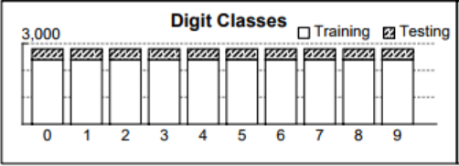
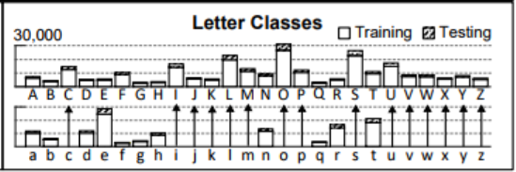
VARIOUS MODELS USED FOR THE PURPOSE
Dataset used for all the models is Extra Keras EMNIST Dataset.
Multiclass Logistic Regression
Decision Tree
Random Forest
Neural Networks
Convolution Neural Networks
Recurrent Neural Networks
Train | 112800
Test | 18800
Total | 131600
Classes | 47

Slide 10
BLOCK DIAGRAM
Raw Data
Data Processing
Processed Data
Train Model (Train Accuracy)
Test Accuracy
Model Tuning
Accuracy Satisfied?
Deploy Model

Slide 11
RESULTS
Accuracy of the various models used is tabulated below:
Model | Accuracy (%)
Multiclass / Multinomial Logistic Regression | 69.42
Decision Tree | 58.90
Random Forest | 80.92
Neural Network | Train: 91.07, Test: 83.36
Convolution Neural Network | Train: 93.51, Test: 85.07
Recurrent Neural Network | Train: 93.15, Test: 86.81

Slide 12
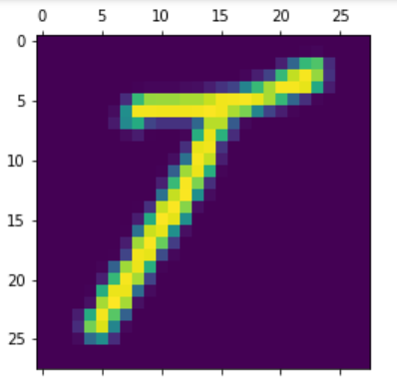
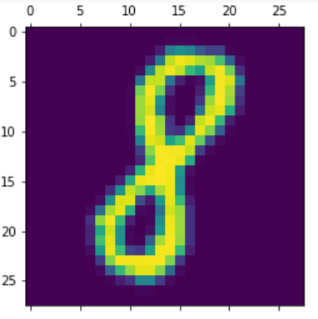
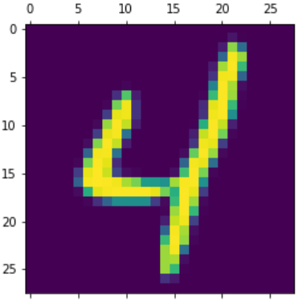
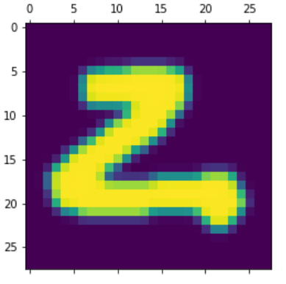
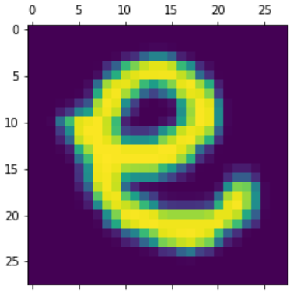
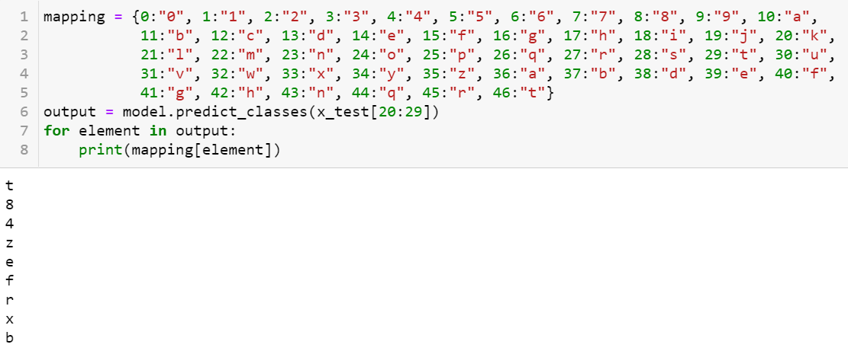

Slide 13
CONCLUSION AND FUTURE SCOPE
A proposed handwritten text to digital text conversion has been designed and tested. A comparison with related work has been presented.
Various models have been trained for this purpose with various types of input datasets.
This model can be extended to recognize and convert words by extracting its characters.
It can also be extended to recognize and convert sentences by segmenting words and thereby extracting the characters.

Slide 14
REFERENCES
https://ieeexplore.ieee.org/document/7130278
https://www.academia.edu/49062168/Classification_of_Documents_Extracted_from_Images_with_Optical_Character_Recognition_Methods
https://ieeexplore.ieee.org/document/8663011
https://www.academia.edu/49062168/Classification_of_Documents_Extracted_from_Images_with_Optical_Character_Recognition_Methods

Slide 15
THANK YOU

