Slide 1

Information Security

Slide 2
Key Security Concepts

Slide 3
Something to worry about
Trust
An extremely important security concept
  You do certain things for those you trust
  You don’t do them for those you don’t
Seems simple, ???
Problems with trust
  How do you express trust?
  Why do you trust something?
  How can you be sure who you’re dealing with?
  What if trust is situational?
  What if trust changes?

Slide 4


Something to worry about
Symmetric Trust
Alice trusts Bob
?

Slide 5
Something to worry about
Transitive Trust
Alice trusts Bob
?
Bob trusts Carol
Carol trusts David

Slide 6
Absolute Security vs Absolute Access
It's very important to understand that in security, one simply cannot say ``what's the best firewall?'‘
There are two extremes: absolute security and absolute access
The closest we can get to an absolutely secure machine is one unplugged from the network, powered off, locked in a safe
Unfortunately, it isn't useful in this state

Slide 7
Absolute Security vs Absolute Access
A machine with absolute access is extremely convenient to use: it's simply there, and will do whatever you tell it, without questions, authorization, passwords, or any other mechanism
Unfortunately, this isn't practical, either
The internet is a bad neighborhood now, and it isn't long before some bonehead will tell the computer to do something like self-destruct, after which, it isn't useful to you

Slide 8
Network Security – First Concepts
Security thus depends on the policies we define and the decisions we take
This is no different from our daily lives
We constantly make decisions about what risks we're willing to accept
When we get in a car and drive to work, there's a certain risk that we're taking
It's possible that something completely out of control will cause us to become part of an accident on the highway
When we get on an airplane, we're accepting the level of risk involved as the price of convenience

Slide 9
Network Security – First Concepts
However, we have a mental picture of what an acceptable risk is, and won't go beyond that in most circumstances
If I happen to be upstairs at home, and want to leave for work, I'm not going to jump out the window
  Yes, it would be more convenient, but the risk of injury outweighs the advantage of convenience

Slide 10
Network Security – First Concepts
Every organization needs to decide for itself where between the two extremes of total security and total access they need to be
A policy needs to articulate this, and then define how that will be enforced with practices and such
Everything that is done in the name of security, then, must enforce that policy uniformly

Slide 11
Cost benefit analysis
A database that provides salary information to a second system that print checks.
  Huge financial loss
A company has several branch offices and each downloads the database copy daily.
  The branch office uses the database to recommend the salary, but the main office use the original database for the final calculations.
  Recoverable !

Slide 12
Some Rational Thinking !
Consider a company where 10000 documents are processed per month with no security mechanism.
Security breaches occur about twice per month, and almost 100 documents are compromised per breach. The administrator needs to restart the processing of the breached documents.
Each document’s processing is worth about $20, and the documents compromised tend to be about half processed when they are restarted.
If some security mechanism is installed, it will increase the average processing cost by about 1% for all the documents.
Should the company install a security mechanism?

Slide 13
Some Rational Thinking !
Case 1: Without Security Mechanism
Documents processed per month = 10,000
Security breaches per month = 2
Documents compromised per breach = 100
Total compromised docs per month = 2 × 100 = 200
Each compromised document is half processed, so the cost lost = $10 per document.
Loss per month from breaches = 200 × $10 = $2,000
Total extra cost without security = $2,000 per month
Case 2: With Security Mechanism
Each document processing cost = $20
Security increases cost by 1% = $20 × 0.01 = $0.20 extra per document
Extra cost for 10,000 docs = 10,000 × $0.20 = $2,000 per month
Total extra cost with security = $2,000 per month

Slide 14
Con.
Comparison
Without security → $2,000 loss per month (due to breaches)
With security → $2,000 loss per month (due to overhead)
Even though the direct costs are equal, installing the security mechanism is the better choice because:
It reduces operational risks and prevents breaches from escalating.
Protects sensitive information and avoids reputation damage.
Ensures regulatory compliance and customer trust.
Yes, the company should install a security mechanism.

Slide 15
Key Security Concepts
Security Goals (the CIA triad)
Confidentiality
Integrity
Availability

Slide 16
Key Security Concepts
Confidentiality:
  only sender, intended receiver should “understand” message contents
Covers both data confidentiality and privacy
  Data confidentiality
  Assures that confidential information is not disclosed to unauthorized individuals.
  Privacy
  Assures that individuals control the information related to them
    What may be collected and stored
    by whom
    To whom that information may be disclosed.

Slide 17
Key Security Concepts
Confidentiality:
Student grade information is an asset whose confidentiality is considered to be highly important by students.
United States – Family Educational Rights and Privacy Act (FERPA)
  Grade information (high rating)
    Available to students, their parents, and employees that require the information to do their job.
  Student enrollment information (moderate rating)
    Less likely to be targeted than grade information, and
    Results in less damage if disclosed.
  Directory information (lists of students/faculty) (low rating)
  Typically freely available to the public and published on a school’s Web site.

Slide 18
Key Security Concepts
Integrity:
  Sender, receiver want to ensure message not altered (in transit, or afterwards) without detection,
  and want to be able to prove that the sender did, in fact, send the message
  covers both data and system integrity
  Data integrity
  Assures that information and programs are changed only in a specified and authorized manner.
  System integrity
  Assures that a system performs its intended function in an unimpaired (perfect) manner,
  free from deliberate or unauthorized manipulation of the system.

Slide 19
Key Security Concepts
Integrity:
Hospital patient’s allergy information database
  High requirement for integrity.
  The doctor should be able to trust that the information is correct and current.
  Inaccurate information could result in serious harm or death to a patient and expose the hospital/doctor to massive liability.
If an employee (e.g., a nurse) authorized to view/update this information deliberately falsifies the data to cause harm to the hospital/patient/doctor.
  The database needs to be restored to a trusted basis quickly
  it should be possible to trace the error back to the person responsible.

Slide 20
Key Security Concepts
Integrity:
Web site that offers a forum to registered users to discuss some specific topic
  Moderate level of integrity
  Either a registered user or a hacker could falsify some entries or deface the Web site.
  If the forum exists only for the enjoyment of the users,
  brings in little or no advertising revenue,
  and is not used for something important such as research,
  then potential damage is not severe.
  The Web master may experience some data, financial, and time loss.

Slide 21
Key Security Concepts
Integrity:
An anonymous online poll
  Low integrity requirement
  Many Web sites, such as news organizations, offer these polls to their users with very few safeguards.
  However, the inaccuracy and unscientific nature of such polls is well understood.

Slide 22
Key Security Concepts
Availability:
  Services must be accessible and available to properly authorized users
  Ensuring timely and reliable access to and use of information

Slide 23
Key Security Concepts
Availability:
The more critical a component or service, the higher is the level of availability required.
  Consider a system that provides authentication services for critical systems, applications, and devices.
  An interruption of service results in the inability for customers to access computing resources and staff to access the resources they need to perform critical tasks.
  The loss of the service translates into a large financial loss in lost employee productivity and potential customer loss.
  Facebook losses $ 24, 420 per minute, if it goes down.

Slide 24
Key Security Concepts
Availability:
Public Web site for a university
  moderate availability requirement
  The Web site provides information for current and prospective students and donors.
  Such a site is not a critical component of the university’s information system, but its unavailability will cause some embarrassment.

Slide 25
Key Security Concepts
Availability:
An online telephone directory lookup application
  low availability requirement
  Although the temporary loss of the application may be an annoyance,
  there are other ways to access the information, such as a hardcopy directory or the operator.

Slide 26
Some additional concepts
Authenticity:
  The property of being genuine and being able to be verified and trusted;
  Confidence in the validity of a transmission, a message, or message originator.
  This means verifying that users are who they say they are and that each input arriving at the system came from a trusted source.
Accountability:
  Actions of an entity should be traced uniquely to that entity.
  This supports nonrepudiation, fault isolation, intrusion detection and prevention, and after-action recovery and legal action.
Secure systems are not yet an achievable goal, we must be able to trace a security breach to a responsible party.

Slide 27
Key Security Concepts
Types of Attacks
Passive Attack
  Make use of information, but not affect system resources, e.g.
    Release message contents
    Traffic analysis
  Relatively hard to detect, but easier to prevent
Active Attack
  Alter system resources or operation, e.g.
    Masquerade
    Replay
    Modification
    Denial of service
  Relatively hard to prevent, but easier to detect

Slide 28
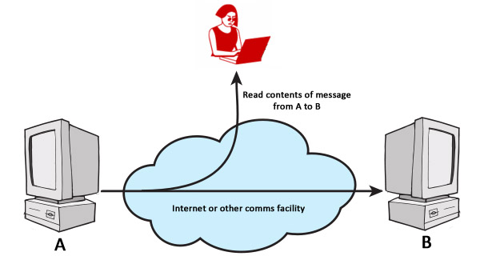
Key Security Concepts
Release message contents – Passive Attack
E

Slide 29
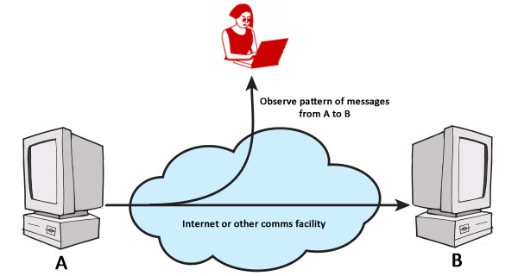
Key Security Concepts
Traffic analysis – Passive Attack
E

Slide 30
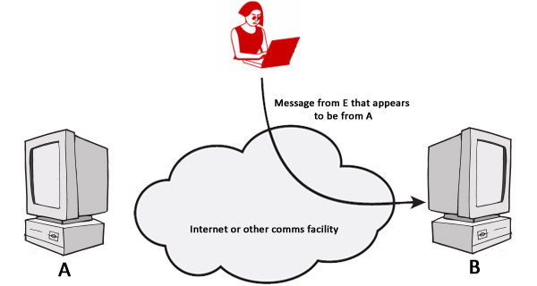
Key Security Concepts
Masquerade – Active Attack
E

Slide 31
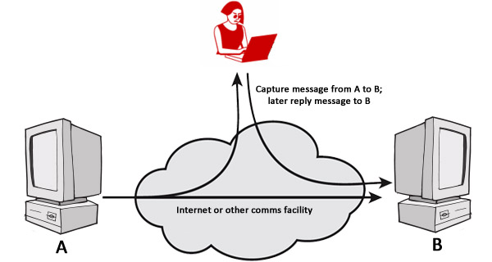
Key Security Concepts
Replay – Active Attack
E

Slide 32
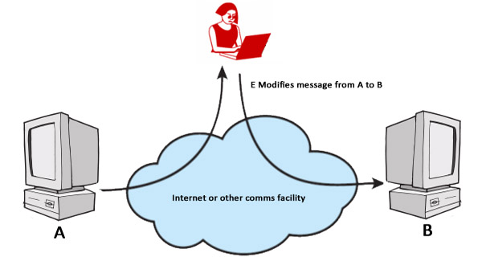
Key Security Concepts
Modification – Active Attack
E

Slide 33
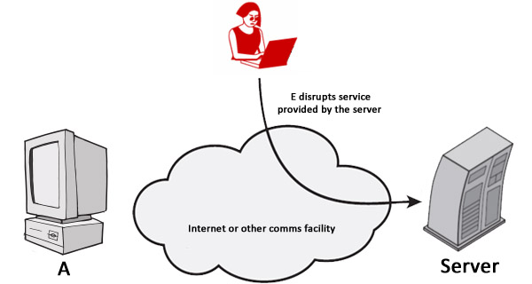
Key Security Concepts
Denial of service – Active Attack
E

Slide 34
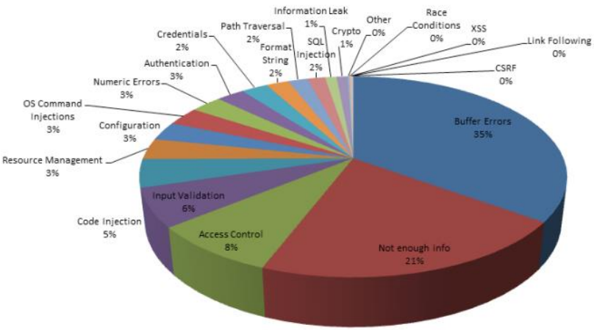
Types of Attacks

Slide 35
Key Security Concepts
Security Services
Authentication assure that the communicating entity is the one that it claims to be
Access Control prevent unauthorized use of a resource
Data Confidentiality protect data from unauthorized disclosure
Data Integrity assure data received are exactly as sent by authorized entity
Nonrepudiation protect against denial of one entity involved in communications of having participated in communications
Availability system is accessible and usable on demand by authorized users according to intended goal

Slide 36



Key Security Concepts
Alice and Bob are the two most famous persons in network security
They are used everywhere
Alice and Bob want to communicate “securely”
Trudy (intruder) may interrupt, intercept, modify, fabricate and so on, to disrupt their communications

Slide 37
Key Security Concepts
Who might Alice and Bob be?
Well, real-life Alice(s) and Bob(s)!
Web browser/server for electronic transactions (e.g., on-line purchases)
On-line banking client/server
DNS servers
Other examples?

Slide 38
Key Security Concepts
Question: What could Trudy do in this case?
Answer: Unfortunately, a lot!
Interruption: Somehow disrupt the service being provided by the network to Alice and Bob
Interception: Eavesdrop on communication meant to be private or confidential
Modification: Tamper with information or network resources
Fabrication: Counterfeit information or network resources or services are inserted into the network

Slide 39
Key Security Concepts
How can we protect ourselves from these attacks?
Interruption attacks:
  Firewalls, replication, backups, and hardware appliances
Interception attacks:
  Encryption, traffic padding
Modification attacks:
  Encryption, traffic padding, backups, messaging techniques (checksums, sequence numbers, digests, authentication codes)
Fabrication attacks:
  Authentication and authorization, firewalls, digital signatures

Slide 40
Key Security Concepts
Security is a policy, Protection is a mechanism
Protection mechanisms implement security policies
Vulnerability is a weakness that can allow an attacker to cause problems
Exploit is an actual incident of taking advantage of a vulnerability

Slide 41
Key Security Concepts
Virus is a potentially damaging computer program (code), can spread and damage files. It attaches itself to programs, disks, or memory to propagate itself
Worm copies itself repeatedly, using up resources and possibly shutting down computer or network
Trojan horse hides within or looks like legitimate program until triggered, does not replicate itself on other computers
Spyware is program placed on computer without user’s knowledge, collects personal information
Adware is a program that displays online advertisements
Spam is unsolicited e-mail message sent to many recipients

Slide 42
Key Security Concepts
Hoax uses emotion to propagate, e.g., child's last wish
Trap door is an undocumented entry point for debugging purposes
Logic bomb are instructions that trigger on some event in the future
Zombie are malicious instructions that can be triggered remotely
Phishing is a scam in which a perpetrator sends an official looking e-mail that attempts to obtain your personal information

Slide 43
Security Service
  is something that enhances the security of the data processing systems and the information transfers of an organization
  intended to counter security attacks
  make use of one or more security mechanisms to provide the service
  replicate functions normally associated with physical documents
    E.g have signatures, dates; need protection from disclosure, tampering, or destruction; be notarized or witnessed; be recorded or licensed

Slide 44
Security Services
X.800 defines it as:
A service provided by a protocol layer of communicating open systems, which ensures adequate security of the systems or of data transfers
X.800 defines it in 5 major categories
Authentication - assurance that the communicating entity is the one claimed

Slide 45
Security Services (X.800)
Access Control - prevention of the unauthorized use of a resource
Data Confidentiality –protection of data from unauthorized disclosure
Data Integrity - assurance that data received is as sent by an authorized entity
Non-Repudiation - protection against denial by one of the parties in a communication

Slide 46
RFC 2828
RFC 2828 defines it as:
A processing or communication service provided by a system to give a specific kind of protection to system resources
Includes the same core services but also broadens them with Internet-specific contexts (e.g., email, IPsec, key management)
More conceptual, explaining security terms and their relationships

Slide 47
Security Mechanism
A mechanism that is designed to detect, prevent, or recover from a security attack.
Examples of mechanisms are encryption algorithms, digital signatures, and authentication protocols.

Slide 48
Security Mechanisms (X.800)
specific security mechanisms:
  encipherment, digital signatures, access controls, data integrity, authentication exchange, traffic padding, routing control
pervasive security mechanisms:
  trusted functionality, security labels, event detection, security audit trails, security recovery

Slide 49
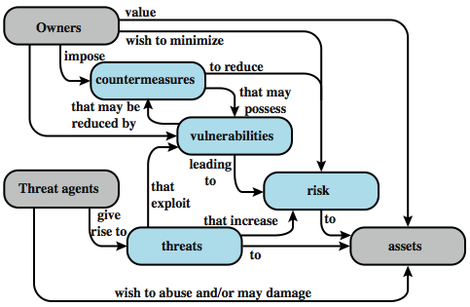

Security Concepts and Relationships
Notes:
Figure 1.2 [CCPS04a] shows the relationship among some terminology that will be useful throughout the book, drawn from RFC 2828, Internet Security Glossary:

Slide 50
Further Readings
Computer Security by William Stallings and Lawrie Brown
Cryptography and Network Security by William Stalling 6th Edition, 2012

Slide 51
Thanks

