Slide 1
Course Project – Credit_Risk_Analyzer

Slide 2
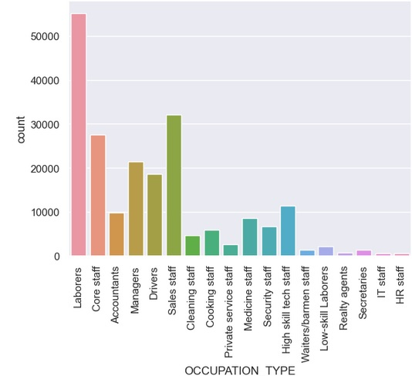
Column: OCCUPATION_TYPE

Slide 3
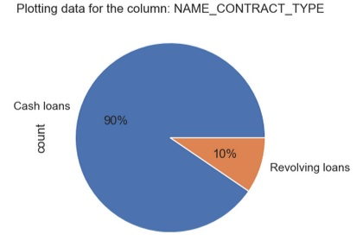
Plotting: NAME_CONTRACT_TYPE

Slide 4
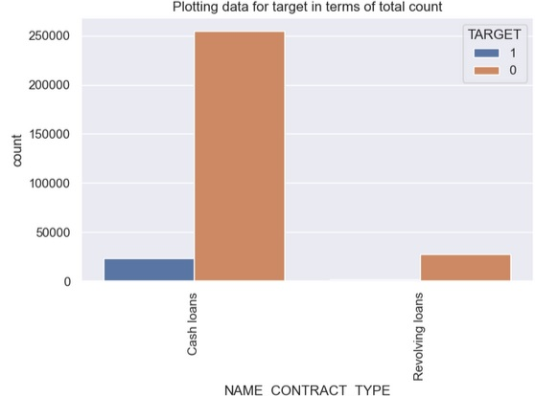
Plotting: NAME_CONTRACT_TYPE

Slide 5
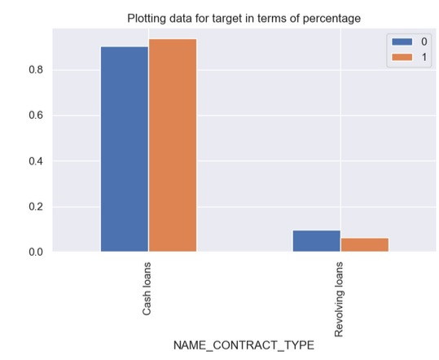
Plotting: %CONTRACT_TYPE

Slide 6
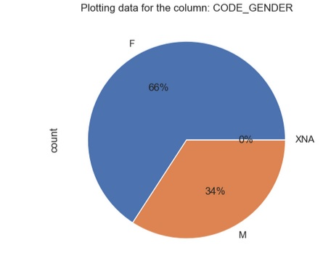
Plotting: CODE_GENDER

Slide 7
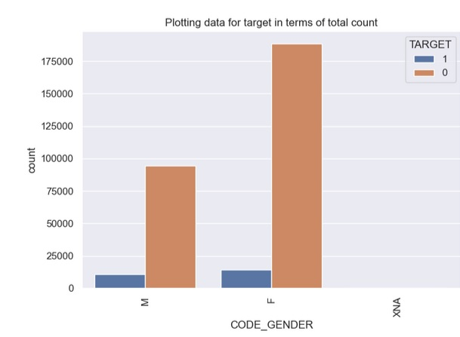
Plotting: CODE_GENDER

Slide 8
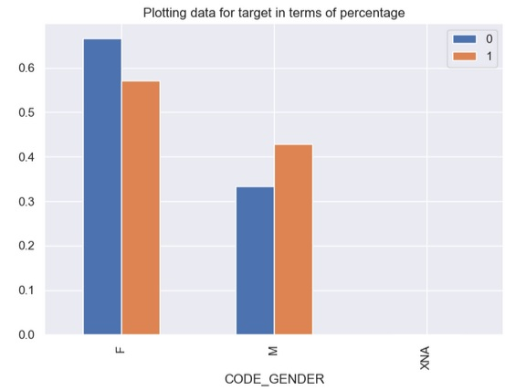
Plotting: CODE_GENDER

Slide 9
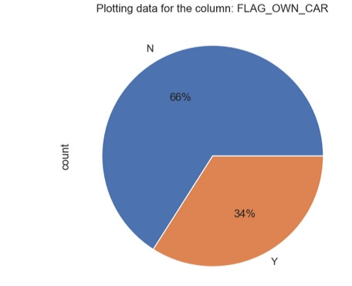
Plotting: FLAG_OWN_CAR

Slide 10
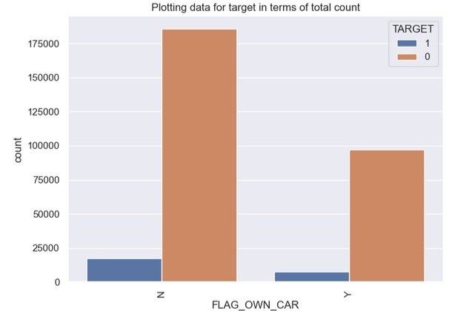
Plotting: FLAG_OWN_CAR

Slide 11
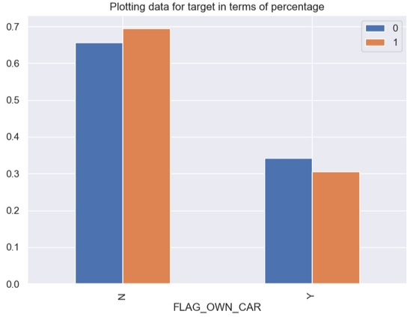
Plotting: FLAG_OWN_CAR

Slide 12
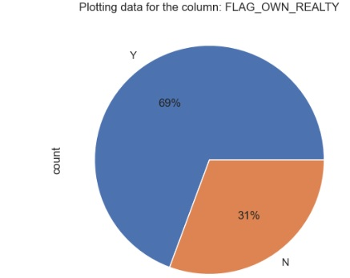
Plotting: FLAG_OWN_REALTY

Slide 13
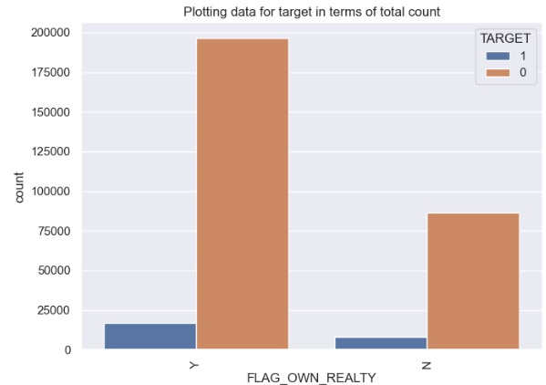
Plotting: FLAG_OWN_REALTY

Slide 14
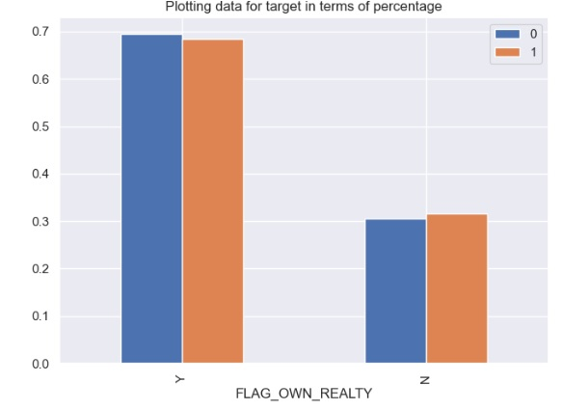
Plotting: FLAG_OWN_REALTY

Slide 15
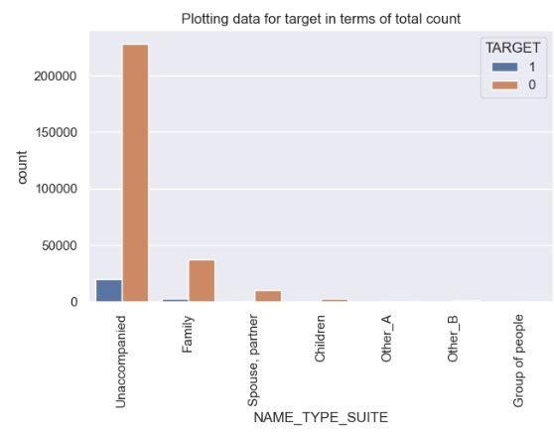
Plotting: NAME_TYPE_SUITE

Slide 16
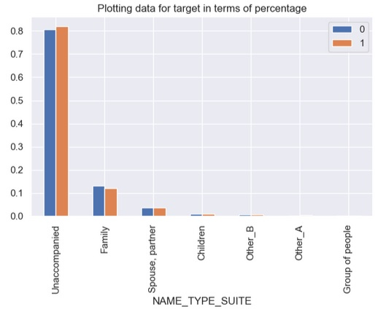
Plotting: NAME_TYPE_SUITE

Slide 17
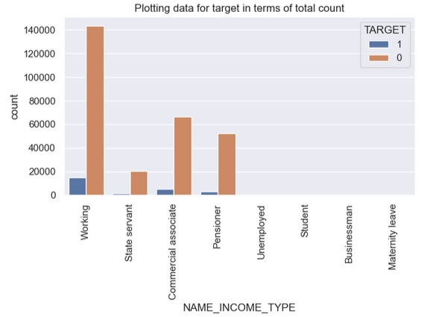
Plotting: NAME_INCOME_TYPE

Slide 18
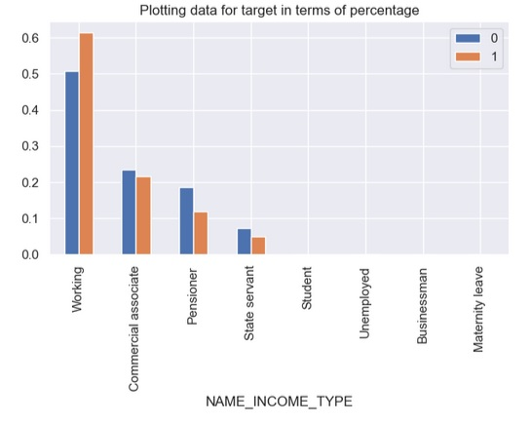
Plotting: NAME_INCOME_TYPE

Slide 19
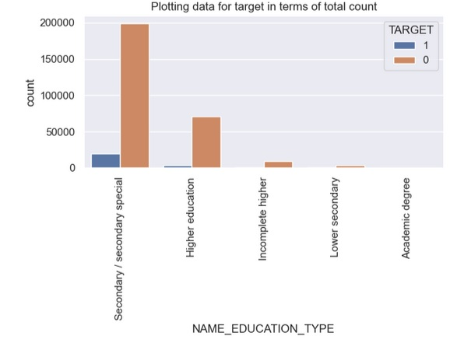
Plotting: NAME_EDUCATION_TYPE

Slide 20
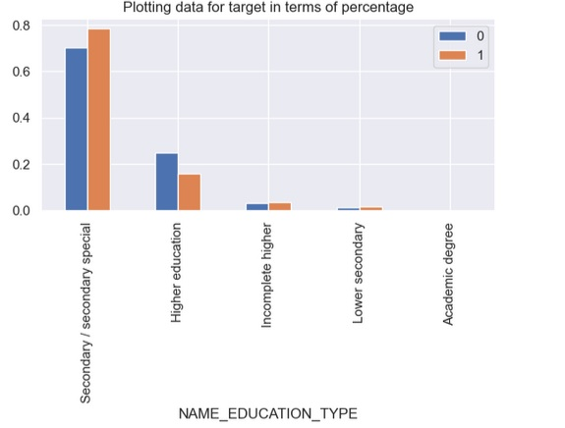
Plotting: NAME_EDUCATION_TYPE

Slide 21
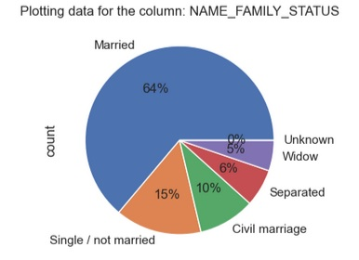
Plotting: NAME_FAMILY_STATUS

Slide 22
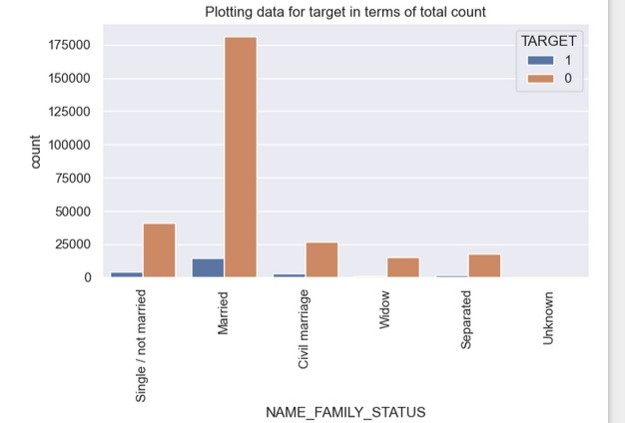
Plotting: NAME_FAMILY_STATUS

Slide 23
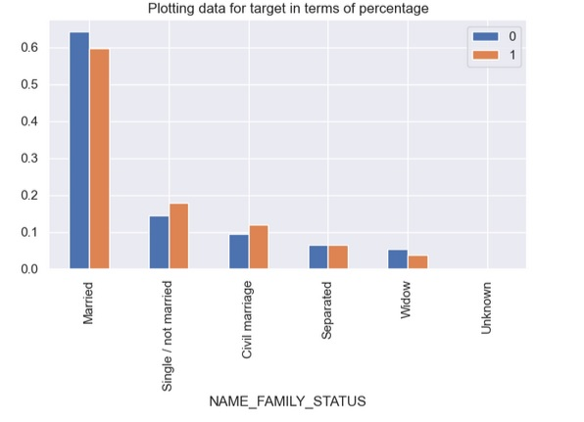
Plotting: NAME_FAMILY_STATUS

Slide 24
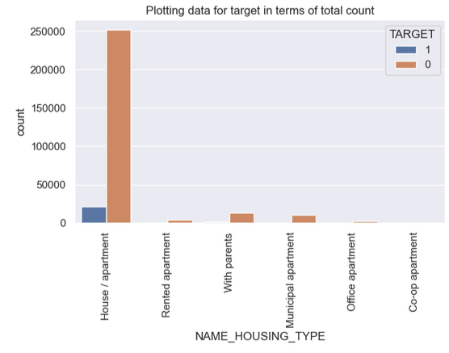
Plotting: NAME_HOUSING_TYPE

Slide 25
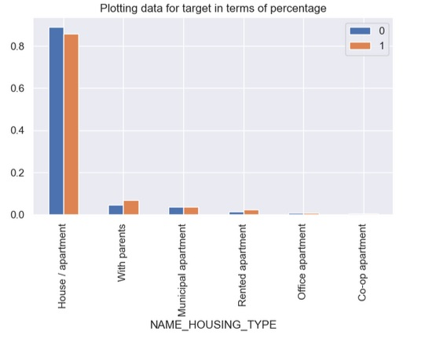
Plotting: NAME_HOUSING_TYPE

Slide 26
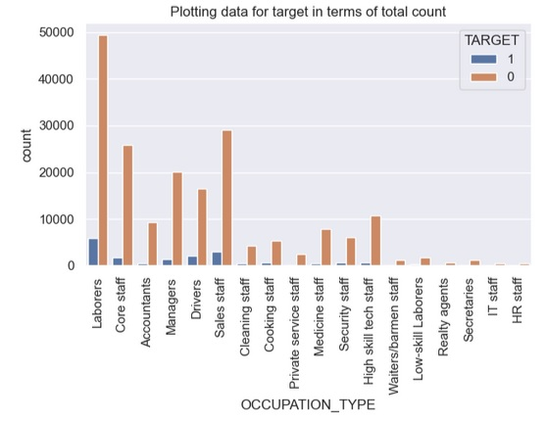
Plotting: OCCUPATION_TYPE

Slide 27
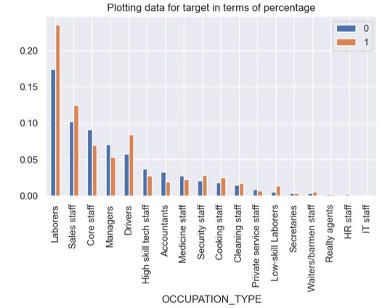
Plotting: OCCUPATION_TYPE

Slide 28
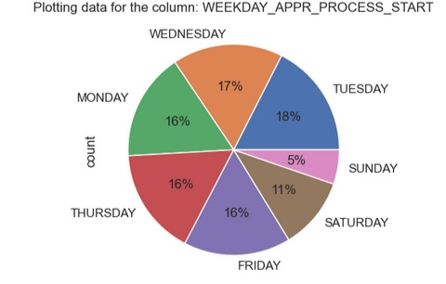
Plotting: WEEKDAY_APPR_PROCESS_START

Slide 29
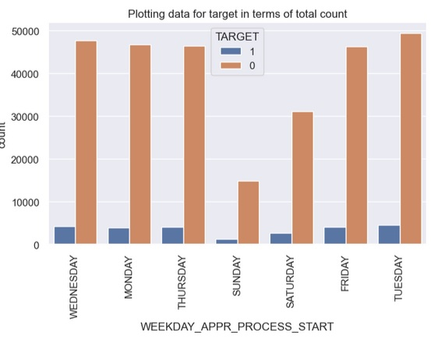
Plotting: WEEKDAY_APPR_PROCESS_START

Slide 30
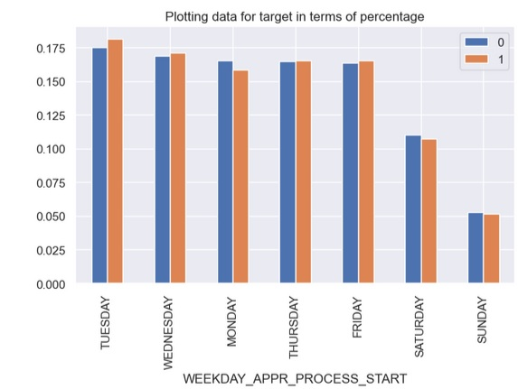
Plotting: WEEKDAY_APPR_PROCESS_START

Slide 31
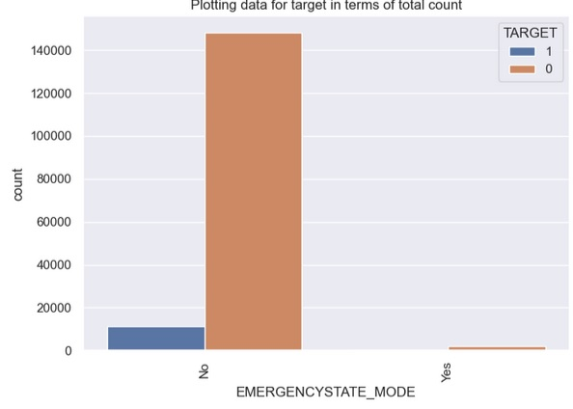
Plotting: EMERGENCYSTATE_MODE

Slide 32
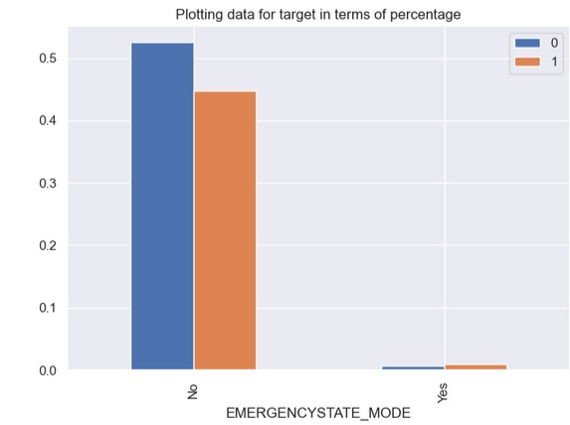
Plotting: EMERGENCYSTATE_MODE

Slide 33
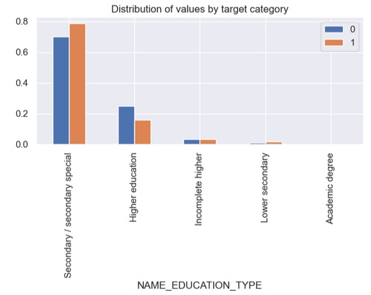
Plotting: NAME_EDUCATION_TYPE

Slide 34
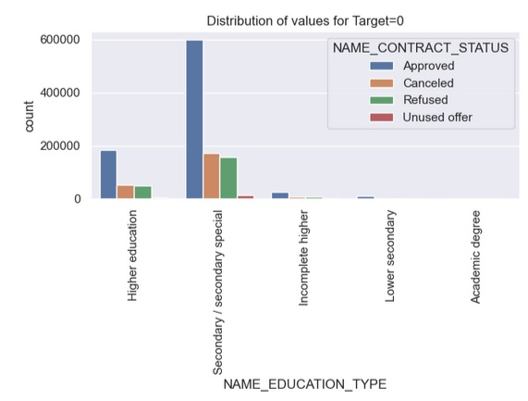
Plotting: NAME_EDUCATION_TYPE

Slide 35
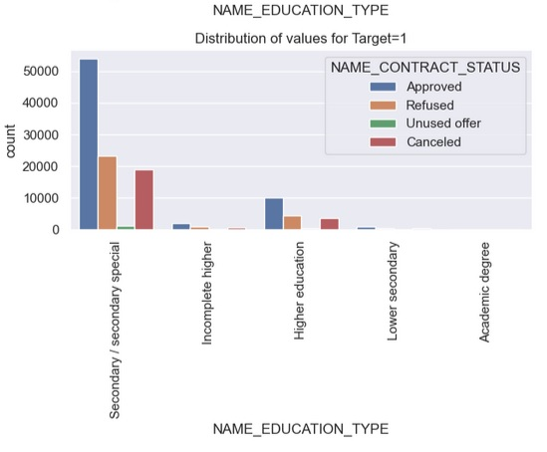
Plotting: NAME_EDUCATION_TYPE

Slide 36
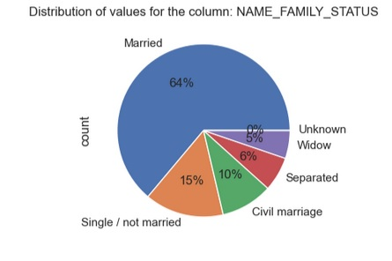
Plotting: NAME_FAMILY_STATUS

Slide 37
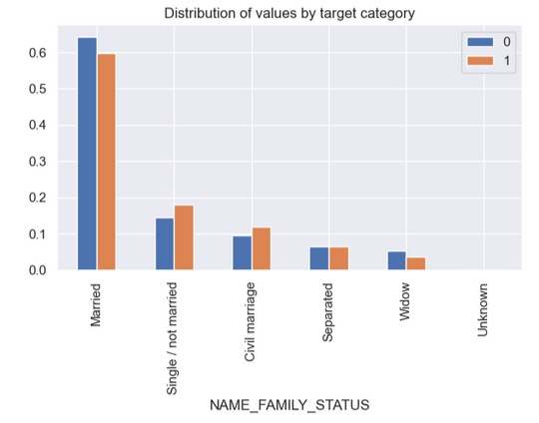
Plotting: NAME_FAMILY_STATUS

Slide 38
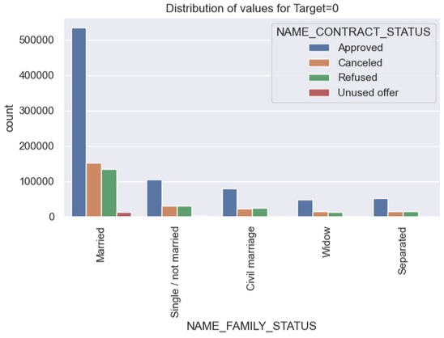
Plotting: NAME_FAMILY_STATUS

Slide 39
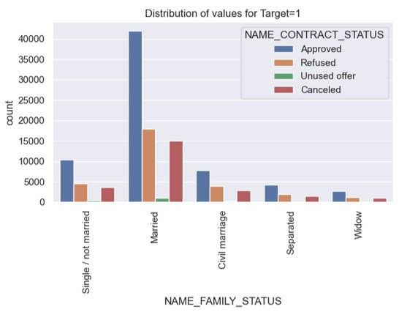
Plotting: NAME_FAMILY_STATUS

Slide 40
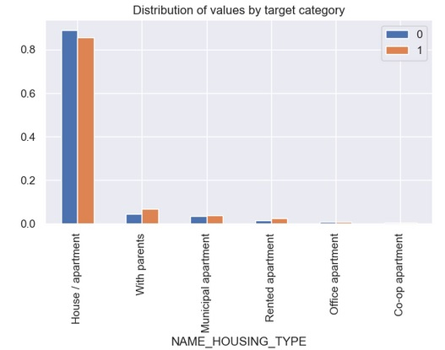
Plotting: NAME_HOUSING_TYPE

Slide 41
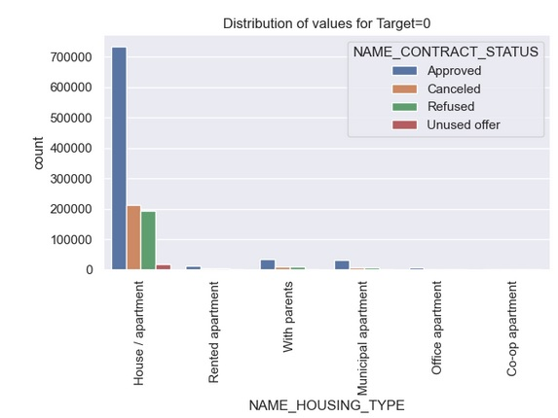
Plotting: NAME_HOUSING_TYPE

Slide 42
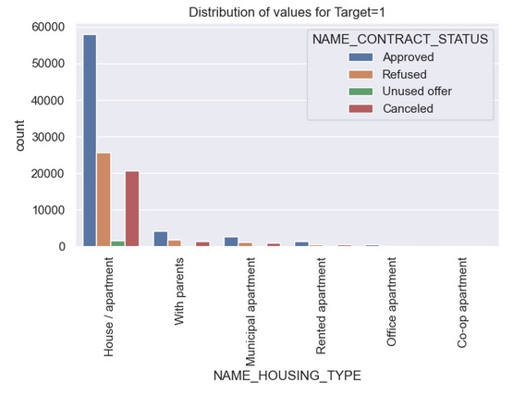
Plotting: NAME_HOUSING_TYPE

Slide 43
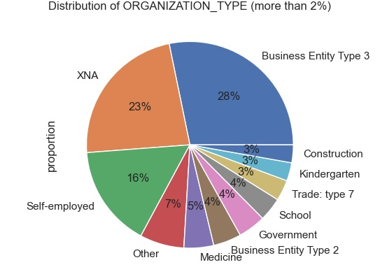
Distribution of Organization Type

