Slide 1



Neuro4j Workflows
neuro4j.org

Slide 2


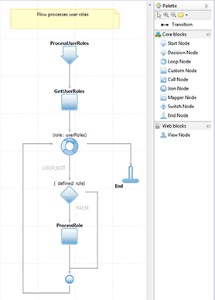
Neuro4j Workflow is an open-source java workflow engine
Module Development
Code becomes simpler, easier to read, understand and maintain
Faster development by Drag-and-Drop
Allows quickly identify bottlenecks and targets for improvement
Provides eclipse-based editor to support the graphical creation of your flows
Easy extend / replace functionality

Slide 3
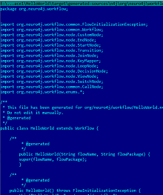


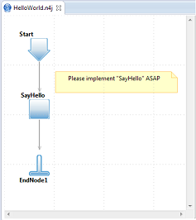
How Does It work?
Neuro4j Studio
Maven
neuro4j-compiler-plugin
JDK
Java Compiler
JVM
WorkflowProcessor
creates .n4j file
generates .java files from .n4j
compiles .java to .class
creates workflow object from class or load from .n4j

Slide 4





Integration with other frameworks.
Workflows Project does not have any dependencies on other frameworks or environments and can be used with existing frameworks (like Spring, Hibernate) or running on Tomcat, JBoss, WebSphere…
Neuro4j Workflows provides integration plugins and examples

Slide 5
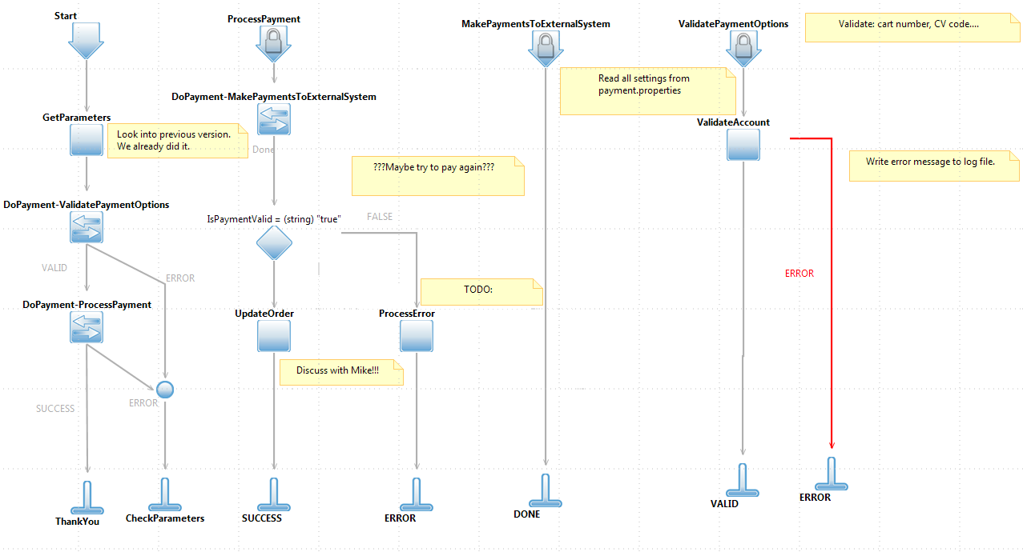
Development Lifecycle. Planning and Designing.
Software architect creates base flows, divides functionality by logical independent steps.
Program does not have implementation but shows how should it look like.
Unimplemented blocks return dummy objects.

Slide 6
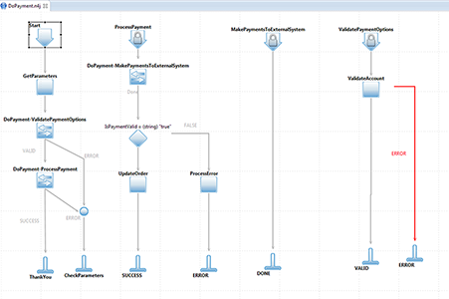
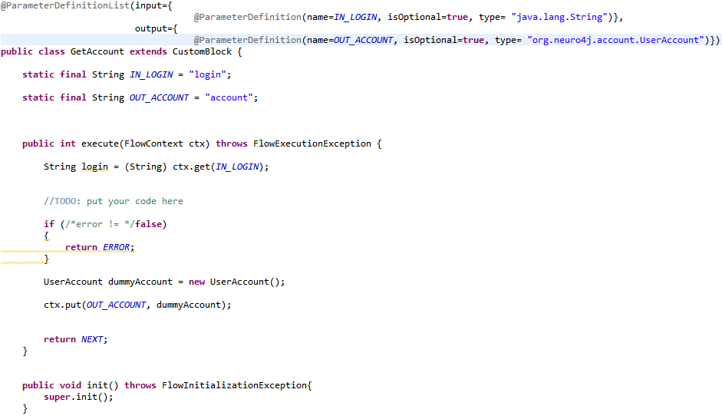

Development Lifecycle. Developing.
Project Manager / Lead Developer assigns developers to each task
(sub-flows or custom blocks).

Slide 7
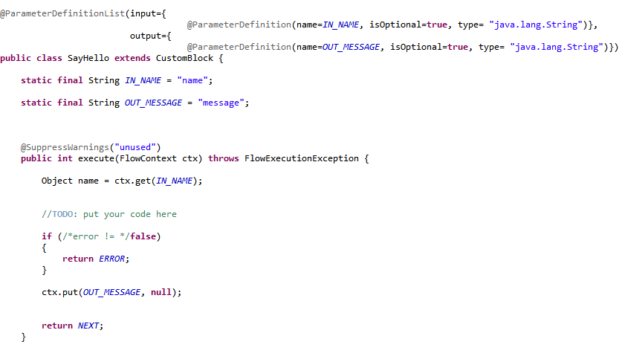
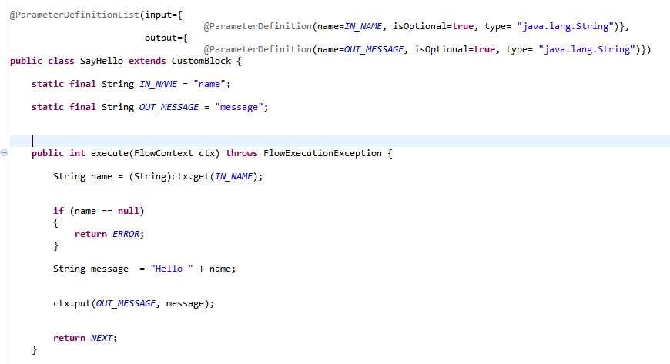
Development Lifecycle. Developing.
Developer implements / tests tasks (sub-flows or custom blocks).

Slide 8


Development Lifecycle. Testing.
QA tests flows and custom blocks.
Tested functionality now can be re-used by other developers
by Drag-and-Drop.

Slide 9
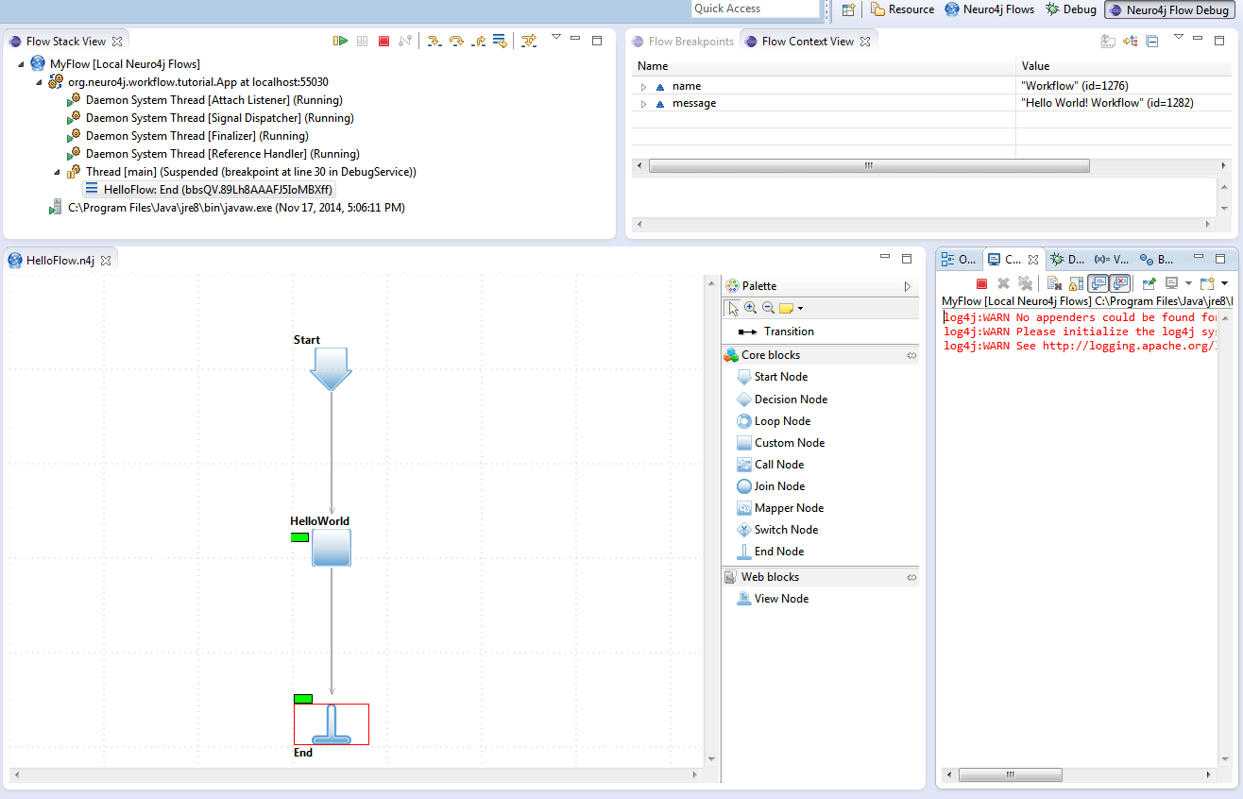
Debugging
Neuro4j Studio supports local and remote debug modes

Slide 10


Thank you!
support@neuro4j.org
https://github.com/neuro4j

