Slide 1

Hamilton Segmenter for R peak detection in ECG signals Robin Berner Hanjing Gao Tom Kuchler Xiaying Wang
TexPoint fonts used in EMF.
Read the TexPoint manual before you delete this box.: AAAAA

Slide 2
General Remarks
Pay attention to the length: e.g., 10 minutes typically means 7–8 slides
Use proper visuals as much as possible, avoid text-only bullet slides
Don’t put an overview or organization slide – the talk is too short
For the very motivated, check out this small guide http://people.inf.ethz.ch/markusp/teaching/guides/guide-presentations.pdf

Slide 3
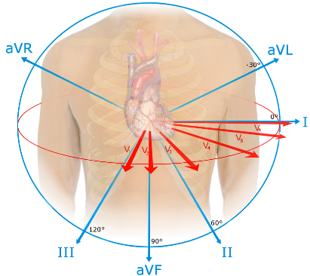
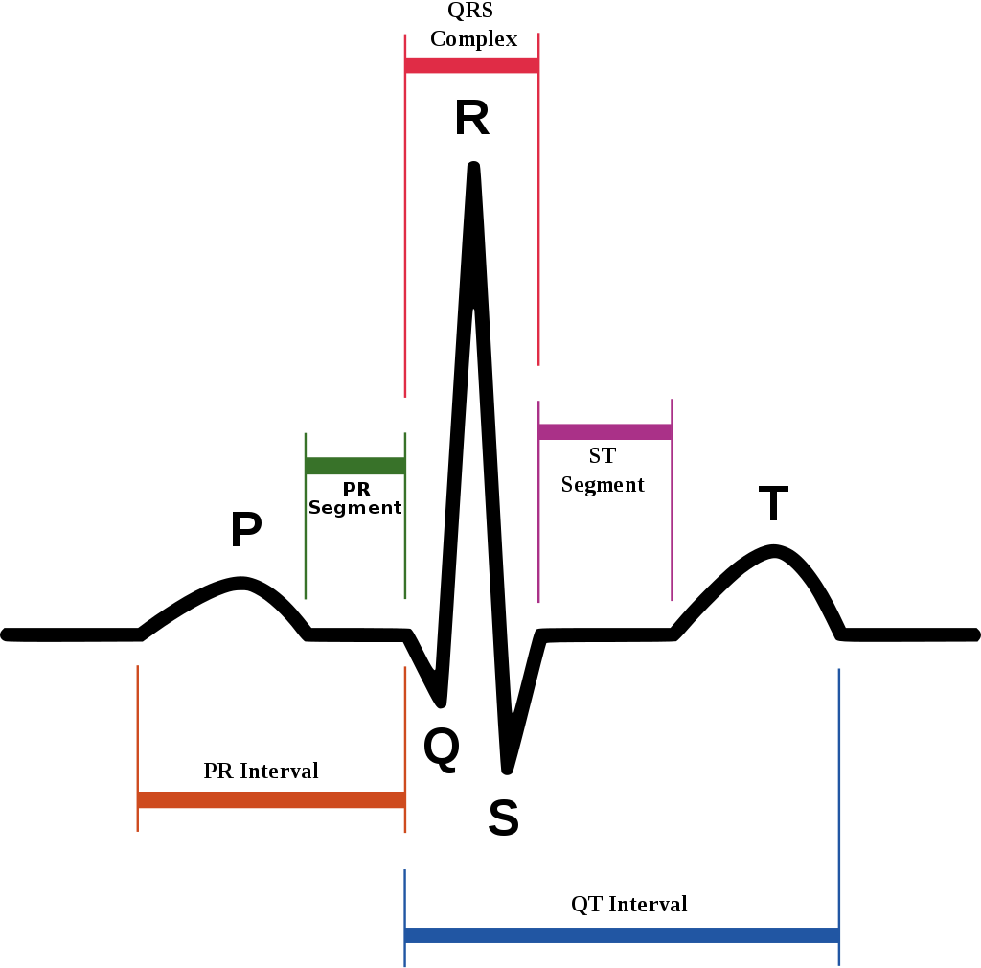
ECG signals
Semi-periodic 1D signals
Reflects the status of the heart
Application
Pre-processing
IIR notch filter
R peak detection
Peak classification
Morphology-based classifier
Hamilton segmenter

Slide 4
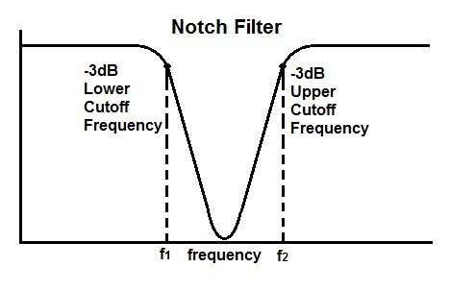
Algorithm
IIR notch filter for cancelling 50 Hz noise
y = …
Hamilton segmenter ^{[1][2]}:
Morphology-based classifier ^{[2]}:
Low-pass Filter
High-pass Filter
Moving Average
|d[]/dt|
Peak Detection
Detection Rules
[1] P. Hamilton, Open Source ECG Analysis, Computers in Cardiology, 2002 (http://www.cinc.org/archives/2002/pdf/101.pdf)
[2] Original Source Code: https://www.eplimited.com/confirmation.htm

Slide 5
Cost Analysis
Original Source code in integer
Our float version as baseline
Here a roofline plot

Slide 6
Optimizations
Function inlining
Blocking
Filter fusion
…

Slide 7
Flame Graph

Slide 8
Experimental results
Platform, compiler

Slide 9
Typical Organization I
Algorithm that you consider (maybe 2 slides)
State problem that it solves (input:…, output: …)
If possible visualize how it works or show high-level pseudocode
State asymptotic runtime
Cost analysis (cost measure, exact count)
Baseline implementation (briefly explain), maybe show already performance plot and extract percentage of peak
Optimizations you performed
Briefly discuss major optimizations/code versions
Maybe explain the most interesting in a bit greater detail
Any analysis (e.g., profifling) you performed is interesting – show the result
If too much, explain only some things and just state the rest

Slide 10
Typical Organization II
Experimental results
Very brief: Experimental setup (platform, compiler)
Performance plot over a range of sizes with different code versions
Make sure you also push input size to the limit in the experiments
Extract overall speedup
Every project is different – so adapt as needed
Focus on the most interesting things, don’t explain everything that will be in the final report.

Slide 11
Try to Make Nice Plots
DFT 2^{n} (single precision) on Pentium 4, 2.53 GHz
[Gflop/s]
Spiral SSE
Intel MKL
Spiral C vectorized
Spiral C
n

