Slide 1


GROUP - 36
SHIVAM – 1906070
RAHUL JHA – 1906077
DEEPAK KUMAR - 1906079
UNDER GUIDANCE OF MR. ABHAY KUMAR SIR
Department of Computer Science and Engineering
National Institute of Technology , Patna

Slide 2
Identifying a host based on data send by them in Software Defined Network using Machine Learning
Submitted By
SHIVAM (1906070)
RAHUL JHA (1906077)
DEEPAK KUMAR (1906079)

Slide 3
OBJECTIVE
This project is intended to identify a host based on data packets send by them in a software defined network using machine learning.

Slide 4
MOTIVATION
The main problem with traditional networking is that it is difficult to identify a host If he/she makes proxy and do malicious activities on a wide network.
In SDN it is relatively easy to catch a harmful host due to it’s centralized property.
So in this project we try to identify the hosts with help of Machine learning Algorithms over Software Defined networks (SDN).

Slide 5
Software Defined Network(SDN)
Software-defined networking (SDN) is an architecture designed to make a network more flexible and easier to manage.
SDN centralizes management by abstracting the control plane from the data forwarding function in the discrete networking devices.

Slide 6
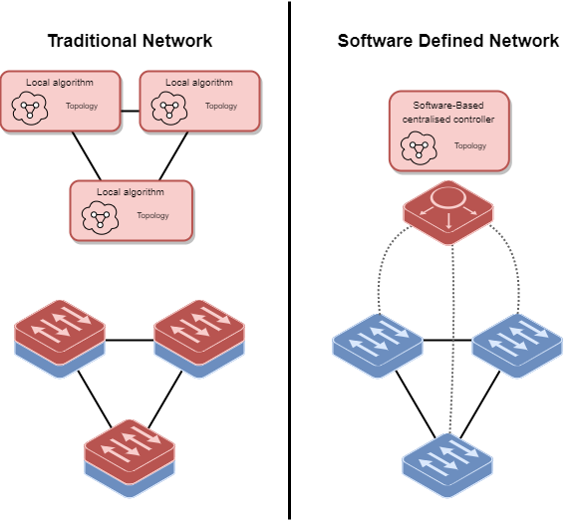
Advantages of SDN over Traditional Networks

Slide 7
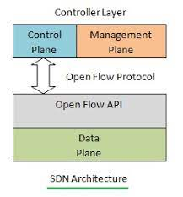
SDN Protocol

Slide 8



Technology Stack Used

Slide 9

Mininet And Miniedit
Mininet is a network emulator which creates a network of virtual hosts, switches, controllers, and links.
MiniEdit is an experimental tool created to demonstrate how Mininet can be extended.

Slide 10
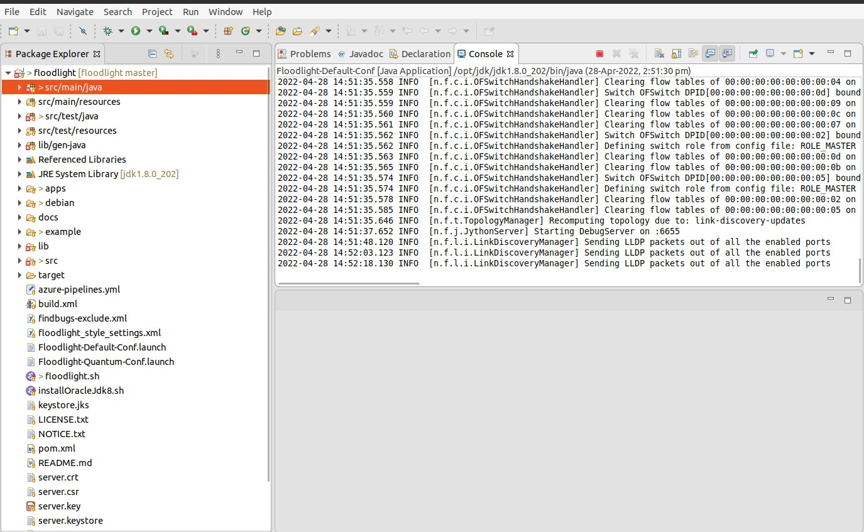
Floodlight
Floodlight Controller is used with the OpenFlow protocol to organize traffic flows in a software-defined networking (SDN) environment.

Slide 11
OpenFlow
OpenFlow defines the open communications protocol in an SDN environment.
OpenFloW allows the SDN Controller to speak to the forwarding plane to make changes to the network.

Slide 12
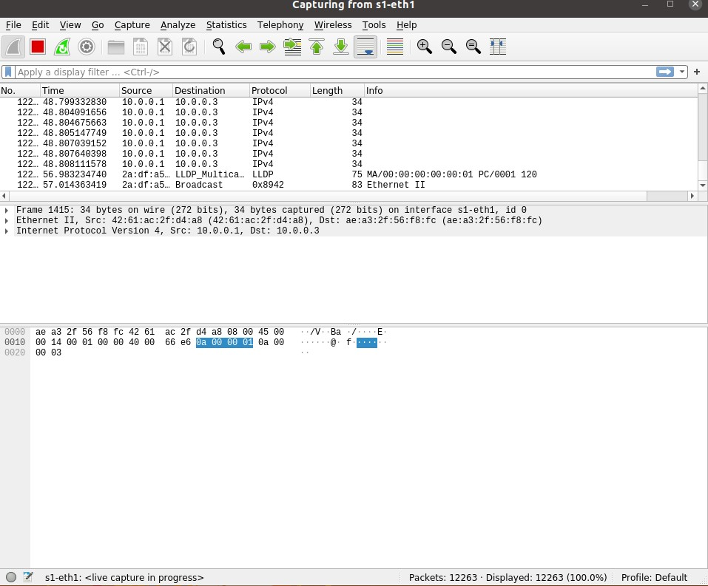
WireShark
Wireshark is a free and open-source packet analyzer. It is used for network troubleshooting, analysis, communications protocol development and education.

Slide 13
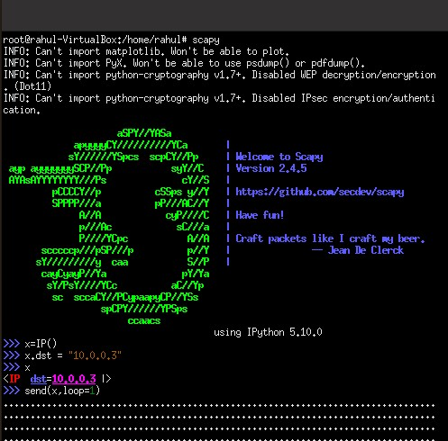
Scapy
Scapy is a powerful interactive packet manipulation program. It is able to forge or decode packets of a wide number of protocols, send them on the wire, capture them, match requests and replies, and much more.

Slide 14
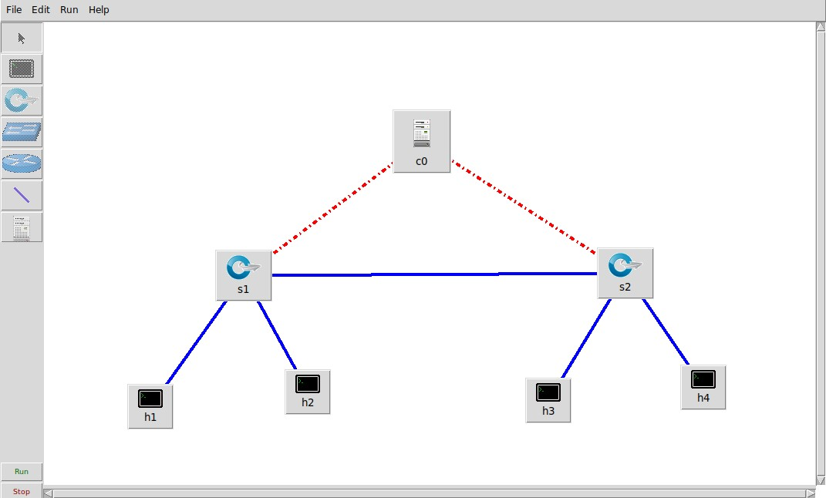
Basic Topology Used

Slide 15
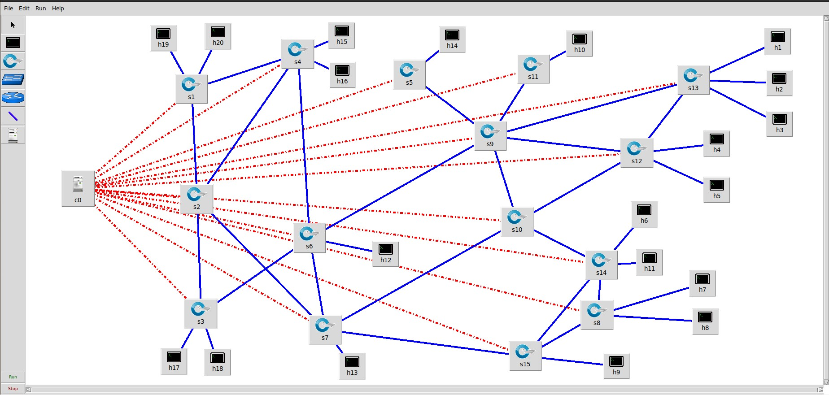
Advanced Topology used

Slide 16
Description of Data Set
The initial data captured from wireshark had a large number of attributes (columns) even after filtering the data.
So we dropped irrelevant data including the source IP address and MAC address.
Finally we got sufficient dataset which was up to the mark to perform to perform machine learning algorithms.

Slide 17
Machine Learning Algorithms used
Decision Tree Classifier- A Decision tree is a flowchart like tree structure, where each internal node denotes a test on an attribute, each branch represents an outcome of the test, and each leaf node (terminal node) holds a class label.
Random Forest Classifier- The Random forest classifier creates a set of decision trees from a randomly selected subset of the training set.
Support Vector Machine- The objective of SVM algorithm is to find a hyperplane in an N-dimensional space that distinctly classifies the data points.

Slide 18
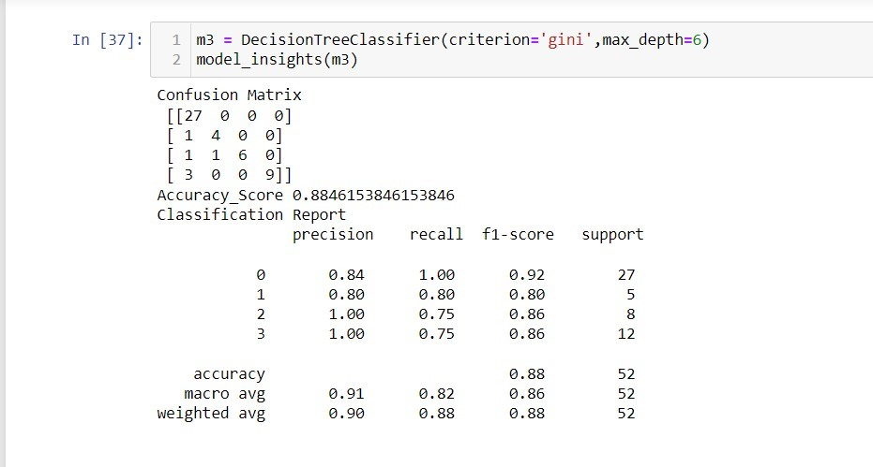
RESULTS

Slide 19
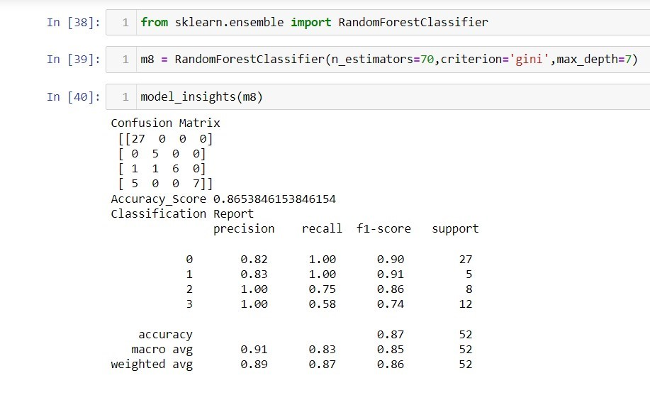

Slide 20
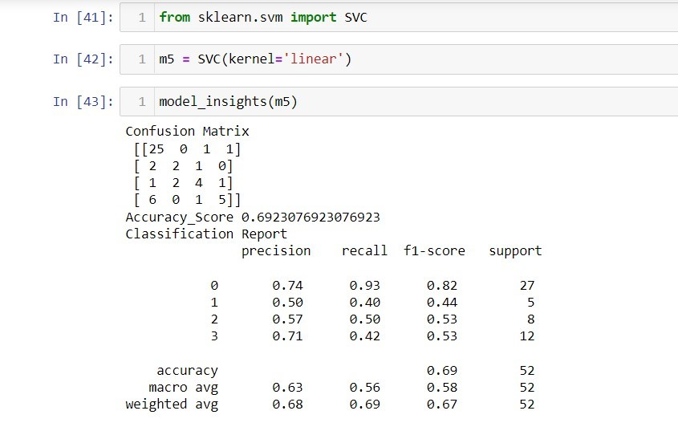

Slide 21
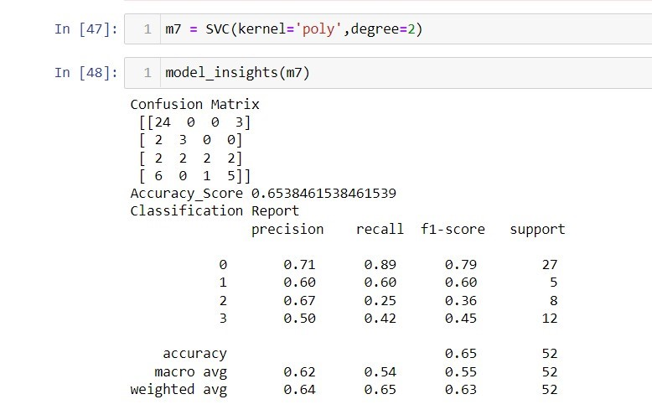

Slide 22
CONCLUSION
Thus , With the help of Machine Learning Algorithms we are satisfactorily
Able to identify correct hosts with a high accuracy.

Slide 23
References
https://pypi.org/project/scapy/
https://github.com/topics/openflow
https://opennetworking.org/wp-content/uploads/2014/10/openflow-spec-v1.3.0.pdf
https://opennetworking.org/sdn-definition/
https://towardsdatascience.com/
https://floodlight.atlassian.net/wiki/spaces/floodlightcontroller/overview

Slide 24
THANK YOU

