Slide 1
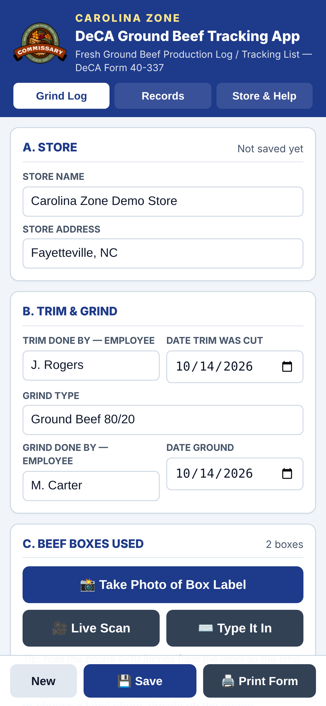
CAROLINA ZONE · PROOF OF CONCEPT
Grind Log
Digital ground beef traceability for DeCA commissaries
Scan · Verify · Save · Print
Presented by: Zone Manager, Carolina Zone
Defense Commissary Agency · October 2026
Notes:
Grind Log is a proof of concept from the Carolina Zone. It replaces hand-copied ground beef records with a phone-based scan of the beef box barcode, and produces DeCA Form 40-337 automatically. Everything shown in this deck is the working app.

Slide 2



When a recall hits, every minute counts
01 · THE STAKES
The grinding log is the only link between the ground beef in our case and the supplier box it came from.
Recall response
Identify affected product by supplier, establishment number and pack date, and remove it quickly.
Federal requirement
USDA FSIS, 9 CFR 320.1(b)(4): stores that grind raw beef must record supplier establishment numbers, lot and production dates, and cleaning and sanitizing times. Records stay at the store for one year.
Without an accurate log, a store cannot prove which product is affected, and may have to pull far more than necessary, or miss what it should pull.
DeCA requirement
DeCAM 40-3.1 prescribes DeCA Form 40-337, the Fresh Ground Beef Production Log / Tracking List, for every grind.
Notes:
Two sets of rules require these records: DeCA's own directive (DeCAM 40-3.1, Form 40-337) and the USDA FSIS rule at 9 CFR 320.1(b)(4), finalized in December 2015. The FSIS rule requires the source establishment numbers, lot and production dates, and the date and time grinding equipment is cleaned and sanitized, kept on site for one year. During a recall, this log is how we prove which product is affected.

Slide 3



Today, every grind is recorded by hand
02 · TODAY
Read the box label
A SINGLE BOX LABEL PRODUCT CODE
Find the product code, pack date and establishment number among many printed numbers.
90027182001564
Copy it by hand
Write each value onto the paper Form 40-337, box after box.
14 digits copied by hand, along with the pack date and establishment number, for every box, in every grind.
File the paper
Store the sheet in a binder in the meat department, kept for one year.
The process works, but it depends entirely on careful handwriting under time pressure, with cold hands, in a busy meat room.
Notes:
This is how every grind is documented today. The barcode label on a beef box already carries the product code, pack date and serial number, yet we copy them by hand onto paper.

Slide 4





Handwritten logs invite human error
03 · THE RISK
ON THE LABEL
WRITTEN ON THE LOG
90027182001564
90027182001645
Two digits swapped, and the trace now points to a product that was never in the grind.
Copying mistakes
Hard to read
Missing fields
Lost or damaged
Slow to search
Long codes are easy to transpose or mis-key
Handwriting can be illegible to an inspector
Blank entries go unnoticed until needed
Paper gets wet, torn or misfiled
Recall lookup means paging through binders
Notes:
The weakness is not the people, it's the method. A 14-digit code copied by hand can be transposed, written illegibly, or skipped, and a paper sheet can be lost or damaged. Any of these breaks the trace exactly when we need it.

Slide 5
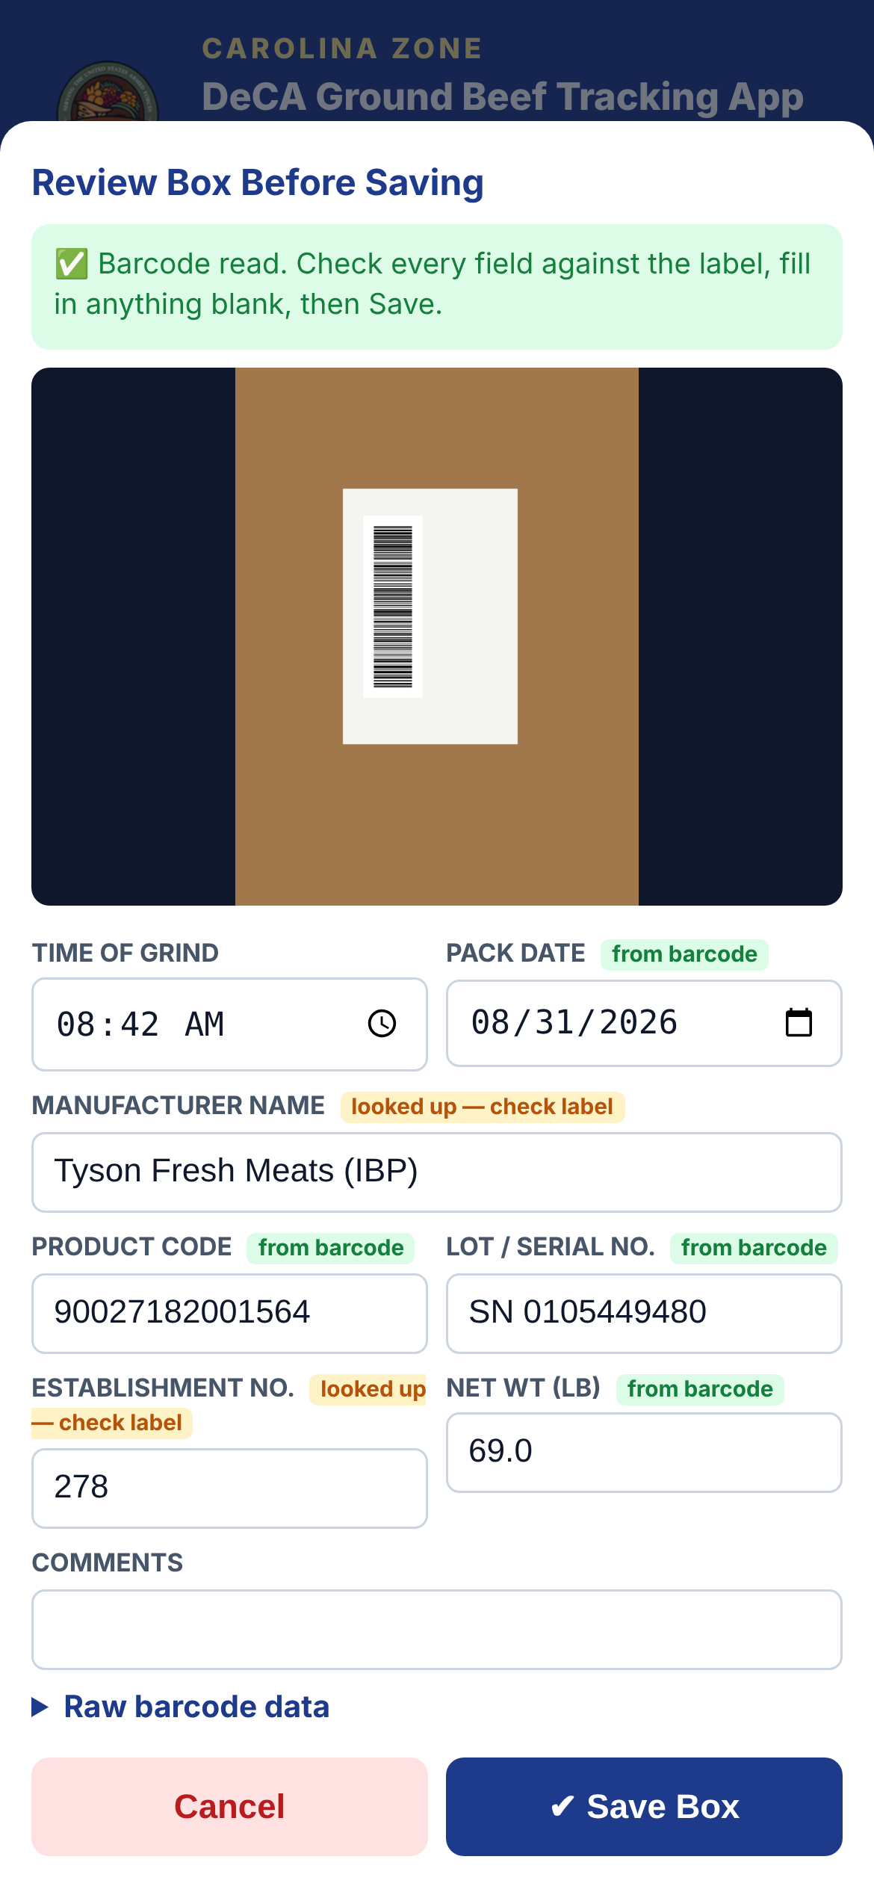
Grind Log puts the barcode to work
04 · THE SOLUTION
1
Scan
Photograph the box label with any Android phone or iPhone. The app reads the barcode on the phone.
2
Verify
Fields fill in automatically, each tagged with its source. The employee confirms against the label.
3
Save
Each box is added to the grind, with cleaning and sanitizing time, date and initials.
4
Print
DeCA Form 40-337 is generated, ready to print, save as PDF, or email.
Notes:
Grind Log follows the same four-step rhythm every time: scan, verify, save, print. The employee stays in control — the app reads the barcode, but a person confirms every value before it is saved.

Slide 6
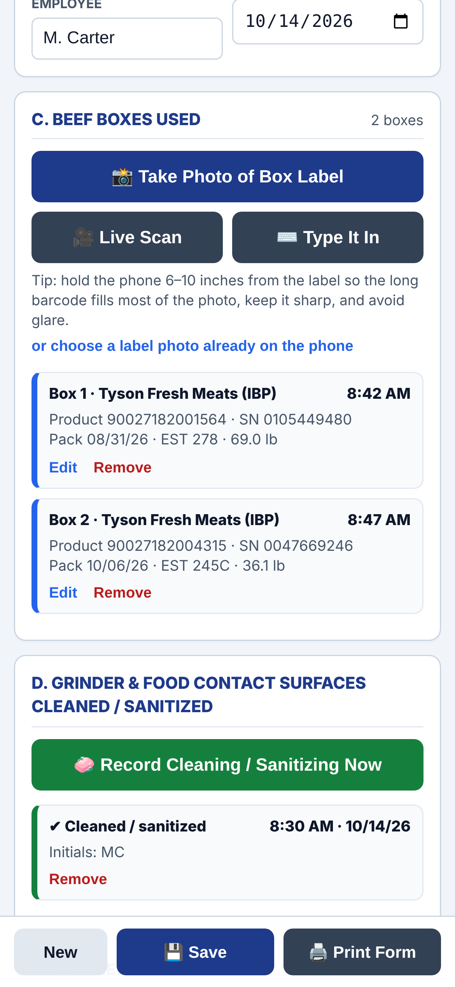
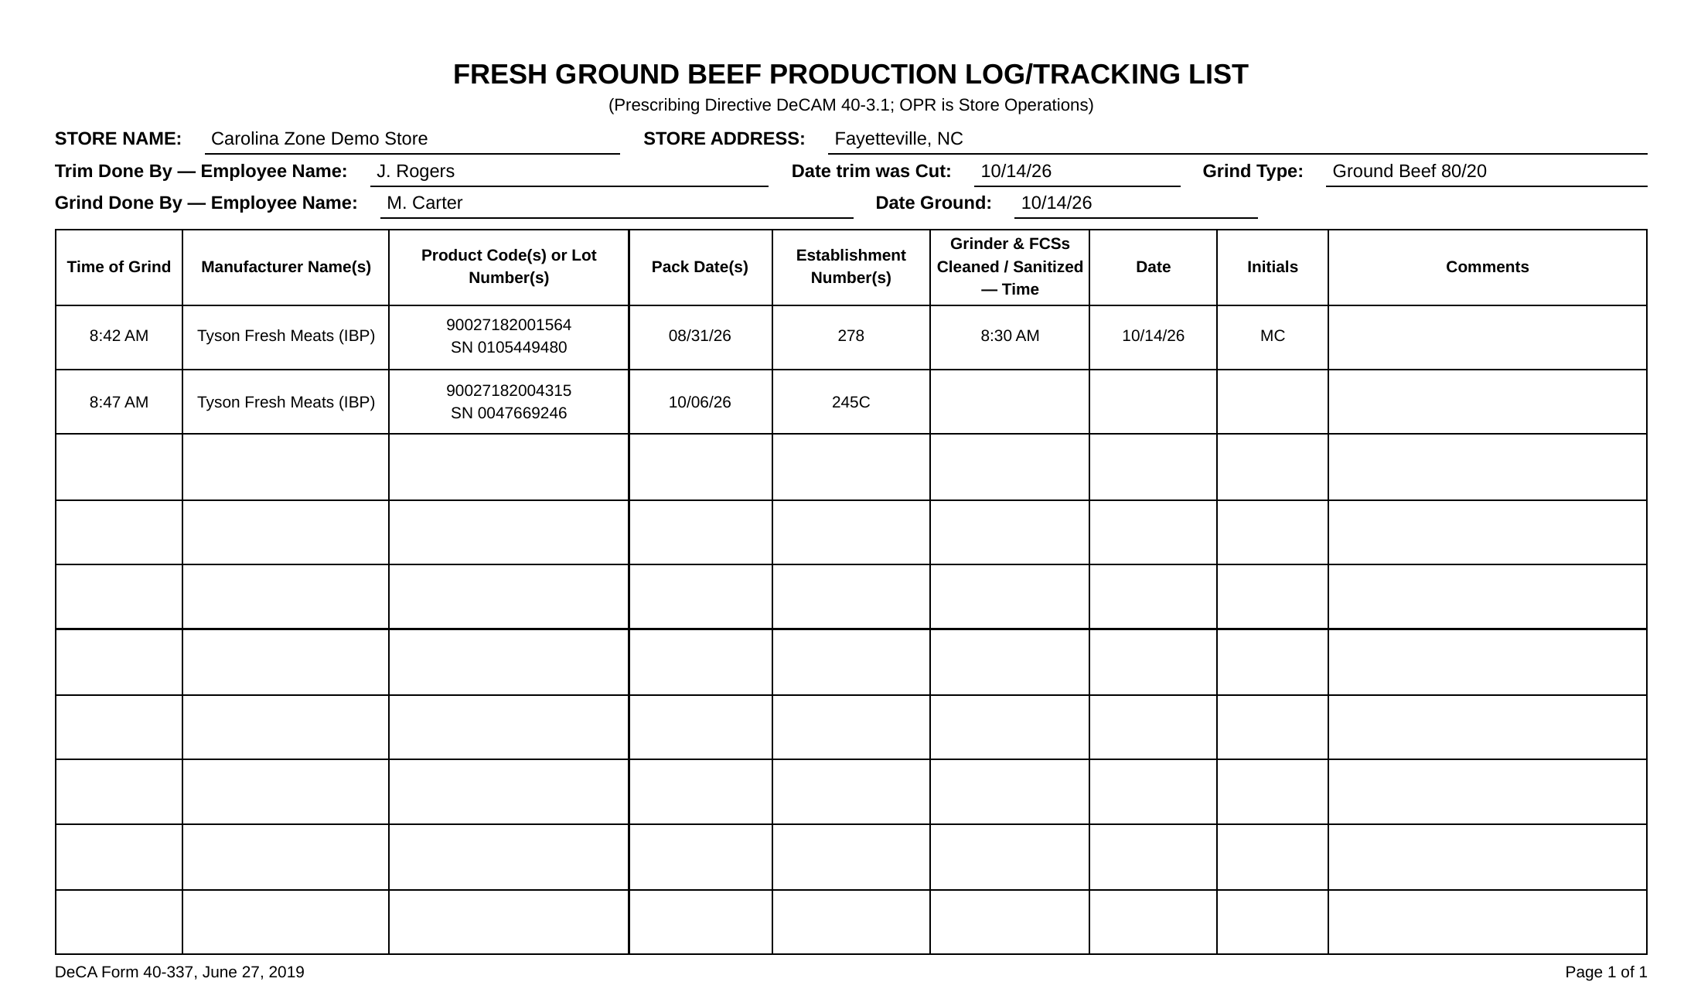
From box label to completed Form 40-337
05 · HOW IT WORKS
Actual screens from the working app, shown with sample data
1 Photograph each box
2 Review the fields
3 Print DeCA Form 40-337
Notes:
These are real screens from the app. Left: the boxes recorded for a grind. Middle: the review screen after a label photo — green tags mean the value came from the barcode, yellow means it was looked up and should be checked against the label. Right: the completed DeCA Form 40-337 the app produces.

Slide 7




Accuracy built in, not added on
06 · ACCURACY
Form 40-337 field | Source in Grind Log
Product code | From barcode
Pack date | From barcode
Lot / serial number | From barcode
Net weight | From barcode
Manufacturer | Looked up, verify
Establishment number | Looked up, verify
Every value shows its source
Green = read from the barcode. Yellow = looked up, check the label.
A person confirms each box
Nothing is saved until the employee reviews it.
Duplicate box warning
Scanning the same box twice is flagged.
Missing-information alerts
Blank required items are listed before the log is saved.
Establishment numbers are suggested from Tyson/IBP plant codes and should always be confirmed against the label.
Notes:
Four of the six traceability values come straight from the GS1-128 barcode that suppliers print on every box, so they are captured exactly as encoded. Manufacturer and establishment number are looked up and clearly flagged for the employee to confirm. The app also catches duplicate boxes and missing information before a log is saved.

Slide 8





Ready when a recall notice arrives
07 · FOOD SAFETY
Recall notice
Open Records
Match the boxes
Act with confidence
Supplier, establishment number and pack dates
Saved grind logs listed by date ground
Product code, EST and pack date for every grind
Pull affected product; print or export the log
Linked
Documented
Portable
Every grind is tied to the exact source boxes used
Cleaning and sanitizing time, date and initials on every log
Spreadsheet export and back-up file for safekeeping
Notes:
When a recall notice arrives, it names the supplier, establishment number and pack dates. With Grind Log, a manager opens Records, finds the grinds by date, and sees the exact boxes used, with their product codes, establishment numbers and pack dates, then prints or exports the log for the file.

Slide 9
Handwritten log vs. Grind Log
08 · SIDE BY SIDE
 | Handwritten log | Grind Log
Data entry | Copied by hand from each label | Read from the barcode, then verified
Accuracy | Open to copying mistakes | Codes captured exactly as encoded
Legibility | Depends on handwriting | Clean, printed form
Completeness | Blank fields easy to miss | Missing items flagged before saving
Storage | Paper binder, can be lost or damaged | Saved on the phone, with export and back-up
Recall lookup | Page through paper logs | Open saved logs by grind date
Cost | Printed forms and binders | No software cost, uses existing phones
Notes:
This is the case in one table. Same required information, captured more accurately, stored more safely, and found faster — at no additional cost.

Slide 10



Practical for every meat department
09 · PRACTICAL
$0
0
2
1
software or licensing cost
special scanners; uses the phone camera
platforms: Android and iPhone
link to share; updates reach every phone
Data stays on the device
Matches the official layout
Commissary branding
No cloud services and no data sent; label photos are not stored.
Produces DeCA Form 40-337 for print or PDF.
Uses the Commissary logo with DeCA's approval.
Notes:
The app runs in the phone's web browser, so there is nothing to buy and nothing to install beyond adding it to the home screen. Records stay on the phone; nothing is sent to the cloud.

Slide 11

Proposed pilot and next steps
10 · THE PATH FORWARD
01
Pilot
Carolina Zone meat departments use Grind Log alongside the paper log.
02
Measure
Time per log, errors caught, completeness and employee feedback.
03
Review
Work with Store Operations and DeCA IT on approved hosting, central storage and retention.
Try it now
04
Expand
Scan with your phone camera to open Grind Log
Recommend agency-wide use if pilot goals are met.
Scan · Verify · Save · Print
Notes:
The request: approve a Carolina Zone pilot, running Grind Log alongside the paper log so we can measure the difference, and engage Store Operations and DeCA IT on approved hosting and central record storage. The QR code opens the working app.

