Slide 1

Q1 2026 · Meta Paid Social Performance Review
From Awareness to Action. How Q1 built the funnel — and what the data demands next.
RITZ-CARLTON YACHT COLLECTION · JUMP · MAY 2026

Slide 2

Q1 2026 vs. Q1 2025: The Headline Numbers
Blended Performance Across All Stages of the Funnel
TOTAL SPEND
RAB EVENTS
RAQ EVENTS
COST PER RAQ
$6.06M
55,178
7,759
$781
$7.75M
60,544
33,792
$229
+28%
+10%
+336%
−71%
"That's not incremental improvement — that's a structural shift in how Meta is working for RCYC."
*Metrics reflect official cross-platform dashboard reporting for Meta Paid Social (Overall Account Blended across all stages of the funnel).

Slide 3
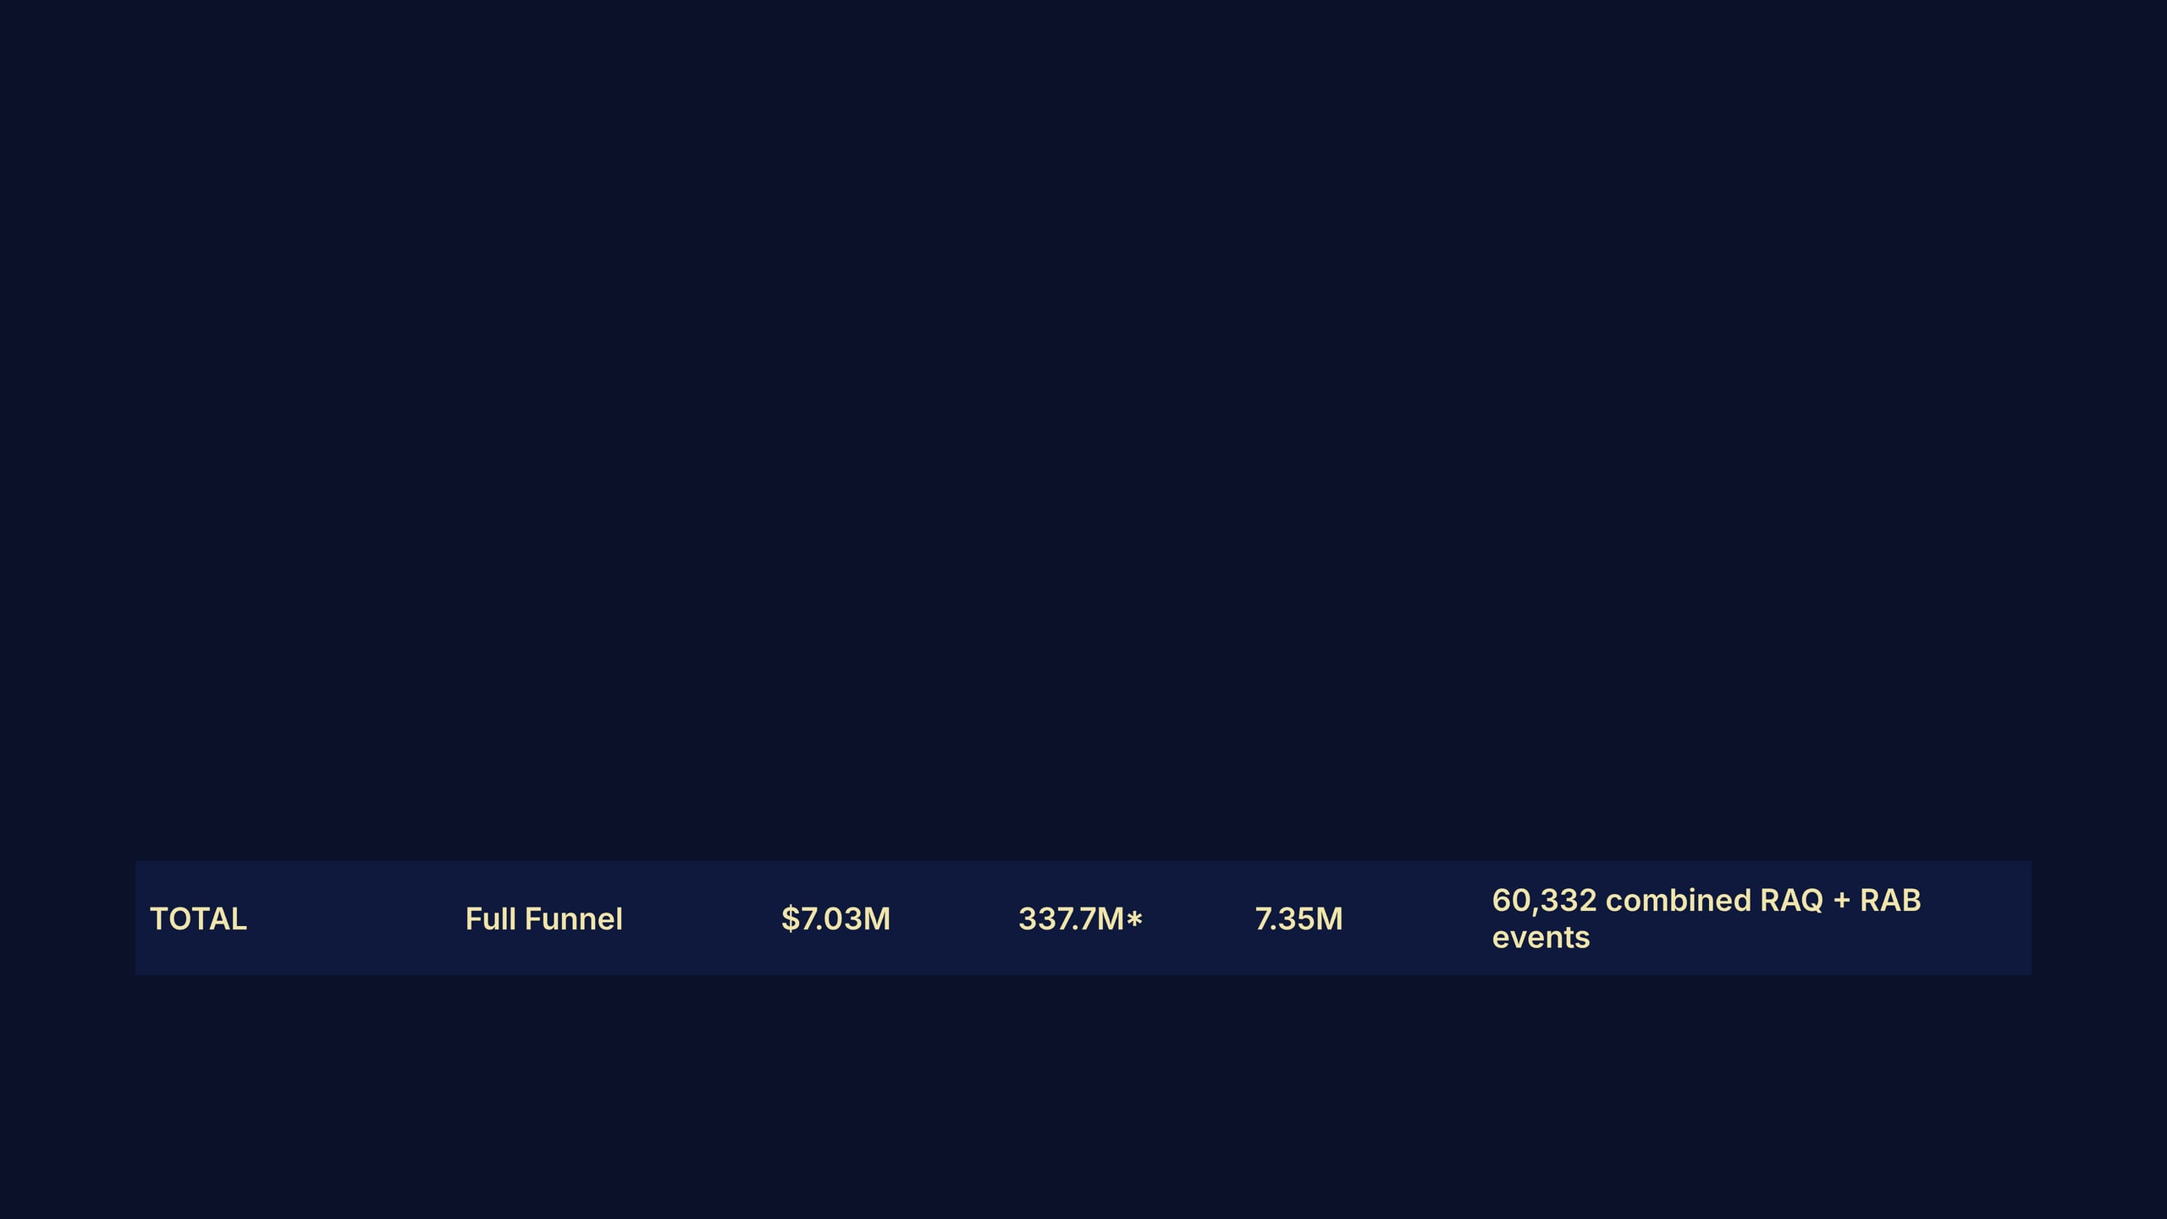
The Full-Funnel Picture
Every layer of the funnel delivered — from mass awareness to high-intent lead capture.
OBJECTIVE
CAMPAIGN TYPE
SPEND
REACH
CLICKS
KEY OUTCOME
Awareness
Reach / Impressions
$1.39M
267.3M
797K
267M Accounts Center accounts reached
Traffic
2-Min Engaged Sessions
$1.92M
32.7M
4.98M
2.12M 2-min sessions · $0.90 per session
Consideration
RAB — Request Brochure
$1.69M
19.3M
909K
38,851 RAB events · $43.62 per RAB
Demand Gen
RAQ — Request Quote
$2.03M
18.3M
666K
21,481 RAQ events · $94.37 per RAQ
★ RAQ cost efficiency improved 64% YoY. The system is learning — and converting.

Slide 4

Reach: Awareness at Scale
Reach Grew 4.5× YoY — RCYC Is Now Visible to a Truly Global HNWI Audience
METRIC
Q1 2025
Q1 2026
CHANGE
KEY INSIGHT
Amount spent (Awareness)
$253.9K
$1.39M
+447%
The global reach campaign (launched Oct 2025, active through Q1 2026) drove the majority of Accounts Center accounts reached — 169M from the Oct 2025 campaign alone, and 98M from the July 2025 campaign. This is the top-of-funnel engine feeding downstream lead quality.
Impressions
176.1M
1.35B
+665%
Reach (Awareness)
15.8M
267.3M
+596%
Reach (All Campaigns)
74.8M
337.7M
+351.6%
*Reach figures represent the number of Accounts Center accounts that saw at least one ad.
1.83 Billion
TOTAL IMPRESSIONS DELIVERED IN Q1 2026
Up from 365.9M in Q1 2025, representing a +399% increase in total ad delivery.

Slide 5

Time on Site: A New Signal, A New Standard
2.66 Million 2-Minute Engaged Sessions — Upgrading from LPVs
Why It Matters
METRIC
Q1 2025
Q1 2026
Total Traffic Volume
1.45M
4.55M
At $2.91 per engaged session, this is the most
cost-efficient way to identify and qualify HNWI
audiences before serving them RAQ or RAB
Cost per Traffic Action
$4.11
$1.54
creative. It feeds the retargeting pool that
drives downstream lead quality.
High-Intent Signal
(LPV only)
2.66M
(2-Min TOS)
Strategic Upgrade: In Q1 2025, we drove 1.45M Landing Page Views at $4.11 per action. In Q1 2026, we upgraded the architecture to optimize for Accounts Center accounts that spend 2+ minutes on the RCYC site — a much stronger proxy for genuine voyage intent.
Cost per High-Intent Signal
N/A
$2.91

Slide 6

38,852 True RAB Events — Cost per Brochure Cut Nearly in Half
Isolating RAB-optimized campaigns to reveal the True CAC of the consideration engine.
METRIC
Q1 2025
Q1 2026
CHANGE
Key Insight
Spend (RAB campaigns)
$2.59M
$1.86M
−28%
Despite 28% less spend on RAB campaigns, total true RAB events grew by 39% and the cost per RAB was cut nearly in half to $48. This is the result of better creative, improved targeting, and a more efficient funnel architecture.
CTR
0.79%
1.33%
+68%
CPM
$22.01
$26.86
+22%
Time on Site 2+ Mins
0
270,366
New
True RAB Events
27,945
38,852
+39%
True Cost per RAB
$93
$48
−49%
New RAB creative launched March 2026 ("Where to Travel 2026") is showing strong early efficiency signals, positioning us to drive the cost per RAB down through the rest of the year.

Slide 7

21,469 True RAQ Events — Cost per Quote Down 81%
Isolating RAQ-optimized campaigns to reveal the True CAC of the demand engine.
SPEND (RAQ CAMPAIGNS)
CTR
TRUE RAQ EVENTS
TRUE COST PER RAQ
$1.79M
0.85%
3,517
$508
$2.03M
0.90%
21,469
$94
+14%
+6%
+510%
−81%
CAMPAIGN (PLATFORM DATA)
TYPE
AMOUNT SPENT
PLATFORM EVENTS
PLATFORM CPR
NA US/CA Prospecting (comp-retest)
Prospecting
$173.3K
~2,430
$71.29
Global Prospecting (comp-retest)
Prospecting
$69.2K
~930
$74.38
NA US/CA Retargeting (Dec 2025)
Retargeting
$1.41M
~15,430
$91.43
Global Retargeting (Jan 2026)
Retargeting
$330.0K
~2,354
$140.17
CRM Retargeting NA (Mar 2026)
CRM List
$15.9K
~91
$174.29
CRM Retargeting Global (Mar 2026)
CRM List
$15.8K
~94
$167.93
With only 14% more spend, RAQ events exploded +510% and cost per RAQ dropped from $508 to $94. This is the most dramatic efficiency gain in the account's history.

Slide 8

What the Data is Saying: The Meta System
The Architecture Is Proven. Now We Optimize the Mix.
Reach Feeds Everything
Time on Site Is the Qualifier
267M ACCOUNTS CENTER ACCOUNTS REACHED
2.66M ENGAGED 2-MINUTE SESSIONS AT $2.91 EACH
Every RAQ and RAB conversion started here. Awareness investment is not a cost — it's the top of the pipeline.
This is the mid-funnel signal that separates voyage-intent Accounts Center accounts from casual browsers. The retargeting pool it builds is what makes RAQ efficient.
RAB Scales Consideration
RAQ Is the Demand Signal
60,544 BROCHURE REQUESTS AT $128 EACH
33,792 QUOTE REQUESTS AT $229 EACH
New "Where to Travel 2026" creative is already showing strong platform efficiency. Scaling this creative will drive the dashboard CPA down.
The dashboard confirms a massive 336% YoY increase in volume and a 71% drop in cost per RAQ. The system is identifying high-intent HNWI audiences and converting them.

Slide 9
June–Dec 2025: The Foundation We Built
Blended Performance Across All Stages of the Funnel
TOTAL SPEND
RAB EVENTS
RAQ EVENTS
COST PER RAQ
$12.2M
178,093
15,458
$790
$11.1M
114,227
79,124
$140
−9%
−36%
+412%
−82%
The system architecture implemented in mid-2025 drove an immediate and massive shift toward high-intent Demand Gen (RAQ). We slashed acquisition costs by 82% while optimizing total spend down 9%.
*Metrics reflect official cross-platform dashboard reporting for Meta Paid Social (June 1 - Dec 31, 2025 vs Previous Period).

Slide 10

2027 Plans: Scaling the Proven Architecture
Pushing the Meta Engine to Maximum Capacity
SCALE DEMAND
EXPAND REACH
Aggressive RAQ Prospecting
Dominate New HNWI Markets
The RAQ system is highly efficient. In 2027, we will aggressively scale prospecting budgets to push the ceiling on RAQ volume while maintaining sub-$200 CACs.
With a 4.5x increase in reach proven, we will expand awareness campaigns into untapped global HNWI markets to continuously feed the top of the funnel.
DEEPEN RETENTION
ELEVATE BRAND
Advanced CRM Retargeting
Next-Gen Creative Testing
Implement advanced CRM list segmentation to re-engage past leads and past guests with highly personalized, voyage-specific creative and offers.
Test new immersive video and dynamic formats to continuously lower the cost of consideration (RAB) and drive higher quality Time on Site.

Slide 11

Strategic Roadmap: May–December 2026
Lean into What's Working. Scale the System.
SCALE
SCALE
OPTIMIZE
TEST
RAQ Prospecting
Time on Site
RAB Creative Win
UGC Hybrid Asset
At $71–74 per RAQ, prospecting campaigns are the most efficient demand generators in the account. Increasing budget here compounds the retargeting pool and drives downstream RAQ efficiency further.
$0.90 per engaged session is exceptional. Expanding TOS campaigns globally (currently NA-focused) builds a larger, higher-quality retargeting pool for both RAQ and RAB.
New "Where to Travel 2026" creative is outperforming legacy by 2.5×. Update a new lander to match the Where to Travel asset but with the RAQ form open vs. the RAB.
UGC remains our highest-performing format for bottom-of-funnel conversions. We should continue leveraging these assets while also experimenting with hybrid variations that blend authentic UGC with stronger brand elements to enhance consistency and impact.

Slide 12

The Model Is Proven. Now We Scale It.
+351.6%
+336%
−71%
2.66M
REACH GROWTH Q1 YOY
RAQ EVENTS Q1 YOY
COST PER RAQ IMPROVEMENT
2-MIN ENGAGED SESSIONS AT $2.91 EACH
Q1 2026 on Meta delivered more reach, more qualified traffic, and more high-intent leads than any prior quarter — at a fraction of the historical cost per RAQ. The architecture is working. The creative is improving. The retargeting pool is growing.
The question for the rest of 2026 is not whether to invest in this system. It's how fast to scale it.

