Slide 1


Slide 2
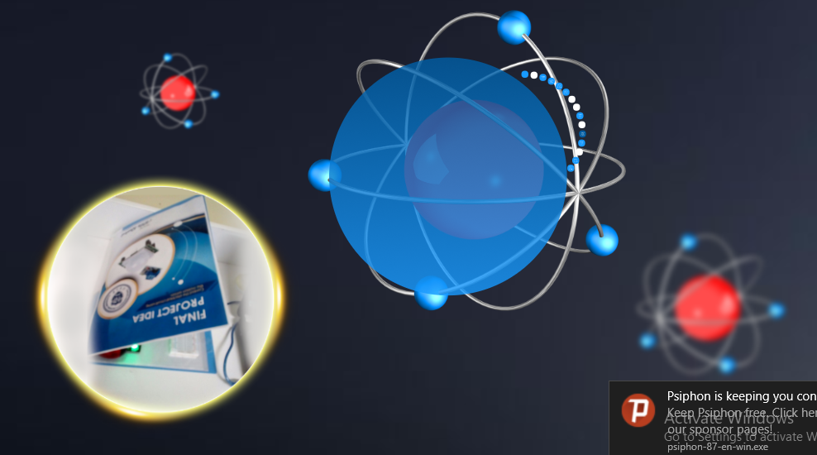

Slide 3


Slide 4


Slide 5


Slide 6


Slide 7


Slide 8


Slide 9
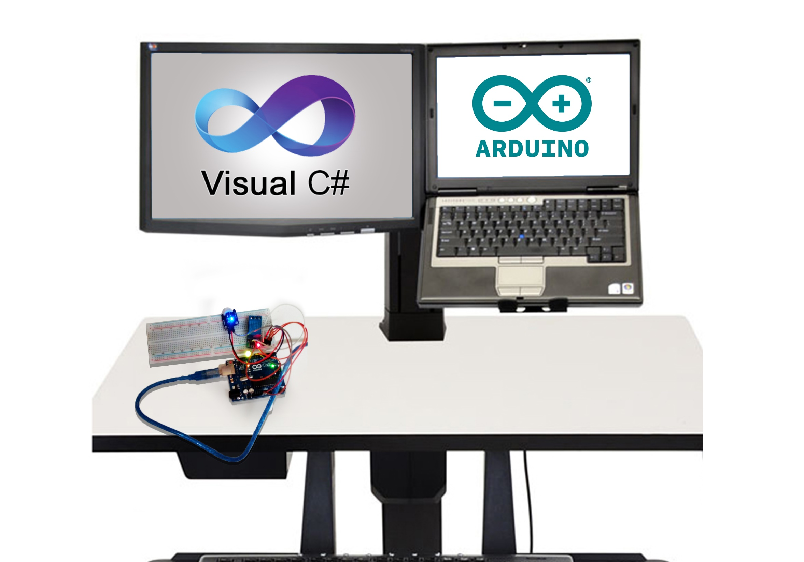

Slide 10


Slide 11
https://www.youtube.com/watch?time_continue=53&v=pePXYfGVo5o

Slide 12


Slide 13
https://www.youtube.com/watch?v=jyIOBil18uY&feature=youtu.be

Slide 14
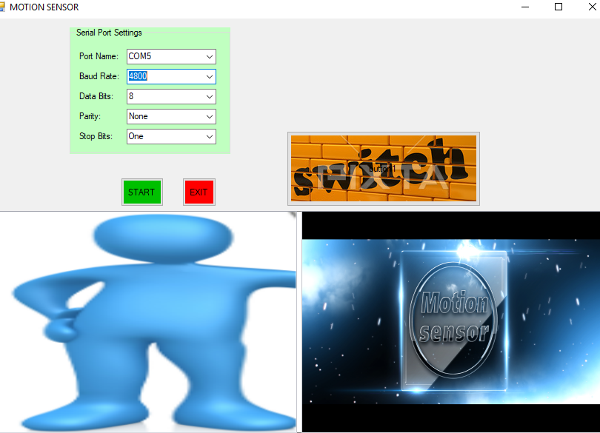

Slide 15
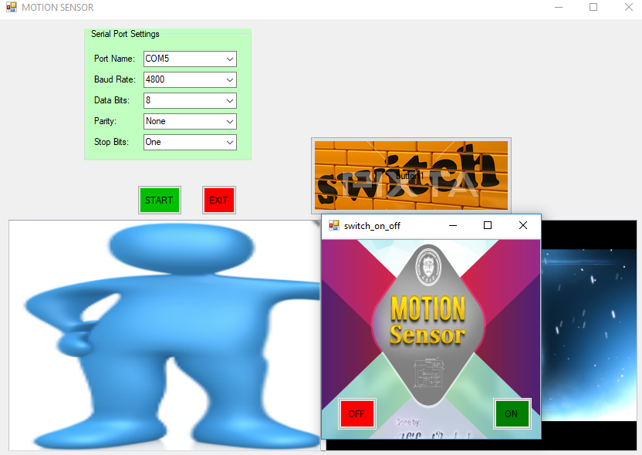

Slide 16


