Slide 1



DEVOPS
SNEHA GUPTA
BTECH IBM (SECOND YEAR)
UNITED UNIVERSITY

Slide 2

Challenges in the Pre-DevOps Era
  Communication gap between Dev and Ops → frequent misunderstandings.
  Slow software releases due to long deployment cycles.
  Manual processes for testing, integration, and deployment → error-prone.
  Developers said “It works on my machine,” while Ops struggled in production.
  High downtime during updates and maintenance.
  Lack of automation → more effort, delayed feedback, lower productivity.

Slide 3


devlopment
Focused only on writing and improving code.
Their goal: add new features, fix bugs, enhance functionality.
DEV + OPS
operation
Responsible for deploying, running, and maintaining applications on servers.

Slide 4

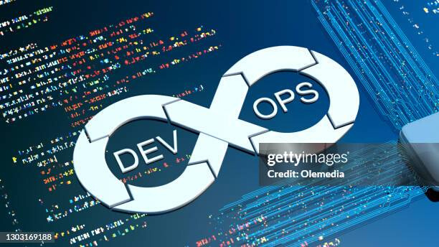
Dev + Ops = DevOps
  Development and Operations work together as one team.
  Uses automation for testing, building, and deployment.
  Software releases become faster, more frequent, and more reliable.
  Reduces errors, downtime, and communication gaps.
  Improves collaboration, speed, quality, and system stability.

Slide 5




Continuous Improvement
Regularly enhancing processes and products based on feedback.
Continuous Integration
Devops
practices
Frequently merging code changes into a shared repository with automated testing.
Continuous Delivery
Automatically preparing code for release so it can be deployed at any time.
Continuous Monitoring
Constantly tracking system performance and errors to detect issues early.

Slide 6


Thank you!

