Slide 1
Exceptional Control Flow Ⅲ

Slide 2
Outline
Reaping(回收) Child Processes
Putting Processes to Sleep
Loading and Running Programs
Suggested reading 8.4

Slide 3
Reap Child Processes

Slide 4
Zombie(僵尸模式)
The kernel does not remove a terminated process from the system immediately after the process terminates
The process is kept around in a terminated state until it is reaped(回收) by its parent.
僵尸模式形容的是一个子进程在结束之后没有被parent进程或者init进程
回收，而一直占用一块不在被使用但是却不能被复用的空间的模式。

Slide 5
Zombie
When the parent reaps the terminated child
the kernel passes the child’s exit status to the parent,
and then discards the terminated process, at which point it ceases to exist.
A terminated process that has not yet been reaped is called a zombie.
exit(n)

Slide 6
Zombie
If the parent process
terminates without reaping its zombie children,
the kernel arranges for the init process to reap them.
The init process
has a PID of 1
and is created by the kernel during system initialization.
一个zombie一般情况下是由其parent进程进行回收，但是若此parent进程
结束之后仍未进行child的回收，则init进程会接管此child进程并会对其进
行回收。

Slide 7
Zombie
Long-running programs such as shells or servers should always reap their zombie children.
Even though zombies are not running, they still consume system memory resources.

Slide 8
Wait_pid Function
#include <sys/types.h> #include <sys/wait.h> pid_t waitpid(pid_t pid, int *status, int options); pid_t wait(int *status); Returns: PID of child if OK, 0 (if WNOHANG) or -1 on error
waitpid就是用于回收zombie的函数，其回收的是函数返回的非0的
pid对应的child进程。
waitpid若返回值为0，则只有opt = WNOWANG一种情况

Slide 9
Wait_pid Function
pid_t waitpid(pid_t pid, int *status, int options);
pid > 0
The wait set is the singleton child process
whose process ID is equal to pid
pid = -1
The wait set consists of all of the parent’s child processes

Slide 10
Wait_pid Function
The waitpid function
If the calling process has no children
returns –1
sets errno to ECHILD
If interrupted by a signal
returns –1
sets errno to EINTR

Slide 11
Wait_pid Function
pid_t waitpid(pid_t pid, int *status, int options);
options = 0
waitpid suspends(not return) execution of the calling process until a child process in its wait-set terminates
If a process in the wait set has already terminated at the time of the call, then waitpid returns immediately
waitpid returns the PID of the terminated child that caused waitpid to return
the terminated child is removed from the system(被回收了)

Slide 12
Wait_pid Function
pid_t waitpid(pid_t pid, int *status, int options);
options
WNOHANG: Return immediately (with a return value of 0 ) if none of the child processes in the waiting set has terminated yet(若set中存在一个已经terminate了的child进程，则仍会返回该进程对应的PID)
WUNTRACED: Suspended execution of the calling process until a process terminated or stopped child that caused the return

Slide 13
Wait_pid Function
pid_t waitpid(pid_t pid, int *status, int options);
options
WUNTRACED | WNOHANG : Return immediately (with a return value of 0) if none of the children in the waiting set has stopped or terminated, or with a return value equal to the PID of one of the stopped or terminated children.

Slide 14
Wait_pid Function
pid_t waitpid(pid_t pid, int *status, int options);
Checking the exit status of a reaped child(检测回收的child进程的属性)
The status argument is non-NULL
waitpid encodes status information about the child
that caused the return in the status argument.
The wait.h include file defines several macros
for interpreting the status argument

Slide 15
Wait_pid Function
pid_t waitpid(pid_t pid, int *status, int options);
WIFEXITED(status)
Returns true if the child terminated normally
via a call to exit or a return.
WEXITSTATUS(status)
Returns the exit status of a normally terminated child.
This status is only defined if WIFEXITED returned true.

Slide 16
Wait_pid Function
pid_t waitpid(pid_t pid, int *status, int options);
WIFSIGNALED(status)
Returns true if the child process terminated because of a signal that was not caught
WTERMSIG(status)
Returns the number of the signal that caused the child process to terminate.
This status is only defined if WIFSIGNALED returned true.

Slide 17
Wait_pid Function
pid_t waitpid(pid_t pid, int *status, int options);
WIFSTOPPED(status)
Returns true if the child that caused the return is currently stopped.
WSTOPSIG(status)
Returns the number of the signal that caused the child to stop.
This status is only defined if WIFSTOPPED returned true.

Slide 18
Wait_pid Function (Nondeterministic)
1 #include "csapp.h"
2 #define N 2
3
4 int main()
5 {
6 int status, i;
7 pid_t pid;
8
9 /* Parent creates N children */
10 for (i = 0; i < N; i++)
11 if ((pid = Fork()) == 0) /* child */
12 exit(100+i);
13

Slide 19
Wait_pid Function (Nondeterministic)
14 /* Parent reaps N chds. in no particular order */
15 while ((pid = waitpid(-1, &status, 0)) > 0) {
16 if (WIFEXITED(status))
17 printf("child %d terminated normally with exit
18 status=%d\n", pid, WEXITSTATUS(status));
19 else
20 printf("child %d terminated abnormally\n", pid);
21 }
22
23 /* The only normal term. is if there no more chds. */
24 if (errno != ECHILD)
25 unix_error("waitpid error");
26
27 exit(0);
28}

Slide 20
Wait_pid Function (Nondeterministic)
unix>./waitpid1
child 22966 terminated normally with exit status=100
child 22967 terminated normally with exit status=101
There is no reaping order, every one is equally correct
Nondeterministic behavior for concurrency

Slide 21
Wait_pid Function (Deterministic)
1 #include "csapp.h"
2 #define N 2
3
4 int main()
5 {
6 int status, i;
7 pid_t pid[N+1], retpid;
8
9 /* Parent creates N children */
10 for (i = 0; i < N; i++)
11 if ((pid[i] = Fork()) == 0) /* Child */
12 exit(100+i);
13
14 /* Parent reaps N children in order */
15 i = 0;

Slide 22
Wait_pid Function (Deterministic)
15 while ((retpid = waitpid(pid[i++], &status, 0)) > 0) {
16 if (WIFEXITED(status))
18 printf("child %d terminated normally with exit
19 status=%d\n", retpid, WEXITSTATUS(status));
20 else
21 printf("child %d terminated abnormally\n", retpid);
22 }
23
24 /* The only normal term. is if there are no more chds. */
25 if (errno != ECHILD)
26 unix_error("waitpid error");
27
28 exit(0);
29}

Slide 23
Putting Process to Sleep
#include <unistd.h> unsigned int sleep(unsigned int secs); Returns: seconds left to sleep int pause(void); Always returns -1
返回(剩余的)休眠时间
Suspends a process for some period of time.
Returns zero if the requested amount of time has elapsed
Returns the number of seconds still left to sleep otherwise.

Slide 24
Load and Run Processes

Slide 25
Loading and Running
execve只有在出错时才会返回
#include <unistd.h> int execve(const char *filename, const char *argv[], const char *envp[]); does not return if OK, returns -1 on error
Loads and runs
the executable object file filename
with the argument list argv(其中存储的是命令及其参数)(argv是一个指针数组)
the environment variable(环境变量) list envp.
returns to the calling program only if there is an error
such as not being able to find filename.
The Execve is called once and never returns

Slide 26
Loading and Running
int execve(const char *filename, const char *argv[], const char *envp[]);
argv[]
argv
argv[0]
"ls"
argv[1]
"-lt"
...
argv[argc-1]
NULL
"/usr/include"
envp[]
envp
envp[0]
"PWD=/usr/droh"
envp[1]
"PRINTER=iron"
...
envp[n-1]
NULL
"USER=droh"

Slide 27
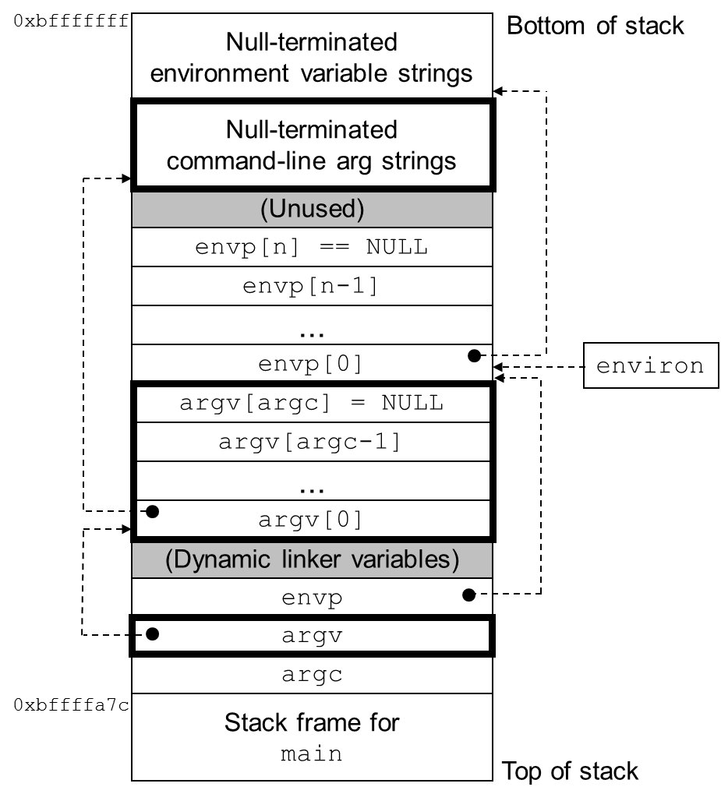
The user stack when a new program starts
0x7fffffffffff
1.会进行框架的替换，
将对应区域的内容更新为
要执行的指令信息
2.envp会以键值对的
形式存储
environ
(global var)
envp
(in %rdx)
argv
(in %rsi)
argc
(in %rdi)
Stack frame for libc_start_main
0x7fffffffe840

Slide 28
Loading and Running
#include <unistd.h> char *getenv(const char *name); Returns: ptr to name if exists, NULL if no match. int setenv(const char *name, const char *newvalue, int overwrite); Returns: 0 on success, -1 on error. void unsetenv(const char *name); Returns: nothing.
(通过上述功能对env环境变量进行操作)

Slide 29
Write your Own Shell

Slide 30
Unix Shell(一种交互界面)
An interactive application-level program that
runs other program on behalf of the user
Variants: sh, csh, tcsh, ksh, bash
Performs a sequence of read/evaluate steps and terminate
Read: reads a command line from the user
Evaluate: parses the command line and runs programs on behalf of the user (解析指令+运行指令)

Slide 31
/* The main routine for a simple shell program */
1 #include "csapp.h"
2 #define MAXARGS 128
3
4 /* function prototypes */
5 void eval(char*cmdline);
6 int parseline(const char *cmdline, char **argv);
7 int builtin_command(char **argv);
8

Slide 32
9 int main()
10 {
11 char cmdline[MAXLINE]; /* command line */
12
13 while (1) {
14 /* read */
15 printf("> ");(要求输入下一个指令)
16 Fgets(cmdline, MAXLINE, stdin);(读取一行命令)
17 if (feof(stdin))
18 exit(0);
19
20 /* evaluate */
21 eval(cmdline);
22 }
23 }

Slide 33
1 /* eval - evaluate a command line */
2 void eval(char *cmdline)
3 {
4 char *argv[MAXARGS]; /* argv for execve() */
5 char buf[MAXLINE]; /* holds modified cmd line */
6 int bg; /* should the job run in bg or fg? */
7 pid_t pid; /* process id */
8
9 strcpy(buf, cmdline);(将cmdline拷贝一份放入buf中)
10 bg = parseline(buf, argv);
11 if (argv[0] == NULL)
12 return; /* ignore empty lines */
13

Slide 34
Parsing command line
Parse the space separated command-line arguments
Builds the argv vector
which will eventually be passed to execve

Slide 35
1 /* parse the cmd line and build the argv array */
2 int parseline(const char *cmdline, char **argv)
3 {
4 char *delim; /* first space delimiter */
5 int argc; /* number of args */
6 int bg; /* background job? */
7
8 buf[strlen(buf)-1] = ’ ’;(进行归一化处理，使得每个子串结构相同，便于处理) /* replace trailing ’\n’ with space */
12 while (*buf && (*buf == ’ ’)) /* ignore spaces */
13 buf++;
14

Slide 36
12 /* build the argv list */
13 argc = 0;
14 while ((delim = strchr(buf, ’ ’))) {
15 argv[argc++] = buf;
16 *delim = ’\0’; /* replace space with ’\0’*/
17 buf = delim + 1;
18 while (*buf && (*buf == ’ ’)) /* ignore spaces */
19 buf++;
20 }
21 argv[argc] = NULL; /* set the end of argv list */
22
23 if (argc == 0) /* ignore blank line */
24 return 1;
25
26 /* should the job run in the background? */
27 if ((bg = (*argv[argc-1] == ’&’)) != 0)
28 argv[--argc] = NULL;
29 return bg;
30 }
查找字符’ ’所在的具体位置
(将一个字符串进行拆分)
此处的&字符代表的是后台运行的意思

Slide 37
Foreground and Background
If the last argument is a “&” character
parseline returns 1
indicating the program should be executed in the background
(the shell returns to the top of the loop and waits for the next command)
Otherwise
parseline returns 0
indicating the program should be run in the foreground
(the shell waits for it to complete) (上一条指令执行完才会读入与执行下一条指令)

Slide 38
Parsing command line
The first argument is assumed to be
either the name of a built-in shell command
that is interpreted immediately
or an executable object file
that will be loaded and run in the context of a new child process

Slide 39
14 if (!builtin_command(argv)) {
15 if ((pid = Fork()) == 0) { /* execute in child */
16 if (execve(argv[0], argv, environ) < 0) {
17 printf("%s: Command not found.\n", argv[0]);
18 exit(0);
19 }
20 }
21

Slide 40
14 if (!builtin_command(argv)) {
15 if ((pid = Fork()) == 0) { /* execute in child */
16 if (execve(argv[0], argv, environ) < 0) {
17 printf("%s: Command not found.\n", argv[0]);
18 exit(0);
19 }
20 }
21
34 /* if 1st arg is a builtin command, run it and return true */
35 int builtin_command(char **argv)
36 {
37 if (!strcmp(argv[0], "quit")) /* quit command */
38 exit(0);
39 if (!strcmp(argv[0], "&")) /* ignore singleton & */
40 return 1;
41 return 0; /* not a builtin command */
42 }
发现是quit指令就直接停止

Slide 41
14 if (!builtin_command(argv)) {
15 if ((pid = Fork()) == 0) { /* execute in child */
16 if (execve(argv[0], argv, environ) < 0) {
17 printf("%s: Command not found.\n", argv[0]);
18 exit(0);
19 }
20 }
21
22 /* parent waits for foreground job to terminate */
23 if (!bg) { /* foreground */
24 int status;
25 if (waitpid(pid, &status, 0) < 0)
26 unix_error("waitfg: waitpid error");
27 }
28 else
29 printf("%d %s", pid, cmdline);
30 }
31 return;
32 }

