Slide 1
Exceptional Control Flow Ⅳ

Slide 2
Outline
Suggested reading Signals
Signal Terminology
Sending Signals
Receiving Signals
Blocking and Unblocking Signals
Suggested reading 8.5

Slide 3
Signals

Slide 4
Signals
Unix signal
A higher-level software form of exception
That allows processes and the kernel to interrupt other processes

Slide 5
The kill Program
Kill program
is located in directory /bin/
sends an arbitrary signal to another process
e.g. unix> kill -9 15213
sends signal 9 (SIGKILL) to process 15213.

Slide 6
Signals Type
Signal is a message that notifies a process
an event of some type has occurred in the system.
Each type corresponds to some kind of system event
Low-level hardware exceptions
are processed by the kernel’s exception handlers would not normally be visible to user processes.
Signals provide a mechanism for exposing the occurrence of such exceptions to user processes.
Higher-level software events
in the kernel
in other user processes

Slide 7
Hardware Events
SIGFPE signal (number 8)
If a process attempts to divide by zero,
then the kernel sends it a SIGFPE signal
SIGILL signal (number 4)
If a process executes an illegal instruction,
the kernel sends it a SIGILL signal.
SIGSEGV signal (number 11)
If a process makes an illegal memory reference,
the kernel sends it a SIGSEGV signal.

Slide 8
Software Events
SIGINT signal (number 2)
While a process is running in the foreground
if you type a ctrl-c
then the kernel sends a SIGINT signal to the process
SIGKILL signal (number 9)
A process can forcibly terminate another process
by sending it a SIGKILL signal
SIGCHLD signal (number 17)
When a child process terminates or stops,
the kernel sends a SIGCHLD signal to the parent.

Slide 9
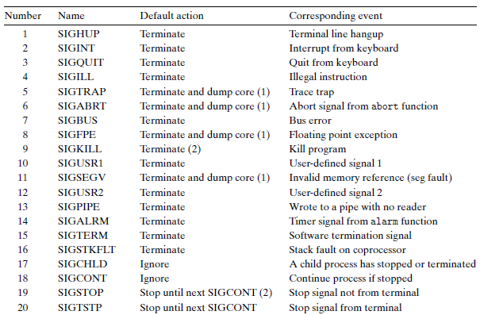
Linux Signals
> man signal

Slide 10
Signal Terminology
Two steps to transfer a signal to a destination process
Sending a signal
Receiving a signal

Slide 11
Sending a signal
The kernel
sends (delivers) a signal to a destination process
by updating some state in the context of the destination process.
The signal is delivered for one of two reasons
The kernel has detected a system event
Divide by zero, termination of a child process
A process has invoked the kill function
to explicitly request the kernel to send a signal to the destination process.
A process can send a signal to itself.

Slide 12
Sending Signals with kill Function
#include <sys/types.h> #include <signal.h> int kill(pid_t pid, int sig); returns: 0 if OK, -1 on error
Will be discussed later

Slide 13
Receiving a signal
A destination process receives a signal
when it is forced by the kernel to react in some way to the delivery of the signal
The process can
Ignore the signal
Terminate
Catch the signal
by executing a user-level function called a signal handler

Slide 14
Pending Signal
Pending signal
A signal that has been sent but not yet received
Only one
At any point in time,
there can be at most one pending signal of a particular type
Not queued
If a process has a pending signal of type k
then any subsequent signals of type k sent to that process are not queued
they are simply discarded.
A pending signal is received at most once.

Slide 15
Blocking a Signal
A process can selectively block the receipt of certain signals.
When a signal is blocked
it can be delivered
but the resulting pending signal will not be received
until the process unblocks the signal

Slide 16
Internal Data Structures
For each process, the kernel maintains
the set of pending signals in the pending bit vector
the set of blocked signals in the blocked bit vector
The kernel sets bit k in pending
whenever a signal of type k is delivered
The kernel clears bit k in pending
whenever a signal of type k is received.

Slide 17
Sending Signals

Slide 18
Process Groups
To send signals to processes
Unix systems provide a number of mechanisms for sending signals to processes
All of them rely on the notion of a process group
Every process belongs to exactly one process group
which is identified by a positive integer (process group ID).
By default, a child process belongs to the same process group as its parent.

Slide 19
Process Groups
#include <unistd.h>
pid_t getpgrp(void);
returns: process group ID of calling process
#include <unistd.h>
pid_t setpgid(pid_t pid, pid_t pgid);
returns: 0 on success, -1 on error
Changes the process group of process pid to pgid
If pid is zero, the PID of the current process is used
If pgid is zero, the PID of the process specified by pid is used for the process group ID

Slide 20
setgpid Function
e.g. setpgid(0, 0);
Suppose process 15213 is the calling process,
then this function call
creates a new process group whose process group ID is 15213
adds process 15213 to this new group.

Slide 21
The kill Program
Kill program
is located in directory /bin/
sends an arbitrary signal to another process
e.g. unix> kill -9 15213
sends signal 9 (SIGKILL) to process 15213.

Slide 22
The kill Program
Sending signals to process group by kill
Using a negative PID
Which causes the signal to be sent to every process in process group PID
e.g. unix> kill -9 -15213
sends a SIGKILL signal to every process in process group 15213.

Slide 23
Sending Signals from the Keyboard
Job
An abstraction used by Unix shells
To represent the processes
that are created as a result of evaluating a single cmdline
At any point, there is at most one foreground job and zero or more background jobs
e.g. unix> ls | sort
a foreground job consisting of two processes connected by a pipe

Slide 24
Sending Signals from the Keyboard
The shell creates a separate process group for each job
Typically, the process group ID is taken from one of the parent processes in the job

Slide 25
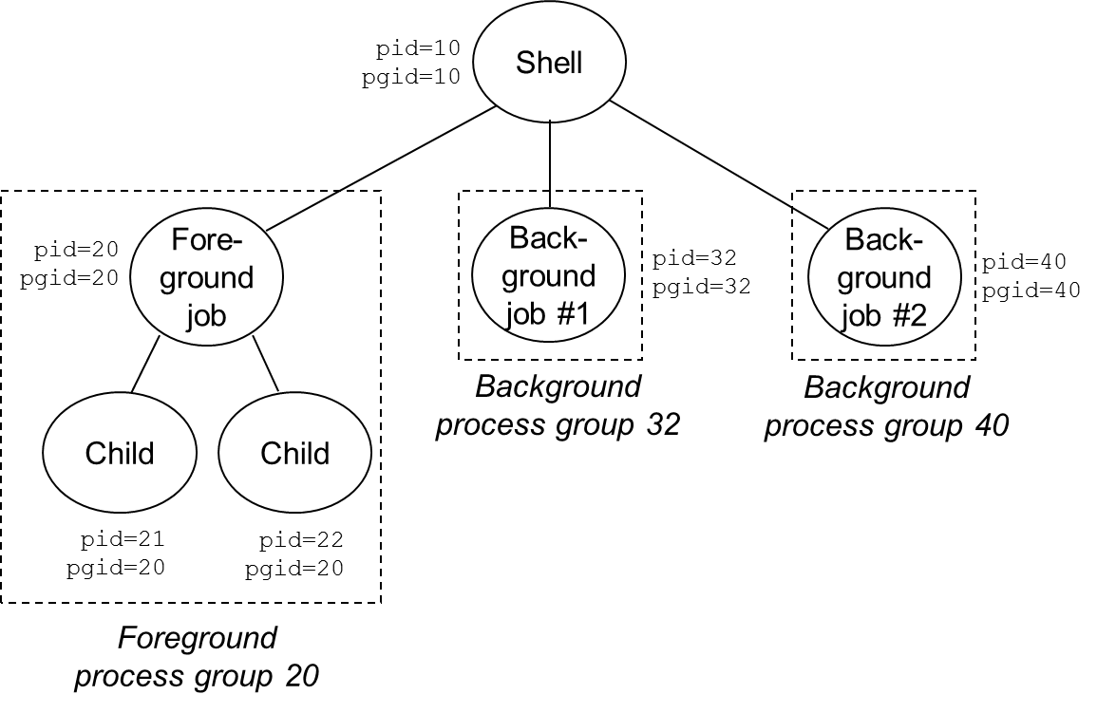
Sending Signals from the Keyboard

Slide 26
Sending Signals from the Keyboard
Typing ctrl-c at the keyboard
causes a SIGINT signal to be sent to the shell
The shell catches the signal
Then sends a SIGINT to every process in the foreground process group
The result is to terminate the foreground job (default)

Slide 27
Sending Signals from the Keyboard
Typing ctrl-z
sends a SIGTSTP signal to the shell
The shell catches the signal
Sends a SIGTSTP signal to every process in the foreground process group
The result is to stop (suspend) the foreground job (default)

Slide 28
Sending Signals with kill Function
#include <sys/types.h> #include <signal.h> int kill(pid_t pid, int sig); returns: 0 if OK, -1 on error
If pid is greater than zero,
then the kill function sends signal number sig to process pid
If pid is less than zero
then kill sends signal sig to every process in process group abs(pid)
要注意的是kill指令实际上就是发送了一个signal，而不是真正的”kill”.

Slide 29
1 #include "csapp.h"
2
3 int main()
4 {
5 pid_t pid;
6
7 /* child sleeps until SIGKILL signal received */
8 if ((pid = Fork()) == 0) {
9 Pause(); /* wait for a signal to arrive */
10 printf("control should never reach here!\n");
11 exit(0);
12 }
13
14 /* parent sends a SIGKILL signal to a child */
15 Kill(pid, SIGKILL);
16 exit(0);
17 }

Slide 30
Sending Signals With the alarm Function
#include <unistd.h> unsigned int alarm(unsigned int secs); returns: remaining secs of previous alarm, or 0 if no previous alarm
Arranges for the kernel to send a SIGALRM signal to the calling process in secs seconds.
If secs is zero
then no new alarm is scheduled.
The call to alarm
cancels any pending alarms
returns the number of seconds remaining until any pending alarm was due to be delivered
returns 0 if there were no pending alarms.

Slide 31
Receiving Signals

Slide 32
Receiving a Signal
Preconditions
When the kernel is returning from an exception handler
and is ready to pass control to process p

Slide 33
Receiving a Signal
Actions
kernel checks the set of unblocked pending signals (pending & ˜blocked)
If this set is empty (the usual case)
then the kernel passes control to the next instruction (I_{next}) in the logical control flow of p.
However, if the set is nonempty
then the kernel chooses some signal k in the set (typically the smallest k)
and forces p to receive signal k.

Slide 34
Receiving a Signal
The receipt of the signal triggers some action by the process.
Once the process completes the action, then control passes back to the next instruction (I_{next}) in the logical control flow of p.
(1) Signal received by process
(2) Control passes
to signal handler
I_{curr}
I_{next}
(3) Signal handler runs
(4) Signal handler
returns to
next instruction

Slide 35
Receiving a Signal
Each signal type has a predefined default action, which is one of the following:
The process terminates.
The process terminates and dumps core.
The process stops until restarted by a SIGCONT signal.
The process ignores the signal.

Slide 36
Receiving a Signal
SIGKILL
The default action is to terminate the receiving process
SIGCHLD
The default action is to ignore the signal.

Slide 37
Receiving a Signal
A process can modify the default action associated with a signal
by using the signal function
The only exceptions are SIGSTOP and SIGKILL, whose default actions cannot be changed.

Slide 38
Signal Function
#include <signal.h> typedef void handler_t(int) handler_t *signal(int signum, handler_t *handler) returns: ptr to previous handler if OK, SIG_ERR on error (does not set errno)
Three ways to change default actions:
If handler is SIG_IGN, then signals of type signum are ignored.
If handler is SIG_DFL, then the action for signals of type signum reverts to the default action.
Otherwise, change action to handler (called signal handler)

Slide 39
Signal Function
Installing the handler
Changing the default action by passing the address of a handler to the signal function
Catching the signal
The invocation of the handler
Handling the signal
The execution of the handler

Slide 40
1 #include "csapp.h"
2
3 void handler(int sig) /* SIGINT handler */
4 {
5 printf("Caught SIGINT\n");
6 exit(0);
7 }
8
9 int main()
10 {
11 /* Install the SIGINT handler */
12 if (signal(SIGINT, handler) == SIG_ERR)
13 unix_error("signal error");
14
15 pause(); /* wait for the receipt of a signal */
16
17 exit(0);
18 }

Slide 41
Signal Function
Handling the signal
When a process catches a signal of type k,
the handler installed for signal k is invoked
with a single integer argument set to k.
When the handler executes its return statement,
control (usually) passes back to the instruction in the control flow
where the process was interrupted by the receipt of the signal.
in some systems, interrupted system calls return immediately with an error.

Slide 42
Signal Function
Normal program flow
Signal handler
return code on
the stack
do_signal()
handle_signal()
setup_frame()
system_call()
sys_sigreturn()
restore_sigcontext()

Slide 43
Signal Function
The same handler function can be used to catch different types of signals
By setting different signal numbers as the argument to the signal handler

Slide 44
Blocking and Unblocking Signals

Slide 45
Signal Handlers can be interrupted
(1) Program catches signal s
(2) Control passes
to handler S
I_{curr}
(3) Program catches signal t
(4) Control passes
to handler T
I_{next}
(5) Handler T
returns to handler S
(7) Main program resumes
(6) Handler S
returns to main programm
s ≠ t

Slide 46
Blocking and Unblocking Signals
Implicit blocking mechanism
Kernel blocks any pending signals of the type currently being processed by a handler
Explicit blocking mechanism
sigprocmask function and its helpers
signal由blocked状态转化为unblocked状态后会执行之前由于block被进程接
受但没有执行的signal

Slide 47
Blocking and Unblocking Signals
#include <signal.h> int sigprocmask(int how, const sigset_t *set, sigset_t *oldset) int sigemptyset(sigset_t *set) ; int sigfillset(sigset_t *set); int sigaddset(sigset_t *set, int signum); int sigdelset(sigset_t *set, int signum); Return: 0 if OK, -1 on error Int sigismember(const sigset_t *set, int signum); Returns: 1 if member, 0 if not, -1 on error

Slide 48
Explicitly Blocking Signals
sigprocmask
Changes the set of currently blocked signals
SIG_BLOCK: add the signals in set to blocked (blocked = blocked | set )
SIG_UNBLOCK: Remove the signals in set from blocked (blocked = blocked & ~set)
SIG_SETMASK: blocked = set
If oldset is non-NULL, the previous value of the blocked bit vector is stored in oldset

Slide 49
Explicitly Blocking Signals
Signal set
Set manipulations are provided by the rest of the functions
sigemptyset
sigfillset
sigaddset
sigdelset

