Slide 1
Exceptional Control Flow

Slide 2
Outline
Suggested reading Signals
Writing Signal Handlers
Nasty Concurrency Bugs
Explicitly waiting for signals
Suggested reading 8.5

Slide 3
Safe Signal Handling

Slide 4
Main Program and Signal Handlers are Concurrent
(1) Program catches signal s
(2) Control passes
to handler S
I_{curr}
(3) Program catches signal t
(4) Control passes
to handler T
I_{next}
(5) Handler T
returns to handler S
(7) Main program resumes
(6) Handler S
returns to main programm
s ≠ t
block

Slide 5
Concurrent Bugs
Concurrent bugs
Tricky and subtle
A program works correctly most the time
When it fails, it fails in unpredictable and unrepeatable ways that are horrendously difficult to debug
(无法预测是因为concurrent bugs发生时很难得知
bug具体发生在那个并行进程中，故很难debug)

Slide 6
Guidlines
G0 keep handlers as simple as possible
Might simply set a global flag and return immediately
all processing associated with the receipt of the signal is performed by the main program
which periodically checks (and reset) the flag

Slide 7
Guidlines
G1 call only asyn-signal-safe functions in your handler(大多是简单的syscall)
Reentrant or cannot be interrupted
printf, sprintf, malloc, exit are not safe

Slide 8
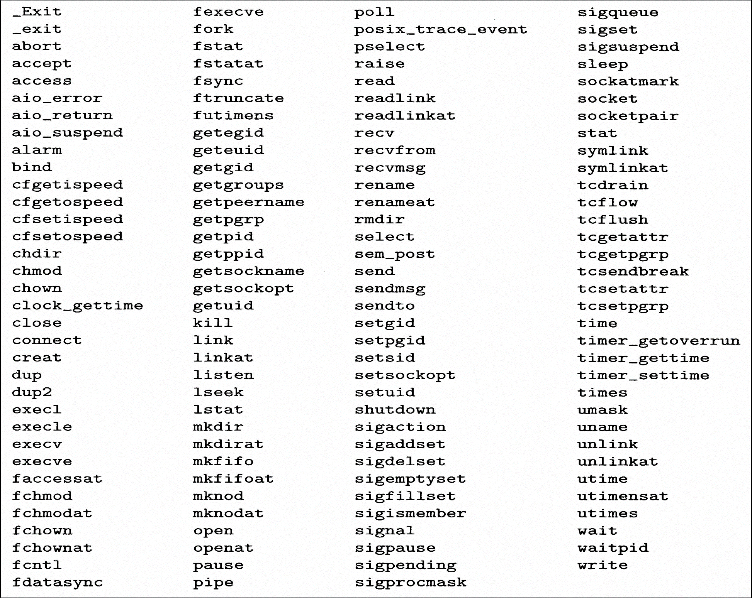
Guidlines

Slide 9
Safe I/O Package(sio)
#include <csapp.h> ssize_t sio_putl(long v); ssize_t sio_puts(char s[]); Returns: number of bytes transferred if OK, -1 on error void sio_error(long v); Returns: nothing
_exit is an asyn_signal_safe variant of exit

Slide 10
Safe I/O Package
ssize_t sio_puts(char s[]) /* Put string */
{
return write(STDOUT_FILENO, s, sio_strlen(s));
}
ssize_t sio_putl(long v) /* Put long */
{
char s[128];
sio_ltoa(v, s, 10); /* Based on K&R itoa() */
return sio_puts(s);
}
void sio_error(char s[]) /*Put error message and exit */
{
sio_puts(s);
_exit(1);
}
三个函数中相对而言
sio_puts()最安全，
因为另外两个是基于此
实现的。

Slide 11
Guidlines
G2 Save and restore errno(防止其他signal
改变errno而对此signal结果产生影响。)
Many async_signal_safe functions set errno when they return with an error
Calling such functions inside a handler might interfere with other parts of the program that rely on errno
G2的处理就类似于对于caller saved register的处理类似

Slide 12
Correct Signal Handling

Slide 13
14 int main()
15 {
16 int i, n; char buf[MAXBUF];
17 if (signal(SIGCHLD, handler1) == SIG_ERR)
18 unix_error("signal error");
19
20 /* parent creates children */
21 for (i = 0; i < 3; i++) {
22 if (Fork() == 0) {
23 printf("Hello from child %d\n", (int)getpid());
25 exit(0);
26 }
27 }
28 /* parent waits for term. input and then processes it */
29 if ((n = read(STDIN_FILENO, buf, sizeof(buf))) < 0)
30 unix_error("read");
31
32 printf("Parent processing input\n");
33 while (1) ;
34
35 exit(0);
36 }

Slide 14
1 #include "csapp.h"
2
3 void handler1(int sig)
4 {
5 int olderrno = errno;
6
7 if ((pid = waitpid(-1, NULL, 0)) < 0)
8 sio_error("waitpid error");
9 sio_puts("Handler reaped child\n");
sleep(1);
errno = olderrno ;
12 }
13

Slide 15
linux> ./signal1
Hello from child 14073
Hello from child 14074
Hello from child 14075
Handler reaped child
Handler reaped child
<cr>
Parent processing input
<ctrl-z>
Suspended
linux> ps t
PID TTY STAT TIME COMMAND
...
14072 pts/3 T 0:02 ./signal1
14075 pts/3 Z 0:00 [signal1] <defunct>
14076 pts/3 R 0:00 ps t
从本图中可以看出，结果与理论结果之间
相差了一个handler输出行，从下图可
见，是因为第三个进程的signal与前两个
进程相同，故会导致在处理signal1的时候
bit map设为了1，此时signal2被blocked，
当signal2被处理时，signal3会由于bitmap
已经为1而被忽略，故signal3对应的进程
不会被回收(父进程回收子进程需要signal
SIG_CHILD)
Notes:
Why?

Slide 16
Signal Handling Issues
Pending signals can be blocked
Unix signal handlers typically block pending signals of the type currently being processed by the handler
Pending signals are not queued(可能会因为此时的bit map对应位已经为1)
There can be at most one pending signal of any particular type
then the second same type of pending signal is simply discarded

Slide 17
1 void handler2(int sig)
2 {
3 int olderrno = errno;
4
5 while ((pid = waitpid(-1, NULL, 0)) > 0) {
6 sio_puts("Handler reaped child\n");
7 }
8 if (errno != ECHILD)
9 sio_error("waitpid error");
10 sleep(1);
11 errno = olderrno ;
12 }
利用while尽可能的再一次handler的过程中回收更多的子进程
来避免有的SIG_CHILD会被discarded的问题

Slide 18
linux> ./signal2
Hello from child 10378
Hello from child 10379
Hello from child 10380
Handler reaped child
Handler reaped child
Handler reaped child
<cr>
Parent processing input

Slide 19
Portable Signal Handling

Slide 20
Different Signal-handling Semantics
Slow system calls
read, write, wait, accept
can potentially block the process for a long period of time
Some older Unix systems
restore the action for signal k to its default after signal k has been caught by a handler
return to the user immediately after a slow system call is interrupted (do not return to slow system call itself)

Slide 21
solaris> ./signal2
Hello from child 18906
Hello from child 18907
Hello from child 18908
Handler reaped child
Handler reaped child
Handler reaped child
read: Interrupted system call
此处就反映出了同一个程序在不同平台上面运行时结果可能不同的情况
(此例子中是由于不同平台对interrupt的处理方式不同)

Slide 22
15 int main()
16 {
17 int i, n; char buf[MAXBUF];
18 if (signal(SIGCHLD, handler2) == SIG_ERR)
19 unix_error("signal error");
20
21 /* parent creates children */
22 for (i = 0; i < 3; i++) {
23 if (Fork() == 0) {
24 printf("Hello from child %d\n", (int)getpid());
25 Sleep(1);
26 exit(0);
27 }
28 }
29 /* Manually restart the read if it is interrupted */
30 while ((n = read(STDIN_FILENO, buf, sizeof(buf))) < 0)
31 if (errno != EINTR)
32 unix_error("read");
33
34 printf("Parent processing input\n");
35 while (1) ;
36 exit(0);
37 }

Slide 23
solaris> ./signal3
Hello from child 19571
Hello from child 19572
Hello from child 19573
Handler reaped child 19571
Handler reaped child 19572
Handler reaped child 19573
<cr>
Parent processing input

Slide 24
sigaction Function
#include <signal.h> int sigaction(int signum, struct sigaction *act, struct sigaction *oldact); returns: 0 if OK, -1 on error struct sigaction { void (*sa_handler)(); /* addr of signal handler, or SIG_IGN, or SIG_DFL */ sigset_t sa_mask; /* additional signals to block */ int sa_flags; /* signal options */ } ;

Slide 25
1 handler_t *Signal(int signum, handler_t *handler)
2 {
3 struct sigaction action, old_action;
4
5 action.sa_handler = handler;
/* block sigs of type being handled */
6 sigemptyset(&action.sa_mask);
/* restart syscalls if possible */
7 action.sa_flags = SA_RESTART;
8
9 if (sigaction(signum, &action, &old_action) < 0)
10 unix_error("Signal error");
11 return (old_action.sa_handler);
12 }

Slide 26
Signal Function
Only signals of the type currently being processed by the handler are blocked
As with all signal implementations, signals are not queued
Interrupted system calls are automatically restarted whenever possible
Once the signal handler is installed, it remains installed until Signal is called with a handler argument of either SIG_IGN or SIG_DEF(忽略)

Slide 27
A Nasty Concurrency Bug

Slide 28
Nasty Concurrency Bugs
1 /* WARNING: This code is buggy */
2 void handler(int sig)
3 {
4 int olderrno = errno ;
5 pid_t pid ;
6
7 while ( (pid = waitpid(-1, NULL, 0) > 0)) > 0) { /*reap a zombie child */
8 deletejob(pid); /*delete the child from the job list*/
9 }
10 if (errno != ECHILD)
11 sio_error(“waitpid error”) ;
12 errno = olderrno ;
13 }

Slide 29
A Nasty Concurrency Bug
14 int main(int argc, char **argv)
15 {
16 int pid;
17
18 Signal(SIGCHLD, handler);
19 initjobs(); /* initialize the job list */
20
21 while(1) {
22 if ((pid = Fork()) == 0) { /*Child process */
23 Execve(“/bin/ls”, argv, NULL);
24 }
25 addjob(pid) ; /* Parent process adds the child to the job list */
26 }
27 exit(0)
28 }
程序可能出错的地方：
1.调度顺序问题：父进程在全部的
子进程之前
2.addjob与deletejob共同作用于一
个initjobs，若两者在运行过程中被
打断就可能出错.

Slide 30
Guidlines
G3 Protect accesses to shared global data structures(公有变量/全局数据结构) by blocking all signals

Slide 31
A Nasty Concurrency Bug
19 int main(int argc, char **argv)
20 {
21 int pid;
sigset_t mask_all, prev_all ;
Sigfillset(&mask_all);
Signal(SIGCHLD, handler);
26 initjobs(); /* initialize the job list */
27
28 while(1) {
29 if ((pid = Fork()) == 0) { /*Child process */
30 Execve(“/bin/ls”, argv, NULL);
}
/* parent process */
32 Sigprocmask(SIG_BLOCK, &mask_all, &prev_all);
33 addjob(pid) ; /* Add the child to the job list */
34 Sigprocmask(SIG_SETMASK, &prev_all, NULL);
35 }
36 exit(0)
37 }

Slide 32
Nasty Concurrency Bugs
1 /* WARNING: This code is still buggy */
2 void handler(int sig)
3 {
4 int olderrno = errno ;
5 sigsret_t mask_all, prev_all;
6 pid_t pid ;
7
8 Sigfillset(&mask_all) ;
/*reap a zombie child */
9 while ((pid = waitpid(-1, NULL, 0) > 0)) > 0) {
10 SigProcmask(SIG_BLOCK, &mask_all, &prev_all);
11 deletejob(pid); /*delete the child from the job list*/
12 SigProcmask(SIG_SETMASK, &prev_all, NULL);
13 }
14 if (errno != ECHILD)
15 sio_error(“waitpid error”) ;
16 errno = olderrno ;
17 }
防止被打断
block all
unblock all

Slide 33
Nasty Concurrency Bugs
Incorrectly sequence of events
Parent executes fork and kernel schedules the newly created child
Child terminates and kernel delivers a SIGCHLD signal to parent
Parent receives the SIGCHLD signal and runs the signal handler
Signal handler calls deletejob
Parent return from fork and calls addjob

Slide 34
A Nasty Concurrency Bug
18 int main(int argc, char **argv)
19 {
20 int pid;
21 sigset_t mask_all, mask_one, prev_one ;
22
23 Sigfillset(&mask_all);
24 Sigemptyset(&mask_one);
25 Sigaddset(&mask_one, SIGCHLD);
26 Signal(SIGCHLD, handler);
27 initjobs(); /* initialize the job list */
28
29 while(1) {
30 Sigprocmask(SIG_BLOCK, &mask_one, &prev_one)/*
31 if ((pid = Fork()) == 0) { /*Child process */
32 Sigprocmask(SIG_SETMASK, &prev_one, NULL);
33 Execve(“/bin/ls”, argv, NULL);
34 }
本页的掩码操作
是保证父进程一定会
在子进程运行之后
才能进行回收，
防止出现父进程全部结
束而子进程未回收
的情况(即只delete
而不add)
Block SIGCHLD
Unblock SIGCHLD

Slide 35
A Nasty Concurrency Bug
/* parent process */
35 Sigprocmask(SIG_BLOCK, &mask_all, NULL);
36 addjob(pid) ; /* Add the child to the job list */
37 Sigprocmask(SIG_SETMASK, &prev_one, NULL);
38 }
38 exit(0)
40 }

Slide 36
Explicitly Waiting for Signals

Slide 37
Guidlines
G4 Declare global variables with volatile
Not to put the global into a register
G5 Declare flags with sig_atomic_t
atomic read/write is guaranteed among the main program and signal handlers
Compound operations are not guaranteed to be atomic such as flag++ or flag+=10

Slide 38
A Nasty Concurrency Bug
1 #include "csapp.h"
2
3 volatile sig_atomic_t pid;
4
5 void sigchld_handler(int s)
6 {
7 int olderrno = errno;
8 pid = waitpid(-1, NULL, 0);
9 errno = olderrno;
10 }
11
12 void sigint_handler(int s)
13 {
14 }
15

Slide 39
A Nasty Concurrency Bug
16 int main(int argc, char **argv)
17 {
18 sigset_t mask, prev;
19
20 Signal(SIGCHILD, sigchld_handler);
21 Signal(SIGINT, sigint_handler);
22 Sigemptyset(&mask);
23 Sigaddset(&mask, SIGCHLD);
24
25 while (1) {
26 Sigprocmask(SIG_BLOCK, &mask, &prev); /* Block SIGCHLD */
27 if (Fork() == 0) /* Child */
28 exit(0);
29

Slide 40
A Nasty Concurrency Bug
30 /* Parent */
31 pid = 0;
32 Sigprocmask(SIG_SETMASK, &prev, NULL);/* Unblock SIGCHLD */
33
34 /* Wait for SIGCHLD to be received (wasteful) */
35 while (!pid)
36 ;
37
38 /* Do some work after receiving SIGCHLD */
39 printf(".");
40 }
41 exit(0);
42 }
会浪费很多时间与空间

Slide 41
Eliminate the Spin Loop
The spin loop is wasteful for CPU resources
inserting a pause in the body of the spin loop:
while (!pid) /* Race! */
pause();
Still need a loop because pause might be interrupted by the receipt of one or more SIGINT signals
This code has a serious race condition:
if the SIGCHLD is received after the while test but before the pause(还是调度的问题)
the pause will sleep forever

Slide 42
Eliminate the Spin Loop
Replace the pause with sleep:
while (!pid) /* Too slow! */
sleep(1);
This code is too slow
If the signal is received after the while and before the sleep
the program must wait a (relatively) long time before it can check the loop termination condition again

Slide 43
Eliminate the Spin Loop
Using a higher-resolution sleep function such as nanosleep isn’t acceptable
because there is no good rule for determining the sleep interval.
Make it too small
the loop is too wasteful.
Make it too high
the program is too slow.

Slide 44
signalsuspend Function
#include <signal.h> int sigsuspend(const sigset_t *mask); returns: −1
temporarily replaces the current blocked set with mask
suspends the process until the receipt of a signal whose action is either to run a handler or to terminate the process
If the action is to terminate, then the process terminates without returning from it.
If the action is to run a handler, then it returns after the handler returns, restoring the blocked set to its state when it was called.

Slide 45
Eliminate the Spin Loop
The sigsuspend function is equivalent to an atomic version of the following:
1 sigprocmask(SIG_SETMASK, &mask, &prev);
2 pause();
3 sigprocmask(SIG_SETMASK, &prev, NULL);
The atomic (uninterruptible) property guarantees that
the calls to sigprocmask (line 1) and pause (line 2) occur together, without being interrupted

Slide 46
A Nasty Concurrency Bug
1 #include "csapp.h"
2
3 volatile sig_atomic_t pid;
4
5 void sigchld_handler(int s)
6 {
7 int olderrno = errno;
8 pid = waitpid(-1, NULL, 0);
9 errno = olderrno;
10 }
11
12 void sigint_handler(int s)
13 {
14 }
15

Slide 47
A Nasty Concurrency Bug
16 int main(int argc, char **argv)
17 {
18 sigset_t mask, prev;
19
20 Signal(SIGCHLD, sigchld_handler);
21 Signal(SIGINT, sigint_handler);
22 Sigemptyset(&mask);
23 Sigaddset(&mask, SIGCHLD);
24
25 while (1) {
26 Sigprocmask(SIG_BLOCK, &mask, &prev); /* Block SIGCHLD */
27 if (Fork() == 0) /* Child */
28 exit(0);
29
在这里exit之后会发出SIGCHILD的
signal

Slide 48
A Nasty Concurrency Bug
30 /* Wait for SIGCHLD to be received */
31 pid = 0;
32 while (!pid)
33 sigsuspend(&prev);
34
35 /* Optionally unblock SIGCHLD */
36 Sigprocmask(SIG_SETMASK, &prev, NULL);
37
38 /* Do some work after receiving SIGCHLD */
39 printf(".");
40 }
41 exit(0);
42 }
在这个问题中，sigsuspend
函数要想正常退出，就要等到
child发出的SIGCHILD被该函数接收

