Slide 1
Memory Hierarchy (Ⅲ)

Slide 2
Outline
Cache Memory
Write Cache Friendly codes
Matrix multiplication
Memory mountain
Suggested Reading: 6.4, 6.5, 6.6

Slide 3
Conflict Misses in Direct-Mapped Caches
1 float dotprod(float x[8], float y[8])
2 {
3 float sum = 0.0;
4 int i;
5
6 for (i = 0; i < 8; i++)
7 sum += x[i] * y[i];
8 return sum;
9 }

Slide 4
Conflict Misses in Direct-Mapped Caches
Assumption for x and y
x is loaded into the 32 bytes of contiguous memory starting at address 0
y starts immediately after x at address 32
Assumption for the cache
A block is 16 bytes
big enough to hold four floats
The cache consists of two sets
A total cache size of 32 bytes

Slide 5
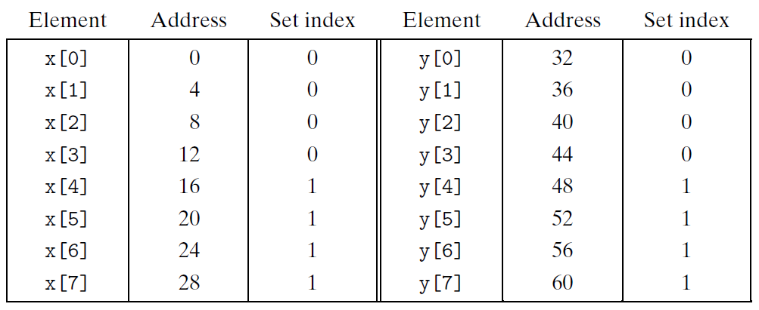
Conflict Misses in Direct-Mapped Caches
Trashing
Read x[0] will load x[0] ~ x[3] into the cache
Read y[0] will overload the cache line by y[0] ~ y[3]
如果像这样连续排列，会导致连续的conflict miss！

Slide 6
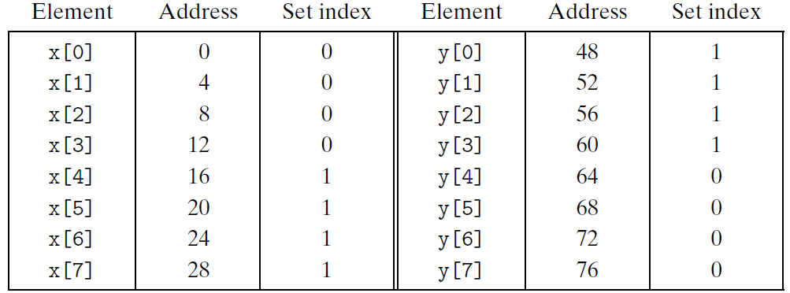
Conflict Misses in Direct-Mapped Caches
Padding can avoid thrashing
Claim x[12] instead of x[8]
一般是要padding一个block的长度，
这样可以正好错开一个set的位置。
(如果是direct-mapped的话)

Slide 7
Why use middle bits as set index?
个人理解：
使用middle bit
主要是因为其变化快
更容易map。
Cache memory
4 cache lines
2-byte block
8-byte capacity
4-line Cache
Middle-Order
Bit Indexing
00
01
0000
10
0001
11
0010
How the first 16 physical addresses mapping to cache lines
0011
0100
0101
Middle-Order Bit Indexing
Consecutive memory lines map to different cache lines
Can hold 8-byte region of address space in cache at one time
0110
0111
1000
1001
1010
1011
1100
1101
1110
1111

Slide 8
Direct-mapped cache simulation
 | Address bits
Address (decimal) | Tag bits (t=) | Index bits (s=2) | Offset bits (b=1) | Set number (decimal)
0 1 2 3 4 5 6 7 8 9 10 11 12 13 14 15 | 0 0 0 0 0 0 0 0 1 1 1 1 1 1 1 1 | 00 00 01 01 10 10 11 11 00 00 01 01 10 10 11 11 | 0 1 0 1 0 1 0 1 0 1 0 1 0 1 0 1 | 0 0 1 1 2 2 3 3 0 0 1 1 2 2 3 3

Slide 9
Direct-mapped cache simulation
 | Address bits
Address (decimal) | Index bits (s=2) | Tag bits (t=1) | Offset bits (b=1) | Set number (decimal)
0 1 2 3 4 5 6 7 8 9 10 11 12 13 14 15 | 00 00 00 00 01 01 01 01 10 10 10 10 11 11 11 11 | 0 0 1 1 0 0 1 1 0 0 1 1 0 0 1 1 | 0 1 0 1 0 1 0 1 0 1 0 1 0 1 0 1 | 0 0 0 0 1 1 1 1 2 2 2 2 3 3 3 3

Slide 10
Why use middle bits as index?
High-Order
Bit Indexing
Middle-Order
Bit Indexing
4-line Cache
00
0000
0000
01
0001
0001
10
0010
0010
11
0011
0011
0100
0100
0101
0101
High-Order Bit Indexing
Adjacent memory lines would map to same cache entry
Poor use of spatial locality
0110
0110
0111
0111
1000
1000
1001
1001
1010
1010
1011
1011
1100
1100
1101
1101
1110
1110
1111
1111

Slide 11
Set associative caches
Characterized by more than one line per set
valid
tag
cache block
set 0:
E=2 lines per set
valid
tag
cache block
valid
tag
cache block
set 1:
valid
tag
cache block
• • •
valid
tag
cache block
set S-1:
valid
tag
cache block

Slide 12
Accessing set associative caches
Set selection
identical to direct-mapped cache
这个步骤与direct-mapped
是一样的
valid
tag
cache block
set 0:
valid
tag
cache block
Selected set
valid
tag
cache block
set 1:
valid
tag
cache block
• • •
valid
tag
cache block
t bits
s bits
b bits
set S-1:
valid
tag
cache block
0 0 0 0 1
m-1
tag
set index
0
block offset

Slide 13
Accessing set associative caches
Line matching and word selection(必须检查所有的line，至少有一个匹配才行，不然下一个set)
must compare the tag in each valid line in the selected set.
=1?
(1) The valid bit must be set.
0
1
2
3
4
5
6
7
1
1001
selected set (i):
1
0110
w₀
w₁
w₂
w₃
(2) The tag bits in one
of the cache lines must
match the tag bits in
the address
(3) If (1) and (2), then
cache hit, and
block offset selects
starting byte.
= ?
t bits
s bits
b bits
这个步骤比较浪费时间
0110
i
100
m-1
tag
set index
0
block offset

Slide 14
Associative Cache
Cache
16 lines
4-byte line size
2-way set associative
Tag
Index
Offset
11
10
9
8
7
6
5
4
3
2
1
0

Slide 15
Simple Memory System Cache
Idx | Tag | Valid | B0 | B1 | B2 | B3
0 | 19 | 1 | 99 | 11 | 23 | 11
0 | 15 | 0 | – | – | – | –
1 | 1B | 1 | 00 | 02 | 04 | 08
1 | 36 | 0 | – | – | – | –
2 | 32 | 1 | 43 | 6D | 8F | 09
2 | 0D | 1 | 36 | 72 | F0 | 1D
3 | 31 | 0 | – | – | – | –
3 | 16 | 1 | 11 | C2 | DF | 03

Slide 16
Simple Memory System Cache
Idx | Tag | Valid | B0 | B1 | B2 | B3
4 | 24 | 1 | 3A | 00 | 51 | 89
4 | 2D | 0 | – | – | – | –
5 | 2D | 1 | 93 | 15 | DA | 3B
5 | 0B | 0 | – | – | – | –
6 | 12 | 0 | – | – | – | –
6 | 16 | 1 | 04 | 96 | 34 | 15
7 | 13 | 1 | 83 | 77 | 1B | D3
7 | 14 | 0 | – | – | – | –

Slide 17
Address Translation Example
Address: 0x354
Tag
Index
Offset
11
10
9
8
7
6
5
4
3
2
1
0
0
0
1
1
0
1
0
1
0
1
0
0
Offset: 0x0 Index: 0x05 Tag: 0x1A
Hit? No

Slide 18
Set Associative Cache Simulation
s=1
Example
M=16 byte addresses
B=2 bytes/block, S=2 sets, E=2 entry/set
t=2
b=1
xx
x
x
Address trace (reads):
0 [0000] 1 [0001] 13 [1101] 8 [1000] 0 [0000]
set
v
tag
data
0
0
0
0
1
0
1
0

Slide 19
Set Associative Cache Simulation
s=1
Example
M=16 byte addresses
B=2 bytes/block, S=2 sets, E=2 entry/set
t=2
b=1
xx
x
x
Address trace (reads):
0 [0000] 1 [0001] 13 [1101] 8 [1000] 0 [0000]
miss
(1)
0 [0000] (miss)
set
v
tag
data
0
1
00
m[0]m[1]
0
0
1
0
1
0

Slide 20
Set Associative Cache Simulation
s=1
Example
M=16 byte addresses
B=2 bytes/block, S=2 sets, E=2 entry/set
t=2
b=1
xx
x
x
Address trace (reads):
0 [0000] 1 [0001] 13 [1101] 8 [1000] 0 [0000]
miss hit
(2)
1 [0001] (hit)
set
v
tag
data
0
1
00
m[0]m[1]
0
0
1
0
1
0

Slide 21
Set Associative Cache Simulation
s=1
Example
M=16 byte addresses
B=2 bytes/block, S=2 sets, E=2 entry/set
t=2
b=1
xx
x
x
Address trace (reads):
0 [0000] 1 [0001] 13 [1101] 8 [1000] 0 [0000]
miss hit miss
(3)
13 [1101] (miss)
set
v
tag
data
0
1
00
m[0]m[1]
0
1
11
m[12]m[13]
1
0
1
0

Slide 22
Set Associative Cache Simulation
s=1
Example
M=16 byte addresses
B=2 bytes/block, S=2 sets, E=2 entry/set
t=2
b=1
xx
x
x
Address trace (reads):
0 [0000] 1 [0001] 13 [1101] 8 [1000] 0 [0000]
miss hit miss miss
(4)
8 [1000] (miss) where to go?
set
v
tag
data
0
1
00
m[0]m[1]
0
1
11
m[12]m[13]
1
0
1
0

Slide 23
Set Associative Cache Simulation
s=1
Example
M=16 byte addresses
B=2 bytes/block, S=2 sets, E=2 entry/set
t=2
b=1
xx
x
x
Address trace (reads):
0 [0000] 1 [0001] 13 [1101] 8 [1000] 0 [0000]
miss hit miss miss
(4)
8 [1000] (miss)
(Replacement Policy LRU)
set
v
tag
data
0
1
00
m[0]m[1]
0
1
11
m[12]m[13]
1
0
1
0

Slide 24
Line Replacement on Misses
If all the cache lines of the set are valid
Which line is selected to be evicted ?
LFU (least-frequently-used)
Replace the line that has been referenced the fewest times over some past time window
LRU (least-recently-used)
Replace the line that was last accessed the furthest in the past(选择距离当前要read的数据最近的并且被获取次数最少的一个记录)
All of these policies require additional time and hardware

Slide 25
Set Associative Cache Simulation
s=1
Example
M=16 byte addresses
B=2 bytes/block, S=2 sets, E=2 entry/set
t=2
b=1
xx
x
x
Address trace (reads):
0 [0000] 1 [0001] 13 [1101] 8 [1000] 0 [0000]
miss hit miss miss
(4)
8 [1000] (miss)
set
v
tag
data
0
1
10
m[8]m[9]
0
1
11
m[12]m[13]
1
1
1
0

Slide 26
Set Associative Cache Simulation
s=1
Example
M=16 byte addresses
B=2 bytes/block, S=2 sets, E=2 entry/set
t=2
b=1
xx
x
x
Address trace (reads):
0 [0000] 1 [0001] 13 [1101] 8 [1000] 0 [0000]
miss hit miss miss miss
(5)
0 [0000] (miss) LRU
set
v
tag
data
0
1
10
m[8]m[9]
0
1
00
m[0]m[1]
1
1
1
0

Slide 27
Fully associative caches
Characterized by all of the lines in the only one set
No set index bits in the address
valid
tag
cache block
set 0:
valid
tag
cache block
E=C/B lines in
the one and only set
…
valid
tag
cache block
t bits
b bits
tag
block offset

Slide 28
Accessing fully associative caches
Line match and Word selection
must compare the tag in each valid line
=1?
(1) The valid bit must be set.
0
1
2
3
4
5
6
7
1
1001
0
0110
1
0110
w₀
w₁
w₂
w₃
0
1110
(2) The tag bits in one
of the cache lines must
match the tag bits in
the address
= ?
(3) If (1) and (2), then
cache hit, and
block offset selects
starting byte.
t bits
b bits
0110
100
m-1
tag
0
block offset

Slide 29
Issues with Writes
Write hits
Write through(同时update了cache与main memory)
Cache updates its copy
Immediately writes the corresponding cache block to memory
Write back(暂时只update cache，在其被舍弃后在update main memory)
Defers the memory update as long as possible
Writing the updated block to memory only when it is evicted from the cache
Maintains a dirty bit for each cache line

Slide 30
Issues with Writes
Write misses
Write-allocate
Loads the corresponding memory block into the cache
Then updates the cache block
No-write-allocate
Bypasses the cache
Writes the word directly to memory
Combination
Write through, no-write-allocate
Write back, write-allocate (modern implementation)

Slide 31
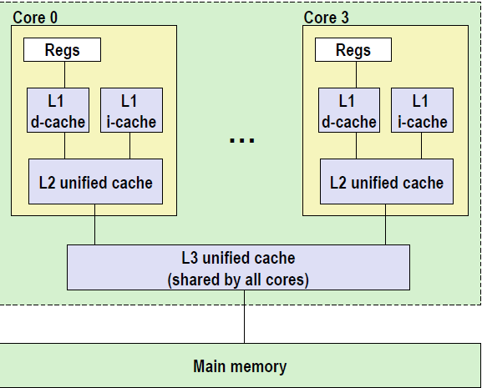
Multi-level caches
L1 d-cache, i-cache
32k 8-way
Access: 4 cycles
L2 unified-cache
256k 8-way
Access: 10 cycles
Block size
64 bytes for all cache
L1 L2是
core-private
此处的d-cache与i-cache是分开的，
与之前讲的CPU中的instruction fetch
与execute分离是对应的。
L3 unified-cache
8M 16-way
Access: 40~75 cycles

Slide 32
Cache performance metrics
Miss Rate(失误率)
fraction of memory references not found in cache (misses/references)
Typical numbers:
3-10% for L1
Can be quite small (<1%) for L2, depending on size
Hit Rate
fraction of memory references found in cache (1 - miss rate)

Slide 33
Cache performance metrics
Hit Time
time to deliver a line in the cache to the processor (includes time to determine whether the line is in the cache)
Typical numbers:
4 clock cycles for L1 in core i7
11 clock cycles for L2 in core i7
Miss Penalty
additional time required because of a miss
Typically 50-200 cycles for main memory (Trend: increasing!)

Slide 34
What does Hit Rate Mean?
Consider
Hit Time: 2 cycles
Miss Penalty: 200 cycles
Average access time:
Hit rate 99%: 2*0.99 + 200*0.01 = 4 cycles
Hit rate 97%: 2*0.97 + 200*0.03 = 8 cycles
This is why “miss rate” is used instead of “hit rate”
Miss Rate虽然很小，但是其发生时的cycle很多，对性能影响很大。

Slide 35
Cache performance metrics
Cache size
Hit rate vs. hit time
Block size
Spatial locality vs. temporal locality
Associativity
Thrashing
Cost
Speed
Miss penalty
Write strategy
Simple, read misses, fewer transfer

Slide 36
Writing Cache-Friendly Code
Principles
Programs with better locality will tend to have lower miss rates
Programs with lower miss rates will tend to run faster than programs with higher miss rates
cache-friendly <=> better use of the locality

Slide 37
Writing Cache-Friendly Code
Basic approach
Make the common case go fast
Programs often spend most of their time in a few core functions.
These functions often spend most of their time in a few loops
Minimize the number of cache misses in each inner loop

Slide 38
Writing Cache-Friendly Code
(pp. 634)
int sumvec(int v[N])
{
int i, sum = 0 ;
for (i = 0 ; i < N ; i++)
sum += v[i] ;
return sum ;
}
Temporal locality,
These variables are usually put in registers
v[i]
i=0
i= 1
i= 2
i= 3
i= 4
i= 5
i= 6
i= 7
Access order,
[h]it or [m]iss
1[m]
2[h]
3[h]
4[h]
5[m]
6[h]
7[h]
8[h]

Slide 39
Writing cache-friendly code
Temporal locality(时间局部性)
Repeated references to local variables are good because the compiler can cache them in the register file

Slide 40
Writing cache-friendly code
Spatial locality(空间局部性)
Stride-1 references patterns are good because caches at all levels of the memory hierarchy store data as contiguous blocks
Spatial locality is especially important in programs that operate on multidimensional arrays

Slide 41
Writing cache-friendly code
Example (pp. 635, M=4, N=8)
int sumarrayrows(int a[M][N])
{
int i, j, sum = 0 ;
for (i = 0 ; i < M ; i++)
for ( j = 0 ; j < N ; j++ )
sum += a[i][j] ;
return sum ;
}
Row Major

Slide 42
Writing cache-friendly code
a[i][j] | j=0 | j= 1 | j= 2 | j= 3 | j= 4 | j= 5 | j= 6 | j= 7
i=0 i=1 i=2 i=3 | 1[m] 9[m] 17[m] 25[m] | 2[h] 10[h] 18[h] 26[h] | 3[h] 11[h] 19[h] 27[h] | 4[h] 12[h] 20[h] 28[h] | 5[m] 13[m] 21[m] 29[m] | 6[h] 14[h] 22[h] 30[h] | 7[h] 15[h] 23[h] 31[h] | 8[h] 16[h] 24[h] 32[h]
这里是假设b = 4.在row major的情况下，先读取每一行时只有
每个block的第一个会miss，之后的3个都为hit，故miss rate = 1/4

Slide 43
Writing cache-friendly code
Example (pp. 636, M=4, N=8)
int sumarraycols(int a[M][N])
{
int i, j, sum = 0 ;
for ( j = 0 ; j < N ; j++ )
for ( i = 0 ; i < M ; i++ )
sum += a[i][j] ;
return sum ;
}

Slide 44
Writing cache-friendly code
a[i][j] | j=0 | j= 1 | j= 2 | j= 3 | j= 4 | j= 5 | j= 6 | j= 7
i=0 i=1 i=2 i=3 | 1[m] 2[m] 3[m] 4[m] | 5[m] 6[m] 7[m] 8[m] | 9[m] 10[m] 11[m] 12[m] | 13[m] 14[m] 15[m] 16[m] | 17[m] 18[m] 19[m] 20[m] | 21[m] 22[m] 23[m] 24[m] | 25[m] 26[m] 27[m] 28[m] | 29[m] 30[m] 31[m] 32[m]
仍然假设b = 4.在row major的情况下，先读取每一列时，由于一整行的size
超过了一个block的大小，故会出现在读第一列第一行先读取四个元素，而在
读取第二行第一列时会将之前读取的内容完全顶掉的情况。(因为在此题中
每一次换行set编号正好重复一次)。故miss rate = 1.(全部miss)

Slide 45
Matrix Multiplication

Slide 46
Matrix Multiplication Implementation
/* ijk */
for (i=0; i<n; i++) {
for (j=0; j<n; j++) {
c[i][j] = 0.0;
for (k=0; k<n; k++)
c[i][j] += a[i][k] * b[k][j];
}
}
O(n³)adds and multiplies
Each n² elements of A and B is read n times

Slide 47
Matrix Multiplication
Assumptions:
Each array is an n×n array of double, with size 8
There is a single cache with a 32-byte block size ( B=32 )
The array size n is so large that a single matrix row does not fit in the cache
The compiler stores local variables in registers, and thus references to local variables inside loops do not require any load and store instructions

Slide 48
Matrix Multiplication
/* ijk */
for (i=0; i<n; i++) {
for (j=0; j<n; j++) {
sum = 0.0;
for (k=0; k<n; k++)
sum += a[i][k] * b[k][j];
c[i][j] = sum;
}
}
Variable sum
held in register

Slide 49
Matrix multiplication (ijk)
对于最内层循环而言，
k是唯一循环变量，故
对于cij而言是一个固定位置的值
，不存在miss
/* ijk */
for (i=0; i<n; i++) {
for (j=0; j<n; j++) {
sum = 0.0;
for (k=0; k<n; k++)
sum += a[i][k] * b[k][j];
c[i][j] = sum;
}
}
Inner loop:
(*,j)
(i,j)
(i,*)
A
B
C
Row-wise
Column-wise
Fixed
Misses per Inner Loop Iteration:
A B C
0.25 1.0 0.0
2 loads, 0 stores
misses/iter = 1.25

Slide 50
Matrix multiplication (jik)
/* jik */
for (j=0; j<n; j++) {
for (i=0; i<n; i++) {
sum = 0.0;
for (k=0; k<n; k++)
sum += a[i][k] * b[k][j];
c[i][j] = sum;
}
}
Inner loop:
(*,j)
(i,j)
(i,*)
A
B
C
Row-wise
Column-wise
Fixed
Misses per Inner Loop Iteration:
A B C
0.25 1.0 0.0
2 loads, 0 stores
misses/iter = 1.25

Slide 51
Matrix multiplication (kij)
/* kij */
for (k=0; k<n; k++) {
for (i=0; i<n; i++) {
r = a[i][k];
for (j=0; j<n; j++)
c[i][j] += r * b[k][j];
}
}
Inner loop:
(i,k)
(k,*)
(i,*)
A
B
C
Fixed
Row-wise
Row-wise
Misses per Inner Loop Iteration:
A B C
0.0 0.25 0.25
2 loads, 1 store(store 的是r)
misses/iter = 0.5
这种情况应该是最好情况。

Slide 52
Matrix multiplication (ikj)
/* ikj */
for (i=0; i<n; i++) {
for (k=0; k<n; k++) {
r = a[i][k];
for (j=0; j<n; j++)
c[i][j] += r * b[k][j];
}
}
Inner loop:
(i,k)
(k,*)
(i,*)
A
B
C
Fixed
Row-wise
Row-wise
Misses per Inner Loop Iteration:
A B C
0.0 0.25 0.25
2 loads, 1 store
misses/iter = 0.5

Slide 53
Matrix multiplication (jki)
/* jki */
for (j=0; j<n; j++) {
for (k=0; k<n; k++) {
r = b[k][j];
for (i=0; i<n; i++)
c[i][j] += a[i][k] * r;
}
}
Inner loop:
(*,k)
(*,j)
(k,j)
A
B
C
Column -wise
Fixed
Column-wise
Misses per Inner Loop Iteration:
A B C
1.0 0.0 1.0
2 loads, 1 store
misses/iter = 2.0

Slide 54
Matrix multiplication (kji)
/* kji */
for (k=0; k<n; k++) {
for (j=0; j<n; j++) {
r = b[k][j];
for (i=0; i<n; i++)
c[i][j] += a[i][k] * r;
}
}
Inner loop:
(*,k)
(*,j)
(k,j)
A
B
C
Column -wise
Fixed
Column-wise
Misses per Inner Loop Iteration:
A B C
1.0 0.0 1.0
2 loads, 1 store
misses/iter = 2.0

Slide 55
Pentium matrix multiply performance

Slide 56
Pentium matrix multiply performance
The performance difference is
almost 40 times for the same application
Pairs of versions have almost identical measured performance
with the same number of memory references and misses per iteration
The worst memory behavior versions run significantly slower than the other versions
in terms of the number of accesses and misses per iteration

Slide 57
Pentium matrix multiply performance
Miss rate, in this case, is a better predictor of performance than the total number of memory accesses.
The performance of the fastest pair of versions (kij and ikj) is constant
the array is much larger than any of the cache
The prefetching hardware is
smart enough to recognize the stride-1 access
fast enough to keep up with memory accesses in the tight inner loop
会根据之前的情况去预测可能的access的方式。

Slide 58
The Memory Mountain

Slide 59
The Memory Mountain
Read throughput (read bandwidth)
The rate that a program reads data from the memory system
Memory mountain
A two-dimensional function of read bandwidth versus temporal and spatial locality
Characterizes the capabilities of the memory system for each computer

Slide 60
Memory mountain main routine
/* mountain.c - Generate the memory mountain. */
#define MINBYTES (1 << 14) /* Working set size ranges from 16 KB */
#define MAXBYTES (1 << 27) /* ... up to 128 MB */
#define MAXSTRIDE 12 /* Strides range from 1 to 12 */
#define MAXELEMS MAXBYTES/sizeof(long)
long data[MAXELEMS]; /* The array we'll be traversing */

Slide 61
Memory mountain main routine
int main()
{
int size; /* Working set size (in bytes) */
int stride; /* Stride (in array elements) */
double Mhz; /* Clock frequency */
init_data(data, MAXELEMS); /* Initialize each element in data to 1 */
Mhz = mhz(0); /* Estimate the clock frequency */
init_data：一种预热方式。把0变为1可以去除所有的cold miss（就
相当于每一个block都已经读入过数据了），从而使得之后的miss完全是由于
读写方式引起的，从而减少对实验结果可能产生的偏差。

Slide 62
Memory mountain main routine
for (size = MAXBYTES; size >= MINBYTES; size >>= 1) {
for (stride = 1; stride <= MAXSTRIDE; stride++)
printf("%.1f\t", run(size, stride, Mhz));
printf("\n");
}
exit(0);
}

Slide 63
Memory mountain test function
/* Run test (elems, stride) and return read throughput (MB/s) */
double run (int size, int stride, double Mhz)
{
double cycles;
int elems = size / sizeof(long);
test (elems, stride); /* warm up the cache */
cycles = fcyc2(test, elems, stride, 0); /* call test (elems,stride) */
return (size / stride) / (cycles / Mhz); /* convert cycles to MB/s */
}

Slide 64
Memory mountain test function
/* The test function */
int test (int elems, int stride) {
long i, sx2=stride*2, sx3=stride*3, sx4=stride*4 ;
long acc0 = 0, acc1 = 0, acc2 = 0, acc3 =0;
long length = elems;
long limit = length – sx4 ;
/*
for (i = 0; i < elems; i += stride)
result += data[i];
*/
limit = length + 1 - k

Slide 65
Memory mountain test function
for (i = 0; i < limit; i += sx4) {
acc0 += data[i];
acc1 += data[i+stride];
acc2 += data[i+sx2];
acc3 += data[i+sx3];
}
for (; i < length; i+=stride)
acc0 += data[i]
return ((acc0+acc1)+(acc2+acc3)) ;
}
此处体现了这个实验的设计的严谨性：
在x86的execute unit中有4个add unit，
通过unrolling的方式将这四个add充分
利用起来，作用类似于init_data,减少实验
对象之外的miss对实验结果的影响。

Slide 66
The Memory Mountain
Size
MAXBYTES(128M) bytes
Partially accessed
Working set: from 128MB to 16KB
Stride: from 1 to 16

Slide 67
The Memory Mountain

Slide 68
Ridges of temporal locality
Slice through the memory mountain with stride=8
illuminates read throughputs of different caches and memory

Slide 69
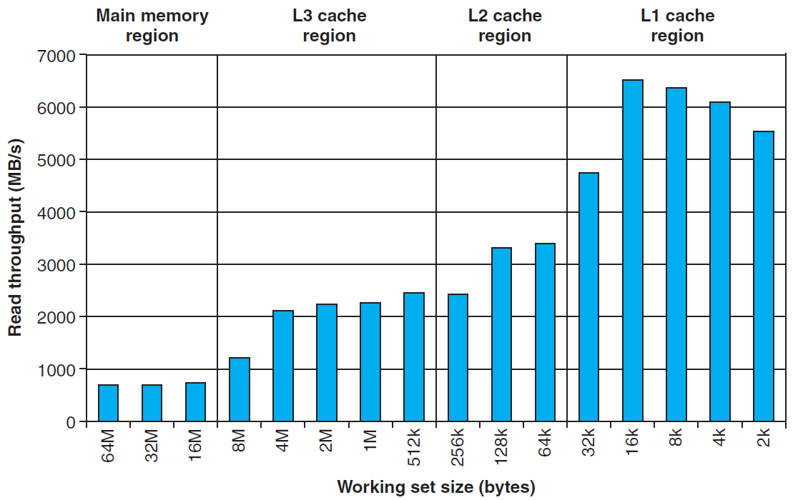
Ridges of temporal locality

Slide 70
A slope of spatial locality
Slice through memory mountain with size=4M
shows cache block size.

Slide 71
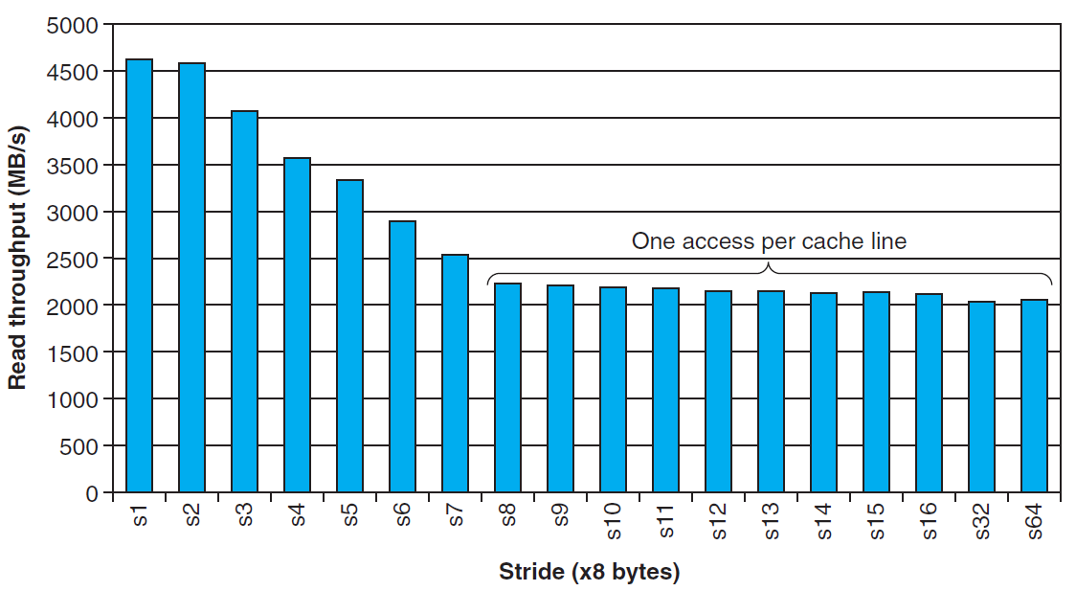
A slope of spatial locality

Slide 72
The Memory Mountain

Slide 73
Interesting Flat Ridge
Extends perpendicular to the stride axis for a stride of 1
The read throughput is a relatively flat 12GB/s even though the working set exceeds the capacities of L1 and L2
This is apparently due to a hardware prefetching mechanism

