Slide 1
Modern Processors

Slide 2
Outline
Understanding Memory Performance
Suggested reading
5.12

Slide 3
Instruction Control
Fetch
Control
Address
Instruction
Cache
Retirement
Unit
Instruction
Decode
Instructions
Register
File
Operations
Register Updates
Register renaming
Reorder
buffer
Prediction OK?
Dispatch
Execution
Functional
Units
Branch
Arithmetic operations
Arithmetic operations
Load
Store
Operation Results
Addr.
Addr.
Data
Data
Data
Cache

Slide 4
因为这里的movq指令两个操作数相互依赖，
只有等到load结束才能进行之后的操作，故
总时间取决于单个load运行的时间(latency)
而不是两个load的间隔时间(issues)
Load Performance
load unit can only initiate one load operation every clock cycle (Issue=1.0)
typedef struct ELE {
struct ELE *next ;
int data ;
} list_ele, *list_ptr ;
long list_len(list_ptr ls) {
long len = 0 ;
while (ls) {
len++ ;
ls = ls->next;
}
return len ;
}
len in %rax, ls in %rdi
.L3:
addq $1, %rax
movq (%rdi), %rdi
testq %rdi, %rdi
jne .L3
Function CPE
list_len 4.0
load latency 4.0
实验得出

Slide 5
Store Performance
store unit can only initiate one store operation every clock cycle (Issue=1.0)(只有一个store unit)
void array_clear(int *dest, int n)
{
int i;
int limit = n-3;
for (i = 0; i < limit; i++)
dest[i] = 0;
}
Function CPE
array_clear 1.0

Slide 6
Store Performance
void write_read(long *src,
long *dest, long n)
{
long cnt = n;
long val = 0;
while (cnt) {
*dest = val;(store)
val = (*src)+1;(load)
cnt--;
}
}
Example A: write_read(&a[0],&a[1],3)
initial
Iter.1
Iter.2
Iter.3
cnt
3
2
1
0
a
-10
17
-10
0
-10
-9
-10
-9
val
0
-9
-9
-9
Example B: write_read(&a[0],&a[0],3)
(有dependency)
initial
Iter.1
Iter.2
Iter.3
cnt
3
2
1
0
a
-10
17
0
17
1
17
2
17
Function CPE
Example A 1.3
Example B 7.3
val
0
1
2
3

Slide 7
Instruction Control Unit
Retirement Unit
Keep track of the ongoing processing
Obey the sequential semantics of the machine-level program (misprediction & exception)
Instruction Control
Fetch
Control
Address
Instruction
Cache
Retirement
Unit
Instruction
Decode
Instructions
Register
File
Operations
Register Updates
Prediction OK?

Slide 8
Instruction Control Unit
Instruction Retired/Flushed
Place instructions into a first-in, first-out queue
Retired: any updates to the memory being made
Operations of the instruction have completed
Any branch prediction to the instruction are confirmed correctly
Flushed: discard any results have been computed
Some branch prediction was mispredicted
Mispredictions can’t alter the program state

Slide 9
Store Units
Store Unit
Store buffer
address
data
是未完成的指令
对应的addr与data
Address
Data
Data Cache

Slide 10
Multi-functional Units
Multiple Instructions Can Execute in Parallel
Haswell CPU (Core i7)
0. Integer arithmetic, FP multiplication, integer and FP division, branches
1. Integer arithmetic, FP addition, integer multiplication, FP multiplication
2. Load, address computation
3. Load, address computation
4. Store
5. Integer arithmetic(basic operations)
6. Integer arithmetic, branches
7. Store address computation(用于匹配缓存中的address来获取缓存中对应的data)
Integer arithmetic: addition, bitwise operations, shifting

Slide 11
Load and Store Units
store buffer主要是用于load与store的操作
数(或结果)相互依赖的情况。可以理解为，
之前Y86中的为了防止依赖性数据的取值出错
而采用的forwarding(ByPass)操作
Load
Unit
Store Unit
Store buffer
(先尝试)
address
data
address
Matching
addresses
Data
Address
Data
Address
Data
Data Cache

Slide 12
Graphical Representation
%rax
%rdi
%rsi
%rdx
s_addr
movq %rax,(%rsi)
s_data
load
movq (%rdi), %rax
add
addq $1,%rax
sub
subq $1,%rdx
jne
jne loop
%rax
%rdi
%rsi
%rdx
//inner-loop
while (cnt) {
*dest = val;
val = (*src)+1;
cnt--;
}

Slide 13
Graphical Representation
%rax
%rdi
%rsi
%rdx
%rax
%rdx
1
s_addr
s_data
s_data
2
load
3
load
sub
add
sub
add
jg
%rax
%rdx
%rax
%rdx
3号线是虚线是因为这个data可能直接从store buffer中取出
(addr matches)。

Slide 14
Graphical Representation
Example A
Example B
Critical Path
s_data
s_data
load
load
add
sub
add
sub
Function bounds
Example A 1
Example B 7
s_data
s_data
load
load
add
sub
add
sub
Notes:
Dependence on addresses of store and load

Slide 15
Getting High Performance
Good compiler and flags
Look carefully at innermost loops
Write compiler-friendly code
Watch out for optimization blockers:
procedure calls & memory references
Tune code for machine
Exploit instruction-level parallelism
Avoid unpredictable branches
Make code cache friendly

Slide 16
Performance Tuning

Slide 17
Outline
Tuning Performance
Suggested reading
5.14

Slide 18
Program Example
Task
Analyzing the n-gram statistics of a text document
an n-gram is a sequence of n words occurring in a document
reads a text file,
creates a table of unique n-grams
specifying how many times each one occurs
sorts the n-grams in descending order of occurrence

Slide 19
Program Example
Steps
Convert strings to lowercase
Apply hash function
Read n-grams and insert into hash table
Mostly list operations
Maintain counter for each unique n-gram
Sort results
Data Set
Collected works of Shakespeare
965,028 total words, 23,706 unique
N=2, called bigrams
363,039 unique bigrams

Slide 20
Amdahl’s Law
S = T_{old} / T_{new} = 1/[(1-α) + α/k]
S∞ = 1/(1-α)(极限情况,k无穷)
T_{old} = 209.0
α = T_{part} / T_{old} = 203.7 / 209.0 = 0.974
S∞ = 1/(1-α) = 39.0
T_{old} / T_{new} = 209.0 / 5.4 = 38.5
Try to optimize
the most time consuming part of a program
hottest part(即上述的消耗时间最长的一部分程序)
α是可优化的程序占原程序的比例，
k指的是优化之后的性能提高的倍数

Slide 21
Identify the hottest part
Using a very useful method profiling
Compile the program correctly
Run it with typical input data
Collect information from the result
Analysis the result
How much time did execution of a function take?
How many times was a particular function called?

Slide 22
Using GPROF
Step 1: Instrument the program(就相当于生成一个专门记录各项运行时间的文件)
$gcc -Og –pg prog.c –o prog
Adds profiling code to prog, that is ”Instruments” prog.c
Step 2: Run the program
$./prog file.txt
Creates file gmon.out containing statistics
Step 3: Create a report
$gprof prog > myreport
Uses prog and gmon.out to create textual report
Step 4: Examine the report
$cat myreport

Slide 23
Examples
% cumulative self self total
time seconds seconds calls s/call s/call name
97.58 203.66 203.66 1 203.66 203.66 sort_words
2.32 208.50 4.85 965027 0.00 0.00 find_ele_rec
0.14 208.81 0.30 12511031 0.00 0.00 Strlen
Each line describes one function
name: name of the function
%time: percentage of time spent executing this function
cumulative seconds: [skipping, as this isn’t all that useful]
self seconds: time spent executing this function
calls: number of times function was called (excluding recursive)
self s/call: average time per execution (excluding descendents)(即不包括调用其他程序的时间)
total s/call: average time per execution (including descendents)
By default, the timings for library functions are not shown
Notes:
-pg let gcc do instrumentation.
What is s/call. What spent on each call.
Self: Called by itself ,
Total: called by itself and others.

Slide 24
How does gprof work?
Essentially, by randomly sampling the code as it runs
… and seeing what line is running, & what function it’s in
Interval counting(定时地打断程序，检查当前运行位置与当前已经花费的时间)
Maintain a counter for each function
Record the time spent executing this function
Interrupted at regular time (1ms~10ms)
Check which function is executing when interrupt occurs
Increment the counter for this function
The calling information is quite reliable

Slide 25
Example
calling history in the report
Ratio : 158655725/965027 = 164.4
The average length of a list in one hash bucket is 164
index % time self called name
158655725 find_ele_rec [5]
4.85 0.10 965027/965027 insert_string [4]
[5] 2.4 4.85 0.10 965027+158655725 find_ele_rec [5]
0.08 0.01 363039/363039 save_string [8]
0.00 0.01 363039/363039 new_ele [12]
158655725 find_ele_rec [5]

Slide 26
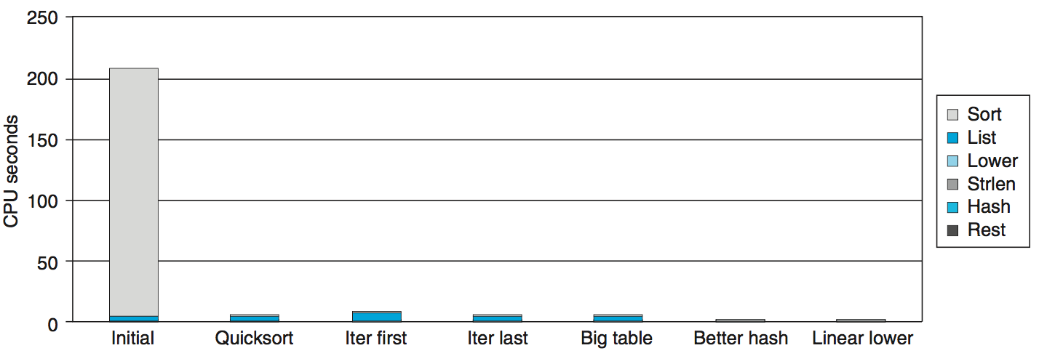
Performance Tuning
Steps to improve execution (time) efficiency:
(1) Do timing studies
(2) Identify hot spots
(3) Use a better algorithm or data structure
(4) Tune the code

Slide 27
Use a Better Algorithm
First step: Use more efficient sorting function
Library function qsort

Slide 28
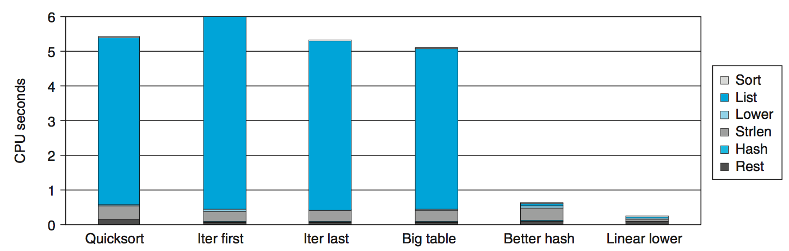
Try Code Optimizations
Replace recursive call to iterative
Insert elements in linked list

Slide 29
Try Code Optimizations
Causes code to slow down
Reason:
Iter first: insert a new element at the beginning of the list
Most common n-grams tend to appear at the end of the list which results the searching time

Slide 30
Try Code Optimizations
Iter last:
iterative function, places new entry at end of the list
Tend to place most common words at front of list

Slide 31
Try Code Optimizations
Initial version: only 1021 buckets.
There are 363039/1021 = 355.6 bigrams in each bucket
Big table: Increase it to 199,999

Slide 32
Try Code Optimizations
Only improves 0.3s
Reason
Hash key is summing character codes for a string
The maximum code is 3371
for “honorificabilitudinitatibus thou”
Cannot differentiate “rat” and “tar”
Most buckets are not used

Slide 33
Try Code Optimizations
Better hash:
Use more sophisticated hash function (Shift and Xor)
Time drops to 0.4 seconds

Slide 34
Optimizaitons
Better hash: Use more sophisticated hash function
Shift and Xor
Time drops to 0.4 seconds
Linear lower: Move strlen out of loop
Time drops to 0.2 seconds

Slide 35
Further Optimizations
Linear lower:
Move strlen out of loop
Time drops to 0.2 seconds

Slide 36
Code Motion
1 /* Convert string to lowercase: slow */
2 void lower1(char *s)
3 {
4 int i;
5
6 for (i = 0; i < strlen(s); i++)
7 if (s[i] >= ’A’ && s[i] <= ’Z’)
8 s[i] -= (’A’ - ’a’);
9 }
10

Slide 37
Code Motion
11 /* Convert string to lowercase: faster */
12 void lower2(char *s)
13 {
14 int i;
15 int len = strlen(s);
16
17 for (i = 0; i < len; i++)
18 if (s[i] >= ’A’ && s[i] <= ’Z’)
19 s[i] -= (’A’ - ’a’);
20 }
21

Slide 38
Code Motion
22 /* Sample implementation of library function strlen */
23 /* Compute length of string */
24 size_t strlen(const char *s)
25 {
26 int length = 0;
27 while (*s != ’\0’) {
28 s++;
29 length++;
30 }
31 return length;
32 }

Slide 39
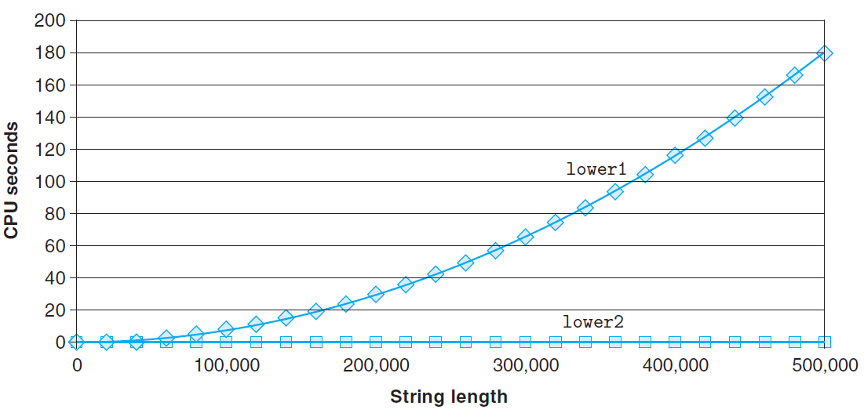
Code Motion

Slide 40
Performance Tuning
Benefits
Helps identify performance bottlenecks
Especially useful when have complex system with many components
Limitations, only shows performance for data tested
if we had run the original function on data consisting of a smaller number of longer strings, we would have found that the lowercase conversion routine was the major performance bottleneck.
Even worse, if it only profiled documents with short words, quadratic inefficiency of lower1 could remain lurking in code
Timing mechanism fairly crude
Only works for programs that run for > 1 seconds

