Slide 1
Relocation and Loading

Slide 2
Outline
Relocation
Executable Object Files
Loading
Suggested reading: 7.7, 7.8, 7.9

Slide 3
ELF relocatable object file format
ELF header
.text
.rodata
.data
.bss
.symtab
Sections
.rel.txt
.rel.data
.debug
.line
Describes
object file
Sections
.strtab
Section header table

Slide 4
Relocation
For each reference to an object with unknown location
Assembler generates a relocation entry
Relocation entries for code are placed in .rel.text
Relocation entries for data are placed in .rel.data

Slide 5
Relocation
In main.o
00<main>:
00: 55 push %rbp
01: 48 89 e5 mov %rsp,%rbp
04: b8 00 00 00 00 mov $0x0,%eax
09: e8 00 00 00 00 callq e <main+0xe>
A swap R_X86_64_PC32 -4
0e: b8 00 00 00 00 mov $0x0,%eax
13: 5d pop %rbp
14: c3 retq

Slide 6
Relocation
In swap.o
00<bufp0>:
00: 00 00 00 00 00 00 00 00
0 buf R_X86_64_64 0
00<bufp1>:

Slide 7
Sections in the ELF object file
.rel.text section
relocation info for .text section
addresses of instructions that will need to be modified in the executable
.rel.data section
relocation info for .data section
addresses of pointer data that will need to be modified in the merged executable

Slide 8
Relocation
Relocation Entry
typedef struct {
long offset ;
long type:32,
symbol:32 ;
long addend;
} Elf64_Rela ;
offset：某个地址的相对于文件头的偏移量
type：相对地址/绝对地址
symbol：是一个整数，从symtab中取出对应的
symbol
addend：某个地址的偏置量

Slide 9
Relocation
9 e8 00 00 00 00 callq e<main+0xe> swap();
There is a relocation entry in rel.text
offset symbol type addend
a swap R_X86_64_PC32 -4
Why PC32?
gcc default mode is the X86_64 small code model which assumes that the total size of the code and data in the executable object file is smaller than 2GB and thus can be accessed at run-time using 32-bit PC-relative addresses
gcc认为解析出来的地址不会超过32bit的范围

Slide 10
Relocation
int *bufp0 = &buf[0] ;
00000000 <bufp0>:
0: 00 00 00 00 00 00 00 00
There is a relocation entry in rel.data
offset symbol type addend
0 buf R_X86_64_64 0

Slide 11
Relocation
Relocation
Merge the input modules
Assign runtime address to each symbol
Two steps
Relocating sections and symbol definitions
Relocating symbol references within sections

Slide 12
Relocation
9 e8 00 00 00 00 callq e<main+0xe> swap();
a: R_X86_64_PC32 swap relocation entry
r.offest = 0xa
r.symbol = swap
r.type = R_X86_64_PC32
r.addend = -4
ADDR(main)=ADDR(.text) = 0x4004d6
ADDR(swap)=0x4004eb
refaddr = ADDR(main)+r.offset = 0x4004e0
ADDR(r.symbol)=ADDR(swap)=0x4004eb
*refptr = (unsigned) (ADDR(r.symbol) + r.addend – refaddr)
= (unsigned) (0x4004eb + (-4) – 0x4004e0)
= (unsigned) 0x7
refaddr指的是要进行relocate的地址
位置。
(指的是main.o在.text中的offset)
PC-relative
(这实际是当前PC地址)

Slide 13
Relocation
00000000 <bufp0>:
0: 00 00 00 00 00 00 00 00 int *bufp0 = &buf[0];
0: R_X86_64_64 buf relocation entry
r.offest = 0x0
r.symbol = buf
r.type = R_X86_64_64
r.addend = 0
ADDR(r.symbol) = ADDR(buf) = 0x601030
*refptr = (unsigned) (ADDR(r.symbol)+ r.addend)
= (unsigned) (0x601030)
0x601038 <bufp0>:
0x601038: 30 10 60 00 00 00 00 00

Slide 14
Relocation
foreach section s {
foreach relocation entry r {
refptr = s + r.offset ; /* ptr to reference to be relocated */
/* relocate a PC-relative reference */
if (r.type == R_X86_64_PC32) {
refaddr = ADDR(s) + r.offset ; /* ref’s runtime address */
*refptr=(unsigned) (ADDR(r.symbol)+r.addend–refaddr) ;
}
/* relocate an absolute reference */
if ( r.type == R_X86_64_64 || r.type == R_X86_64_32||…)
*refptr = (unsigned) (ADDR(r.symbol) + r.addend) ;
}
}

Slide 15
Relocation
601030<buf>:
601030: 01 00 00 00 02 00 00 00
601038<bufp0>:
601038: 30 10 60 00 00 00 00 00
601048<bufp1>:

Slide 16
Relocatable Object Files(swap.o)
00<swap>:
00: 55 push %rbp
01: 48 89 e5 mov %rsp,%rbp
04: 48 c7 05 00 00 00 00 movq $0x0,0x0(%rip) get bufp1
7: R_X86_64_PC32 bufp1 -8
0b: 00 00 00 00 get &buf[1]
b: R_X86_64_32S buf +4(int)
0f: 48 8b 05 00 00 00 00 mov 0x0(%rip),%rax get bufp0
12: R_X86_64_PC32 bufp0 -4
16: 8b 00 mov (%rax),%eax
18: 89 45 fc mov %eax,-0x4(%rbp)
1b: 48 8b 05 00 00 00 00 mov 0x0(%rip),%rax get bufp0
1e: R_X86_64_PC32 bufp0 -4

Slide 17
Relocatable Object Files(swap.o)
22: 48 8b 15 00 00 00 00 mov 0x0(%rip),%rdx get bufp1
25: R_X86_64_PC32 bufp1 -4
29: 8b 12 mov (%rdx),%edx
2b: 89 10 mov %edx,(%rax)
2d: 48 8b 05 00 00 00 00 mov 0x0(%rip),%rax get bufp1
30: R_X86_64_PC32 bufp1 -4
34: 8b 55 fc mov -0x4(%rbp),%edx
37: 89 10 mov %edx,(%rax)
39: 90 nop
3a: 5d pop %rbp
3b: c3 retq

Slide 18
Example (Relocation)
.rel.text
7: R_X86_64_PC32 bufp1 -8
b: R_X86_64_32S buf + 4
12: R_X86_64_PC32 bufp0 -4
1e: R_X86_64_PC32 bufp0 -4
25: R_X86_64_PC32 bufp1 -4
30: R_X86_64_PC32 bufp1 -4
ADDR(swap)=0x4004eb ADDR(buf) = 0x601030
ADDR(bufp0)=0x601038 ADDR(bufp1)=0x601048

Slide 19
Executable Object Files
00000000004004eb <swap>:
4004eb: 55 push %rbp
4004ec: 48 89 e5 mov %rsp,%rbp
4004ef: 48 c7 05 4e 0b 20 00 movq $0x601034,0x200b4e(%rip)
4004f6: 34 10 60 00 (这行是数据不是指令！) bufp1= &buf[1]
4004fa: 48 8b 05 37 0b 20 00 mov 0x200b37(%rip),%rax get bufp0
400501: 8b 00 mov (%rax),%eax
400503: 89 45 fc mov %eax,-0x4(%rbp)
400506: 48 8b 05 2b 0b 20 00 mov 0x200b2b(%rip),%rax get bufp0
40050d: 48 8b 15 34 0b 20 00 mov 0x200b34(%rip),%rdx get bufp1
400514: 8b 12 mov (%rdx),%edx
400516: 89 10 mov %edx,(%rax)
400518: 48 8b 05 29 0b 20 00 mov 0x200b29(%rip),%rax get bufp0
40051f: 8b 55 fc mov -0x4(%rbp),%edx
400522: 89 10 mov %edx,(%rax)

Slide 20
Executable Object Files
400524: 90 nop
400525: 5d pop %rbp
400526: c3 retq
601030<buf>:
601030: 01 00 00 00 02 00 00 00
601038<bufp0>:
601038: 30 10 60 00 00 00 00 00
601048<bufp1>:

Slide 21
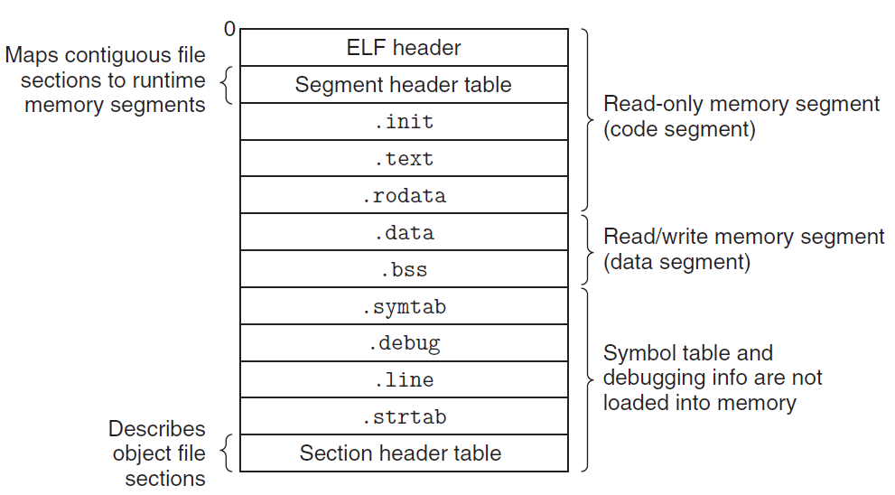
Executable Object Files
与relocatable file相比，多了
segment header table
code segment和
data segment会在
运行时存储在内存中

Slide 22
ELF Header
此处新添加的program header部分即为
segment header的信息
typedef struct{
unsigned char e_ident[16]; /* ELF identification */
Elf64_Half e_type; /* Object file type */
Elf64_Half e_machine; /* Machine type */
Elf64_Word e_version; /* Object file version */
Elf64_Addr e_entry; /* Entry point address */
Elf64_Off e_phoff; /* Program header offset */
Elf64_Off e_shoff; /* Section header offset */
Elf64_Word e_flags; /* Processor-specific flags */
Elf64_Half e_ehsize; /* ELF header size */
Elf64_Half e_phentsize; /* Size of program header entry */
Elf64_Half e_phnum; /* Number of program header entries */
Elf64_Half e_shentsize; /* Size of section header entry */
Elf64_Half e_shnum; /* Number of section header entries */
Elf64_Half e_shstrndx; /* Section name string table index */
} Elf64_Ehdr;

Slide 23
Executable Object File Header
ELF header
Overall information
Entry point
Program (Segment) header table information
Starting point
Size
Size of each entry
Number of entries

Slide 24
Executable Object File Segment Header Table
typedef struct {
Elf64_Word p_type; /* Entry type. */
Elf64_Word p_flags; /* Access permission flags. */
Elf64_Off p_offset; /* File offset of contents. */
Elf64_Addr p_vaddr; /* Virtual address in memory image. */
Elf64_Addr p_paddr; /* Physical address (not used). */
Elf64_Xword p_filesz; /* Size of contents in file. */
Elf64_Xword p_memsz; /* Size of contents in memory. */
Elf64_Xword p_align; /* Alignment in memory and file. */
} Elf64_Phdr;
filesz和memsz可能不相等，比如说.bss区域中的
COMM UNDEFINED类型的symbol在.o文件中
不占空间只是声明，但是在executable文件中将会
有具体的信息(memory中)，因而会产生size的差异

Slide 25
Executable Object File Segment Header Table
p_type
PT_LOAD (1): loadable segment
p_offset
Offset from the beginning of the file to the first byte in the segment
p_vaddr
The virtual address of the first byte in the segment
p_paddr
Not very useful

Slide 26
Executable Object File Segment Header Table
p_filesz
Segment size in the object file (≤p_memsz)
p_memsz
Segment size in the memory (≥p_filesz)
p_flags
Run time permissions (rwx)
p_align
Alignment requirement for the beginning address of the segment
Usually 2**12 or 2**21(2M)

Slide 27
Executable Object Files

Slide 28
2⁴⁷-1
%rsp

Slide 29
ELF format
data segment部分的offset与vaddr相等，说明了
在copy进memory的时候实际上是把整个code+data
segment+header全部一次性copy进去了，即copy一些
并没有很大作用的信息到memory中去。
Read only code segment
LOAD off 0x0000000000000000 vaddr 0x0000000000400000
paddr 0x0000000000400000 align 2**21
filesz 0x000000000000069c memsz 0x000000000000069c
flags r-x
Read/write data segment
LOAD off 0x0000000000000df8 vaddr 0x0000000000600df8
paddr 0x0000000000000df8 align 2**21
filesz 0x0000000000000228 memsz 0x0000000000000230
flags rw
Difference between filesz and memsz means the uninitialized data in .bss
.init section contains a small function _init called by program’s initialization code
_init属于是在程序被copy进内存进行运行之前需要额外运行的部分

Slide 30
Startup code
_start
the entry point of the program
Defined in the crt1.o
Same for all C program
Calls
system startup function
__libc_start_main
Defined in libc.so
Initializes the execution environment
Calls the main function
Handles return value
Returns control to OS (if necessary)

Slide 31
Loading
Unix> ./p
Loader
Memory-resident operating system code
Invoked by call the execve function
Copy the code and data in the executable object file from disk into memory
Jump to the entry point
Run the program

