Slide 1
Replacement Policy

Slide 2
Outline
The Optimal Replacement Policy
The FIFO Policy
The Random Policy
The LRU Policy
Workload Studies
Implementation Issues
Suggested reading: 22

Slide 3
The Optimal Replacement Policy
The best possible replacement policy
developed by Belady many years ago
replacing the page that will be accessed furthest in the future (通过未来情况来确定那个page被替换)
hard to implement(不容易实现)
incredibly useful as a comparison point in simulation or other studies

Slide 4
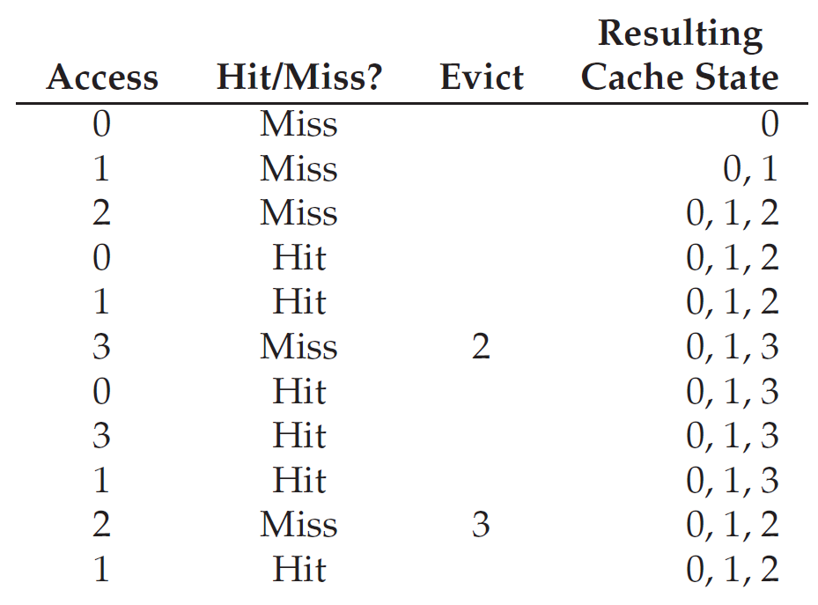
Example
Trace:0, 1, 2, 0, 1, 3, 0, 3, 1, 2, 1
Hit rate = 6/11 = 54.5%
这里的预测未来是指：
每次要进行replace的
时候，要看在这之后的
操作中那一个是最晚被
访问的，就把那个替换
掉

Slide 5
First-In, First-Out Replacement Policy(FIFO)
Hate rate = 4/11 =36.4%

Slide 6
Belady’s Anomaly(异常)
The reference trace is 0,1,2,3,0,1,4,0,1,2,3,4
Time | 1 | 2 | 3 | 4 | 5 | 6 | 7 | 8 | 9 | 10 | 11 | 12
reference string | 0 | 1 | 2 | 3 | 0 | 1 | 4 | 0 | 1 | 2 | 3 | 4
primary device contents | - - - | 0 - - | 0 1 - | 0 1 2 | 1 2 3 | 2 3 0 | 3 0 1 | 0 1 4 | 0 1 4 | 0 1 4 | 1 4 2 | 4 2 3 | pages brought in
remove | - | - | - | 0 | 1 | 2 | 3 | - | - | 0 | 1 | -
bring in | 0 | 1 | 2 | 3 | 0 | 1 | 4 | - | - | 2 | 3 | - | 9

Slide 7
Belady’s Anomaly(异常)
The reference trace is 0,1,2,3,0,1,4,0,1,2,3,4
Time | 1 | 2 | 3 | 4 | 5 | 6 | 7 | 8 | 9 | 10 | 11 | 12
reference string | 0 | 1 | 2 | 3 | 0 | 1 | 4 | 0 | 1 | 2 | 3 | 4
primary device contents | - - - - | 0 - - - | 0 1 - - | 0 1 2 3 | 0 1 2 3 | 0 1 2 3 | 0 1 2 3 | 1 2 3 4 | 2 3 4 0 | 3 4 0 1 | 4 0 1 2 | 0 1 2 3 | pages brought in
remove | - | - | - | - | - | - | 0 | 1 | 2 | 3 | 4 | 0
bring in | 0 | 1 | 2 | 3 | - | - | 4 | 0 | 1 | 2 | 3 | 4 | 10
这个”异常”说的是随着容量的扩大，hit-rate却会出现下降。

Slide 8
Random Replacement Policy
Hate rate = 5/11 =45.5%

Slide 9
Random Replacement Policy
How many hits Random achieves
over 10,000 trials
each with a different random seed
over 40% of the time Random is as good as optimal

Slide 10
LRU Replacement Policy
Lean on the past and use history as our guide
Frequency
if a page has been accessed many times, perhaps it should not be replaced as it clearly has some value
Least-Frequently-Used (LFU)
Replace the least-frequently used page
Recency of access
the more recently a page has been accessed, perhaps the more likely it will be accessed again
Least-Recently-Used (LRU)
Replace the least-recently-used page

Slide 11
LRU Replacement Policy
Hit rate = 6/11 =54.5%

Slide 12
Stack Algorithms
Subset property
For the optimal policy, at all times
the pages it keeps in the 3-page memory
is a subset of that it keeps in the 4-page memory
No Belady’s anomaly if subset property holds
At all times and
For every possible capacity of primary device
It creates a total ordering for pages at a given time

Slide 13
Stack Algorithms for LRU
Time | 1 | 2 | 3 | 4 | 5 | 6 | 7 | 8 | 9 | 10 | 11 | 12
reference string | 0 | 1 | 2 | 3 | 0 | 1 | 4 | 0 | 1 | 2 | 3 | 4
stack contents after reference | 0 - - - - | 1 0 - - - | 2 1 0 - - | 3 2 1 0 - | 0 3 2 1 - | 1 0 3 2 - | 4 1 0 3 2 | 0 4 1 3 2 | 1 0 4 3 2 | 2 1 0 4 3 | 3 2 1 0 4 | 4 3 2 1 0 | number of moves in
size 1 in/out | 0/- | 1/0 | 2/1 | 3/2 | 0/3 | 1/0 | 4/1 | 0/4 | 1/0 | 2/1 | 3/2 | 4/3 | 12
size 2 in/out | 0/- | 1/- | 2/0 | 3/1 | 0/2 | 1/3 | 4/0 | 0/1 | 1/4 | 2/0 | 3/1 | 4/2 | 12
size 3 in/out | 0/- | 1/- | 2/- | 3/0 | 0/1 | 1/2 | 4/3 | -/- | -/- | 2/4 | 3/0 | 4/1 | 10
size 4 in/out | 0/- | 1/- | 2/- | 3/- | -/- | -/- | 4/2 | -/- | -/- | 2/3 | 3/4 | 4/0 | 8
size 5 in/out | 0/- | 1/- | 2/- | 3/- | -/- | -/- | 4/2 | -/- | -/- | -/- | -/- | -/- | 5
move-in的次数实际上就是miss的次数

Slide 14
Random Access Workload
the workload
accesses 100 unique pages over time
choosing the next page to refer to at random
overall 10,000 pages are accessed

Slide 15
Random Access Workload
It doesn’t matter much which realistic policy you are using
LRU, FIFO, and Random all perform the same
the hit rate exactly determined by the size of the cache
When the cache is large enough to fit the entire workload
it also doesn’t matter which policy you use
all policies (even Random) converge to a 100% hit rate when all the referenced blocks fit in cache
不能是精确地100%，因为还有最开始读入时候的cold miss。

Slide 16
Random Access Workload
Optimal performs noticeably better than the realistic policies
peeking into the future if it were possible
does a much better job of replacement

Slide 17
“80-20” Workload
Hot pages
80% of the references
is about to 20% of the pages
Cold pages
the remaining 20% of the references
is about the remaining 80% of the pages
Example
there are a total 100 unique pages
“hot” pages are referred to most of the time
“cold” pages the remainder.

Slide 18
“80-20” Workload

Slide 19
“80-20” Workload
both random and FIFO do reasonably well
LRU does better
it is more likely to hold onto the hot pages
those pages have been referred to frequently in the past
they are likely to be referred to again in the near future
Optimal does best
showing that LRU’s historical information is not perfect
Does LRU do better than random or FIFO?
It depends

Slide 20
“Looping Sequential” Workload
Refer to 50 pages in sequence
start at 0, then 1, ..., up to page 49,
repeat those accesses
for a total of 10,000 accesses to 50 unique pages

Slide 21
“Looping Sequential” Workload
Common in many applications such as databases
A worst case for both LRU and FIFO
kick out older pages
these older pages are going to be accessed sooner than the pages that the policies prefer to keep in cache
even with a cache of size 49, hit rate remains 0%
Random fares notably better
not quite approaching optimal, but at least achieving a non-zero hit rate
not having weird corner-case behaviors
used as TLB replacement policy

Slide 22
How to implement LRU?
Hardware should put a time stamp on each physical page whenever it is accessed
When evicting, it should sort the pages by their time stamps
It may be too many pages to be sorted
One million pages for 4GB memory with 4KB page-size
思路就是这样的，但是直接使用时间戳在page很多的时候对应的
时间戳会占据很多位bits。

Slide 23
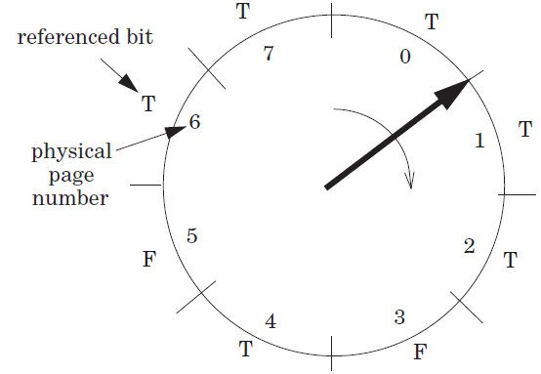
Clock Algorithm
Access bit
a hardware bit for each page
Set to true when accessed
Pages are organized as a clock
Start from a position
Move clockwise and checks the bit page-wise
If T, clear to F
Otherwise, choose as the victim and stop
clock算法相对于LRU的优点
：1.节省时间，不需要进行
额外的对于时间戳的排序
2.节省空间，不需要额外的
对于每个symbol的访问的
时间戳的记录(并且时间戳
占据的位置可能还比较大)

Slide 24
Clock Algorithm
It doesn’t do quite as well as perfect LRU
It does better than approaches that don’t consider history at all
It can use dirty bit to reduce disk writing furthur

Slide 25
Page Selection Policies
When to bring pages into memory?
Demand paging
Prefetching
the OS could
guess a page is about to be used
and bring it in ahead of time
Clustering (grouping)(分组)
Set two numbers as low/high water mark
when available page number is less than the low water mark,
OS begins to evict pages
until the number of available pages reaches the high water mark

Slide 26
Control Thrashing
admission control
not to run some processes
hope to reduce working sets (the pages that they are using actively) to fit in memory
out-of-memory killer
A daemon
choose a memory intensive process and kill it
thus reducing memory
it kills the X server and thus renders any applications requiring the display unusable

Slide 27
Level 1, Level 2 and Level 3 Page Table Entry
63
62
52
51
12
11
9
8
7
6
5
4
3
2
1
0
XD
Unused
Page table physical base addr
Unused
G
PS
A
CD
WT
U/S
R/W
P=1
Available for OS (page table location in secondary storage)
P=0
XD Disable or enable instruction fetches
Base addr 40 most significant bits of base address of child page table (forces page tables to be 4KB aligned)
G global page (don’t evict from TLB on task switch)
PS Page size either 4K or 2M or 1G(may set to 1 only for
Level 2 or level 3 PTEs)
A Reference bit (set by MMU on reads and writes, cleared by software)
CD Cache disabled(1) or enabled(0) for child page table
WT Write-through or write-back cache policy
U/S User or supervisor(kernel) mode access permission
R/W Read-only or read-write access permissiom
P Child page table present in memory(1) or not(0)

Slide 28
Level 4 Page Table Entry
63
62
52
51
12
11
9
8
7
6
5
4
3
2
1
0
XD
Unused
Page table physical base addr
Unused
G
D
A
CD
WT
U/S
R/W
P=1
Available for OS (page table location in secondary storage)
P=0
XD Disable or enable instruction fetches
Base addr 40 most significant bits of base address of child page table (forces page tables to be 4KB aligned)
G global page (don’t evict from TLB on task switch)
D Dirty bit (Set by MMU on writes, cleared by software)
A Reference bit (set by MMU on reads and writes, cleared by software)
CD Cache disabled(1) or enabled(0) for child page table
WT Write-through or write-back cache policy
U/S User or supervisor(kernel) mode access permission
R/W Read-only or read-write access permissiom
P Child page table present in memory(1) or not(0)

Slide 29
Level 2 and Level 3 Page Table Entry
63
62
52
51
12
11
9
8
7
6
5
4
3
2
1
0
XD
Unused
Page table physical base addr
Unused
G
D
A
CD
WT
U/S
R/W
P=1
Available for OS (page table location in secondary storage)
P=0
XD Disable or enable instruction fetches
Base addr 40 most significant bits of base address of child page table (forces page tables to be 4KB aligned)
G global page (don’t evict from TLB on task switch)
D Dirty bit (used in Level 2 or level 3 PTEs for page
size 2M or 1G respectively)
A Reference bit (set by MMU on reads and writes, cleared by software)
CD Cache disabled(1) or enabled(0) for child page table
WT Write-through or write-back cache policy
U/S User or supervisor(kernel) mode access permission
R/W Read-only or read-write access permissiom
P Child page table present in memory(1) or not(0)

Slide 30
Linux Virtual Memory System
Process-specific data structures (e.g. task and mm structs,
page tables, kernel stack)
Different for each process
Kernel virtual memory
Physical memory
Identical for each process
Kernel code and data
User stack
%esp
Memory mapped region for shared libraries
Process virtual memory
brk
Run-time heap (via malloc)
Uninitialized data (.bss)
Initialized data (.data)
Program text (.text)
x08048000 (32) x40000000 (64)

Slide 31
How to Evict Page Table
20
12
It is physical address accessed
Each physical address has a virtual counter part
VPN
VPO
VPN1
VPN2
Mem
PDE
p=0
PDBR
Page directory
Disk
PTE
p=0
data
Page table
Data page

Slide 32
Questions
How does the clock algorithm get the reference bit for Physical Pages?
MMU only sets the access bit in VP.
DMA does not set the A bit, how does the clock algorithm handle these Physical Pages?
1.采用一种数据结构，将此PP对应的所有的VP连接起来，并检查所有VP是否
有A bit被设置为1的，如果有，说明这个PP被访问了，并将A设为0
2.在DMA中，直接不考虑被DMA访问的pages。

