Slide 1
SEQ CPU Implementation

Slide 2
Outline
SEQ Stage Implementation
Suggested Reading 4.3.4

Slide 3
Determinate Values
Fetch
PC Program Count
icode Instr. Code
ifun Instr. Function
rA Instr. Register A
rB Instr. Register B
valC Instr. Constant
valP Incremented PC
Decode
valA Register value A
valB Register value B
Execute
valE ALU result
CC Condition Code
Cnd Condition Flag
Memory
valM Value from Memory
Write back
valE ALU result
valM Value from Memory

Slide 4
Indeterminate Values
Memory
addr address of memory
valA, valE
data data of Memory
valA, valP
Write back
dstE dest. of ALU result
rB, %rsp
dstM dest of Memory
rA
PC
newPC next of PC
valP, valC, valM
Decode
srcA location of valA
rA, %rsp
srcB location of valB
rB, %rsp
Execute
aluA input A of ALU
valA, valC, +8, -8
aluB input B of ALU
valB, 0
, Cnd F

Slide 5
PC
Write back
valM
Memory
Data memory
addrs,data
valE
Cnd
CC
CC
Execute
CC
ALU
aluA,aluB
valA, valB
Decode
srcA, srcB
A B
Register File
M
E
M
dstE,dstM
Register
icode:ifun, rA:rB
valC
valE,
valM
valP
Instruction memory
Fetch
Instruction
PC increment
PC
PC
PC
newPC

Slide 6
newPC
PC
New PC
data out
valM
read
Memory
Mem Control
Data memory
write
Addr
Data
Bch
valE
Execute
CC
ALU
ALU fun
ALUA
ALUB
valA
valB
dstE
dstM
srcA
srcB
Decode
dstE
dstM
srcA
srcB
A
B
M
Register file
E
Write Back
icode
ifun
rA
rB
valC
valP
Instruction Memory
PC increment
Fetch
PC

Slide 7
SEQ Hardware
Blue boxes: predesigned hardware blocks
e.g., memories, ALU
Gray boxes: control logic
Describe in HCL
White ovals: labels for signals
Thick lines: 64-bit word values
Thin lines: 4-8 bit values
Dotted lines: 1-bit values
Notes:
这个图中有些控制信号没有标出来。
似乎PC也应该是蓝色的。

Slide 8
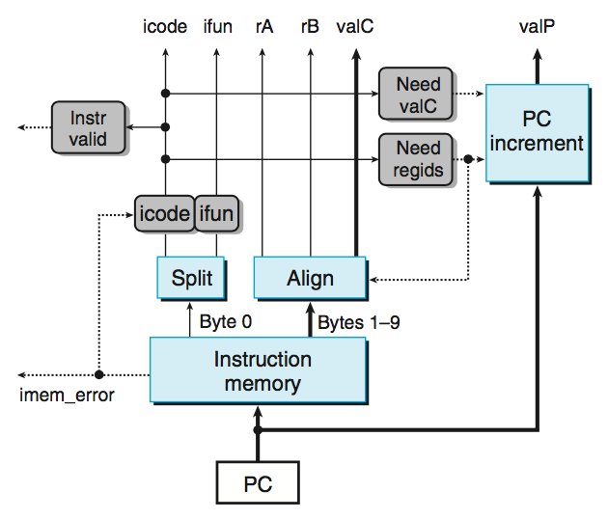
Fetch Logic
要注意图中的各个灰框只是一种表示符号，本质上都是计算机中的
一种信号
need valC与need regids
分别占一个bit，可取0/1
,其具体取值情况有icode
确定。
0,0：PC+1;
0,1:PC+2;
1,0:PC+9;
1,1:PC+10;
PC:valC valP valM
Notes:
事实上，不管需要几个字节，读入都是6个字节。
Split实际上是非常简单的。因为读出的一个字节就是8根信号线，只要将他们分为两股就可以了。
一个问题：Align没有使用Need valC信号，因为如果这条指令没有带常数，那么valC不管产生什么内容都无所谓。但valC到底是1-4字节还是2-5字节却要根据Need regids信号来确定。所以Need regids必须要，而Need valC可以不需要。
这也是一种常用的硬件设计方法：如果我们说一个信号在某种情况下用不到，那么它就可以是任意值。这样通过对它赋予某种赋值可以将他与其他信号合并或者其他简化。这里就是一个例子，valC并不是如果不需要的话，就为0。

Slide 9
Fetch Logic
Predefined Blocks
PC: Register containing PC
Instruction memory: Read 10 bytes (PC to PC+9)
Split: Divide instruction byte into icode and ifun
Align: Get fields for rA, rB, and valC
PC increment: increases PC to valP

Slide 10
Fetch Logic
Control Blocks
Instr. Valid: Is this instruction valid?
Need regids: Does this instruction have a register bytes?
Need valC: Does this instruction have a constant word?
icode|ifun: Set to “nop” if imem_error
注意异常情况的处理！

Slide 11
Some Macros(使用这些宏来表示不同形式指令)
Name | Value | Meaning
IHALT | 0 | Code for halt instruction
INOP | 1 | Code for nop instruction
IRRMOVQ | 2 | Code for rrmovq instruction
IIRMOVQ | 3 | Code for irmovq instruction
IRMMOVQ | 4 | Code for rmmovq instruction
IMRMOVQ | 5 | Code for mrmovq instruction
IOPQ | 6 | Code for integer op instructions
IJXX | 7 | Code for jump instructions
………… | …… | ……………………………
IPOPQ | B | Code for popq instruction
Notes:
用在HCL中表示指令、寄存器、操作符类型

Slide 12
Some Macros
Name | Value | Meaning
RRSP | 4 | Register ID for %rsp
FNONE | 0 | Default Function Code
RNONE | F | Indicates no register file access
ALUADD | 0 | Function for addition operation
SAOK | 1 | Status code for normal operations
SADR | 2 | Status code for address exception
SINS | 3 | Status code for illegal instruction Exception
SHLT | 4 | Status code for halt
Notes:
用在HCL中表示指令、寄存器、操作符类型

Slide 13
nop
nop
halt
0
0
0
0
0
0
0
0
halt
halt
nop
1
1
1
1
0
0
0
0
rA
rA
rA
rB
rB
rB
rA
rA
rA
rA
rB
rB
rB
2
rB
2
2
2
0
0
0
rrmovl
0
rrmovl
rrmovq
,
,
,
V
V
V
rB
rB
rB
rB
rB
rB
rB
V
V
3
V
3
3
3
0
0
0
0
8
8
8
irmovl
8
irmovl
irmovq
,
,
,
rA
rA
rA
D
D
D
rB
rB
rB
rA
rA
rA
rA
rB
rB
rB
rB
D
D
4
D
4
4
4
0
0
0
rmmovl
0
rmmovl
rmmovq
,
,
,
(
(
(
)
)
)
D
D
D
rB
rB
rB
rA
rA
rA
rA
rA
rA
rA
rB
rB
rB
rB
D
D
5
D
5
5
5
0
0
0
mrmovl
0
mrmovl
mrmovq
(
(
(
),
),
),
rA
rA
rA
rB
rB
rB
fn
fn
fn
fn
rA
rA
rA
rA
rB
rB
rB
6
rB
6
6
OPl
6
OPl
OPq
,
,
,
Dest
Dest
Dest
fn
fn
fn
fn
Dest
Dest
7
Dest
7
7
jXX
7
jXX
jXX
Dest
Dest
Dest
Dest
Dest
8
Dest
8
8
8
0
0
0
call
0
call
call
ret
ret
ret
9
9
9
9
0
0
0
0
rA
rA
rA
rA
rA
rA
A
rA
A
A
A
0
0
0
0
8
8
8
pushl
F
pushl
pushq
rA
rA
rA
rA
rA
rA
B
rA
B
B
B
0
0
0
0
8
8
8
popl
F
popl
popq
need_regids

Slide 14
Fetch Control Logic
bool need_regids = icode in { IRRMOVQ, IIRMOVQ, IRMMOVQ, IMRMOVQ, IOPQ, IPUSHQ, IPOPQ };
bool instr_valid = icode in { IHALT, INOP, IRRMOVQ, IIRMOVQ, IRMMOVQ, IMRMOVQ, IOPQ, IJXX, ICALL, IRET, IPUSHQ, IPOPQ };

Slide 15
Fetch Control Logic
Practice Problem
need_valC
icode
int icode = [
imem_error: INOP;
1: icode0;
]
若出错则认为该指令为空，什么都不做

Slide 16
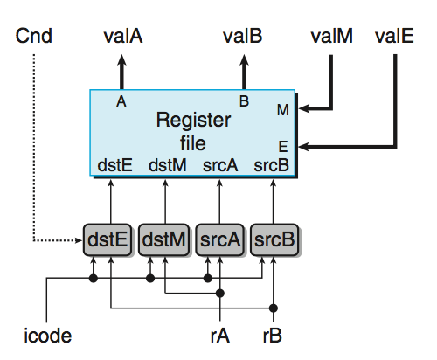
Decode(Read) & Write-Back(Write) Logic
Notes:
因为Decode阶段和Write Back阶段都主要是在操作register file，所以我们把他们合在一起讲。
写口E是用来写Execute阶段来的结果的，写口M是用来写Memory阶段来的结果的。
这里主要是要处理4个读写信号的地址。
当dstE和dstM相同时（这发生在popl %esp时），根据语义，应该是使用valM的值。

Slide 17
Decode & Write Back Logic
Predefined Blocks
Registers File
Read ports A, B & Write ports E, M
Addresses are register IDs or F (no access)

Slide 18
Decode & Write Back Logic
Cnd:
How to set dstE (cmovXX)
Control Logic
srcA: read port address for valA {rA, %rsp}
srcB: read port address for valB {rB, %rsp}
dstE: write port address for valE {rB, %rsp}
dstM: write port address for valM {rA}

Slide 19
A Source
opq rA, rB
Decode
valA ← R[rA]
Read operand A
rmmovq rA, D(rB)
Decode
valA ← R[rA]
Read operand A
popq rA
Decode
valA ← R[%rsp]
Read stack pointer
jXX Dest
Decode
No operand
call Dest
Decode
No operand
ret
Decode
valA ← R[%rsp]
Read stack pointer
Notes:
具体的表见P283-284

Slide 20
A Source
int srcA = [
icode in { IRRMOVQ, IRMMOVQ, IOPL, IPUSHQ } : rA;
icode in { IPOPQ, IRET } : RRSP;
1 : RNONE; # Don't need register
];
Notes:
具体的表见P283-284

Slide 21
E Destination
opq rA, rB
Write-back
R[rB] ← valE
Write back result
rmmovq rA, D(rB)
Write-back
None
popq rA
Write-back
R[%rsp] ← valE
Update stack pointer
jXX Dest
Write-back
None
call Dest
Write-back
R[%rsp] ← valE
Update stack pointer
ret
Write-back
R[%rsp] ← valE
Update stack pointer

Slide 22
E Destination
int dstE = [
icode in { IRRMOVQ, IIRMOVQ,
IOPQ} : rB;
icode in { IPUSHQ, IPOPQ, ICALL,
IRET }: RRSP;
1 : RNONE; # Don't need register
];
// How to consider cmovXX ?
icode==IRRMOVQ&&ifun&&Cnd:rB;

Slide 23
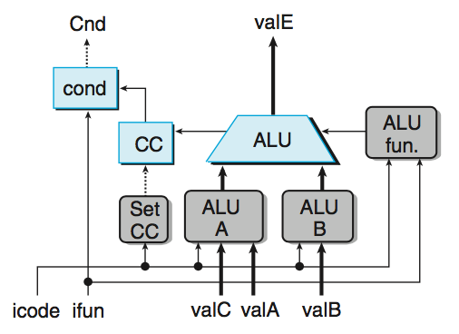
Execute Logic
Notes:
Set CC信号表示CC寄存器是否需要被更新。

Slide 24
Execute Logic
Predefined Blocks
ALU: implements 4 required functions and generate condition code values
CC: register with 3 condition code bits
cond: computes condition flag

Slide 25
Execute Logic
Control Logical
Set CC: Should condition code register be loaded?
ALU A: Input A to ALU {valA, valC, +8, -8}
ALU B: Input B to ALU {valB, 0}
ALU fun: What function should ALU compute?

Slide 26
ALU A Input
opq rA, rB
Execute
valE ← valB OP valA
Perform ALU operation
rmmovq rA, D(rB)
Execute
valE ← valB + valC
Compute effective address
popq rA
Execute
valE ← valB + 8
Increment stack pointer
jXX Dest
Execute
No operation
call Dest
Execute
valE ← valB + –8
Decrement stack pointer
ret
Execute
valE ← valB + 8
Increment stack pointer

Slide 27
ALU A Input
int aluA = [
icode in { IRRMOVQ, IOPQ } : valA;
icode in { IIRMOVQ, IRMMOVQ,IMRMOVQ} : valC;
icode in { ICALL, IPUSHQ } : -8;
icode in { IRET, IPOPQ } : 8;
# Other instructions don't need ALU
];

Slide 28
ALU Operation
opq rA, rB
Execute
valE ← valB OP valA
Perform ALU operation
rmmovq rA, D(rB)
Execute
valE ← valB + valC
Compute effective address
popq rA
Execute
valE ← valB + (-8)
Increment stack pointer
jXX Dest
Execute
No operation
call Dest
Execute
valE ← valB + (-8)
Decrement stack pointer
ret
Execute
valE ← valB + 8
Increment stack pointer

Slide 29
ALU Operation / Condition Set
int alufun = [
icode == IOPQ : ifun;
1 : ALUADD;
];
Bool set_cc = icode in { IOPQ };
除去opq之外的指令都默认为加法!

Slide 30
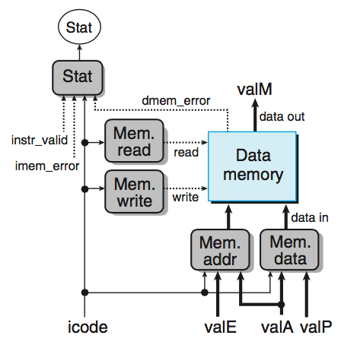
Memory Logic
status状态只在此处设置
read和write操作每次只
能进行一个，即两者不能
同时取到1。
Notes:
Mem read信号和Mem write信号不会同时为1。

Slide 31
Memory Logic
Predefined Blocks
Memory: Reads or writes memory word

Slide 32
Memory Logic
Control Logical
Mem. read: should word be read?
Mem. write: should word be written?
Mem. addr.: Select address {valA, valE}
Mem. data.: Select data {valA, valP}
Stat: Compute the status code

Slide 33
Memory Address
opq rA, rB
Memory
No operation
rmmovq rA, D(rB)
Memory
M₈[valE] ← valA
Write value to memory
popq rA
Memory
valM ← M₈[valA]
Read from stack
jXX Dest
Memory
No operation
call Dest
Memory
M₈[valE] ← valP
Write return value on stack
ret
Memory
valM ← M₈[valA]
Read return address

Slide 34
Memory Address
int mem_addr = [
icode in { IRMMOVQ, IPUSHQ, ICALL, IMRMOVQ } : valE;
icode in { IPOPL, IRET } : valA;
# Other instructions don't need address
];

Slide 35
Memory Read
opq rA, rB
Memory
No operation
rmmovq rA, D(rB)
Memory
M₈[valE] ← valA
Write value to memory
popq rA
Memory
valM ← M₈[valA]
Read from stack
jXX Dest
Memory
No operation
call Dest
Memory
M₈[valE] ← valP
Write return value on stack
ret
Memory
valM ← M₈[valA]
Read return address

Slide 36
Memory Read/Write
bool mem_read = icode in { IMRMOVQ, IPOPQ, IRET };
bool mem_write = icode in { IRMMOVQ, IPUSHQ, ICALL };

Slide 37
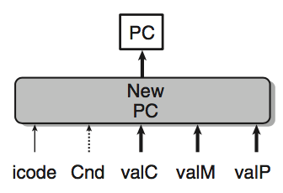
PC Update Logic
New PC
Select next value of PC(SEQ)

Slide 38
PC Update
opq rA, rB
PC update
PC ← valP
Update PC
rmmovq rA, D(rB)
PC update
PC ← valP
Update PC
popq rA
PC update
PC ← valP
Update PC
jXX Dest
PC update
PC ← Cnd ? valC : valP
Update PC
call Dest
PC update
PC ← valC
Set PC to destination
ret
PC update
PC ← valM
Set PC to return address

Slide 39
PC Update
int new_pc = [
icode == ICALL : valC;
icode == IJXX && Cnd : valC;
icode == IRET : valM;
1 : valP;
];

Slide 40
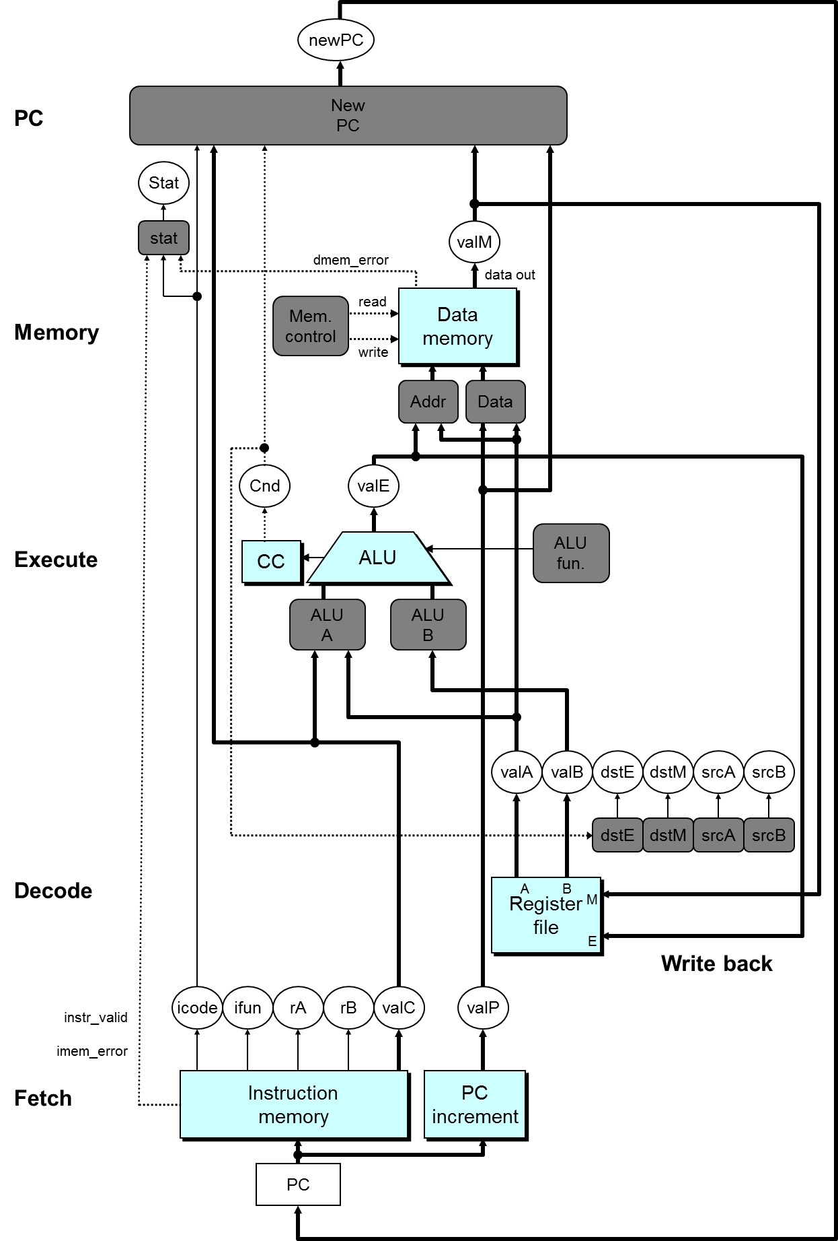

Slide 41
SEQ Summary
Implementation
Express every instruction as series of simple steps
Follow same general flow for each instruction type
Assemble registers, memories, predesigned combinational blocks
Connect with control logic

Slide 42
Limitations of SEQ
Too slow to be practical
Too many tasks needed to finish in one clock cycle
instruction memory, register file, ALU, and data memory
Signals need long time to propagate through all of the stages
The clock must run slowly enough
Does not make good use of hardware units
Every unit is active for part of the total clock cycle

