Slide 1
Outline
Data Hazard
Control Hazard
Suggested Reading 4.5.5

Slide 2
Data Hazard

Slide 3
Data Dependencies in Processors
1 irmovq $50, %rax
2 addq %rax , %rbx
3 mrmovq 100(%rbx),%rdx
Result from one instruction used as operand for another
Read-after-write (RAW) dependency
Very common in actual programs
Must make sure our pipeline handles these properly
Get correct results
Minimize performance impact
但是如果write操作发生在read之后就会出现问题。

Slide 4
Data Dependencies
1
2
3
4
5
6
7
8
F
F
D
D
E
E
M
M
W
W
F
F
D
D
E
E
M
M
W
W
F
F
D
D
E
E
M
M
W
W
F
F
D
D
E
E
M
M
W
W
# demo-h0.ys
0x000:irmovq $10,%rdx
0x00a:irmovq $3,%rax
0x014:addq %rdx,%rax
0x016:halt
Cycle 4
Memory
M_valE=10
M_dstE=%rdx
Execute
e_valE←0+3=3
E_dstE=%rax
•
•
Decode
val←R[%rdx]=0
val←R[%rax]=0
Error

Slide 5
Data Dependencies: 3 Nop’s
1
2
3
4
5
6
7
8
9
10
11
F
F
D
D
E
E
M
M
W
W
F
F
D
D
E
E
M
M
W
W
F
F
D
D
E
E
M
M
W
W
F
F
D
D
E
E
M
M
W
W
F
F
D
D
E
E
M
M
W
W
# demo-h3.ys
0x000:irmovq $10,%rdx
0x00a:irmovq $3,%rax
0x014:nop
0x015:nop
0x016:nop
0x017:addq %rdx,%rax
0x019:halt
F
F
D
D
E
E
M
M
W
W
F
F
D
D
E
E
M
M
W
W
Cycle 6
Write Back
R[%rax]←3
Cycle 7
Decode
通过添加nop指令来延长指令调用的时机来防止错误
val←R[%rdx]=10
val←R[%rax]=3
实质上是等待目标指令对应的clock rise

Slide 6
Data Dependencies: 2 Nop
1
2
3
4
5
6
7
8
9
F
F
D
D
E
E
M
M
W
W
F
F
D
D
E
E
M
M
W
W
F
F
D
D
E
E
M
M
W
W
F
F
D
D
E
E
M
M
W
W
F
F
D
D
E
E
M
M
W
W
# demo-h2.ys
0x000:irmovq $10,%rdx
0x00a:irmovq $3,%rax
0x014:nop
0x015:nop
0x016:addq %rdx,%rax
0x018:halt
F
F
D
D
E
E
M
M
W
W
Cycle 6
Write Back
R[%rax]←3
•
•
Decode
val←R[%rdx]=10
val←R[%rax]=0
Error

Slide 7
Data Dependencies: 1 Nop
1
2
3
4
5
6
7
8
9
F
F
D
D
E
E
M
M
W
W
F
F
D
D
E
E
M
M
W
W
F
F
D
D
E
E
M
M
W
W
F
F
D
D
E
E
M
M
W
W
F
F
D
D
E
E
M
M
W
W
# demo-h1.ys
0x000:irmovq $10,%rdx
0x00a:irmovq $3,%rax
0x014:nop
0x015:addq %rdx,%rax
0x017:halt
Cycle 5
Write Back
R[%rdx]←10
Memory
M_valE=3
M_dstE=%rax
•
•
Decode
val←R[%rdx]=0
val←R[%rax]=0
Error

Slide 8
Data Dependencies: 2 Nop’s
1
2
3
4
5
6
7
8
9
10
11
F
D
E
M
W
F
D
E
M
W
F
D
E
M
W
F
D
E
M
W
# demo-h2.ys
0x000:irmovq $10,%rdx
0x00a:irmovq $3,%rax
0x014:nop
0x015:nop
0x016:addq %rdx,%rax
0x018:halt
F
D
D
E
M
W
F
F
D
E
M
W
Cycle 6
Write Back
W_dstE=%rax
W_valE=3
•
•
•
•
Decode
srcA=%rdx
srcB=%rax

Slide 9
Stalling
1
2
3
4
5
6
7
8
9
10
11
# demo-h2.ys
0x000:irmovq $10,%rdx
0x00a:irmovq $3,%rax
0x014:nop
0x015:nop
bubble
0x016:addq %rdx,%rax
0x018:halt
F
D
E
M
W
F
D
E
M
W
F
D
E
M
W
F
D
E
M
W
E
M
W
F
D
D
E
M
W
F
F
D
E
M
W
每个stall结束之后其后面一定有一个bubble
If instruction follows too closely after one that writes register, slow it down
Hold instruction in decode
Dynamically(动态的) inject nop into execute stage
每个stall后面都必须要添加bubble，
因为要跳过被错误停止的那个stage
对应的指令

Slide 10
Stalling X3
1
2
3
4
5
6
7
8
9
10
11
F
D
E
M
W
F
D
E
M
W
# demo-h0.ys
0x000:irmovq $10,%rdx
0x00a:irmovq $3,%rax
bubble
bubble
bubble
0x014:addq %rdx,%rax
0x016:halt
E
M
W
E
M
W
E
M
W
F
D
D
D
D
E
M
W
F
F
F
F
D
E
M
W
Cycle 6
Write Back
Cycle 5
W_dstE=%rax
stall的都是要出错的
那条指令。
Memory
•
•
•
•
Cycle 4
M_dstE=%rax
Execute
•
•
E_dstE=%rax
Decode
Decode
Decode
srcA=%rdx
srcB=%rax
srcA=%rdx
srcB=%rax
srcA=%rdx
srcB=%rax

Slide 11
Data Forwarding
Observation
Value generated in execute or memory stage
Trick
Pass value directly from generating instruction to decode stage
Needs to be available at end of decode stage

Slide 12
Data Dependencies: 2 Nop’s
1
2
3
4
5
6
7
8
9
10
F
F
D
D
E
E
M
M
W
W
F
F
D
D
E
E
M
M
W
# demo-h2.ys
0x000:irmovq $10,%rdx
0x00a:irmovq $3,%rax
0x014:nop
0x015:nop
0x016:addq %rdx,%rax
0x018:halt
W
F
F
D
D
E
E
M
M
W
W
F
F
D
D
E
E
M
M
W
W
F
F
D
D
E
E
M
M
W
W
F
F
D
D
E
E
M
M
W
W
Cycle 6
Write Back
W_dstE=%rax
W_valE=3
R[%rax]←3
irmovl in W stage
Destination value in W pipeline register
Forward as valB for D stage
•
•
•
•
Decode
srcA=%rdx
srcB=%rax
valA←R[%rdx]=10
valB←W_valE=3

Slide 13
Data Dependencies: 1 Nop
1
2
3
4
5
6
7
8
9
F
F
D
D
E
E
M
M
W
W
F
F
D
D
E
E
M
M
W
W
F
F
D
D
E
E
M
M
W
# demo-h1.ys
0x000:irmovq $10,%rdx
0x00a:irmovq $3,%rax
0x014:nop
0x015:addq %rdx,%rax
0x017:halt
W
F
F
D
D
E
E
M
M
W
W
F
F
D
D
E
E
M
M
W
W
Cycle 5
Write back
W_valE=10
W_dstE=%rdx
Register %rdx
Generated by ALU during previous cycle
Forward from M stage as valA
Register %rax
Value just generated by ALU
Forward from E stage as valB
Memory
M_valE=3
M_dstE=%rax
•
•
Decode
srcA=%rdx
srcB=%rax
val←M_valE=10
val←e_valE=3

Slide 14
Data Dependencies: No Nop
1
2
3
4
5
6
7
8
F
F
D
D
E
E
M
M
W
W
F
F
D
D
E
E
M
M
W
# demo-h0.ys
0x000:irmovq $10,%rdx
0x00a:irmovq $3,%rax
0x014:addq %rdx,%rax
0x016:halt
W
F
这里说明了forward
也可以从当前竖行
来取出来数值来用。
F
D
D
E
E
M
M
W
W
F
F
D
D
E
E
M
M
W
W
Cycle 4
Memory
M_valE=10
M_dstE=%rdx
Register %edx
Generated by ALU during previous cycle
Forward from M stage as valA
Register %eax
Value just generated by ALU
Forward from E stage as valB
Execute
e_valE←0+3=3
E_dstE=%rax
•
•
Decode
srcA=%rdx
srcB=%rax
val←M_valE=10
val←e_valE=3

Slide 15
Bypass Paths
Decode Stage
Forwarding logic selects valA and valB
Normally from register file
Forwarding: get valA or valB from later pipeline stage
Forwarding Sources
Execute: valE
Memory: valE, valM
Write back: valE, valM

Slide 16
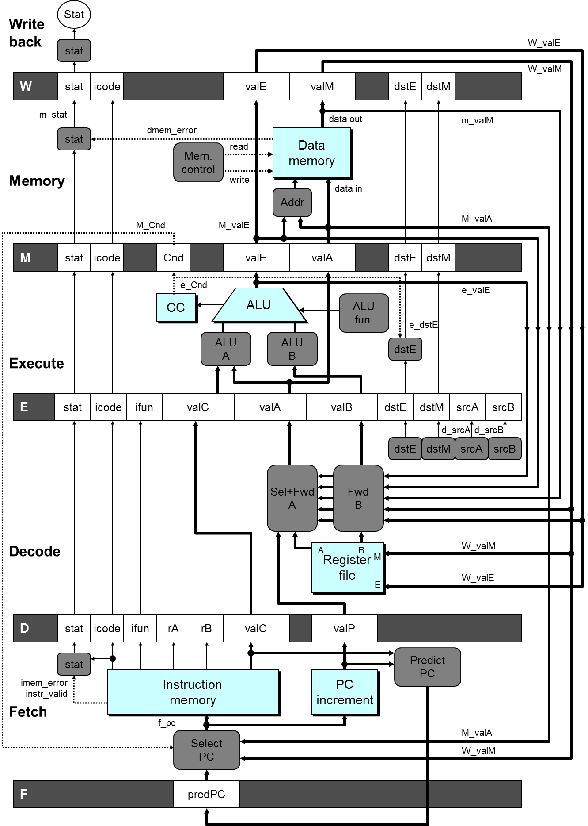

Slide 17
Practice Problem
There is an instruction
addq %rax, %rbx
What happens if the value needed by %rbx exists at several previous stages?
irmovq $1, %rbx
irmovq $2, %rbx
addq %rax, %rbx
应该选最新的那一个

Slide 18
Limitation of Forwarding
1
2
3
4
5
6
7
8
9
10
11
#demo-luh.ys
0x000: irmovq $128, %rdx
0x00a: irmovq $3, %rcx
0x014: rmmovq %rcx, 0(%rdx)
0x01e: irmovq $10, %rbx
#Load %rax
0x028: mrmovq 0(%rdx), %rax
#Use %rax
0x032: addq %rbx, %rax
0x034: halt
Load-use dependency
Value needed by end of D stage in cycle 7
Value read from memory in M stage of cycle 8
F
D
E
M
W
F
D
E
M
W
F
D
E
M
W
F
D
E
M
W
F
F
D
D
E
E
M
M
W
W
F
D
E
M
W
F
D
E
M
W
Cycle 7
Cycle 8
Memory
Memory
load操作一定要等到M stage结束才行。
M_dstE=%rbx
M_valE=10
M_dstM=%rax
m_valM ← M[128]=3
•
•
Decode
valA←M_valM=10
valB←R[%rax]=0
Error
Notes:
Forward可以解决大部分data dependence问题。对于上面的load/use问题，虽然他属于我们已经给出的五种forward数据的来源之一（寄存器的结果来自于内存），应该用forward技术。但因为memory来得太晚，所以addl指令必须要stall才能正确。
推广开来，如果产生数据的源和目的之间的最小stage>1，那么就必须stall。dstE之所以不引起stall是因为dstE的值由execute stage产生，要使用它的是decode stage。两者之间的stage差为1。

Slide 19
Avoiding Load/Use Hazard
1
2
3
4
5
6
7
8
9
10
11
12
F
F
D
D
E
E
M
M
W
W
#demo-luh.ys
0x000: irmovq $128, %rdx
0x00a: irmovq $3, %rcx
0x014: rmmovq %ecx, 0(%rdx)
0x01e: irmovq $10, %rbx
#Load %rax
0x028: mrmovq 0(%rdx), %rax
#Use %rax
0x032: addq %rbx, %rax
0x034: halt
Stall using instruction for one cycle
Can then pick up loaded value by forwarding from memory
F
F
D
D
E
E
M
M
W
W
F
F
D
D
E
E
M
M
W
W
F
F
D
D
E
E
M
M
W
W
F
F
F
D
D
D
E
E
E
M
M
M
W
W
W
E
M
W
F
D
D
E
M
W
F
F
D
E
M
W
Cycle 8
Write Back
W_dstE=%rbx
W_valE=10
Memory
M_dstM=%rax
m_valM ← M[128]=3
•
Decode
valA←W_valM=10
valB←m_valM=3

Slide 20
Control Hazard

Slide 21
Control Dependence
Example:
loop:
subq %rdx, %rbx
jne targ
irmovq $10, %rdx
jmp loop
targ:
halt
The jne instruction create a control dependency
Which instruction will be executed?

Slide 22
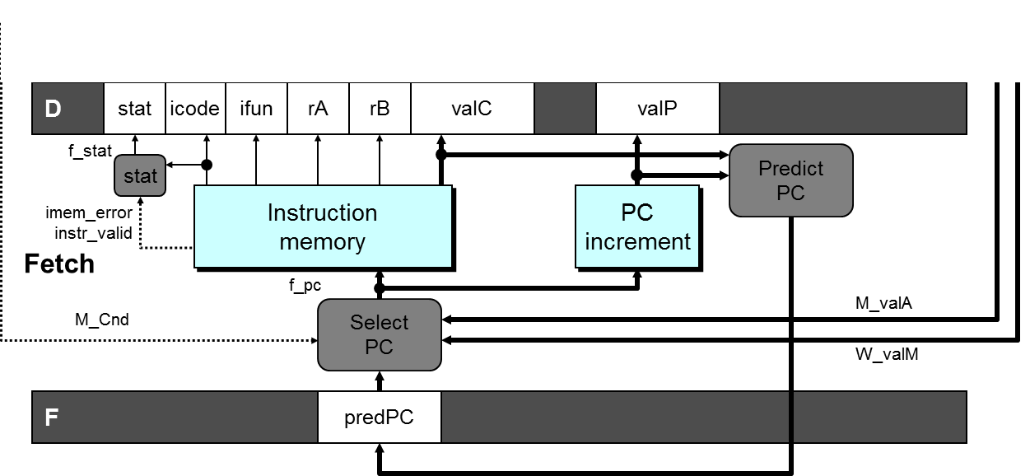
Predict PC
int F_predPC = [
f_icode in {IJXX, ICALL} : f_valC;
1: f_valP;
];

Slide 23
Select PC
int f_PC = [
#mispredicted branch. Fetch at incremented PC
M_icode == IJXX && !M_Cnd : M_valA;
#completion of RET instruciton
W_icode == IRET : W_valM;
#default: Use predicted value of PC
1: F_predPC
];
Notes:
对于mispredicted的情况，因为默认是跳转，所以这时该执行的指令地址是branch指令的下一条指令。这条指令的地址已经被放在valA中传递到了
Memory阶段，所以要从M_valA中恢复。
在实际中要根据预测的方法来确定new_F_predPC和f_PC的计算方法。关键的一点是预测时必须保证另一个出口地址被妥善的保存好。

Slide 24
Practice Problem
Does the order matter?
ret
jg target

Slide 25
Return Example
#demo-retB.ys
0x000: irmovq Stack,%rsp # Intialize stack pointer
0x00a: call p # Procedure call
0x013: irmovq $5,%rsi # Return point
0x01d: halt
0x020: .pos 0x20
0x020: p: irmovq $-1,%rdi # procedure
0x02a: ret
0x02b: irmovq $1,%rax # Should not be executed
0x035: irmovq $2,%rcx # Should not be executed
0x03f: irmovq $3,%rdx # Should not be executed
0x049: irmovq $4,%rbx # Should not be executed
0x100: .pos 0x100
0x100: Stack: # Stack: Stack pointer
Previously executed three additional instructions

Slide 26
Incorrect Return Example
1
2
3
4
5
6
7
8
9
1: 0x02a: ret
2: 0x02b: irmovq $1,%rax #Oops
3: 0x035: irmovq $2,%rcx #Oops
4: 0x03f: irmovq $3,%rdx #Oops
5: 0x013: irmovq $5,%rsi #Ret point
F
D
E
M
W
F
D
E
M
W
F
D
E
M
W
F
D
E
M
W
F
F
D
D
E
E
M
M
W
W
Cycle 5
Write Back
W_ValM=0x013
Memory
Incorrectly execute 3 instructions following ret
M_valE=1
M_dstE=%rax
Excute
e_valEf2
E_dstE=%rcx
为何不使用m_valM来作为forwarding的值？
因为F stage在一开始就要取PC，而m_valM要在
M stage的结尾才能得到，两者不同步，所以
仍然会错，所以选择W_valM.
Decode
D
D_valC=3
D_dstE=%rdx
Fetch
F
f_valCf5
rBf%rsi
Notes:
在ret知道正确的返回地址之前，流水线中已经有三条错误的指令被读入了。（因为ret知道返回地址是在memory stage，这时在fetch, decode, execute stage各有一条指令在执行）

Slide 27
Correct Return Example
1
2
3
4
5
6
7
8
9
#demo_retb
1: 0x02a: ret
2: bubble
3: bubble
4: bubble
5: 0x013: irmovq $5, %rsi #return
F
D
E
M
W
F
D
E
M
W
F
D
E
M
W
F
D
E
M
W
F
F
D
D
E
E
M
M
W
W
As ret passes through pipeline, stall at F stage
While in D, E, and M stage
fetch the same instruction after ret 3 times.
Inject bubble into D stage
Release stall when reach W stage
Cycle 5
Write Back
W_ValM=0x013
•
•
•
Fetch
F
f_valCf5
rBf%rsi

Slide 28
Branch Misprediction Example
#demo-j.ys
0x000: xorq %rax,%rax
0x002: jne t # Not taken
0x00b: irmovq $1, %rax # Fall through
0x015: halt
0x016: t: irmovq $2, %rdx # Target (Should not execute)
0x020: irmovq $3, %rbx # Should not execute
0x02a: halt
Should only execute first 4 instructions

Slide 29
Select PC
int f_PC = [
#mispredicted branch. Fetch at incremented PC
M_icode == IJXX && !M_Cnd : M_valA;
#completion of RET instruciton
W_icode == IRET : W_valM;
#default: Use predicted value of PC
1: F_predPC
];
Notes:
对于mispredicted的情况，因为默认是跳转，所以这时该执行的指令地址是branch指令的下一条指令。这条指令的地址已经被放在valA中传递到了
Memory阶段，所以要从M_valA中恢复。
在实际中要根据预测的方法来确定new_F_predPC和f_PC的计算方法。关键的一点是预测时必须保证另一个出口地址被妥善的保存好。

Slide 30
Branch Misprediction Trace
1
2
3
4
5
6
7
8
9
1: 0x000: xorq %rax,%rax
2: 0x002: jne T # Not taken
3: 0x016: irmovq $2, %rdx # T
4: 0x020: irmovq $3, %rbx # T+1
F
D
E
M
W
F
D
E
M
W
F
D
E
M
W
F
D
E
M
W
F
F
D
D
E
E
M
M
W
W
# demo-j.ys
0x000: xorq %rax,%rax
0x002: jne T # Not taken
0x00b: irmovq $1, %rax
0x015: halt
0x016: T:irmovq $2, %rdx
0x020: irmovq $3, %rbx
0x02a: halt
Cycle 5
Memory
M_Cnd=0
M_valA=0x00b
Excute
e_valEf2
E_dstE=%rdx
Decode
D
D_valC=3
D_dstE=%rbx
Incorrectly execute two instructions at branch target
Fetch
F
Notes:
在M中的是jne，M_Bch=0表示不跳转，M_valA表示下一条指令地址是0x007。
RISC中规定一条branch指令之后总会执行一条指令就是为了减少这个问题造成的性能损失。
因为在execute阶段可以算出不跳转，这样在下一个阶段会执行正确的指令，但已经执行了两条错误指令了。

Slide 31
Branch Misprediction Trace
1
2
3
4
5
6
7
8
9
1: 0x000: xorq %rax,%rax
2: 0x002: jne T # Not taken
3: 0x016: irmovq $2, %rdx # T
4: 0x020: irmovq $3, %rbx # T+1
5: 0x00b: irmovq $1, %rax # Fall Through
F
D
E
M
W
F
D
E
M
W
F
D
E
M
W
F
D
E
M
W
F
F
D
D
E
E
M
M
W
W
# demo-j.ys
0x000: xorq %rax,%rax
0x002: jne T # Not taken
0x00b: irmovq $1, %rax
0x015: halt
0x016: T:irmovq $2, %rdx
0x020: irmovq $3, %rbx
0x02a: halt
Cycle 5
Memory
M_Cnd=0
M_valA=0x00b
Excute
e_valEf2
E_dstE=%rdx
Decode
D
D_valC=3
D_dstE=%rbx
Incorrectly execute two instructions at branch target
Fetch
F
f_valCf1
rBf%rax
Notes:
在M中的是jne，M_Bch=0表示不跳转，M_valA表示下一条指令地址是0x007。
RISC中规定一条branch指令之后总会执行一条指令就是为了减少这个问题造成的性能损失。
因为在execute阶段可以算出不跳转，这样在下一个阶段会执行正确的指令，但已经执行了两条错误指令了。

Slide 32
Practice Problem
Why do we not use the e_cnd?
使用forwarding把e_cnd传递到M_cnd，可以节省一个Cnd Register的位置。
并且e_Cnd会在E stage的结尾才能得到，而F stage要在开始时就判断PC，所以会有
时间上的偏差，所以即使将e_Cnd forwarding回来仍然是错误的。

Slide 33
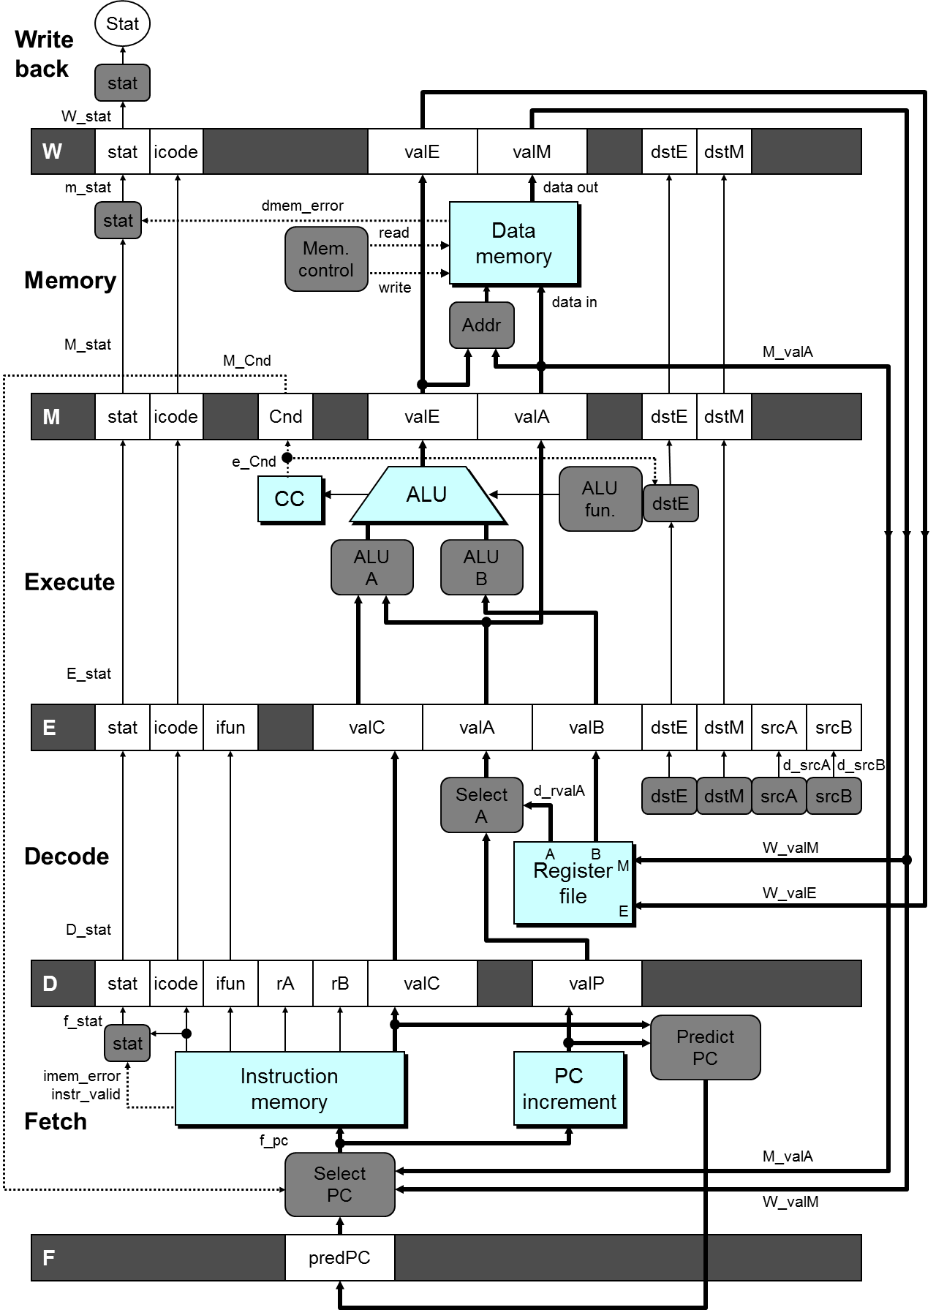

Slide 34
Naïve Method
# demo-j.ys
0x000: xorq %rax,%rax
0x002: jne T # Not taken
0x00b: irmovq $1, %rax
0x015: halt
0x016: T:irmovq $2, %rdx
0x020: irmovq $3, %rbx
0x02a: halt
# demo-j2.ys
0x000: xorq %eax,%eax
0x002: jne T # Not taken
0x00b: irmovq $1, %rax
0x015: halt
0x016: T:nop
0x017: nop
0x018: irmovq $2, %rdx
0x022: irmovq $3, %rbx
0x02c: halt
Notes:
这是control dependency引起问题的一个例子。

Slide 35
Handling Misprediction
#demo-j.ys
1: 0x000: xorq %rax, %rax
2: 0x002: jne T #Not Taken
3: 0x016: irmovq $2, %rdx # T
4: bubble
5: 0x020: irmovq $3, %rbx # T+1
6: bubble
7: 0x00b: irmovq $1, %rax # Fall through
8: 0x015: halt
Predict branch as taken
Fetch 2 instructions at target
Cancel when mispredicted
Detect branch not-taken in execute stage
On following cycle, replace instructions in execute and decode by bubbles
No side effects have occurred yet
1
2
3
4
5
6
7
8
9
10
F
F
D
D
E
E
M
M
W
W
F
F
D
D
E
E
M
M
W
W
F
D
E
M
W
F
D
E
M
W
F
F
D
D
E
E
M
M
W
W
F
F
D
D
E
E
M
M
W
W
这里添加2个bubble的前提是
jXX没有被taken
Notes:
只是简单的取消已经进入流水线的两条指令（通过在execute和decode阶段插入bubble的方法，这就把这两条指令替换掉了）

Slide 36
Outline
Exception Handling
Suggested Reading 4.5.6

Slide 37
Exceptions
Condition: instruction encounter an error condition
Deal flow:
Break the program flow
Invoke the exception handler provided by OS.
(Maybe) continue the program flow
E.g. page fault exception
对于书上实现的这种PIPE结构，当发生exception的时候，后续指令全不执行，当前指令可以被
执行，并且最终会停在发生exception的指令的W stage不动(因为没有exception handler)
Notes:
很重要的一点就是在exception发生时，引起exception的语句之前的语句已经全部执行完毕，而在exception之后的语句还没有被执行。
Precise exception包括exception之间的相互关系，exception的类型, exception的位置等等。

Slide 38
Exceptions
Conditions under which processor cannot continue normal operation
Causes
Halt instruction (Current)
Bad address for instruction or data (Previous)
Invalid instruction (Previous)
Typical Desired Action
Complete some instructions
Either current or previous (depends on exception type)
Discard others
Call exception handler
Like an unexpected procedure call
Notes:
完成当前还是前面的指令，主要是说当出现exception时，首先当前指令（引起exception的指令）之前的指令必须已经完成。然后，看语义决定当前指令要不要完成。

Slide 39
Exception Examples
Detect in Fetch Stage
jmp $-1 # Invalid jump target
.byte 0xFF # Invalid instruction code
halt # Halt instruction
Detect in Memory Stage
irmovq $100,%rax
rmmovq %rax,0x10000(%rax) # invalid address

Slide 40
Exceptions in Pipeline Processor #1
# demo-exc1.ys
irmovq $100,%rax
rmmovq %rax,0x10000(%rax) # invalid address
nop
nop
halt # Halt instruction
Exceptions triggered simultaneously.
Which one should be reported?
The first one
exception会使得之后的指令无法进行。

Slide 41
Exceptions in Pipeline Processor #2
# demo-exc2.ys
irmovq $100,%rax
rmmovq %eax,0x10000(%rax) # Invalid address
nop
.byte 0xFF # Invalid instruction code
1
2
3
4
5
0x000: irmovq $100,%rax
F
D
E
M
W
0x00a: rmmovq %rax,0x10000(%rax)
F
D
E
M
0x014: nop
F
D
E
0x015: .byte 0xFF
F
D
Exception detected
Desired Behavior
rmmovq should cause exception
Following instructions should have no effect on processor stat
Notes:
假定我们不允许访问地址超过0x10000以上的内存。
上图中出现了两个exception. 显然我们希望在比较后面阶段的那条指令（也就是先执行的那条指令）触发的exception

Slide 42
Exceptions in Pipeline Processor #3
# demo-exc3.ys
0x000: xorq %rax,%rax # Set condition codes
0x002: jne t # Not taken
0x00b: irmovq $1,%rax
0x015: irmovq $2,%rdx
0x01f: halt
0x020: t: .byte 0xFF # Target
1
2
3
4
5
6
7
8
9
0x000: xorl %rax,%rax
F
D
E
M
W
0x002: jne t
F
D
E
M
0x020: t: .byte 0xFF
F
D
E
M
W
0x???: (I’m lost!)
F
D
E
M
W
0x00b: irmovq $1,%rax
F
D
E
M
W
Desired Behavior
No exception should occur
Exception detected
Notes:
因为misprediction造成的branch错误，使得本来不该执行的指令执行了。这也可能引发exception。

Slide 43
Exceptions in Pipeline Processor #4
# demo-exc4.ys
0x000: irmovq $1,%rax
0x00a: xorq %rsp,%rsp # Set %rsp to 0 & Set CC to 100
0x00c: pushq %rax # attempt to write 0xfffffffffffffff8
0x00e: addq %rax,%rax #(Should not be executed)
# Would set CC to 000
1
2
3
4
5
6
0x000: irmovq $1, %rax
F
D
E
M
W
0x00a: xorq %rsp, %rsp
F
D
E
M
W
0x00c: pushq %rax
F
D
E
M
0x00b: addq %rax,%rax
F
D
E
Exception detected
Desired Behavior
The fourth instruction should not have side effect
CC set

Slide 44
Maintaining Exception Ordering
W
stat
icode
valE
valM
dstE
dstM
M
stat
icode
Cnd
valE
valA
dstE
dstM
E
stat
icode
ifun
valC
valA
valB
dstE
dstM
srcA
srcB
D
stat
icode
ifun
rA
rB
valC
valP
F
predPC
Add exception status field to pipeline registers
Fetch stage sets to either “AOK”, “ADR” (when bad fetch address), “HLT” (halt instruction) or “INS” (illegal instruction)
Decode & Execute pass values through
Memory either passes through or sets to “ADR”
Exception triggered only when instruction hits Write-back
Notes:
AOK表示合法的指令。其他两种表示错误的指令。
只在Write back阶段才去处理exception，因为指令是顺序流出的，这样exception的先后顺序就保证了。
当某些指令先fetch了，后来又取消了（比如misprediction），那么我们只要简单的将其取消就可以了（连同保存的exception状态）。因为它无法到达Write back阶段，所以也就不会爆出exception.

Slide 45
Avoiding Side Effects
Presence of Exception Should Disable State Update
Invalid instructions are converted to pipeline bubbles
Except have stat indicating exception status
Data memory will not write to invalid address
Prevent invalid update of condition codes
Detect exception in memory stage
Disable condition code setting in execute
Must happen in same clock cycle

Slide 46
Avoiding Side Effects
Presence of Exception Should Disable State Update
Handling exception in final stages
When detect exception in memory stage
Start injecting bubbles into memory stage on next cycle
When detect exception in write-back stage
Stall excepting instruction
Included in HCL code

Slide 47
Rest of Exception Handling
Calling Exception Handler
Push PC onto stack
Either PC of faulting instruction or of next instruction
Usually pass through pipeline along with exception status
Jump to handler address
Usually fixed address
Defined as part of ISA
Implementation
Haven’t tried it yet!

