Slide 1
Machine-Independent Optimization

Slide 2
Outline
Machine-Independent Optimization
Code motion
Memory optimization
Optimizing Blockers
Memory alias
Side effect in function call
Suggested reading
5.2 ~ 5.6, 5.1

Slide 3
Motivation
Constant factors matter too!
easily see 10:1 performance range depending on how code is written
must optimize at multiple levels
algorithm, data representations, procedures, and loops

Slide 4
Motivation
Understand system to optimize performance
how programs are compiled and executed
how to measure program performance and identify bottlenecks
how to improve performance without destroying code modularity and generality

Slide 5
Time Scales
Absolute Time
Typically use nanoseconds: 10^{–9} seconds
Time scale of computer instructions
Clock Cycles
Typical Range
100 MHz
10⁸ cycles per second, clock period = 10ns
2 GHz
2 X 10⁹ cycles per second, clock period = 0.5ns
对一个程序性能的描述：
1.绝对时间
2.cycle的数量

Slide 6
Cycles Per Element
Convenient way to express performance of program that operators on vectors or lists
Length = n
T = CPE*n + Overhead

Slide 7
CPE
1 void psum1(float a[], float p[], long n)
2 {
3 long i;
4
5 p[0] = a[0] ;
6 for (i = 1; i < n; i++)
7 p[i] = p[i-1] + a[i];
8 }
9

Slide 8
CPE
10 void psum2(float a[], float p[]; long n)
11 {
12 long i;
13 p[0] = a[0] ;
14 for (i = 1; i < n-1; i+=2) {
15 float mid_val = p[i-1] + a[i] ;
16 p[i] = mid_val ;
17 p[i+1] = mid_val + a[i+1];
18 }
/* For odd n, finish remaining element */
if ( i < n )
p[i] = p[i-1] + a[i] ;
}
loop unrolling

Slide 9
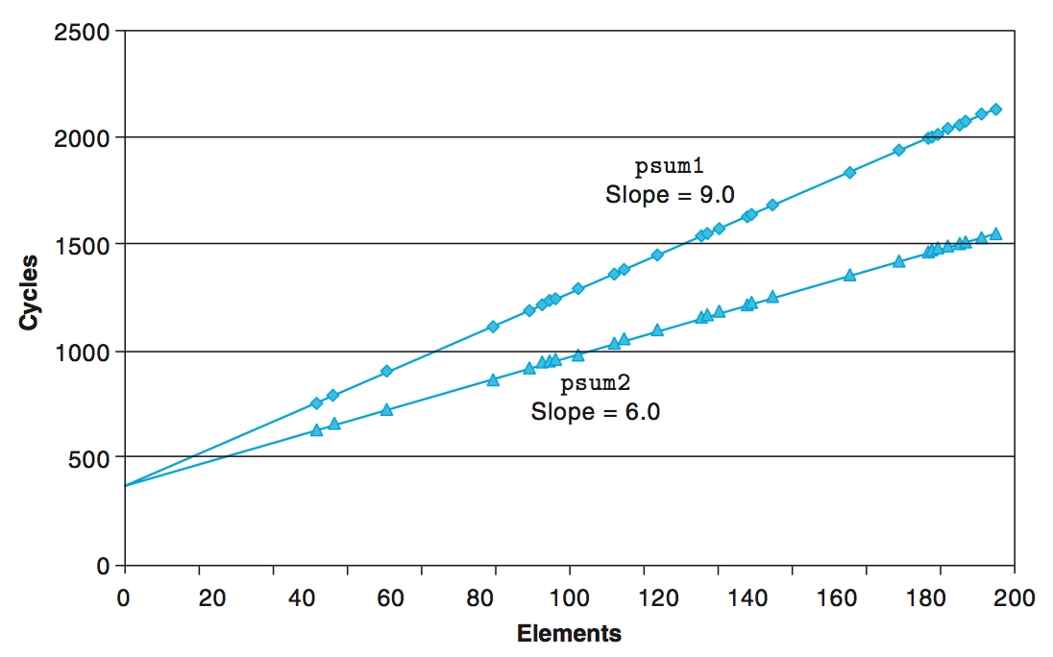
Cycles Per Element

Slide 10
Vector ADT
length
0
1
2
length–1
data
• • •
typedef struct {
long len ;
data_t *data ;
} vec_rec, *vec_ptr ;
typedef long data_t ;

Slide 11
Procedures
vec_ptr new_vec(long len)
Create vector of specified length
long vec_length(vec_ptr v)
Return length of vector
data_t *get_vec_start(vec_ptr v)
Return pointer to start of vector data
long get_vec_element(vec_ptr v, long index, int *dest)
Retrieve vector element, store at *dest
Return 0 if out of bounds, 1 if successful
Similar to array implementations in Pascal, Java
E.g., always do bounds checking

Slide 12
Vector ADT
vec_ptr new_vec(long len)
{
/* allocate header structure */
vec_ptr result = (vec_ptr) malloc(sizeof(vec_rec)) ;
data_t *data = NULL;
if ( !result )
return NULL ; /* Couldn’t allocate storage */
result->len = len ;

Slide 13
Vector ADT
/* allocate array */
if ( len > 0 ) {
data = (data_t *)calloc(len, sizeof(data_t)) ;
if ( !data ) {
free( (void *) result ) ;
return NULL ; /* couldn’t allocte stroage */
}
}
/* Data will either be NULL or allocated array */
result->data = data;
return result ;
}

Slide 14
Vector ADT
/*
* Retrieve vector element and store at dest.
* Return 0 (out of bounds) or 1 (successful)
*/
int get_vec_element(vec_ptr v, long index, data_t *dest)
{
if ( index < 0 || index >= v->len)
return 0 ;
*dest = v->data[index] ;
return 1;
}
总是会进行边界的检查

Slide 15
Vector ADT
/* Return length of vector */
long vec_length(vec_ptr)
{
return v->len ;
}
/* Return pointer to start of vector data */
data_t *get_vec_start(vec_ptr v)
{
return v->data ;
}

Slide 16
Optimization Example
void combine1(vec_ptr v, data_t *dest)
{
long i;
*dest = IDENT;
for (i = 0; i < vec_length(v); i++) {
data_t val;
get_vec_element(v, i, &val);
*dest = *dest OP val;
}
}
Compute sum (product) of all elements of vector
Store result at destination location

Slide 17
Optimization Example
Using different definitions of compile-time constants
#define IDENT 0
#define OP +
#define IDENT 1
#define OP *
typedef long data_t ;
typedef double data_t ;

Slide 18
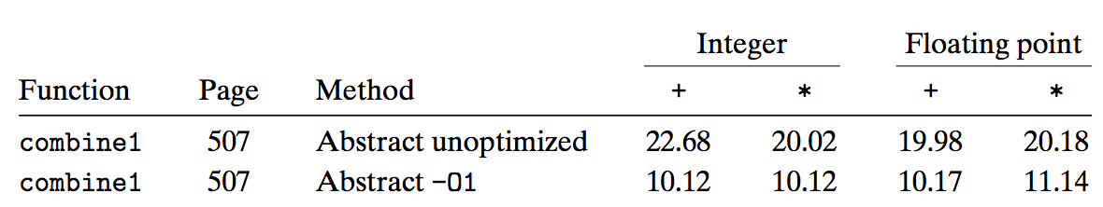
Time Scales
-01是使得编译器自动进行优化的参数

Slide 19
Understanding Loop
void combine1(vec_ptr v, data_t *dest)
{
long i;
*dest = IDENT;
for (i = 0; i < vec_length(v); i++) {
data_t val;
get_vec_element(v, i, &val);
*dest = *dest OP val;
}
}

Slide 20
Understanding Loop
void combine1-goto(vec_ptr v, data_t *dest)
{
long i = 0;
data_t val;
*dest = 0;
if (i >= vec_length(v))
goto done;
loop:
get_vec_element(v, i, &val);
*dest += val;
i++;
if (i < vec_length(v))
goto loop
done:
}
Procedure vec_length called every iteration
Even though result always the same
1 iteration

Slide 21
Code Motion(代码外移)
void combine2(vec_ptr v, data_t *dest)
{
long i;
long length = vec_length(v);(因为每次的结果相同所以不必每次重新计算)
*dest = IDENT;
for (i = 0; i < length; i++) {
data_t val;
get_vec_element(v, i, &val);
*dest = *dest OP val;
}
}

Slide 22
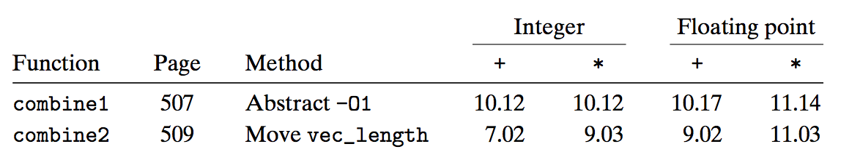
Code Motion
Optimization
Move call to vec_length out of inner loop
Value does not change from one iteration to next
Code motion

Slide 23
Code Motion
1 /* Convert string to lowercase: slow */
2 void lower1(char *s)
3 {
4 long i;
5
6 for (i = 0; i < strlen(s); i++)
7 if (s[i] >= ’A’ && s[i] <= ’Z’)
8 s[i] -= (’A’ - ’a’);
9 }
10

Slide 24
Code Motion
11 /* Convert string to lowercase: faster */
12 void lower2(char *s)
13 {
14 long i;
15 long len = strlen(s);
16
17 for (i = 0; i < len; i++)
18 if (s[i] >= ’A’ && s[i] <= ’Z’)
19 s[i] -= (’A’ - ’a’);
20 }
21

Slide 25
Code Motion
22 /* Sample implementation of library function strlen */
23 /* Compute length of string */
24 size_t strlen(const char *s)
25 {
26 long length = 0;
27 while (*s != ’\0’) {
28 s++;
29 length++;
30 }
31 return length;
32 }
因为strlen函数本身带有循环，故为优化
时性能与优化后的差距明显

Slide 26
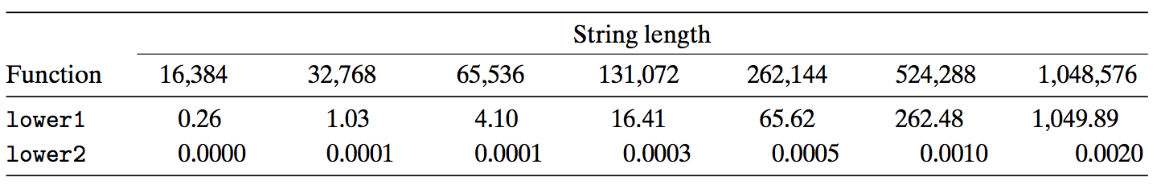
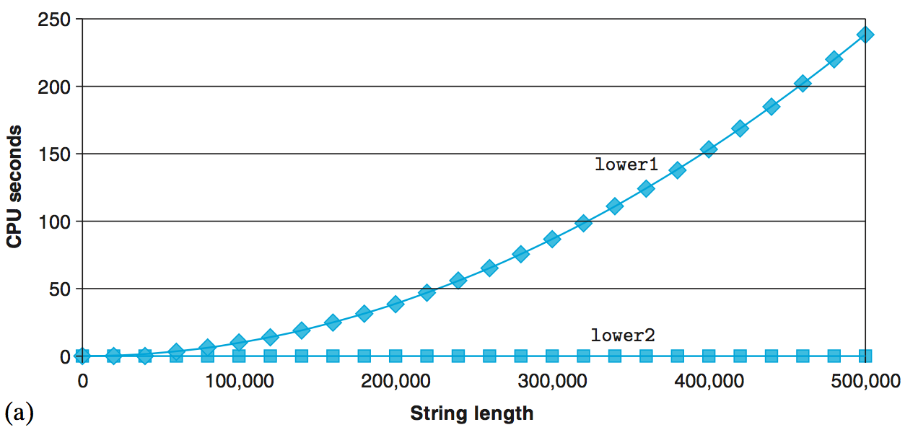
Code Motion

Slide 27
Reduction in Strength(减少运算强度)
void combine3(vec_ptr v, data_t *dest)
{
long i;
long length = vec_length(v);
data_t *data = get_vec_start(v);
*dest = IDENT;
for ( i = 0 ; i < length ; i++ ) {
*dest = *dest OP data[i] ;
}
一般减少的都是从内存中
读取数据的操作。

Slide 28
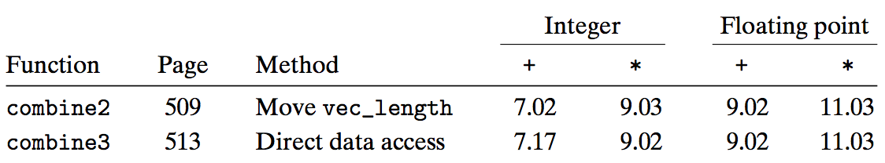
Reduction in Strength
Optimization
Avoid procedure call to retrieve each vector element
Get pointer to start of array before loop
Within loop just do pointer reference
No apparent performance improvement

Slide 29
Eliminate Unneeded Memory References
combine3: data_t = double, OP = *
data+length in %rax, data+i in %rdx, dest in %rbx
1 .L17: loop:
2 vmovsd (%rbx), %xmm0 Read product from dest
3 vmulsd (%rdx), %xmm0, %xmm0 Multiply product by data[i]
4 vmovsd %xmm0, (%rbx) Store product at dest
5 addq $8, %rdx Increment data+i
6 cmpq %rax, %rdx Compare to data+length
7 jne .L17 If !=, goto loop
这种优化一般是相对于汇编而言的。

Slide 30
Eliminate Unneeded Memory References
void combine4(vec_ptr v, data_t *dest)
{
long i;
long length = vec_length(v);
data_t *data = get_vec_start(v);
data_t acc = IDENT;
for (i = 0; i < length; i++)
acc = acc OP data[i];
*dest = acc;
}

Slide 31
Eliminate Unneeded Memory References
combine4: data_t = double, OP = *
data+length in %rax, data+i in %rdx, limit in %rbp, acc in %xmm0
1 .L25: loop:
2 vmulsd (%rdx), %xmm0, %xmm0 Multiply acc by data[i]
3 addq $8, %rdx Increment data+i
4 cmpq %rax, %rdx Compare to data+length
5 jne .L25 If !=, goto loop

Slide 32
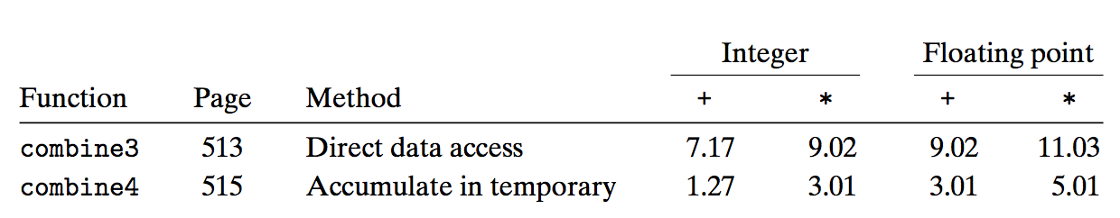
Eliminate Unneeded Memory References
Optimization
Don’t need to store in destination until end
Local variable sum held in register
Avoids 1 memory read, 1 memory write per cycle

Slide 33
Machine Independent Opt. Results
Optimizations
Reduce function calls and memory references within loop

Slide 34
Optimizing Compilers
Provide efficient mapping of program to machine
register allocation
code selection and ordering
eliminating minor inefficiencies

Slide 35
Optimizing Compilers
Don’t (usually) improve asymptotic efficiency
up to programmer to select best overall algorithm
big-O savings are (often) more important than constant factors
but constant factors also matter
Have difficulty overcoming “optimization blockers”
potential memory aliasing
potential procedure side-effects

Slide 36
Optimization Blockers ⎯ Memory aliasing
void twiddle1(int *xp, int *yp)
{
*xp += *yp ;
*xp += *yp ;
}
void twiddle2(int *xp, int *yp)
{
*xp += 2* (*yp) ;
}
对于这两个程序，若两个指针
指向的memory区域不同，则没问题
但是若指向的memory区域相同，就会
出现问题。(既出现了memory重叠的
问题)

Slide 37
Optimization Blockers ⎯ Function call and side effect
int f(int) ;
int func1(x)
{
return f(x)+f(x)+f(x)+f(x) ;
}
int func2(x)
{
return 4*f(x) ;
}

Slide 38
Optimization Blockers ⎯ Function call and side effect
int counter = 0 ;
int f(int x)
{
return counter++ ;
}
对于这个程序，由于对一个全局变量
进行了操作，f(x)+f(x)与2*f(x)结果是不同
的，这就是一种side effect

Slide 39
Optimization Blocker: Memory Aliasing
Aliasing
Two different memory references specify single location
Example
v: [2, 3, 5]
combine3(v, get_vec_start(v)+2) --> ?
combine4(v, get_vec_start(v)+2) --> ?
Function | Intial | Before loop | i=0 | i=1 | i=2 | Final
Combine3 | [2,3,5] | [2,3,1] | [2,3,2] | [2,3,6] | [2,3,36] | [2,3,36]
combine4 | [2,3,5] | [2,3,5] | [2,3,5] | [2,3,5] | [2,3,5] | [2,3,30]

Slide 40
Optimization Blocker: Memory Aliasing
Observations
Easy to have happen in C
Since allowed to do address arithmetic
Direct access to storage structures
Get in habit of introducing local variables
Accumulating within loops
Your way of telling compiler not to check for aliasing

Slide 41
Limitations of Optimizing Compilers
Operate Under Fundamental Constraint
Must not cause any change in program behavior under any possible condition
Often prevents it from making optimizations when would only affect behavior under pathological conditions.

Slide 42
Limitations of Optimizing Compilers
Behavior that may be obvious to the programmer can be obfuscated by languages and coding styles
e.g., data ranges may be more limited than variable types suggest
e.g., using an “int” in C for what could be an enumerated type
When in doubt, the compiler must be conservative

Slide 43
Example
void combine1(vec_ptr v, data_t *dest)
{
long i;
*dest = IDENT;
for (i = 0; i < vec_length(v); i++) {
data_t val;
get_vec_element(v, i, &val);
*dest = *dest OP val;
}
}

Slide 44
Example
void combine2(vec_ptr v, data_t *dest)
{
long i;
long length = vec_length(v);
*dest = IDENT;
for (i = 0; i < length; i++) {
data_t val;
get_vec_element(v, i, &val);
*dest = *dest OP val;
}
}

Slide 45
Example
void combine3(vec_ptr v, data_t *dest)
{
long i;
long length = vec_length(v);
data_t *data = get_vec_start(v);
*dest = IDENT;
for (i = 0; i < length; i++) {
*dest = *dest OP data[i];
}

Slide 46
Example
void combine4(vec_ptr v, data_t *dest)
{
long i;
long length = vec_length(v);
data_t *data = get_vec_start(v);
data_t x = IDENT;
for (i = 0; i < length; i++)
x = x OP data[i];
*dest = x;
}

Slide 47
Effectiveness of the Optimization
 |  |  |  | Integer |  |  | Floating point
Function |  | Method |  | + | * |  | + | *
combine 1 |  | Abstract -O1 |  | 10.12 | 10.12 |  | 10.17 | 11.14
combine 4 |  | Accumulate in temporary |  | 1.27 | 3.01 |  | 3.01 | 5.01
此时优化之后的性能已经接近上限了

Slide 48
Modern Processors

Slide 49
Outline
Understanding Modern Processor
Super-scalar
Out-of –order execution(OoO)
Suggested reading
5.7

Slide 50
Modern Processor
Superscalar
Perform multiple operations on every clock cycle
Instruction level parallelism
Out-of-order execution
The order in which the instructions execute need not correspond to their ordering in the assembly program
OoO说的是在processor中指令的顺序与在
汇编中不完全相同。

Slide 51
Instruction Control
Fetch
Control
Address
Instruction
Cache
Retirement
Unit
Instruction
Decode
Instructions
Register
File
Operations
Register Updates
Prediction OK?
dispatch
Execution
Functional
Units
Branch
Arithmetic operations
Arithmetic operations
Load
Store
Operation Results
Addr.
Addr.
Data
Data
Data
Cache

Slide 52
Modern Processor
Two main parts
Instruction Control Unit (ICU)
Responsible for reading a sequence of instructions from memory
Generating from above instructions a set of primitive operations to perform on program data
Execution Unit (EU)
Execute these operations

Slide 53
Instruction Control Unit
Instruction Cache(存储指令的区域)
A special, high speed memory containing the most recently accessed instructions.
Instruction Control
Fetch
Control
Address
Instruction
Cache
Retirement
Unit
Register
File
Instruction
Decode
Instructions
Operations
Register Updates
Prediction OK?

Slide 54
Instruction Control Unit
Fetch Control(从cache中取出要执行的instruction)
Fetches ahead of currently accessed instructions
enough time to decode instructions and send decoded operations down to the EU
Instruction Control
Fetch
Control
Address
Instruction
Cache
Retirement
Unit
Register
File
Instruction
Decode
Instructions
Operations
Register Updates
Prediction OK?

Slide 55
Fetch Control
Branch Predication
Branch taken or fall through
Guess whether branch is taken or not
Speculative(投机的) Execution
Fetch, decode and execute only according to the branch prediction
Before the branch predication has been determined whether or not

Slide 56
Instruction Control Unit
Instruction Decoding Logic
Take actual program instructions
Instruction Control
Fetch
Control
Address
Instruction
Cache
Retirement
Unit
Register
File
Instruction
Decode
Instructions
Operations
Register Updates
Prediction OK?

Slide 57
Instruction Control Unit
Instruction Decoding Logic
Take actual program instructions
Converts them into a set of primitive operations
An instruction can be decoded into a variable number of operations(用一些基本指令集合来代替原来的指令)
Each primitive operation performs some simple task
Simple arithmetic, Load, Store
Register renaming
load 8(%rdx) → t1
addq %rax, t1 → t2
store t2, 8(%rdx)
addq %rax, 8(%rdx)
t1 t2等是程序员不可见的
内部寄存器。

Slide 58
Instruction Control Unit
addq $8, %rdx is translated to
addq $8, %rdx.0 → %rdx.1
Register Renaming
Values passed directly from producer to consumers
A tag t is generated to the result of the operation
e.g. %rcx.0, %rcx.1
Renaming table
Maintain the association between program register r and tag t for an operation that will update this register

Slide 59
Translation Example
Example
combine4 (data_t = float, OP = *)
void combine4(vec_ptr v, data_t *dest)
{
long i;
long length = vec_length(v);
data_t *data = get_vec_start(v);
data_t x = IDENT;
for (i = 0; i < length; i++)
x = x OP data[i];
*dest = x;
}

Slide 60
Translation Example
.L25: # Loop:
vmulsd (%rdx),%xmm0,%xmm0 # t *= data[i]
addq $8, %rdx # Increment data+i
cmpq %rax,%rdp # Comp to data+len
jne .L25 # if !=, goto Loop
load (%rdx.0) ➔ t.1
mulq t.1, %xmm0.0 ➔ %xmm0.1
addq $8, %rdx.0 ➔ %rdx.1
cmpq %rax, %rdx.1 ➔ cc.1
jne-taken cc.1

Slide 61
Understanding Translation Example
vmulsd (%rdx),%xmm0,%xmm0
load (%rdx.0)➔ t.1
mulq t.1, %xmm0.0 ➔ %xmm0.1
Split into two operations
Load reads from memory to generate temporary result t.1
Multiply operation just operates on registers

Slide 62
Understanding Translation Example
vmulsd (%rdx),%xmm0,%xmm0
load (%rdx.0)➔ t.1
mulq t.1, %xmm0.0 ➔ %xmm0.1
Operands
Register %xmm0 changes on every iteration
Uniquely identify different versions as
%xmm0.0, %xmm0.1, %xmm0.2, …
Register renaming
Values passed directly from producer to consumers

Slide 63
Understanding Translation Example
addq $8, %rdx
addq $8, %rdx.0 ➔ %rdx.1
Register %rdx changes on each iteration
Renamed as %rdx.0, %rdx.1, %rdx.2, …

Slide 64
Understanding Translation Example
cmpq %rax,%rdx
cmpq %rax, %rdx.1 ➔ cc.1
Operands
Registers %rax does not change in loop
Values will be retrieved from register file during decoding

Slide 65
Understanding Translation Example
cmpq %rax,%rdx
cmpq %rax, %rdx.1 ➔ cc.1
Condition codes are treated similar to registers
Assign tag to define connection between producer and consumer(因为在一个程序中cc类似于register都有可能被重复修改)

Slide 66
Understanding Translation Example
jne .L25
jne-taken cc.1
Execution unit simply checks whether or not prediction was OK
If not, it signals instruction control unit
Instruction control unit then “invalidates” any operations generated from misfetched instructions
Begins fetching and decoding instructions at correct target

Slide 67
Execution Unit
Multi-functional Units(多功能模块)
Receive operations from ICU
Execute a number of operations on each clock cycle
Handle specific types of operations
Execution
Functional
Units
Branch
Arithmetic operations
Arithmetic operations
Load
Store
Operation Results
Addr.
Addr.
Data
Data
Data
Cache

Slide 68
Multi-functional Units
Multiple Instructions Can Execute in Parallel
Haswell CPU (Core i7)(有足够的operations就可以让8个part一起同时运行)
0. Integer arithmetic, FP multiplication, integer and FP division, branches
1. Integer arithmetic, FP addition, integer multiplication, FP multiplication
2. Load, address computation
3. Load, address computation
4. Store
5. Integer arithmetic(basic operations)
6. Integer arithmetic, branches
7. Store address computation
Integer arithmetic: addition, bitwise operations, shifting

Slide 69
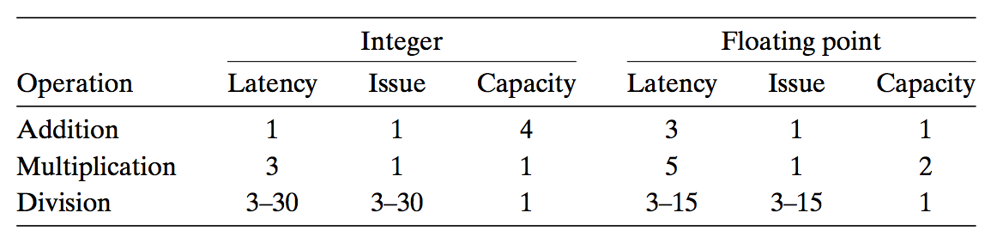
Multi-functional Units
Some Instructions Take > 1 Cycle, but Can be Pipelined
Haswell (Core i7)
每个功能部件都是部分流水线。比如部件0，FP乘法3级流水线，除法则没有
流水线，整数加法不需要流水线。这是因为：加法快，以此为基数定为1个
cycle。乘法慢，1个cycle做不完，而且程序中又频繁出现，所以需要流水线。
除法因为出现频率低，所以不需要。

Slide 70
Instruction Control
Fetch
Control
Address
Instruction
Cache
Retirement
Unit
Instruction
Decode
Instructions
Register
File
Operations
Register Updates
Prediction OK?
dispatch
Execution
Functional
Units
Branch
Arithmetic operations
Arithmetic operations
Load
Store
Operation Results
Addr.
Addr.
Data
Data
Data
Cache

Slide 71
Execution Unit
Operation is dispatched to one of multi-functional units, whenever
All the operands of an operation are ready
Suitable functional units are available
Execution results are passed among functional units
Instruction Control
Fetch
Control
Address
Instruction
Cache
Retirement
Unit
Instruction
Decode
Instructions
Register
File
Operations
Prediction OK?
dispatch

