Slide 1


Distributed shared memory and consistency models (mostly sequential & release consistency)
SE3331-1 (2022 Fall)
Yubin Xia
IPADS, Shanghai Jiao Tong University
https://www.sjtu.edu.cn
Credits: Rong Chen@IPADS, jinyang Li@NYU

Slide 2
Review: GFS architecture
A GFS cluster = 1 Master + N Chunkservers
chunk server
chunk server
chunk server
Master
. . .
chunk server
File system metadata
Maps files to chunks
chunk server
Data Storage: fixed-size chunks
Chunks replicated on several system

Slide 3
Review: GFS files
A File is made of 64MB chunks, possibly spawn multiple machines
That are replicated for fault-tolerance
Chunks live on chunkservers
chunkserver
chunkserver
chunkserver
checkpoint image
operation log
The master manages the file system namespace
master
In-memory FS metadata

Slide 4
Review: Reading a file in GFS
Reading a file is simple in GFS
1. Contact the master
2. Get file’s metadata: chunk handles
3. Get the location of each of the chunk handles
Multiple replicated chunkservers per chunk
4. Contact any available chunkserver for chunk

Slide 5
Review: Writing a File in GFS
Less frequent than reading
But is more complex, e.g., what about consistency?
GFS adopts a relaxed consistency model
E.g, may have inconsistency state, but work well for their apps
Benefits: simple & efficient to implement
Master grants a chunk lease to one of the replicas
This replica will be the primary chunkserver
The only one that can modify the chunk
Primary can request extensions (of lease), if needed
Master increases the chunk version number and informs replicas

Slide 6
Writing a File in GFS: Two-phases
Phase 1: send data
Deliver data but don’t write to the file
A client is given a list of replicas
Identifying the primary and secondaries
Client writes to the closest replica
Pipeline forwarding
Chunkservers store this data in a cache (in memory)
Client App
chunkserver
1
chunkserver
2
chunkserver
3
Notes:
Why two phases? Primary should guarantee the same order for applying chunks.

Slide 7
Writing a File in GFS: Two-phases
Phase 2: write data
Add the data to the file (commit)
Client waits for replicas’ ack of receiving data
Send a write request to the primary
The primary is responsible for serialization of writes (applying then forwarding)
Once all acks have been received → The primary sends ack the client
secondary chunkserver
Client App
Primary chunkserver
secondary chunkserver

Slide 8
Writing a File in GFS: Two-phases
Data flow (phase 1) is different from control flow (phase 2)
Data flow
Client → chunkserver → chunkserver → ...
Order does not matter
Control flow
Client → primary → all secondaries
Order maintained (also for concurrent writes from multiple clients)
Chunk version numbers are used to detect if any replica has stale data
Is maintained by the primary chunkserver
If a replica has stale data, it shall be replaced

Slide 9
Naming in GFS: namespace
No per-directory data structure like most file systems
E.g., directory file contains names of all files in the directory
No aliases (i.e., no hard or symbolic links)
Namespace is a single lookup table
Maps pathnames to metadata
Like a key-value store

Slide 10











HDFS: another popular (open-source) DFS
Hadoop Distributed FS
Primary storage system for Hadoop apps
A framework that allows for the distributed processing of large data sets across clusters of computers

Slide 11
Design Goals & Assumptions of HDFS
HDFS is an open source (Apache) implementation inspired by GFS design
Similar goals as GFS
Run on commodity hardware
Highly fault tolerant
High throughput & large-scale deployments
…

Slide 12
Recall GFS files
A File is made of 64MB chunks, possibly spawn multiple machines
That are replicated for fault-tolerance
Chunks live on chunkservers
chunkserver
chunkserver
chunkserver
checkpoint image
operation log
The master manages the file system namespace
master
In-memory FS metadata

Slide 13
HDFS files
A File is made of 64MB blocks, possibly spawn multiple machines
That are replicated for fault-tolerance
Blocks live on DataNodes
DataNode
DataNode
DataNode
FSImage
EditLog
NameNode
The NameNode manages the file system namespace
In-memory FS metadata

Slide 14
Summary
Designing distributed file system (DFS) is not simply
Single-node file system + RPC
Many design choices for performance, consistency model & failure handling
Interface
Caching
Access model
Two case studies
NFS: transparent access files on a remote server
GFS: highly-scalable & fault-tolerant DFS optimized for Google’s workload

Slide 15
GFS or NFS are not Perfect
NFS
Can not scale
Is not fault-tolerant
But is well-enough for many workloads, e.g., sharing the data for experiments in the lab
GFS
Relaxed consistency model: the results of concurrent mutations are undefined
Single-node master: single point of failures (though next-generation of GFS refines this)
Work well in Google’s datacenter workloads

Slide 16
GFS or NFS are not Perfect
NFS
Can not scale
Is not fault-tolerant
But is well-enough for many workloads, e.g., sharing the data for experiments in the lab
GFS
Relaxed consistency model: the results of concurrent mutations are undefined
Single-node master: single point of failures (though next-generation of GFS refines this)
Work well in Google’s datacenter workloads
We will see system principles to cope with them in future lectures.
For other workloads (e.g., Database) may not be sufficient.

Slide 17
Distributed Computing

Slide 18
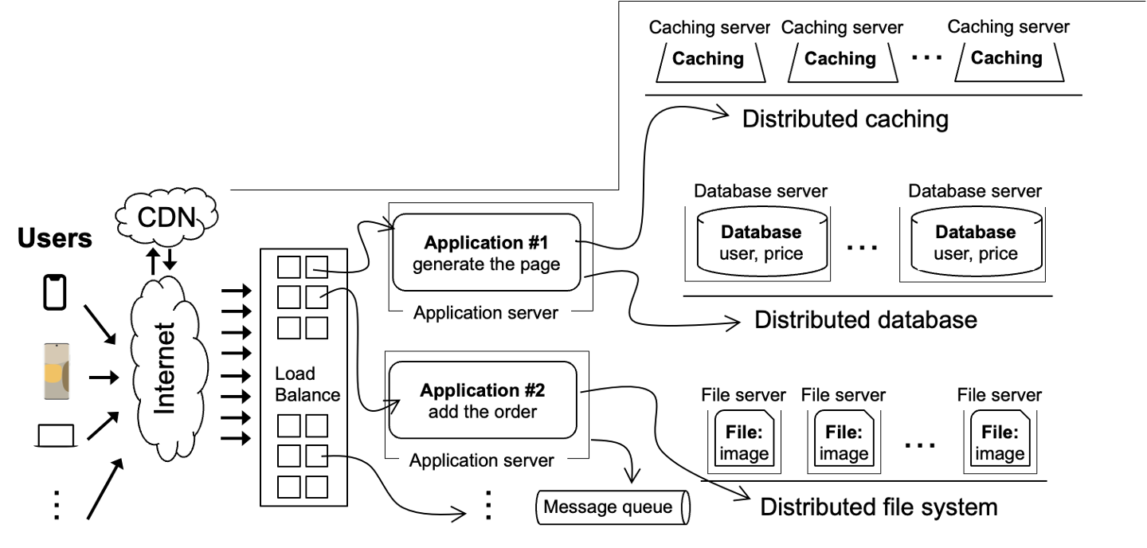
Scalable websites overview
Scalable websites powered by distributed systems
For request handling, data storage
Application #1
generate the page
requests
results
Application server

Slide 19
Distributing computing
Simple requests can be easily handled by DFS or databases
E.g., read a file, read a data record
Complex requests require huge computations
E.g., make a summation of an array of values
We will see more complex examples later
int data[100000];
int sum = 0;
for i in 100000:
sum += data[i]
print(sum)

Slide 20
Multiple threads for better performance
Traditional system is single-threaded
i.e., one thread continuously executing the application code
Challenge: single-thread performance is not growing
Due to end of Moore’s law, a single thread cannot become faster nowadays
Solution: multiple threads
Different threads running concurrently to finish the job

Slide 21
Example: parallel sum
Single-threaded version
Multiple-threaded version
int data[100000];
int sum = 0;
for i in 100:
sum += data[i]
print(sum)
int data[100000];
int sum = 0;
for i in nthreads:
start = 100000 / nthreads * i;
end = start + 100000 / nthreads;
create_thread(do_sum(start, end))
for i in nthreads:
sum += join_thread()
print(sum)

Slide 22
Example: parallel sum
Multiple-threaded version
extern int data[];
def do_sum(int start,int end) {
int local_sum = 0;
for i in start..end:
local_sum += data[i]
return local_sum
}
int data[100];
Iint sum = 0;
for i in nthreads:
create_thread(do_sum(start,end))
for i in nthreads:
sum += join_thread()
print(sum)

Slide 23
Example: parallel sum
Ideal case: with more threads, we can boost the performance
i.e., the computation time decreases with the number of threads
Question: how does each thread access the shared variable?
Each thread share the global memory address space (same page table)
(前提是这些thread属于同一个process，且位于同一个machine上面)
extern int data[];
def do_sum(int start,int end) {
int local_sum = 0;
for i in start..end:
local_sum += data[i]
return local_sum
}
Page#, Physical
Page#, Physical
Data page, Addr
Data page, Addr
Thread 0
Thread 1
Page
int data[];

Slide 24
Problem: single machine is not enough
Each machine has a limited resource to scale
The number of CPUs is limited (100 cores typically the maximum)
The capacity of memory is also limited (1TB typically the maximum)
int data[100000 1000000000000000000];
int sum = 0;
for i in nthreads:
create_thread(do_sum(100 / nthreads * i))
for i in nthreads:
sum += join_thread()
print(sum)

Slide 25
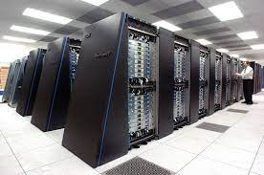
Observation: the cluster has (nearly) unlimited resources
The aggregated computing resources of a data center are huge
10PB + of memory
100,000 + CPU cores (threads)

Slide 26
Idea: global address space across multiple machine?
Multiple-threaded version / DSM
extern int data[];
def do_sum(int start,int end) {
int local_sum = 0;
for i in start..end:
local_sum += data[i]
return local_sum
}
int data[100];
Iint sum = 0;
for i in nthreads:
create_thread(do_sum(start, end))
for i in nthreads:
sum += join_thread()
print(sum)
So that we can run the same multi-threaded code on multiple machines!

Slide 27

Challenge: how can a CPU access remote mem address?
Stored on
Page#, Physical
…
Data page 0, Addr
Page 0
int data[0 : 512];
Page 1
int data[512 : 1024];
Thread 0
Machine 0
Page 2
Page 3
Page#, Physical
Stored on
…
Machine 1
Data page 0, Addr
…
…
Thread 1

Slide 28
Challenge: how can a CPU access remote mem address?
Stored on
Page#, Physical
…
Data page 0, Addr
Page 0
int data[0 : 512];
Page 1
int data[512 : 1024];
Thread 0
Machine 0
Page 2
What if thread 1 wants to access page 0?
Page 3
Page#, Physical
Stored on
…
Machine 1
Data page 0, Addr
…
…
Thread 1

Slide 29
DSM

Slide 30
DSM: distributed shared memory
Transparently offer a distributed global address space to multiple machines
How to implement DSM? A strawman approach:
If a memory address is local, then CPU can directly use load/store to access it
If a memory address is remote, the kernel will fetch the page (through network) to local on-behave of the CPU (more details later)
Question: how does the kernel detect a remote page access?
Notes:
可以引申问题：这样的好处是什么？

Slide 31
Address layout of a thread in DSM
Kernel virtual memory
Stack for CPU0
…
Stack for CPU1
Each thread has its dedicated region
For stack & heap
Others are the same as a local thread
i.e., .text is stored locally
The physical addresses behind the other’s stack & heap are remote physical addresses
We can infer the destination from the virtual memory range , e.g., record a (va -> machine location) mapping in the kernel
…
Heap for CPU1
Heap for CPU0
Read/write segment
(.data, .bss)
Read-only segment
(.init, .text, .rodata)
Unused

Slide 32
Using page table to implement DSM
Suppose we only have three pages, two at machine 0 & one at machine 1
Page#, Physical, Present
Page 0
int data[0 : 512];
Data page 0, Addr0, 1
Data page 1, Addr1, 1
Page 1
int data[512 : 1024];
Machine 0
Data page 2, Addr2, 0
Page#, Physical, Present
Data page 0, Addr0, 0
Page 2
int data[1024 : 2048];
Data page 1, Addr1, 0
Machine 1
Data page 2, Addr2, 1

Slide 33
Using page table to implement DSM (Read)
extern int data[];
def do_sum(int start,int end) {
int local_sum = 0;
for i in start..end:
local_sum += data[i]
return local_sum
}
Page#, Physical, Present
Suppose CPU access data[0]
Data page 0, Addr0, 1
Data page 1, Addr1, 1
Machine 0
Data page 2, Addr2, 0
Page 0
int data[0 : 512];
Page 2
int data[1024 : 2048];
Machine 0
Page 1
int data[512 : 1024];
Machine 1

Slide 34
Using page table to implement DSM (Read)
extern int data[];
def do_sum(int start,int end) {
int local_sum = 0;
for i in start..end:
local_sum += data[i]
return local_sum
}
Page#, Physical, Present
Suppose CPU access data[1024]
Data page 0, Addr0, 1
Data page 1, Addr1, 1
Machine 0
Data page 2, Addr2, 0
Notice that the present bit is 0
Page 0
int data[0 : 512];
Page 2
int data[1024 : 2048];
Machine 0
Page 1
int data[512 : 1024];
Machine 1

Slide 35
Using page table to implement DSM (Read)
Remote page needs special treatment
Otherwise, the CPU will treat the remote physical address (Addr2) as a local physical address, reading a wrong value
We do this by marking the present bit as 0
Page#, Physical, Present
Page 0
int data[0 : 512];
Data page 0, Addr0, 1
Data page 1, Addr1, 1
Page 1
int data[512 : 1024];
Machine 0
Data page 2, Addr2, 0

Slide 36
Using page table to implement DSM (Read)
extern int data[];
def do_sum(int start,int end) {
int local_sum = 0;
for i in start..end:
local_sum += data[i]
return local_sum
}
Page#, Physical, Present
Suppose CPU access data[1024]
Data page 0, Addr0, 1
Data page 1, Addr1, 1
Machine 0
Data page 2, Addr2, 0
Request: read addr2
Page fault for Page 2 on data[1024]
The kernel sends a messages to machine 1 to read the page
Page 2
int data[1024 : 2048];
Machine 1

Slide 37
Using page table to implement DSM (Read)
extern int data[];
def do_sum(int start,int end) {
int local_sum = 0;
for i in start..end:
local_sum += data[i]
return local_sum
}
Page#, Physical, Present
Suppose CPU access data[1024]
Data page 0, Addr0, 1
Data page 1, Addr1, 1
Machine 0
Data page 2, Addr2, 0
int data[1024 : 2048];
Page fault for Page 2 on data[1024]
The kernel sends a messages to machine 1 to read the page
Machine 1 sends back the page
Page 2
int data[1024 : 2048];
Machine 1

Slide 38
Using page table to implement DSM (Read)
extern int data[];
def do_sum(int start,int end) {
int local_sum = 0;
for i in start..end:
local_sum += data[i]
return local_sum
}
Page#, Physical, Present
Suppose CPU access data[1024]
Data page 0, Addr0, 1
Data page 1, Addr1, 1
Machine 0
Data page 2, Addr2, 0
Page c
int data[1024 : 2048];
Page fault for Page 2 on data[1024]
The kernel sends a messages to machine 1 to read the page
Machine 1 sends back the page
Machine 0 allocates a new page to store the data (Page c)

Slide 39
Using page table to implement DSM (Read)
extern int data[];
def do_sum(int start,int end) {
int local_sum = 0;
for i in start..end:
local_sum += data[i]
return local_sum
}
Page#, Physical, Present
Suppose CPU access data[1024]
Data page 0, Addr0, 1
Data page 1, Addr1, 1
Machine 0
Data page 2, AddrC, 1
Page c
int data[1024 : 2048];
Page fault for Page 2 on data[1024]
The kernel sends a messages to machine 1 to read the page
Machine 1 sends back the page
Machine 0 allocates anew page to store the data (Page c)
Modify the page table
Return to the user program

Slide 40
Our solution essentially caches the remote page locally
If we read the remote page, allocate a local page and caches it
Question:
What would happen when machine 1 makes a modification?
On machine 0, future read will get a stale value!
Naïve solution
Machine 0 invalidates the page once the application finishes the read
Question remains: how can the kernel know when the application has finished reading the data w/o changing the program?
If we rely on the application modifications, we cannot directly run multi-threaded program on DSM!
问题：不好确定什么时候read才真正结束

Slide 41
Cache or not cache? It is a trade-off
Cache improves the performance of future reads
Network is much slower than local memory accesses
E.g., 10ms (network) vs. 100ns (local memory access)
Especially difficult to reduce for large-scale clusters
Cache introduces anomalies if not implementing properly
E.g., application reads a stale data
Whether it is ok depends on the application scenarios
Our parallel sum works fine, but what about others? (will see later)

Slide 42
What about Write?
extern int data[];
def do_sum(int start,int end) {
int local_sum = 0;
for i in start..end:
data[i] += 73;
return local_sum
}
Page#, Physical, Present, RW
Suppose CPU write data[1024]
Data page 0, Addr0, 1,Write
Data page 1, Addr1, 1,Write
Machine 0
Data page 2, AddrC, 1,Read
Page c
int data[1024 : 2048];
Page 2
int data[1024 : 2048];
Besides read, we need to write back
Question: how can kernel detect there is a write?
Setting the write-bit of the page to 0, even it is write-permitted

Slide 43
What about Write?
extern int data[];
def do_sum(int start,int end) {
int local_sum = 0;
for i in start..end:
data[i] += 73;
return local_sum
}
Page#, Physical, Present, RW
Suppose CPU write data[1024]
Data page 0, Addr0, 1,Write
Data page 1, Addr1, 1,Write
Machine 0
Data page 2, AddrC, 1,Read
Page c
int data[1024 : 2048];
Page fault for Page 2 on data[1024](尝试写一个readonly page会发生page fault。)
The kernel checks whether it is ok to write the page
Mark the page as dirty
Mark the page as write
Page 2
int data[1024 : 2048];
Wait for a while, and write the page back

Slide 44
Write the data back to remote is tricky
The kernel cannot decide when the client finishes the write
It can only detect there is an on-going write
Therefore, the write back is flushed later in a timely manner
Note that the write back will also need to update other’s cache

Slide 45
Write is tricky to handle
在这时候去读取data时由于data[1024]还没有写到远端，
所以读取到的是staledata，所以对于CPU0而言相当于先更新了data[0]后更新了data[1024],这样与实际顺序
就相反了。
A naïve implementation of DSM can only flush the write in a timely manner
Causes significant issues
Example anomaly
E.g., program reordering even in a single thread
data[1024] = 73;
data[0] = 73;
CPU0
Machine 1
W(data[1024]) 73
W(data[0]) 73
Network
What if we read
data[] at this time?
Time

Slide 46
Recap of our simple DSM so far
Kernel handles the remote page’s read/write
With the help of the page table
Kernel caches the remote pages to improve performance
Also not relies on the application to flush the page
The fastest DSM implementation (naïve)
Read: always read from the cache
Write: send updates to the remote (and caches) in a timely manner
However, the fastest implementation would result in subtle consistency issues

Slide 47
Consistency Issue of DSM

Slide 48
Example: Mutual Exclusion on naïve DSM
extern int x; //0
extern int y; //0
x = 1
if (y==0)
critical sec
CPU1
extern int x;//0
extern int y;//0
y = 1
if (x==0)
critical sec
CPU0
Read/Write
DSM
但是如果不加额外的约束还是会出现两个thread都进入sec与
两个thread都不进入的情况(死锁)
Assumptions
CPU0 and CPU1 are on different machines
x and y reside on different pages and have been cached to two machines
Goal: critical section
Two CPUs should not execute the code simultaneously
Notes:
SVM simplifies application development

Slide 49
OK case: CPU0 goes first
x = 1
if (y==0)
critical sec
y = 1
if (x==0)
critical sec
CPU0
CPU1
W(x) 1
R(y) 0
Network
W(y) 1
R(x) 1
Time
Time

Slide 50
OK case: CPU1 goes first
x = 1
if (y==0)
critical sec
y = 1
if (x==0)
critical sec
CPU0
CPU1
W(y) 1
R(x) 0
Network
W(x) 1
R(y) 0
Time
Time

Slide 51
OK case, may need to handle, but still OK
x = 1
if (y==0)
critical sec
y = 1
if (x==0)
critical sec
CPU0
CPU1
W(x) 1
W(y) 1
两个都没进入critical
section，但是也没有
违背两个不能同时进入
section的规则
Network
R(y) 1
R(x) 1
Time
Time

Slide 52
Bad case!!!
Cache states
x = 1
if (y==0)
critical sec
X=0
Y=0
X=0
Y=0
y = 1
if (x==0)
critical sec
CPU0
CPU1
W(x) 1
W(y) 1
R(y) 0
R(x) 0
Network
Time
Time

Slide 53
What is the problem?
The order of the updates seen by different CPUs are different
CPU0
W(x) 1
R(y) 0
CPU0 sees Y is updated after updating X
CPU1
W(y) 1
R(x) 0
CPU1 sees Y is updated before updating X
Time
Inconsistent!

Slide 54
What is consistency?
Consistency model defines rules for the apparent order and
visibility of updates, and it is a continuum with tradeoffs.
- Todd Lipcon
Single object consistency is
also called “coherence”
Examples
Local shared virtual memory
Database
W(y) 1
R(y) (should be 1)
Time
X <- X + 1 ; Y <- Y - 1
Assert X+Y unchanged
Consistency across multiple objects
e.g., all-or-nothing + before-or-after
Notes:
Todd Lipcon: Hadoop and H

Slide 55
Consistency Challenges
No Right or Wrong consistency models
Tradeoffs between ease of programmability & performance
Consistency is hard in (distributed) systems
Data replication (& caching)
Concurrency (multi-core & multi-host)
Failures (e.g., machine or network)

Slide 56
Example on naïve DSM
Consistency model defines rules for the apparent order and
visibility of updates, and it is a continuum with tradeoffs.
- Todd Lipcon
Assume all x,y is cached at each machine
Read operation: return the content in the cache
Write operation: write to the DRAM, send to the other CPU’s cache, but don’t wait
Questions: what is the order of the visibility of an update? Undefined!

Slide 57
Sequential Consistency

Slide 58
What is the desired consistency model?
Each read should get the latest write
i.e., if CPU0 writes 1, then later CPU1 should get 1
Rule#1
Each read gets the latest write value
CPU0
CPU1
W(x) 1
R(x) 1
Question: is rule#1 sufficient for mutual exclusion?
Time

Slide 59
Intuitive results of rule 1
Goal: proof no two nodes/CPUs enter the critical section
Proof: suppose mutual exclusion is violated, then we have:
CPU-0:
CPU-1:
W(x) 1
R(y) 0
W(y) 1
R(x) 0
Due to Rule 1, W(y) 1 must happens later
W(x) 1
R(y) 0
W(y) 1
Time
extern int x;
extern int y;
x = 1
if (y==0)
critical sec
extern int x;
extern int y;
y = 1
if (x==0)
critical sec
1. Each read gets the latest write value

Slide 60
Intuitive results of rule 1
Goal: proof no two nodes/CPUs enter the critical section
Proof: suppose mutual exclusion is violated, then we have:
CPU-0:
CPU-1:
W(x) 1
R(y) 0
W(y) 1
R(x) 0
Due to Rule 1, R(x) 1 must happens before
R(x) 0
W(x) 1
R(y) 0
W(y) 1
Time
extern int x;
extern int y;
x = 1
if (y==0)
critical sec
extern int x;
extern int y;
y = 1
if (x==0)
critical sec
1. Each read gets the latest write value

Slide 61
Can this execution flow happen in our sample?
Yes, thread #2 issues write (y), not wait it to finish, and issue a read to x
Therefore, we need rule#2
All operations at one CPU have the execution order of the program
i.e., wait for the w(y) to finish, then issue read x
R(x) 0
W(x) 1
R(y) 0
W(y) 1
Time
extern int x;
extern int y;
x = 1
if (y==0)
critical sec
extern int x;
extern int y;
y = 1
if (x==0)
critical sec
Each read gets the latest write value
All operations at one CPU have the execution order of the program

Slide 62
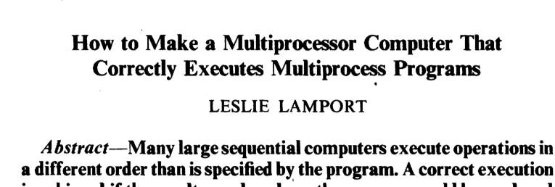
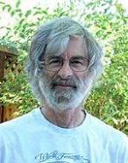
The desire model: sequential consistency
The rules (informally) are defined as sequential consistency:
Rule-1. Each read gets the latest write memory
Rule-2. All operations at one CPU have the execution order of the program
Sequential consistency dates to Lamport's 1979 paper
Our informal definition is slightly stronger than the original definition

Slide 63
Implementation of SC
Requirements
Requests to an individual memory location are served from a single (logical) FIFO queue
Each page has one owner (moved a cross nodes)
The latest writer becomes the owner
invalidate all the caches before a write is seemed finished
Each CPU issues requests in the order specified by the program

Slide 64
Challenges about the protocol
How to find the owner of a page?
How to ensure one owner per page?
How to ensure all cached pages are invalidated upon writes?

Slide 65
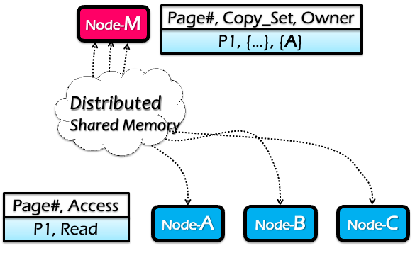
Centralized manager (Node-M)
Maintain a table which has the following info per-page
Owner machine: the most recent machine that has write access to it
Copy set: all machines that have copies of this page

Slide 66
Read operations (at node C)
RQ: Read reQuest
RF: Read Forward
RC: Read Confirm
Node-M
Page#, Copy_Set, Owner
P1, { }, { }
C
A
3: RF
Page fault for P1 on C
C sends RQ to M
M sends RF to A, M adds C to Copy_Set
A sends P1 to C, C marks P1 as Read-only
C sends RC to M
5: RC
Distributed Shared Memory
2: RQ
4: P1
Node-A
Node-B
Node-C
Page#, Access
Page#, Access
...
P1, Read
P1, Read

Slide 67
Write operations (at node B)
WQ: Write reQuest
IV: Invalidate
IC: Invalidate Confirm
WF: Write Forward
WC: Write Confirm
Node-M
Page#, Copy_Set, Owner
P1, { }, { }
C
A
B
5: WF
Page fault for P1 on B
B sends WQ to M
M sends IV to Copy_Set={C}
C send IC to M
M clears Copy_Set, sends WF to A
A sends P1 to B, clear Access
B send WC to M
3: IV
Distributed Shared Memory
4: IC
7: WC
6: P1
2: WQ
Node-A
Node-B
Node-C
Why does it need WC?
Page#, Access
Page#, Access
Page#, Access
P1, Read
P1, Write
P1, nil
To prevent another write become an onwer
P1, nil
P1, Read

Slide 68
DSM Invariants
Every page has exactly one current owner
Current owner has a copy of the page
If mapped r/w(read/write) by owner, no other copies(因为在write之前其他copies已经被invalidate了)
If mapped r/o(read only) by owner, identical to other copies
Centralized manager knows about all copies

Slide 69
DSM summary
RPC
Distributed shared memory
Pros:
Program a cluster of machines like a single machine => easy to program
Sequential consistency
Cons
Scalability bottleneck of the global manager
Single-point of failure
Many synchronizations upon reads/writes
Scalability
Ease of
programming
Performance
Consistency
Fault tolerance
Notes:
五芒星图

Slide 70
Drawback of SC
In any implementation of SC, there should be some global control mechanism
Scalability & fault-tolerance challenges
Either of writes or reads require memory synchronization operations
Performance issue
W(x)
W(y)
W(x)
Node-0
Time
It’s necessary
Time
Node-1
R(x)
R(y)
R(x)

Slide 71
Drawback of SC
In any implementation of SC, there should be some global control mechanism
Scalability & fault-tolerance challenges
Either of writes or reads require memory synchronization operations
Performance issue
W(x)
W(x)
W(x)
Node-0
Time
What about this?
Time
Node-1
R(y)
R(y)
R(y)

Slide 72
Drawback of SC
Problem: false sharing
Two or more machines access different variables within a page
and at least one of the accesses is a write.
W(x)
W(x)
W(x)
Node-0
Time
x
“Ping-pong”
y
Time
Node-1
R(y)
R(y)
R(y)

Slide 73
Drawback of SC
Problem: false sharing
Drawbacks
Ping-Pong: the ownership of pages is transferred between two (irrelevant) machines
Write amplifications: even I update an integer (8B), the DSM will transfer the entire page (4KB)
x
y

