Slide 1


Distributed Computing: Batch Processing Systems
SE3331-1 (2022 Fall)
Yubin Xia
IPADS, Shanghai Jiao Tong University
https://www.sjtu.edu.cn
Credits: Rong Chen@IPADS

Slide 2
Scalable websites overview
Scalable websites powered by distributed systems
For request handling, data storage
Caching server
Caching server
Caching server
…
Caching
Caching
Caching
Distributed caching
Database server
Database server
CDN
Users
Application #1
generate the page
Database
user, price
…
Database
user, price
Application server
Distributed database
Internet
Load
Balance
Application #2
add the order
File server
File server
File server
File:
image
File:
image
…
File:
image
Application server
…
…
Message queue
Distributed file system

Slide 3
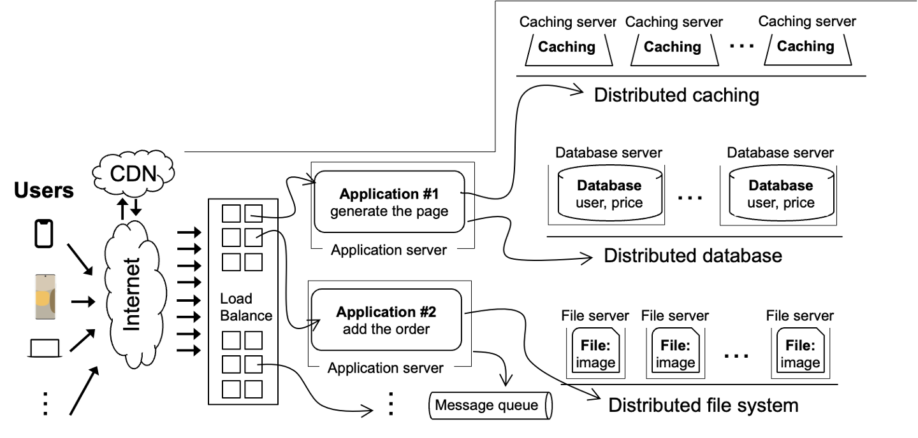
Scalable websites overview
Scalable websites powered by distributed systems
For request handling, data storage
Application #1
generate the page
requests
results
Application server

Slide 4
Review: DSM -- distributed shared memory
Transparently offer a distributed global address space to multiple machines
How to implement DSM? A strawman approach:
If a memory address is local, then CPU can directly use load/store to access it
If a memory address is remote, the kernel will fetch the page (through network) to local on-behave of the CPU (more details later)
Question: how does the kernel detect a remote page access?
Notes:
可以引申问题：这样的好处是什么？

Slide 5
Review: The inconsistency problem
The order of the updates seen by different CPUs are different
CPU0
W(x) 1
R(y) 0
CPU0 sees Y is updated after updating X
CPU1
W(y) 1
R(x) 0
CPU1 sees Y is updated before updating X
Time
Inconsistent!

Slide 6
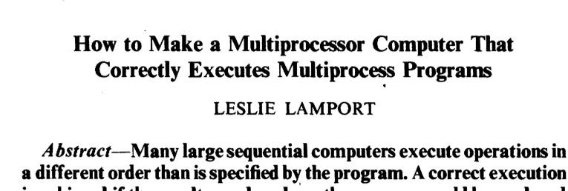

Review: The desire model -- sequential consistency
The rules (informally) are defined as sequential consistency:
Rule-1. Each read gets the latest write memory
Rule-2. All operations at one CPU have the execution order of the program
Sequential consistency dates to Lamport's 1979 paper
Our informal definition is slightly stronger than the original definition

Slide 7
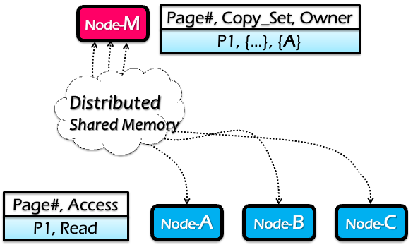
Review: Centralized manager (Node-M)
Maintain a table which has the following info per-page
Owner machine: the most recent machine that has write access to it
Copy set: all machines that have copies of this page

Slide 8
Read operations (at node C)
RQ: Read reQuest
RF: Read Forward
RC: Read Confirm
Node-M
Page#, Copy_Set, Owner
P1, { }, { }
C
A
3: RF
Page fault for P1 on C
C sends RQ to M
M sends RF to A, M adds C to Copy_Set
A sends P1 to C, C marks P1 as Read-only
C sends RC to M
5: RC
Distributed Shared Memory
2: RQ
4: P1
Node-A
Node-B
Node-C
Page#, Access
Page#, Access
...
P1, Read
P1, Read

Slide 9
Write operations (at node B)
WQ: Write reQuest
IV: Invalidate
IC: Invalidate Confirm
WF: Write Forward
WC: Write Confirm
Node-M
Page#, Copy_Set, Owner
P1, { }, { }
C
A
B
5: WF
Page fault for P1 on B
B sends WQ to M
M sends IV to Copy_Set={C}
C send IC to M
M clears Copy_Set, sends WF to A
A sends P1 to B, clear Access
B send WC to M
3: IV
Distributed Shared Memory
4: IC
7: WC
6: P1
2: WQ
Node-A
Node-B
Node-C
Why does it need WC?
Page#, Access
Page#, Access
Page#, Access
P1, Read
P1, Write
P1, nil
To prevent another write become an onwer
P1, nil
P1, Read

Slide 10
DSM Invariants
Every page has exactly one current owner
Current owner has a copy of the page
If mapped r/w by owner, no other copies
If mapped r/o by owner, identical to other copies
Centralized manager knows about all copies

Slide 11
DSM summary
Pros:
Program a cluster of machines like a single machine => easy to program
Sequential consistency
Cons
Scalability bottleneck of the global manager
Single-point of failure
Many synchronizations upon reads/writes
scale:
scale up:提升单机的CPU数量来提升单机性能，但是这个明显是有上限的
scale out：multithread从单机到多机。
Notes:
五芒星图

Slide 12
Drawback of SC
In any implementation of SC, there should be some global control mechanism
Scalability & fault-tolerance challenges
Either of writes or reads require memory synchronization operations
Performance issue
但是需要频繁的通过network进行交互，性能较差
W(x)
W(y)
W(x)
Node-0
Time
It’s necessary
Time
Node-1
R(x)
R(y)
R(x)

Slide 13
Drawback of SC
In any implementation of SC, there should be some global control mechanism
Scalability & fault-tolerance challenges
Either of writes or reads require memory synchronization operations
Performance issue
W(x)
W(x)
W(x)
Node-0
Time
What about this?
Time
Node-1
R(y)
R(y)
R(y)

Slide 14
Drawback of SC
Problem: false sharing
Two or more machines access different variables within a page
and at least one of the accesses is a write.
两个node上面的读写操作本来是不相关的，所以此时的频繁的同步是无意义的。
同时由此带来大量不必要的额外的磁盘读写也会降低性能。
W(x)
W(x)
W(x)
Node-0
Time
x
Ping-pong
y
Time
Node-1
R(y)
R(y)
R(y)

Slide 15
Drawback of SC(sequential consistency)
Problem: false sharing
Drawbacks
Ping-Pong: the ownership of pages is transferred between two (irrelevant) machines
Write amplifications: even if updating an integer (8B), the DSM will transfer the entire page (4KB)
x
y

Slide 16
Summary: Distributing computing
Simple requests can be easily handled by DFS or databases
E.g., read a file, read a data record
Complex requests require huge computations
E.g., make a summation of an array of values
We will see more complex examples later
DSM is an ideal programming framework for distributed computing
However, DSM fails in two ways
Performance
Fault tolerance
People develop specialized frameworks for different applications

Slide 17

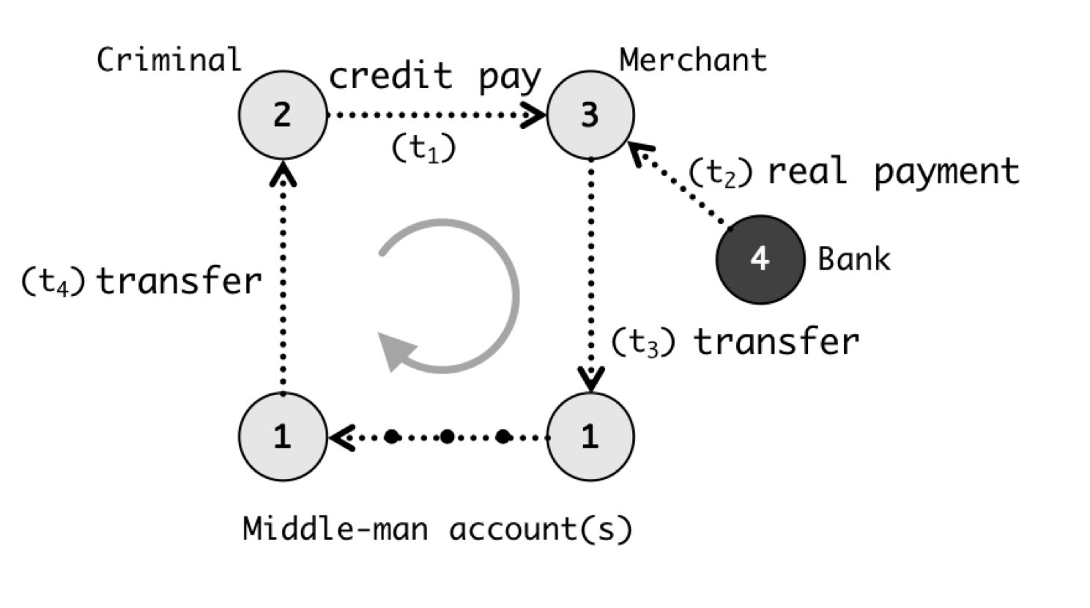

Distributing computing
For simple web page
Application server’s framework (PHP) is sufficient
Complex queries are processed by powerful distributed computing frameworks
Fraud detection -> Graph processing system
Hot lists -> MapReduce
Online vs. offline
Online: compute the requests based on requests
Offline: return the pre-computed results
Render the page
Alipay detects frauds w/ graph systems
Generate hot lists

Slide 18
How does application server handle requests?
For simple web page
Application server’s framework (PHP) is sufficient
Complex queries are processed by powerful distributed computing frameworks
Fraud detection -> Graph processing system
Hot lists -> MapReduce
Online vs. offline
Online: compute triggered by the user requests
Offline: return the pre-computed results
Render the page
Alipay detects frauds w/ graph systems
Generate hot lists

Slide 19
DSM fails to provide a tool for the application developers
Performance is poor
E.g., ping-pong in the previous example
Cannot tolerate failure
In the multi-threaded environment, the CPU must live with the memory

Slide 20
Idea: specialized framework
Distributed shared memory
DSM is good at
Ease of programming
We can lower the ease of programming
With specialized framework for specifical application
Scalability
Ease of
programming
Performance
Consistency
Fault tolerance

Slide 21

Idea: specialized framework
Distributed application
User-space
APIs
Distributed application
Frameworks
store
load
OS
OS
OS
OS
OS
OS
OS
OS
OS
OS
Distributed shared memory
Kernel space

Slide 22
Distributed Frameworks

Slide 23




Distributed frameworks are common
Each fits a common application scenario
One sit (typically) does not fit all!
Batch processing system
Spark, Hadoop, etc.
Graph processing system
GraphLab, etc.
Machine learning system
TensorFlow, etc.
Note that we can also use one for another
At the cost of programming effort and performance
batch processing(批处理)
更适用于短时间内基本不会发生变化
的数据情景，并且该情景下用户对数
据的实时性要求较低
graph processing(图处理)
更适用于对于时延要求较高，并且对于
实时性要求较高的场景。e.g.：支付宝
反洗钱检测。

Slide 24
Example: batching processing
Suppose our web server records every requests in a log file
E.g., using nginx log format, a log record looks like this:
216.58.210.78 - - [27/Feb/2015:17:55:11 +0000] "GET /css/typography.css HTTP/1.1" 200 3377 "http://martin.kleppmann.com/" "Mozilla/5.0 (Macintosh; Intel Mac OS X 10_9_5) AppleWebKit/537.36 (KHTML, like Gecko) Chrome/40.0.2214.115 Safari/537.36"
Abstract format: $remote_addr - $remote_user [$time_local] "$request" $status $body_bytes_sent "$http_referer" "$http_user_agent"
Task (simple log analysis): how to find top five popular pages?

Slide 25
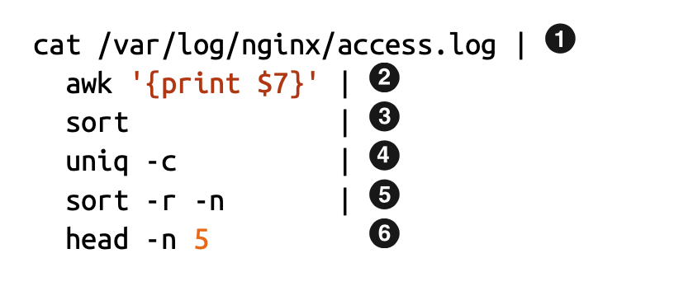
Old days: using command line to process the log
216.58.210.78 - - [27/Feb/2015:17:55:11 +0000] "GET /css/typography.css HTTP/1.1" 200 3377 "http://martin.kleppmann.com/" "Mozilla/5.0 (Macintosh; Intel Mac OS X 10_9_5) AppleWebKit/537.36 (KHTML, like Gecko) Chrome/40.0.2214.115 Safari/537.36"
Find top five most popular pages w/ command line tools

Slide 26
Use command line tools for batch processing
Find top five most popular pages
1
Read log file
4
Aggregate, with a counter for each
line
Filter the line, pick the 7th token,
i.e., /css/typography.css
Sort again (using the counter)
2
5
3
Sort so that the same requests come together
6
Print 1-5 items

Slide 27
Does batch processing with command line tools scale?
Command line tools are mostly single-threaded, and single-machine
: scalability is restricted by the disk capacity
～ : restricted by single-thread computing power
～ : also restricted by the machine’s DRAM capacity
1
Scale using GFS
2
6
2
6
DSM helps little for single-threaded programs

Slide 28


We need distributed computing
Multiprocessor systems don’t scale enough
Disney’s Cars 2 required 11.5 hours to render each frame (average)
Some took 90 hours
~152,640 frames = 1,755,360 hours = 200years for a single core
12,500 cores on Dell render blades

Slide 29
Complex tasks require distributed computing
Multiprocessor system don’t scale enough
Disney’s Cars 2 required 11.5 hours to render each frame (average)
some took 90 hours
~152,640 frames = 1,755,360 hours = 200years for a single core
12,500 cores on Dell render blades
Google
Approximately 1 billion queries per day
Index > 25 billion web pages
Hundreds of thousands of servers

Slide 30
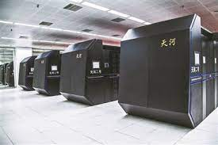
Distributed computing
Cluster computing
Hundreds or thousands of PCs connected by high-speed LANs
Example: supercomputer, datacenter
Grid computing
Hundreds of supercomputers connected by high-speed network
Etc
Tianhe supercomputer has 16,000 nodes in total
Goal: 1000 nodes potentially give 1000X speedup

Slide 31
Scaling log processing using RPC
for w in workers:
execute_command(w,...) // parallelly
res = []
for machines in workers:
res.append(get_res(w))
.3
.4
…

Slide 32
Accelerate batch processing with distributed computing
Distributed computing
Split data into equal-size chunks
Each process can work on a chunk parallelly
Why equal-size?
Assume each process has nearly identical computing power

Slide 33
Accelerate batch processing with distributed computing
Distributed computing
Split data into equal-size chunks
Each process can work on a chunk parallelly
Most significant challenge: identify concurrency
It should be noted that not all tasks can be parallelized
E.g., dependencies
4
depends on
3

Slide 34
Challenges
Communicating between two machines
can be simple, e.g., with RPC
But, what about 10,000 machines?
Sending data to/from nodes
Coordinating among nodes
Recovering from node failure
Optimizing for locality

Slide 35
Challenges
Sending data to/from nodes
Coordinating among nodes
Recovering from node failure
Optimizing for locality
When can we collect computing results from all the computing nodes?

Slide 36
Challenges
Sending data to/from nodes
Coordinating among nodes
Recovering from node failure
Optimizing for locality
Failure is common,
especially at large-scale

Slide 37
Challenges
Sending data to/from nodes
Coordinating among nodes
Recovering from node failure
Optimizing for locality
Transferring data over network is usually much slower than local data access

Slide 38
Which are solved by DSM?
Sending data to/from nodes
Good: DSM support transparently share data between machines
Bad: the performance is typically slow (even for data not shared)
2. Coordinating among nodes
Still need special implementation from the user
3. Recovering from node failure
No support
4. Optimizing for locality
No support

Slide 39
MapReduce: Simplified Data Processing on Large Clusters

Slide 40
MapReduce: a distributed batch processing system
Created by Google (OSDI’04)
Jeffrey Dean and Sanjay Ghemawat
Inspired by LISP (function language)
Map (function, set of values)
Applies function to each value in the set
Reduce (function, set of values)
Combines all the values using a function (e.g., +)
input->MAP->划分中间值->REDUCE->output
(map #‘length’ (() (a) (a b) (a b c))) → (0 1 2 3)
(reduce #‘+’ (1 2 3 4 5)) → 15

Slide 41
MapReduce abstraction models our requirements well
Sending data to/from nodes
Data is sent between Map & Reduce
Coordinating among nodes
Framework can use the same MapReduce semantic to coordinate
i.e.， only need to schedule the reducer after the mapper
Recovering from node failure
If the original data can tolerate failure, we can simply use re-execution for fault tolerance
Optimizing for locality
We can execute the Map & Reduce on the machine stored the data

Slide 42
MapReduce Programming Model
Allows user to process huge amounts of data on thousands of nodes
Framework for data-parallel computing
Programmers get simple yet restricted API
Users don’t have to worry about handling:
parallelization
data distribution
load balancing
fault tolerance
因为中间的处理过程已经被MapReduce封装好了

Slide 43

MapReduce Programming Model
Functionality
Parallelization
Data Distribution
Fault Tolerance
user
Load Balance

Slide 44
MapReduce Programming Model
Functionality
Two Primitives:
Map (input)
Parallelization
Data Distribution
MapReduce
Runtime
Reduce (key, values)
Fault Tolerance
user
Load Balance

Slide 45
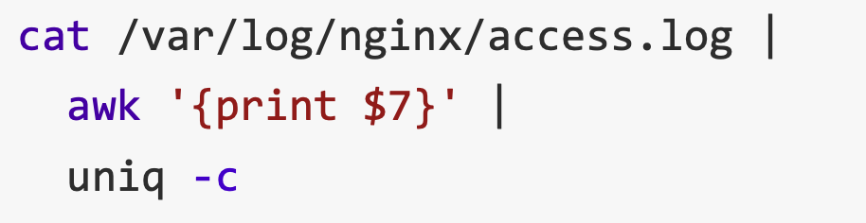
MapReduce example：Word count
Word Count: Count # occurrences of each word in a collection of documents
A simplified process of our previous log analysis example
1
2
4

Slide 46
MapReduce example：Word count
Word Count: Count the occurrences number of each word in a collection of documents
Map:
Parse data and emit each word with a count (1)
Reduce:
Sort: sort by keys (words)
Reduce: sum together counts each key (words)
(在map时不考虑重复出现的单词的次数的叠加，
这个要交给reduce来做)
map (String key, String value)
for each word w in value
EmitIntermediate (w, “1”);
Reduce (String key, Iterator values)
int result = 0;
for each v in values
result += ParseInt (v);
emit (AsString (result));

Slide 47
MapReduce Programming Model
E.g., to find the most
popular keywords (热词)
Two Primitive:
Map (input)
for each word in input
emit (word, 1)
Word Count
Functionality
MapReduce
Runtime
Reduce (key, values)
int sum = 0;
for each value in values
sum += value;
emit (word, sum)
user

Slide 48
MapReduce Programming Interface
Map: (input shard) → intermediate(中间值) (k/v pairs)
Partition the input data into M “shards”
Group all intermediate values associated with the same key
Pass them to the Reduce function
Reduce: intermediate (k/v pairs) → (results)
Partition the key space into R “pieces” using a Partition function
E.g., hash(key) mod R
Accept a key & a set of values
Merge these values to form result of the key

Slide 49
MapReduce Execution Flow
Map
Grab the relevant data from the source
User function gets called for each chunk of input
Map Worker
Reduce Worker
Reduce
Aggregate the results
User function gets called for each unique key

Slide 50
MapReduce Execution Flow
Map
Grab the relevant data from the source
User function gets called for each chunk of input
Partition
Identify which Reducers will handle which keys
Map partitions data to target Reducers
Map Worker
Reduce Worker
Sort
Fetch the relevant partition data from all mappers
Sort by keys
Reduce
Aggregate the results
User function gets called for each unique key

Slide 51
MapReduce: The Complete Picture
这里的master就类似于之前的
node-M，起到一个全局的管理调度
的作用,还需要注意的是，一个
reduce-worker不一定只接收来自一
个mapworker的数据
Client
Master
一般来说一个shard应该
由一个mapper来处理，但
不绝对
assign tasks
Shard 0
Map Worker
IF
Shard 1
Shard 2
Reduce Worker
Output
File 1
M items
Shard 3
Map Worker
IF
R items
...
Reduce Worker
Output
File 2
Shard M-2
Shard M-1
Map Worker
IF
Input Files
Map Workers
Intermediate Files
Reduce Workers
Output Files
Notes:
具体到实现，以文件作为input

Slide 52
MapReduce: The Complete Picture
Step1: (Client/Master) split input files into chunks (shards)
Typically, 64MB --> chunkserver!
Shard 0
Shard 1
Shard 2
Shard 3
...
Shard M-1
Input Files
Divided into M shards

Slide 53
MapReduce: The Complete Picture
Step2: fork processes
Start up many copies of the program on cluster
1 master: scheduler & coordinator
Lots of workers
Idle workers are assigned either
Map tasks (each works on a shard)
Reduce tasks (each works on intermediate files)
其实所谓的“worker”就是一个process，所以
并没有规定map与reducer一定要跑在不同的
process上面，甚至可以共用一个process/
machine.(即map-worker，reduce-worker是一
个逻辑上的概念)
Client
remote fork
Master
...
Map Worker
..
Map Worker
Reduce Worker
..
Reduce Worker

Slide 54
MapReduce: The Complete Picture
Step3: map task
Reads contents of the input shard assigned to it
Parses key/value pairs out of the input data
Passes each pair to a user-defined Map function
Produces intermediate key/value pairs
These are buffered in memory
read
Map Worker
Shard 2

Slide 55
MapReduce: The Complete Picture
Step4: create intermediate files
Intermediate k/v pairs buffered in memory and periodically written to the local disk
Partitioned into R regions by a Partition function
Notifies master when complete
Passes location of intermediate data to the master
Master forwards locations to the Reduce worker
Intermediate File
read
Map Worker
local write
partition 1
Shard 2
partition 2
partition R

Slide 56
MapReduce: The Complete Picture
Step4a: partitioning
Map data will be processed by reduce workers
The user’s Reduce function will be called once per unique key
Sort all the (key, value) data by keys
Partition function: decides which of R reduce workers will work on which key
Default function: hash(key) mod R
Map worker partitions the data by keys
Each reduce worker will read their partition from every map worker

Slide 57
MapReduce: The Complete Picture
Step5: sorting intermediate data
Notified by master about the location of intermediate files for its partition
Uses RPCs to read the data from the local disks of map workers
Sorts the data by the intermediate keys
All occurrences of the same key are grouped
local write
remote read
Map Worker
Intermediate file
Reduce Worker
Map Worker
local write
Intermediate file
remote read
Reduce Worker
Notes:
XD： 为什么mapreduce需要sort key？加速reduce worker的merge key过程

Slide 58
MapReduce: The Complete Picture
Step6: reduce task
Groups data with a unique intermediate key
User’s Reduce function is given the key and the set of intermediate values for that key
<key, (value1, value2, ...)>
The output is appended to an output file
Intermediate file
Intermediate file
remote read
Reduce Worker
write
Output
File 1
Intermediate file

Slide 59
MapReduce: The Complete Picture
Step7: return to user
When all map and reduce tasks have completed
Master wakes up the user program
The MapReduce call in the user program returns, and the program can resume execution
Output of MapReduce is available in R output files

Slide 60
Recall MapReduce example：Word count
Word Count: Count # occurrences of each word in a collection of documents
Map:
Parse data and emit each word with a count (1)
Reduce:
Sort: sort by keys (words)
Reduce: sum together counts each key (words)
map (String key, String value)
for each word w in value
EmitIntermediate (w, “1”);
Reduce (String key, Iterator values)
int result = 0;
for each v in values
result += ParseInt (v);
emit (AsString (result));

Slide 61
MapReduce example：Word count
After Map
After Sort
After Reduce
Input file
[Intermediate]
[In-memory]
It will be seen that this mere painstaking burrower and grub-worm of a poor devil of a Sub-Sub appears to have gone through the long Vaticans and streetstalls of the earth, picking up whatever random allusions to whales he could anyways find in any book whatsoever, sacred or profane. Therefore you must not, in every case at least, take the higgledy-piggledy whale statements, however authentic, in these extracts, for veritable gospel cetology. Far from it. As touching the ancient authors generally, as well as the poets here appearing, these extracts are solely valuable or entertaining, as affording a glancing bird's eye view of what has been promiscuously …
...
it 1
will 1
be 1
seen 1
that 1
this 1
mere 1
painstaking 1
burrower 1
and 1
grub-worm 1
of 1
a 1
poor 1
devil 1
of 1
a 1
sub-sub 1
…
...
a 1
a 1
aback 1
aback 1
abaft 1
abaft 1
abandon 1
abandon 1
abandon 1
abandoned 1
abandoned 1
abandoned 1
abandoned 1
abandoned 1
abandoned 1
abandoned 1
abased 1
abased 1
…
a 4736
aback 2
abaft 2
abandon 3
abandoned 7
abased 2
abasement 1
abashed 2
abate 1
abated 3
abatement 1
abating 2
abbreviate 1
abbreviation 1
abeam 1
abed 2
abednego 1
abel 1
abhorred 3
...
Map
Reduce

Slide 62
Other examples of MapReduce
Distributed grep
Search for words in lots of documents
Map: emit a line if it matches a given pattern
Reduce: just output the intermediate data
Count URL access frequency
Find the frequency of each URL in web logs
Map: process logs of web page access; output <URL, 1>
Reduce: add all values for the same URL

Slide 63
Other examples of MapReduce
Inverted index
Find what documents contain a specific word
Map: parse document, emit <word, doc-ID>
Reduce: sort the doc-ID for each word, and output <word, list(doc-ID)>
Reverse web-link graph
Find where page links come from
Map: output <target, source> for each link to target in a page source
Reduce: concatenate all source for each target, output <target, list(source)>

Slide 64
Other examples of MapReduce
Google used MapReduce to support distributed computing
Large-scale machine learning jobs
Large-scale graph analytic jobs
Etc.

Slide 65
Recall, common challenges of Distributed Computing
Sending data to/from nodes
Coordinating among nodes
Recovering from node failure
Optimizing for locality
How does MapReduce handle these challenges?
1 & 2 are simple because the framework can hide the communication & coordination from the applications
Same for
all problems

Slide 66
Fault tolerance of MapReduce
Machine failures are common in datacenters
A MapReduce job can possibly run on thousands of machines
MapReduce simplifies fault tolerance due to the following two choices:
Programming model simplifies fault recovery
e.g., no side-effect: a map or a reduce can simply re-execute the computation to recover from failures
A DSM must ensure all the memory is fault tolerant
Builds on a reliable service (i.e., GFS)

Slide 67
Fault tolerance of MapReduce
Worker failure
Master pings each worker periodically via heartbeat
If no response is received within a certain time (timeout), the worker is marked as failed
Map or reduce tasks given to this worker are reset back to the initial state and rescheduled for other worker (re-execution)
Robust: lost 1,600 of 1,800 machines once, but finished fine

Slide 68
Fault tolerance of MapReduce
Master failure
Master’s state is persisted to GFS
Recover master from GFS and continue
For each mapper & reduce
Executing state: idle, in-progress or completed
Locations of intermediate files
The state is checkpointed to GFS for fault tolerance
Yet, master is unlikely to fail, since there is only one!

Slide 69
Fault tolerance of MapReduce
Skipping Bad Records
Map/Reduce functions sometimes fail for particular inputs
Best solution is to debug & fix, but not always possible
On segmentation fault:
Send UDP packet to master from signal handler
Include sequence number of record being processed
If master sees two failures for same record:
Next worker is told to skip the record
Effect: Can work around bugs in third-party libraries

Slide 70
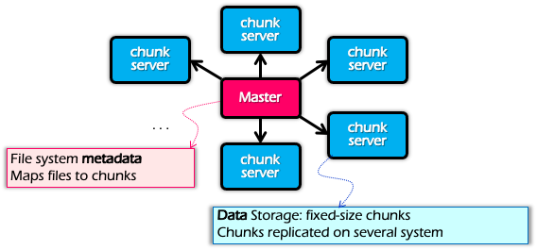
Locality
Problem: the bandwidth of datacenter network (at that time) is scarce
If a Map worker reads all the data from the network, it would be slow
Google: Input and Output files are stored on GFS
Google File System (SOSP’03), see previous lectures
Each chunk is replicated on multiple servers (3)
A review of GFS architecture

Slide 71
Locality
Problem: the bandwidth of datacenter network (at that time) is scarce
If Map worker reads all the data from the network, it would be slow
Google: Input and Output files are stored on GFS
Google File System (SOSP’03), see previous lectures
Each chunk is replicated on multiple servers (3)
MapReduce runs on GFS chunkservers
Collocate(搭配，连用) computation and storage
Master tries to schedule map worker on one of the nodes that has a copy of the input chunk it needs

Slide 72
Refinement: redundant execution(冗余执行)
Some workers can be slower than others, aka, stragglers
Other jobs consuming resources on machine
Bad disks with soft errors transfer data slowly
Weird things: processor caches disabled ☹
Near end of phase, MapReduce spawn backup copies of tasks
Whichever one finishes first “wins” ☺
Dramatically shortens job completion time:“significantly reduces the time to complete large MapReduce operations ”(check the paper)

Slide 73
Question
Compare two choices: saving intermediate results on mapper’s local disk VS. saving on reducer’s local disk
Mapper-side:
Pre-aggregation → save network resource
Map task failure → no partial data
Reduce task failure → just pull data again
Reducer-side:
Pipeline → overlap the transfer time
Paper: Tyson Condie et al, MapReduce Online, NSDI, 2010

Slide 74
Summary of MapReduce
Get a lot of data from input files
Map
Parse & extract items of interest
Partition & Sort
Reduce
Aggregate results
Write results to output files

Slide 75
Summary of MapReduce
The user does not need to care concurrency, fault-tolerant, data transfer, etc.
Reduce the user code burden and quality:
Sort: only needs 50 LoC
Indexing: reduce the code lines from 3800 LoC to 700LoC

Slide 76
Summary of MapReduce
MapReduce
Distributed shared memory
Pros:
Easy to scale
Fault tolerant
Good performance (depends!)
Good for tasks that suits MapReduce, e.g., wordcount
Cons
Limited programming abstraction
Scalability
Ease of
programming
Performance
Consistency
Fault tolerance

Slide 77
MapReduce cannot address all the issues
MapReduce was used to process webpage data collected by Google’s crawlers
It would extract the links and metadata needed to search the pages
Determine the site’s PageRank
The process took around eight hours
Results were moved to search servers
This was done continuously
批处理系统时延较高，
实时性很差
Web crawlers
MapReduce
Migrate to search server
~8 hours!

Slide 78
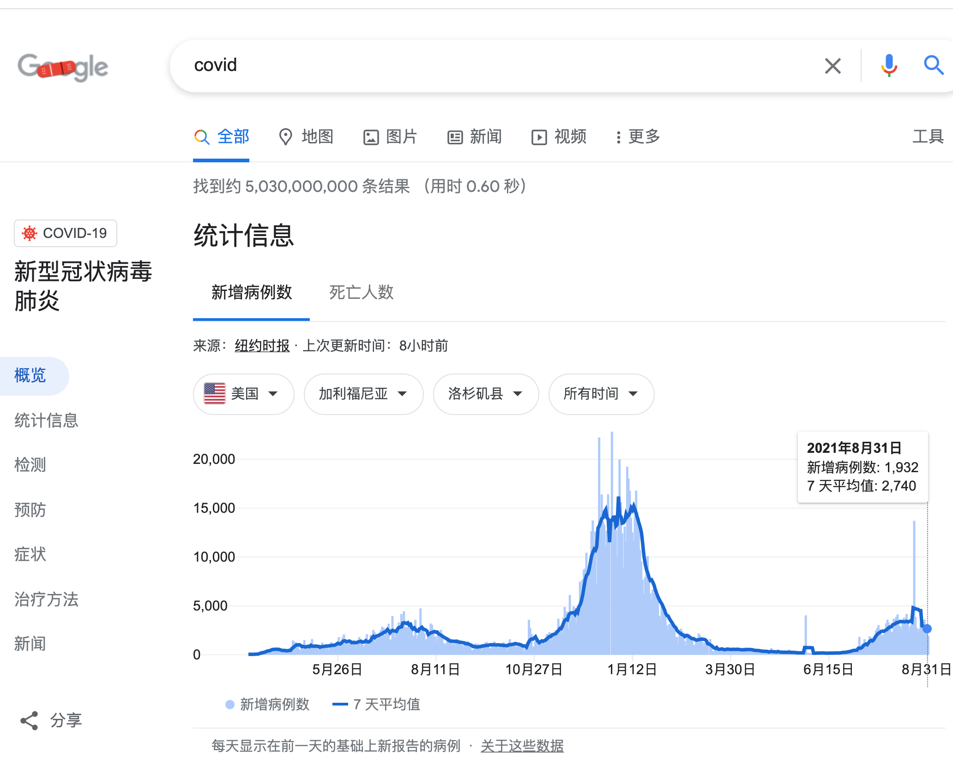
MapReduce cannot address all the issues
Web has become more dynamic
An 8+ hour delay is a lot for some sites
Goal: refresh certain pages within seconds
MapReduce
Batch-oriented
Not suited for near-real-time processes
Cannot start a new phase util previous completed
Not optimized for specific tasks (e.g., Graph)

Slide 79


MapReduce cannot address all the issues
Time
Graph
Graph analytics frameworks
MapReduce
Machine
Learning
…
Machine learning
frameworks
Caffeine
Search
Engine
Google’s new search
engine

Slide 80
Restrictiveness of MapReduce Programming Model
Question#1
How can we use MapReduce to implement “find the five most popular pages”?
Hint:
We can chain multiple MapReduce tasks together (will implement in Lab4)

Slide 81
Restrictiveness of MapReduce Programming Model
Question#2:
Is chaining multiple MapReduce tasks a good solution?
E.g., programming is not easy
Fault tolerance of multiple map-reduce tasks is not supported, should be handled by the users

Slide 82
MapReduce is not optimized for multiple-sages execution
MapReduce runtime is not optimized for iteration
Persistent I/O (e.g., GFS)
. . .
Awk
sort
Time
Data
Data
Map
Reduce
Map
Reduce
Data
Data
Data
Map
Reduce
Map
Reduce
Startup Penalty
Disk Penalty
Startup Penalty
Disk Penalty
Data
Data
Map
Reduce
Data
Data
Data
Map
Reduce
Map
Reduce
Data

Slide 83
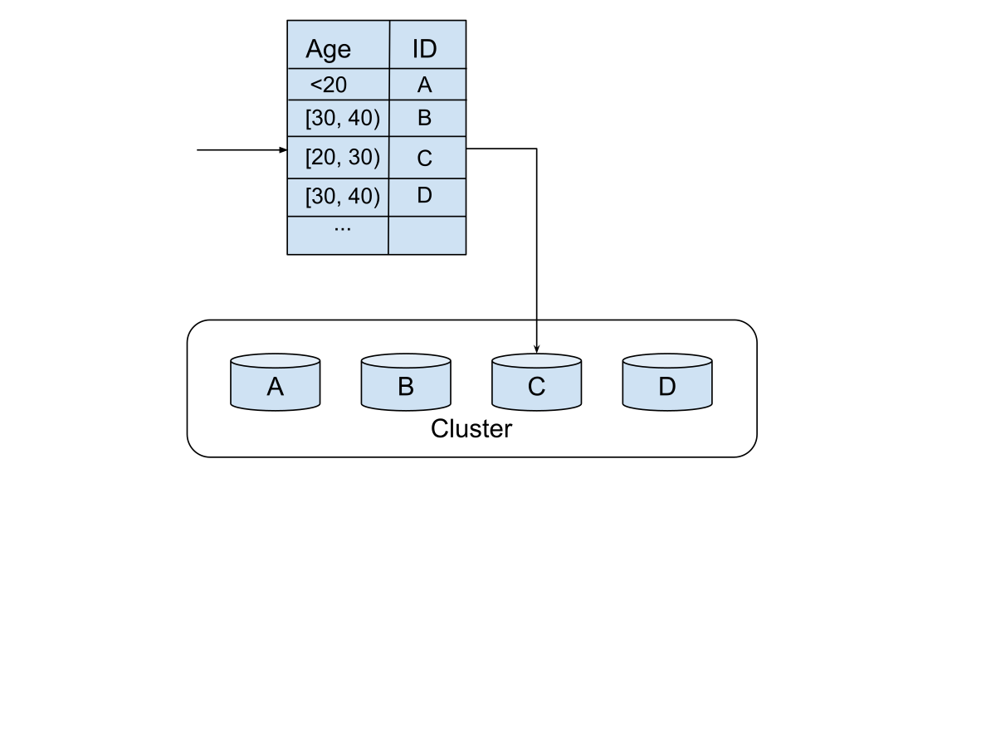
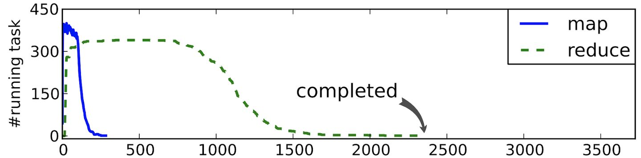
Sharding is critical
Example: Weibo’s user data
Sharding by age?
Most users in [20,30)
Node-C becomes the straggler
How to shard may depend on the application semantics

Slide 84
Dryad: Distributed Data-Parallel Programs from Sequential Building Blocks

Slide 85
Dryad
Created by Microsoft (EuroSys’07)
Authors: Michael Isard, Andrew Birrell, et al.
Similar goals as MapReduce
A general-purpose distributed execution engine for coarse-grain data-parallel applications
Focus on throughput, not latency
Automatic management of scheduling, distribution, and fault tolerance

Slide 86
Programming model of Dryad
Computations are expressed as a graph
Vertices are computations
Edges are communication channels
Each vertex has several input and output edges
A
A
B
B
B
B
C
D
AS=A^n
B
B
A
A
A
A
A
BS=B^n
AS>=BS
AS>>BS
A>=C || A>=D

Slide 87
Dryad uses a dataflow graph
Why?
Many programs can be represented as a distributed dataflow graph
Dryad Job = Directed Acyclic Graph (DAG)(有向无环图)
Outputs
Processing Vertices
Channels (file, pipe, memory)
Inputs

Slide 88
Dryad uses a dataflow graph
Dryad Job = Directed Acyclic Graph (DAG)
Back to our log analysis example
…
unique
sort
awk
Inputs

Slide 89
The runtime of Dryad
Vertices (V) run arbitrary app code, exchange data through TCP pipes etc., and communicate with JM to report status
Job Schedule
Data Plane
Files FIFO Network
V
V
V
JM
NS
D
D
D
Control Plane

Slide 90
The runtime of Dryad
Job Manager (JM) consults name server (NS) to discover available nodes, and maintains job graph and schedules vertices
Job Schedule
Data Plane
Files FIFO Network
V
V
V
JM
NS
D
D
D
Control Plane

Slide 91
The runtime of Dryad
Daemon process (D) executes vertices
Job Schedule
Data Plane
Files FIFO Network
V
V
V
JM
NS
D
D
D
Control Plane

Slide 92
Scheduling in JM
General scheduling rules
Vertex can run anywhere once all its inputs are ready
Prefer executing a vertex near its inputs (locality)
Fault tolerance
Vertex fails → run it again
Vertex’s inputs are gone → run upstream vertices again (recursively)
Vertex is slow → run another copy elsewhere and use output from whichever finishes first
What if the vertex execution is non-idempotent？

Slide 93
Advantages of Dryad
Big jobs more efficient with Dryad
MapReduce: big job runs multiple (>=1) stages
Reducers of each stage with regard to distributed storage (GFS)
Output of reduce → 2 network copies + 3 disk writes
Dryad: each job is represented with a DAG
Intermediate vertices write to local file
Dryad provides more flexible operations

Slide 94
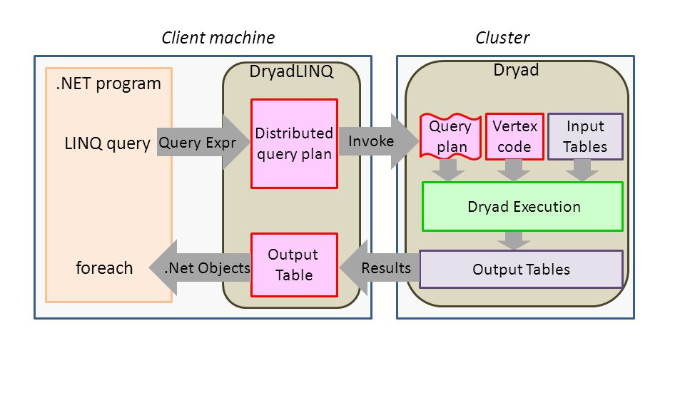
DryadLINQ: Dryad + LINQ (SQL like)
More friendly to traditional data programmers: use LINQ (SQL-like language)

Slide 95
Summary
Dryad lets developers easily create large-scale distributed apps without requiring them to master any concurrency techniques beyond being able to draw a graph of the data dependencies of their algorithms. -- Michael Isard
Sacrifice some architectural simplicity compared with MapReduce system design
Provide more flexible abstract to developers expressing their code as a DAG

Slide 96
Next lecture
Graph analytics frameworks

