Slide 1


Consistency models and eventual consistency
SE3331-1 (2022 Fall)
Xingda Wei, Yubin Xia
IPADS, Shanghai Jiao Tong University
https://www.sjtu.edu.cn
Credits: Rong Chen@IPADS, jinyang Li@NYU

Slide 2
Scalable websites overview
Scalable websites powered by distributed systems
For request handling, data storage
Caching server
Caching server
Caching server
…
Caching
Caching
Caching
Distributed caching
Database server
Database server
CDN
Users
Application #1
generate the page
Database
user, price
…
Database
user, price
Application server
Distributed database
Internet
Load
Balance
Application #2
add the order
File server
File server
File server
File:
image
File:
image
…
File:
image
Application server
…
…
Message queue
Distributed file system

Slide 3
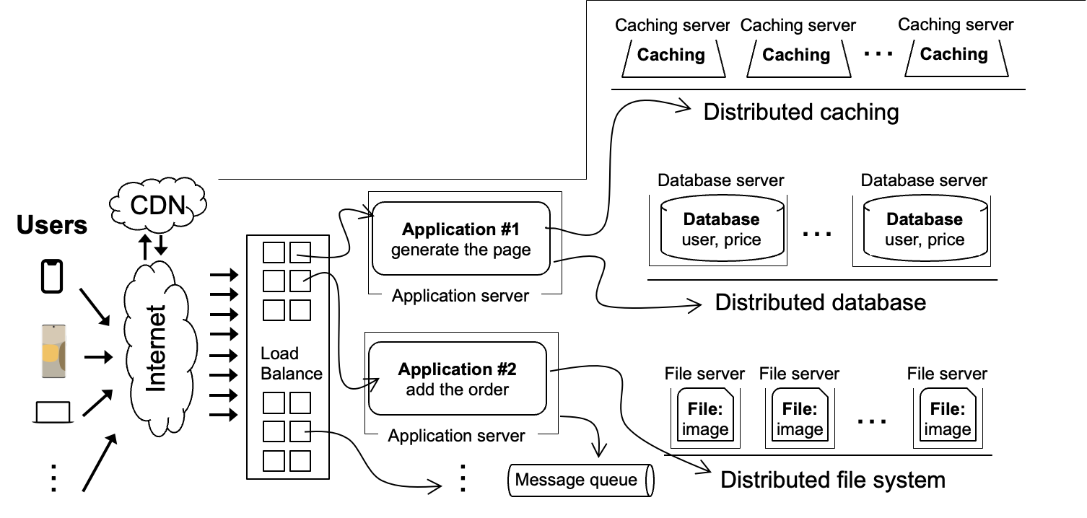
Scalable websites overview
Scalable websites powered by distributed systems
For request handling, data storage
Database server
Database server
Database
user, price
…
Database
user, price
Distributed database

Slide 4
Database is a very large topic
(Informally) A database system is system to store & manage the data
Data can be
File
Key-value storage
More complex model
E.g., SQL, Graph, etc.

Slide 5
Database is a very large topic
(Informally) A database system is system to store the data
Systems related to database
(Distributed) Filesystem (e.g., GFS, see previous lectures)
Database management system (see later lectures)
Key-value storage (single-node KVS)
Single key-value storage is insufficient

Slide 6



Motivating example: photo gallery
App: photo gallery
Consist of many albums (identified by an ‘aid’)
Each album contains an ordered list of photos (identified by a ‘pid’)
Operations
Add/delete album
Add photo to album
...
Use case: photos on the phone
Photo Gallery
Album (aid=0)
Album (aid=1)
...
Photo
(pid=2)
Photo (pid=2)
Photo
(pid=1)
Photo (pid=1)
Photo
(pid=0)
Photo (pid=0)
Photo (pid=0)

Slide 7
Approach one: store the photos locally
Photo Gallery
Album (aid=0)
Album (aid=1)
...
We directly store the photos on the phone
w/ a single-node key-value store
Pros
Optimal access performance
Cons
No fault tolerant support
Cannot share with others
Photo
(pid=2)
Photo (pid=2)
Photo
(pid=1)
Photo (pid=1)
Photo
(pid=0)
Photo (pid=0)
Photo (pid=0)

Slide 8
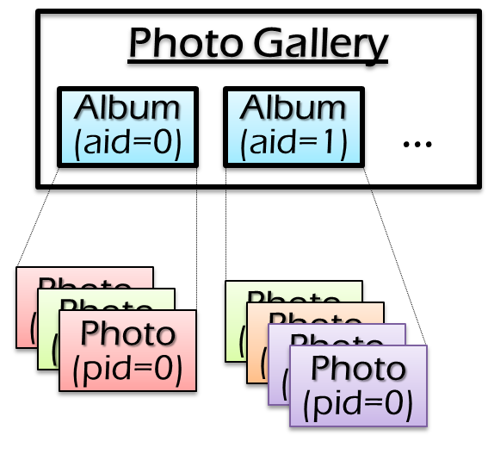
Approach two: use a cloud server (e.g., iCloud)
One server (e.g., RPC + LSM Tree)
The server may be replicated to tolerate failures (see later lectures)
More fault-tolerant than the iPhone
But what about more devices?
E.g., Share photos on iPad
Server
Network
X
Y
Client
Add photo X
Add photo Y
Client

Slide 9
Essentially, the photos are stored on multiple servers
The servers can be iPhone (unreliable), iPad and iCloud servers (reliable)
Modify on any node, as well as read
Challenge: network connectivity
Periodic connectivity to net and other nodes
E.g., added photos are only synced when WiFi is available
连接不同类型机器的问题：
1.不同类型设备对于数据类型的异构性
2.网络连接问题，在于数据中心连接时网络较好，但是与其他单机连接可能比较依
赖外部的网络环境
SRV
iPad
Client
SRV
SRV
iPhone

Slide 10
Challenge in multiple-servers scenarios
The photos are stored on multiple servers
Can be viewed as replicated (e.g., multiple iCloud servers)(一般是对于数据中心而言)
Can be viewed as cached (iPhone cache the content of iCloud)(一般指的是本地机器获取远端server数据并存储在cache中)
Problem: consistency issues
An update on my iPhone may not be immediately seen on iPad
SRV
iPad
Client
SRV
SRV
iPhone

Slide 11
Review: what is consistency model?
Consistency model defines rules for the apparent order and
visibility of updates, and it is a continuum with tradeoffs.
- Todd Lipcon
Notes:
Todd Lipcon: Hadoop and H

Slide 12
Review: what is consistency model?
Consistency model defines rules for the apparent order and
visibility of updates, and it is a continuum with tradeoffs.
- Todd Lipcon
Single object consistency is
also called “coherence”
Examples
Local shared virtual memory
W(y) 1
R(y) (should be 1)
Time
Notes:
Todd Lipcon: Hadoop and H

Slide 13
Review: what is consistency model?
Consistency model defines rules for the apparent order and
visibility of updates, and it is a continuum with tradeoffs.
- Todd Lipcon
Single object consistency is
also called “coherence”
Examples
Local shared virtual memory
Database
W(y) 1
R(y) (should be 1)
Time
X <- X + 1 ; Y <- Y - 1
Assert X+Y unchanged
Consistency across multiple objects
e.g., all-or-nothing + before-or-after
Notes:
Todd Lipcon: Hadoop and H

Slide 14
Consistency Challenges
No Right or Wrong consistency models
Tradeoffs between ease of programmability & performance
Consistency is hard in (distributed) systems
Data replication (& caching)
Concurrency (multi-core & multi-host)
Failures (e.g., machine or network)

Slide 15
Consistency so far
Concurrency forces us to think about meaning of read/write
Sequential consistency (e.g., DSM)
Everyone sees same read/write order

Slide 16
Can we use DSM? i.e., sequential consistency
Recall DSM’s protocol
DSM needs a central server as the coordinator
DSM should wait for machine’s ACK to process each request
Not practical for our photo applications
Performance issue: adding a photo requires syncing all my devices
Availability issue: what if iPhone is the owner, and its wifi/5G is broken?
SRV
iPhone
Client
SRV
SRV
iPhone

Slide 17
Drawback of sequential consistency
Very slow
Must ask before each operation
Single master may become the performance bottleneck
Sequential: ask master
Read and write (Copy_Set, Owner)
DSM w/ SC
Scalability
Ease of
programming
Performance
Consistency
Fault tolerance

Slide 18
Drawback of sequential consistency
Require highly available network connections
Lots of chatter between master/worker
Not suitable for certain scenarios
Disconnected clients (e.g., laptop, iPhone)
Apps might prefer potential inconsistency to loss of availability (e.g., shopping cart)
Geo-graphically distant apps (e.g., facebook)
DSM w/ SC
Scalability
Ease of
programming
Performance
Consistency
Fault tolerance

Slide 19
Spectrum(谱) of Consistency Models
Better performance/
Fault tolerance
Sequential
Eventual
Easy to program

Slide 20
Spectrum of Consistency Models
Better performance/
Fault tolerance
Previous lecture
Sequential
Eventual
Easy to program

Slide 21
Spectrum of Consistency Models
Better performance/
Fault tolerance
Sequential
Eventual
Today’s lecture
Easy to program

Slide 22
Eventual consistency

Slide 23
Ideal write execution flow for performance
Directly write to the server closest to the clients
After server acks the writes, propagate(传播) the updates to the other servers later
Question
What can go wrong in this setup? (assuming only writes now)
SRV
iPhone
Client
SRV
SRV
iPhone

Slide 24
Problem: write-write conflict
A common anomaly that can happen is called write-write conflict
Update the same thing concurrently without knowing each other
Result: two albums diverges, i.e., one server add X then Y, the other in a reverse order(出现顺序的不一致性)
Write-write conflict
SRV
Y
iPhone
Add photo X time=13:00
SRV
Add photo Y time=13:00
iPad
SRV
X
对于距离ipad较近的机器，在距离iphone较近的机器对其进行同步操作时，这个距离ipad较近的机器获取的add顺序为先x后y，iphone的机器相反。

Slide 25
Sequential consistency handles write-write conflict well
Sequential: pessimistic conflict handling
Assumption: conflicting writes is common case(与体系结构课程中讲的一样，所谓的”悲观”指的就是保守的考虑所有可能的conflict)
Updates cannot take effect unless they are serialized first
Therefore, no write-write conflict, the first server getting the owner permission wins!
But the server cannot always get the owner in our scenario!

Slide 26
Sequential consistency vs. Eventual consistency
Sequential: pessimistic conflict handling
Conflicting writes is common case
Updates cannot take effect unless they are serialized first
Eventual: optimistic conflict handling
Conflicting writes is rare case(即假定conflict基本不会发生，而是在操作完成之后去完善一致性，即不保证中间过程的一致性)
Let updates happen, worry about whether they can be serialized later

Slide 27
Eventual consistency
A specific of weak consistency model, informally:
All servers eventually receives all writes, and servers holding the same set of writes will have the same data contents(保证最终收敛到相同的最终状态)
Thus, if no new updates are made to the data, eventually all accesses will return the last update value
Possible(因为只需要最终实现同步，中间实现过程正确即可) read/write rule implementations
Read: return the latest local copies of the data
Write: write locally (and directly returns), propagate the writes to all the servers in background (e.g., upon sync)

Slide 28
Eventual consistency
Trade consistency for better performance
Accept a write before being able to serialize it
Reads can return a (possible) stale value than blocking for the latest value
But still need to cope with anomalies(异常)
Write-write conflict
Loss of causality(因果关系)
Need converging state
Need causality preserving

Slide 29
Eventual consistency
For better performance
Accept a write before being able to serialize it
Reads can return a (possible) stale value than blocking for the latest value
But still need to cope with anomalies
Write-write conflict
Loss of causality
Need converging state

Slide 30
Handling write-write conflict
Solution
After a local write, send writes to all the servers in the background
Each server apply the writes, resolve the conflicts if necessary
Problem #1: how to apply updates ?
Can we directly overwrite the original content? (不好)
Assumption: albums is a key-value store, where the value is a vector
Overwrite origin content: albums[aid][pid] = new_photo

Slide 31
Apply the updates
Strawman
Can we directly replace the old value with the new writes?
No. losing application semantic will also be “inconsistent”
Conflicts handling is application specific
Different applications may have different requirements
Write-write conflict
SRV
Y
iPhone
Add photo X time=13:00
SRV
Add photo Y time=13:00
iPad
SRV
X
Notes:
Note: 两个SRV的结果不一致

Slide 32
Solution: update function
Have update be a function (provided by the user), not a new value
e.g., function:
Read current state of storage, decide best change
Function must be deterministic(指函数返回值应确定)
Otherwise servers will get different answers
add ‘pid’ to album with ‘aid’
在不考虑函数嵌套的情况下，两个update function
必须要按照一定顺序执行，就不会出现前面的分别同时写入而导致的写冲突问题。但是这里的问题是，顺序暂时是无法确定的。
SRV1
SRV1
same state
same state
func1
func2
SRV2
SRV2
Ordered function alone is insufficient for the state divergence

Slide 33
Challenge: ordering
X
Y
Client
SRV1
SRV2
iPhone
Add X to album w/ aid
Add Y to album w/ aid
sync
在没有额外的约束情况下，这两种情况其实都可能，所以还是没有根本解决问题。
X (pid=10)
Y (pid=10)
Y (pid=11)
Time
X (pid=11)
Will Server1 show X in front of Y, and Server2 show Y in front of X?
Goal: eventual state convergence

Slide 34
Solution: Ordered Update Log
Ordered list of updates at each node
Record the updates in a log, and sort it according to some order
Storage state is result of applying updates in order
Syncing: ensure both nodes have the same updates in log
X
Y
Client
SRV1
SRV2
iPhone
Add X to album w/ aid
Add Y to album w/ aid
sync
Add X
Add Y
Add Y
Time
Add X
Log
Log

Slide 35
Solution: Ordered Update Log
Ordered list of updates at each node
Record the updates in a log, and sort it according to some order
Storage state is result of applying updates in order
Syncing: ensure both nodes have the same updates in log
X
Y
Client
SRV1
SRV2
iPhone
Add X to album w/ aid
Add Y to album w/ aid
Sort
sync
Sort
Add X
Add X
Add Y
Time
Add Y
Log
Log

Slide 36
Solution: Ordered Update Log
Ordered list of updates at each node
Record the updates in a log, and sort it according to some order
Storage state is result of applying updates in order
Syncing: ensure both nodes have the same updates in log
X
Y
Client
SRV1
SRV2
iPhone
Add X to album w/ aid
Add Y to album w/ aid
sync
Add X
X (pid=10)
X (pid=10)
Add X
Add Y
Y (pid=11)
Time
Y (pid=11)
Add Y
Log
Log

Slide 37
Problems of using ordered update log
How to determine the order of updates?
When to update the local copies of the data?

Slide 38
Determine the order of updates: using time
Tag update with the time the server receiving the events
Since each update has a timestamp, we can sort it in the log
Problem: there are ties
Two events happen to be at the same time
Note: it is challenging to synchronize clocks in a distributed setting

Slide 39
Assign unique IDs to the updates
Update ID: <time T, node ID>(此处采用优先比较的原则，即排在前的先比较，注意顺序)
Assigned by node that creates the update
Node ID is used to break the tie
Ordering update X and Y:
X < Y iff
(X.T < Y.T)
or
(X.T=Y.T and X.ID < Y.ID)

Slide 40
Assign unique IDs to the updates
Example
Assume the current last slot of the album is 10
Question
What is the final output of eventual consistency?
<10, Srv1>: Photo X at 10th or 11th position for album#1
<20, Srv2>: Photo Y at 10th or 11th position for album#1
Photo X at 10th and Photo Y at 11th position

Slide 41
Using unique update IDs to sort entries in the log
Update ID: <time T, node ID>
<10, Srv1>: Photo X at 10th or 11th position for album#1
<20, Srv2>: Photo Y at 10th or 11th position for album#1
X
Y
Client
SRV1
SRV2
iPhone
Add X to album w/ aid
Add Y to album w/ aid
sync
<10, SRV1> Add X
X (pid=10)
X (pid=10)
<10, SRV1> Add X
<20, SRV2> Add Y
Y (pid=11)
Time
Y (pid=11)
<20, SRV2> Add Y
Log
Log

Slide 42
Problems of using ordered update log
How to determine the order of updates?
When to update the local copies of the data?

Slide 43
Can we immediately apply the updates to local storage?
After receiving the updates, directly reflect to the storage
i.e., after adding a photo, I can directly read it at my phone
However, ordered log forbids this happen
Because we are unsure the order of the update this time (e.g., Y)
不能再获取update数据之后就直接写入disk，那样这个log就不起作用了
X
Y
Client
SRV1
SRV2
iPhone
Add X to album w/ aid
Add Y to album w/ aid
sync
Add X
Add Y
Add Y
Time
Add X
Log
Log

Slide 44
Problem: local updates break the order of the log
If we naively update the local storage, we cannot directly run the update functions after the sync
Because the initial state of the servers are different!
X
Y
Client
SRV1
SRV2
iPhone
Add X to album w/ aid
Add Y to album w/ aid
Add X
X (pid=10)
Y (pid=10)
Add X
Add Y
Time
Add Y
Log
Log
若采用先写入磁盘在使用log进行同步的方式，会出现最终状态还是不一致的情况，即最开始写入的X,Y是不一样的。(考虑side-effect的情况)

Slide 45
Solution: Rollback and Replay
Rollback all the updates before the sync
Essentially clean the storage to an empty state
Re-run all update functions, starting from empty storage state
After syncing, Srv1 and Srv2 have same set of updates (ordered logs)
Srv1 and Srv2 arrive at same final state
We will optimize this in a bit

Slide 46
Question: is the current unique ID solution ok?
Note consider immediately do the updates after receiving the request.

Slide 47
How to choose the unique IDs are important
Question#1: can we use <node ID, time T> as the ID?
Correctness: no problem
User-experience: no so good. For example, I will always see my iphone’s photo before my Ipad’s photos, even I posted the photos earlier
Question#2: can <time T, node ID> prevent the above user-experience issue?
Depends on the clock time of the nodes
Yet we know that clocks are unsynchronized
计算机计时是通过物理时钟实现的，而这种实现在不同机器或者系统上会出现较大偏差。即，不同节点之间的系统时钟是不同步的。

Slide 48
Challenge: unsynchronized clock time
Goal: clock time reflect the (real wall clock time) update order
Will update order be consistent with wall-clock time?
E.g., if I first post a photo on iPhone, and later post a photo on iPad, the iphone’s time will be smaller
However, the clock time between nodes is not synchronized
Example
Srv1 went first in wall-clock time with <10, Srv1>
Srv2 could still generate update ID <9, Srv2>

Slide 49
Unsynchronized clocks can cause subtle problem
Time=11
Time=8
X
X
Client
SRV1
SRV2
iPhone
Add X to album w/ aid
Sees X
sync
X <10, Srv1>
Srv2 re-run “add X”
Note that we assume updates apply to local storage immediately
So that we can see the latest results
Inconsistency will be rollback and replay later

Slide 50
Unsynchronized clocks can cause subtle problem
Time=12
Time=9
X
Client
SRV1
SRV2
iPhone
Add X to album w/ aid
Delete X
Add X <10, Srv1>
Srv2 re-run “add X”
Delete X <9, Srv2>

Slide 51
Unsynchronized clocks can cause subtle problem
Time=13
Time=10
X
Client
SRV1
SRV2
iPhone
Add X to album w/ aid
Delete X
sync
Add X <10, Srv1>
Srv2 re-run “add X”
Delete X <9, Srv2>
Re-run delete before add
Causality preserving

Slide 52
Causal ordering
Definition of causal relationship(因果关系): X -> Y iff
X,Y is created on the same node and X happens before Y (single-thread)
X, Y created by node_{i} and node_{j}, and X “causes” Y
Example
X is add photo, Y is delete the photo
There exists Z, such that X -> Z -> Y(传递性)

Slide 53
Causal ordering
<Time, ID> does not preserve the casual ordering
Why? The lock is unsynchronized
Goal
Clock should reflect the causal order
Idea
Sync clock using the events dependencies
Why possible? Because we don’t sync w/ wall clock time (doesn’t exist)

Slide 54
Solution: Lamport clock
We need causality timestamp
Lamport clock: a logical clock used to assign timestamps to events at each node
If event #1 and event #2 are created on the same node, and event #1 is before event #2
→ TS(event #1) < TS(event #2)
If event #1 “cause” event #2,
→ TS(event #1) < TS(event #2)

Slide 55
Lamport clock algorithms
Lamport logical clock
Each server keeps a clock T
Increments T as real time passes, e.g., one second per second
Modify T = Max(T, T’+1) if sees T’ from another server(这里+1是因为这个lock实际上是一个计数器，在机器1传到机器2的时候是要执行新的指令了(即引入了一个新的因果关系)，所以在机器1看来应该+1来表示新的指令)
Srv1: Add X with <10, Srv1>, Suppose T₁ = 10
Srv2: Sees “add X”, then update T₂ = Max(T₂, 11)
Srv2: Delete X with <11, Srv2>
Now, causality preserving!

Slide 56
Questions on Lamport clock
Can lamport clock give a total order to all the events?
i.e., given e1 & e2, T(e1) < T(e2) or T(e1) > T(e2)
No. There are ties
Yet, we can trivially break the tie by adding an additional order:
E.g., <Logical time, node ID>
The total ordering preserves the causality
Why total ordering is ideal?
If replicas apply writes according to total ordering, then replicas converge

Slide 57
Questions on Lamport clock
If TS(event #1) < TS(event #2), what does it say about event #1 (create on node #1) and event #2 (created on node #2)?
Event #1 occurred at a physical time earlier than event #2
Node #1 must have communicated with Node #2(只有通信过之后才能知道到底谁有更小的logical time)
If event #1 has been synced to node #2, then event #1 must have occurred at a physical time earlier than event #2
Notes:
No
No
Yes

Slide 58
Lamport clock gives a total order to events
For every pair of events, we can compare their time
i.e., T(e1) < T(e2) or T(e1) > T(e2)
Problem: too strong
The order may disagree with the external observer, especially for un-related events(无因果关系的事件无法保证其绝对的”正确”顺序)
E.g., suppose I add a photo to Alice, bob adds a photo to Bob independently
The system may order Bob’s event earlier than me with Lamport‘s clock, even they are unrelated

Slide 59
Requirement: partial order
Consider two events e1 & e2, they may have
T(e1) < T(e2)
T(e2) < T(e1)
Incomparable! (用于描述时间的无关联性)

Slide 60
Realizing partial order: vector clock
Clocks are represented as a vector (one entry per server)
Each entry corresponds to a local lamport clock on the server
[1, 2]
[1, 2]
Server0
Server1

Slide 61
Realizing partial order: vector clock
Clocks are represented as a vector (one entry per server)
Each entry corresponds to a local lamport clock on the server
Increments local T as real time passes, e.g., one second per second
[2, 2]
[1, 2]
Server0
Server1

Slide 62
Realizing partial order: vector clock
Clocks are represented as a vector (one entry per server)
Each entry corresponds to a local lamport clock on the server
Increments local T as real time passes, e.g., one second per second
Suppose we have two independent events here
Srv0: Add X with [2, 2]
Srv1: Add Y with [1, 3]
Incomparable!
[2, 2]
[1, 3]
vector clock的比较应该是每一项
都小于或大于才能说结果是
小于或大于，其余情况都是不
可比较的。
Server0
Server1

Slide 63
Realizing partial order: vector clock
Clocks are represented as a vector (one entry per server)
Each entry corresponds to a local lamport clock on the server
Increments local T as real time passes, e.g., one second per second
Modify T_{i} = Max(T_{i}, T_{i}’+1) if sees T from another server
Srv0: Add X with [2, 2]
Srv1: Add Y with [1, 3]
Sync
这里是[2,4]的原因:对于srv0，
其在进行同步的时候原始时间为2，从srv1那里获取的时间为1,(这个1就是上述的T‘)，
所以新的srv0时间为max(2,1+1),类似的，新的srv1时间为max(2, 3+1)=4,
所以sync后为[2,4]
[2, 4]
[1, 3]
Server0
Server1

Slide 64
Realizing partial order: vector clock
Clocks are represented as a vector (one entry per server)
Each entry corresponds to a local lamport clock on the server
Increments local T as real time passes, e.g., one second per second
Modify T_{i} = Max(T_{i}, T_{i}’+1) if sees T from another server
Srv0: Add X with [2, 2]
Srv1: Add Y with [1, 3]
Srv0: Delete Y with [3, 4]
Sync
[3, 4]
[1, 3]
这里在同步之后为[2,4],之后srv0进行了delete Y，所以新的srv0时间为[3,4]，因为这时候还没有将delete Y操作同步到srv1，所以srv1时间不需要修改
Server0
Server1

Slide 65
Lamport clock vs. Vector clock
Both captures the causal relationships between events
In comparison:
Lamport clock: total order
Vector clock: partial order
Our current usage of clock is still lamport
Sufficient to order events
Save space for storing the clock(vector lock大小与机器数量成正比，空间占用过大)
We will see the adoption of vector clock in later classes

Slide 66
Lamport clock in our previous example
Time=11
Time=8
X
X
Client
SRV1
SRV2
iPhone
Add X to album w/ aid
Sees X
sync
X <10, Srv1>
Srv2 re-run “add X”
Note that we assume updates apply to local storage immediately
So that we can see the latest results
Inconsistency will be rollback and replay later

Slide 67
Challenge remains: Local writes are tentative
Recall
For performance, we place a write immediately at the local node
However, the write may be unstable
E.g., Never know if there’s some other photo from servers you haven’t yet synced
Our previous solution will re-run all update functions, starting from empty storage state
Inefficient
Question
Can we avoid re-run all the update functions?
Notes:
问题：本地写完了，真的就能出现在本地了吗？

Slide 68
Idea: distinguish tentative writes from stable ones
Each server’s log consists of 2 portions:
Stable writes, followed by
Tentative writes
Stable writes are not rolled backup upon sync
Question
How to determine which writes are stable? (hint: using the lamport clock!)
Answer
An update (W) is stable iff no entries will have a lamport timestamp < W
(即某个update拥有当前的最小的lamport lock时间戳)

Slide 69
De-centralized approach
Commit (write) scheme
Update <10, A> is stable if all nodes have seen all updates with time <= 10
Because it will never see a timestamp < 10 (according to the rule of lamport time)
Still so many writes may be rolled back on re-connect
Problem: If any node is offline, the stable portion of all logs stops growing

Slide 70
Centralized approach
Commit scheme
One server designated “primary”
Assign a total commit order: CSN to each write
Complete timestamp: <CSN, local-TS, SrvID>
Any write with a known CSN is stable
All stable writes are ordered before tentative writes
CSNs are exchanged between servers
CSNs define a total order for committed update
CSN: Commit-Seq-No
Advantage: as long as the primary is up, writes can be committed and stabilized
Notes:
Any write with a known CSN is stable
Why? Because later writes will have a larger CSN

Slide 71
Does CSN order preserve causality?
Complete timestamp: <CSN, local-TS, SrvID>
Should do some works
A server asks the primary to assign CSN for all tentative writes (include those received from others)
i.e., the primary can assign a larger CSN for a dependent write
Question
Does complete timestamp always match the tentative order?

Slide 72
Will CSN matches update order?
Not always. The primary can see newer updates before the old ones, as long as they don’t have casualty relationship
<-, 10, Srv1>
Time
Primary
Server
Server
<-, 10, Srv1>
Server

Slide 73
Will CSN matches update order?
Not always. The primary can see newer updates before the old ones, as long as they don’t have casualty relationship
<-, 10, Srv1>
Time
<-, 20, Srv2>
Primary
Server
Server
<-, 10, Srv1>
<-, 20, Srv2>
Server

Slide 74
Will CSN matches update order?
Not always. The primary can see newer updates before the old ones, as long as they don’t have casualty relationship
<-, 10, Srv1>
sync
Time
<-, 20, Srv2>
Primary
Server
Server
<-, 10, Srv1>
sync
<-, 20, Srv2>
Server
<-, 10, Srv1>

Slide 75
Will CSN matches update order?
Not always. The primary can see newer updates before the old ones, as long as they don’t have casualty relationship
<-, 10, Srv1>
sync
Time
<-, 20, Srv2>
sync
Primary
Server
Server
sync
<-, 10, Srv1>
sync
<-, 20, Srv2>
Server
<-, 10, Srv1>
<-, 20, Srv2>

Slide 76
Will CSN matches update order?
Not always. The primary can see newer updates before the old ones, as long as they don’t have casualty relationship
<-, 10, Srv1>
sync
Time
<-, 20, Srv2>
sync
sync primary
Primary
<5, 20, Srv2>
sync
Server
Server
sync
<-, 10, Srv1>
sync
<-, 20, Srv2>
Server
<-, 10, Srv1>
<-, 20, Srv2>

Slide 77
Will CSN matches update order?
Not always. The primary can see newer updates before the old ones, as long as they don’t have casualty relationship
<-, 10, Srv1>
sync
sync primary
Time
<-, 20, Srv2>
sync
sync primary
Primary
<5, 20, Srv2>
<6, 10, Srv1>
sync
sync
Server
Server
sync
<-, 10, Srv1>
sync
<-, 20, Srv2>
Server
<-, 10, Srv1>
<-, 20, Srv2>

Slide 78
Does CSN order preserve causality?
Not always. The primary can see newer updates before the old ones, as long as they don’t have casualty relationship
<-, 10, Srv1>
sync
sync primary
sync
Time
<-, 20, Srv2>
sync
sync primary
只有当两个事件有因果关系时，
才会同时的同步到primary
Primary
<5, 20, Srv2>
<6, 10, Srv1>
sync
sync
Server
sync
Server
sync
<-, 10, Srv1>
sync
<-, 20, Srv2>
Server
<-, 10, Srv1>
Commit order unmatch tentative order
<-, 20, Srv2>

Slide 79
Does CSN order preserve causality?
Not always. The primary can see newer updates before the old ones, as long as they don’t have casualty relationship
<-, 10, Srv1>
sync
sync primary
sync
Time
<-, 20, Srv2>
sync
sync primary
Primary
<5, 20, Srv2>
<6, 10, Srv1>
sync
sync
Server
sync
Server
sync
<-, 10, Srv1>
sync
<-, 20, Srv2>
Server
<5, 20, Srv2>
Re-order the updates
<6-, 20, Srv1>

Slide 80
Trimming the log
Logs can be kept long without trimming
When nodes receives new CSNs, can discard all committed log entries seen up to this point
Result: No need to keep years of log data

Slide 81
Summary so far
Eventual consistency is a weak consistency model
Result in anomalies
Techniques to deal with these anomalies in this lecture comes from Bayou⁺
Introduced some very influential design ideas
Update functions
Ordered update log is the real truth, not the storage/database
Use lamport clock for casually ordered writes
Techniques everyone should know when consider distributed systems
Lamport clock, vector clocks, causal relationships
+Managing Update Conflicts in Bayou, a Weakly Connected Replicated Storage System (SOSP’95)

Slide 82
What about reads?
Possible read/write rule implementations
Read: return the latest local copies of the data
Write: write locally (and directly returns), propagate the writes to all the servers in background (e.g., upon sync)
Read may return
Tentative data
Outdated data
Trade read/write consistency for high performance

Slide 83





Reading tentative data is sometimes dangerous
For Users:
For Programmers:
Friends
Boss
Photo Upload
Add to album
New Job!
Employment Integrity
Referential Integrity
Can these happen in our current system?

Slide 84

Reading tentative data is sometimes dangerous
<-, 11, Srv1> ”Delete boss
for the album permission”
Time
<-, 20, Srv1> ”new job!”
What about read at server 3?
Primary
<-, 20, Srv1> ”new job!”
Server
Server
<-, 10, Srv1> ”Delete boss
for the album permission”
sync
Server
<-, 11, Srv1> ”Delete boss
for the album permission”
What about read at server 3?

Slide 85
Eventual vs. Sequential consistency
DSM w/ SC
Bayou w/ eventual
Scalability
Still have a single primary (but operations are much lightweight)
Ease of programming
Not so easy: update function & anomalies
Fault tolerance
As long as a single replica is up, client can work
Scalability
Ease of
programming
Performance
Consistency
Fault tolerance

Slide 86
Is eventual consistency a useful idea?
Depends on the applications
Yes, people want fast writes to local copies iPhone sync, Dropbox, etc.
Question: does eventual consistency have anomalies?
Obviously, yes.
Example
My updates to the iphone may not immediately appear on the iPad
Usually, the window of inconsistency is small
Small enough to be observed

Slide 87
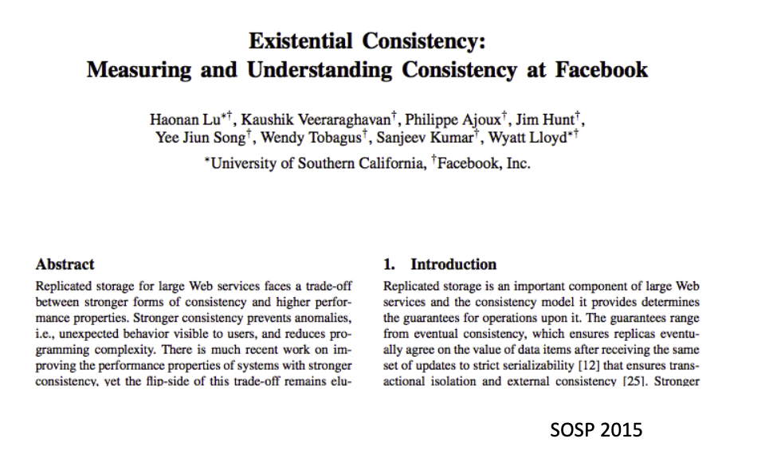
Does eventual consistency anomalies matter?
It depends on the application scenarios
Frequencies of the anomalies
Importance of the anomalies
For example, do conflicting operations happen a lot
Facebook has conducted a research to measure the frequencies of anomalies under eventual consistency. Some highlights are:
Per-Object sequential Results: 1 anomaly per million reads (user should see their writes)
A social networking website can tolerate many anomalies
However, many scenarios (e.g., Bank) require stronger models (even stronger than sequential consistency), see the later lectures.

