Slide 1


Before-or-after atomicity, Serializability & Transaction
SE3331-1 (2022 Fall)
Yubin Xia
IPADS, Shanghai Jiao Tong University
https://www.sjtu.edu.cn

Slide 2
Consistency can break under fault, even for the strongest consistency model

Slide 3
Review: All-or-Nothing atomicity
An action is atomic if it happens completely or not at all(取决于commit的时机以及crash的时机)
Action is an abstraction, can contain many operations
E.g., multiple disk writes, multiple memory reads/writes
Atomicity makes it much easier to reason about failures
Need to think about the consequences of the action happening or not happening, but not about the action partially happening
An action can be a group of other atomic actions
Under certain scenarios, a group of action is not atomic even all its sub-op is atomic! E.g., write the disk page containing record A

Slide 4
Review: techniques to support all-or-nothing
Systematic methods to support all-or-nothing atomicity
Shadow copy
Logging
Logging
REDO logging
UNDO-REDO logging
UNDO-only logging

Slide 5
Consistency can break under concurrency, even for the strongest consistency model + all-or-nothing atomicity

Slide 6
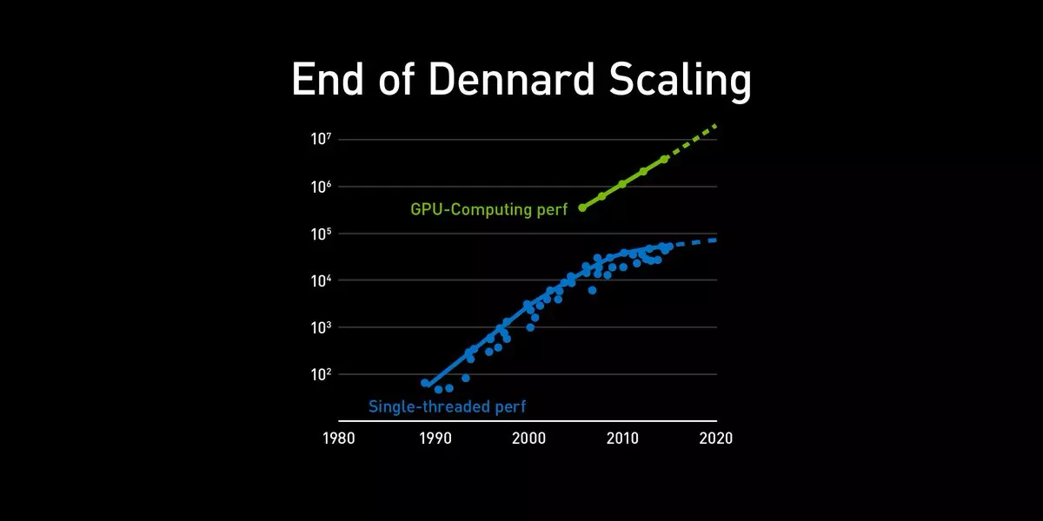


Why we need concurrency?
In order to scale to a higher performance
Single-thread is insufficient
The end of Moore‘s Law and Dennard's scaling: single core perf. doesn’t grow
Scale up
Using multiple cores
Scale out
Using multiple machines
Scale up
Scale out

Slide 7


Example: bank account deposit
…
Bob: 0¥
Bank = [ ... ]
Single-thread (core)
Expected performance: D
Multiple-core (scale up)(ideal)
Expected performance: D * C
Multiple-machine (scale out)(ideal)
Expected performance: D * C * M
Alice: 0¥
Deposit(bank, acct, amt):
bank[acct] += amt
Single-thread
Multiple-core
Multiple-machine
Deposit(bank,"alice”,10)
Time
…

Slide 8
Motivating example
Example: consider two threads access the same account concurrently
T0
T1
Deposit(bank,"alice”,10)
Deposit(bank, acct, amt):
bank[acct] += amt
Time
Question: what would happen?

Slide 9
Problem: missing updates
Example: consider two threads access the same account concurrently
T0
T1
Deposit(bank,"alice”,10)
Deposit(bank, acct, amt):
bank[acct] += amt
Time
Question: what would happen?
Alice: 0¥
Alice: 10¥ (20¥)
Notes:
这个例子里，没有all-or-nothing的问题

Slide 10
Core problem: atomicity of the + operator
Example: consider two threads access the same account concurrently
Why would this happen?
The deposit function is not atomic
Because CPU can only guarantee the atomicity of one instruction (而一行运算一般涉及到多个指令)
mov acct, %eax
add $amt, %eax
mov %eax, acct
Deposit(bank, acct, amt):
bank[acct] += amt
Developer’s written code
Compiler’s generated code

Slide 11
Core problem: atomicity of the + operator
mov acct, %eax
add $amt, %eax
mov %eax, acct
Deposit(bank, acct, amt):
bank[acct] += amt
Developer’s written code
Compiler’s generated code
Thread 0
Thread 1
Bank[Alice]
0
T0
T1
Deposit(bank,"alice”,10)
Time

Slide 12
Core problem: atomicity of the + operator
mov acct, %eax
add $amt, %eax
mov %eax, acct
Deposit(bank, acct, amt):
bank[acct] += amt
Developer’s written code
Compiler’s generated code
Thread 0
Thread 1
Bank[Alice]
0
Read acct
0
T0
T1
Deposit(bank,"alice”,10)
Time

Slide 13
Core problem: atomicity of the + operator
mov acct, %eax
add $amt, %eax
mov %eax, acct
Deposit(bank, acct, amt):
bank[acct] += amt
Developer’s written code
Compiler’s generated code
Thread 0
Thread 1
Bank[Alice]
0
Read acct
0
T0
T1
Read acct
0
Deposit(bank,"alice”,10)
Time

Slide 14
Core problem: atomicity of the + operator
mov acct, %eax
add $amt, %eax
mov %eax, acct
Deposit(bank, acct, amt):
bank[acct] += amt
Developer’s written code
Compiler’s generated code
Thread 0
Thread 1
Bank[Alice]
0
Read acct
0
T0
T1
Read acct
0
Deposit(bank,"alice”,10)
0
Increase
Time

Slide 15
Core problem: atomicity of the + operator
mov acct, %eax
add $amt, %eax
mov %eax, acct
Deposit(bank, acct, amt):
bank[acct] += amt
Developer’s written code
Compiler’s generated code
Thread 0
Thread 1
Bank[Alice]
0
Read acct
0
T0
T1
Read acct
0
Deposit(bank,"alice”,10)
0
Increase
Increase
0
Time

Slide 16
Core problem: atomicity of the + operator
mov acct, %eax
add $amt, %eax
mov %eax, acct
Deposit(bank, acct, amt):
bank[acct] += amt
RMW
Developer’s written code
Compiler’s generated code
Thread 0
Thread 1
Bank[Alice]
0
Read acct
0
T0
T1
Read acct
0
Deposit(bank,"alice”,10)
0
Increase
Increase
0
Write acct
10
Time

Slide 17
Core problem: atomicity of the + operator
mov acct, %eax
add $amt, %eax
mov %eax, acct
Deposit(bank, acct, amt):
bank[acct] += amt
Developer’s written code
Compiler’s generated code
Thread 0
Thread 1
Bank[Alice]
0
Read acct
0
T0
T1
Read acct
0
Deposit(bank,"alice”,10)
0
Increase
Increase
0
Write acct
10
Time
Write acct
10

Slide 18
The race condition problem
When two or more threads access shared data and at least one is write
Timing dependent error involving shared state
Whether it happens depends on how threads scheduled
Thread 0
Thread 1
Bank[Alice]
Thread 0
Thread 1
Bank[Alice]
0
0
Read acct
0
Read acct
0
Read acct
0
Increase
0
Increase
0
Write acct
10
Increase
0
Read acct
10
Write acct
10
Increase
10
Write acct
10
Write acct
20

Slide 19
Race condition is hard to control
Must make sure all possible schedules are safe
Number of possible schedules permutations is huge
Bad schedules that will and will not work sometimes
They are intermittent(断断续续的)
Small timing changes between invocations might result in different behavior which can hide bug (e.g., Therac-25)
Also known as Heisenbugs (Heisenberg uncertainty)(并发BUG)
Possible system solution-1: DMT (Deterministic Multi-Threading)
Possible system solution-2: Record and Replay
Both are hard in either correctness or cost, or both
DMT:就是尝试记录程序正确运行时的状态，并在之后的并发运行中进行一个恢复的操作，而这不是很现实，一个主要原因是状态很难保存，多是底层的interleave以及指令。

Slide 20
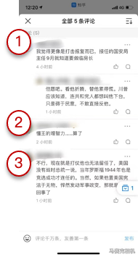

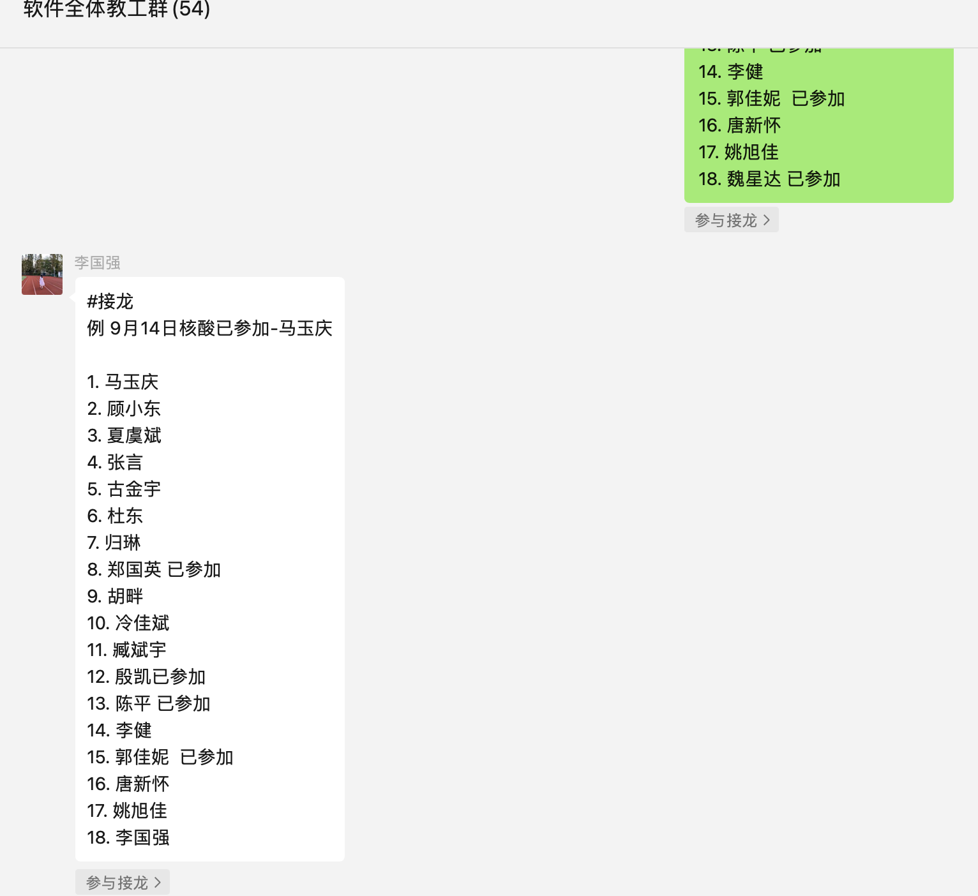
Race condition is bad, and is common
Real-world computing systems embrace concurrency
E.g., embrace the design of distributed systems
Bad: race condition brings unsatisfactory to the customers
E.g., the comment system in
Show 5 comments;
But only 3 presented on the app

Slide 21
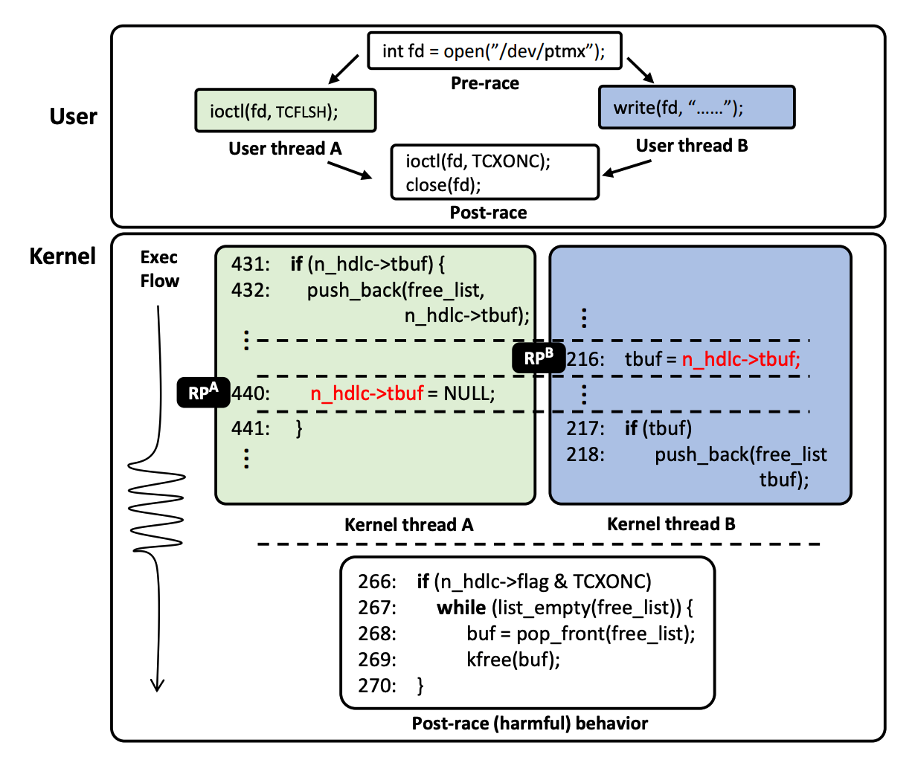
Race in Kernel
A simplified race example on CVE-2017-2636
As a user program executes two syscalls concurrently, a data race on n_hdlc->tbuf may occur depending on the execution order, which leads to a double-free issue allowing an attacker to launch privilege escalation attack
[S&P'19] RAZZER: Finding Kernel Race Bugs through Fuzzing

Slide 22
Race condition in Therac-25
The equipment control task did not properly synchronize with the operator interface task, so that race conditions occurred if the operator changed the setup too quickly. In three cases, the injured patients later died as a result of the overdose.

Slide 23
Before-or-After Atomicity(isolation)

Slide 24
Goal: before-or-after atomicity
To prevent hazard produced by race condition, we need concurrent actions to be atomic
E.g., cannot see/overwrites the intermediate states of a concurrent action
Thread 1 should not see the intermediate states of thread 0
Thread 0
Thread 1
Bank[Alice]
0
Read acct
0
before-or-after atomicity
相对于all-or-nothing atomicity而言更加强调的是执行的顺序问题。(all-or-nothing更加强调的是执行的完整性。)
Read acct
0
Increase
0
Increase
0
Write acct
10
Write acct
10

Slide 25
Goal: before-or-after atomicity (a.k.a, Isolation)
To prevent hazard produced by race condition, we need concurrent actions to be atomic
E.g., cannot see/overwrites the intermediate states of a concurrent action
Before or after atomicity
Concurrent actions have the before-or-after property if their effect from the point of view of their invokers is as if the actions occurred either completely before or completely after one another

Slide 26
Use locking to achieve before-or-after
Locks: allow only one CPU to be inside a piece of code at a time
Programs can acquire and release the lock
Example: pthread_mutex
Implementing the locks efficiently is a broad topic
And is non-trivial: out of the scope of this lecture
ICS中已经提到了一些关于软件层面手动实现”锁”得方式：
Test-and-Set,Compare-and-Swap,Fetch-and-Add

Slide 27
Use locking to achieve before-or-after: global lock
Locks: allow only one CPU core to run a piece of code at a time
Programs can acquire and release the lock
Global lock:(全局锁，好处是直接防止了内部代码的并行问题，但是性能不好)
The action must acquire the global lock before executing, and release it after it commits
Deposit(bank, lock, acct, amt):
acquire(lock)
bank[acct] += amt
release(lock)
Deposit(bank, acct, amt):
bank[acct] += amt

Slide 28
Use locking to achieve before-or-after: global lock
Deposit(bank, lock, acct, amt):
acquire(lock)
bank[acct] += amt
release(lock)
Deposit(bank, acct, amt):
bank[acct] += amt
Thread 0
Thread 1
Bank[Alice]
Thread 0
Thread 1
Bank[Alice]
0
0
Read acct
0
Read acct
0
Increase
0
Increase
0
Write acct
10
Write acct
10
Notes:
Can global lock prevent our previous race condition?

Slide 29
Use locking to achieve before-or-after: global lock
Deposit(bank, lock, acct, amt):
acquire(lock)
bank[acct] += amt
release(lock)
Deposit(bank, acct, amt):
bank[acct] += amt
Thread 0
Thread 1
Bank[Alice]
Thread 0
Thread 1
Bank[Alice]
0
0
Read acct
0
Acquire(lock)
0
Read acct
0
Increase
0
Increase
0
Write acct
10
Write acct
10
Notes:
Can global lock prevent our previous race condition?

Slide 30
Use locking to achieve before-or-after: global lock
Deposit(bank, lock, acct, amt):
acquire(lock)
bank[acct] += amt
release(lock)
Deposit(bank, acct, amt):
bank[acct] += amt
Thread 0
Thread 1
Bank[Alice]
Thread 0
Thread 1
Bank[Alice]
0
0
Read acct
0
Acquire(lock)
0
Read acct
0
Read acct
0
Increase
0
Increase
0
Write acct
10
Write acct
10
Notes:
Can global lock prevent our previous race condition?

Slide 31
Use locking to achieve before-or-after: global lock
Deposit(bank, lock, acct, amt):
acquire(lock)
bank[acct] += amt
release(lock)
Deposit(bank, acct, amt):
bank[acct] += amt
Thread 0
Thread 1
Bank[Alice]
Thread 0
Thread 1
Bank[Alice]
0
0
Read acct
0
Acquire(lock)
0
Read acct
0
Read acct
0
Increase
0
Acquire(lock)
0
Increase
0
Write acct
10
Write acct
10
Notes:
Can global lock prevent our previous race condition?

Slide 32
Use locking to achieve before-or-after: global lock
Deposit(bank, lock, acct, amt):
acquire(lock)
bank[acct] += amt
release(lock)
Deposit(bank, acct, amt):
bank[acct] += amt
Thread 0
Thread 1
Bank[Alice]
Thread 0
Thread 1
Bank[Alice]
0
0
Read acct
0
Acquire(lock)
0
Read acct
0
Read acct
0
Increase
0
Acquire(lock)
0
Increase
0
Read acct
0
Write acct
10
Write acct
10
Can this happen?
Notes:
Can global lock prevent our previous race condition?

Slide 33
Use locking to achieve before-or-after: global lock
Deposit(bank, lock, acct, amt):
acquire(lock)
bank[acct] += amt
release(lock)
Deposit(bank, acct, amt):
bank[acct] += amt
Thread 0
Thread 1
Bank[Alice]
Thread 0
Thread 1
Bank[Alice]
0
0
Read acct
0
Acquire(lock)
0
Read acct
0
Read acct
0
Increase
0
Acquire(lock)
0
Increase
0
Write acct
10
Write acct
10
Notes:
Can global lock prevent our previous race condition?

Slide 34
Use locking to achieve before-or-after: global lock
Deposit(bank, lock, acct, amt):
acquire(lock)
bank[acct] += amt
release(lock)
Deposit(bank, acct, amt):
bank[acct] += amt
Thread 0
Thread 1
Bank[Alice]
Thread 0
Thread 1
Bank[Alice]
0
0
Read acct
0
Acquire(lock)
0
Read acct
0
Read acct
0
Increase
0
Acquire(lock)
0
Increase
0
Increase
Acquire(lock)
0
Write acct
10
Write acct
10
Thread is stuck at the acquiring the lock
Notes:
Can global lock prevent our previous race condition?

Slide 35
Use locking to achieve before-or-after: global lock
Deposit(bank, lock, acct, amt):
acquire(lock)
bank[acct] += amt
release(lock)
Deposit(bank, acct, amt):
bank[acct] += amt
Thread 0
Thread 1
Bank[Alice]
Thread 0
Thread 1
Bank[Alice]
0
0
Read acct
0
Acquire(lock)
0
Read acct
0
Read acct
0
Increase
0
Acquire(lock)
0
Increase
0
Increase
Acquire(lock)
0
Write acct
10
Write back
Acquire(lock)
10
Write acct
10
Notes:
Can global lock prevent our previous race condition?

Slide 36
Use locking to achieve before-or-after: global lock
Deposit(bank, lock, acct, amt):
acquire(lock)
bank[acct] += amt
release(lock)
Deposit(bank, acct, amt):
bank[acct] += amt
Thread 0
Thread 1
Bank[Alice]
Thread 0
Thread 1
Bank[Alice]
0
0
Read acct
0
Acquire(lock)
0
Read acct
0
Read acct
0
Increase
0
Acquire(lock)
0
Increase
0
Increase
Acquire(lock)
0
Write acct
10
Write back
Acquire(lock)
10
Write acct
10
Release(lock)
Acquire(lock)
10
Notes:
Can global lock prevent our previous race condition?

Slide 37
Use locking to achieve before-or-after: global lock
Deposit(bank, lock, acct, amt):
acquire(lock)
bank[acct] += amt
release(lock)
Deposit(bank, acct, amt):
bank[acct] += amt
Thread 0
Thread 1
Bank[Alice]
Thread 0
Thread 1
Bank[Alice]
0
0
Read acct
0
Acquire(lock)
0
Read acct
0
Read acct
0
Increase
0
Acquire(lock)
0
Increase
0
Increase
Acquire(lock)
0
Write acct
10
Write back
Acquire(lock)
10
Write acct
10
Release(lock)
Acquire(lock)
10
Increase
10
Notes:
Can global lock prevent our previous race condition?

Slide 38
Use locking to achieve before-or-after: global lock
Deposit(bank, lock, acct, amt):
acquire(lock)
bank[acct] += amt
release(lock)
Deposit(bank, acct, amt):
bank[acct] += amt
Thread 0
Thread 1
Bank[Alice]
Thread 0
Thread 1
Bank[Alice]
0
0
Read acct
0
Acquire(lock)
0
Read acct
0
Read acct
0
Increase
0
Acquire(lock)
0
Increase
0
Increase
Acquire(lock)
0
Write acct
10
Write back
Acquire(lock)
10
Write acct
10
Release(lock)
Acquire(lock)
10
Increase
10
Write back
20
Notes:
Can global lock prevent our previous race condition?

Slide 39
Use locking to achieve before-or-after: global lock
Deposit(bank, lock, acct, amt):
acquire(lock)
bank[acct] += amt
release(lock)
Deposit(bank, acct, amt):
bank[acct] += amt
Thread 0
Thread 1
Bank[Alice]
Thread 0
Thread 1
Bank[Alice]
0
0
Read acct
0
Acquire(lock)
0
Read acct
0
Read acct
0
Increase
0
Acquire(lock)
0
Increase
0
Increase
Acquire(lock)
0
Write acct
10
Write back
Acquire(lock)
10
Write acct
10
Release(lock)
Acquire(lock)
10
Increase
10
Write back
20
Release(lock)
20
Notes:
Can global lock prevent our previous race condition?

Slide 40
Use locking to achieve before-or-after: global lock
Locks: allow only one CPU to be inside a piece of code at a time
Programs can acquire and release the lock
Global lock:
The action must acquire the global lock before executing, and release it after it commits
Drawback
Only allow one action to run at a time(
并行程序被完全的串行化了，与希望的
通过并行来提高性能相悖，并且在一个
thread拿到锁之后其余的thread会处于
饥饿状态)
+ global lock
T0
T1
T0
T1
Requiring Lock
Deposit(Alice)
Deposit(bob)
Time

Slide 41

Use locking to achieve before-or-after: fine-grained(细粒度) locking
…
Fine-grained locking:
Each shared data has one lock
E.g., a lock for Alice & a lock for Bob
Locking rule:
The action must acquire the shared data’s lock before access it, and releases it after the data access finishes
Bank = [
Alice: 0¥
Bob: 0¥
Lock = [
Deposit(bank, lock, acct, amt):
acquire(lock)
bank[acct] += amt
release(lock)
Deposit(bank, lock, acct, amt):
acquire(lock[acct])
bank[acct] += amt
release(lock[acct])

Slide 42
Use locking to achieve before-or-after: fine-grained locking
Global
Fine-grained
Deposit(bank, lock, acct, amt):
acquire(lock)
bank[acct] += amt
release(lock)
Deposit(bank, lock, acct, amt):
acquire(lock[acct])
bank[acct] += amt
release(lock[acct])
Thread 0
Thread 1
Bank[Alice]
Thread 0
Thread 1
Bank[Alice]
0
0
Acquire(lock)
0
Acquire(lock[alice])
0
Read acct
0
Read acct
0
Acquire(lock)
0
Acquire(lock[alice])
0
Increase
Acquire(lock)
0
Increase
Acquire(lock[alice])
0
Write back
Acquire(lock)
10
Write back
Acquire(lock[alice])
10
Release(lock)
Acquire(lock)
10
Release(
lock[alice])
Acquire(lock[alice])
10
Increase
10
Increase
10
Write back
20
Write back
20
Release(lock)
20
Release(lock[alice])
20
Notes:
Correctness

Slide 43
Use locking to achieve before-or-after: fine-grained locking
Fine-grained locking allows more concurrency
If the deposits operate on different accounts, they can run concurrently
Thread 0
Thread 1
Bank[Alice]
Bank[Bob]
T0
T1
Acquire(lock[alice])
Acquire(lock[bob])
0
0
Read acct
Read acct
0
0
Increase
Increase
0
0
Write back
Write back
10
10
Release(lock[alice])
Release(lock[bob])
10
10
Time
Two deposits can run concurrently!
👍
Deposit(Alice)
Deposit(bob)
Notes:
Performance

Slide 44
Use locking to achieve before-or-after: fine-grained locking
…
Fine-grained locking:
Each data record has one lock
E.g., a lock for Alice & a lock for Bob
Lock acquire rule:
The action must acquire the account lock before access it, and releases it after the data access finishes
Bank = [
Alice: 0¥
Bob: 0¥
Lock = [
Question: can fine-grained locking avoids all the race conditions?

Slide 45
Another example: multiple records
…
Alice: 10¥
Bob: 10¥
Transfer + Audit for the bank application
Transfer(bank, locks, a, b, amt):
Acquire(lock[b])
bank[b] += amt
Release(lock[b])
Acquire(lock[a])
bank[a] -= amt
Release(lock[a])
Audit(bank):
sum = 0
for acct in bank:
Acquire(locks[acct])
sum += bank[acct]
Release(locks[acct])
print(sum)
放锁操作本身也可能是非原子的，并且放锁与获取下一把锁之间的间隙也是可能被并行的。
Question: what is the ideal output of Audit? 20！

Slide 46
Accessing multiple records
Transfer
(alice, bob, 10)
Audit()
Thread 0 (Transfer) | Thread 1 (Audit) | Bank[Alice] | Bank[bob] | Sum
 |  | 10 | 10 | 0
Time

Slide 47
Accessing multiple records
Transfer
(alice, bob, 10)
Audit()
Thread 0 (Transfer) | Thread 1 (Audit) | Bank[Alice] | Bank[bob] | Sum
 |  | 10 | 10 | 0
Acquire(lock[b]) | Acquire(lock[b]) | 10 | 10 | 0
Time

Slide 48
Accessing multiple records
Transfer
(alice, bob, 10)
Audit()
Thread 0 (Transfer) | Thread 1 (Audit) | Bank[Alice] | Bank[bob] | Sum
 |  | 10 | 10 | 0
Acquire(lock[b]) | Acquire(lock[b]) | 10 | 10 | 0
Read(b) = 10 | Acquire(lock[b]) | 10 | 10 | 0
Time

Slide 49
Accessing multiple records
Transfer
(alice, bob, 10)
Audit()
Thread 0 (Transfer) | Thread 1 (Audit) | Bank[Alice] | Bank[bob] | Sum
 |  | 10 | 10 | 0
Acquire(lock[b]) | Acquire(lock[b]) | 10 | 10 | 0
Read(b) = 10 | Acquire(lock[b]) | 10 | 10 | 0
Write(b) = 20 | Acquire(lock[b]) | 10 | 20 | 0
Time

Slide 50
Accessing multiple records
Transfer
(alice, bob, 10)
Audit()
Thread 0 (Transfer) | Thread 1 (Audit) | Bank[Alice] | Bank[bob] | Sum
 |  | 10 | 10 | 0
Acquire(lock[b]) | Acquire(lock[b]) | 10 | 10 | 0
Read(b) = 10 | Acquire(lock[b]) | 10 | 10 | 0
Write(b) = 20 | Acquire(lock[b]) | 10 | 20 | 0
Release(lock[b]) | Acquire(lock[b]) | 10 | 20 | 0
Time

Slide 51
Accessing multiple records
Transfer
(alice, bob, 10)
Audit()
Thread 0 (Transfer) | Thread 1 (Audit) | Bank[Alice] | Bank[bob] | Sum
 |  | 10 | 10 | 0
Acquire(lock[b]) | Acquire(lock[b]) | 10 | 10 | 0
Read(b) = 10 | Acquire(lock[b]) | 10 | 10 | 0
Write(b) = 20 | Acquire(lock[b]) | 10 | 20 | 0
Release(lock[b]) | Acquire(lock[b]) | 10 | 20 | 0
 | Read(b) = 20 | 10 | 20 | 20
按照正常的事务逻辑而言，应该是b放锁之后会去获取a对应的细粒度锁来完成整个事务，但是由于并没有对于拿锁顺序做出任何保证，使得上述的audit在错误的时间去获取lock的现象发生，即audit事务获取了转账事务的一个中间状态。
Time

Slide 52
Accessing multiple records
Transfer
(alice, bob, 10)
Audit()
Thread 0 (Transfer) | Thread 1 (Audit) | Bank[Alice] | Bank[bob] | Sum
 |  | 10 | 10 | 0
Acquire(lock[b]) | Acquire(lock[b]) | 10 | 10 | 0
Read(b) = 10 | Acquire(lock[b]) | 10 | 10 | 0
Write(b) = 20 | Acquire(lock[b]) | 10 | 20 | 0
Release(lock[b]) | Acquire(lock[b]) | 10 | 20 | 0
 | Read(b) = 20 | 10 | 20 | 20
 | Release(lock[b]) | 10 | 20 | 20
Time

Slide 53
Accessing multiple records
Transfer
(alice, bob, 10)
Audit()
Thread 0 (Transfer) | Thread 1 (Audit) | Bank[Alice] | Bank[bob] | Sum
 |  | 10 | 10 | 0
Acquire(lock[b]) | Acquire(lock[b]) | 10 | 10 | 0
Read(b) = 10 | Acquire(lock[b]) | 10 | 10 | 0
Write(b) = 20 | Acquire(lock[b]) | 10 | 20 | 0
Release(lock[b]) | Acquire(lock[b]) | 10 | 20 | 0
 | Read(b) = 20 | 10 | 20 | 20
 | Release(lock[b]) | 10 | 20 | 20
 | Acquire(lock[a]) | 10 | 20 | 20
Time

Slide 54
Accessing multiple records
Transfer
(alice, bob, 10)
Audit()
Thread 0 (Transfer) | Thread 1 (Audit) | Bank[Alice] | Bank[bob] | Sum
 |  | 10 | 10 | 0
Acquire(lock[b]) | Acquire(lock[b]) | 10 | 10 | 0
Read(b) = 10 | Acquire(lock[b]) | 10 | 10 | 0
Write(b) = 20 | Acquire(lock[b]) | 10 | 20 | 0
Release(lock[b]) | Acquire(lock[b]) | 10 | 20 | 0
 | Read(b) = 20 | 10 | 20 | 20
 | Release(lock[b]) | 10 | 20 | 20
 | Acquire(lock[a]) Read(a) = 10 | 10 10 | 20 20 | 20 30
Time

Slide 55
Accessing multiple records
Transfer
(alice, bob, 10)
Audit()
Thread 0 (Transfer) | Thread 1 (Audit) | Bank[Alice] | Bank[bob] | Sum
 |  | 10 | 10 | 0
Acquire(lock[b]) | Acquire(lock[b]) | 10 | 10 | 0
Read(b) = 10 | Acquire(lock[b]) | 10 | 10 | 0
Write(b) = 20 | Acquire(lock[b]) | 10 | 20 | 0
Release(lock[b]) | Acquire(lock[b]) | 10 | 20 | 0
 | Read(b) = 20 | 10 | 20 | 20
 | Release(lock[b]) | 10 | 20 | 20
 | Acquire(lock[a]) Read(a) = 10 | 10 10 | 20 20 | 20 30
 | Release(lock[a]) | 10 | 20 | 30
Time

Slide 56
Accessing multiple records
Transfer
(alice, bob, 10)
Audit()
Thread 0 (Transfer) | Thread 1 (Audit) | Bank[Alice] | Bank[bob] | Sum
 |  | 10 | 10 | 0
Acquire(lock[b]) | Acquire(lock[b]) | 10 | 10 | 0
Read(b) = 10 | Acquire(lock[b]) | 10 | 10 | 0
Write(b) = 20 | Acquire(lock[b]) | 10 | 20 | 0
Release(lock[b]) | Acquire(lock[b]) | 10 | 20 | 0
 | Read(b) = 20 | 10 | 20 | 20
 | Release(lock[b]) | 10 | 20 | 20
 | Acquire(lock[a]) Read(a) = 10 | 10 10 | 20 20 | 20 30
 | Release(lock[a]) | 10 | 20 | 30
Acquire(lock[a]) |  | 10 | 20 | 30
Time

Slide 57
Accessing multiple records
Transfer
(alice, bob, 10)
Audit()
Thread 0 (Transfer) | Thread 1 (Audit) | Bank[Alice] | Bank[bob] | Sum
 |  | 10 | 10 | 0
Acquire(lock[b]) | Acquire(lock[b]) | 10 | 10 | 0
Read(b) = 10 | Acquire(lock[b]) | 10 | 10 | 0
Write(b) = 20 | Acquire(lock[b]) | 10 | 20 | 0
Release(lock[b]) | Acquire(lock[b]) | 10 | 20 | 0
 | Read(b) = 20 | 10 | 20 | 20
 | Release(lock[b]) | 10 | 20 | 20
 | Acquire(lock[a]) Read(a) = 10 | 10 10 | 20 20 | 20 30
 | Release(lock[a]) | 10 | 20 | 30
Acquire(lock[a]) Read(a) = 10 |  | 10 10 | 20 20 | 30 30
Time

Slide 58
Accessing multiple records
Transfer
(alice, bob, 10)
Audit()
Thread 0 (Transfer) | Thread 1 (Audit) | Bank[Alice] | Bank[bob] | Sum
 |  | 10 | 10 | 0
Acquire(lock[b]) | Acquire(lock[b]) | 10 | 10 | 0
Read(b) = 10 | Acquire(lock[b]) | 10 | 10 | 0
Write(b) = 20 | Acquire(lock[b]) | 10 | 20 | 0
Release(lock[b]) | Acquire(lock[b]) | 10 | 20 | 0
 | Read(b) = 20 | 10 | 20 | 20
 | Release(lock[b]) | 10 | 20 | 20
 | Acquire(lock[a]) Read(a) = 10 | 10 10 | 20 20 | 20 30
 | Release(lock[a]) | 10 | 20 | 30
Acquire(lock[a]) Read(a) = 10 |  | 10 10 | 20 20 | 30 30
Write(a) = 0 |  | 0 | 20 | 30
Time

Slide 59
Accessing multiple records
Transfer
(alice, bob, 10)
Audit()
Thread 0 (Transfer) | Thread 1 (Audit) | Bank[Alice] | Bank[bob] | Sum
 |  | 10 | 10 | 0
Acquire(lock[b]) | Acquire(lock[b]) | 10 | 10 | 0
Read(b) = 10 | Acquire(lock[b]) | 10 | 10 | 0
Write(b) = 20 | Acquire(lock[b]) | 10 | 20 | 0
Release(lock[b]) | Acquire(lock[b]) | 10 | 20 | 0
 | Read(b) = 20 | 10 | 20 | 20
 | Release(lock[b]) | 10 | 20 | 20
 | Acquire(lock[a]) Read(a) = 10 | 10 10 | 20 20 | 20 20
 | Release(lock[a]) | 10 | 20 | 30
Acquire(lock[a]) Read(a) = 10 |  | 10 10 | 20 20 | 30 30
Write(a) = 0 |  | 0 | 20 | 30
Release(lock[a]) |  | 0 | 20 | 30
Time

Slide 60
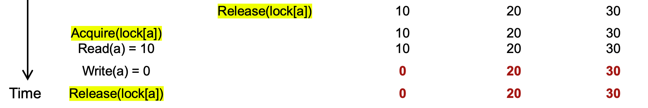
Problem: accessing multiple records
Question #1:
Is the final state of the program correct? Yes.
Question #2:
Is the sum of the audit correct? No !

Slide 61
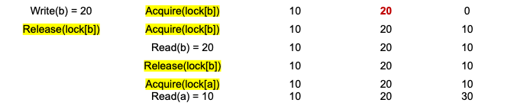
Problem: accessing multiple records
Core problem
Thread 1 is seeing Thread 0‘s action’s intermediate result
Insight
we need to delay the lock release time for each shared data
Until all the transaction’s updates finish

Slide 62
Solution: acquire all locks first, and release them at last
Lock Point
Lock
Acquire lock-D
Release lock-D
Acquire lock-C
Release lock-C
Acquire lock-B
Release lock-B
Acquire lock-A
Release lock-A
Time

Slide 63
Two-phase locking (2PL)
…
Fine-grained locking:
Each shared data has one lock
E.g., a lock for Alice & a lock for Bob
2PL locking rule:
The action must acquire the shared data’s lock before access it, and releases it after the data access finishes and release it until the action finishes
Bank = [
Alice: 0¥
Bob: 0¥
Lock = [
2PL机制是：在拿锁过程中不允许放锁，在放锁过程中不允许在拿锁。即，在事务已经release第一把锁之后，就不会再去重新acquire一个lock了。

Slide 64
Two-phase locking (2PL)
这里的一个问题是,在程序刚开始时并不好确定需要访问的shared var有哪些，但是可以在运行过程中遇到要访问的变量之前在acquire lock
2PL Lock acquire rule:
The action must acquire the shared data’s lock before access it, and release it until all the action finishes
Fine-grained locking
Fine-grained locking + 2PL
Transfer(bank, locks, a, b, amt):
Acquire(lock[b]
bank[b] += amt
Release(lock[b])
Acquire(lock[a])
bank[a] -= amt
Release(lock[a])
Transfer(bank, locks, a, b, amt):
Acquire(lock[b]
bank[b] += amt
Acquire(lock[a])
bank[a] -= amt
Release(lock[a])
Release(lock[b])

Slide 65
Two-phase locking (2PL)
Transfer
(alice, bob, 10)
Transfer
(alice, bob, 10)
Audit()
Audit()
Thread 0 (Transfer) | Thread 1 (Audit) | Bank[Alice] | Bank[bob] | Sum
 |  | 10 | 10 | 0
Acquire(lock[b]) | Acquire(lock[b]) | 10 | 10 | 0
Read(b) = 10 | Acquire(lock[b]) | 10 | 10 | 0
Write(b) = 20 | Acquire(lock[b]) | 10 | 20 | 0
Release(lock[b]) | Acquire(lock[b]) | 10 | 20 | 0
Time
Time

Slide 66
Two-phase locking (2PL)
Transfer
(alice, bob, 10)
Transfer
(alice, bob, 10)
Audit()
Audit()
Thread 0 (Transfer) | Thread 1 (Audit) | Bank[Alice] | Bank[bob] | Sum
 |  | 10 | 10 | 0
Acquire(lock[b]) | Acquire(lock[b]) | 10 | 10 | 0
Read(b) = 10 | Acquire(lock[b]) | 10 | 10 | 0
Write(b) = 20 | Acquire(lock[b]) | 10 | 20 | 0
Acquire(lock[a]) | Acquire(lock[b]) | 10 | 20 | 0
Time
Time

Slide 67
Two-phase locking (2PL)
Transfer
(alice, bob, 10)
Transfer
(alice, bob, 10)
Audit()
Audit()
Thread 0 (Transfer) | Thread 1 (Audit) | Bank[Alice] | Bank[bob] | Sum
 |  | 10 | 10 | 0
Acquire(lock[b]) | Acquire(lock[b]) | 10 | 10 | 0
Read(b) = 10 | Acquire(lock[b]) | 10 | 10 | 0
Write(b) = 20 | Acquire(lock[b]) | 10 | 20 | 0
Acquire(lock[a]) | Acquire(lock[b]) | 10 | 20 | 0
Read(a) = 10 | Acquire(lock[b]) | 10 | 10 | 0
Time
Time

Slide 68
Two-phase locking (2PL)
Transfer
(alice, bob, 10)
Transfer
(alice, bob, 10)
Audit()
Audit()
Thread 0 (Transfer) | Thread 1 (Audit) | Bank[Alice] | Bank[bob] | Sum
 |  | 10 | 10 | 0
Acquire(lock[b]) | Acquire(lock[b]) | 10 | 10 | 0
Read(b) = 10 | Acquire(lock[b]) | 10 | 10 | 0
Write(b) = 20 | Acquire(lock[b]) | 10 | 20 | 0
Acquire(lock[a]) | Acquire(lock[b]) | 10 | 20 | 0
Read(a) = 10 | Acquire(lock[b]) | 10 | 10 | 0
Write(a) = 0 | Acquire(lock[b]) | 0 | 20 | 0
Time
Time

Slide 69
Two-phase locking (2PL)
Transfer
(alice, bob, 10)
Transfer
(alice, bob, 10)
Audit()
Audit()
Thread 0 (Transfer) | Thread 1 (Audit) | Bank[Alice] | Bank[bob] | Sum
 |  | 10 | 10 | 0
Acquire(lock[b]) | Acquire(lock[b]) | 10 | 10 | 0
Read(b) = 10 | Acquire(lock[b]) | 10 | 10 | 0
Write(b) = 20 | Acquire(lock[b]) | 10 | 20 | 0
Acquire(lock[a]) | Acquire(lock[b]) | 10 | 20 | 0
Read(a) = 10 | Acquire(lock[b]) | 10 | 10 | 0
Write(a) = 0 | Acquire(lock[b]) | 0 | 20 | 0
Release(lock[b]) | Acquire(lock[b]) | 0 | 20 | 0
Time
Time

Slide 70
Two-phase locking (2PL)
Transfer
(alice, bob, 10)
Transfer
(alice, bob, 10)
Audit()
Audit()
Thread 0 (Transfer) | Thread 1 (Audit) | Bank[Alice] | Bank[bob] | Sum
 |  | 10 | 10 | 0
Acquire(lock[b]) | Acquire(lock[b]) | 10 | 10 | 0
Read(b) = 10 | Acquire(lock[b]) | 10 | 10 | 0
Write(b) = 20 | Acquire(lock[b]) | 10 | 20 | 0
Acquire(lock[a]) | Acquire(lock[b]) | 10 | 20 | 0
Read(a) = 10 | Acquire(lock[b]) | 10 | 10 | 0
Write(a) = 0 | Acquire(lock[b]) | 0 | 20 | 0
Release(lock[b]) Release(lock[a]) | Acquire(lock[b]) | 0 | 20 | 0
 | Read(b) = 20 | 0 | 20 | 20
Time
Time

Slide 71
Two-phase locking (2PL)
Transfer
(alice, bob, 10)
Transfer
(alice, bob, 10)
Audit()
Audit()
Thread 0 (Transfer) | Thread 1 (Audit) | Bank[Alice] | Bank[bob] | Sum
 |  | 10 | 10 | 0
Acquire(lock[b]) | Acquire(lock[b]) | 10 | 10 | 0
Read(b) = 10 | Acquire(lock[b]) | 10 | 10 | 0
Write(b) = 20 | Acquire(lock[b]) | 10 | 20 | 0
Acquire(lock[a]) | Acquire(lock[b]) | 10 | 20 | 0
Read(a) = 10 | Acquire(lock[b]) | 10 | 10 | 0
Write(a) = 0 | Acquire(lock[b]) | 0 | 20 | 0
Release(lock[b]) Release(lock[a]) | Acquire(lock[b]) | 0 | 20 | 0
 | Read(b) = 20 Acquire(lock[a]) | 0 0 | 20 20 | 20 20
Time
Time

Slide 72
Two-phase locking (2PL)
Transfer
(alice, bob, 10)
Transfer
(alice, bob, 10)
Audit()
Audit()
Thread 0 (Transfer) | Thread 1 (Audit) | Bank[Alice] | Bank[bob] | Sum
 |  | 10 | 10 | 0
Acquire(lock[b]) | Acquire(lock[b]) | 10 | 10 | 0
Read(b) = 10 | Acquire(lock[b]) | 10 | 10 | 0
Write(b) = 20 | Acquire(lock[b]) | 10 | 20 | 0
Acquire(lock[a]) | Acquire(lock[b]) | 10 | 20 | 0
Read(a) = 10 | Acquire(lock[b]) | 10 | 10 | 0
Write(a) = 0 | Acquire(lock[b]) | 0 | 20 | 0
Release(lock[b]) Release(lock[a]) | Acquire(lock[b]) | 0 | 20 | 0
 | Read(b) = 20 Acquire(lock[a]) Read(a) = 0 | 0 0 0 | 20 20 20 | 20 20 20
Time
Time

Slide 73
Two-phase locking (2PL)
Transfer
(alice, bob, 10)
Transfer
(alice, bob, 10)
Audit()
Audit()
Thread 0 (Transfer) | Thread 1 (Audit) | Bank[Alice] | Bank[bob] | Sum
 |  | 10 | 10 | 0
Acquire(lock[b]) | Acquire(lock[b]) | 10 | 10 | 0
Read(b) = 10 | Acquire(lock[b]) | 10 | 10 | 0
Write(b) = 20 | Acquire(lock[b]) | 10 | 20 | 0
Acquire(lock[a]) | Acquire(lock[b]) | 10 | 20 | 0
Read(a) = 10 | Acquire(lock[b]) | 10 | 10 | 0
Write(a) = 0 | Acquire(lock[b]) | 0 | 20 | 0
Release(lock[b]) Release(lock[a]) | Acquire(lock[b]) | 0 | 20 | 0
 | Read(b) = 20 Acquire(lock[a]) Read(a) = 0 Release(lock[a]) | 0 0 0 0 | 20 20 20 20 | 20 20 20 20
这里的”appear”的意思是:虽然audit事务可能是在转账事务之前或者同时开始的，但是由于锁的控制作用使得其真正起作用的时间点是在转账事务之后。
Time
Audit appears to run after the transfer
Time

Slide 74
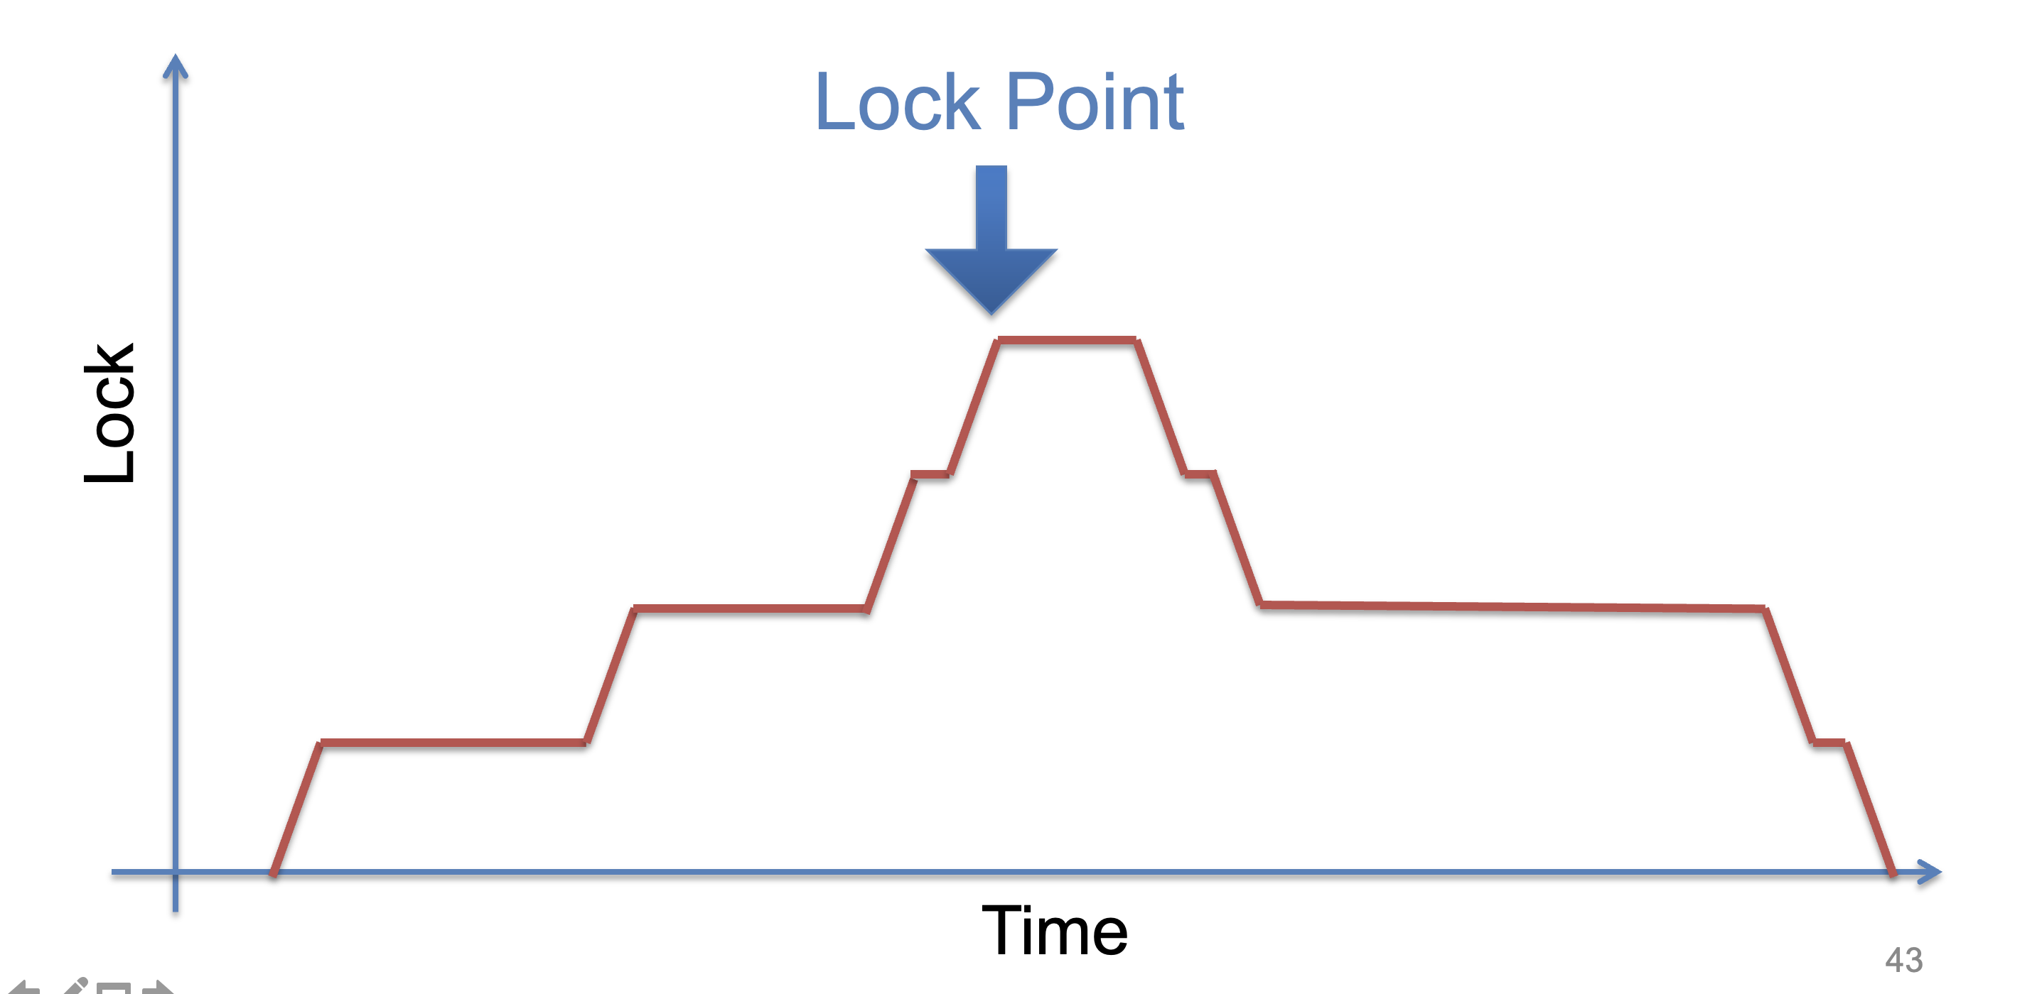
Two-phase locking (2PL)

Slide 75
Use locking to achieve before-or-after: 2PL
2PL can guarantee before or after atomicity with serializability
Run actions T1, T2, .., TN concurrently, and have it "appears" as if they ran sequentially (we will prove it later)
Before or after atomicity
Concurrent actions have the before-or-after property if their effect from the point of view of their invokers is as if the actions occurred either completely before or completely after one another

Slide 76
Serializability
2PL can guarantee before or after atomicity with serializability
Run actions T1, T2, .., TN concurrently, and have it "appears" as if they ran sequentially (we will prove it later)
What does this mean?

Slide 77
Serializability
2PL can guarantee before or after atomicity with serializability
Run actions T1, T2, .., TN concurrently, and have it "appears" as if they ran sequentially (we will prove it later)
What does this mean?
T1
begin
read(x)(读取x却没有使用)
tmp = read(y)
write(y, tmp+10)
commit
T2
begin
write(x, 20)(blind write)
write(y, 30)
commit
Action start
Action end

Slide 78
Init: x=0, y=0
T1
begin
read(x)
tmp = read(y)
write(y, tmp+10)
commit
T2
begin
write(x, 20)
write(y, 30)
commit
Possible sequential schedules
T1 -> T2: x=20, y=30
T2 -> T1: x=20, y=40
（可能的正确结果）
T2: write(x, 20)
T1: read(x)
T2: write(y, 30)
T1: tmp = read(y)
T1: write(y, tmp+10)
At end: x=20, y=40
T1: read(x)
T2: write(x, 20)
T1: tmp = read(y)
T2: write(y, 30)
T1: write(y, tmp+10)
At end: x=20, y=10

Slide 79
Init: x=0, y=0
T1
begin
read(x)
tmp = read(y)
write(y, tmp+10)
commit
T2
begin
write(x, 20)
write(y, 30)
commit
Possible sequential schedules
T1 -> T2: x=20, y=30
T2 -> T1: x=20, y=40
T2: write(x, 20)
T1: read(x)
T2: write(y, 30)
T1: tmp = read(y)
T1: write(y, tmp+10)
At end: x=20, y=40
x=0
T1: read(x)
T2: write(x, 20)
T2: write(y, 30)
T1: tmp = read(y)
T1: write(y, tmp+10)
At end: x=20, y=40
y=30
In the second schedule, the results are correct. But T1 reads x=0 and y=30; those reads are not possible in a sequential schedule. Is that ok?

Slide 80
Init: x=0, y=0
Whether OK depends:
There are many ways for multiple transactions to "appear" to have been run in sequence; there are different notions of serializability
Chose a type of serializability depends on applications
T1
begin
read(x)
tmp = read(y)
write(y, tmp+10)
commit
T2
begin
write(x, 20)
write(y, 30)
commit
Possible sequential schedules
T1 -> T2: x=20, y=30
T2 -> T1: x=20, y=40
T2: write(x, 20)
T1: read(x)
T2: write(y, 30)
T1: tmp = read(y)
T1: write(y, tmp+10)
At end: x=20, y=40
x=0
T1: read(x)
T2: write(x, 20)
T2: write(y, 30)
T1: tmp = read(y)
T1: write(y, tmp+10)
At end: x=20, y=40
y=30
In the second schedule, the results are correct. But T1 reads x=0 and y=30; those reads are not possible in a sequential schedule. Is that ok?

Slide 81
Serializability has many types
Final-state serializability(类似于eventual consistency,只需要保证最终结果正确)
A schedule is final-state serializable if its final written state is equivalent to that of some serial schedule
Conflict serializability
View serializability
Final-state serializability
Our focus
x=0
T1: read(x)
T2: write(x, 20)
T2: write(y, 30)
T1: tmp = read(y)
T1: write(y, tmp+10)
At end: x=20, y=40
y=30

Slide 82
Conflict Serializability

Slide 83
Conflict Serializability
Two operations conflict if:
they operate on the same data object, and
at least one of them is write, and
they belong to different transactions (即两个事务的执行流发生了race)
Conflict serializability(关注的是冲突指令的执行顺序)
A schedule is conflict serializable if the order of its conflicts (the order in which the conflicting operations occur) is the same as the order of conflicts in some sequential schedule

Slide 84
Init: x=0, y=0
T1
begin
read(x)
tmp = read(y)
write(y, tmp+10)
commit
T2
begin
write(x, 20)
write(y, 30)
commit
Possible sequential schedules
T1 -> T2: x=20, y=30
T2 -> T1: x=20, y=40
T1.1
T2.1
T1.2
T2.2
T1.3
Conflicts
T1.1 read(x) and T2.1 write(x,20) on x
T1.2 tmp = read(y) and T2.2 write(y,30) on y
T1.3 write(y, tmp+10) and T2.2 write(y,30) on y

Slide 85
Conflict Graph
Conflict Graph
Nodes are transactions, edges are directed
Edge between T_{i} and T_{j} if and only if:
T_{i} and T_{j} have a conflict between them, and
the first step in the conflict occurs in T_{i}
A schedule is conflict serializable if and only if:
It has an acyclic conflict graph(只有conflict graph为一个无环图,才能说明满足conflict serializability)

Slide 86
T1
begin
read(x)
tmp = read(y)
write(y, tmp+10)
commit
T2
begin
write(x, 20)
write(y, 30)
commit
Possible sequential schedules
T1 -> T2: x=20, y=30
T2 -> T1: x=20, y=40
Conflicts
T1.1 read(x) -> T2.1 write(x,20)
T1.2 tmp = read(y) -> T2.2 write(y,30)
T1.3 write(y, tmp+10) -> T2.2 write(y,30)
(T1 -> T2)

Slide 87
T1
begin
read(x)
tmp = read(y)
write(y, tmp+10)
commit
T2
begin
write(x, 20)
write(y, 30)
commit
Possible sequential schedules
T1 -> T2: x=20, y=30
T2 -> T1: x=20, y=40
Conflicts
T2.1 write(x,20) -> T1.1 read(x)
T2.2 write(y,30) -> T1.2 tmp = read(y)
T2.2 write(y,30) -> T1.3 write(y, tmp+10)
(T2 -> T1)

Slide 88
Conflicts
T2.1, T1.1
T2.2, T1.2
T2.2, T1.3
Conflict order for sequential schedules
T1.1 -> T2.1 T2.1 -> T1.1
T1.2 -> T2.2 or T2.2 -> T1.2
T1.3 -> T2.2 T2.2 -> T1.3
(T1 -> T2) (T2 -> T1)
T2: write(x, 20)
T1: read(x)
T2: write(y, 30)
T1: tmp = read(y)
T1: write(y, tmp+10)
T1: read(x)
T2: write(x, 20)
T2: write(y, 30)
T1: tmp = read(y)
T1: write(y, tmp+10)
T2.1 -> T1.1
T2.2 -> T1.2
T2.2 -> T1.3
T1.1 -> T2.1
T2.2 -> T1.2
T2.2 -> T1.3

Slide 89
Conflicts
T2.1, T1.1
T2.2, T1.2
T2.2, T1.3
Conflict order for sequential schedules
T1.1 -> T2.1 T2.1 -> T1.1
T1.2 -> T2.2 or T2.2 -> T1.2
T1.3 -> T2.2 T2.2 -> T1.3
(T1 -> T2) (T2 -> T1)
T2: write(x, 20)
T1: read(x)
T2: write(y, 30)
T1: tmp = read(y)
T1: write(y, tmp+10)
T2 -> T1
T1: read(x)
T2: write(x, 20)
T2: write(y, 30)
T1: tmp = read(y)
T1: write(y, tmp+10)
-->
<--
T2 T1
It's final-state serializable,
not conflict serializable
Both at end: x=20, y=40

Slide 90



Conflict Equivalence
=
conflict-equal
Schedule A
if
Schedule B
T1 → T2
T4 → T3
=
equal
Conflicts order A
Conflicts order B
If conflicts-order-A equals to conflicts-order-B,
then schedule-A conflict-equals to schedule-B

Slide 91
View Serializability
T1 T2 T3
read(x)
write(x)
write(x)
write(x)
Conflict graph
T3
T2 T1
Cyclic -> Not conflict serializable
But compare it to running T1 then T2 then T3 (serially)
Final-state is fine
Intermediate reads are fine
Question: why shouldn't we allow this schedule?

Slide 92
View Serializability
Informal definition
A schedule is view serializable if the final written state as well as intermediate reads are the same as in some serial schedule
Formally, for those interested
Two schedules S and S' are view equivalent if:
If T_{i} in S reads an initial value for X, so does T_{i} in S'
If T_{i} in S reads the value written by T_{j} in S for some X, so does T_{i} in S'
If T_{i} in S does the final write to X, so does T_{i} in S'
A schedule is view serializable if it is view equivalent to some serial schedule

Slide 93
Question
Why conflict serializability when it seems too strict?
Why not focus on view serializability?(难以实现,因为更多的时候很难确定真正的’正确结果’是什么)
Final-state Serializability
View
Serializability
Conflict
Serializability
⊃
⊃
Care the final state only
Care the final state as well as intermediate read
Care the final state as well as all the data dependency
理论上来说,应该是约束越少的serializability越好

Slide 94
Conflict Serializability VS. View Serializability
Conflict serializability is easy to test
i.e., check whether a graph is acyclic
View serializability is hard to test (likely NP-hard)
Conflict serializable schedules are easy to generate
Using concurrency control protocols. E.g., 2PL (two-phase-locking)
Conflict serializable schedules are also view serializable(子集关系)
No easy way to generate view schedules that allows for ones like the previous example

Slide 95
Use locking to achieve before-or-after: 2PL
2PL can guarantee before or after atomicity
Run actions T1, T2, .., TN concurrently, and have it "appears" as if they ran sequentially
2PL locking rule:
The action must acquire the shared data’s lock before access it and release it until the action finishes
Question
Which serializability does 2PL guarantee?
Conflict serializability!

Slide 96
Proof of 2PL
T1 and T2 conflict on x1
T2 and T3 conflict on x2
...
Tk and T1 conflict on x_k
Suppose 2PL does not generate conflict serializable schedule
Suppose the conflict graph produced by an execution of 2PL has a cycle, which without loss of generality, is:
T1 --> T2 --> ... --> Tk --> T1
Let the shared variable (the one that causes the conflict) between T_i and T_{i+1} be represented by x_i.
T1 acquires x1.lock
T2 acquires x1.lock and x2.lock
T3 acquires x2.lock and x3.lock
...
Tk acquires x_{k-1}.lock and x_k.lock
T1 acquires x_k.lock
T1 violates 2PL!
T1 acquires x1.lock
T1 releases x1.lock
...
...
...
T1 acquires x_k.lock
若是想让T2正确执行，T1就需要放掉x1.lock
T1 acquires x1.lock
T1 releases x1.lock
T2 acquires x1.lock and x2.lock
...
Tk acquires x_{k-1}.lock and x_k.lock
T1 acquires x_k.lock
在2PL的机制下,只要是放过lock了,就不能再重新acquire了!

Slide 97
Serializability simplifies enforcing concurrent correctness / data consistency

Slide 98
Correctness (app-semantic consistency)
Correctness is hard for computer system to enforce
It is at the application level, with application specific semantic
E.g., developer can write a buggy program, even no concurrency (single-threaded)
To ensure concurrent correctness, we need assumptions
i.e., The single-threaded implementation of actions must be correct
Buggy
Transfer(bank, a, b, amt):
bank[b] += amt
bank[a] -= amt
Transfer(bank, a, b, amt):
bank[b] += amt * 2
bank[a] -= amt

Slide 99
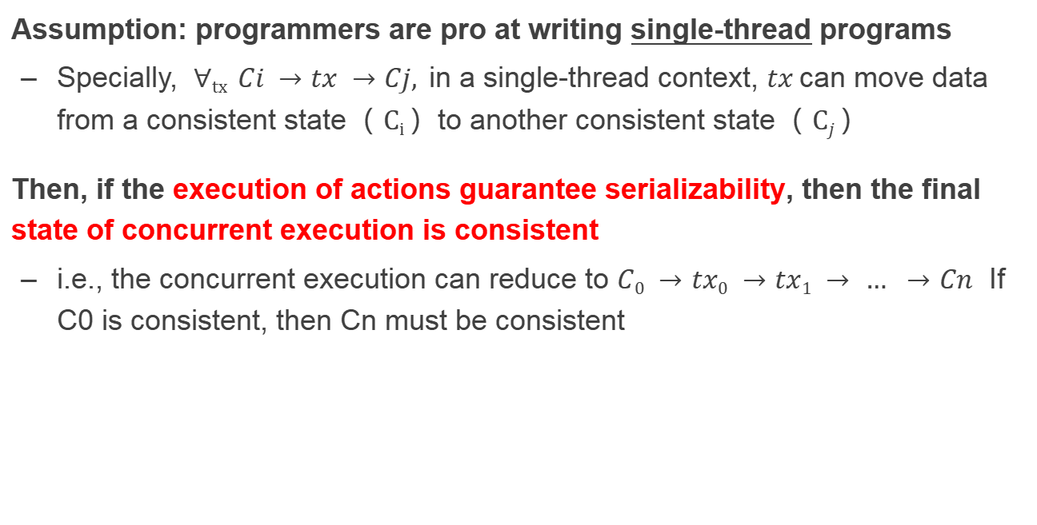
Correctness and serializability
Assumption: programmers are pro at writing single-thread programs
Specially, $∀tx Ci →tx →Cj,$in a single-thread context, $tx$can move data from a consistent state（ $Ci$）to another consistent state（ $Cj$）
Then, if the execution of actions guarantee serializability, then the final state of concurrent execution is consistent
i.e., the concurrent execution can reduce to $C0 →tx0 →tx1 → … →Cn$ If C0 is consistent, then Cn must be consistent

Slide 100
Question: what are the drawbacks of 2PL?

Slide 101
Deadlock
Two-phase lock is pessimistic(悲观的):
Before proceed, each TX must wait for conflicting TX to release the lock
What can happen if two TX are waiting for each other?

Slide 102
Deadlock: what if Thread 1 first acquires lock[a]?
Thread 0 (Transfer) | Thread 1 (Audit) | Bank[Alice] | Bank[bob] | Sum
 |  | 10 | 10 | 0
Acquire(lock[b]) | Acquire(lock[b]) | 10 | 10 | 0
Read(b) = 10 | Acquire(lock[b]) | 10 | 10 | 0
Write(b) = 20 | Acquire(lock[b]) | 10 | 20 | 0
Acquire(lock[a]) | Acquire(lock[b]) | 10 | 20 | 0
Read(a) = 10 | Acquire(lock[b]) | 10 | 10 | 0
Write(a) = 0 | Acquire(lock[b]) | 0 | 20 | 0
Release(lock[b]) | Acquire(lock[b]) | 0 | 20 | 0
 | Read(b) = 20 Acquire(lock[a]) Read(a) = 0 Release(lock[a]) | 0 0 0 0 | 20 20 20 20 | 20 20 20 20

Slide 103
Deadlock: what if Thread 1 first acquires lock[a]?
Thread 0 (Transfer) | Thread 1 (Audit) | Bank[Alice] | Bank[bob] | Sum
 |  | 10 | 10 | 0
Acquire(lock[b]) | Acquire(lock[a]) | 10 | 10 | 0

Slide 104
Deadlock: what if Thread 1 first acquires lock[a]?
Thread 0 (Transfer) | Thread 1 (Audit) | Bank[Alice] | Bank[bob] | Sum
 |  | 10 | 10 | 0
Acquire(lock[b]) | Acquire(lock[a]) | 10 | 10 | 0
Read(b) = 10 | Read(a) = 10 | 10 | 10 | 10

Slide 105
Deadlock: what if Thread 1 first acquires lock[a]?
Thread 0 (Transfer) | Thread 1 (Audit) | Bank[Alice] | Bank[bob] | Sum
 |  | 10 | 10 | 0
Acquire(lock[b]) | Acquire(lock[a]) | 10 | 10 | 0
Read(b) = 10 Acquire(lock[a]) | Read(a) = 10 Acquire(lock[b]) | 10 | 10 | 10

Slide 106
Deadlock: what if Thread 1 first acquires lock[a]?
Thread 0 (Transfer) | Thread 1 (Audit) | Bank[Alice] | Bank[bob] | Sum
 |  | 10 | 10 | 0
Acquire(lock[b]) | Acquire(lock[a]) | 10 | 10 | 0
Read(b) = 10 Acquire(lock[a]) Acquire(lock[a]) | Read(a) = 10 Acquire(lock[b]) Acquire(lock[b]) | 10 | 10 | 10
Question: can thread 0 or thread 1 finishes the execution?

Slide 107
Resolving deadlock
1. Acquire locks in a pre-defined order
Not support general TX: TX must know the read/write sets before execution
2. Detect deadlock by calculating the conflict graph
If there is a cycle, then there must be a deadlock
Abort one TX to break the cycle
High cost for detection
3. Using heuristics (e.g., timestamp) to pre-abort the TXs
May have false positive, or live locks

Slide 108
Recap data management in a distributed setting is hard
Need consider multiple atomicity
All-or-nothing Atomicity, when an action container multiple steps
Before-or-after Atomicity , when actions can run concurrently (this lecture)
To distinguish these, we typically use different terms
Atomicity -> commonly known as all-or-nothing
Isolation -> common refer to before-or-after
Resolving all these issues are challenging for the developers
Logging, recovery, locking, deadlock, etc.
Can we provide a systematic abstraction to simplify data management?

Slide 109
Transactions

Slide 110
What is a transaction (TX)?
An abstraction to manage the data
Data is also an abstract concept, can be arbitrary computing data. Concrete examples including:
Key-value store entries
File system metadata (e.g., directory, inode, etc)
Processor’s metadata (e.g., child processors)
Look like similar program, with data managed by the TX system, and extra mark to denote the start/end of a TX

Slide 111
TX: an abstraction to ease data management
Transactions handle failure atomicity & race conditions
Writing with TX is straightforward
Use TX.begin to mark when a TX starts
Use TX.commit to commit the TX
Rewrite the data read/write with TX’s interface
E.g., bank[a] = bank[a] – amt
tx.write(a, tx.read(a) – amt);
transfer(bank, a, b, amt, tx):
tx.begin()
tx.write(b, tx.read(b) + amt);
tx.write(a, tx.read(a) – amt);
tx.commit()
transfer(bank, a, b, amt):
bank[b] = bank[b] + amt
bank[a] = bank[a] - amt
Program
Transaction

Slide 112

What can a TX provide? ACID
The program btw { tx.begin() & tx.commit() } has the following properties:
A：Atomicity
All or nothing atomicity
C：Consistency
I：Isolation
(informally) before-of-after atomicity
D：Durability
Committed TX’s data on durable storage
...
tx.begin();
...
...
tx.commit();
...
ACID
Application program

Slide 113
Atomicity
An action is atomic if happens completely or not at all
Action is an abstraction, can contain many operations
E.g., multiple disk writes, multiple memory reads/writes
Tools & techniques to achieve so
Logging

Slide 114
Isolation & Durability
Isolation: Two concurrently transactions are isolated
E.g., not viewing the intermediate results of another TX
Avoid the race conditions
Serializability is the ideal one (Achieved via 2PL & others)
Durability
Once a transaction is committed, its changes (e.g., writes) must durably stored to a persistent storage
But there are other isolation levels, we will talk about this later

Slide 115
What about consistency? Do logging & locking sufficient to ensure consistency?

Slide 116
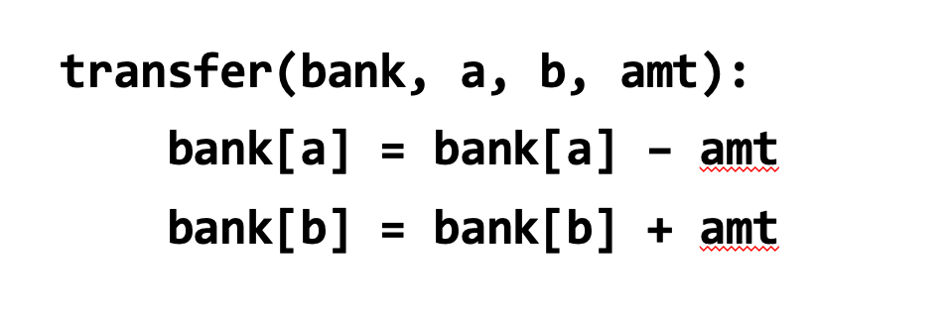
Consistency
Transaction must change the data from a consistent state to another
Being consistent is defined by the applications
E.g., transfer should leave the sum(bank[a] + bank[b]) unchanged
Transaction alone is not sufficient for consistency
E.g., if the programmer writes the incorrect program...
bank[a] = bank[a] - amt * 2

Slide 117
Enforcing ACID properties
Enforcing A & D:
Logging and recovery (see the last lecture)
Enforcing C:
Database constraint system (not covered in this class)
Enforcing I:
Concurrency control methods (this lecture)
Transactions will automatically & transparently apply these techniques for the programmer
E.g., acquire locking during tx.read() / tx.write()

Slide 118
Summary of systems that support transactions
e.g., relational databases
Easy of programming
E.g., Developers don’t need to consider race condition
Consistency
Support Serializability
Fault tolerance
Durability (But no availability)
Performance & scalability
ACID comes at costs!
Scalability
Ease of
programming
Performance
Consistency
Fault tolerance

