Slide 1


Transaction: OCC & MVCC
SE3331-1 (2022 Fall)
IPADS, Shanghai Jiao Tong University
https://www.sjtu.edu.cn

Slide 2

Review: widely used transaction (TX)s
Caching server
Caching server
…
Caching server
All can use TX to manager data!
e.g., FS meta data
Caching
Caching
Caching
Distributed caching
Database server
Database server
CDN
Users
Application #1
generate the page
Database
user, price
…
Database
user, price
Application server
Distributed database
Internet
Load
Balance
Application #2
add the order
File server
File server
File server
File:
image
File:
image
…
File:
image
Application server
…
…
Message queue
Distributed file system

Slide 3

Review: widely used transaction (TX)s
if item.count > 0:
item.count -= 1
Cart.add(item)

Slide 4
Review: What is a transaction (TX)?
An abstraction to manage the data
Data is also an abstract concept, can be arbitrary computing data. Concrete examples including:
Key-value store entries
File system metadata (e.g., directory,, inode, etc)
Processor’s metadata (e.g., child processors)
Look like similar program, with data managed by the TX system, and extra mark to denote the start/end of a TX

Slide 5

Review: What a TX typically provide? ACID
The program btw { tx.begin() & tx.commit() } has the following properties:
A：Atomicity
C：Consistency
I：Isolation
D：Durability
...
tx.begin();
...
...
tx.commit();
...
ACID
Application program

Slide 6
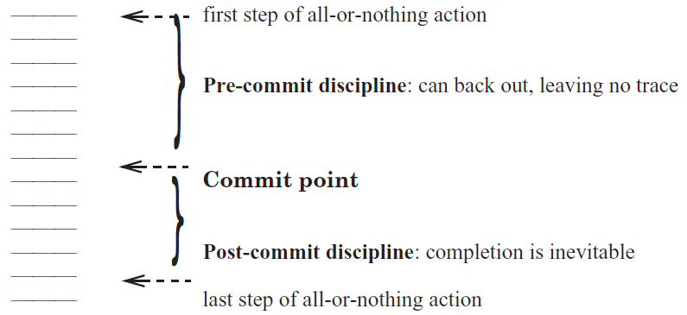
Review: Atomicity: All-or-nothing

Slide 7
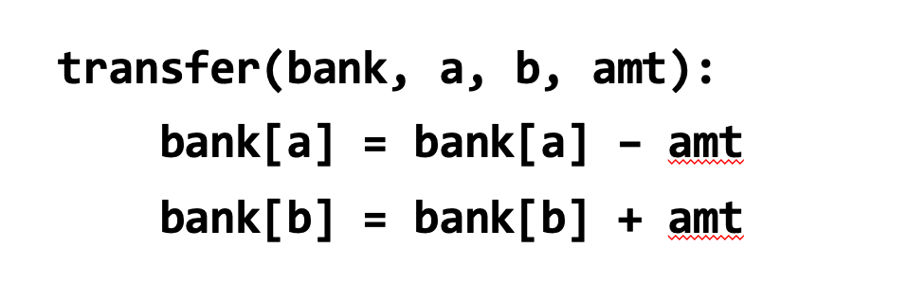
Review: Consistency
Transaction must change the data from a consistent state to another
What is consistent is defined by the applications
E.g., transfer should leave the sum(bank[a] + bank[b]) unchanged
Transaction alone is not sufficient for application consistency
E.g., If the programmer writes the incorrect program.
bank[a] = bank[a] - amt * 2

Slide 8
Review: Isolation & Durability
Isolation: Two concurrently transactions are isolated
E.g., not viewing the intermediate results of another TX
Avoid the race conditions
Durability
Once a transaction is committed, its changes (e.g., writes) must durably stored to a persistent storage

Slide 9
Review: Enforcing ACID properties
Enforcing A & D:
Logging and recovery (see the last last lecture)
Enforcing C:
Database constraint system (not covered in this class)
Enforcing I:
Concurrency control methods (last & this lecture)

Slide 10
Review: Serialization
Goal: run transactions T1, T2, .., TN concurrently, and have it "appears" as if they ran sequentially
T1
begin
read(x)
tmp = read(y)
write(y, tmp+10)
commit
T2
begin
write(x, 20)
write(y, 30)
commit

Slide 11
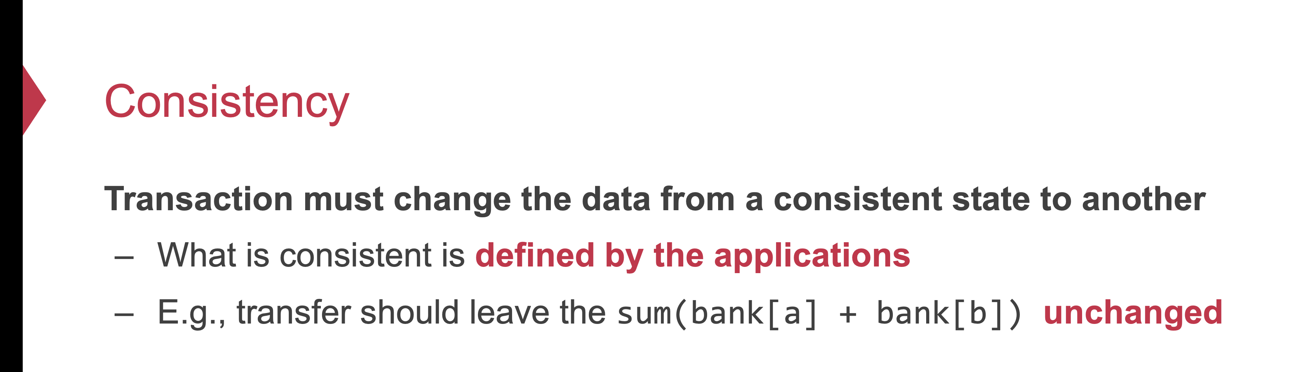
Review: Why serializability is ideal?
Because it simplifies the programmer to enforce consistency
Recall: consistency depends on how the programmer writes the program

Slide 12
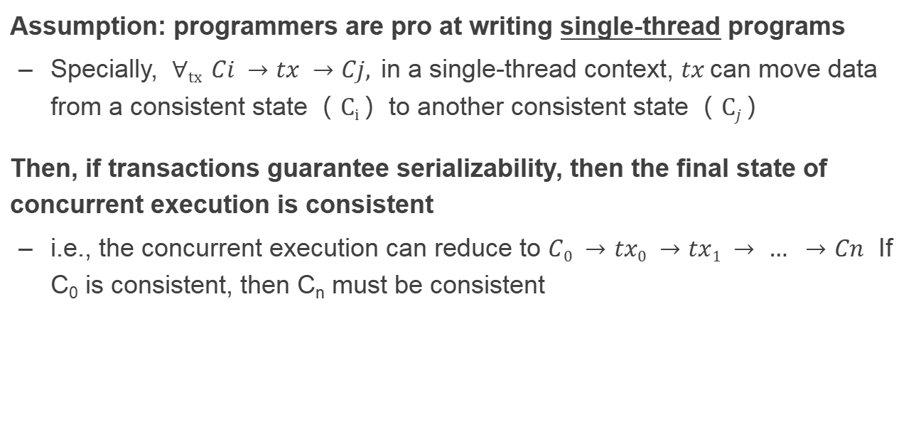
Review: Why serializability is ideal?
Assumption: programmers are pro at writing single-thread programs
Specially, $∀tx Ci →tx →Cj,$in a single-thread context, $tx$can move data from a consistent state（ $Ci$）to another consistent state（ $Cj$）
Then, if transactions guarantee serializability, then the final state of concurrent execution is consistent
i.e., the concurrent execution can reduce to $C0 →tx0 →tx1 → … →Cn$ If C₀ is consistent, then C_{n} must be consistent

Slide 13
Review: two-phase locking to achieve serializability
Only acquire the data lock before accessing
Release the lock after the TX commits
How to implement?
Recall that TX must call TX’s read/write interfaces to read/write data
Co-locate the lock in the TX’s read/write
...
tx.begin();
...
tx.read(A)
...
tx.commit();
...
Lock_set = {}
这一过程需要保证原子性
Acquire(A)
Lock_set.add(A)
for r in Lock_set:
Release(r)

Slide 14
Why we need to use a TX?
Programmers can manually add logging & locking to their program
Can guarantee all-or-nothing and before-of-after
However, this is a typically bad idea
Question: what if the programmer falsely releases the lock (like the fine-grained lock example in our previous lecture?)
What if the programmer write the wrong logging & recovery mechanism?

Slide 15
Review of TX: an abstraction to ease data management
Handle failure atomicity (all-or-nothing) & race conditions (before-or-after)
Writing with TX is straightforward, the atomicity is left to the system
Use TX.begin to mark when a TX starts
Use TX.commit to commit the TX
Rewrite the data read/write with TX’s interface
E.g., bank[a] = bank[a] – amt
tx.write(a, tx.read(a) – amt);
transfer(bank, a, b, amt, tx):
tx.begin()
tx.write(b, tx.read(b) + amt);
tx.write(a, tx.read(a) – amt);
tx.commit()
transfer(bank, a, b, amt):
bank[b] = bank[b] + amt
bank[a] = bank[a] - amt
Program
Transaction

Slide 16
Question: Is 2PL sufficient to guarantee serializability?

Slide 17
Question: Is 2PL sufficient to guarantee serializability?
Depends on whether the lock is properly held.

Slide 18
Case study: the software department’s salary system
A system to manage the salary of the employers of the software department
Data to store: the employers
Operations
Update the salaries of a group of people
Print the status of a group of employers satisfying a condition
Add new employers
Etc.

Slide 19
Case study: the software department’s salary system
Operations
Update the salaries of a group of people
Print the status of a group of employers satisfying a condition
Add new employers
Detailed system implementations
For simplicity, we use a simple linked list to store all the emplyers
The list is stored in-memory
Fault tolerance can be made with logging

Slide 20
Implementing the software department’s salary system
Data layout
In-memory vector to storing all the employers
Each employer has a fine-grained lock to realize 2PL
database = std::List<Employer *>;
Struct Employer {
Lock lock;
string name;
double salary;
}

Slide 21
Employments
T1
Update emp (set salary=1.1*salary where salary >= 3000)
Print emp where salary > 3000
T2
Insert emp (
Xingda, 3100,
Yubin, 3100)
Xingda
3100
Yubin
3100
Haibo
3000
Rong
3000
Sees Xingda & Yubin but w/o(without) updates
U1(H)
U1(R)
Ins(X)
Ins(Y)
R1(H)
R1(R)
R1(X)
R1(Y)
Time
这是满足final-state serializability的，但是由于中间状态读取的不对，所以不满足view和conflict serializability
Problem
If T1 sees Xingda & Yubin, it must have updated it
But T1 misses the insertions on the first updates

Slide 22
Phantom Problem(幻读问题)
Issue:
Only lock the things you touch,
but must guarantee non-existence of any new ones!
Solutions
Predicate locking
Range locks in a B-tree index (e.g., assumes an index on salary), or lock entire table
Sometimes ignore in practice
Two operations conflict → they access the same data item and at least one is a write
e.g., object, row, list, entire table, ...

Slide 23
Does two-phase-locking work well in practice?

Slide 24

Deadlock

Slide 25
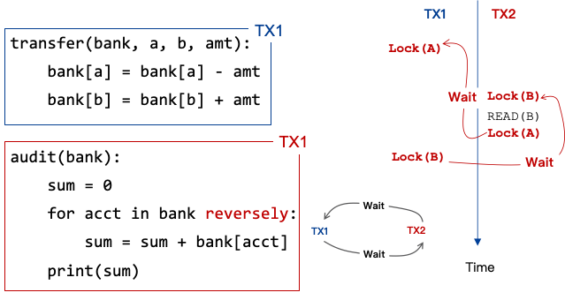
Problem of 2PL: deadlock
Two-phase lock is pessimistic:
Before proceed, each TX must wait for conflicting TX to release the lock
What can happen if two TX are waiting for each other?

Slide 26
Methods for resolving the deadlock
1. Acquire locks in a pre-defined order
Not support general TX: TX must know the read/write sets before execution
2. Detect deadlock by calculating the conflict graph
If there is a cycle, then there must be a deadlock
Abort one TX to break the cycle
High cost for detection
3. Using heuristics(启发式) (e.g., timestamp) to pre-abort the TXs
May have false positive, or live locks
Prevention
Detection
Retry
需要注意的是pre-abort只是提前强行终止了当前的TX，即与之前的undo差不多，目的是使得错误的数据不会持久化到数据库层去。但是之后是可能会被重新执行的。

Slide 27
Can we run transaction optimistically?

Slide 28



Optimistic concurrency control
Executing TXs optimistically w/o acquiring the lock
Checks the results of TX before it commits
If violate serializability, then aborts & retries
First proposed in 1981, widely used today

Slide 29
OCC Executes a Transaction in 3 Phases
Phase 1: Concurrent local(in memory) processing
Reads data into a read set
Buffers writes into a write set
Phase 2: Validation in critical section
Validates whether serializability is guaranteed:
Has any data in the read set been modified?
Phase 3: Commit the results in critical section or abort
Aborts: aborts the transaction if validation fails
Commits: installs the write set(将write set中的最终结果写入到磁盘中去) and commits the transaction

Slide 30
OCC Executes a Transaction in 3 Phases
Before phase one, TX needs to allocate the execution context
Read-set & write set
...
tx.begin();
...
tx.read(A)
...
tx.commit();
...
Init read-set
Init write-set

Slide 31
OCC Executes a Transaction in 3 Phases
Phase 1:
Reads data into a read set
Buffers writes into a write set
This step should be atomic!
...
tx.begin();
...
tx.read(A)
...
tx.commit();
...
val_a = read(A)
read-set.add(val_a)

Slide 32
OCC Executes a Transaction in 3 Phases
Phase 1:
Reads data into a read set
Buffers writes into a write set
What about a second read?
Read from the read-set!(类似于cache,但是与cache也不完全一样,因为他是不会去读取disk数据的,因为这时候还没有validate,直接读disk可能由于disk数据已经被修改而出现不一致)
Why? Need to provided repeated read!
...
tx.begin();
...
tx.read(A)
tx.read(A)
tx.commit();
...
if A in read-set:
return read-set[A]

Slide 33
OCC Executes a Transaction in 3 Phases
Phase 1:
Reads data into a read set
Buffers writes into a write set
...
tx.begin();
...
tx.read(A)
tx.write(A)
tx.commit();
...
Write-set[A] = ..
Notes:
假设A之前没有被TX写过，即A只写一次

Slide 34
OCC Executes a Transaction in 3 Phases
Phase 2:
Validates whether serializability is guaranteed:
Has any data in the read set been modified?
...
tx.begin();
...
tx.read(A)
...
tx.commit();
...
for d in read-set:
if d has changed:
abort()
注意此处的validation：是将read-set中的数据与数据库中对应数据进行比对，如果不一样，说明在这中间有其他的事务的其他操作修改了数据，从而导致了serializability的失效，所以只能abort。要注意的是，当前transaction本身引起的write不会产生影响，因为这个时候还没有写入disk

Slide 35
OCC Executes a Transaction in 3 Phases
Phase 3:
Aborts: aborts the transaction if validation fails
Commits: installs the write set and commits the transaction
...
tx.begin();
...
tx.read(A)
...
tx.commit();
...
for d in read-set:
if d has changed:
abort()
for d in write-set:
write(d)

Slide 36
OCC Executes a Transaction in 3 Phases
Phase 3:
Aborts: aborts the transaction if validation fails
Commits: installs the write set and commits the transaction
Phase 2 & 3 should execute in a critical section
Otherwise, what if a value has changed during validation?
...
tx.begin();
...
tx.read(A)
...
tx.commit();
...
Critical section
for d in read-set:
if d has changed:
abort()
for d in write-set:
write(d)
validation-and-commit atomicity

Slide 37
Why phase 2 & phase 3 must be in critical section?
Both TX:
A += 1
B += 1
Time
T1
T2
Read(A_{T0})
Phase #1
Read(B_{T0})
Read(A_{T0})
Read(B_{T0})
Phase #2
Validate(A_{T0})
Validate(B_{T0})
Validate(A_{T0})
Validate(B_{T0})

Slide 38
Why phase 2 & phase 3 must be in critical section?
Both TX:
A += 1
B += 1
Time
T1
T2
Read(A_{T0})
Phase #1
Read(B_{T0})
Read(A_{T0})
Read(B_{T0})
Phase #2
Validate(A_{T0})
这里就出现了两个TX同时validate通过的情况，这样就会出现提交时候的覆盖问题(lost update)
What happen we execute phase #3?
Validate(B_{T0})
Validate(A_{T0})
Validate(B_{T0})
Phase #3
Write(A, A_{T0} + 1)
Write(A , A_{T0} + 1)

Slide 39
How to implement the critical section for phase 2 & 3?
Global lock may satisfy
The phase 2 & 3 are typically short
No TX logic is executed, only the validation

Slide 40
How to implement the critical section for phase 2 & 3?
Global lock may satisfy
The phase 2 & 3 are typically short
No TX logic is executed, only the validation
Using two-phase locking
Allow more concurrency: TXs access different records don’t compete with each other
Question#1: how to lock? Read-set or write-set?
Only the write-set is enough (before the validation). Why?
Question#2: does two-phase locking have deadlock issue here?
No. Because all the read/write data is known! So the order is known (e.g., order with key ID)
Notes:
Only the write-set is enough. Equivalent to have a read lock (when read) and release it (when commit)

Slide 41
OCC: An Example
Tuple A in T1's read set has been changed by T2, thus T1 must be aborted.
Thread1
Thread2
T1:
B = A + B;
T2:
A = A * 1.1;
T2's read set remains unchanged, thus T2 is allowed to commit
BEGIN
BEGIN
T1's read set:
A (100)
B (100)
R(A);
R(A);
T2's read set:
A (100)
B (200)
R(B);
W(A);
T1's write set:
T2's write set:
A (110)
W(B);
Commit
Validation
Thread-local memory
Abort
Validation
Thread-local memory
Time
Database
storage
ID | Value
A | 110
B | 100
ID | Value
A | 100
B | 100

Slide 42
OCC Advantages
Phase 1: Concurrent local processing
Reads data into a read set
Buffers writes into a write set
Phase 2: Validation in critical section
Validates whether serializability is guaranteed:
Has any data in the read set been modified?
Phase 3: Commit the results in critical section or abort
Aborts: aborts the transaction if validation fails
Commits: installs the write set and commits the transaction
Operates in private workspace; rare inter-thread synchronization (optimistic)

Slide 43
OCC Advantages
Phase 1: Concurrent local processing
Reads data into a read set
Buffers writes into a write set
Phase 2: Validation in critical section
Validates whether serializability is guaranteed:
Has any data in the read set been modified?
Phase 3: Commit the results in critical section or abort
Aborts: aborts the transaction if validation fails
Commits: installs the write set and commits the transaction
Needs synchronization (e.g., with lock), but usually very short at low contention

Slide 44
OCC Advantages
Use reads more than writes (for each read-only data access)
OCC (in the optimal case, i.e., no abort) (此处的read是指的是读取数据库中数据)
1 read to read the data value
1 read to validate whether the value has been changed or not
2PL
1 operation to acquire the lock (typically an atomic CAS)
1 read to read the data value
1 write to release the lock
A single CPU write is atomic, no need to do the atomic CAS
Locking is costly especially compared to reads

Slide 45
Locking preliminary(预备工作)
Many implementation exists to achieve the best performance & scalability
Still an active topic in system research
We will focus on the basic design
The details will be left to the OS class
Interesting, acquiring the lock itself also requires before-or-after
Both threads will read the current lock status
If the status is not locked, update it to locked
What if two threads concurrently read an unlocked state?

Slide 46
Locking preliminary: atomic compare and swap
Hardware primitive to guarantee before-or-after atomicity
Compare-and-swap (on SPARC)
Compare-and-exchange (on x86)
Lock prefix to ensure an instruction is atomically executed on a memory address(因为拿锁和放锁都需要将新的lock status写入到磁盘中去,所以lock-prefix的作用就是使得在修改锁的状态的时候的操作是原子的。)
1 int CompareAndSwap(int *ptr, int expected, int new) {
2 int actual = *ptr;
3 if (actual == expected)
4 *ptr = new;
5 return actual;
6 }
Notes:
x86 provides a “lock” prefix that tells the hardware: “don’t let anyone read/write the value until I’m done with it”
An instruction for atomic CAS

Slide 47
Locking (Spin Lock) using Compare-and-swap
1 typedef struct __lock_t {
2 int flag;
3 } lock_t;
4
5 void init(lock_t *lock) {
6 // 0 indicates that lock is available, 1 that it is held
7 lock->flag = 0;
8 }
9
10 void lock(lock_t *lock) {
11 while (CompareAndSwap(&lock->flag, 0, 1) == 1)
12 ; // spin-wait (do nothing)
13 }
14
15 void unlock(lock_t *lock) {
16 lock->flag = 0;
17 }

Slide 48
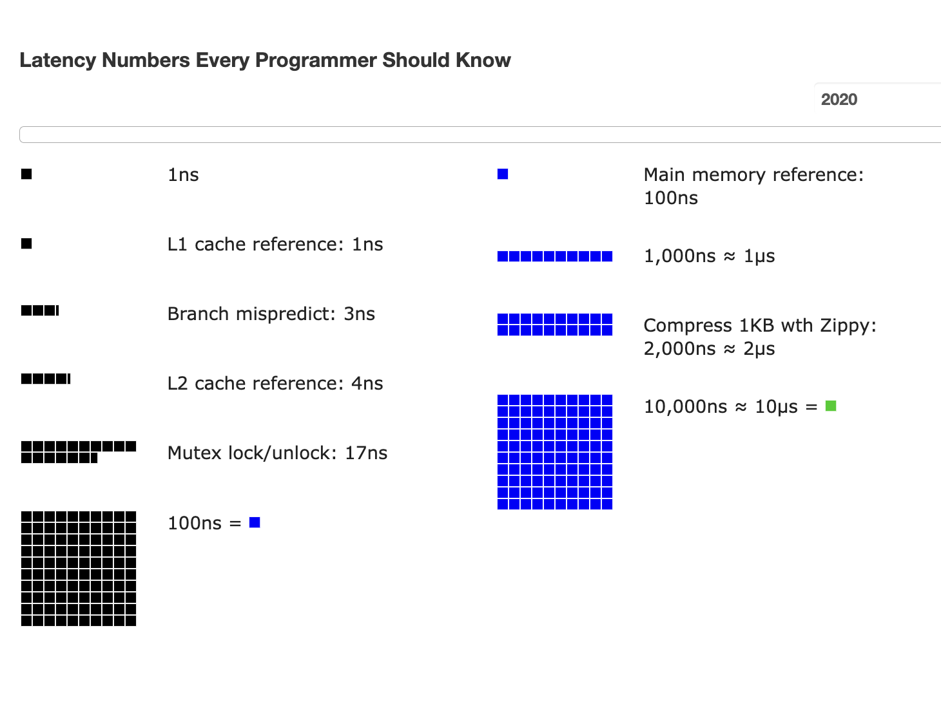
Atomic operations are costly for spin lock

Slide 49
OCC's Problem: False Aborts
Some transactions aborted by OCC could have been allowed to commit without causing an unserializable schedule
Thread1
Thread2
T1:
B = A + B;
T2:
A = A * 1.1;
No cycle is formed
OCC only allows serialized execution of T2, T1, but is not able to recognize serialized execution of T1, T2.
T1 is falsely aborted
BEGIN
BEGIN
R(A);
rw
R(A);
R(B);
W(A);
W(B);
Commit
Abort

Slide 50
OCC's Problem: False Aborts
Some transactions aborted by OCC could have been allowed to commit without causing an unserializable schedule
Especially for TXs with a lot of reads
E.g., read a lot of items → large read set → easier to abort(这样更可能由于少数几个数据的额外修改而导致大部分数据的读取会被强制失败)
May abort even under low-contention
Notes:
因为执行的时间很长，所以会abort

Slide 51
OCC’s Problem: livelock
Under high contention, OCC may continuously abort
Especially with large read/write sets, or long execution time
Transaction is executing, but no progress!

Slide 52
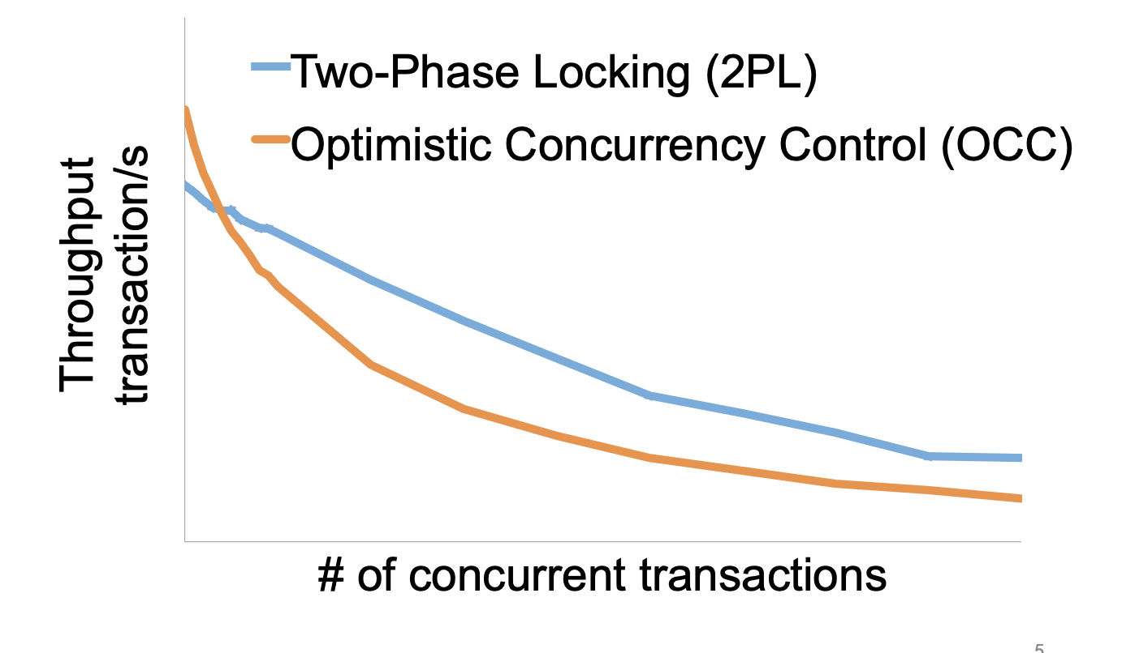
Serializability is costly under contention
from: Rococo [OSDI'14]

Slide 53
OCC and hardware transactional memory

Slide 54

Hardware Transactional Memory
A new CPU feature, inspired by the ACID properties of transactions
CPU guarantees the ACI properties of memory accesses
i.e., no race conditions & no locks
Intel supports HTM named as RTM
Restricted Transactional Memory
In Haswell processor
Semantic of both all-or-nothing and before-or-after
Not handles failure since it is memory

Slide 55

Does RTM[*] solve all the problem?
Restricted transactional memory
* Since we focus on RTM in this course, we will use RTM and HTM interchangeablely.

Slide 56
A little introduction to RTM
ISA support for transactional memory
Recall: Writing with TX is straightforward
Use TX.begin to mark when a TX starts
Use TX.commit to commit the TX
In RTM, the concept is similar (using new instructions)
Use xbegin to mark an RTM execution start
Use xend to mark an RTM end

Slide 57
Programming with RTM
If transaction starts successfully
Do work protected by RTM, and then try to commit
Fallback routine to handle abort event
If abort, system rollback to xbegin, return an abort code
Manually abort inside a transaction
if _xbegin() == _XBEGIN_STARTED:
if conditions:
_xabort()
critical code
_xend()
else
fallback routine

Slide 58
Programming with RTM
If transaction starts successfully
Do work protected by RTM, and then try to commit
Fallback routine to handle abort event
If abort, CPU rollbacks to line xbegin, return an abort code, and goto fallback
Manually abort inside a transaction
if _xbegin() == _XBEGIN_STARTED:
if conditions:
_xabort()
critical code (access x)
_xend()
else
fallback routine
Another process
x = 1

Slide 59
Programming with RTM
If transaction starts successfully
Do work protected by RTM, and then try to commit
Fallback routine to handle abort event
If abort, CPU rollbacks to line xbegin, return an abort code, and goto fallback
Manually abort inside a transaction
if _xbegin() == _XBEGIN_STARTED:
if conditions:
_xabort()
critical code
_xend()
else
fallback routine

Slide 60
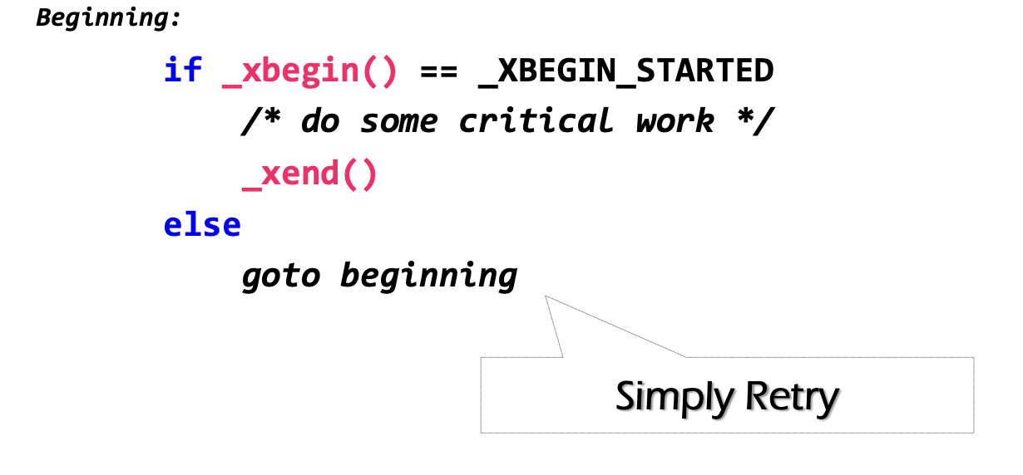
How to handle aborts? Can we use simple retry?
RTM provides new instruction set
xbegin(), xend() & xabort()
Problem: RTM cannot guarantee success

Slide 61
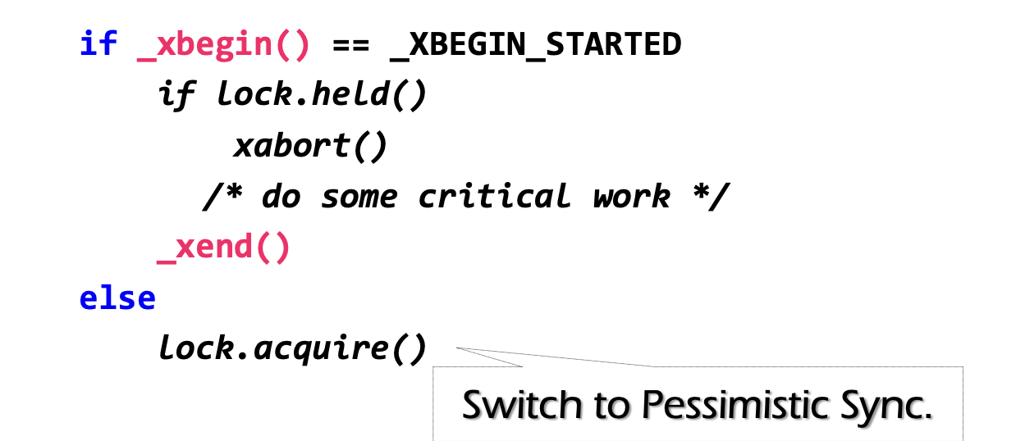
Can we use simple retry? No
Problem: RTM cannot guarantee success
Similar to OCC, code in RTM can be frequently aborted due to conflicts
Must switch to a fallback path after some reties (e.g., using a counter)
E.g., degrade to use lock in the fallback path (since it's not in a transaction)
check lock status to avoid conflict with fallback handlers on other CPU

Slide 62
Fun facts about the implementation of RTM
The benefits of RTM
Memory operations between xbegin() & xend()satisfy ACI properties
HTM itself is inspired from transactions
Drawbacks
Cannot guarantee success
Sounds familiar?

Slide 63
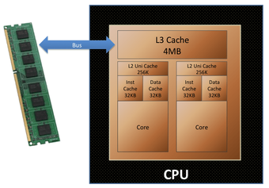
Fun facts about the implementation of RTM
The benefits of RTM
Memory operations between xbegin() & xend()satisfy ACI properties
HTM itself is inspired from transactions
Drawbacks
Cannot guarantee success
Intel implements RTM using OCC
Use CPU cache to track the read/write sets
How to detect conflicts? Cache coherence(cache中内容与数据库中不一致)
Questions: what are the other limits of using CPU cache to tack read/write sets?

Slide 64
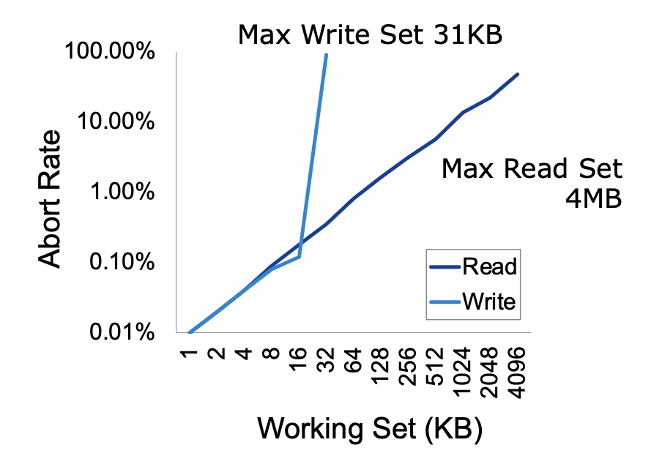
Another drawback of RTM: limited working set
Reason: CPU has limited cache size
How big is the RTM read/write sets?
Depends on various factors
Hardware setup (e.g., CPU cache size)
Access pattern: read or write
L1 cache tracks all the writes
L2, or L3 to tracks all the reads
Why read set is bigger?(因为read操作
数量一般要多于write操作数量)

Slide 65
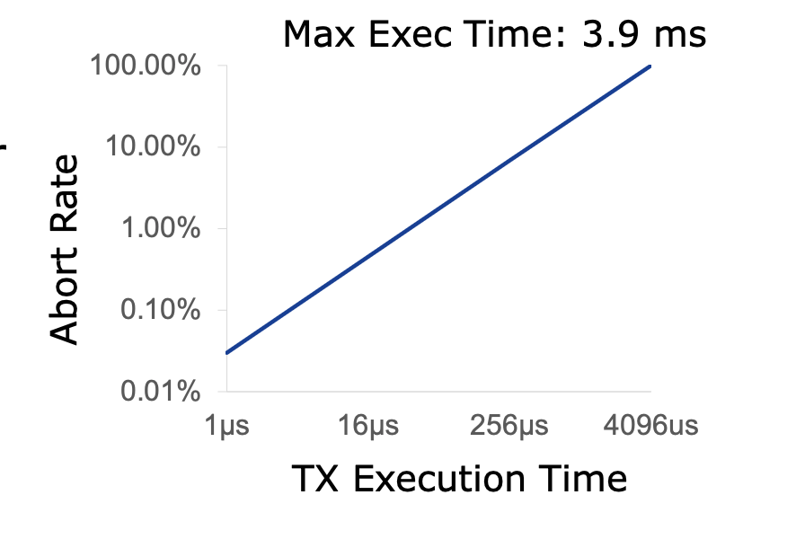
How long can an RTM program execute?
Not very long
The longer the execution, the higher the probability a TX aborts
Affected by other facts, e.g., CPU interrupts

Slide 66
HTM on transactions
Naïve: using HTM to execute the in-memory transaction
Smallbank: transfer &. Audit
TPC-C: much complex, insert 10+ orders and update 10+ stocks
Silo@SOSP’13: the fastest in-memory OCC implementation

Slide 67
Short summary of RTM
Hardware support for transactional memory
Easy programming model for the programmer (no need to wrap transaction in read/write API of the transaction)
As long as the programmer do the in-memory computations, e.g., in-memory database
Good performance if using properly
No need for locking & atomic operations
However, the programmer should handle its pitfalls

Slide 68
Can we avoid locking/validation for reads?
Maybe use weaker isolation level?

Slide 69

Maybe less than Serializability (for better concurrency)?
Performance
Long-duration locks on all READ/WRITE
Scenarios:
run analytics on a companion data, while update a piece of data
long running read-only transaction
Disadvantages of locking-based approach (2PL)
May involve in deadlocks
Transactions may hold a lock for a long time(long-lived transaction)
Read-only transactions (e.g., data mining) can block update transactions

Slide 70
Maybe less than Serializability (for better concurrency)?
Performance
Long-duration locks on all READ/WRITE
Scenarios:
run analytics on a companion data, while update a piece of data
long running read-only transaction
Disadvantages of OCC
May involve in a livelock
Transactions may retry for many times
Read-only transactions (e.g., data mining) is more likely to abort

Slide 71
Why need lock or retry in 2PL or OCC?
Data item is single-version
Only one copy
As a result, any concurrent accesses are conflicts, so we need coordination (e.g., locks or validations)
Can we avoid these conflicts?

Slide 72
Multi-version Concurrency Control
Each data item has multiple versions
When accessing different versions of data, probably no conflict!
Key (high-level) idea
Writes don’t overwrite the original data
Instead, writes install new versions of data
Reads read from a "snapshot" of data
Benefits: no lock or validation during TX’s execution
bankA: 100, ver: 12, pre:xx
bankA: 100
bankA: 200, ver: 10, pre:xx
Single-version
Multi-version

Slide 73
Snapshot Isolation
A popular multi-version concurrency control (MVCC) scheme
Transactions will get start and commit timestamp
Use start timestamp to read find the snapshot to read
Use commit timestamp to install new versions
Transactions:
WRITEs a local buffer (similar to OCC)
READs a “snapshot” of entire data image
COMMIT only if no write-write conflict
Install new versions of data

Slide 74
Snapshot Isolation Implementation
T is assigned a commit timestamp T.cts
System checks all data within T.wset, if T.sts < X.cts < T.cts(这里就说明这个X被其他的TX修改了), then abort T
Update all data within T.wset with T.cts
T is assigned a start timestamp T.sts
T
START
READ(X)
WRITE(X)
COMMIT
Time
T reads the biggest version of X(i), such that X(i).cts <= T.sts
T buffers writes to X and adds X to its write-set, T.wset += {X}

Slide 75
Time in Snapshot Isolation
Timestamp of start & commit should be assigned in a increasing order
E.g., global counters with atomic increase
Question: can we directly use the physical clock of the machine?
It depends. If all cores have global order of physical clock, then yes; otherwise not.
T is assigned a commit timestamp T.cts
System checks all data within T.wset, if T.sts < X.cts < T.cts, then abort T
Update all data within T.wset with T.cts
T is assigned a start timestamp T.sts
T
START
COMMIT
Time
Notes:
answer: depends. if all cores have global order of physical clock, then yes. otherwise not.

Slide 76
Snapshot Isolation Example (T1)
5
10
40
50
60
70
Time
T1
S
R(A)
R(B)
W(A)
W(B)
C
T2
S
R(A)
R(B)
C
T3
S
R(A)
R(B)
C
10
T.sts =
R(A) =
R(B) =
T.cts =
W(A) =
W(B) =
A₀
A₂
A₇
A₅₀
A₇
B₈
B₀
B₃
B₈
B₅₀
50
A₅₀
B₅₀

Slide 77
Snapshot Isolation Example (T2)
5
10
40
50
60
70
Time
T1
S
R(A)
R(B)
W(A)
W(B)
C
T2
S
R(A)
R(B)
C
T3
S
R(A)
R(B)
C
10
40
T.sts =
R(A) =
R(B) =
T.cts =
W(A) =
W(B) =
T.sts =
R(A) =
R(B) =
T.cts =
A₀
A₂
A₇
A₅₀
A₇
A₇
B₈
B₈
B₀
B₃
B₈
B₅₀
50
70
A₅₀
B₅₀
No uncommitted-read (A₅₀)

Slide 78
Snapshot Isolation Example (T3)
5
10
40
50
60
70
Time
T1
S
R(A)
R(B)
W(A)
W(B)
C
T2
S
R(A)
R(B)
C
T3
S
R(A)
R(B)
C
5
10
40
T.sts =
R(A) =
R(B) =
T.cts =
T.sts =
R(A) =
R(B) =
T.cts =
W(A) =
W(B) =
T.sts =
R(A) =
R(B) =
T.cts =
A₀
A₂
A₇
A₅₀
A₇
A₇
A₂
B₈
B₈
B₃
50
70
60
B₀
B₃
B₈
B₅₀
A₅₀
B₅₀
No unrepeatable-read

Slide 79
Snapshot Isolation Example
5
10
40
50
60
70
Time
T1
S
R(A)
R(B)
W(A)
W(B)
C
T2
S
R(A)
R(B)
C
T3
S
R(A)
R(B)
C
Equivalent Serial Order
A₀
A₂
A₇
A₅₀
T3
A₇
B₈
T2
T1
B₀
B₃
B₈
B₅₀
Can Snapshot Isolation guarantee serializable or not ?

Slide 80
Question of Snapshot Isolation
Snapshot isolation (SI) differs from serializability due to one anomaly that is possible under SI but not under serializability.
Describe the anomaly and also give a concrete application for which the anomaly is undesirable.
右图中这两个事务是不能保证序列化的，因为若T1先发生，则根据MVCC,T2就不可能读取到Y0，反之同理，所以这两个事务不等价与任何顺序执行时候的TX序列，所以不具有序列化特性，故MVCC不等价于OCC，2PL
T1
S
R(X)
W(Y)
C
R(X) = X₀
W(Y) = Y₁
T2
S
R(Y)
W(X)
C
R(Y) = Y₀
W(X) = X₁
Possible Serial Order
X₀
X₁
T1
T2
Y₀
Y₁
T2
T1

Slide 81
Write skew & DSM
Recall our memory consistency problem in DSM
Suppose both TX reads from an early snapshot of x & y (w/ 0)
extern int x; //0
extern int y; //0
x = 1
if (y==0)
critical sec
CPU1
extern int x;//0
extern int y;//0
y = 1
if (x==0)
critical sec
CPU0
Read/Write
DSM

Slide 82
Summary
Transactions provide ACID properties
OCC & 2PL are basic protocols to provide serializability
Problem of 2PL: locking & deadlock
Problem of OCC: False abort & livelock
Hardware transactional memory (HTM)
Advanced CPU features inspired by ACID properties of TXs
Commercial implementation of HTM uses OCC
Leads to several drawbacks
The cost of concurrency control can be reduced w/ relaxed isolation level
Snapshot Isolation (require global counter, not serializable)

