Slide 1


Atomicity across multiple transactions, multiple sites
SE3331-1 (2022 Fall)
Yubin Xia
IPADS, Shanghai Jiao Tong University
https://www.sjtu.edu.cn
Credits: Rong Chen@IPADS

Slide 2

Review: The ACID property of TX
The program btw { tx.begin() & tx.commit() } has the following properties:
A：Atomicity (all-or-nothing)
C：Consistency
I：Isolation (before-or-after)
D：Durability
...
tx.begin();
...
...
tx.commit();
...
ACID
consistency的层次：
1.应用层(用户层):需要根据具体的具体的语义环境来保证一致性(如银行·转账需要保证转账前后两人的账户中数目总和不变)
2.系统层：即consistency的表面意思，即保证同一个数据在被多机访问时是一致的
Application program

Slide 3



We talked about before-or-after in previous lectures
Before-or-nothing allows two transactions correctly running concurrently
Why do we particularly care about concurrency?
In order to scale to a higher performance
Single-thread doesn’t scale
Scale up & Scale out
Scale up
Scale out

Slide 4
Tools to achieve before-or-after
Pessimistic
Two-phase locking
Optimistic
Optimistic concurrency control

Slide 5
Review: optimistic concurrency control
OCC中的ABA问题：
TX1读取A，TX2将A修改为B，TX3将B又修改回A，这是TX1在TX3修改完成之后进行validate，这时候仍然不会abort，因为判定标准是数据库中的数据与read-set种数据是否相同
Phase 1: Concurrent local processing
Reads data into a read set
Buffers writes into a write set
Phase 2: Validation in critical section
Validates whether serializability is guaranteed:
Has any data in the read set been modified?
Phase 3: Commit the results in critical section or abort
Aborts: aborts the transaction if validation fails
Commits: installs the write set and commits the transaction

Slide 6
Review: OCC Executes a Transaction in 3 Phases
Phase 3:
Aborts: aborts the transaction if validation fails
Commits: installs the write set and commits the transaction
Phase 2 & 3 should execute in a critical section
Otherwise, what if a value has changed during validation?
...
tx.begin();
...
tx.read(A)
...
tx.commit();
...
Critical section
for d in read-set:
if d has changed:
abort()
for d in write-set:
write(d)

Slide 7
How to implement the critical section for phase 2 & 3?
OCC中使用global-lock来保证validate-and-commit原子性：
1.性能并不差2.VAC部分逻辑相对于整个TX而言比较短3.对于整个write-set上一把锁，进行锁的状态修改需要的原子指令数量少
Global lock may satisfy
The phase 2 & 3 are typically short
No TX logic is executed, only the validation
def validate_and_commit() // phase 2 & 3
global_lock.lock()
for d in read-set:
if d has changed:
abort()
for d in write-set:
write(d)
global_lock.unlock()

Slide 8
How to implement the critical section for phase 2 & 3?
也可以使用2PL，尤其是在write-set较小，TX总体时间较短，并发量较大时其相对于global-lock性能更好。
Using two-phase locking
Allow more concurrency
What about the problem of deadlock? We can pre-sort all the locks
def validate_and_commit() // phase 2 & 3
for d in read-set:
d.lock()
if d has changed:
abort() // abort will release all the held lock
for d in write-set:
d.lock()
write(d)
// release the locks
...
图中的这种实现，很容易导致死锁

Slide 9
How to implement the critical section for phase 2 & 3?
Using two-phase locking
Allow more concurrency
Use sort to avoid deadlock
Question: do we need to lock the read-set?
def validate_and_commit() // phase 2 & 3
for d in sorted(read-set + write-set):
d.lock()
for d in read-set:
if d has changed:
abort()
for d in write-set:
write(d)
// release the locks
...
由于read-set与write-set内容已知，且顺序已知，所以较好排序

Slide 10
How to implement the critical section for phase 2 & 3?
Observation (for the read-set):
If the validation passes, then it “appears ” that a lock is held during
这里是在说,因为validate通过了，所以就相当于在这个过程中read-set的值都没有被修改，所以就相当于单独对于read-set上了一把lock来保证了isolation
def validate_and_commit() // phase 2 & 3
for d in sorted(read-set + write-set):
d.lock()
for d in read-set:
if d has changed:
abort()
for d in write-set:
write(d)
// release the locks
...

Slide 11
How to implement the critical section for phase 2 & 3?
Observation (for the read-set):
If the validation passes, then it “appears ” that a lock is held during
def validate_and_commit() // phase 2 & 3
for d in sorted(write-set):
d.lock()
for d in read-set:
if d has changed:
abort()
for d in write-set:
write(d)
// release the locks
...
What if we remove read-set?

Slide 12

Problem: read-write conflict
T1:
A += B
T2:
B += A
Time
T1
T2
因为这里只对write-set的数据上锁了，所以在最后对于A和B进行write的时候就会出现可能同时write的情况，就不能通过OCC来保证serializability了。
Read(A_{T0})
Phase #1
Read(B_{T0})
Read(A_{T0})
Read(B_{T0})
Missing the lock!
Phase #2
Lock(A)
Validate(B_{T0})
Lock(B)
Validate(A_{T0})
Write(A, A_{T0} + B_{To})
Write(B, A_{T0} + B_{To})

Slide 13
How to implement the critical section for phase 2 & 3?
要注意OCC保证的”before-or-after”一定要是保证一个事务一定要在另一个事务前面/后面。
Use two-phase locking + read validation
Only lock the write set, after that,
Check the read set has not changed & locked
def validate_and_commit() // phase 2 & 3
for d in sorted(write-set):
d.lock()
for d in read-set:
if d has changed or d has been locked:
abort()
for d in write-set:
write(d)
// release the locks
...

Slide 14
OCC's Problem: False Aborts
Some transactions aborted by OCC could have been allowed to commit without causing an unserializable schedule
Especially for TXs with a lot of reads
E.g., read a lot of items → large read set → easier to abort
May abort even under low-contention
关于OCC与2PL的等价性：
OCC通过对于validate-and-commit部分添加lock来保证数据的一致性以及serializability，而2PL也通过分阶段拿锁和放锁来保证了serializability，所以二者的”等价性”实际上是因为两者都保证了serializability
Notes:
因为执行的时间很长，所以会abort

Slide 15
Can we avoid locking/validation for reads?
Maybe use weaker isolation level?

Slide 16
Multi-version Concurrency Control
Each data item has multiple versions
When accessing different versions of data, probably no conflict!
Key (high-level) idea
Writes don’t overwrite the original data
Instead, writes install new versions of data
Reads read from a "snapshot" of data
Benefits: no lock or validation during TX’s execution
MVCC需要保证每一个TX在每一轮的read的时候读取的value均为同一时间维度下的数据。
bankA: 100, ver: 12, pre:xx
bankA: 100
bankA: 200, ver: 10, pre:xx
Single-version
Multi-version

Slide 17
Snapshot Isolation
A popular multi-version concurrency control (MVCC) scheme
Transactions will get start and commit timestamp
Use start timestamp to find the snapshot to read
Use commit timestamp to install new versions
Transactions:
WRITEs a local buffer (similar to OCC)
READs a “snapshot” of entire data image
COMMIT only if no write-write conflict
Install new versions of data

Slide 18
Snapshot Isolation Implementation
T is assigned a commit timestamp T.cts
System checks all data within T.wset, if T.sts < X.cts < T.cts, then abort T
Update all data within T.wset with T.cts
T is assigned a start timestamp T.sts
T
START
READ(X)
WRITE(X)
COMMIT
Time
T reads the biggest version of X(i), such that X(i).cts <= T.sts
T buffers writes to X and adds X to its write-set, T.wset += {X}

Slide 19
Time in Snapshot Isolation
Timestamp of start & commit should be assigned in a increasing order
E.g., global counters with atomic increase
Question: can we directly use the physical clock of the machine?
It depends. If all cores have global order of physical clock, then yes; otherwise not.
timestamp其实可以简单的实现为一个全局的
time-counter(使用fetch-and-add来增加counter)
T is assigned a commit timestamp T.cts
System checks all data within T.wset, if T.sts < X.cts < T.cts, then abort T
Update all data within T.wset with T.cts
T is assigned a start timestamp T.sts
T
START
COMMIT
Time
Notes:
answer: depends. if all cores have global order of physical clock, then yes. otherwise not.

Slide 20
Snapshot Isolation Example (T1)
5
10
40
50
60
70
Time
T1
S
R(A)
R(B)
W(A)
W(B)
C
T2
S
R(A)
R(B)
C
T3
S
R(A)
R(B)
C
10
T.sts =
R(A) =
R(B) =
T.cts =
W(A) =
W(B) =
A₀
A₂
A₇
A₅₀
A₇
B₈
B₀
B₃
B₈
B₅₀
50
A₅₀
B₅₀

Slide 21
Snapshot Isolation Example (T2)
5
10
40
50
60
70
Time
T1
S
R(A)
R(B)
W(A)
W(B)
C
T2
S
R(A)
R(B)
C
T3
S
R(A)
R(B)
C
10
40
这里注意R(B)只能是B8，
因为要保证一个TX读取的事务是同一时间级的，
即都小于TX的sts
T.sts =
R(A) =
R(B) =
T.cts =
W(A) =
W(B) =
T.sts =
R(A) =
R(B) =
T.cts =
A₀
A₂
A₇
A₅₀
A₇
A₇
B₈
B₈
B₀
B₃
B₈
B₅₀
50
70
A₅₀
B₅₀
No uncommitted-read (A₅₀)

Slide 22
Snapshot Isolation Example (T3)
5
10
40
50
60
70
Time
T1
S
R(A)
R(B)
W(A)
W(B)
C
T2
S
R(A)
R(B)
C
T3
S
R(A)
R(B)
C
5
10
40
T.sts =
R(A) =
R(B) =
T.cts =
T.sts =
R(A) =
R(B) =
T.cts =
W(A) =
W(B) =
T.sts =
R(A) =
R(B) =
T.cts =
A₀
A₂
A₇
A₅₀
A₇
A₇
A₂
B₈
B₈
B₃
50
70
60
B₀
B₃
B₈
B₅₀
A₅₀
B₅₀
No unrepeatable-read

Slide 23
Snapshot Isolation Example
MVCC的排序原则是：读取的数据越”旧”,
排名的优先级就越高，并且要保证每次读的一定是当前“最新的”数据，所以TX2排在TX1前面，因为如果TX1在前面，则2的R(B)不应读到B8
5
10
40
50
60
70
Time
T1
S
R(A)
R(B)
W(A)
W(B)
C
T2
S
R(A)
R(B)
C
T3
S
R(A)
R(B)
C
Equivalent Serial Order
A₀
A₂
A₇
A₅₀
T3
A₇
B₈
T2
T1
B₀
B₃
B₈
B₅₀
Can Snapshot Isolation guarantee serializable or not ?

Slide 24
Question of Snapshot Isolation
Snapshot isolation (SI) differs from serializability due to one anomaly(异常) that is possible under SI but not under serializability.
Describe the anomaly and also give a concrete application for which the anomaly is undesirable.
从这里可以看出，
MVCC使用的SI并没有保证serializability，所以MVCC不等价于2PL
T1
S
R(X)
W(Y)
C
R(X) = X₀
W(Y) = Y₁
T2
S
R(Y)
W(X)
C
R(Y) = Y₀
W(X) = X₁
Possible Serial Order
X₀
X₁
T1
T2
Y₀
Y₁
T2
T1

Slide 25
Write skew & DSM
Recall our memory consistency problem in DSM
Suppose both TX reads from an early snapshot of x & y (w/ 0)
extern int x; //0
extern int y; //0
x = 1
if (y==0)
critical sec
CPU1
extern int x;//0
extern int y;//0
y = 1
if (x==0)
critical sec
CPU0
Read/Write
DSM

Slide 26
Recap till now
Transactions provide ACID properties
OCC & 2PL are basic protocols to provide serializability
Problem of 2PL: locking & deadlock
Problem of OCC: False abort & livelock
Hardware transactional memory (HTM)
Advanced CPU features inspired by ACID properties of TXs
Commercial implementation of HTM uses OCC
Leads to several drawbacks
The cost of concurrency control can be reduced w/ relaxed isolation level
Snapshot Isolation (require global counter, not serializable)

Slide 27
Is 2PL + OCC sufficient?

Slide 28
Review bank transfer
Transfer(bank, locks, a, b, amt):
bank[b] += amt
bank[a] -= amt
All-or-nothing atomicity
Write ahead logging (WAL)
Before-or-after atomicity
Two-phase locking (2PL), OCC.
Yet, techniques so far (WAL + 2PL + OCC) is insufficient for all the TXs(单机)

Slide 29
Case study #1:
Nested transaction

Slide 30
Nested transactions
发工资(bank, accts, amt):
for acct in accts:
deposit(bank, acct, amt)
Deposit(bank, a, amt):
tx.begin()
bank[a] += amt
tx.commit()

Slide 31
Nested transactions
What will happen if any one in the middle fails?
The atomicity of 「发工资」is broken
Even if we assume that each transfer is atomic (ACID transaction)
发工资
Deposit(…)
Deposit(…)
Deposit(…)
Deposit(…)
Time
Goal: the entire 「发工资」 should be atomic

Slide 32
Case study #2:
Multi-site transaction

Slide 33



Multi-site transaction
Accounts are shared over multiple sites (多机)
i.e., a single site cannot store all the bank accounts
The setup
Client + coordinator + two servers
One server handles bank accounts A-M
The other server handles bank accounts N-Z
Coordinator and servers all have logs to ensure single transaction atomicity
Coordinators
e.g., frontend servers
Storage servers
e.g., key-value stores
Clients,
e.g., iPhone
A - M
N - Z

Slide 34

Nested transactions across multiple sites
Multi-site transaction
Single transactions whose values across sites
Coordinator sends multiple deposit to different servers
They use RPCs to send requests to the server to execute transaction
发工资(bank, accts, amt):
for acct in accts:
deposit(bank, acct, amt)
发工资
Coordinator
Server 0
Audit(“Alice”)
Audit(“Zack”)
Server 1
Time

Slide 35
Multi-site transaction
Nested transactions across multiple sites
Single transactions whose values across sites
Coordinator sends multiple deposit to different servers
They use RPCs to send requests to the server to execute transaction
发工资(bank, accts, amt):
for acct in accts:
deposit(bank, acct, amt)
发工资
Coordinator
Server 0
deposit(“Alice”)
deposit(“Zack”)
Server 1
Time
What if one server commits and the other aborts?

Slide 36
Single transactions whose values across sites
transfer(bank, accts, first, second, amt):
accts[first] -= amt
accts[second] += amt

Slide 37
Single transactions whose values across sites
transfer(bank, accts, “alice”, “bob”, amt):
accts[“alice"] -= amt
accts[“bob"] += amt
Coordinator
Storage server
A - M
begin
ok
A - amt
ok
B + amt
ok
Commit
ok
Notes:
讲单机

Slide 38
Single transactions whose values across sites
transfer(bank, accts, “alice”, “bob”, amt):
accts[“alice"] -= amt
accts[“zack"] += amt
Coordinator
Storage server
A - M
Storage server
N - Z
begin
ok
A - amt
ok
Z + amt
ok
Commit
ok
Notes:
讲单机

Slide 39
Multi-site transaction
Can single transactions whose values across sites be viewed as a special form of nested transactions across multiple sites?
Yes: each modifications to a value can be viewed as a low-level transaction
Problems remain: What if one TX commits and others not?
begin
ok
A - amt
ok
B + amt
ok
Commit
ok

Slide 40
Problems so far
Transaction atomicity may across
Nested transactions
Multiple-sites
Sub-transactions (Actions) may fail to commit at the same time
One commits while the other crashes, or
One commits while the other aborts, etc.
Current solutions (e.g., OCC) focus on a single transaction
We can glue multiple transactions together with a single protocol
Two-phase commit

Slide 41
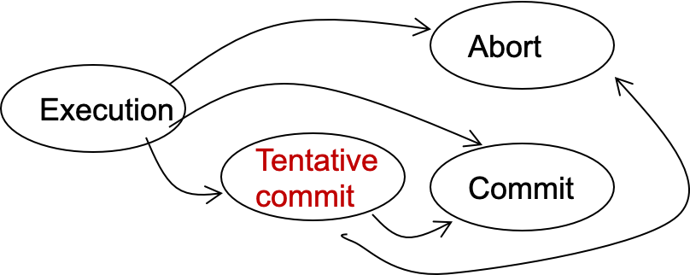
Two-phase Commit
Phase-1: preparation / voting
Delay the commitment of low-layer TXs
Lower-layer transactions either abort or tentatively committed(tentative commit:指的是低级事务只能准备好commit,而需要等待high-TX消息才能提交)
Higher-layer transaction evaluate lower situation
Phase-2: commitment
If top-layer, then COMMIT or ABORT
If nested itself, then become tentatively committed
State transitions of a TX

Slide 42
Two-phase commit in nested transaction
High-layer TX(caller)
Transaction that calls the other transactions
Low-layer TX(callee)
Transactions other than the high-layer TX
Higher-layer transaction evaluate lower situation(这里的”评估”指的是根据子事务返回的消息来判断之后的操作)
发工资(bank, accts, amt):
tx.high_begin()
for acct in accts:
deposit(bank, acct, amt)
tx.high_commit()
High-layer TX
Deposit(bank, a, amt):
tx.begin()
bank[a] += amt
tx.commit()
Low-layer TX

Slide 43
Two-phase commit in nested transaction
High-layer TX
发工资(bank, accts, amt):
tx.high_begin()
for acct in accts:
deposit(bank, acct, amt)
tx.high_commit()
High_begin
Mark itself as a high-level transaction
High_commit
Send prepare messages to the low-level transactions to check whether it can commit
tx.high_begin()
tx.high_commit()
for each deposit:
if deposit.abort: abort()
for each deposit:
deposit.commit()
Deposit(…)
Deposit(…)
Time

Slide 44
Question: what about the log content?
Low-layer TX
Deposit(bank, a, amt):
tx.begin()
bank[a] += amt
tx.commit()
Recall: the WAL logging in lecture xx
At commit point, append a commit record to the log
Question
Can we directly append the commit record to the lower-level transaction log?
...
log.append("TX {id} commit”).sync()
...
Commit
No! The high-level transaction can abort
Log
不能直接在low-level上面commit，因为low-level的提交应该是要等待high-level的指令的，而high-level是可能出现crash的

Slide 45
Question: what to log under 2PC?
Suppose the coordinator passes the first phase (can commit)
Do we need to log the prepare information?
tx.high_begin()
tx.high_commit()
for each deposit:
if deposit.abort: abort()
for each deposit:
deposit.commit()
Deposit(…)
Deposit(…)
Time

Slide 46
Question: what to log under 2PC?
Suppose the coordinator passes the first phase (can commit)
Do we need to log the prepare information?
Yes. Otherwise, a TX will be undo even the prepare passes
E.g., Deposit2 in the following example
tx.high_begin()
tx.high_commit()
All deposits agree to commit
Deposit(…)
Deposit(…)
Write commit record of Deposit1
Time
Crash

Slide 47
Logging rule of WAL under 2PC
High-layer transaction （Responsible for commit of low-layer TXs)
REDO-UNDO log entries: like normal (high-layer TX can also do read/writes)
Log the prepare log as a commitment of a high-layer TX
Low-layer transaction
REDO-UNDO log entries: like normal
Commit log entry -> Tentative commit log entry
Contains a reference to the high-layer TX

Slide 48

Recovery rules under 2PC
Rules:
Travel from end to start
Mark all transaction’s log record without CMT log and append ABORT log
If a TXs log record is tentative, check whether its referenced high-layer TX has a CMT entry. If no, mark it as abort. Otherwise, mark it as commit
UNDO ABORT logs from end to start
REDO CMT logs from start to end
Log

Slide 49
Question: what about the lock release?
Low-layer TX
Deposit(bank, a, amt):
tx.begin()
bank[a] += amt
tx.commit()
Recall: the 2PL in previous lecture
Transaction must release the lock of its records upon the commitment
Question:
Can we release the lock upon the low-level commitment?
...
Release(bank[a].lock)
...

Slide 50
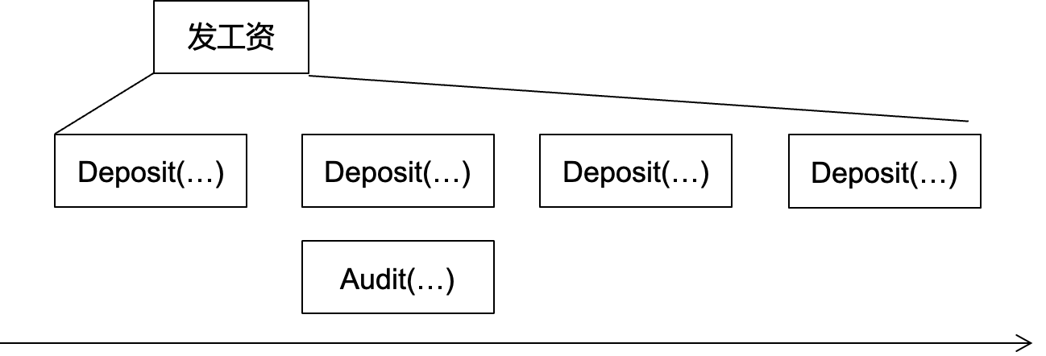
Question: what about the lock release?
Low-layer TX
Deposit(bank, a, amt):
tx.begin()
bank[a] += amt
tx.commit()
Recall: the 2PL in previous lecture
Transaction must release the lock of its records upon the commitment
Question:
Can we release the lock upon the low-level commitment?
...
Release(bank[a].lock)
...
No!
e.g., a concurrently audit can read
an internal value of 发工资
Read uncommitted value

Slide 51
Lock releases in nested transaction
If a low-level TX commits
It can only release locks to other low-level TXs belonging to the same high-level TX
But not other TXs
在2PC中，只可以在同级别的(即属于同一个high-level TX)low-level之间进行放锁和拿锁，但是不可以把锁放给这个high-level事务之外的其他事务，因为这样将会使得2PC的high-low的之间的通信机制无法保证2PC的原子性。

Slide 52
Short summary: 2PC for nested transaction
Lower-layer transaction
Upon commit, only mark itself in a "can commit" state
The high-level transaction is responsible to commit the transaction under the second phase of 2PC
High-layer transaction
Check whether all lower-level transaction can commit
Commit all the lower-level TX if the check passes
发工资(bank, accts, amt):
tx.high_begin()
for acct in accts:
deposit(bank, acct, amt)
tx.high_commit()
High-layer TX
Deposit(bank, a, amt):
tx.begin()
bank[a] += amt
tx.commit()
Low-layer TX
Write the commit log, release locks

Slide 53
2PC for multi-site TX

Slide 54
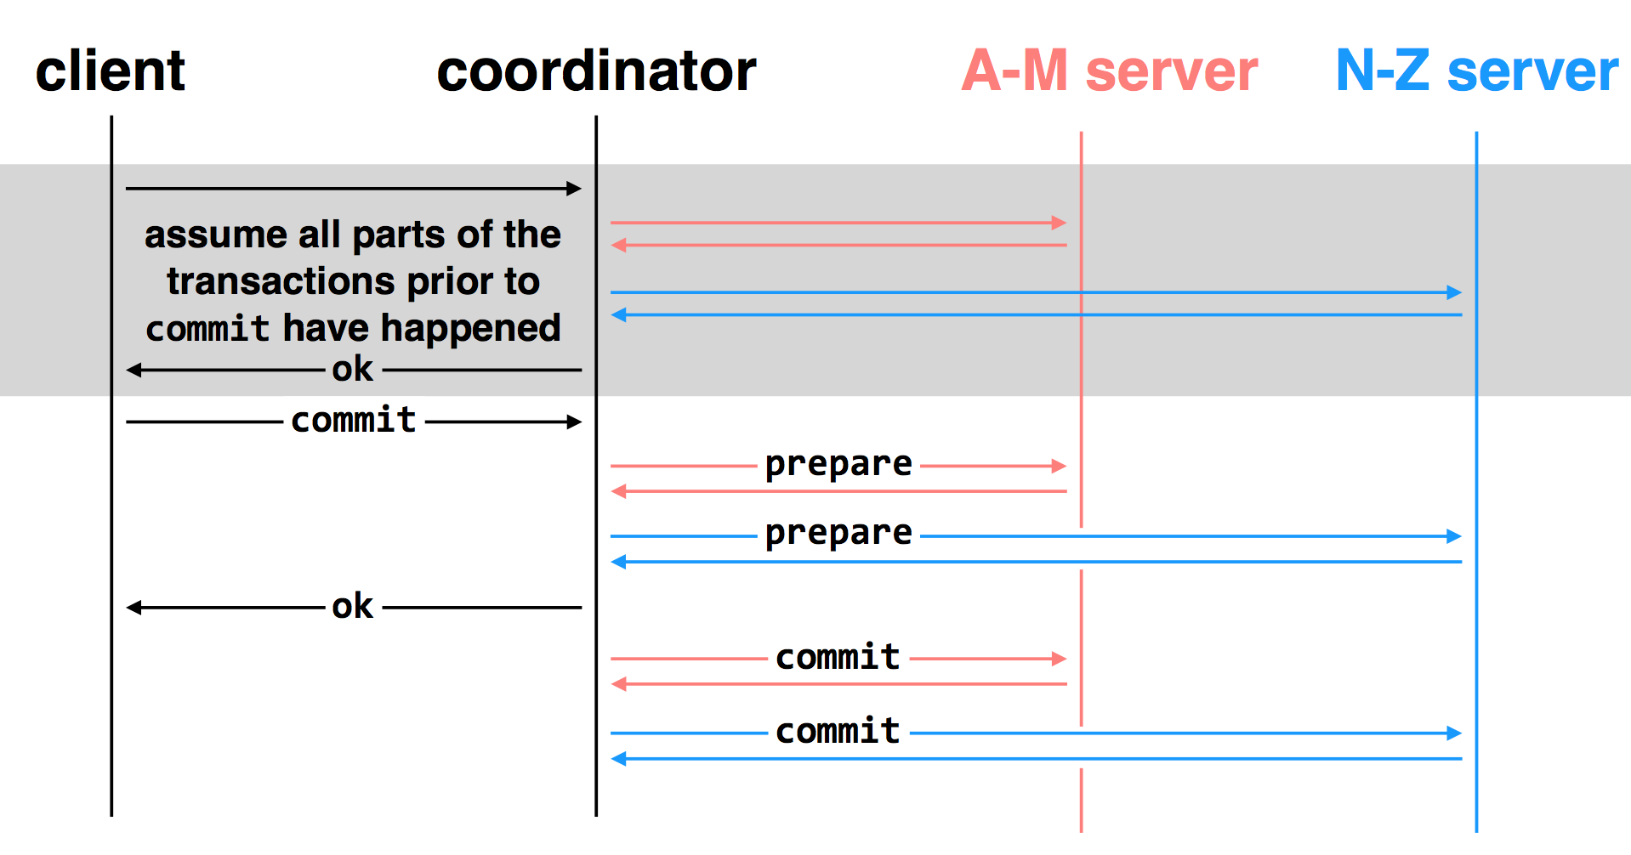
Multi-site transactions under two-phase commit
2PC中high-level的事务添加commit-log的时机是在所有low-level的TX都回复说可以commit之后，在向low-level发送commit请求之前
two-phase commit: nodes agree that they are ready to commit before committing

Slide 55
Multiple-site Atomicity
Worker: Bob, Charles, Dawn
Does three transactions: X, Y, Z
Coordinator: Alice
Create a higher-layer transaction
Send three messages to the three workers
More Challenging: un-reliable communication

Slide 56
Deal with the Network
Message may be lost, delayed or duplicated
Use RPC to communicate
Ensure at-least-once by persistent sender
Ensure at-most-once by duplicate suppression
However, neither is enough to ensure atomicity here

Slide 57
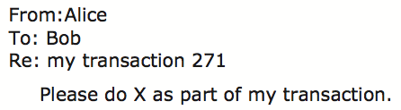
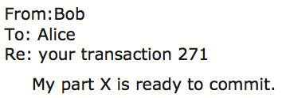
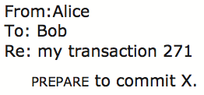


Commit Phase-1
Bob: tentative committed
State: PREPARED
Commit Phase-2
Bob: COMMITTED
Bob will perform post-commit

Slide 58
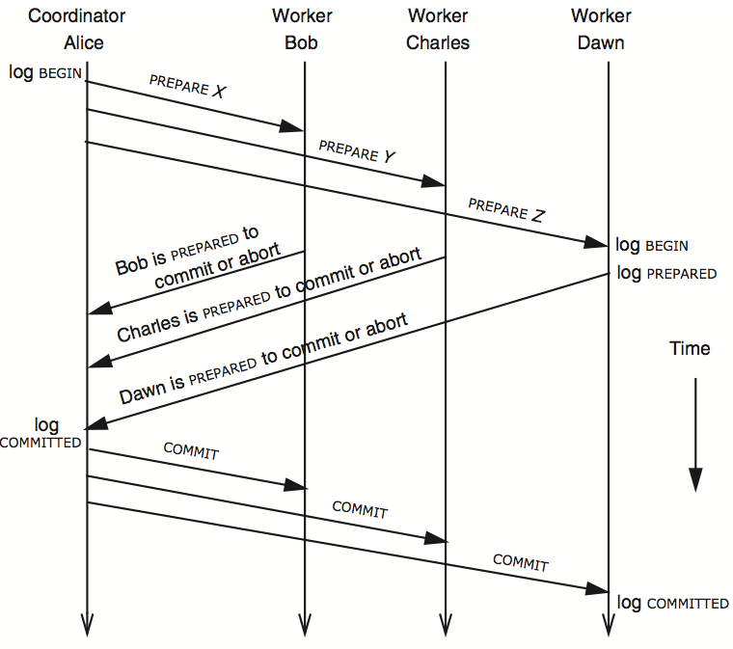
3N messages

Slide 59
Multiple-site Atomicity
Coordinator
Collect some ABORT or nothing: ABORT or assign the work to another worker
Collect all COMMIT: then COMMIT
Worker
When receive nothing: resend PREPARED
- Coordinator will send current state if it receives duplicate message
When receive COMMIT: then COMMIT

Slide 60
client
coordinator
A-M server
N-Z server
assume all parts of the transactions prior to
commit have happened
OK
commit
prepare
prepare
OK
commit
commit
two-phase commit: nodes agree that they are ready to commit before committing

Slide 61
client
coordinator
A-M server
N-Z server
OK
commit
X
timeout; resend
prepare
prepare
OK
commit
commit
failure: lost prepare：coordinator重新发送

Slide 62
client
coordinator
A-M server
N-Z server
OK
commit
prepare
X
timeout; resend
prepare
prepare
OK
failure: lost ACK for prepare:因为最终结果还是coordinator没收到，所以coordinator需要重新发送

Slide 63

client
coordinator
A-M server
N-Z server
OK
commit
prepare
prepare
abort
abort
因为有子server在没有prepare之前发生crash，所以coordinator在得知之后(通过heart-beat)直接abort
failure: worker failure during prepare
coordinator can safely abort transaction, will send explicit abort messages to live workers

Slide 64
client
coordinator
A-M server
N-Z server
OK
commit
prepare
prepare
OK
commit
X
Why? Just wait..
tx?
timeout; resend
commit
commit
failure: lost commit message:A-M server等待并重新发送PREPARED

Slide 65
client
coordinator
A-M server
N-Z server
OK
commit
prepare
prepare
OK
commit
X
timeout; resend
commit
commit
failure: lost ACK of commit message:server实际上已经tentative commit了,但是coordinator没有收到,所以coordinator会重发COMMIT

Slide 66

client
coordinator
A-M server
N-Z server
OK
commit
prepare
prepare
OK
commit
commit
failure: worker failure during commit:等待server重启,并读取log发现已经prepared但是没有commit的TX并重新COMMIT(注意这时候只能等待重启，因为high-level TX已经COMMIT了，所以这时候已经不能abort了)
Notes:
workers write PREPARE records once prepared. the recovery process — reading through the log — will indicate which transactions are prepared but not committed

Slide 67
Worker Failure During Commit
If workers fail after the commit point
We cannot ABORT the transaction
Workers must be able to recover into a prepared state
Workers write PREPARE records to log once prepared
The recovery process will:
Read through the log, and
Indicate which transactions are prepared but not committed
Prepared workers must commit the transaction during recovery

Slide 68

client
coordinator
A-M server
N-Z server
OK
commit
prepare
prepare
OK
commit
commit
tx?
restart
commit
failure: worker failure during commit

Slide 69

client
coordinator
A-M server
N-Z server
OK
commit
prepare
coordinator recovers
abort
abort
failure: coordinator failure during prepare :prepare过程还未结束coordinator就崩溃，直接crash

Slide 70
client
coordinator
A-M server
N-Z server
OK
commit
prepare
prepare
OK
commit
coordinator recovers
commit
commit
failure: coordinator failure during commit:此状态下只能等待coordinator重启因为high-level TX已经commit了

Slide 71
Summary of 2-phase Commit
Two-phase commit allows us to achieve multi-site (nested) atomicity: transaction remains atomic even when they require communication with multiple machines
In two-phase commit, failures prior to the commit point can be aborted. If workers (or the coordinator) fail after the commit point, they recover into the PREPARED state, and complete the transaction

Slide 72
Case study
2PC in a real systems: Sinfonia@SOSP’07

Slide 73
Problems Statement of Sinfonia
Target:
The systems or infrastructural apps within a datacenter
Sinfonia: a shared data store service
Span multiple servers
Address space sharding
Goal:
Reduce development efforts for system programmers

Slide 74
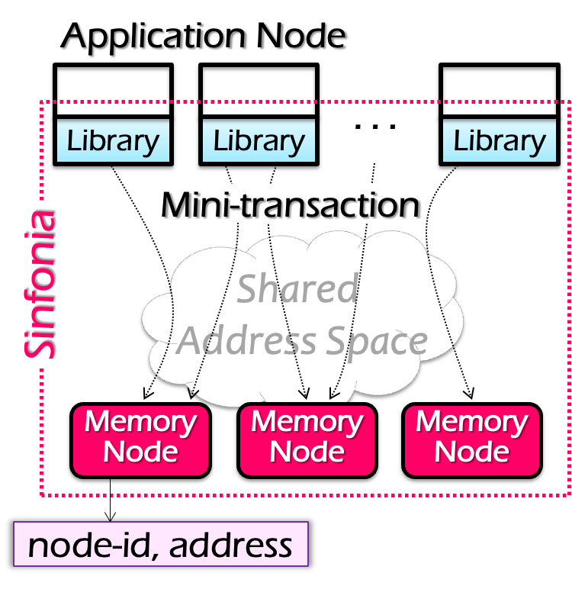
System Architecture
Application node
E.g., frontend servers
Interface: transaction + simple read/write
An optimized version of two-phase commit (mini-transaction) given some workloads
Why not DSM?
Single global manager limits the performance & scalability
False sharing
Notes:
Application
减少一个RTT
Interface
- 用户可以自己选择是否需要TX

Slide 75
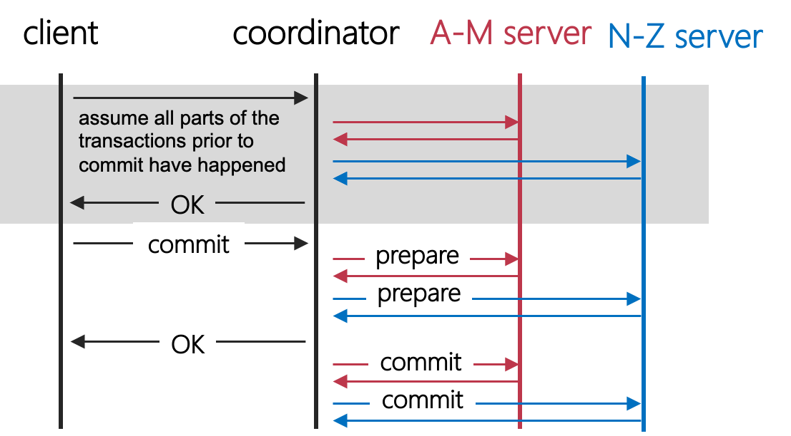
Review of 2PC: optimization spaces
Question: how many roundtrips are there for this simple TX?
Can we reduce the RTTs?

Slide 76
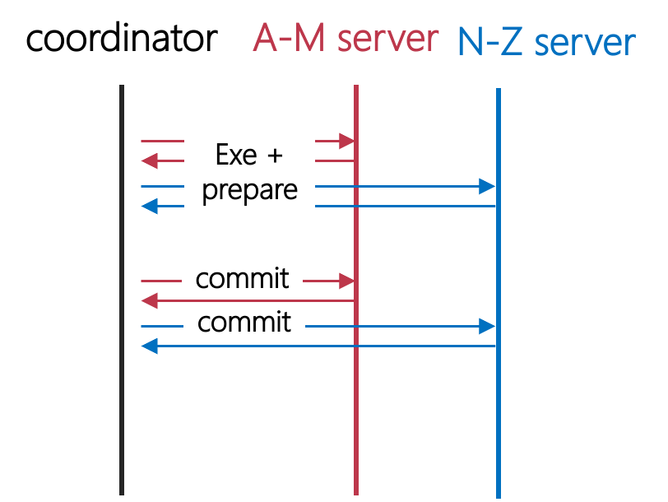
Observation
Send the prepare w/ the last action sending to a server
Question: when can we piggyback these two RPCs together?
Only when the execution of the last operation does not affect the overall commit/abort decision

Slide 77
Mini-transactions
Provide atomicity and concurrency control
Trade off expressiveness for efficiency
Fewer network round-trip-times to execute
Less flexible, general-purpose than traditional transactions
Only the transaction’s last action does not affect the coordinator’s decision to abort or commit is allowed
Mini-transactions
A lightweight, short-lived type of transaction
Over unstructured data (partitioned shared address spaces)
Use re-do log to tolerate failures

Slide 78
Mini-transactions in details
Only supports a limited operations
E.g., read/write operations and they cannot alter the decisions of the coordinator
Semantics of a mini-transaction
Check data by CMP ops (no if: only use CMP to decide whether a TX can commit or not)
if all match then → retrieve data by READ ops
Mini-
Transaction:
WRITE
READ
+
CMP
COMMIT & EXEC
t = new tx()
a = t->read(n1:A, 4)
b = t->read(n2:B, 4)
if (a==3000 && b==2000){
t->write(n1:A, 4, 2000)
t->write(n2:B, 4, 3000)
}
stat = t->commit()
COMMIT
t = new mini_tx()
t->cmp(n1:A, 4, 3000)
t->cmp(n2:B, 4, 2000)
t->write(n1:A, 4, 2000)
t->write(n2:B, 4, 3000)
Stat = t->exec_commit()
Notes:
4: data length
可以看到， 左边的coordinator是没有abort的判断；

Slide 79
Mini-transactions in details
Question:
What is the minimal RTTs does this TX commit? (2)
t = new mini_tx()
t->cmp(n1:A, 4, 3000)
t->cmp(n2:B, 4, 2000)
t->write(n1:A, 4, 2000)
t->write(n2:B, 4, 3000)
Stat = t->exec_commit()
Coordinator
Memory (A)
Memory (B)
Prepare
ok
Cmp
Write
Cmp
Write
Prepare
ok
Commit

Slide 80
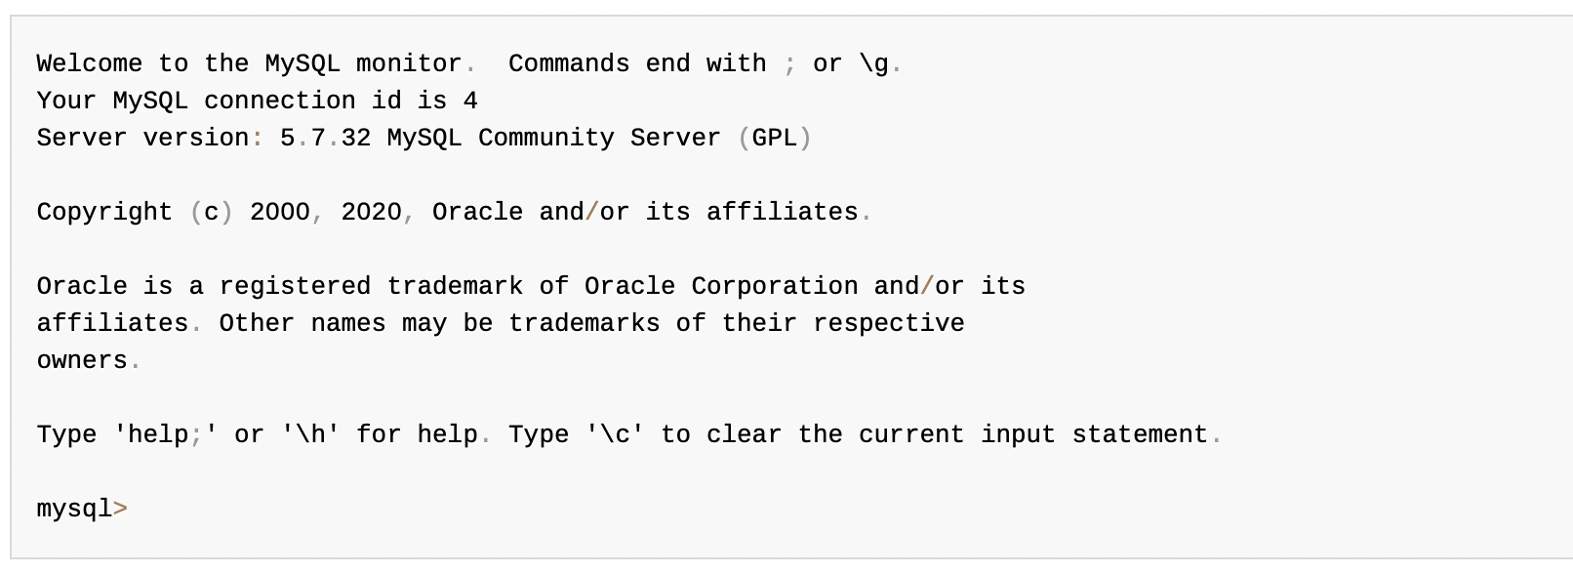
Mini-transactions trade expressiveness
Case study: cannot support interactive applications
E.g., MySQL terminal
Why? Because the code of mini-transactions must be known beforehand
Otherwise, you never know which instruction is the last one!

Slide 81
But still many use cases of mini-transaction
Atomic swap operation
Atomic read of multiple data
Validate cache then change data
…

Slide 82
Example: SinfoniaFS
SinfoniaFS: file system based on Sinfonia
Hosts share the same set of files (in Sinfonia)
Scalability: performance improves with more memory nodes
i.e., inodes sharded at the memory nodes
SinfoniaFS exports a NFS interface
It simplifies the implementation of a distributed file system
E.g., Each NFS operation → one mini-transaction
E.g., No need for a fault tolerant design, the mini-transaction has provided redo logging!

Slide 83
SinfoniaFS Architecture
SinfoniaFS
NFS
NFS
NFS
cache:
inode
bolcks
. . .
cache:
inode
bolcks
. . .
cache:
inode
bolcks
. . .
. . .
superblock
superblock
Library
Library
Library
inodes
inodes
free block
bitmap
free block
bitmap
Mini-transaction
data blocks
data blocks
Sinfonia
Shared Address Space
. .
. . .
. . .
Memory Node
Memory Node
Memory Node
NFS image

Slide 84
setattr
void setattr(ino_t inum, sattr_t newattr){
do {
addr = ... // get address of inode
curr_version = inode->version;
t = new mini_transaction();
t->cmp(addr, 4, curr_version);
t->write(addr, 4, curr_version + 1);
t->write(addr, 20, newattr);
} while(t->status == fail);
}
General use of mini-transaction in SinfoniaFS
If local cache is empty, load it
Make modifications to local cache
Issue a mini-transaction to check the validity of cache, apply modification
If mini-transaction fails, reload cached item and try again

Slide 85
2PC and CAP

Slide 86
Review of The CAP theorem: 2 out of 3
It is impossible for a distributed computer system to simultaneously provide all three of the following guarantees
Consistency (all nodes see the same data at the same time)
Availability (a guarantee that every request receives a response about whether it succeeded or failed)
Partition tolerance (the system continues to operate despite arbitrary message loss or failure of part of the system)
v₀
v₀
v₀
v₀
v₁
v₀
v₁
v₀
v₁
v₀
S₁
S₂
S₁
S₂
S₁
S₂
S₁
S₂
S₁
S₂
S₁
S₂
A=v₁
done
A=?
1. A=v₀
C
C
C
C
C
C
2. Not available

Slide 87
Review of The CAP theorem: 2 out of 3
It is impossible for a distributed computer system to simultaneously provide all three of the following guarantees
Consistency (all nodes see the same data at the same time)
Availability (a guarantee that every request receives a response about whether it succeeded or failed)
Partition tolerance (the system continues to operate despite arbitrary message loss or failure of part of the system)
Question: which property does 2PC achieve?
v₀
v₀
v₀
v₀
v₁
v₀
v₁
v₀
v₁
v₀
S₁
S₂
S₁
S₂
S₁
S₂
S₁
S₂
S₁
S₂
S₁
S₂
A=v₁
done
A=?
1. A=v₀
C
C
C
C
C
C
2. Not available

Slide 88
2PC only guarantees consistency!
If the coordinator failure before sending the commit
All other transaction must wait until it wake about
The coordinator logs its decisions and recovery & resume after the failure
Question: can we tolerate coordinator failure for mini-transaction?
Yes, the coordinator can also keep no log!

Slide 89
Sinfonia’s two-phase commit Protocol
transfer between app-nodes (failure)
TC keeps no log
A transaction is committed iff all participants have “YES” in their logs
Recovery TC cleans up
Ask all participants for existing vote (or vote “NO” if not voted “YES”)
COMMIT iff all vote “YES”
Transaction blocks if a memory node crashes
Must wait for memory node to recovery

Slide 90
Summary of 2PC
2PC
DSM
2PC w/ miniTX
Scalability
Ease of
programming
Performance
Consistency
Fault tolerance

