Slide 1


RSM & PAXOS Consistency across multiple machines
SE3331-1 (2022 Fall)
IPADS, Shanghai Jiao Tong University
https://www.sjtu.edu.cn
Credits: Rong Chen@IPADS & Jinyang Li@NYU & John Ousterhout

Slide 2
Review: Two-phase Commit
Phase-1: preparation / voting
Lower-layer transactions either aborts or tentatively committed
Higher-layer transaction evaluate lower situation
Phase-2: commitment
If top-layer, then COMMIT or ABORT
If nested itself, then become tentatively committed

Slide 3
2PC and CAP

Slide 4
Review of The CAP theorem: 2 out of 3
It is impossible for a distributed computer system to simultaneously provide all three of the following guarantees
Consistency (all nodes see the same data at the same time)
Availability (a guarantee that every request receives a response about whether it succeeded or failed)
Partition tolerance (the system continues to operate despite arbitrary message loss or failure of part of the system)

Slide 5
Review of The CAP theorem: 2 out of 3
It is impossible for a distributed computer system to simultaneously provide all three of the following guarantees
Consistency (all nodes see the same data at the same time)
Availability (a guarantee that every request receives a response about whether it succeeded or failed)
Partition tolerance (the system continues to operate despite arbitrary message loss or failure of part of the system)
Question: which property does 2PC achieve?

Slide 6
2PC only guarantees consistency!
If the coordinator fails before sending the commit
All other transaction must wait until it wakes up
The coordinator logs its decisions to recovery & resume after the failure
If one site fails during the transaction’s execution
All TX requiring this site’s involvement must wait until it wakes up
We need replication to achieve high availability!
2PC只能保证consistency，但是由于其在一些特殊情况下无法进行恢复(如在commit log生成之前)时只能直接abort，这导致了很差的availability。

Slide 7
Review: Two-phase Commit
Two-phase commit allows us to achieve multi-site atomicity: transaction remains atomic even when they require communication with multiple machines
In two-phase commit, failures prior to the commit point can be aborted. If workers (or the coordinator) fail after the commit point(此时已经不能abort了,因为log已经写入disk), they recover into the PREPARED state, and complete the transaction
Our remaining issue deals with availability and replication: we will replicate data across sites to improve availability, we may also replicate the coordinator, but must deal with keeping multiple copies of the data consistent (对于多机replicas，核心问题就是如何保证consistency)
We focus on replicating the data. Replicating the coordinator is similar

Slide 8
Why Replication?
For performance
Higher throughput: replicas can serve concurrently
Lower latency: cache is also a form of replication
For fault tolerance
Maintain availability even if some replicas fail

Slide 9
Replication Consistency
Optimistic Replication (e.g., eventual consistency)
Tolerate inconsistency, and fix things up later
Works well when out-of-sync replicas are acceptable
Pessimistic Replication
Ensure strong consistency between replicas
Needed when out-of-sync replicas can cause serious problems
关于多机备份的consistency的定义：
指的是多个server在访问多机上面的备份数据时候，其行为应该与单机的行为相同。这里的行为并不是完全指的是要保证在操作过程中数据一定相同，只需要保证最终返给用户的数据是一致的就可以了

Slide 10
Pessimistic replication

Slide 11
Pessimistic Replication
Some applications may prefer not to tolerate inconsistency
E.g., a replicated lock server, or replicated coordinator for 2PC
Better not give out the same lock twice
E.g., Better have a consistent decision about whether transaction commits
Trade-off: stronger consistency with pessimistic replication means:
Lower availability than what you might get with optimistic replication
Performance overhead for waiting syncing w/ other replicas

Slide 12
Single-copy Consistency
Problem of optimistic way: replicas get out of sync
One replica writes data, another doesn't see the changes
This behavior was impossible with a single server
Ideal goal: single-copy consistency
Property of the externally-visible behavior of a replicated system
Operations appear to execute as if there's only a single copy of the data
Internally, there may be failures or disagreement, which we have to mask
Similar to how we defined serializability goal ("as if executed serially")
但是single-copy不好处理network partition的问题。
-->majority!

Slide 13



Replicating a Server
Straw-man
Clients send requests to both servers
Tolerating faults: if one server is down, clients send to the other
Tricky case: what if there's a network partition?
Each client thinks the other server is dead, keeps using its server
Bad situation: not single-copy consistency!

Slide 14
Handling Network Partitions
关于majority的问题：只说了在读的时候要保证majority是一样的就认为保证了一致性，但是怎样保证这个”majority”一定是最新的数据呢?
答：只需要在写入的时候保证”majority”是一样的并且是最新的就好了
Issue: Clients may disagree about what servers are up
Hard to solve with 2 servers, but possible with 3 servers
Idea: require a majority servers to perform operation
In case of 3 servers, 2 form a majority
If client can contact 2 servers, it can perform operation (otherwise, wait)
Thus, can handle any 1-server failure

Slide 15
Quorum
QR+QW>N成立是因为:在写入的时候需要保证”至少一半”是最新且相同的数据，在读取的时候也要读取”至少一半”才能进行majority投票，所以加起来一定至少等于N。
Define separate read &write quorums: Q_{r} & Q_{w}
Qr + Qw > Nreplicas (Why?)
Confirm a write after writing to at least Qw of replicas
Read at least Qr agree on the data or witness value
Example
In favor of reading: N_{replicas} = 5, Q_{w} = 4, Q_{r} = 2
In favor or updating: N_{replicas} = 5, Q_{w} = 2, Q_{r} = 4
Enhance availability by Q_{w} = N_{replicas} & Q_{r} = 1(但这种情况write的时候失败的可能性很大)
Quorum容错能力=N - Q(写入/读取的机器越多，容错越差,因为越有可能遇到出问题的机器)
Qr+Qw>N就保证了每次读取的replica与写过的replica一定有交集，这样就保证了每次读取的数据一定至少读取到一个write replica，所以就保证了一定能读到最新的数据从而保证了一致性。

Slide 16
Quorum
Provide no before-or-after or all-or-nothing
If reading & writing requests come from a site
Easy…
If reading from multiple sites, writing from one site
Maintain a version number at that site
If writing from multiple sites
Protocol must provide a distributed sequencer
Another complicating consideration
Performance maximization

Slide 17
Majority in Distributed Systems
Why does the majority rule work?
Any two majority sets of servers overlap(两个“至少一半”的数据一定有重复)
Suppose two clients issue operations to a majority of servers
Must have overlapped in at least one server, will help ensure single-copy
When is it OK to reply to client?
Must wait for majority of replicas to reply
Otherwise, if a minority crashes, remaining servers may continue without op

Slide 18
Inconsistency of Replicas
Problem: replicas can become inconsistent
Issue: clients' requests to different servers can arrive in different order
How do we ensure the servers remain consistent?
Unlike optimistic replication (e.g., eventual consistency), we cannot re-order events later, we must order it right now

Slide 19
Replicated State Machines (RSM)

Slide 20
RSM: Replicated State Machines
A general approach to making consistent replicas of a server:
Start with the same initial state on each server
Provide each replica with the same input operations, in same order
Ensure all operations are deterministic
E.g., no randomness, no reading of current time, etc.
These rules ensure each server will end up in the same final state
想保证相同的输入和输入顺序是比较难的

Slide 21
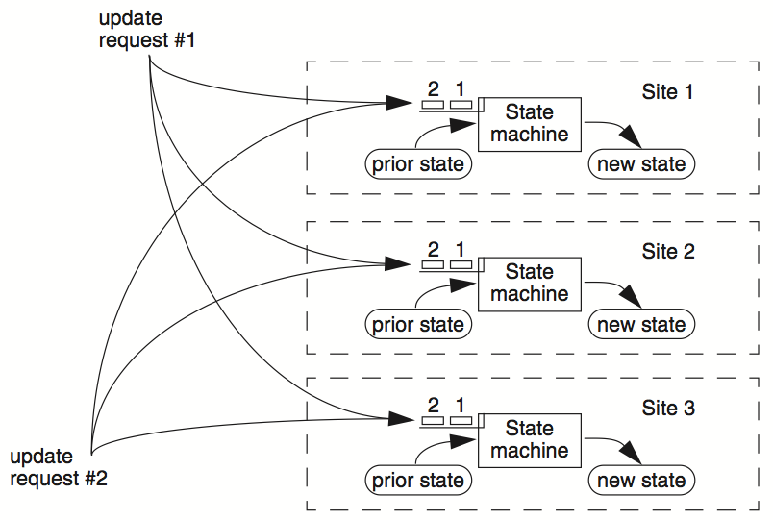
RSM

Slide 22
Clients
Servers
C₁
S₁
write₁(x)
C₂
S₂
write₂(x)
(replica of S₁)

Slide 23
Clients
Servers
C₁
S₁
write₁(x)
write₂(x)
C₂
S₂
write₁(x)
write₂(x)
(replica of S₁)
problem: How to ensure the order of operations?

Slide 24
RSM: Replicated State Machines
RSMs provide single-copy consistency
Operations complete as if there is a single copy of the data
Though internally there are replicas
RSMs can use a primary-backup mechanism for replication
Using view server to ensure only one replica acts as the primary
It can also recruit new backups after servers fail

Slide 25
Primary/Backup Model
Primary does important stuff
Ensures that it sends all updates to the backup before ACKing the coordinator(而backup server会直接拒绝coordinator的请求，就是啥都不会主动做)
Chooses an ordering for all operations, so that the primary and backup agree (i.e., one writer)
Decides all non-deterministic values (e.g., random(), time())

Slide 26
What if Primary Fails?
Idea 1: Coordinator knows about both primary and backup, and decides which to use
Won't work: the "split brain" syndrome
Multiple coordinators come to independent, and different, conclusions about who is primary when there are network partitions
Idea 2: Have human decide when to switch from primary to backup
Not unreasonable for small web services

Slide 27
Primary/Backup Model
(primary)
Clients
Coordinator
S₁
向primary发送请求
C
S1将新的更新信息同步到backup S2中去
S2接收到信息之后在同步成功之后将成功信息返回给primary S1
彻底结束之后响应coordinator
S₂
if primary fails, C knows about S₂, and switches
(backup)
attempt: coordinators communicate with primary servers, who communicate with backup servers

Slide 28
Primary/Backup Model
这里的primary是真正的crash了，而不是因为网络问题在coordinator看来”crash”了
(primary)
X
Clients
Coordinator
S₁
C
S₂
if primary fails, C knows about S₂, and switches
(backup)
attempt: coordinators communicate with primary servers, who communicate with backup servers

Slide 29
Multiple Coordinators + the Network = Problems
X
Clients
Coordinator
S₁
C
S₂
if primary fails, C knows about S₂, and switches
(primary)
attempt: coordinators communicate with primary servers, who communicate with backup servers

Slide 30
Multiple Coordinators + the Network = Problems
(primary)
C₁
S₁
network partition
C₂
S₂
(backup)
attempt: coordinators communicate with primary servers, who communicate with backup servers

Slide 31
Multiple Coordinators + the Network = Problems
(primary)
C₁
S₁
network partition
C₂
S₂
这个图说的是由于C2的网络问题，认为S1已经”crash”了，但是实际上S1还在正确运行，而这时C2认为的primary已经变成S2了，所以出现了关于primary的不一致
(backup, but primary for C₂)
C₁ and C₂ are using different primaries;
S₁ and S₂ are no longer consistent

Slide 32
View Server
The view server keeps a table that maintains a sequence of "view"
Each view contains view number, primary server, and backup servers
The view server alerts each server as to whether it's the primary or the backup
Upon receiving any updates, the primary will receive an ACK from the backup before responding to the view server (just as before)
Coordinators make requests to the view server asking who is primary
Coordinators then contact the primary

Slide 33

View Server
(primary)
S₁
S₁
primary
C
primary?
VS
S₁
backup
1: S₁, S₂
S₂
VS通过心跳来检测primary是否挂了
(backup)
Use a view server, which determines which replica is the primary

Slide 34
View Server
To discover failures
Replicas ping to the view server
If view server misses N pings in a row, it deems a server to be dead
Basic failure (actual worker crash):
1. Primary fails; pings cease
2. View server lets S2 know it's primary,(但是这个过程是需要一段时间的，取决于network) and it handles any client requests
Before S2 knowing it's the primary, it will simply reject requests that come directly from the coordinator
3. View server will eventually recruit a new idle server to act as backup

Slide 35
Failure of Primary
(dead)
X
S₁
C
VS
lack of pings indicates to VS that S₁ is down
1: S₁, S₂
S₂
(backup)
Use a view server, which determines which replica is the primary

Slide 36
Failure of Primary
(dead)
X
S₁
C
primary?
VS
S₂
primary
1: S₁, S₂
2: S₂, --
S₂
S₂
(primary)
before S₂ knows it's primary, it will reject any requests from clients

Slide 37
Rules when Facing Network Partitions
Primary must wait for backup to accept each request
Non-primary must reject direct coordinator requests
That's what happened in the earlier failure, in the interim between the failure and S2 hearing that it was primary(在S2知道自己成为了primary之前，S1fail之后)
Primary must reject forwarded requests
i.e., it won't accept an update from the backup
Primary in view i must have been primary or backup in view i-1

Slide 38
Network Partitions
Network Partition between VS and S₁
(primary)
S₁
lack of pings indicates to VS that S₁ is down
S₁
C
VS
1: S₁, S₂
上图中，S1出现了net-partition，因而VS认为S1发生了crash(但是实际上S1没有crash)，这时候VS会向S2发送成为新的primary的”通知”，而在这个通知到达S2之前，S2仍然是一个backup(原来的backup知道自己成为新的primary的时机是S2接收到成为primary的通知消息)，所以这时候出现了问题。首先，C这时候还不知道S2已经变成primary了，仍然将req发给S1，(这时由于S2还没与接收到通知，所以还是会rejectC的请求)但是由于S1正确运行，所以他会真正的接收并处理请求，并将结果尝试同步到S2，而这时候S2已经认为接收到通知了，知道自己是一个primary了，所以S2不会接受S1的同步forwarded update request，这时候S1会接受到错误，多次尝试之后，S1会向C发送请求，C会向VS发送请求看谁是新的primary。，知道是S2之后C就直接向S2发送消息了。
S₂
(backup)

Slide 39
Network Partitions
Network Partition between VS and S₁
(primary)
S₁
S₁
VS makes S₂ primary
C
VS
primary
1: S₁, S₂
2: S₂, --
S₂
rejected by S₂
(backup)
it's okay! S2 will act as backup
(accept updates from S1, reject coordinator's requests)
problem: what happens before S₂ knows it's the primary?

Slide 40
Network Partitions
Network Partition between VS and S₁
rejected by S₁
(Cannot get ACK from S₂)
(primary)
S₁
S₁
C
VS
1: S₁, S₂
2: S₂, --
S₂
(primary)
also okay! S1 won't be able to act as primary
(can't accept client requests because it won't get ACKs from S2)
problem: what happens after S2 knows it's the primary,
but S1 also thinks it is?

Slide 41
Consider S₁ being Partitioned from the VS
Before S2 hears about View #2:
S1 can process operations from coordinators, S2 will accept forwarded requests
S2 will reject operations from coordinators who have heard about view #2
After S2 hears about View #2:
If S1 receives coordinator requests, it will forward. S2 will reject (not ACK), so S1 can no longer act as primary
S1 will send error to coordinator, coordinator will ask VS for new view, learn about view #2, and coordinator will re-send to S2
The commit point of switch-over:
When S2 hears about View #2

Slide 42
What if view server fails?
对于一个RSM系统，primary+backup的workload最大，而VS 由于只需要存储一个关于primary-backup关系的KVS，所以workload最小，而coordinator需要重定向client-req值不同的server，需要接受primary server的响应，其workload不是很大，但是需要特别的保证其network正常。
(primary)
S₁
S₁
C
X
VS
1: S₁, S₂
S₂
(backup)
problem: what if view server fails?
Now, we need Paxos

Slide 43
Paxos
Distributed consensus mechanism

Slide 44

Leslie Lamport
http://ipads.se.sjtu.edu.cn/courses/cse-g/2012f/Schedule_files/paxos-simple.pdf

Slide 45

Paxos solves the consensus problem

Slide 46
Single-decree Paxos
Agree on a single value

Slide 47
Paxos' properties: correct + fault-tolerance
No guaranteed termination (i.e., lack of availability guarantee)
paxos不能保证一定能正常的结束
Goal: have all acceptors agree to a value V associated with a proposal
Proposer
Proposer
Proposer
E.g., a view
Acceptor
Client
Network
Acceptor
Acceptor
leader
此处的proposer，acceptor，learner是三个逻辑上的概念，所以一个节点可以同时充当多个角色。
Learner
Learner
quorum
Learner
Paxos: one machine may serve several roles

Slide 48
Paxos Players
Client
makes a request
Proposer
Get a request and run the protocol
Leader = elected Coordinator
Acceptor
Remember the state of the protocol
Quorum = any majority of Acceptors
Learner
When agreement has been reached, a Learner executes the request and/or sends a response back to the Client

Slide 49
General Approach
One proposer decides to be the leader (optional)
Leader proposes a value and solicits acceptance from acceptors (majority)
Leader announces result or try again
What if >1 proposers become leaders simultaneously?
What if there is a network partition?
What if a leader crashes in the middle of solicitation?
What if a leader crashes after deciding but before announcing results?
. . .

Slide 50
Political Science 101
Paxos has rounds; each round has a unique ID (N)
Rounds are asynchronous
Time synchronization not required
If you are in round j and hear a message from round j+1, abort everything and move over to round j+1
Use timeouts; may be pessimistic
Each round itself broken into phases
Phases are also asynchronous

Slide 51
Paxos in Action: Phase 0
Client sends a request to a proposer
Proposer
request
Acceptor
Client
Network
Acceptor
Acceptor
quorum
Learner

Slide 52
Paxos in Action: Phase 1a (Prepare)
Leader creates a proposal N and send to quorum
每次的N需要保证为对应proposer见到的最大的N，小于这个最大值的N会被简单的舍弃掉
N is greater than any previous proposal number seen by this proposer
Leader
proposal N
Acceptor
Client
Network
Acceptor
Acceptor
quorum
Learner

Slide 53
Paxos in Action: Phase 1b (Prepare)
Acceptor: if proposal ID > any previous proposal
reply with the highest past proposal number and value(这个value指的是proposer返回到leader的数值，可以为空，若不为空的话则返回这个proposer得到的最新数值)
promise to ignore all IDs < N
else ignore (proposal is rejected)
Leader
promise N
Acceptor
Client
Network
Acceptor
Acceptor
quorum
Learner

Slide 54
Paxos in Action: Phase 2a (Accept)
Leader: if receive enough promise
set a value V to the proposal V, if any accepted value returned, replace V with the returned one(若无返回值，则leader自己选一个值，若返回了值，则leader将自己的value设置成返回的那个value)
send accept request to quorum with the chosen value V
Leader
accept request(N, V)
Acceptor
Client
Network
Acceptor
Acceptor
quorum
Learner
Ignore all proposals < N

Slide 55
Paxos in Action: Phase 2b (Accept)
Acceptor: if the promise still holds
register the value V
send accepted message to Proposer/Learners
else ignore the message
Leader
accepted
Acceptor
Client
Network
Acceptor
Acceptor
accepted
quorum
Learner
Learner
Ignore all proposals < N

Slide 56
Paxos in Action: Phase 3 (Learn)
Learner: responds to Client and/or take action on the request
Leader
Acceptor
Client
Network
Acceptor
Acceptor
quorum
Learner
Learner
Ignore all proposals < N

Slide 57
Paxos Setup
Client
Client
Paxos Node
Paxos Node
Paxos Node
Proposer
Proposer
Proposer
Acceptor
Acceptor
Acceptor
. . .
Learner
Learner
Learner
N_{a}: highest proposal number accepted
V_{a}: accepted value of N_{a}
N_{h}: highest proposal number seen
M_{n}: my proposal number
each round of Paxos, each Node

Slide 58
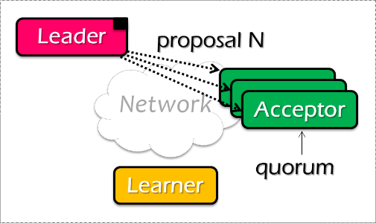
Paxos Pseudo-code
N_{a}: highest proposal number accepted
V_{a}: accepted value of N_{a}
N_{h}: highest proposal number seen
M_{n}: my proposal number
A node decides to be Leader
Leader chooses M_{n} > N_{h}
Leader sends <proposal, M_{n} > to all nodes
Acceptor receives <proposal, N>
if N < N_{h}
reply <promise-reject>
else
N_{h} = N
reply <promise-ok, N_{a}, V_{a}>
Ignore all proposals < N_{h}

Slide 59

Paxos Pseudo-code
N_{a}: highest proposal number accepted
V_{a}: accepted value of N_{a}
N_{h}: highest proposal number seen
M_{n}: my proposal number
If Leader gets promise-ok from a majority
If Leader fails to get majority promise-ok
Upon receiving <accept, N, V>
if V != null, V = the value of the highest N_{a} received
if V = null, then Leader can pick any V
send <accept, M_{n}, V> to all nodes
delay and restart Paxos
if N < N_{h}
reply <accept-reject>
else
N_{a} = N; V_{a} = V; N_{h} = N;
reply <accept-ok>

Slide 60
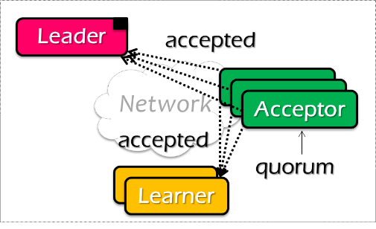
Paxos Pseudo-code
N_{a}: highest proposal number accepted
V_{a}: accepted value of N_{a}
N_{h}: highest proposal number seen
M_{n}: my proposal number
If Leader gets accept-ok from a majority
If Leader fails to get majority accept-ok
send <decide, V_{a}> to all nodes
delay and restart Paxos

Slide 61
Paxos Pseudo-code
N_{a}: highest proposal number accepted
V_{a}: accepted value of N_{a}
N_{h}: highest proposal number seen
M_{n}: my proposal number
N_{a} = V_{a} = null
N_{h} = N0:0
N_{a} = V_{a} = null
N_{h} = N1:0
N_{a} = V_{a} = null
N_{h} = N2:0
M_{n} = N1:1(1为leader)
V1是N1自己确定的一个数值
<proposal, N1:1>
<proposal, N1:1>
N_{h} = N1:1
N_{a} = null
V_{h} = null
N_{h} = N1:1
N_{a} = null
V_{h} = null
<promise, null, null>
<promise, null, null>
<accept, N1:1, V1>
<accept, N1:1, V1>
N_{h} = N1:1
N_{a} = N1:1
V_{h} = V1
N_{h} = N1:1
N_{a} = N1:1
V_{h} = V1
<accept-ok>
<accept-ok>
<decide, V1>
<decide, V1>
Time

Slide 62
Inside of Paxos
N_{a}: highest proposal number accepted
V_{a}: accepted value of N_{a}
N_{h}: highest proposal number seen
M_{n}: my proposal number
Why setups multiple acceptors?
Failure of the single acceptor halts decision
Why not accepts the first proposal and rejects the rest?
Multiple leaders result in no majority accepting
Leader dies
What if more than one leader is active?
Can both leaders see a majority of promises?

Slide 63
Inside of Paxos
N_{a}: highest proposal number accepted
V_{a}: accepted value of N_{a}
N_{h}: highest proposal number seen
M_{n}: my proposal number
When is the value V chosen?
Leader receives a majority <promise, …>
A majority acceptors receive <accept, N, V>
Leader receives a majority <accepted, …>
What if acceptor fails after sending promise?
Must remember N_{h}
What if acceptor fails after receiving accept?
Must remember N_{h} and N_{a} V_{a}
What if leader fails while sending accept?
Propose M_{n} again
当大多数的acceptor接受到了value V的时候，才认为数值V已经被确定(leader刚选定V的时候并不是最终时刻，是因为leader可能在选定之后发送给所有的acceptors之前可能发生crash而导致V丢失)
Notes:
When is the value V chosen?
- As long as majority send <accepted>, even if the leader has not received that much.
Why not the second case?
- The acceptor may receive the request, than fail
If not remember Nh, than another leader may get the same promise

Slide 64
Question
N_{a}: highest proposal number accepted
V_{a}: accepted value of N_{a}
N_{h}: highest proposal number seen
M_{n}: my proposal number
Suppose that the acceptors are A, B, and C. A and B are also proposers. How does Paxos ensure that the following sequence of events can't happen? What actually happens, and which value is ultimately chosen?
A sends <prepare, 1> requests with proposal number 1, and gets responses from A, C
A sends <accept,1, "foo"> to A and C and gets responses from both. Because a majority accepted, A thinks that "foo" has been chosen. However, A crashes before sending an <accept, 1, "foo"> to B
B sends <prepare, 2> messages with proposal number 2, and gets responses from B and C
B sends <accept, 2, "bar"> messages to B and C and gets responses from both, so B thinks that "bar" has been chosen

Slide 65

Question
N_{a}: highest proposal number accepted
V_{a}: accepted value of N_{a}
N_{h}: highest proposal number seen
M_{n}: my proposal number
A
C
M_{n} = 1
<proposal, 1>
<promise, …>
B
<accept, 1, foo>
M_{n} = 2(因为1会被舍弃，
所以B会发现只能从2开始
proposal)
<proposal, 2>
<promise, …>
<accept, 2, bar>
Time

Slide 66
Question
N_{a}: highest proposal number accepted
V_{a}: accepted value of N_{a}
N_{h}: highest proposal number seen
M_{n}: my proposal number
A
C
M_{n} = 1
<proposal, 1>
<promise, …>
B
<accept, 1, foo>
M_{n} = 2
<proposal, 2>
<promise, 1, foo>
<accept, 2, foo>
Time

Slide 67
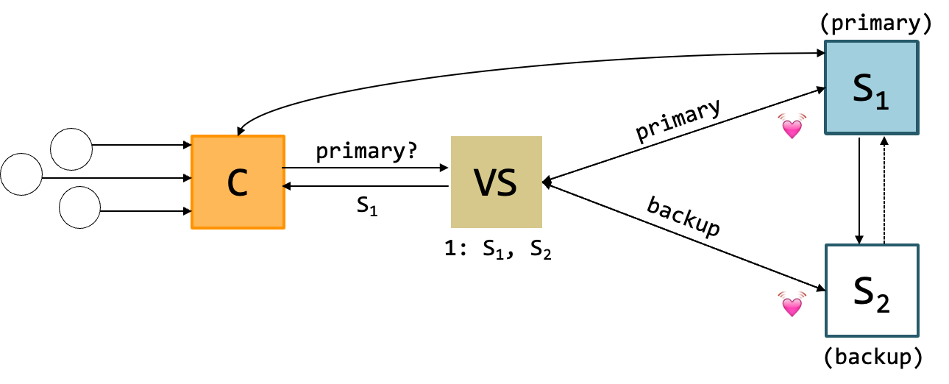
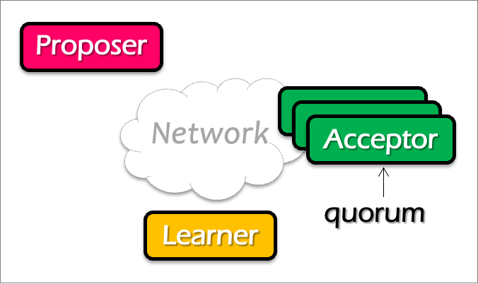
Question
Does single-decree Paxos works fine for our view server example?
When can it go wrong? Accepting a single value is not enough (because view can change)
Notes:
No. What about configuration updates?

Slide 68
Paxos Summary
Paxos allows us to ensure consistent (total) ordering over a set of events in a group of nodes
Events = commands / actions / state updates
Each machine will have the latest state or a previous version of the state

Slide 69
Multi-Paxos
Agree on a sequence of values

Slide 70
Multi-Paxos builds on top of the basic Paxos
Useful when agreeing on a sequences of values, examples including:
Views in primary-backup replication
Logs in a replicated state machine
i.e., use Multi-Paxos to implement RSM
The basic approach
Run a separate instance of Paxos to agree on the value of each index
Each instance of Paxos has its own copy of state
highest proposal seen
accepted proposal number
accepted proposal value

Slide 71

Basic Multi-Paxos
Question: what could happen if instance 3 has already gotten a value?
Server simultaneously acts as proposer, acceptor & learner
After receiving a value, the server:
Decides where to place the value (e.g., the latest)
Start Paxos at the decided position
x
0
1
2
Select 3
S1
S1
S2
S2
S3
S3
Prepare
Accept
Notes:
初始状态： 每个server都确认了0，1，2的value

Slide 72
Basic Multi-Paxos is inefficient
With multiple concurrent proposers, conflicts and restarts are likely
higher load → more conflicts
Will be slow (but still correct!)
2 rounds of RPCs for each value chosen
Prepare, Accept
Solution
Select a leader: most of the time, only one server can propose
Batch prepare requests from multiple instances sent from a leader

Slide 73
Multi-paxos uses a distinguished proposer (leader)
Distinguished proposer (aka. leader)
The only one that issues proposals
i.e., reduce proposer conflicts
Client sends the commands only to the leader
Decides the value position
Note, single leader is not necessary for Multi-paxos
E.g., if two or more servers act as proposers at the same time, the protocol still works correctly

Slide 74
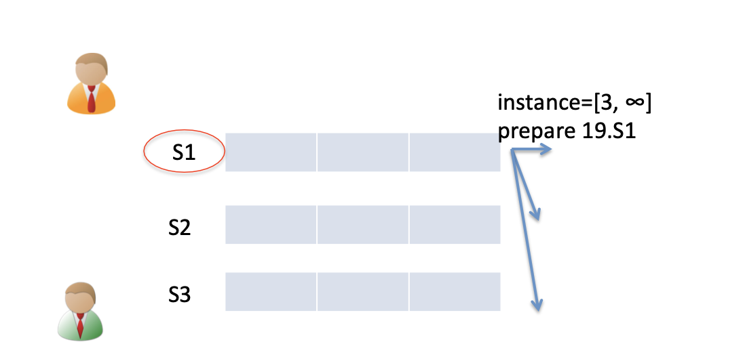
Prepare message batching
All instances of the leader share the same state
i.e., highest proposal number seen
Can use one message to prepare for a batch of instances

Slide 75
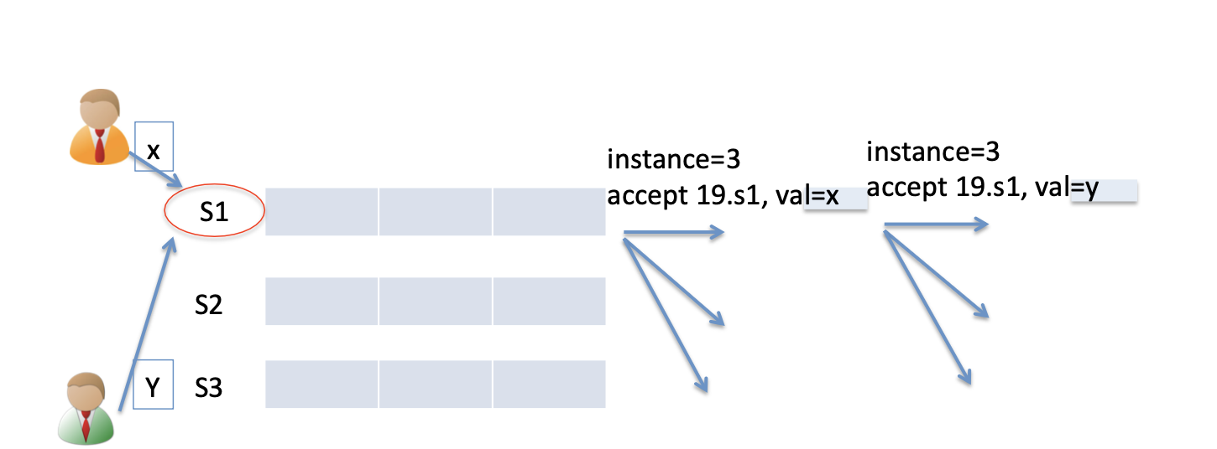
Benefits of batched prepare message
Leader only needs to run the accept phase to replicate an operation during normal time

Slide 76
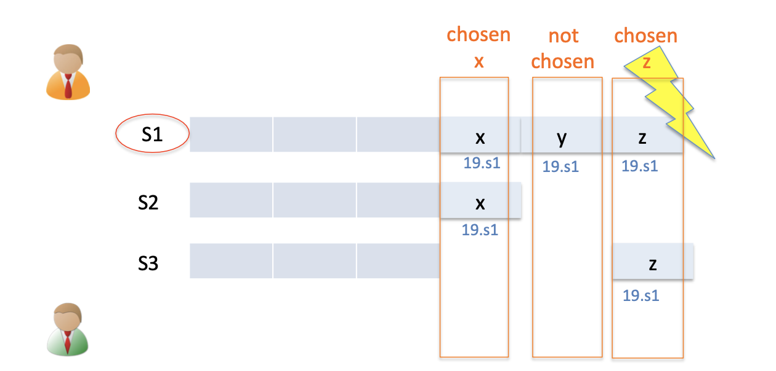
Multi-Paxos can run multiple instances concurrently
i.e., the prefix of chosen values are not contiguous
Need to re-run Paxos after an old leader crashes to fill the holes
If there is no value chosen, use a no-op to fill the hole

Slide 77
Paxos Summary
Paxos allows us to ensure consistent (total) ordering over a set of events in a group of nodes
Events = commands / actions / state updates
Each machine will have the latest state or a previous version of the state

Slide 78
Single Paxos Summary
To make a change to the system
Tell the proposer(leader) the event
(NOTE: these requests may occur concurrently)
The leader picks its next highest ID and asks proposal to all the acceptors with that ID
When the majority of acceptors accept the proposal, accepted event are sent to learners
The learners do event (e.g., update system state)

Slide 79
Paxos for RSM
Fault-tolerant RSM requires consistent replica view
View: <primary, backups> (e.g., <node1, node2>)
All active nodes must agree on the sequence of view changes
<vid-1, primary, backups>, . . .
Use Paxos to agree on the <primary, backups>
Each Paxos instance agree to a single view
(e.g., <2, Node1, Node2>)
Paxos itself can also be used to implement RSM
E.g., agree on multiple states
Usually inefficient: e.g., two RTTs to agree on a value
Multi-Paxos can batch prepares to improve the performance

