Slide 1


Consistent Log Replication with Paxos & Raft
SE3331-1 (2022 Fall)
Yubin Xia & Xingda Wei
IPADS, Shanghai Jiao Tong University
https://www.sjtu.edu.cn
Credits: Jinyang@NYU, Ongaro and Ousterhout’s raft user study

Slide 2

Review: View Server
Network Partition between VS and S₁
rejected by S₁
(Cannot get ACK from S₂)
(primary)
S₁
S₁
C
VS
1: S₁, S₂
2: S₂, --
S₂
View Server不能通过多机备份的方式来容错，那样的话多个
VS还需要一个VS来保证KV的一致性，这样就死循环下去了。所以需要使用paxos来保证KV存储的数据的一致性。
(primary)
problem: what if view server fails?

Slide 3
Paxos in Action: Phase 0
Client sends a request to a proposer
Proposer
request
Acceptor
Client
Network
Acceptor
Acceptor
quorum
Learner

Slide 4
Paxos in Action: Phase 1a (Prepare)
Leader creates a proposal N and send to quorum
N is greater than any previous proposal number seen by this proposer
Leader
proposal N
Acceptor
Client
Network
Acceptor
Acceptor
quorum
Learner

Slide 5
Paxos in Action: Phase 1b (Prepare)
Acceptor: if proposal ID > any previous proposal
reply with the highest past proposal number and value(应当是当前最大的N以及对应的V)
promise to ignore all IDs < N
else ignore (proposal is rejected)
Leader
promise N
Acceptor
Client
Network
Acceptor
Acceptor
quorum
Learner

Slide 6
Paxos in Action: Phase 2a (Accept)
Leader: if receive enough promise
set a value V to the proposal V, if any accepted value returned, replace V with the returned one
send accept request to quorum with the chosen value V
Leader
accept request(N, V)
Acceptor
Client
Network
Acceptor
Acceptor
quorum
Learner
Ignore all proposals < N

Slide 7
Paxos in Action: Phase 2b (Accept)
Acceptor: if the promise still holds
register the value V
send accepted message to Proposer/Learners
else ignore the message
Leader
accepted
Acceptor
Client
Network
Acceptor
Acceptor
accepted
quorum
Learner
Learner
Ignore all proposals < N

Slide 8
Paxos in Action: Phase 3 (Learn)
Learner: responds to Client and/or take action on the request
Leader
Acceptor
Client
Network
Acceptor
Acceptor
quorum
Learner
Learner
Ignore all proposals < N

Slide 9
Paxos Setup
Client
Client
Paxos Node
Paxos Node
Paxos Node
Proposer
Proposer
Proposer
Acceptor
Acceptor
Acceptor
. . .
Learner
Learner
Learner
N_{a}: highest proposal number accepted
V_{a}: accepted value of N_{a}
N_{h}: highest proposal number seen
M_{n}: my proposal number
each round of Paxos, each Node

Slide 10
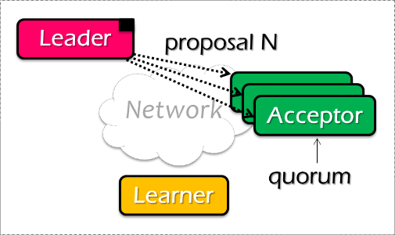
Paxos Pseudo-code
N_{a}: highest proposal number accepted
V_{a}: accepted value of N_{a}
N_{h}: highest proposal number seen
M_{n}: my proposal number
A node decides to be Leader
Leader chooses M_{n} > N_{h}
Leader sends <proposal, M_{n} > to all nodes
Acceptor receives <proposal, N>
if N < N_{h}
reply <promise-reject>
else
N_{h} = N
reply <promise-ok, N_{a}, V_{a}>
Ignore all proposals < N_{h}

Slide 11

Paxos Pseudo-code
N_{a}: highest proposal number accepted
V_{a}: accepted value of N_{a}
N_{h}: highest proposal number seen
M_{n}: my proposal number
If Leader gets promise-ok from a majority
If Leader fails to get majority promise-ok
Upon receiving <accept, N, V>
if V != null, V = the value of the highest N_{a} received
if V = null, then Leader can pick any V
send <accept, M_{n}, V> to all nodes
delay and restart Paxos
if N < N_{h}
reply <accept-reject>
else
N_{a} = N; V_{a} = V; N_{h} = N;
reply <accept-ok>

Slide 12
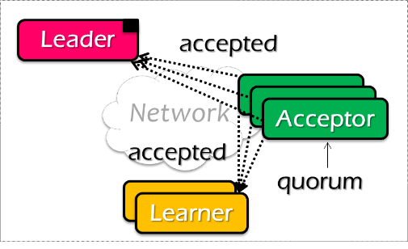
Paxos Pseudo-code
N_{a}: highest proposal number accepted
V_{a}: accepted value of N_{a}
N_{h}: highest proposal number seen
M_{n}: my proposal number
If Leader gets accept-ok from a majority
If Leader fails to get majority accept-ok
send <decide, V_{a}> to all nodes
delay and restart Paxos

Slide 13
Paxos Pseudo-code
N_{a}: highest proposal number accepted
V_{a}: accepted value of N_{a}
N_{h}: highest proposal number seen
M_{n}: my proposal number
N_{a} = V_{a} = null
N_{h} = N0:0
N_{a} = V_{a} = null
N_{h} = N1:0
N_{a} = V_{a} = null
N_{h} = N2:0
M_{n} = N1:1
<proposal, N1:1>
<proposal, N1:1>
N_{h} = N1:1
N_{a} = null
V_{h} = null
N_{h} = N1:1
N_{a} = null
V_{h} = null
<promise, null, null>
<promise, null, null>
<accept, N1:1, V1>
<accept, N1:1, V1>
N_{h} = N1:1
N_{a} = N1:1
V_{h} = V1
N_{h} = N1:1
N_{a} = N1:1
V_{h} = V1
<accept-ok>
<accept-ok>
<decide, V1>
<decide, V1>
Time

Slide 14
Inside of Paxos
N_{a}: highest proposal number accepted
V_{a}: accepted value of N_{a}
N_{h}: highest proposal number seen
M_{n}: my proposal number
Why setups multiple acceptors?
Failure of the single acceptor halts decision
Why not accepts the first proposal and rejects the rest?
Multiple leaders result in no majority accepting
Leader dies
What if more than one leader is active?
Can both leaders see a majority of promises?

Slide 15
Inside of Paxos
N_{a}: highest proposal number accepted
V_{a}: accepted value of N_{a}
N_{h}: highest proposal number seen
M_{n}: my proposal number
When is the value V chosen?(选第三个，因为可能一个acceptor在接受到一个accept-req之后发生了crash。)
Leader receives a majority <promise, …>
A majority acceptors receive <accept, N, V>
Leader receives a majority <accepted, …>
What if acceptor fails after sending promise?
Must remember N_{h}
What if acceptor fails after receiving accept?
Must remember N_{h} and N_{a} V_{a}
What if leader fails while sending accept?
Propose M_{n} again
必须要记住Nh，是因为恢复之后要保证能够正确的接收Nh及以上请求的信息，而正确的拒绝Nh以下的数据的信息(因为可能有另一个leader会发送相同编号的proposal)
需要记住Va和Na是因为在恢复之后若不能恢复原来的value，可能会导致后续的value的出错
需要重新发送Mn是因为在恢复之后如果之前promise的server并没有全部接收新的val的话则可能会导致之后的val出错(49%的例子)
Notes:
When is the value V chosen?
- As long as majority send <accepted>, even if the leader has not received that much.
Why not the second case?
- The acceptor may receive the request, than fail
If not remember Nh, than another leader may get the same promise

Slide 16
Question
N_{a}: highest proposal number accepted
V_{a}: accepted value of N_{a}
N_{h}: highest proposal number seen
M_{n}: my proposal number
Suppose that the acceptors are A, B, and C. A and B are also proposers. How does Paxos ensure that the following sequence of events can't happen? What actually happens, and which value is ultimately chosen?
A sends <prepare, 1> requests with proposal number 1, and gets responses from A, C
A sends <accept,1, "foo"> to A and C and gets responses from both. Because a majority accepted, A thinks that "foo" has been chosen. However, A crashes before sending an <accept, 1, "foo"> to B
B sends <prepare, 2> messages with proposal number 2, and gets responses from B and C
B sends <accept, 2, "bar"> messages to B and C and gets responses from both, so B thinks that "bar" has been chosen

Slide 17

Question
N_{a}: highest proposal number accepted
V_{a}: accepted value of N_{a}
N_{h}: highest proposal number seen
M_{n}: my proposal number
A
C
M_{n} = 1
<proposal, 1>
<promise, …>
B
<accept, 1, foo>
M_{n} = 2
<proposal, 2>
<promise, …>
<accept, 2, bar>
Time

Slide 18
Question
N_{a}: highest proposal number accepted
V_{a}: accepted value of N_{a}
N_{h}: highest proposal number seen
M_{n}: my proposal number
A
C
M_{n} = 1
<proposal, 1>
<promise, …>
B
<accept, 1, foo>
M_{n} = 2
<proposal, 2>
<promise, 1, foo>
<accept, 2, foo>
Time

Slide 19
上课举的例子(single-paxos)
1.可能存在某时刻，majority server返回的promise均为None，因为第一次发送的proposal的时候就是这样的(即Mn=Nh=1)
2.可能存在某个时刻，49%的server存储的val为foo(一个数值),51%的val为None，因为这可能发生在第二轮proposal的情况下(Mn=2)，因为可能是leader在向49%的promise server发送accept req后就crash了，那么在leader recover之前的一段时间就是只有49%的server存储的foo数值。而这时候再发起一轮proposal，其majority的数值很有可能还是None，所以说，leader发出majority的req的时候foo并没有确定，而要等到majority acceptor接收到之后才是真正的确定了这一轮的val
3.一种可能的极端情况：每一个leader只发送一个accept req就crash了。假设有100个acceptor。并假设每一个server在crash前发送到的acceptor都是不同的。则，在上述情况发生了49次后(认为每个leader crash之后一定会有新的leader起来发送新的proposal)，则100个中存储了49个不同的val。则这时候新的leader50在进行proposal，可能的情况：
a.在新一次的promise中，返回给leader的majority正好是那51个val为None的server，则会产生一个新的值val50，而在这之后的proposal中，majority promise中一定会至少包含一个val(鸽巢原理)，所以一定不需要再由leader随机val，而会选取promise中最大的N对应的val
b.返回的majority promise中已经包含了val，则直接选取最大的N对应的val作为新的val就行了

Slide 20
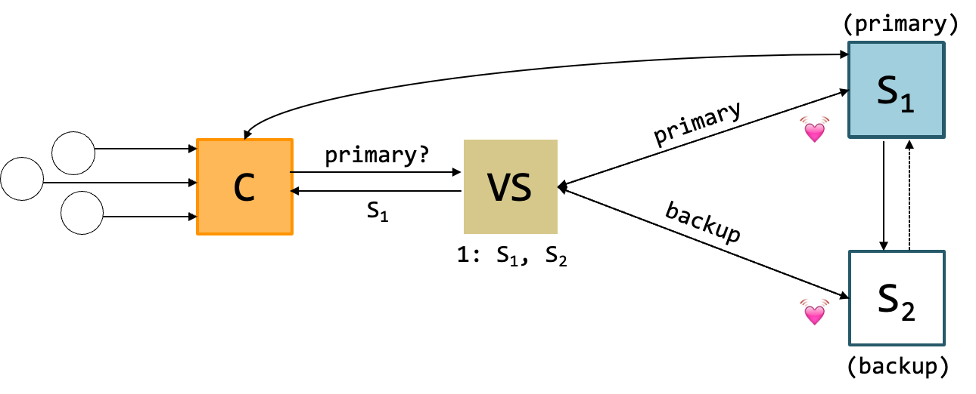
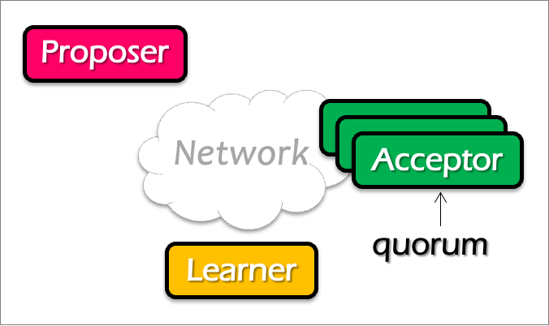
Question
Does single-decree Paxos works fine for our view server example?
When can it go wrong? Accepting a single value is not enough (because view can change)
Notes:
No. What about configuration updates?

Slide 21
Paxos Summary
Paxos allows us to ensure consistent (total) ordering over a set of events in a group of nodes
Events = commands / actions / state updates
Each machine will have the latest state or a previous version of the state

Slide 22
Multi-Paxos
Agree on a sequence of values

Slide 23
Multi-Paxos builds on top of the basic Paxos
Useful when agreeing on a sequences of values, examples including:
Views in primary-backup replication
Logs in a replicated state machine
i.e., directly use Multi-Paxos to implement RSM
The basic approach
Run a separate instance of Paxos to agree on the value of each index
Each instance of Paxos has its own copy of state
highest proposal seen
accepted proposal number
accepted proposal value

Slide 24
Single-decree Paxos vs. Multi-Paxos
0
1
2
Log
add
cmp
xxx
Client
Client
Proposer
Proposer
Proposer
Proposer
Acceptor
Acceptor
Acceptor
Acceptor
Learner
Learner
Learner
Learner
Single-decree Paxos
Single-decree
instance for 0
Single-decree
instance for 1
Single-decree
instance for 2
Multi-Paxos

Slide 25
Basic Multi-Paxos
Server simultaneously acts as proposer, acceptor & learner
Example
Suppose we want to append an entry to the log
Client
0
1
2
S1
add
cmp
xxx
S1
S2
add
cmp
xxx
S2
S3
add
cmp
xxx
S3
Notes:
初始状态： 每个server都确认了0，1，2的value

Slide 26
Basic Multi-Paxos
Question: what could happen if instance 3 has already gotten a value?
After receiving the request from a client, the server will
Decide the number of the instance to append (3 in our example)
Do the single-decree paxos to append the log entry to the instance 3
Prepare + Accept
Client
0
1
2
3
Prepare
Accept
S1
add
cmp
xxx
yyy
S1
Select 3
yyy
S2
add
cmp
xxx
yyy
S2
yyy
S3
add
cmp
xxx
yyy
S3

Slide 27
Basic Multi-Paxos
Question: what could happen if instance 3 has already gotten a value?
Example: S1 receives the request, but S2 and S3 has already accepted the value (zzz)
Our single-decree paxos will not choose the value client sent
Client
0
1
2
3
Prepare
Accept
S1
add
cmp
xxx
zzz
S1
Select 3
zzz
add
cmp
xxx
xxx
S2
zzz
S2
zzz
add
cmp
xxx
xxx
S3
zzz
S3
Notes:
初始状态： 每个server都确认了0，1，2的value

Slide 28
Basic Multi-Paxos
In case of conflict, S1 will choose a larger instance (e.g., 4)
And re-run the instance until find the largest available instance
May possible try many times until find an available slot
Client
0
1
2
3
4
Prepare
Accept
Prepare
S1
add
cmp
xxx
zzz
yyy
S1
Select 3
Select 4
zzz
add
cmp
xxx
xxx
yyy
S2
zzz
S2
zzz
add
cmp
xxx
xxx
yyy
S3
zzz
S3

Slide 29
Question
How many RTTs are required for appending a single log entry?

Slide 30
Basic Multi-Paxos is correct but inefficient
2 rounds of RPCs for each value chosen in the optimal case
Prepare, Accept
With multiple concurrent proposers, conflicts and restarts are likely
1. The server may conflict on the position of the new log entry to insert
(our previous example)
2. Even in the same Paxos instance, different proposer may conflict
Only the proposers with the highest number can win
Solution
Select a leader: most of the time, only one server can propose
Batch the prepare requests from multiple instances sent from a leader

Slide 31
Multi-paxos uses a distinguished proposer (leader)
Distinguished proposer (aka. leader)
The only one that issues proposals
i.e., no proposer conflicts in the optimal case
Client only sends the commands to the leader
Decides the value position
Note, single leader is not necessary for Multi-paxos
E.g., if two or more servers act as proposers at the same time, the protocol still works correctly
leader只是更方便解决conflict，并且可以一定程度上提升paxos的性能，但是没有leader的时候paxos在optimal case下还是可以正确工作的

Slide 32
Not relying a single leader simplifies user implementation
i.e., the user can choose the leader in an arbitrary way
i.e., all the server don't need to agree on the same leader
Performance degradations if multiple leaders exist
We can also use multi-paxos for the leader election ☺

Slide 33
Benefits of leader election: prepare message batching
Suppose S1 is the leader (w/o batching)
Paxos 0
Paxos 1
Paxos 2
Paxos 3
N_{a} : S1.19
V_{a} : add
N_{h} : S1.19
M_{h} : S1.19
N_{a} : S1.19
V_{a} : cmp
N_{h} : S1.19
M_{h} : S1.19
N_{a} :
V_{a} :
N_{h} :
M_{h} :
N_{a} :
V_{a} :
N_{h} :
M_{h} :
S1.19
S1.19
xxx
yyy
S1.19
S1.19
S1.19
S1.19
Client
0
1
2
3
xxx, yyy
Prepare
Accept
Prepare
Accept
S1
add
cmp
xxx
yyy
S1
Select
2
Select
3
xxx
yyy
S2
add
cmp
xxx
yyy
S2
xxx
yyy
S3
add
cmp
xxx
yyy
S3

Slide 34
Benefits of leader election: prepare message batching
Suppose S1 is the leader (+ batching)
Paxos 0
Paxos 1
Paxos 2
Paxos 3
N_{a} : S1.19
V_{a} : add
N_{h} : S1.19
M_{h} : S1.19
N_{a} : S1.19
V_{a} : cmp
N_{h} : S1.19
M_{h} : S1.19
N_{a} :
V_{a} :
N_{h} :
M_{h} :
N_{a} :
V_{a} :
N_{h} :
M_{h} :
S1.19
S1.19
xxx
xxx
S1.19
S1.19
S1.19
S1.19
Client
0
1
2
3
xxx, yyy
Prepare 2 + 3
Accept
Accept
Select
3
S1
add
cmp
xxx
yyy
S1
Select
2
xxx
yyy
S2
add
cmp
xxx
yyy
S2
xxx
yyy
S3
add
cmp
xxx
yyy
S3

Slide 35


Multi-paxos can leave the whole in the log
0
1
2
3
Suppose S1 is the leader (with batching)
What happens after S1 crashes w/ unfinished entry?
Entry 2 will be empty
Application should fill the gap itself, e.g., w/ no-op
S1
add
cmp
yyy
S2
add
cmp
S3
add
yyy
Client
Client
Prepare 2 + 3
xxx
yyy
S1
Select
2
Retry 2
Select
3
S2
S3

Slide 36
Paxos Summary
Paxos allows us to ensure consistent (total) ordering over a set of events in a group of nodes
Events = commands / actions / state updates
Each machine will have the latest state or a previous version of the state

Slide 37
Today: Raft replicated log
A different approach for consensus
Paxos’s approach (bottom-up)(先解决single-log的同步，在解决multi-log的同步)
solve single-decree consensus first
replicate a sequence of values using single-decree consensus
Raft’s approach (top-down)
directly solve log replication without first solving single-decree consensus

Slide 38






Why learn raft?
Raft is described in a concrete form that favors system design & impl.
Widely implemented and deployed nowadays

Slide 39
What’s wrong w/ Paxos (from raft’s point of view)
Paxos’s descriptions focus on single-decree protocol
i.e., agree on a single value
Distributed systems have more details to consider
E.g., log in a replicated state machine
Though we can build replicated logs using Multi-Paxos

Slide 40
What’s wrong w/ Paxos (from raft’s point of view)
Abstraction mismatches the implementation
Examples include
No log (single decree)
Proposer, acceptor and learner have no concrete concept in the system!
Paxos also suggests a weak form of leader for improving its performance
But is not required for the protocol, which leaves the questions
E.g., how to implement the leader election?
How to cope with multiple leaders?
Etc.

Slide 41
Raft’s high-level approach: problem decomposition
Leader election
Select one server as the leader
Detect crashes, choose new leader
Log replication (normal operation)
Leader accepts commands from clients, append to its log
Leader replicates its log to other servers (overwrites inconsistencies)
Safety
Keep logs consistent
Only servers with up-to-date logs can become the leader
Notes:
Safety can violate if a replication happens partially

Slide 42
Raft server states
Server
Server
Network
At any time, each server is either:
Leader: handles all client interactions, log replication
Invariant: At most 1 viable leader at a time
Follower: passive (only responds to incoming RPCs)
Candidate: used to elect a new leader
Normal workloads
1 server is the leader, others are the followers
Server
Servers communicates
w/ RPCs
Timeout, start election
Receive acks from majority of servers
Start
Follower
Candidate
Leader
Discover current server or
w/ high term
Discover server w/ high term

Slide 43
Raft server states
Leader is active
Receive client requests, replicate logs to the followers
Followers are passive
Only respond to the requests from leaders or candidates
Passive
Activate
Follower
Candidate
Leader

Slide 44
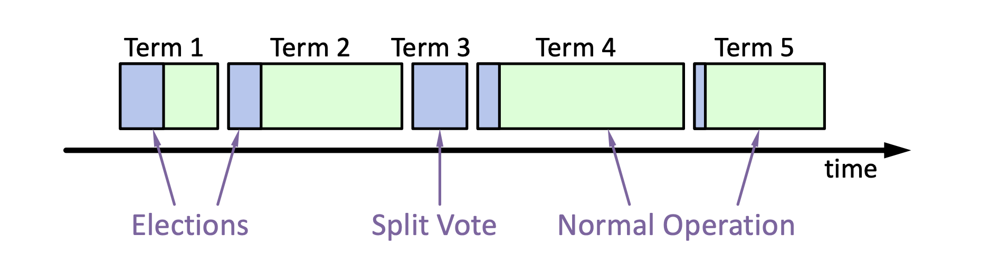
Raft basics: terms
Raft divides time into terms (with arbitrary length):
Each term starts with an election
Ends with one leader or no leader
At most one leader per term
Each leader is uniquely associated with a term
Key role: identify obsolete information
candidate应该由发现leader发生了crash的follower来承担。
Notes:
obsolete information, e.g., as stale leaders
Servers exchange with others to build the global view of the terms

Slide 45
Raft startup, Heartbeats & Timeouts
Servers start as followers
Followers expect to receive RPCs from leaders or candidates
Leaders must send heartbeats to maintain authority in a term
If election timeout(即过一段时间没有接收到leader的heartbeat) elapses with no RPCs:
Follower assumes leader has crashed
this Follower starts new election
Timeouts typically 100-500ms
Notes:
election timeout: a follower receives no communication over a period of time

Slide 46
Election Basics
Change its state to the candidate state
Increment current term
Vote for itself(一个candidate可以给自己投票)
Send RequestVote RPCs to all other servers, retry until either
Receive votes from majority of servers ➔ Become the leader!
Receiver RPC from a valid leader ➔ Return to the follower
Question: what is the condition to vote?
The leader’s term >= self’s term

Slide 47
Election Basics
Change its state to the candidate state
Increment current term
Vote for itself
Send RequestVote RPCs to all other servers, retry until either
Receive votes from majority of servers ➔ Become the leader!
Receiver RPC from a valid leader ➔ Return to the follower
No one wins election (timeouts on the election) ➔ Increase the term, start the new election(则当前的term没有leader)

Slide 48
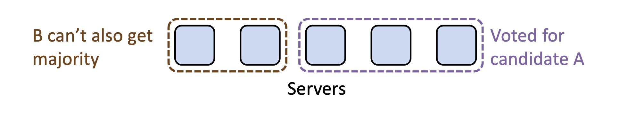
Election requirements: safety
At most one winner per term
How to achieve so? Each server only gives one vote per term (persist on disk)
Question
Can different candidates exist in the same term?
Yes. Each server should keep a VotedFor variable to ensure it only gives vote to one candidate.

Slide 49
Election requirements: liveness
Some candidate must eventually win
If multiple candidates started, non will win
Raft’s key idea: use random timeout before the retry
So as to minimize the possibilities that two candidates retry at the same time
Typically, it randomly selects a time between [T, 2T]
T is the election timeout (大于等于T可以使得本来应该一起发生的candidate的vote变成串行的vote，因为过了时间T，第一个发生的vote要么成功，要么失败)
Notes:
Liveness: something good happens

Slide 50
Raft’s high-level approach: problem decomposition
Leader election
Select one server as the leader
Detect crashes, choose new leader
Log replication (normal operation)
Leader accepts commands from clients, append to its log
Leader replicates its log to other servers (overwrites inconsistencies)
Safety
Keep logs consistent
Only servers with up-to-date logs can become the leader
Notes:
Safety can violate if a replication happens partially

Slide 51
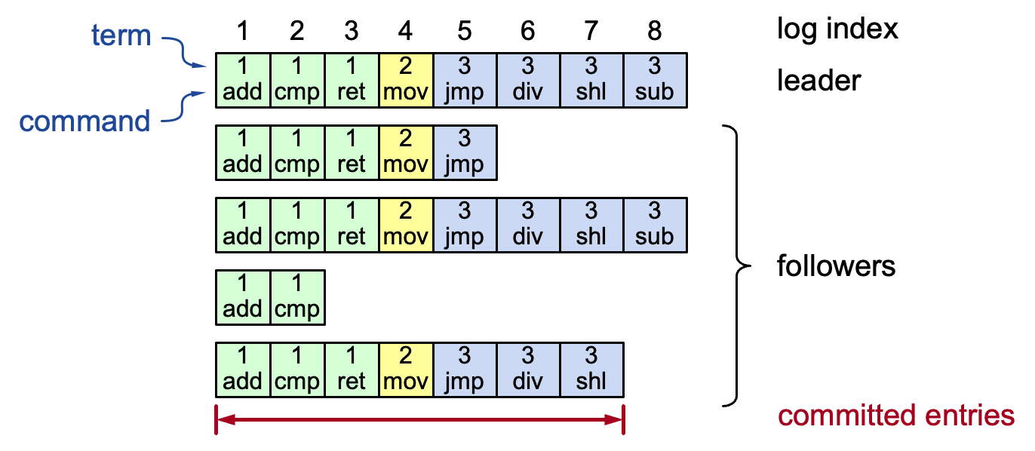
Log structure
term log：由leader控制，一定要保证是latest的logData。
raft中的log不允许有中间的empty log的部分
Log entry = index, term, command
Stored on the disk to tolerate failures
A log is committed if it can be safely applied to the state machine
i.e., eventually stored on all the servers with the same value
Not all entries are committed (will talk about later)
Notes:
Interesting things:
Each log entry store an additional term
Commit: can safely execute on the state machine, no others will execute a different command

Slide 52
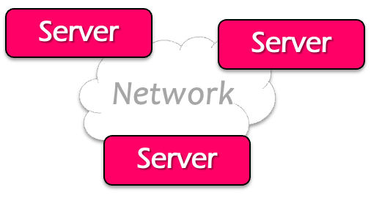

Normal operations to update the log
Command
Client
Send command to the leader
Leader appends command to its log
Leader sends AppendEntries RPCs to followers
Once a new entry (of log) committed:
Leader passes command to its state machine, returns results to client
Notifies followers of committed entries, Follower pass committed commands to their state machines
We will talk about how to
decide committed later

Slide 53
Normal operations to update the log
Command
Client
Crashed/slow followers?
Leader retries RPCs until they succeed (at least once)
Performance is optimal in the common case
One successful RPC to any majority of servers

Slide 54
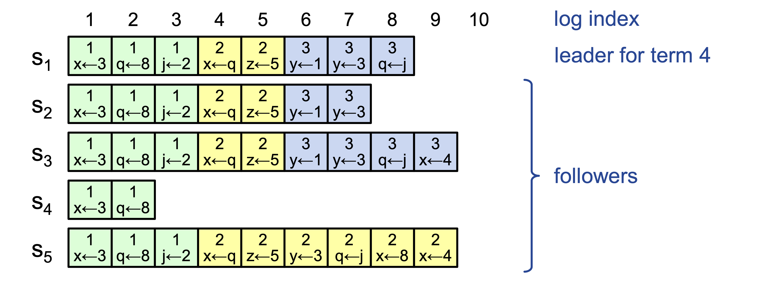
Challenge: crash can cause log to inconsistencies
Raft minimizes special code for repairing inconsistencies
Leaders assume its log is correct
Normal operation will repair all inconsistencies
Notes:
Case in the example: server 4 crashes
Server 5 becomes the leader for 2, and keeps appending the logs from the clients

Slide 55
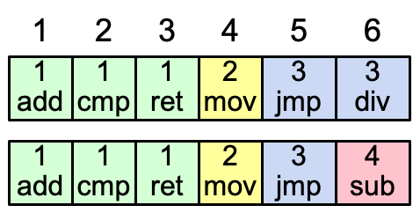
Consistency of the log
Question: how to achieve this property?
High level of coherency between logs maintained by the raft:
If log entries on different servers have the same index & term
They store the same command
The logs are identical in all preceding entries
If a given entry is committed, all preceding entries are also committed
Note that not all log entries are committed
Notes:
Commands must be equal: issued by the same leader

Slide 56
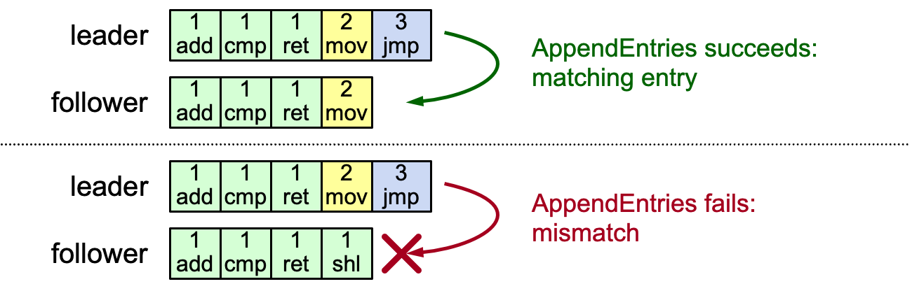
AppendEntries consistency checks
Implements an induction step, ensures coherency
Each RPC argument contains
Append index, term, term of entry preceding new ones
Follower checks whether it has the matching entry(会检查这个index之前的entry是否匹配)
Otherwise, it rejects the request

Slide 57
When can rejection happens? Leader changes
At beginning of new leader’s term:
Old leader may have left entries partially replicated(因为一个term的时间长度是不固定的，随机的)
No special steps by new leader: just start normal operation
Leader’s log is “the truth”
Will eventually make follower’s logs identical to leader’s (overwrite the divergent log entries with the leader’s ones)
The rejected entries will be overwritten by the leader’s log entry

Slide 58
Handle rejections
Implements an induction step, ensures coherency
In this example, the leader will
Overwrite index 4 with [2 mov] with AppendEntries
Then append entry [3 jmp] to the end of the follower
Fail to append case
Overwrite mismatched entry
L
1
add
1
cmp
1
ret
2
mov
3
jmp
L
1
add
1
cmp
1
ret
2
mov
3
jmp
1
ret
2
mov
F
1
add
1
cmp
1
ret
1
shi
F
1
add
1
cmp
1
shi
L
1
add
1
cmp
1
ret
2
mov
3
jmp
Append the new entry
1
ret
2
mov
3
jmp
F
1
add
1
cmp
1
shi

Slide 59
More on Repairing Follower Logs
The log may diverge in multiple entries
New leader must make follower logs consistent with its own
Delete extraneous entries
Fill in missing entries
Leader keeps nextIndex for each follower:
Index of next log entry to send to that follower
Initialized to (1 + leader’s last index)

Slide 60
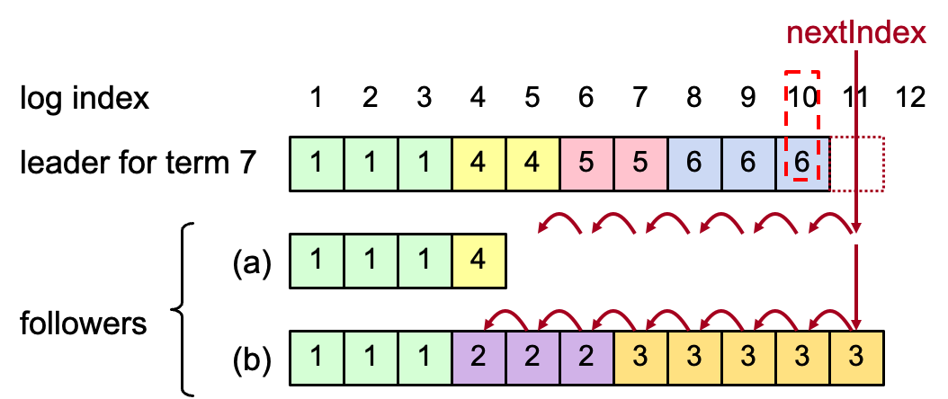
Repairing Follower Logs
When AppendEntries consistency check fails, decrement nextIndex and try again:

Slide 61
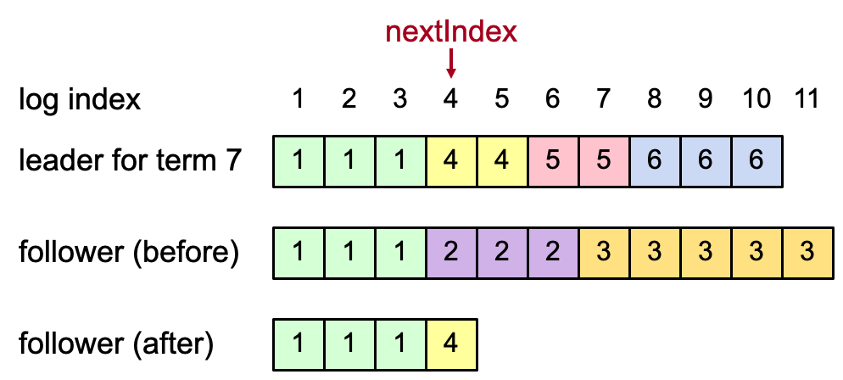
Repairing Follower Logs
When follower overwrites inconsistent entry, it deletes all subsequent entries:

Slide 62
Question
Since our log is consistent, when can we apply the log entry to the state machine?
a.k.a., log entry seemed as committed

Slide 63
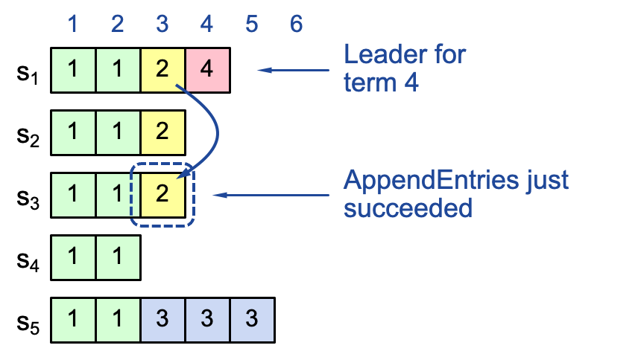
Question
When can log entry be applied to a state machine?
An intuitive idea: if the log is replicated on a majority of servers, it can be replicated on the state machine
Not always true for raft, consider the following example:
2.为什么右面的例子不对，即2不能commited
因为如果2在term2就commit的话，在左图这种情况下，在进行term3时，新的leader S5在想要append log的时候会将已经commited的entry2替换掉，而这是不可能的(commited的log不可以在被删除了)，具体见下一页PPT
1.右面的图片中为啥S5能够成为term3的leader？
因为在2还没有被写入log之前，S1,2与其他的三个server发生了network-partition，所以在elect term3的leader的时候S5如果能够收到S3,4以及自己的vote，就可以成为term3新的leader

Slide 64
Case study: a majority replicated entry can be overwritten
Leader S1
Leader S5
Leader S1
Leader S5
Leader S5
1
2
3
1
2
3
4
5
1
2
3
4
5
1
2
3
4
1
1
2
1
1
2
1
1
2
4
1
1
3
s₁
2
1
1
2
1
1
2
1
1
2
1
1
2
s₂
3
s₃
1
1
1
1
1
1
2
1
1
3
s₄
1
1
1
1
1
1
1
1
3
s₅
1
1
1
1
3
3
3
1
1
3
3
3
1
1
3
3
3
Term 2
Term 3
Term 4
Term 5
Time

Slide 65
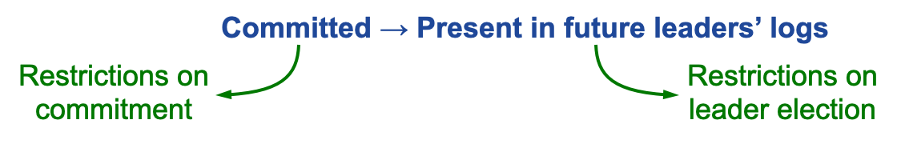
Safety requirement of the commit entry
Once a log entry has been applied to a state machine, no other state machine must apply a different value for that log entry
Raft safety property:
If a leader has decided that a log entry is committed, that entry will be present in the logs of all future leaders
This guarantees the safety requirement
Leaders never overwrite entries in their logs
Only entries in the leader’s log can be committed
Entries must be committed before applying to state machine
Notes:
1. Delay the commitment of an entry until we know it is committed

Slide 66
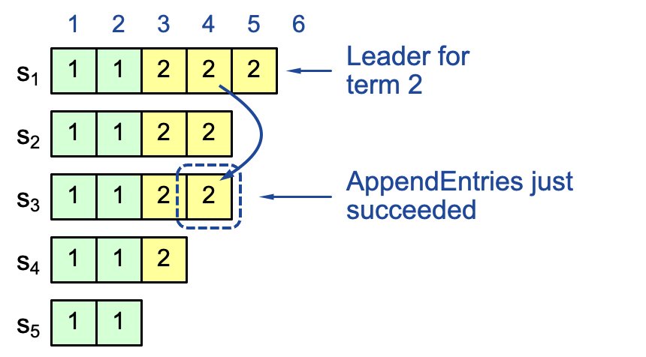
Committing Entry from the Current Term
Case #1/2: Leader decides entry in current term is committed
Question: how to prevent index 4 from being overwritten? Prevent S4 or S5 from becoming the leader

Slide 67
Picking the Best Leader
During elections, choose candidate with log most likely to contain all committed entries
Candidates include log info in RequestVote RPCs (index & term of last log entry)
Voting server V denies vote if its log is “more complete”: (lastTermV > lastTermC) || (lastTermV == lastTermC) && (lastIndexV > lastIndexC)
Leader will have “most complete” log among electing majority

Slide 68
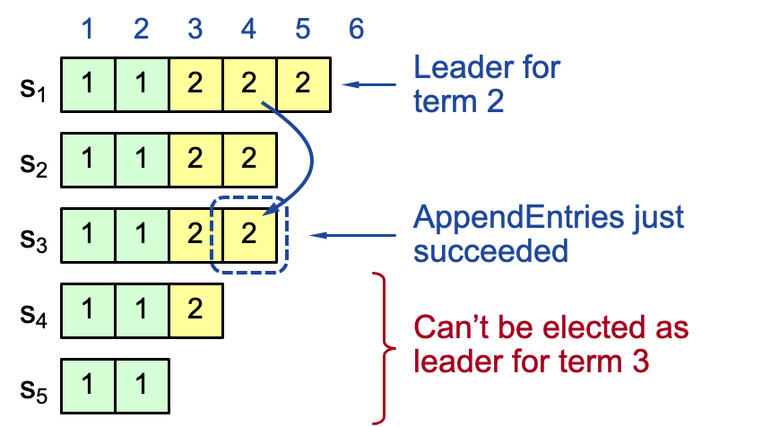
Committing Entry from the Current Term
Case #1/2: Leader decides entry in current term is committed
Safe: leader for term 3 must contain entry 4

Slide 69
Committing Entry from the Current Term
Once a log is fully replicated at a majority of the servers
What about replicate entry from a previous term?

Slide 70
Committing Entry from Earlier Term
Case #2/2: Leader is trying to finish committing entry from an earlier term
Entry 3 not safely committed:
S5 can still be elected as leader for term 5
If elected, it will overwrite entry 3 on S1, S2 and S3 (recall our previous example)

Slide 71
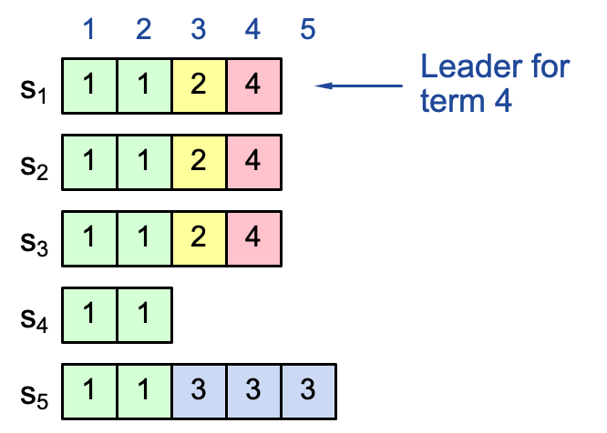
New commitment rules
For a leader to decide an (previous) entry is committed:
Must be stored on a majority of servers
At least one new entry from leader’s term must also be stored on majority of servers
This is because once entry 4 committed:
s₅ cannot be elected leader for term 5
Entries 3 and 4 both safe
Combination of election rules & commitment rules makes Raft safe

Slide 72
Neutralizing Old Leaders
Deposed leader may not be dead:
Temporarily disconnected from network
Other servers elect a new leader
Old leader becomes reconnected, attempts to commit log entries
Terms used to detect stale leaders (and candidates)
Every RPC contains term of the sender
If sender’s term is older, RPC is rejected, sender reverts to follower and updates its term
If receiver’s term is older, it reverts to follower, updates its term, then processes RPC normally

Slide 73
More about raft
Client protocol
E.g., how to contact the new leaders
Configuration changes
Replace failed machine
Change the degrees of replication
Notes:
Refer to the paper

Slide 74
Paxos vs. Raft
Notes:
https://ongardie.net/static/raft/userstudy/

Slide 75
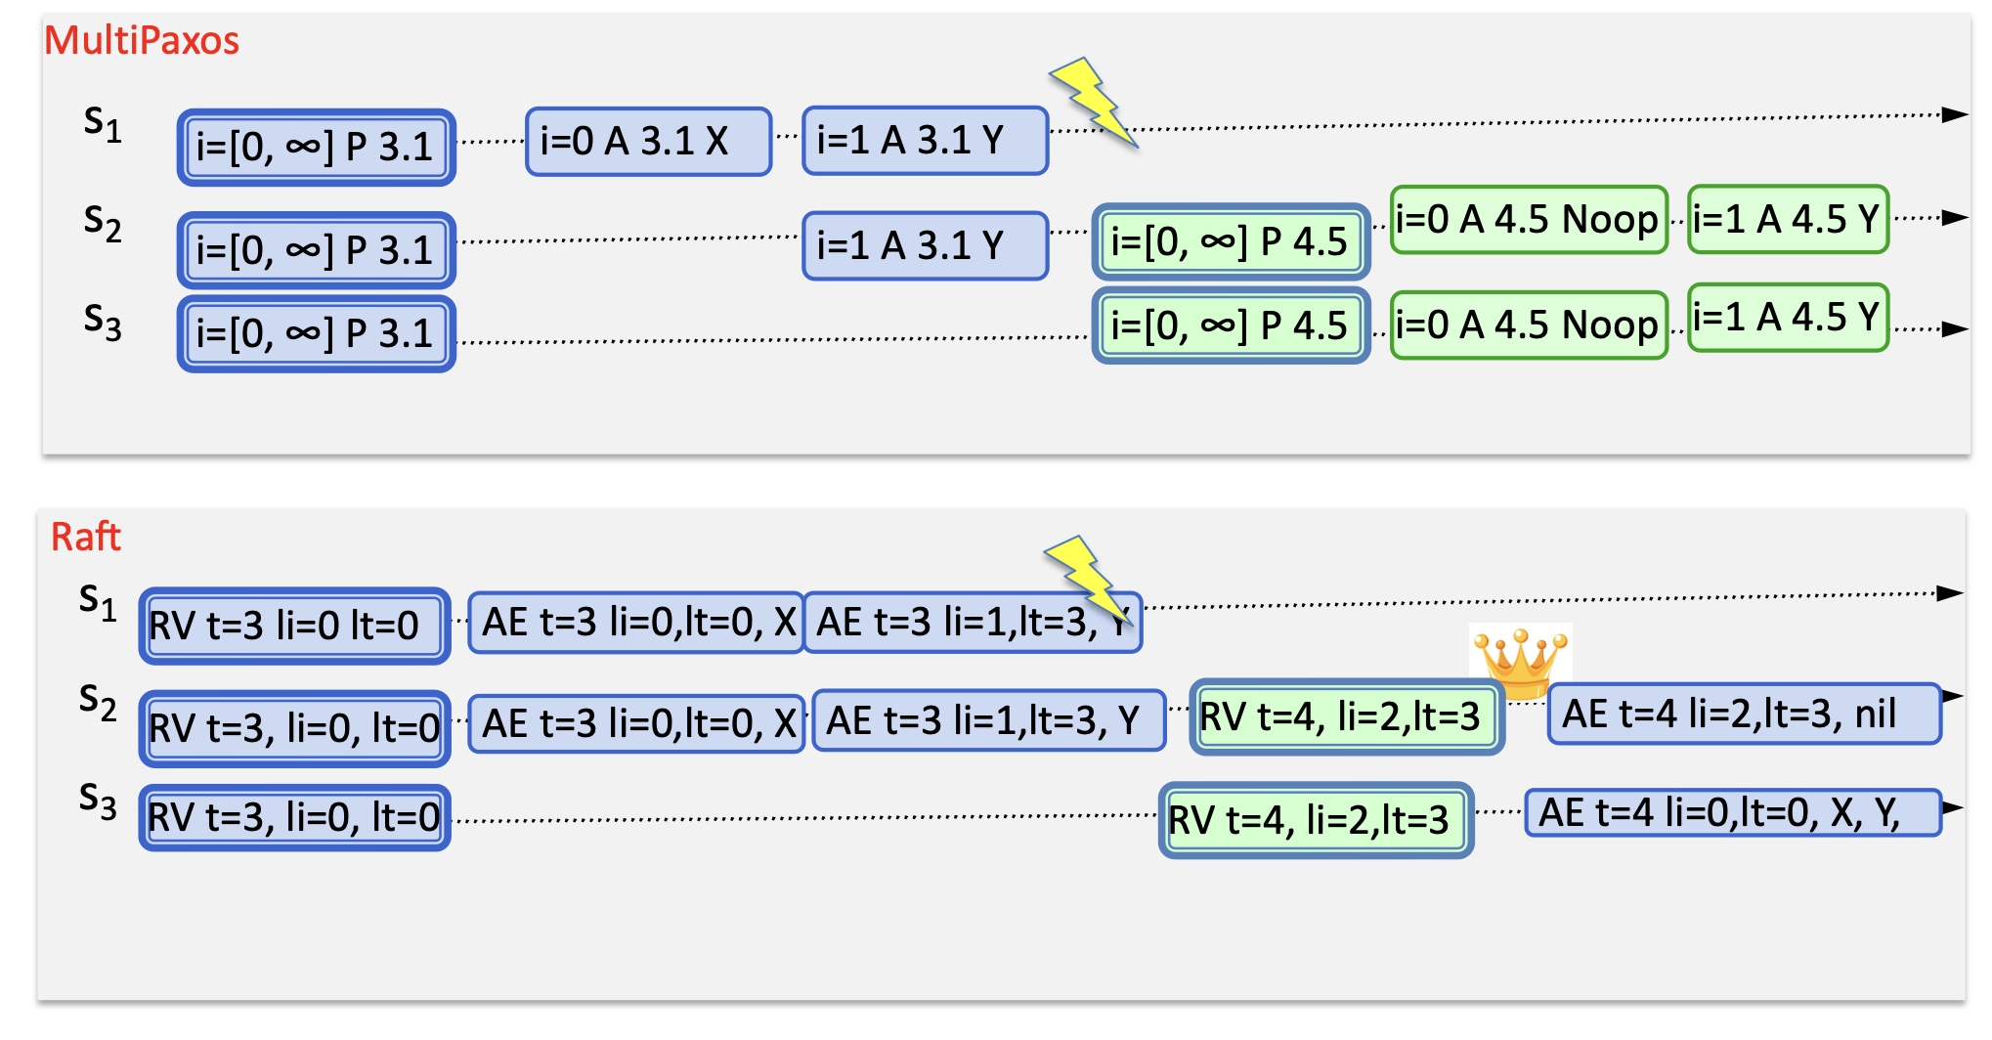
Different protocols? or variants of the same thing?

Slide 76
Raft exam
Notes:
https://ongardie.net/static/raft/userstudy/

Slide 77


Can the below log content happen?
(a)
(b)
Notes:
No
Yes

Slide 78


Can the below log content happen?
(c)
(b)
Notes:
(c) Yes
(d) no

Slide 79
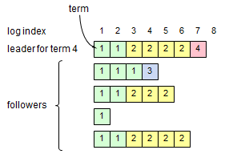
Which log entries may safely be applied to state machines?
Only <1,1> and <2,1>
Notes:
If server 2 (1113) becomes the leader, then it can overwrite the entries later than 3
场景：term 2的log entry都是由term 4进行replicate的

Slide 80
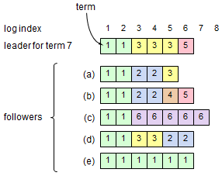
Could the given log configuration occur in a properly functioning Raft?

Slide 81
About Failure.
Suppose that a hardware or software error corrupts the nextIndex value stored by the leader for a particular follower. Could this compromise the safety of the system?
No.

Slide 82
Setups
Suppose that you implemented Raft and deployed it with all servers in the same datacenter. Now suppose that you were going to deploy the system with each server in a different datacenter, spread over the world. What changes would you need to make, if any, in the wide-area version of Raft compared to the single-datacenter version, and why?
Yes. The timeout for leader election should be longer.

Slide 83
Crashes
Suppose that the follower crashes, and when it restarts, its most recent vote has been lost. Is it safe for the follower to rejoin the cluster (assuming no modifications to the algorithm)? Explain your answer.
No it is not. It can elect a different leader (different than the most recent voted)
Now suppose that the follower's log is truncated during a crash, losing some of the entries at the end. Is it safe for the follower to rejoin the cluster (assuming no modifications to the algorithm)? Explain your answer.
No. a committed entry may be overwritten.

