Slide 1


Review
SE3331-1 (2022 Fall)
IPADS, Shanghai Jiao Tong University
https://www.sjtu.edu.cn

Slide 2

Review: widely used transaction (TX)s
Caching server
Caching server
…
Caching server
All can use TX to manager data!
e.g., FS meta data
Caching
Caching
Caching
Distributed caching
Database server
Database server
CDN
Users
Application #1
generate the page
Database
user, price
…
Database
user, price
Application server
Distributed database
Internet
Load
Balance
Application #2
add the order
File server
File server
File server
File:
image
File:
image
…
File:
image
Application server
…
…
Message queue
Distributed file system

Slide 3
Review: What is a transaction (TX)?
An abstraction to manage the data
Data is also an abstract concept, can be arbitrary computing data. Concrete examples including:
Key-value store entries
File system metadata (e.g., directory,, inode, etc)
Processor’s metadata (e.g., child processors)
Look like similar program, with data managed by the TX system, and extra mark to denote the start/end of a TX

Slide 4
Review: TX enforces ACID properties
Enforcing A & D:
Logging and recovery
Enforcing C:
Database constraint system (not covered in this class)
Enforcing I:
2PL & OCC

Slide 5
Problem of OCC & 2PL
Locking and validation overheads
Reason: Data item is single-version
Only one copy
As a result, any concurrent accesses are conflicts, so we need coordination (e.g., locks or validations)
Can we avoid these conflicts?

Slide 6
Multi-version Concurrency Control
Each data item has multiple versions
When accessing different versions of data, probably no conflict!
Key (high-level) idea
Writes don’t overwrite the original data
Instead, writes install new versions of data
Reads read from a "snapshot" of data
Benefits: no lock or validation during TX’s execution
bankA: 100, ver: 12, pre:xx
bankA: 100
bankA: 200, ver: 10, pre:xx
Single-version
Multi-version

Slide 7
Snapshot Isolation
A popular multi-version concurrency control (MVCC) scheme
Transactions will get start and commit timestamp
Use start timestamp to read find the snapshot to read
Use commit timestamp to install new versions
Transactions:
WRITEs a local buffer (similar to OCC)
READs a “snapshot” of entire data image
COMMIT only if no write-write conflict
Install new versions of data

Slide 8
Snapshot Isolation Implementation
T is assigned a commit timestamp T.cts
System checks all data within T.wset, if T.sts < X.cts < T.cts, then abort T
Update all data within T.wset with T.cts
T is assigned a start timestamp T.sts
T
START
READ(X)
WRITE(X)
COMMIT
Time
T reads the biggest version of X(i), such that X(i).cts <= T.sts
T buffers writes to X and adds X to its write-set, T.wset += {X}

Slide 9
Time in Snapshot Isolation
Timestamp of start & commit should be assigned in a increasing order
E.g., global counters with atomic increase
Question: can we directly use the physical clock of the machine?
It depends. If all cores have global order of physical clock, then yes; otherwise not.
T is assigned a commit timestamp T.cts
System checks all data within T.wset, if T.sts < X.cts < T.cts, then abort T
Update all data within T.wset with T.cts
T is assigned a start timestamp T.sts
T
START
COMMIT
Time
Notes:
answer: depends. if all cores have global order of physical clock, then yes. otherwise not.

Slide 10
Question of Snapshot Isolation
Snapshot isolation (SI) differs from serializability due to one anomaly that is possible under SI but not under serializability.
Describe the anomaly and also give a concrete application for which the anomaly is undesirable.
T1
S
R(X)
W(Y)
C
R(X) = X₀
W(Y) = Y₁
T2
S
R(Y)
W(X)
C
R(Y) = Y₀
W(X) = X₁
Possible Serial Order
X₀
X₁
T1
T2
Y₀
Y₁
T2
T1

Slide 11
Nested transactions
What will happen if any one in the middle fails?
The atomicity of 「发工资」is broken
Even if we assume that each transfer is atomic (ACID transaction)
发工资
Deposit(…)
Deposit(…)
Deposit(…)
Deposit(…)
Time
Goal: the entire 「发工资」 should be atomic

Slide 12



Multi-site transaction
Accounts are shared over multiple sites
i.e., a single site cannot store all the bank accounts
The setup
Client + coordinator + two servers
One server handles bank accounts A-M
The other server handles bank accounts N-Z
Coordinator and servers all have logs to ensure single transaction atomicity
Coordinators
e.g., frontend servers
Storage servers
e.g., key-value stores
Clients,
e.g., iPhone
A - M
N - Z

Slide 13
Multi-site transaction
Can single transactions whose values across sites be viewed as a special form of nested transactions across multiple sites?
Yes: each modifications to a value can be viewed as a low-level transaction
Problems remain: What if one TX commits and others not?
begin
ok
A - amt
ok
B + amt
ok
Commit
ok

Slide 14
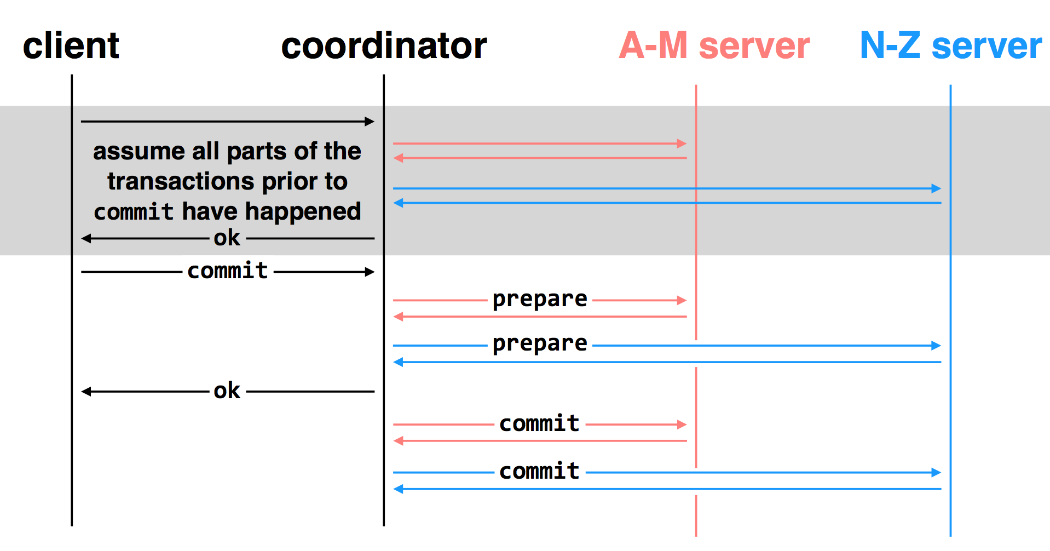
2-Phase Commit: for distributed transactions

Slide 15
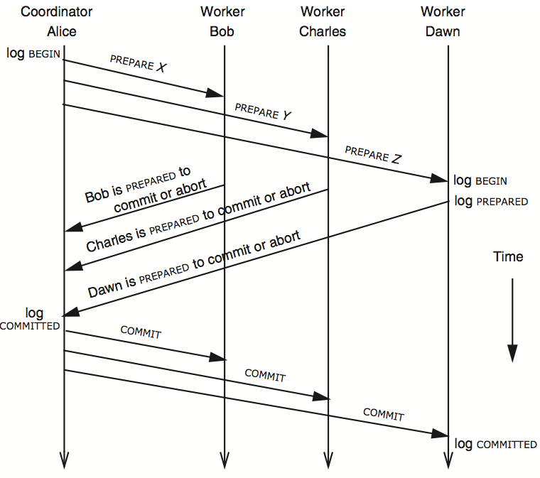
3N messages

Slide 16
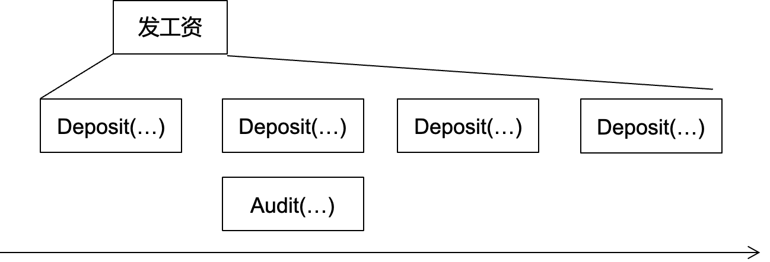
Question: what about the lock release?
Low-layer TX
Deposit(bank, a, amt):
tx.begin()
bank[a] += amt
tx.commit()
Recall: the 2PL in previous lecture
Transaction must release the lock of its records upon the commitment
Question:
Can we release the lock upon the low-level commitment?
...
Release(bank[a].lock)
...
No!
e.g., a concurrently audit can read
an internal value of 发工资
Read uncommitted value

Slide 17
Lock releases in nested transaction
If a low-level TX commits
It can only release locks to other low-level TXs belonging to the same high-level TX
But not other TXs

Slide 18
Summary: Two-phase Commit
Two-phase commit allows us to achieve multi-site atomicity: transaction remains atomic even when they require communication with multiple machines
In two-phase commit, failures prior to the commit point can be aborted. If workers (or the coordinator) fail after the commit point, they recover into the PREPARED state, and complete the transaction
Our remaining issue deals with availability and replication: we will replicate data across sites to improve availability, we may also replicate the coordinator, but must deal with keeping multiple copies of the data consistent

Slide 19
Replication Consistency
Optimistic Replication
Tolerate inconsistency, and fix things up later
Works well when out-of-sync replicas are acceptable
Pessimistic Replication
Ensure strong consistency between replicas
Needed when out-of-sync replicas can cause serious problems

Slide 20
Pessimistic Replication
Some applications may prefer not to tolerate inconsistency
E.g., a replicated lock server, or replicated coordinator for 2PC
Better not give out the same lock twice
E.g., Better have a consistent decision about whether transaction commits
Trade-off: stronger consistency with pessimistic replication means:
Lower availability than what you might get with optimistic replication
Performance overhead for waiting syncing w/ other replicas

Slide 21
Quorum
Define separate read &write quorums: Q_{r} & Q_{w}
Q_{r} + Q_{w} > N_{replicas} (Why?)
- Confirm a write after writing to at least Q_{w} of replicas
- Read at least Q_{r} agree on the data or witness value
Example
In favor of reading: N_{replicas} = 5, Q_{w} = 4, Q_{r} = 2
In favor or updating: N_{replicas} = 5, Q_{w} = 2, Q_{r} = 4
Enhance availability by Q_{w} = N_{replicas} & Q_{r} = 1

Slide 22
Quorum
Provide no before-or-after or all-or-nothing
If reading & writing requests come from a site
Easy…
If reading from multiple sites, writing from one site
Maintain a version number at that site
If writing from multiple sites
Protocol must provide a distributed sequencer
Another complicating consideration
Performance maximization

Slide 23
RSM: Replicated State Machines
A general approach to making consistent replicas of a server:
Start with the same initial state on each server
Provide each replica with the same input operations, in same order
Ensure all operations are deterministic
E.g., no randomness, no reading of current time, etc.
These rules ensure each server will end up in the same final state

Slide 24
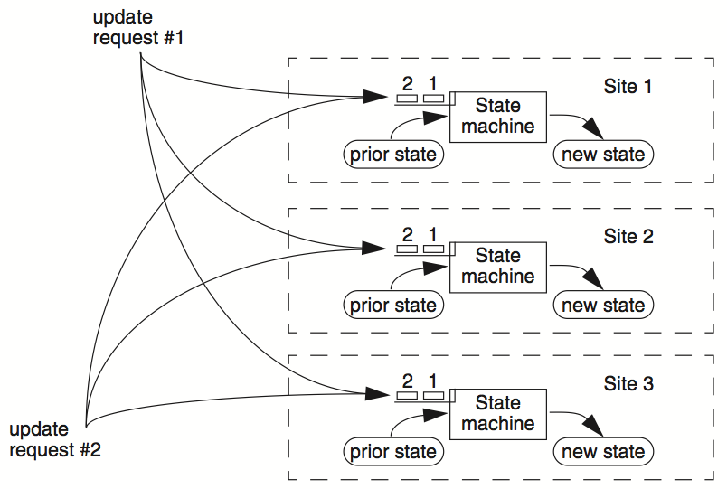
RSM

Slide 25

Primary-backup with viewserver
(primary)
S₁
S₁
C
X
VS
1: S₁, S₂
S₂
(backup)
problem: what if view server fails?
Now, we need Paxos

Slide 26
Paxos' properties: correct + fault-tolerance
No guaranteed termination (i.e., lack of availability guarantee)
Goal: have all acceptors agree to a value V associated with a proposal
Proposer
Proposer
Proposer
E.g., a view
Acceptor
Client
Network
Acceptor
Acceptor
leader
Learner
Learner
quorum
Learner
Paxos: one machine may serve several roles

Slide 27
Paxos Players
Client
makes a request
Proposer
Get a request and run the protocol
Leader = elected Coordinator
Acceptor
Remember the state of the protocol
Quorum = any majority of Acceptors
Learner
When agreement has been reached, a Learner executes the request and/or sends a response back to the Client

Slide 28
Paxos in Action: Phase 0
Client sends a request to a proposer
Proposer
request
Acceptor
Client
Network
Acceptor
Acceptor
quorum
Learner

Slide 29
Paxos in Action: Phase 1a (Prepare)
Leader creates a proposal N and send to quorum
N is greater than any previous proposal number seen by this proposer
Leader
proposal N
Acceptor
Client
Network
Acceptor
Acceptor
quorum
Learner

Slide 30
Paxos in Action: Phase 1b (Prepare)
Acceptor: if proposal ID > any previous proposal
reply with the highest past proposal number and value
promise to ignore all IDs < N
else ignore (proposal is rejected)
Leader
promise N
Acceptor
Client
Network
Acceptor
Acceptor
quorum
Learner

Slide 31
Paxos in Action: Phase 2a (Accept)
Leader: if receive enough promise
set a value V to the proposal V, if any accepted value returned, replace V with the returned one
send accept request to quorum with the chosen value V
Leader
accept request(N, V)
Acceptor
Client
Network
Acceptor
Acceptor
quorum
Learner
Ignore all proposals < N

Slide 32
Paxos in Action: Phase 2b (Accept)
Acceptor: if the promise still holds
register the value V
send accepted message to Proposer/Learners
else ignore the message
Leader
accepted
Acceptor
Client
Network
Acceptor
Acceptor
accepted
quorum
Learner
Learner
Ignore all proposals < N

Slide 33
Paxos in Action: Phase 3 (Learn)
Learner: responds to Client and/or take action on the request
Leader
Acceptor
Client
Network
Acceptor
Acceptor
quorum
Learner
Learner
Ignore all proposals < N

Slide 34
(Basic) Paxos Summary
Paxos agrees on a single value
Value = view, integer, etc.
But is insufficient in practical
Real-world applications require agree on a sequence of values
E.g., view changes

Slide 35
Multi-Paxos builds on top of the basic Paxos
Basic Paxos only agrees on a single value
Useful when agreeing on a sequences of values, examples including:
Views in primary-backup replication
Logs in a replicated state machine
i.e., directly use Multi-Paxos to implement RSM
The basic approach
Run a separate instance of Paxos to agree on the value of each index
Each instance of Paxos has its own copy of state
highest proposal seen
accepted proposal number
accepted proposal value

Slide 36
Single-decree Paxos vs. Multi-Paxos
0
1
2
Log
add
cmp
xxx
Client
Client
Proposer
Proposer
Proposer
Proposer
Acceptor
Acceptor
Acceptor
Acceptor
Learner
Learner
Learner
Learner
Single-decree Paxos
Single-decree
instance for 0
Single-decree
instance for 1
Single-decree
instance for 2
Multi-Paxos

Slide 37
Basic Multi-Paxos
S1 chooses a slot, then run the Paxos on it
In case of conflict, S1 will choose a larger instance (e.g., 4)
And re-run the instance until find the largest available instance
May possible try many times until find an available slot
0
1
2
3
4
Client
Prepare
Accept
Prepare
S1
add
cmp
xxx
zzz
yyy
S1
Select 3
Select 4
zzz
add
cmp
xxx
xxx
yyy
S2
zzz
S2
zzz
add
cmp
xxx
xxx
yyy
S3
zzz
S3

Slide 38
Optimization with leaders
Suppose S1 is the leader (+ batching)
Paxos 0
Paxos 1
Paxos 2
Paxos 3
N_{a} : S1.19
V_{a} : add
N_{h} : S1.19
M_{h} : S1.19
N_{a} : S1.19
V_{a} : cmp
N_{h} : S1.19
M_{h} : S1.19
N_{a} :
V_{a} :
N_{h} :
M_{h} :
N_{a} :
V_{a} :
N_{h} :
M_{h} :
S1.19
S1.19
xxx
xxx
S1.19
S1.19
S1.19
S1.19
Client
0
1
2
3
xxx, yyy
Prepare 2 + 3
Accept
Accept
Select
3
S1
add
cmp
xxx
yyy
S1
Select
2
xxx
yyy
S2
add
cmp
xxx
yyy
S2
xxx
yyy
S3
add
cmp
xxx
yyy
S3

Slide 39
What’s wrong w/ Paxos (from raft’s point of view)
Abstraction mismatches the implementation
Examples include
No log (single decree)
Proposer, acceptor and learner have no concrete concept in the system!
Paxos also suggests a weak form of leader for improving its performance
But is not required for the protocol, which leaves the questions
E.g., how to implement the leader election?
How to cope with multiple leaders?
Etc.

Slide 40
Raft’s high-level approach: problem decomposition
Leader election
Select one server as the leader
Detect crashes, choose new leader
Log replication (normal operation)
Leader accepts commands from clients, append to its log
Leader replicates its log to other servers (overwrites inconsistencies)
Safety
Keep logs consistent
Only servers with up-to-date logs can become the leader
Notes:
Safety can violate if a replication happens partially

Slide 41
Raft server states
Server
Server
Network
At any time, each server is either:
Leader: handles all client interactions, log replication
Invariant: At most 1 viable leader at a time
Follower: passive (only responds to incoming RPCs)
Candidate: used to elect a new leader
Normal workloads
1 server is the leader, others are the followers
Server
Servers communicates
w/ RPCs
Timeout, start election
Receive acks from majority of servers
Start
Follower
Candidate
Leader
Discover current server or
w/ high term
Discover server w/ high term

Slide 42
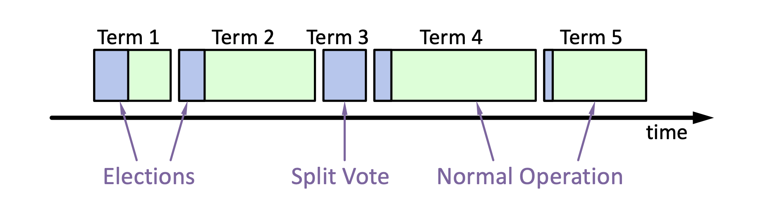
Raft basics: terms
Raft divides time into terms (with arbitrary length):
Each term starts with an election
Ends with one leader or no leader
At most one leader per term
Each leader is uniquely associated with a term
Key role: identify obsolete information
Notes:
obsolete information, e.g., as stale leaders
Servers exchange with others to build the global view of the terms

Slide 43
Raft startup, Heartbeats & Timeouts
Servers start as followers
Followers expect to receive RPCs from leaders or candidates
Leaders must send heartbeats to maintain authority in a term
If election timeout elapses with no RPCs:
Follower assumes leader has crashed
Follower starts new election
Timeouts typically 100-500ms
Notes:
election timeout: a follower receives no communication over a period of time

Slide 44
Review: Election Basics
If a follower detects a leader is crash (heartbeat timeout):
Change its state to the candidate state
Increment current term
Vote for itself
Send RequestVote RPCs to all other servers, retry until either
Receive votes from majority of servers ➔ Become the leader!
Receiver RPC from a valid leader ➔ Return to the follower
No one wins election (timeouts on the election) ➔ Increase the term, start the new election

Slide 45
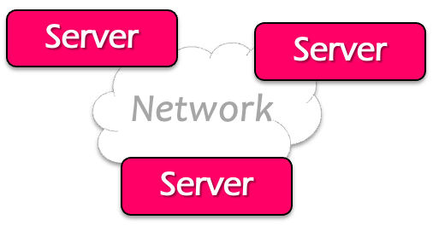

Normal operations (append log entry) of raft
Command
Client
Send command to the leader
Leader appends command to its log
Leader sends AppendEntries RPCs to followers
Once a new entry (of log) committed:
Leader passes command to its state machine, returns results to client
Notifies followers of committed entries, Follower pass committed commands to their state machines
We will talk about how to
decide committed later

Slide 46
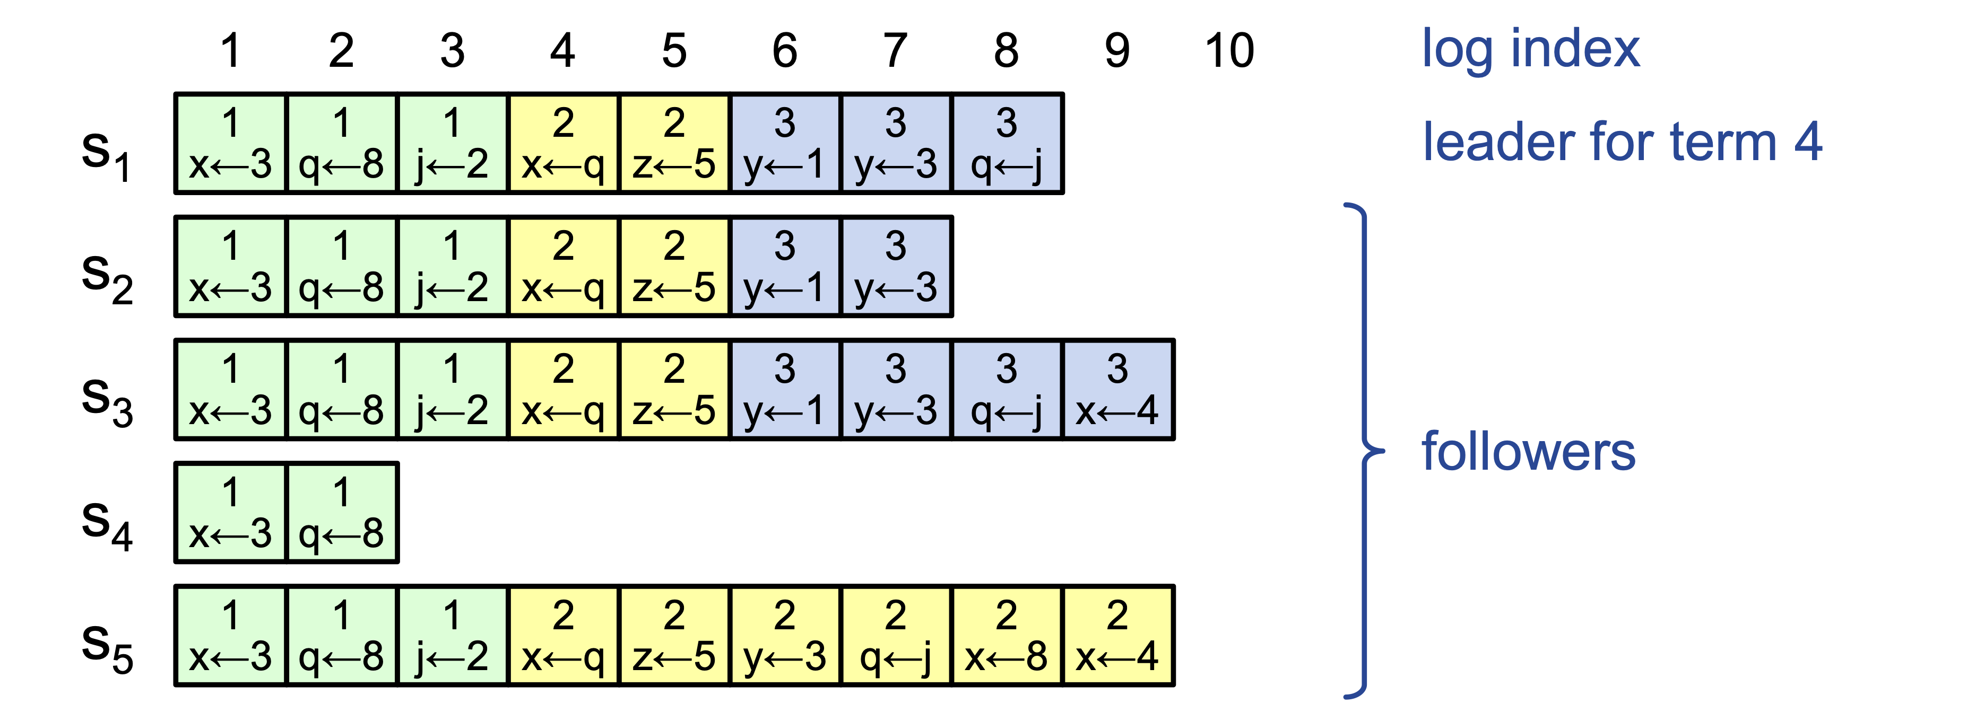
Challenge: crash can cause log to inconsistencies
Raft must repair logs in case of inconsistency
Leaders assume its log is correct
Leaders use normal operation to repair all inconsistencies
Notes:
Case in the example: server 4 crashes
Server 5 becomes the leader for 2, and keeps appending the logs from the clients

Slide 47
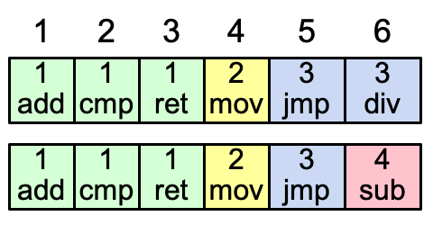
Consistency of the log
Question: how to achieve this property?
High level of coherency between logs maintained by the raft:
If log entries on different servers have the same index & term
They store the same command
The logs are identical in all preceding entries
If a given entry is committed, all preceding entries are also committed
Note that not all log entries are committed
Notes:
Commands must be equal: issued by the same leader

Slide 48
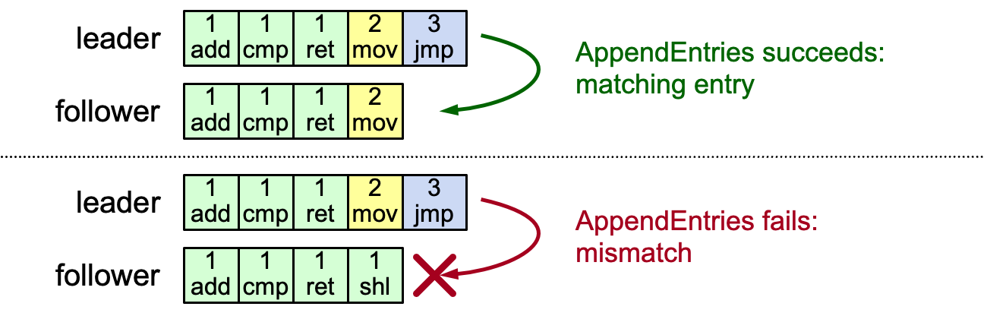
AppendEntries consistency checks
Each RPC argument contains
Append index, term, term of entry preceding new ones
Follower checks whether it has the matching entry
Otherwise, it rejects the request

Slide 49
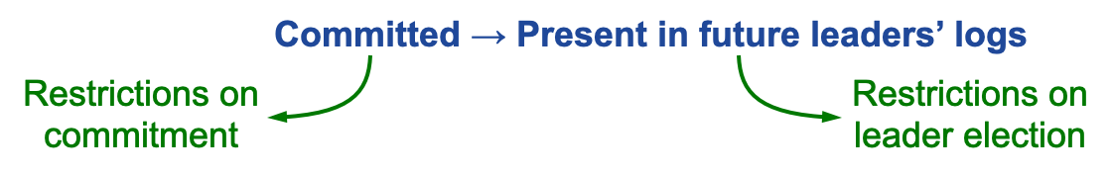
Safety requirement of the commit entry
Raft safety property:
If a leader has decided that a log entry is committed, that entry will be present in the logs of all future leaders (not being overwritten)
This guarantees the safety requirement
Leaders never overwrite entries in their logs
Only entries in the leader’s log can be committed
Entries must be committed before applying to state machine
We should help the leader deciding which its entry cannot be overwritten
Notes:
1. Delay the commitment of an entry until we know it is committed

Slide 50
Distributed Transaction & Replications
Caching server
Caching server
…
Caching server
Caching
Caching
Caching
Distributed caching
Database server
Database server
CDN
Users
Application #1
generate the page
Database
user, price
…
Database
user, price
Application server
Distributed database
Internet
Load
Balance
Application #2
add the order
File server
File server
File server
File:
image
File:
image
…
File:
image
Application server
…
…
Message queue
Distributed file system

Slide 51
Big picture of Spanner (a standard distributed database)
How to scale to a larger dataset?
Shading
How to tolerate failures across machines & datacenters?
Replicated state machine w/ Paxos
Can also use raft (e.g., TiDB)
How to execute read-write transaction to ensure before-or-after atomicity and multi-site atomicity?
2PL + 2PC

Slide 52












Read-write TX: put it all together
Multiple physical nodes
backed by PAXOS
$$2PL+2PC+Paxos$$
$$Client$$
$$read x$$
$$Shard0$$
$$Shard1$$
$$read y$$
Client Buffer:
$$x=x+1$$
$$y=y −1$$
$$Coordiantor$$
$$perpare$$
$$perpared$$
$$perpare$$
$$perpared$$
$$commit$$
$$applied$$
$$commit$$
$$applied$$
Note: we skip the network RTTs of Paxos
Notes:
Prepared: get the lock, record 2PC state and Paxos state
Applied: release the lock
Prepare + Commit both require Paxos

Slide 53
Data models of computing systems
Data model: collection of concepts for describing the data in a database
Schema: a description of a particular collection of data, using a given data model
Example data model:
Relational
Key-value
Graph
Document
...
Though some models are more nature in specific workloads
E.g., the graph data model is more natural for graph workloads
More expressiveness

Slide 54
Principle: be declarative, not procedural
Declarative: knowledge of
Example: ”Stop at the red traffic light”
Procedural: knowledge of how
Example: “play a song”
Example: “Write a program to forbid malicious insertions”
In psychology, declarative language is easier to learn
Procedural knowledge needs many practices
E.g., you have to code 10,000+ LoC to be a good c++ programmer

Slide 55

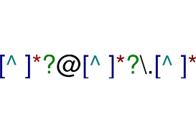


Relational model vs. key-value model
Declarative vs. procedural
Which one is better?
Declarative
You say what you want without having to say how to do it
Example:
Procedural
You have to specify exact steps to get the result
Example:
Notes:
Procedure: c, c++
Declarative; SQL, regular expression

Slide 56
Review: Network

Slide 57
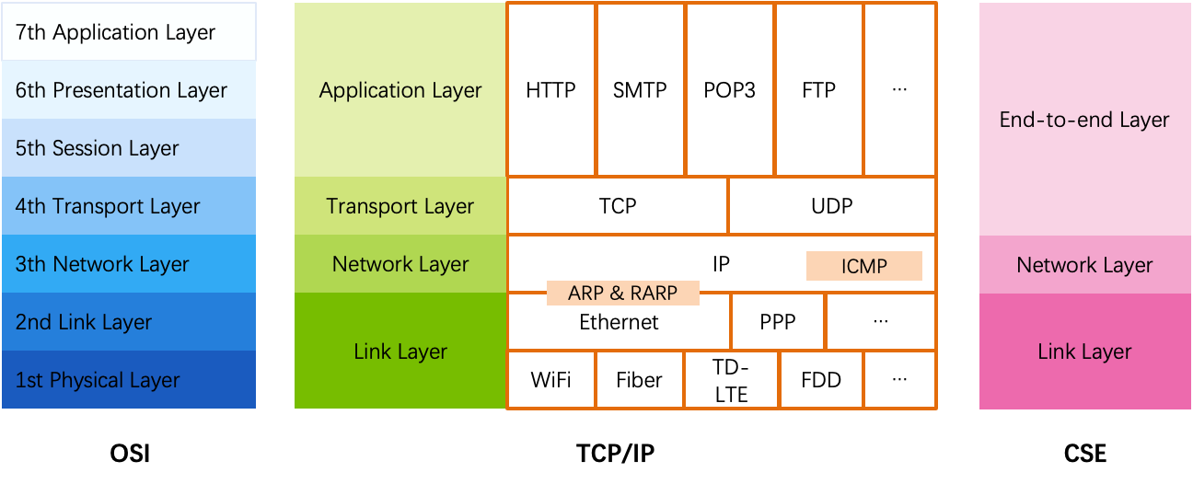
OSI, TCP/IP & Protocol Stack
OSI
The open systems interconnection (OSI) model
7-layer architecture

Slide 58
Layers in Network
Application
Can be thought of as a fourth layer
Not part of the network
End-to-end layer
Everything else required to provide a comfortable application interface
Network layer
Forwarding data through intermediate points to the place it is wanted
Link layer
Moving data directly from one point to another

Slide 59
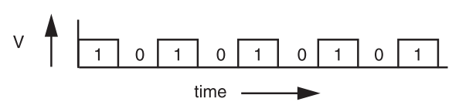
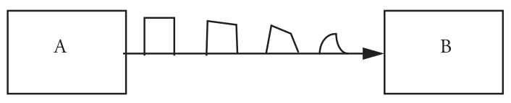
Signal Transmission on Analog Line
It is hard for B to understand the signal
B doesn't have a copy of A's clock, so when to sample the signal?

Slide 60
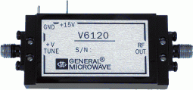
VCO: Voltage Controlled Oscillator
How to make two ends agree on the data rate without clock line?
The receiver run a VCO at about the same data rate
VCO's output is multiplied by the voltage of incoming signal
The product is suitably filtered and sent back to adjust the VCO
VCO will finally be locked to both the frequency and phase of the arriving signal: phase-locked loop
Then the VCO becomes a clock source for the receiver
Problem: if no transition in the stream (e.g., a lot of zero), the phase-locked loop cannot synchronize

Slide 61
Manchester Code
Solution: sender encodes the data to ensure transitions
Phase encoding: at least 1 level transition for a bit
Manchester code: 0 -> 01, 1 -> 10
Max data rate is only half, but simple enough
1
0
1
0
1
1
1
0
0
Polar NRZ
Manchester
Encoding

Slide 62
Error Handling
Error detection code
Adding redundancy: e.g., checksum at the end
What to do if detect an error
Error correction code: with enough redundancy
Where noise is well understood, e.g., disk
Ask sender to resend: sender holds frame in buffer
Let receiver discard the frame
Blending these techniques

Slide 63
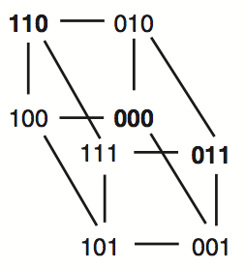
Example-1: Simple Parity Check
2 bits -> 3 bits
Detect 1-bit errors
8 patterns total
Only 4 correct patterns
00 -> 000
11 -> 110
10 -> 101
01 -> 011
Hamming distance of this code is 2
1-bit flipping will cause incorrect pattern

Slide 64
Control-plane VS. Data-plane
Control-plane
Control the data flow by defining rules
E.g., the routing algorithm
Data-plane
Copies data according to the rules
Performance critical
E.g., the IP forwarding process

Slide 65
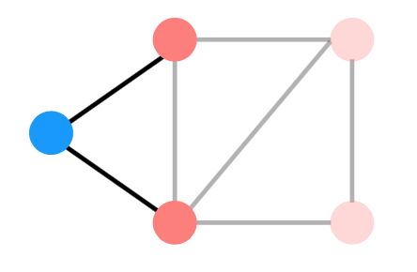
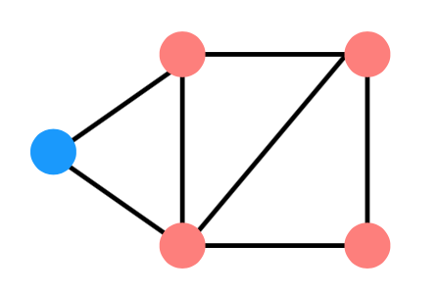
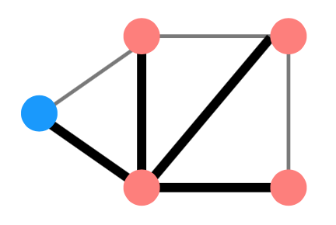
Distributed Routing: 3 Steps in General
Nodes learn about their neighbors via the HELLO protocol
Nodes learn about other reachable nodes via advertisements
Nodes determine the minimum-cost routes (of the routes they know about)

Slide 66
Two Types of Routing Protocol
Protocol 1: Link-state
A node's advertisements contain a list of its neighbors and its link costs to those nodes
Nodes advertise to everyone their costs to their neighbors
via flooding
Integrate using Dijkstra's shortest path algorithm
Protocol 2: Distance-vector
Nodes advertise to neighbors with their cost to all known nodes
Update routes via Bellman-Ford integration

Slide 67
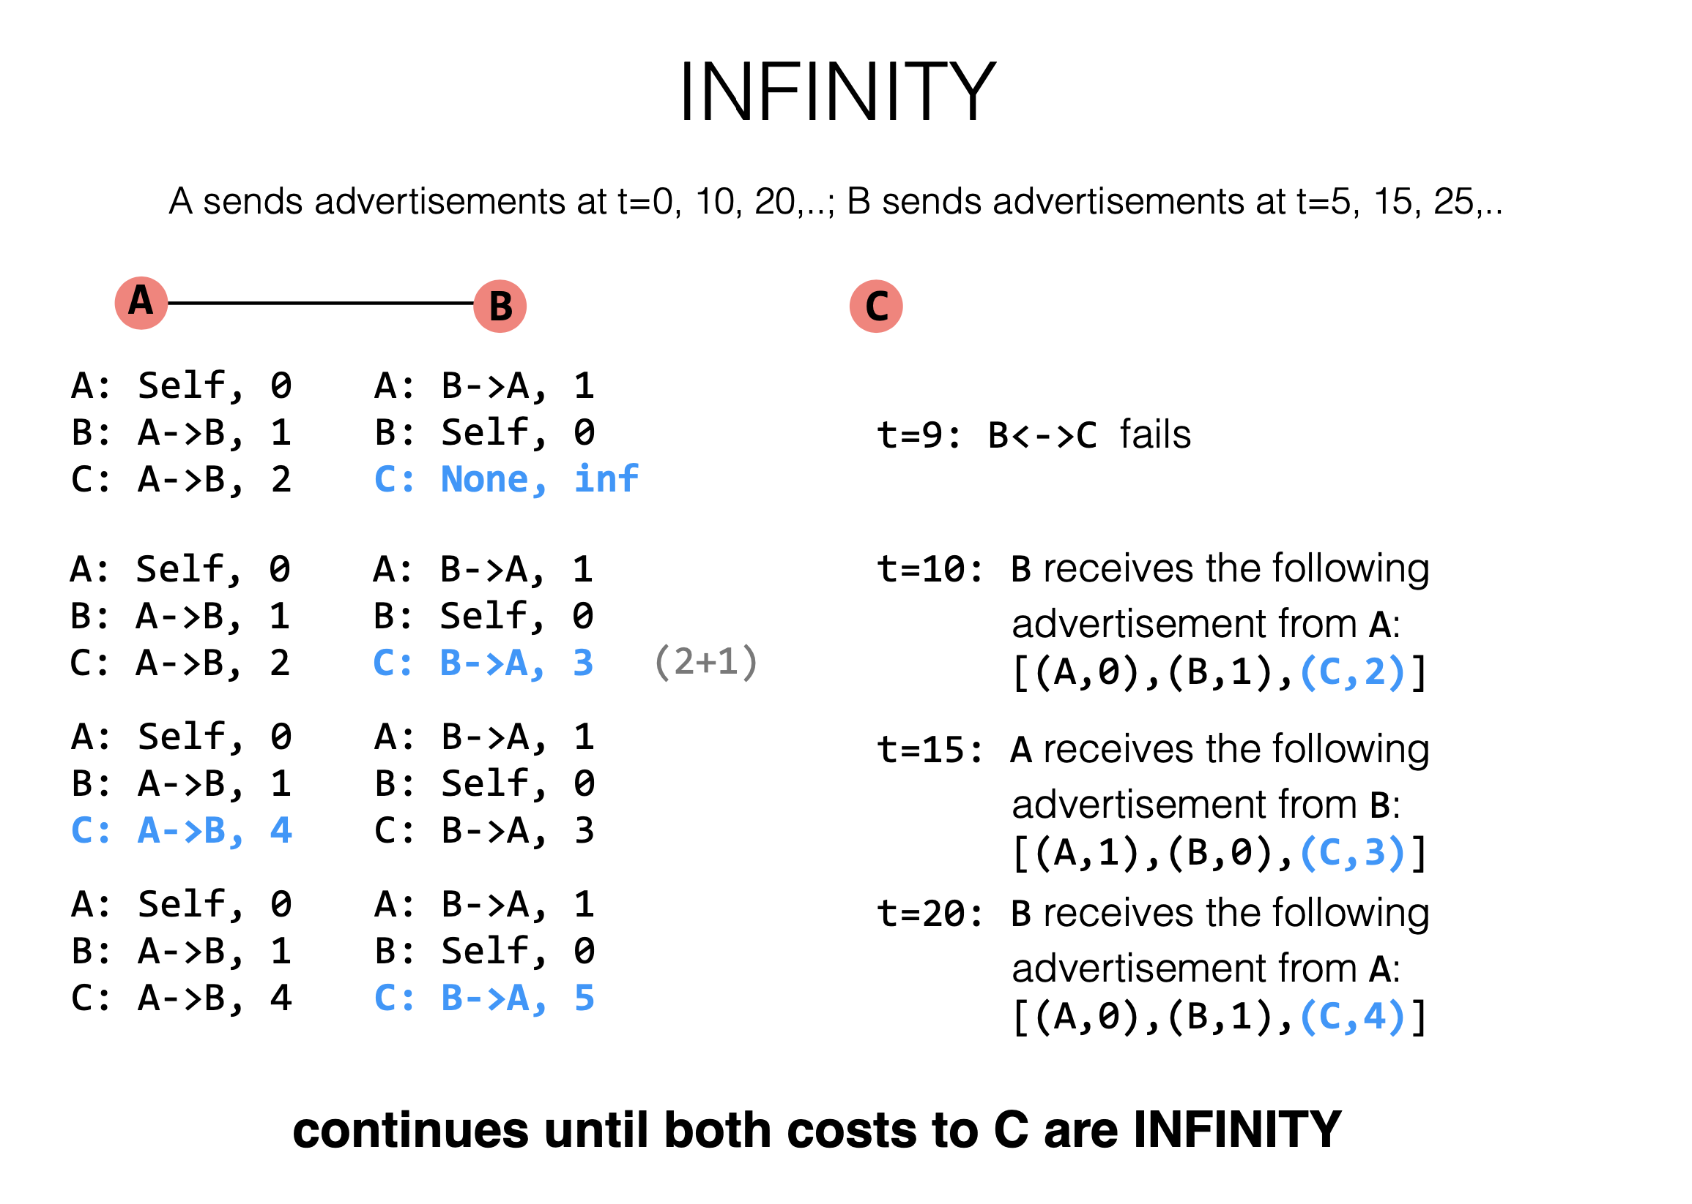
Notes:
But because the order in which advertisements are sent matters, sometimes nodes can incorrectly think there's a route when there isn't one

Slide 68
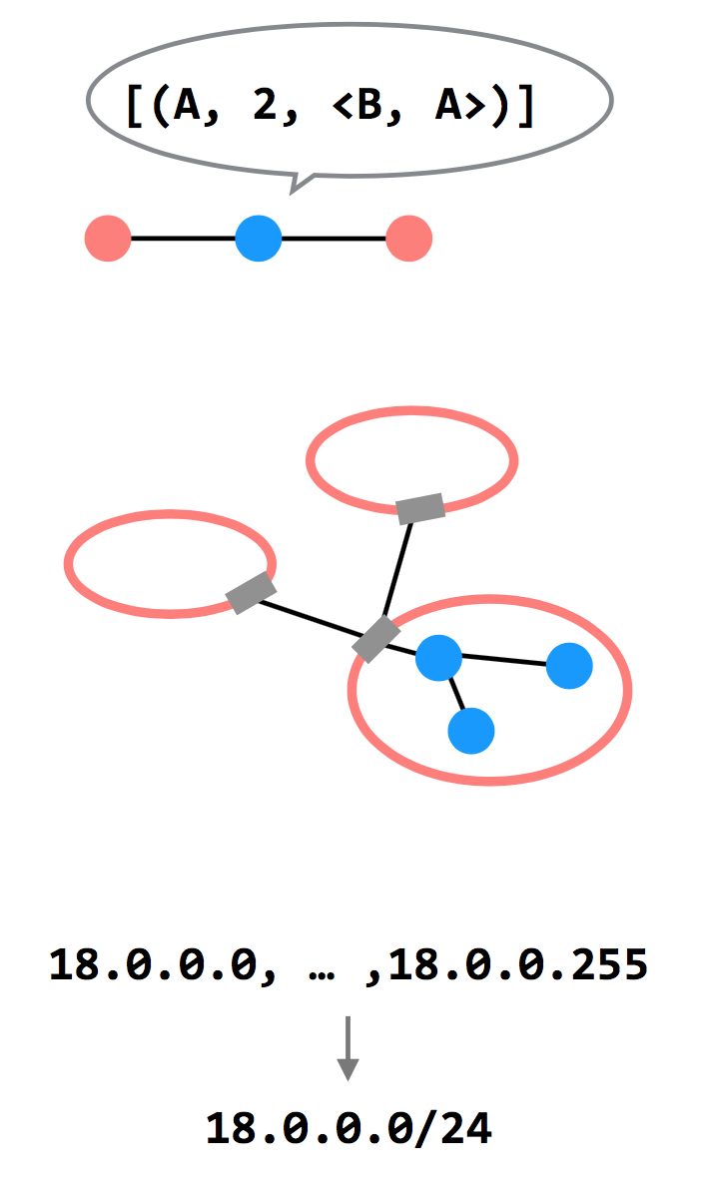
3 Ways to Scale
Path-vector Routing
Advertisements include the path, to better detect routing loops
Hierarchy of Routing
Route between regions, and then within a region
Topological Addressing
Assign addresses in contiguous blocks to make advertisements smaller

Slide 69
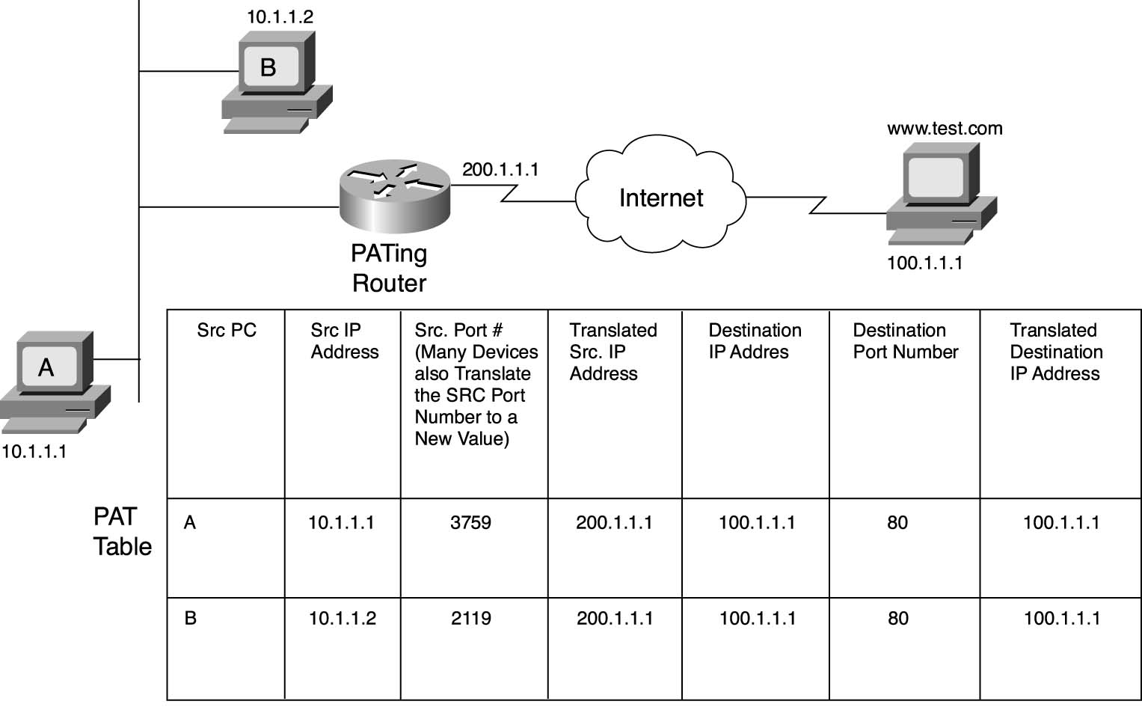
NAT
Notes:
A PATable, also known as a Port Address Translation (PAT) table or a Network Address Translation (NAT) table

Slide 71
The End-to-end Layer
Network layer has no guarantees on:
Delay - Order of arrival
Certainty of arrival - Accuracy of content
Right place to deliver
End-to-end layer
No single design is likely to suffice
Transport protocol for each class of application

Slide 72
Assurance of End-to-end Protocol
Assurance of at-least-once delivery
Assurance of at-most-once delivery
Assurance of data integrity
Assurance of stream order & closing of connections
Assurance of jitter control
Assurance of authenticity and privacy
Assurance of end-to-end performance

Slide 73
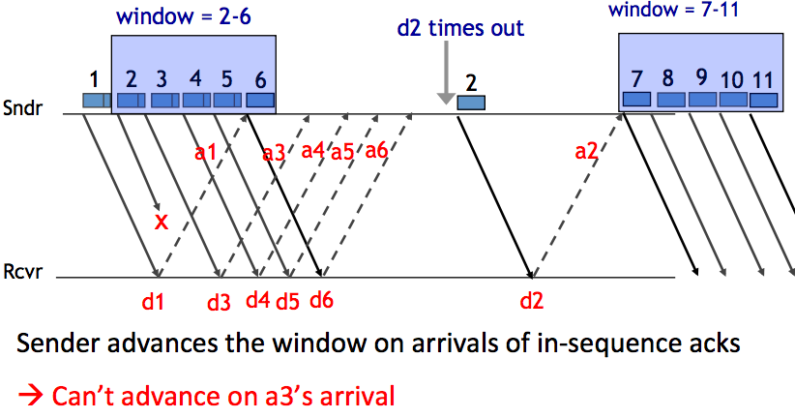
Handling Packet Loss

Slide 74
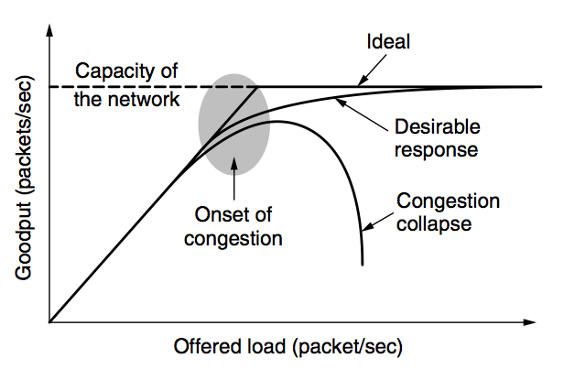
Network Congestion

Slide 75
Congestion Control
Basic idea:
Increase congestion window slowly
If no drops -> no congestion yet
If a drop occurs -> decrease congestion window quickly
Use the idea in a distributed protocol that achieves:
Efficiency: i.e., uses the bottleneck capacity efficiently
Fairness, i.e., senders sharing a bottleneck get equal throughput (if they have demands)

Slide 76
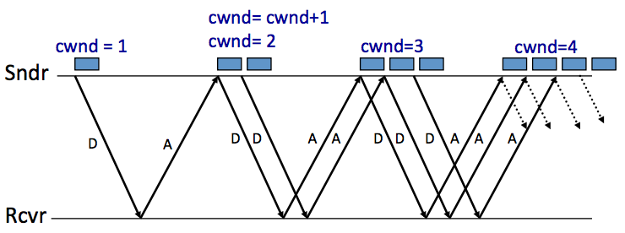
AIMD (Additive Increase, Multiplicative Decrease)
Every RTT:
No drop: cwnd = cwnd + 1
A drop: cwnd = cwnd / 2

Slide 77
Problems with AIMD
Increases very slowly at the beginning
Initial window size is 1
Probably too small in practice
Solution: do multiplicative increase at the beginning
Congestion_window _{init} = 1
Initially, do Congestion_window ← 2 * Congestion_window each RTT until we hit congestion
Named "slow start" (even though it's exponentially fast!)

Slide 78
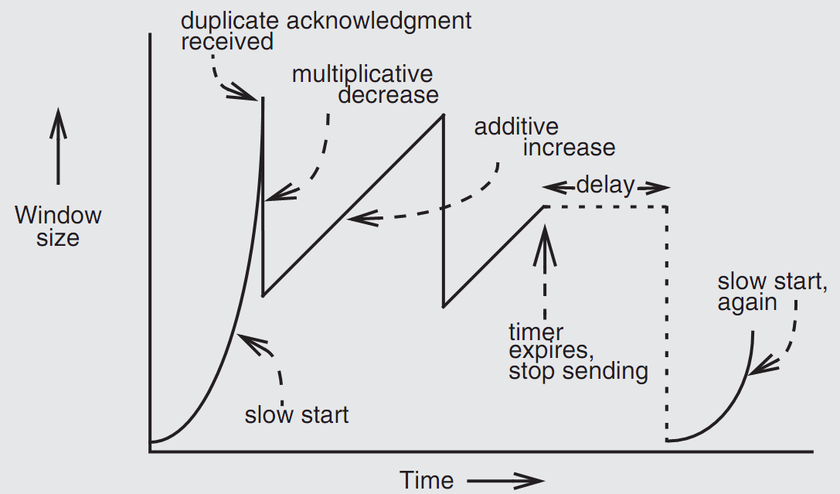
Retrofitting TCP

Slide 79
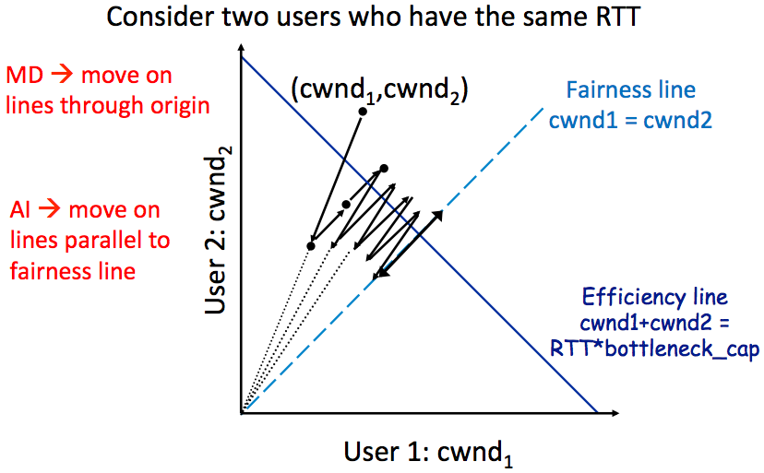
AIMD Leads to Efficiency and Fairness
Notes:
AIMD (Additive Increase Multiplicative Decrease) is an algorithm used in computer networking to control the rate at which data is transmitted over a network.

Slide 80
How to Use socket to Access www.baidu.com ?
You code as if your PC connect directly with Baidu
Call connect() with Baidu's IP address
But how does the system find next hop?

Slide 81
DNS Hierarchy (a partial view)

Slide 82
DNS Request Process
a.root.net
a.root.net
names.edu
names.edu
NS: for edu
ns.iss.edu
ns.iss.edu
NS: for
Scholarly.edu
ginger.
Scholar.edu
ginger.
Scholar.edu
ginger.
Scholar.edu
AP: for
ginger.Scholar.edu
Name client
Name client
Non-Recursion
Recursion
Notes:
Non-recursion: the server directly returns its current content
Recursion: the server help resolves the address
Overall, the choice between recursive and non-recursive DNS queries will depend on the specific needs of the application. In general, recursive queries are simpler and more efficient, while non-recursive queries can provide more control over the DNS query process.

Slide 83
Scalable Lookup: DHT
DHT: Distributed hash table
Used to find the node responsible for a key quickly
Distributed index: each node keeps a subset of the index
Typical DHT interface:
put(key, value)
get(key) -> value
Loose guarantees about keeping data alive
Notes:
Two options: find the data, find the node ID, who knows the data. focus on the latter.

Slide 84
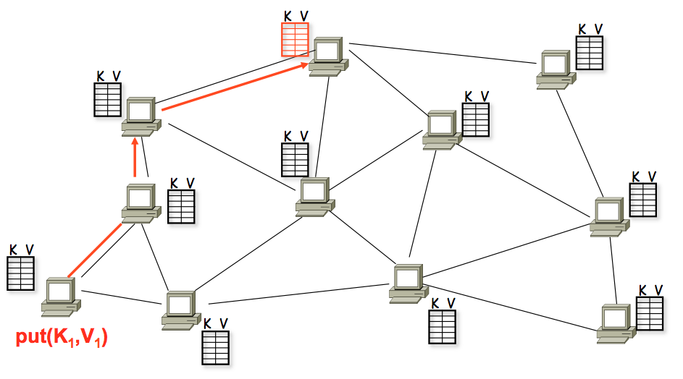
A DHT in Operation: put()
Notes:
每台机器只看到局部的信息

Slide 85
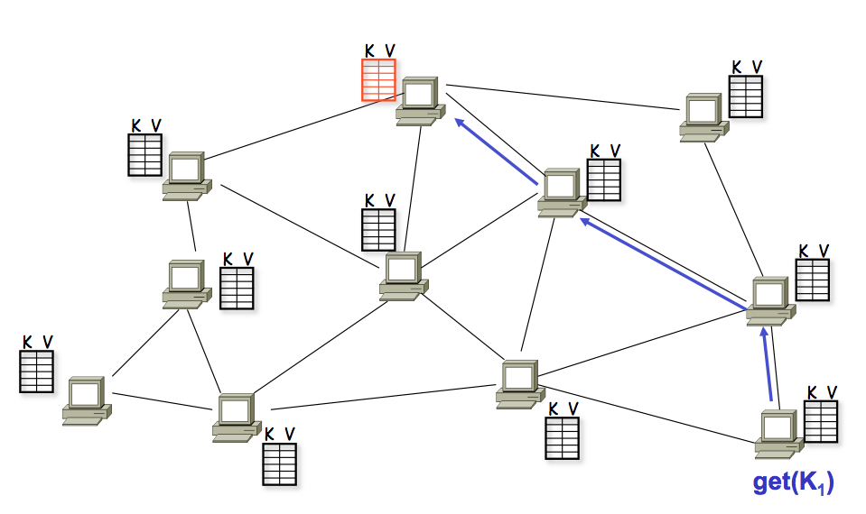
A DHT in Operation: get()

Slide 86
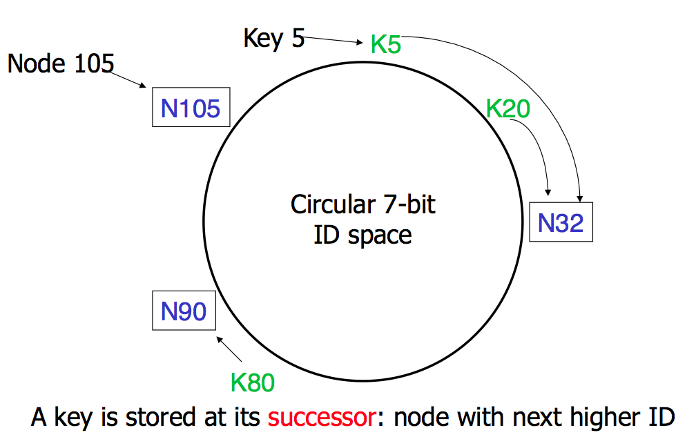
Consistent Hashing
Notes:
节点只知道一部分信息

Slide 87
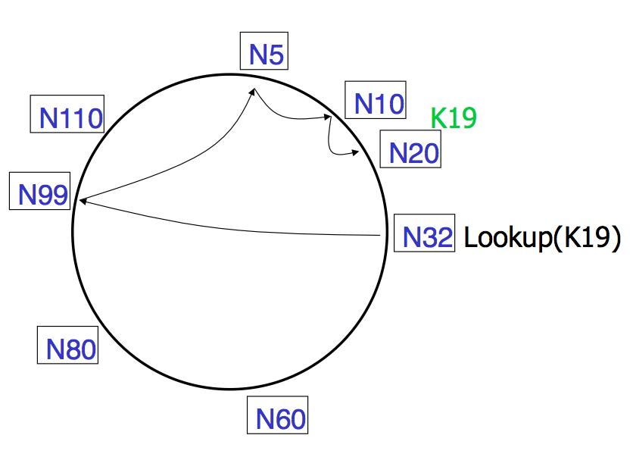
Lookups take O(log(N)) hops
Notes:
一个节点记录一个fingertable：不仅仅记录下一跳是谁，还记录网络对面是谁

Slide 88
Failures might cause incorrect lookup
N120
N10
N113
^{Lookup(90)}
N102
N85
N80
N80 doesn't know correct successor, so incorrect lookup
Notes:
怎么解决呢？ 加冗余

Slide 89
Review: Security

Slide 90
2 Steps towards Building a More Secure System
How to make progress in building a secure system?
Be clear about goals: "policy"
Be clear about assumptions: "threat model"
Notes:
怎么才能build一个安全的系统？
目标又分为很多：Confidentiality: limit who can read dataIntegrity: limit who can write data；Liveness goals:
Availability: ensure service keeps operating， DOS

Slide 91
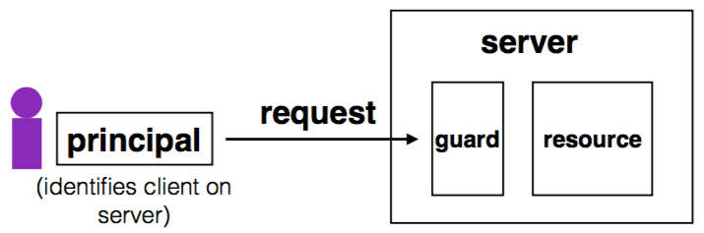
Complete Mediation
Guard typically provides:
Authentication: is the principal who they claim to be?
Authorization: does principal have access to perform request on resource?
Notes:
Authentication: 看是谁
Authorization： 我有没有权限
两者是互相依赖的

Slide 92
Example: Unix FS
Resource: files, directories.
Server: OS kernel.
Client: process.
Requests: read, write system calls.
Mediation: U/K bit / system call implementation.
Principal: user ID.
Authentication: kernel keeps track of user ID for each process.
Authorization: permission bits & owner uid in each file's inode.

Slide 93
Review: Stack Buffer Overflow
A Typical Buffer Overflow Attack
Inject malicious code in buffer
E.g., shellcode
Overwrite return address to buffer
Once return, the malicious code runs
0101011010111010111010
return addr
ebp
saved ebp
01101101010101010101011010101010101011101010
void function(char *str) {
char buf[16];
strcpy(buf,str);
}
buf

Slide 94
Defense: DEP (Data Execution Prevention)
Execute Code, not Data
Data areas marked non-executable
Stack marked non-executable
Heap marked non-executable
Enforced by hardware
NX: Non-eXecutable (the name on hardware)
You can load your shellcode in the stack or the heap…but you can't jump to it to execute

Slide 95
Attack: Code Reuse (instead of inject) Attack
ROP: Return-oriented Programming
Find code gadgets in existed code base
Usually 1-3 instructions, ends with 'ret'
In libc and application, intended and unintended
Push address of gadgets on the stack
Leverage 'ret' at the end of gadget to connect each code gadgets
No code injection
0101011010
0101011010
0101011010
return addr
0101011010
saved ebp
0101011010
0101011010
0101011010

Slide 96
CFI: Control Flow Integrity
Main idea: pre-determine control flow graph (CFG) of an application
Static analysis of source code
Static binary analysis ← CFI
Execution profiling
Explicit specification of security policy
Execution must follow the pre-determined control flow graph

Slide 97
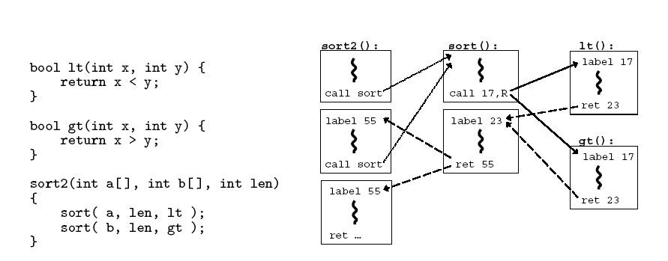
CFI: Control Flow Integrity

Slide 98
Data flow tracking
Usage-1: protect critical data
E.g., track data to ensure none is leaked
Usage-2: defend against suspicious input data
E.g., one input data cannot flow to return address!

Slide 99
Tainting: Data Flow Tracking
Apply access policy along the data flow
E.g., a password cannot be sent to Internet
E.g., credit card number cannot be sent to other apps
E.g., untrusted data cannot be executed
Notes:
怎么taint？编译器插代码

Slide 100
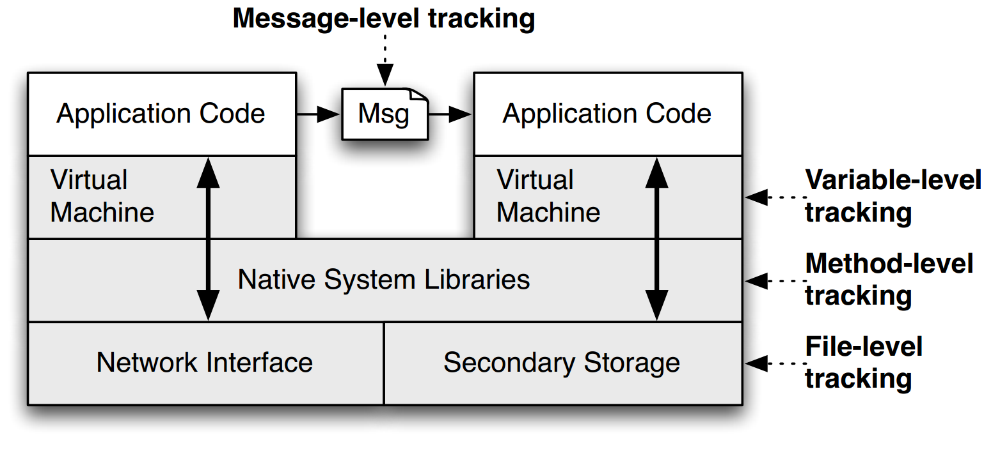
TaintDroid
Notes:
Taint应用：在android中应用

Slide 101
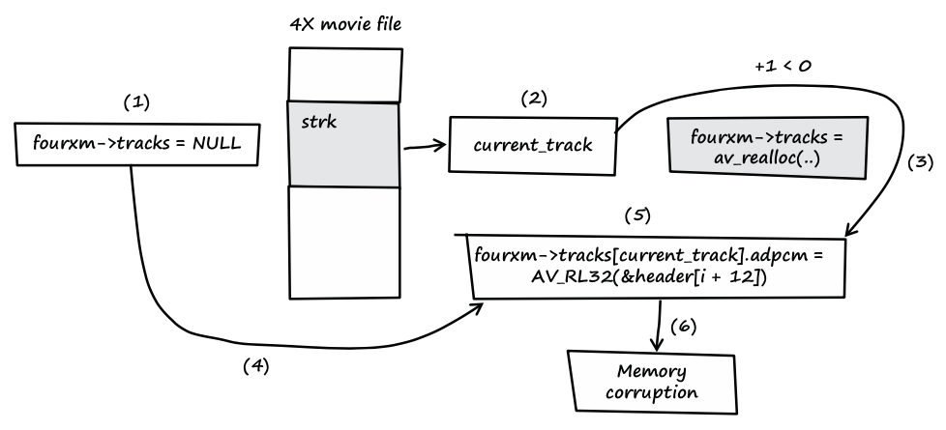
Trace the Input Data
Notes:
fourxm->tracks is initialized with NULL (see line 107).
If the processed media file contains a strk chunk, the value of current_track is extracted from the user-controlled data of the chunk (see line 166).
If the value of current_track + 1 is less than zero, the heap buffer isn't allocated.
fourxm->tracks still points to memory address NULL.
The resulting NULL pointer is then dereferenced by the user- controlled value of current_track, and four 32-bit values of user- controlled data are assigned to the dereferenced locations (see lines 178–181).
Four user-controlled memory locations can be overwritten with four user-controlled data bytes each.

Slide 102
Data Privacy
Will data be vulnerable to misuse?
What's the target of data privacy system?
Allow data to be used, and
Protect data from being stolen
What are introduced in the class?
Basic data privacy method
HE, ZKP, sMPC, SS, OT, GC, DP, Enclave/TEE, …
Systems which try to enforce data privacy

Slide 103
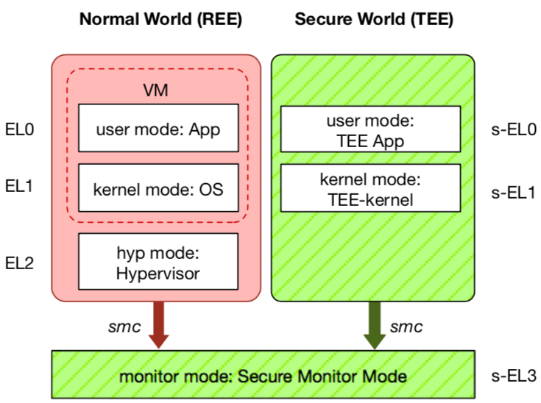
TEE: Trusted Execution Environment
Widely deployed on mobile devices
Every Android device must deploy TEE
Mostly based on ARM TrustZone
An isolated & privileged environment
TEE can access all DRAM & peripherals
REE cannot access TEE's resources
Designed to be secured and small
For security-critical tasks (e.g., fingerprint checker, mobile payment, etc.)
Notes:
Before presenting virtualization of TEE, let me introduce TEE a little bit.
TEE is short for xxx. It has been widely deployed on mobile devices. Thanks to Google, now every Android phone needs to have TEE to pass Google's test.
On mobile phone, most TEE are based on ARM TrustZone.
TrustZone divides one system to two worlds: xxx and xxx.
The normal world, aka REE, runs rich OS like Android or iOS. It has three layers: one for hypervisor, one for kernel and one for application.
The secure world, aka TEE, has three layers: one for TEE OS and one for TEE applications.
There is a special layer, called monitor mode or s-EL3, is used for switching between the two worlds. It is also part of the secure world but share the same privilege with s-EL1.
The switching is done through smc instruction.
The green part is TEE, which is an isolated environment with higher privileged than the REE.
It means that xxx
The TEE is designed to xxx, its typical usage is xxx.

