Slide 1
Register Allocation Implementation in the Tiger Compiler

Slide 2
Graph
Graph abstract data type
graph::Graph()
Create an empty directed graph
g->NewNode(x)
Make a new node within graph g
x is any extra information “attached” to the new node
g->AddEdge(n,m)
Create a direct edge from n to m
n->Succ()->Append(m), m->Pred()->Append(n)
m->Adj()=m->Succ()∪m->Pred(m)
Notes:
删除了图里删除边的函数

Slide 3
Attach additional information to nodes
Each node represents some thing
An instruction in a program
Dataflow information
A variable in a program
Two ways to map from node to things
Put things in node directly (via a pointer)
n=g->NewNode(x)
n->Nodeinfo() retrieves x
Using graph::Table = tab::Table<Node<T>, ValueType>
mytable->Enter(n, y)
Associates information y to node n in a mapping mytable

Slide 4
Control Flow Graph
class Instr {
public:
[[nodiscard]] virtual temp::TempList *Def() const = 0;
[[nodiscard]] virtual temp::TempList *Use() const = 0;
};
def information is obtained from the dst fields of the instruction
use information is obtained from the src fields of the instruction
typeid(*instr) == typeid(MoveInstr)
check if the instruction is a move instruction
Notes:
nodiscard是一个c++语言特性，代表该值不允许忽略，即不能出现Def()； 这种只调用不处理结果的语句（在编译时提示）

Slide 5
Control Flow Graph
class FlowGraphFactory {
public:
void AssemFlowGraph();
graph::Graph<assem::Instr> *GetFlowGraph() { return flowgraph_; }
private:
assem::InstrList *instr_list_;
graph::Graph<assem::Instr> *flowgraph_;
tab::Table<temp::Label, graph::Node<assem::Instr>> *label_map_;
};
AssemFlowGraph() will construct the flow graph and store into flowgraph_
Info of each graph::Node is actually a pointer to an assem::Instr
jump fields of the instrs are used to in creating control flow edges

Slide 6
Liveness Analysis
Takes a flow graph produce liveness information at the exit of each flownode
tab::Table<temp::Label, graph::Node<assem::Instr>>
Remember what is live at the exit of flownode
Using a table to attach information
Using Enter to remember, Lookup to get info

Slide 7
Register Allocation
Takes a flow graph produce a live::LiveGraph
An interference graph
Using liveness information at the exit of each node
A list of node-pairs representing MOVE instructions
If a variable is defined but never used, we still need to generate interference edge from this variable because this instruction needs to be executed(此时没有进行死码的移除)
Notes:
Live_gtemp(n)
Tells what temporary variable is represented by n
Implemented by making info field point to a Temp_temp
这个删了，因为我感觉n->NodeInfo()就可以了？

Slide 8
Register Allocation
Two ways to represent edges
Adjacent list
Only for normal temporaries
Because the adjacent list for machine registers may be too large
Machine registers cannot be selected
We only coalesce temporary node to machine registers using George method
Bitmap
Both for temporaries and machine registers
Move-related node
associated with a count number of moves
easy to maintain and test if it is no longer move-related

Slide 9
Register Allocation
All nodes
associated with a count of the number of neighbors currently in the graph
This number is used to determine whether
a node is of significant degree(>=K) during coalescing
a node can be removed from the graph during simplification

Slide 10
Program Code
Node work-list, sets, stacks
simplifyWorklist
low-degree non-move-related nodes
freezeWorklist
low-degree move-related nodes
spillWorklist
high-degree nodes
spillNodes
Nodes marked for spilling
procedure Main()
LivenessAnalysis()
Build()
MakeWorklist()
repeat
if simplifyWorklist != {} then Simplify()
else if worklistMoves != {} then Coalesce()
else if freezeWorklist != {} then Freeze()
else if spillWorklist != {} then SelectSpill()
until simplifyWorklist = {} && worklistMove={} &&
freezeWorklis={} && spillWorklist={}
AssignColor()
if spilledNodes != {} then
RewriteProgram(spilledNodes)
Main()
Move sets
worklistMoves
Moves enabled for coalescing

Slide 11
Program Code
Other data structures
moveList
A mapping from a node to the list of moves it is associated with
procedure Build()
forall b∈blocks in program
let live = liveOut(b)
forall I∈instruction(b) in reverse order
if isMoveInstruction(I) then
live ← live\use(I)
forall n∈def(I)∪use(I)
moveList[n] ← moveList[n]∪{I}
workListMoves ← workListMoves∪{I}
live ← live∪def(I)
forall d∈def(I)//def(I)中不一定只包含一个指令
forall l∈live
AddEdge(l, d)
live ← use(I)∪(live\def(I))

Slide 12
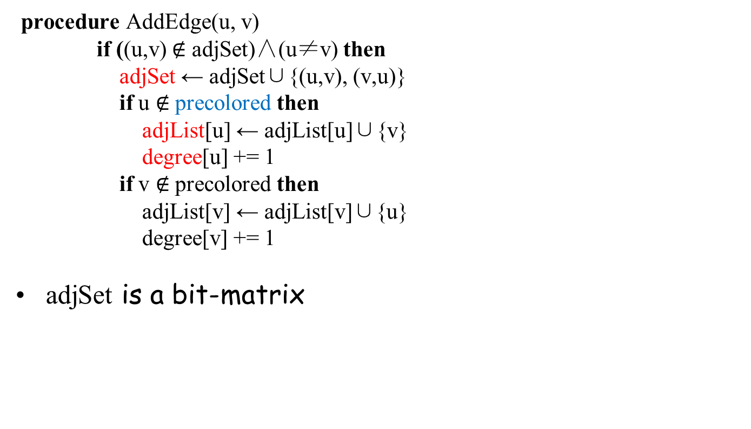
Program Code
Other data structures
adjSet
The bit-matrix of edges
adjList
Adjacent nodes list of a non-precolored node
degree
An array containing the current degree of each node

Slide 13
Program Code
procedure MakeWorkList()
forall n∈intial
initial ← initial\{n}
if degree[n] ≥ K then
spillWorkList ← spillWorkList∪{n}
else if MoveRelated(n) then
freezeWorkList ← freezeWorkList∪{n}
else
simplifyWorkList ← simplifyWorkList∪{n}
Node work-list, sets, stacks
initial
Temporary registers, not precolored and not yet processed

Slide 14
Program Code
Move sets
activeMoves
Moves not yet ready for coalescing
function Adjacent(n)
adjList[n] \ (selectStack∪coalescedNodes)
function NodeMoves(n)
moveList[n]∩(activeMoves∪worklistMoves)
function MoveRelated(n)
NodeMoves(n) ≠ {}
procedure Simplify()
let n∈simplifyWorkList
simplifyWorkList ← simplifyWorkList\{n}
push(n, selectStack)
forall m∈Adjacent(n)
DecrementDegree(m)
Node work-list, sets, stacks
selectstack
Containing temporaries removed from the graph
coalescedNodes
Registers been coalesced

Slide 15
Program Code
procedure Decrement(m)
let d = degree[m]//由于是无向图,直接将对应节点的度-1即可
degree[m] ← d - 1
if d = K then
EnableMoves(m∪Adjcent(m))
spillWorkList ← spillWorkList \ {m}
if MoveRelated(m) then
freezeWorkList ← freezeWorkList∪{n}
else
simplifyWorkList ← simplifyWorkList∪{n}
procedure EnableMoves(nodes)
forall n∈nodes
forall m∈NodeMoves(n)
if m∈activeMoves then//之后可能进行合并
activeMoves ← activeMoves \ {m}
workListMoves ← workListMoves∪{m}

Slide 16
Program Code
Other data structures
alias
When a move (u, v) has been coalesced, v put in coalescedNodes and u put back on some work-list, then alias[v]=u
procedure Coalesce()
let m(_{=copy(x,y)})∈workListMoves
x ← GetAlias(x)
y ← GetAlias(y)
if y∈ precolored then
let (u,v) = (y, x)
else
let (u,v) = (x, y)
workListMoves ← workListMoves\{m}
if ( u = v ) then
coalescedMoves ← coalescedMoves∪{m}
AddWorkList(u)
else if v∈ precolored∨(u,v)∈adjSet then
constrainedMoves ← contrainedMoves∪{m}
AddWorkList(u)
AddWorkList(v)
Move sets
coalescedMoves
Moves has been coalesced
constrainedMoves
Moves whose source and target intefere

Slide 17
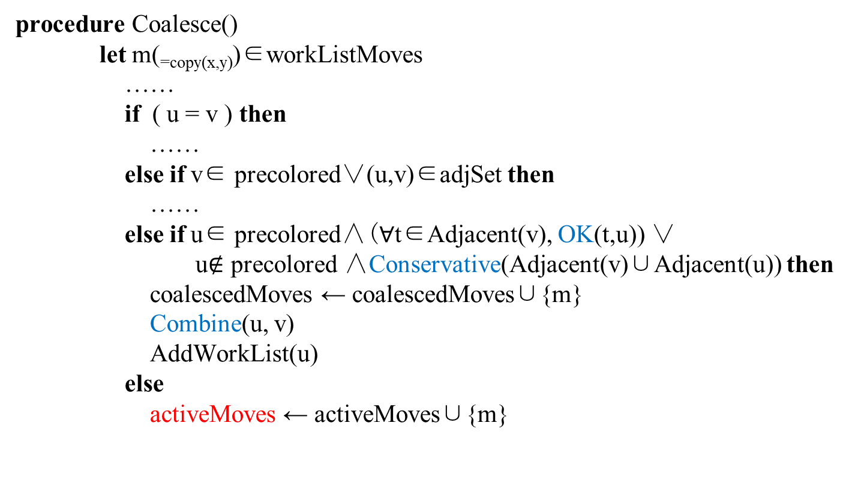
Program Code
Conservative:Briggs
OK：George
//可以合并的情况
//不可以合并的情况

Slide 18
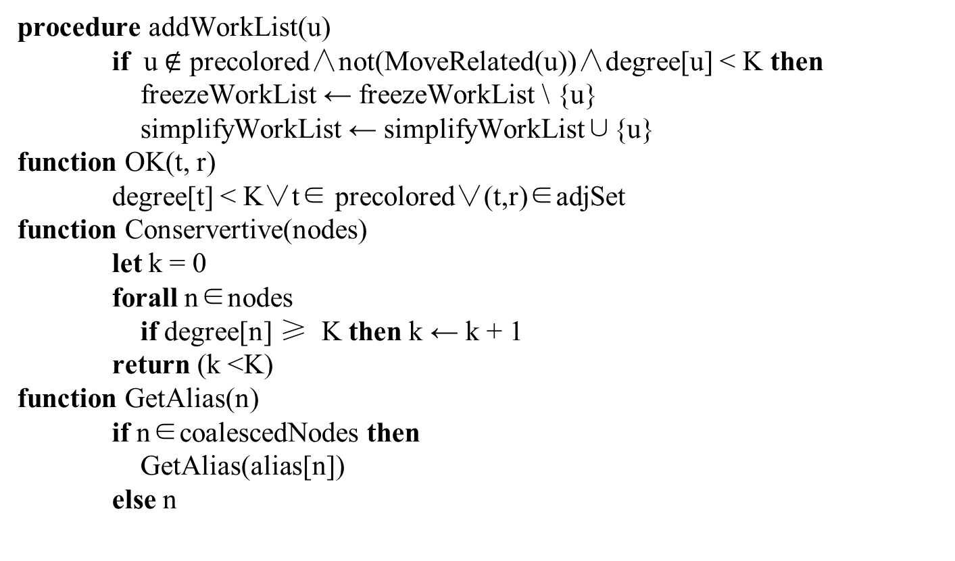
Program Code

Slide 19
Program Code
procedure Combine(u,v)
if v∈freezeWorkList then
freezeWorkList ← freezeWorkList \ {v}
else
spillWorkList ← spillWorkList \ {v}
coalescedNodes ← coalescedNodes ∪{v}
alias[v] ← u
moveList[u] ← moveList[u] ∪moveList[v]
EnableMoves(v)
forall t ∈Adjacent(v)
addEdge(t, u)//这里需要额外的判断边是否已经存在了
DecrementDegree(t)
if degree[u]≥K∧ u ∈freezeWorkList then
freezeWorkList ← freezeWorkList \ {u}
spillWorkList ← spillWorkList ∪ {u}

Slide 20
Program Code
Move sets
frozenMoves
Moves that will no longer been considered for coalescing
procedure Freeze()
let u∈freezeWorkList
freezeWorkList ← freezeWorkList \ {u}
simplifyWorkList ← simplifyWorkList ∪{u}
FreezeMoves(u)
procedure FreezeMoves(u)
forall m(_{=copy(x,y)})∈NodeMoves(u)
if GetAlias(y)=GetAlias(u) then
v ← GetAlias(x)
else
v ← GetAlias(y)
activeMoves ← activeMoves \ {m}
frozenMoves ← frozenMoves ∪ {m}
if NodeMoves(v) = {}∧ degree[v] < K then
freezeWorkList ← freezeWorkList \ {v}
simplifyWorkList ← simplifyWorkList ∪ {v}

Slide 21
Program Code
procedure SelectSpill()
let u∈spillWorkList /* Should use heuristic algoriths */
spillWorkList ← spillWorkList \ {m}
simplifyWorkList ← simplifyWorkList ∪ {m}
FreezeMoves(m)

Slide 22
Program Code
procedure AssignColor()
while SelectStack not empty
let n = pop(SelectStack)
okColors ← [0, … , K-1]
forall w∈adjList[n]
if GetAlias[w]∈(ColoreNodes∪precolored) then
okColors ← okColors \ {color[GetAlias(w)]}
if okColor = {} then
spillWorkList ← spillWorkList ∪{n}
else
coloredNodes ← coloredNodes ∪ {n}
let c ∈ okColor
color[n] ← c

Slide 23
Program Code
procedure RewriteProgram()//重写的assem code
Allocate memory locations for each v∈spilledNodes
Create a new temporary v_{i} for each definition and each use
In the program (instructions), insert a store after each
definition of a v_{i} , a fetch before each use of a v_{i}
Put All the v_{i} into a set newTemps
spilledNode ← {}
initial ← coloredNodes∪coalescedNodes∪newTemp
coloredNodes ← {}
coalescedNodes ←{}
//定义的指令重写成一个store,获取的指令重写成一个load。

Slide 24
Register Allocation for Trees
procedure SimpleAlloc(t)
for each nontrivial tile u that is a child of t
SimpleAlloc(u)
for each nontrivial tile u that is a child of t
n ← n – 1
n ← n + 1
assign r_{n} to hold the value at the root of t
Assume we have enough number of registers
Still we want to minimize the number of registers to be used
The above code is only sub-optimal
n is a global initialize as 0

Slide 25
Example
+
r₁
MEM(NAME a)
*
r₂
r₁
MEM(NAME b)
MEM(NAME c)
r₂
r₃

Slide 26
Sethi-Ullman Labeling Algorithm
procedure Label(t)
for each tile u that is a child of t
Label(u)
if t is trivial(为空) then need[t] ← 0
else if t has two children, u_{left} and u_{right} then
if need[u_{left}] = need[u_{right}] then
need[t] ← 1+ need[u_{left}]
else need[t] ← max(1, need[u_{left}], need[u_{right}])
else if t has one child, u then
need[t] ← max(1, need[u])
else if t has no children then
need[t] ← 1

Slide 27
Sethi-Ullman Labeling Algorithm
+
2
1
MEM(NAME a)
*
2
1
1
MEM(NAME b)
MEM(NAME c)

Slide 28
Sethi-Ullman Labeling Algorithm
Maximal Munch should identify the tiles simultaneously with the labeling algorithm
Next pass emits Assem instruction for the tiles
In descendent order of need
Will minimize the number of simultaneously live temporaries and reduce the number of spills

Slide 29
Putting It All Together

Slide 30
As simple as possible, but not simpler
Nested functions
Escape analysis
Structured l-value
No record or array variables
Only pointers to heap
Register allocation
Back end much bigger
We can put all the temporaries to the stack without register allocation
Need load and store instruction
Optimized in basic block
Using labeling algorithm to assign registers for trees

Slide 31
As simple as possible, but not simpler
Tree intermediate representation
Cannot describe procedure entry and exit
Not completely machine independent
No enough information to simulate the execution of an entire program
View shift is partly done implicitly by procedure prologues and epilogues
Useful as a low-level IR
Useful for instruction selection and intraprocedural optimization
High-level IR would be more tied to a particular family of source languages
Preserve more of the source program semantics

Slide 32
Data structures for frame
registers
A list of all the register names on the machine
Can be used as “color” for register allocation
temp::Map
For each machine register, a particulare temp::Temp is maintained by the Frame module to serve as the “precolored temporary” that stands for the register, appears
in the Assem CALL instructions
Procedure entry/exit sequences generated by ProcEntryExit1
temp::Map tells the “color” of each these precolored temps

Slide 33
Prolog and Epilog
NewFrame
creates a sequence of Tree::MoveStm as it creates all the formal parameter “accesses”
puts this into the frame data structure
ProcEntryExit1
Concatenates the sequence in the frame data structure onto the procedure body
On entry move all the callee-save registers to their new temporary locations
On exit move back the called save register from their new temporary locations
These moves will be eliminated by register coalescing

Slide 34
Prolog and Epilog (ProcEntryExit3)
Creates the procedure prologue and epilogue assembly language
Calculates the size of the outgoing parameter space in the frame
Maximum number of outgoing parameters of any CALL instructions in the procedure body
In Assem trees it is not obvious
ProcEntryExit2 should scan the body and record this information
Or the maximum legal value is used
Generates the assembly language for procedure entry, stack-pointer adjustment, and procedure exit

Slide 35
string
A string literal in Tiger is translated into a frame::StringFrag fragment
It will be translated into machine-dependent assembly language that reserves and initializes a block of memory
frame::StringFrag::OutputAssem function returns a string containing the assembly-language instructions required to define and initialize a string literal
Be careful \0 in tiger

