Slide 1
Garbage Collection

Slide 2
Garbage Collection
Heap allocated records that are not reachable by any chain of pointers from program variables are garbage
Garbage collection
a runtime system of reclaiming the garbage for reusing the space
conservative approximation that a dynamic live variable is always reachable guaranteed by compilers (such as the tiger compiler and the java compiler but not the C compiler)

Slide 3
Example
12
●
●
let
type list = {link: list, key: int}
type tree = {key: int, left: tree, right: tree}
function maketree() = ……
function showtree() = ……
in
let var x := list{link=nil, key=7}
var y := list{link=x, key=9}
in x.link := y
end
let var p := maketree()
var r := p.right
var q := r.key
in garbage collection here
showtree(r)
end
end
15
●
●
p
q
r
37
●
7
37
●
●
59
●
●
●
9
20
●
●

Slide 4
Mark and Sweep
Directed graph
nodes: program variables and heap-allocated records
edges: pointers
Mark
Search the graph from the roots (program variables)
Mark all the nodes searched
Sweep
Sweep the entire heap
Reclaim nodes not marked (put them into a freelist)
Unmark marked nodes
Program resumes execution after GC
Allocates records from the freelist
Do GC again when freelist is empty

Slide 5
Mark and Sweep
Mark phase: function DFS(x)
for each root v if x is a pointer and points to record y
DFS(v) if record y is not marked
mark y
Sweep phase: for each field f_{i} of record y
p ← first address in heap DFS(y.f_{i})
while p < last address in heap
if record p is marked
unmark p
else let f₁ be the first field in p
p.f₁ ← freelist
freelist ← p
p ← p + (size of record p)

Slide 6
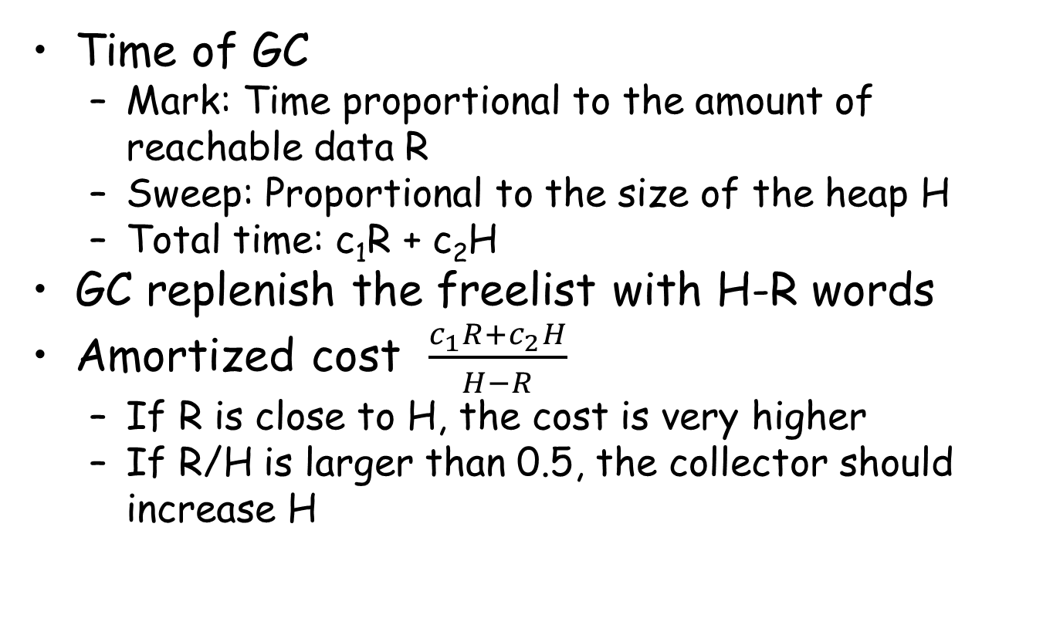
Cost of garbage collecction

Slide 7
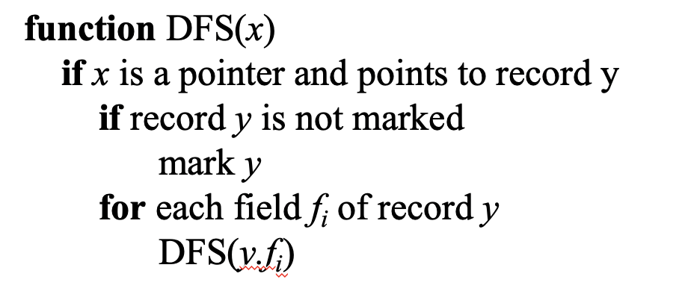
Explicit Stack
A recursive mark phase (DFS) may generate too many stack frames
Extreme case: N frames for an N-elem linked list
Easy to cause stack overflow!

Slide 8
Explicit Stack
A vector to replace the original stack
function DFS(x)
if x is a pointer to record y which is not marked
mark y
t ← 1
stack[t] ← y
while t > 0
y ← stack[t]; t ← t – 1
for each field f_{i} of record y
if y.f_{i} is a pointer to record z which is not marked
mark z
t ← t + 1; stack[t] ← z
…
y
t
stack

Slide 9
Pointer reversal
function DFS(x)
if x is a pointer to record y which is not marked
t ← nil; mark y; done[y] ← 0
while true
i ← done[y]
if i < # of fields in record y
x ← y.f_{i}
if x is a pointer to record z which is not marked
y.f_{i} ← t ; t ← y; y ← z; mark y; done[y] ← 0
else
done[y] ← i + 1
else
z ← y; y ← t
if y = nil then return
i ← done[y]; t ← y.f_{i}; y.f_{i} ← z; done[y] ← i+1
t
nil
x
c
b
a(y)
0
b
c
d

Slide 10
Pointer reversal
function DFS(x)
if x is a pointer to record y which is not marked
t ← nil; mark y; done[y] ← 0
while true
i ← done[y]
if i < # of fields in record y
x ← y.f_{i}
if x is a pointer to record z which is not marked
y.f_{i} ← t ; t ← y; y ← z; mark y; done[y] ← 0
else
done[y] ← i + 1
else
z ← y; y ← t
if y = nil then return
i ← done[y]; t ← y.f_{i}; y.f_{i} ← z; done[y] ← i+1
t
nil
x
c
b
a(y)
0
b
c
i
0
d

Slide 11
Pointer reversal
function DFS(x)
if x is a pointer to record y which is not marked
t ← nil; mark y; done[y] ← 0
while true
i ← done[y]
if i < # of fields in record y
x ← y.f_{i}
if x is a pointer to record z which is not marked
y.f_{i} ← t ; t ← y; y ← z; mark y; done[y] ← 0
else
done[y] ← i + 1
else
z ← y; y ← t
if y = nil then return
i ← done[y]; t ← y.f_{i}; y.f_{i} ← z; done[y] ← i+1
t
nil
x
c
b(z)
a(y)
0
b
c
i
0
d

Slide 12
Pointer reversal
function DFS(x)
if x is a pointer to record y which is not marked
t ← nil; mark y; done[y] ← 0
while true
i ← done[y]
if i < # of fields in record y
x ← y.f_{i}
if x is a pointer to record z which is not marked
y.f_{i} ← t ; t ← y; y ← z; mark y; done[y] ← 0
else
done[y] ← i + 1
else
z ← y; y ← t
if y = nil then return
i ← done[y]; t ← y.f_{i}; y.f_{i} ← z; done[y] ← i+1
x
t
0
c
b(y)
a
0
nil
c
i
0
d

Slide 13
Pointer reversal
function DFS(x)
if x is a pointer to record y which is not marked
t ← nil; mark y; done[y] ← 0
while true
i ← done[y]
if i < # of fields in record y
x ← y.f_{i}
if x is a pointer to record z which is not marked
y.f_{i} ← t ; t ← y; y ← z; mark y; done[y] ← 0
else
done[y] ← i + 1
else
z ← y; y ← t
if y = nil then return
i ← done[y]; t ← y.f_{i}; y.f_{i} ← z; done[y] ← i+1
t
0
c
b(y)
x
a
0
nil
c
i
0
d

Slide 14
Pointer reversal
function DFS(x)
if x is a pointer to record y which is not marked
t ← nil; mark y; done[y] ← 0
while true
i ← done[y]
if i < # of fields in record y
x ← y.f_{i}
if x is a pointer to record z which is not marked
y.f_{i} ← t ; t ← y; y ← z; mark y; done[y] ← 0
else
done[y] ← i + 1
else
z ← y; y ← t
if y = nil then return
i ← done[y]; t ← y.f_{i}; y.f_{i} ← z; done[y] ← i+1
t
0
c
b(y)
x
a
0
nil
c(z)
i
0
d

Slide 15
Pointer reversal
function DFS(x)
if x is a pointer to record y which is not marked
t ← nil; mark y; done[y] ← 0
while true
i ← done[y]
if i < # of fields in record y
x ← y.f_{i}
if x is a pointer to record z which is not marked
y.f_{i} ← t ; t ← y; y ← z; mark y; done[y] ← 0
else
done[y] ← i + 1
else
z ← y; y ← t
if y = nil then return
i ← done[y]; t ← y.f_{i}; y.f_{i} ← z; done[y] ← i+1
t
a
0
b
x
a
0
nil
0
c(y)
i
0
d

Slide 16
Pointer reversal
function DFS(x)
if x is a pointer to record y which is not marked
t ← nil; mark y; done[y] ← 0
while true
i ← done[y]
if i < # of fields in record y
x ← y.f_{i}
if x is a pointer to record z which is not marked
y.f_{i} ← t ; t ← y; y ← z; mark y; done[y] ← 0
else
done[y] ← i + 1
else
z ← y; y ← t
if y = nil then return
i ← done[y]; t ← y.f_{i}; y.f_{i} ← z; done[y] ← i+1
t
a
0
b
x
a
0
nil
1
c(y)
i
0
d

Slide 17
Pointer reversal
function DFS(x)
if x is a pointer to record y which is not marked
t ← nil; mark y; done[y] ← 0
while true
i ← done[y]
if i < # of fields in record y
x ← y.f_{i}
if x is a pointer to record z which is not marked
y.f_{i} ← t ; t ← y; y ← z; mark y; done[y] ← 0
else
done[y] ← i + 1
else
z ← y; y ← t
if y = nil then return
i ← done[y]; t ← y.f_{i}; y.f_{i} ← z; done[y] ← i+1
t
a
0
b
x
a
0
nil
1
c(y)
i
1
d

Slide 18
Pointer reversal
function DFS(x)
if x is a pointer to record y which is not marked
t ← nil; mark y; done[y] ← 0
while true
i ← done[y]
if i < # of fields in record y
x ← y.f_{i}
if x is a pointer to record z which is not marked
y.f_{i} ← t ; t ← y; y ← z; mark y; done[y] ← 0
else
done[y] ← i + 1
else
z ← y; y ← t
if y = nil then return
i ← done[y]; t ← y.f_{i}; y.f_{i} ← z; done[y] ← i+1
t
a
0
b(y)
x
a
0
nil
1
c(z)
i
1
d

Slide 19
Pointer reversal
function DFS(x)
if x is a pointer to record y which is not marked
t ← nil; mark y; done[y] ← 0
while true
i ← done[y]
if i < # of fields in record y
x ← y.f_{i}
if x is a pointer to record z which is not marked
y.f_{i} ← t ; t ← y; y ← z; mark y; done[y] ← 0
else
done[y] ← i + 1
else
z ← y; y ← t
if y = nil then return
i ← done[y]; t ← y.f_{i}; y.f_{i} ← z; done[y] ← i+1
t
c
1
b(y)
x
a
0
nil
1
c(z)
i
0
d

Slide 20
Pointer reversal
function DFS(x)
if x is a pointer to record y which is not marked
t ← nil; mark y; done[y] ← 0
while true
i ← done[y]
if i < # of fields in record y
x ← y.f_{i}
if x is a pointer to record z which is not marked
y.f_{i} ← t ; t ← y; y ← z; mark y; done[y] ← 0
else
done[y] ← i + 1
else
z ← y; y ← t
if y = nil then return
i ← done[y]; t ← y.f_{i}; y.f_{i} ← z; done[y] ← i+1
t
c
1
b(y)
x
a
0
nil
1
c(z)
i
0
d
What if we have multiple GC threads?

Slide 21
Array of freelist
Just like aggregate lists in malloc
Classifying free blocks into lists to reduce the search overhead for allocation

Slide 22
Reference Counts
Reference count
An extra field in a record to keep how many pointers point to the record
y is a record
Y is stored into x.f_{i}, reference count of y is increased
The record z originally stored in x.f_{i} is decreased
If the reference count of z is 0, z is put into the freelist
Defer reducing the reference count of z.f_{i} when z is removed from the freelist (allocator)
Avoid batched, recursive decrement operations

Slide 23
Two Problems in Reference Counts
Cycles of garbage prevent the reference counts to be zero
Too many emitted codes (x.fi ← p)
z ← x.fi
c ← z.count
c ← c – 1
z.count ← c
if c = 0 call putOnFreelist
x.fi ← p
c ← p.count
c ← c + 1
p.count ← c

Slide 24
Tackle Cycles
Programmer breaks all cycles explicitly when doing with a data structure
Better than calling free explicitly
Combine reference counting with an occasional mark-sweep collection
Less attractive in practice because of the two problems

Slide 25
Copying Collection
from-space
to-space
from-space
to-space
root
root
next
next
limit
limit

Slide 26
Copying Collection
Split the heap into two parts
from-space, to-space
Without sweep
Copy the reachable nodes from from-space to to-space with a compact way
All the reachable nodes are around the beginning of to-space
The rest part of the to-space are freed
When next reaches the limit
Switch the roles of from-space and to-space

Slide 27
Cheney’s algorithm
function Forward(p) scan ← next ← beginning of to-space
if p is a pointer to from-space then for each root r
if p.f₁ points to to-space then r ← Forward(r)
return p.f₁ while scan < next
else for each field f_{i} at scan
for each field f_{i} of *p scan.f_{i} ← Forward(scan.f_{i})
next.f_{i} ← p.f_{i} scan ← scan + size of record at scan
p.f₁ ← next
next ← next +size of record p
return p->f₁
else
return p
From
To
scan
next

Slide 28
Cheney’s algorithm
function Forward(p) scan ← next ← beginning of to-space
if p is a pointer to from-space then for each root r
if p.f₁ points to to-space then r ← Forward(r)
return p.f₁ while scan < next
else for each field f_{i} at scan
for each field f_{i} of *p scan.f_{i} ← Forward(scan.f_{i})
next.f_{i} ← p.f_{i} scan ← scan + size of record at scan
p.f₁ ← next
next ← next +size of record p
return p->f₁
else
return p
From
To
scan
next

Slide 29
Cheney’s algorithm
function Forward(p) scan ← next ← beginning of to-space
if p is a pointer to from-space then for each root r
if p.f₁ points to to-space then r ← Forward(r)
return p.f₁ while scan < next
else for each field f_{i} at scan
for each field f_{i} of *p scan.f_{i} ← Forward(scan.f_{i})
next.f_{i} ← p.f_{i} scan ← scan + size of record at scan
p.f₁ ← next
next ← next +size of record p
return p->f₁
else
return p
From
To
scan
next

Slide 30
Cheney’s algorithm
function Forward(p) scan ← next ← beginning of to-space
if p is a pointer to from-space then for each root r
if p.f₁ points to to-space then r ← Forward(r)
return p.f₁ while scan < next
else for each field f_{i} at scan
for each field f_{i} of *p scan.f_{i} ← Forward(scan.f_{i})
next.f_{i} ← p.f_{i} scan ← scan + size of record at scan
p.f₁ ← next
next ← next +size of record p
return p->f₁
else
return p
From
To
scan
next

Slide 31
Cheney’s algorithm
Pro
No external stack
No pointer reverse
Con
Poor locality
Irrelevant records are copied together

Slide 32
Semi-depth-first algorithm
function Forward(p)
if p points to from-space then
if p.f₁ points to to-space then
return p.f₁
else
chase(p)
return p.f₁
else
return p

Slide 33
Semi-depth-first algorithm
function Chase(p)
repeat
q ← next
next ← next + size of record p
r ← nil
for each field f_{i} of record p
q.f_{i} ← p.f_{i}
if q.f_{i} points to from-space and q.f_{i}.f₁ does not points to to-space then
r ← q.f_{i}
p.f₁ ← q
p ← r
until p = nil

Slide 34
Semi-depth-first algorithm
function Chase(p)
repeat
q ← next
next ← next + size of record p
r ← nil
for each field f_{i} of record p
q.f_{i} ← p.f_{i}
if q.f_{i} points to from-space and q.f_{i}.f₁ does not points to to-space then
r ← q.f_{i}
p.f₁ ← q
p ← r
until p = nil
p
From
To
scan
q
next

Slide 35
Semi-depth-first algorithm
function Chase(p)
repeat
q ← next
next ← next + size of record p
r ← nil
for each field f_{i} of record p
q.f_{i} ← p.f_{i}
if q.f_{i} points to from-space and q.f_{i}.f₁ does not points to to-space then
r ← q.f_{i}
p.f₁ ← q
p ← r
until p = nil
p
r
From
To
scan
q
next

Slide 36
Semi-depth-first algorithm
function Chase(p)
repeat
q ← next
next ← next + size of record p
r ← nil
for each field f_{i} of record p
q.f_{i} ← p.f_{i}
if q.f_{i} points to from-space and q.f_{i}.f₁ does not points to to-space then
r ← q.f_{i}
p.f₁ ← q
p ← r
until p = nil
p
r
From
To
scan
q
next

Slide 37
Semi-depth-first algorithm
function Chase(p)
repeat
q ← next
next ← next + size of record p
r ← nil
for each field f_{i} of record p
q.f_{i} ← p.f_{i}
if q.f_{i} points to from-space and q.f_{i}.f₁ does not points to to-space then
r ← q.f_{i}
p.f₁ ← q
p ← r
until p = nil
p
r
From
To
scan
q
next

Slide 38
Semi-depth-first algorithm
function Chase(p)
repeat
q ← next
next ← next + size of record p
r ← nil
for each field f_{i} of record p
q.f_{i} ← p.f_{i}
if q.f_{i} points to from-space and q.f_{i}.f₁ does not points to to-space then
r ← q.f_{i}
p.f₁ ← q
p ← r
until p = nil
r
p
From
To
scan
q
next

Slide 39
Semi-depth-first algorithm
function Chase(p)
repeat
q ← next
next ← next + size of record p
r ← nil
for each field f_{i} of record p
q.f_{i} ← p.f_{i}
if q.f_{i} points to from-space and q.f_{i}.f₁ does not points to to-space then
r ← q.f_{i}
p.f₁ ← q
p ← r
until p = nil
p
From
To
nil
r
scan
q
next

Slide 40
Semi-depth-first algorithm
function Chase(p)
repeat
q ← next
next ← next + size of record p
r ← nil
for each field f_{i} of record p
q.f_{i} ← p.f_{i}
if q.f_{i} points to from-space and q.f_{i}.f₁ does not points to to-space then
r ← q.f_{i}
p.f₁ ← q
p ← r
until p = nil
From
p
To
nil
r
scan
q
next

Slide 41
Generational Collection
Observations
Newly created objects are likely to die soon
Object will probably survive for many collections more if it is still reachable after many collections
Collector concentrates on “young data”
The heap is divided into generations G₀, G₁, G_{2,} …
The collector just collects G₀
Roots are not just program variables
But also pointers in G₁, G_{2,} … that points to G₀

Slide 42
Generational Collection
It is rare that pointers in G₁, G_{2,} … point to G₀
An object a is created, its fields are created immediately which point to objects b and c which are already created
An object a in old generation whose field points to young generation may the field is updated by latter which is a rare case
To avoid all of G₁, G_{2,} … for roots of G₀
Compilers must let the program remember where there are pointers from old objects to new ones

Slide 43
Ways of Remembering
Remembered List
After each update store of the form b.f ← a
Put b into a vector updated objects
Remembered Set
Like remembered list, but uses a bit within object b to record that b is already in the vector
To avoid duplicate references to b in the vector

Slide 44
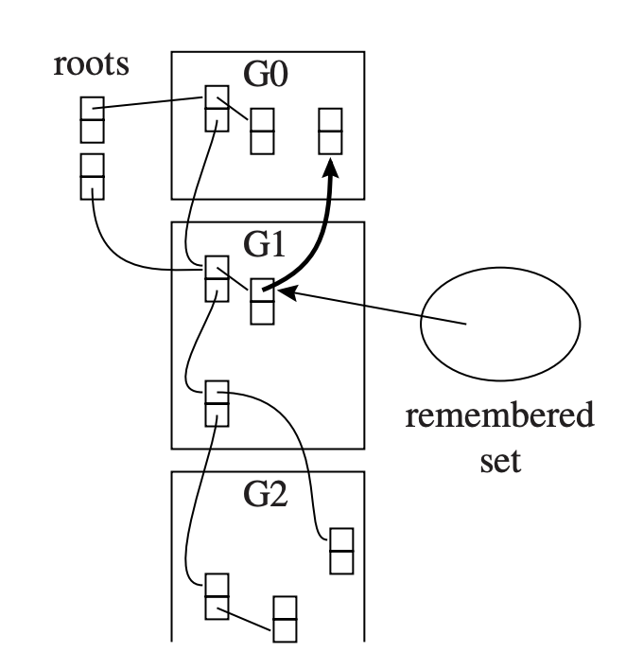
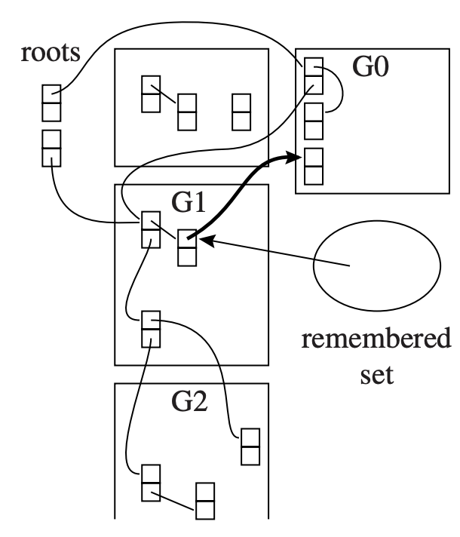
An Example of Remember Set
Remember sets mark all inter-gen references

Slide 45
Ways of Remembering
Card Marking
Divide memory into logical “cards” of size 2^{k} bytes
An object can
occupy part of a card or
start in the middle of one card and continue onto the next
Whenever address b is updated, the card containing that address is marked
There is an array of bytes that serves marks
The byte index can be found by shifting address b right by k bits

Slide 46
Ways of Remembering
Page Marking
Like card marking, but 2^{k} is the page size
Update an object in a page makes the page dirty
User level program can protect each page write-protected after each GC
When a write protect violation occurs, user lever fault handler can record the dirtiness and unprotects the page

Slide 47
Generational Collection
When garbage collection begins
the remembered set tells which objects of the old generation can possibly contain pointers in G₀
After several collections of G₀,
generation G₁ may have accumulated a significant amount of garbage that should be collected
It is better to collect G₀ and G₁ together
Each old generation should be exponentially bigger than the previous one
An object should be promoted from G_{i} to G_{i+1}
When it survives two or three collections of G_{i}

Slide 48
Memory Overhead of Cheney’s Algorithm
Two spaces (From/To) should be used
One of them should be empty (50% overhead)
Solution 1: reducing the size of to-space
More memory is used for allocation
Should be enough for live objects
Solution 2: in-place compaction
Only one space is used

Slide 49
Incremental Collection
Prior collection algorithms require applications to pause
So GC threads can move objects correctly
However, the pause time might be long
Especially for a whole-heap collection (G₁ + G₀)
Undesirable for interactive/real-time programs
That‘s why we need an “incremental” collection

Slide 50
Terminology
Two executors are included:
Collector: collecting the garbage and reclaim memory
Mutator: mutate the graph of reachable data
Incremental and Concurrent collectors
Incremental: the collector operates only when the mutator requests it
Concurrent: the collector operates during any instructions executed by the mutator

Slide 51
Logic Model: Tri-color Records
A record must have one of the following three colors:
White: not visited by GC
Grey: visited by GC, but its children are not
Black: visited by GC, so as its children

Slide 52
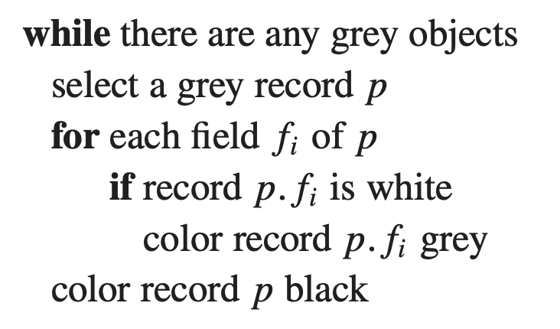
Tricolor Marking: The Basic Model for Marking
Tricolor generalizes the marking phase of GC
All records are white before GC
When a record is visited, marking it grey and examine its (reachable) children
Marking it black, go processing more grey records

Slide 53
Tricolor Marking: The Basic Model for Marking
Tricolor generalizes the marking phase of GC
All records are white before GC
When a record is visited, marking it grey and examine its (reachable) children
Marking it black, go processing more grey records

Slide 54
Tricolor Marking: The Basic Model for Marking
Tricolor generalizes the marking phase of GC
All records are white before GC
When a record is visited, marking it grey and examine its (reachable) children
Marking it black, go processing more grey records

Slide 55
Tricolor Marking: The Basic Model for Marking
Tricolor generalizes the marking phase of GC
All records are white before GC
When a record is visited, marking it grey and examine its (reachable) children
Marking it black, go processing more grey records

Slide 56
Tricolor Marking: The Basic Model for Marking
Tricolor generalizes the marking phase of GC
All records are white before GC
When a record is visited, marking it grey and examine its (reachable) children
Marking it black, go processing more grey records

Slide 57
Tricolor Marking: The Basic Model for Marking
Tricolor generalizes the marking phase of GC
Different algorithms only have different UDFs during marking
inserting into stack
removing from stack

Slide 58
Invariants of Tricolor Marking
Invariant 1: No black object points to white
This suggests black objects are not completely processed
Invariant 2: Every grey is on the collector’s data structure (stack, queue, etc.)
Or an under-processed object is missing

