Slide 1
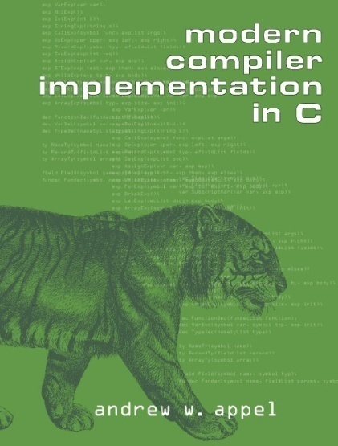
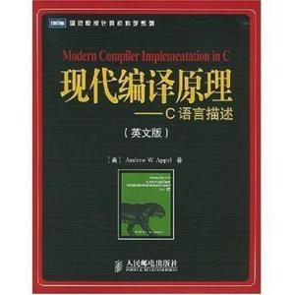
Teaching Staffs
Instructor
臧斌宇、吴明瑜
Email: byzang@sjtu.edu.cn
mingyuwu@sjtu.edu.cn
phone: 13917124245 18817556042
Teaching Assistants
王祖来、斯金哲
Website
ipads.se.sjtu.edu.cn/courses/compilers
Text book
Modern Compiler Implementation in C
Andrew W. Appel

Slide 2
Grade
There are 6 labs
The only homework
60% total
The final due date is end of this semester
The are two quizzes
20% each
The first quiz contains the first five chapters
The second one contains the rest

Slide 3
What are Compilers

Slide 4
Outline
The basic structure of compilers
The input of compilers
The output of compilers
A variety of compiler structures
How a compiler is developed

Slide 5
The basic structure of compilers
Source Program
Target Program
compiler
Error message

Slide 6
Sources languages
Usually, high level programming languages
Fortran, Algo, Pascal, C
Lisp, ML
Prolog
Java, Python
Sometimes, others
Verilog, lex languages, …

Slide 7
Target languages
Usually, machine languages
Assembly languages
Binary languages
Sometimes, others
High level programming languages

Slide 8
A Variety of Compiler structures
There are many source and target languages
There are several kinds of compiler structures
Single pass, multi-pass, load-and-go,
debugging,
optimizing
The basic tasks are essentially the same
The basic techniques are the same

Slide 9
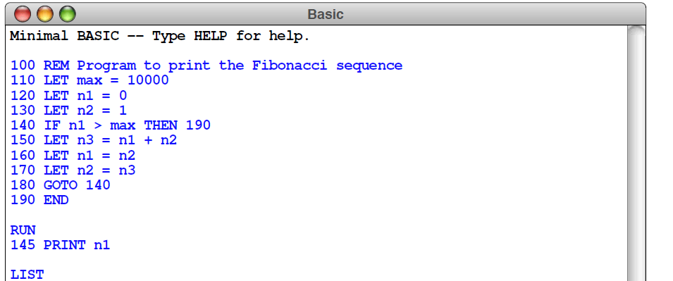
Mini-Basic Interpreter
Build a minimal BASIC interpreter

Slide 10

History of Compilers
The first compiler was initiated by John Backus in 1953(Speedcoding), and completed in 1957(Fortran)
Since then, a bunch of theories were developed. And a lot of tools were developed according to these theories
In the early 1980s, theories and implementations about traditional compilers go to mature
In the middle 1980s, compiler designers turned to optimization techniques and how to compile modern programming languages
1977 ACM Turing Award

Slide 11
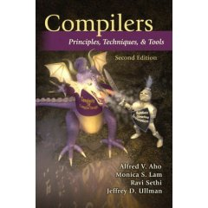
About the text book
There two parts in this book
We study the first part
And part of the second
There is another famous text book
Compilers: Principles, Techniques, and Tools(2nd Ed.)
By Alfred V. Aho, Ravi Sethi, Jeffrey D. Ullman and Monica S. Lam
2006, the "Purple Dragon Book"

Slide 12
A journey to the internal compiler world

Slide 13
Outline
How to define source languages?
How to represent programs internally?
How to translate sources to internals?
How to translate internals to targets?
Tiger langague

Slide 14
A simple language
Straight line
Assign statements
Print statements
Sequence of statements
Form of expressions
Identifies, numbers
Expressions connected by operators such as
+, -, *, /
Expression sequence
(statement, expression)

Slide 15
Example
a := 5 + 3 ; b := (print(a, a-1), 10*a); print (b)
Output
8, 7
80

Slide 16
Syntax Definition for the Source
Regular expression
Used to define alphabet and vocabulary
Will be explained in chapter 2
Context free grammar
Used to define statements and expressions
Will be explained in chapter 3

Slide 17
Syntax Definition for the Source
Alphabet
letter → A | B | … | Z | a | b | … | z
digit → 0 | 1 | … | 9
Vocabulary
id → letter ( letter | digit )*
num → digit digit*
Delimiter
White space, newline, tab

Slide 18
Syntax Definition for the Source
Statement
Stm → Stm; Stm (CompoundStm)
Stm → id := Exp (AssignStm)
Stm → print(ExpList) (PrintStm)
Exp
Exp → id (IdExp)
Exp → num (NumExp)
Exp → Exp Binop Exp (OpExp)
Exp → (Stm, Exp) (EseqExp)

Slide 19
Syntax Definition for the Source
ExpList
ExpList → Exp, ExpList (PairExpList)
ExpList → Exp (LastExp)
Binop
Binop → + (Plus)
Binop → - (Minus)
Binop → * (Times)
Binop → / (Div)

Slide 20
Context-free Grammar
A set of tokens
terminal symbol
A set of nonterminals
A set of productions, where each production consists of
a nonterminal
the left side of the production
an arrow
a sequence of tokens and/or nonterminals
the right side of the production

Slide 21
Context-free Grammar
A designation of one of the nonterminals as the start symbol
Example
stm → id := expr
Right side
Left side
token
nonterminal

Slide 22
Context-free Grammar
Group the productions
Productions with the same nonterminal on the left
Their right sides can be grouped
with the alternative right sides separated by the symbol “|”
read “or”

Slide 23
Syntax Definition for the Source
Statement
Stm → Stm; Stm (CompoundStm)
| id := Exp (AssignStm)
| print(ExpList) (PrintStm)
Exp
Exp → id (IdExp)
| num (NumExp)
| Exp Binop Exp (OpExp)
| (Stm, Exp) (EseqExp)

Slide 24
Syntax Definition for the Source
ExpList
ExpList → Exp, ExpList (PairExpList)
| Exp (LastExp)
Binop
Binop → + (Plus)
| - (Minus)
| * (Times)
| / (Div)

Slide 25
Outline
How to define source languages?
Regular Expressions and Context free grammars
How to represent programs internally?
How to translate sources to internals?
How to translate internals to targets?
Tiger language

Slide 26
Basic Structures of Compilers
Analysis(解析)
From source programs to intermediate representations
Synthesis(合并)
From intermediate representations to target programs
Analysis
Synthesis
source
IR
target
IR Tree

Slide 27
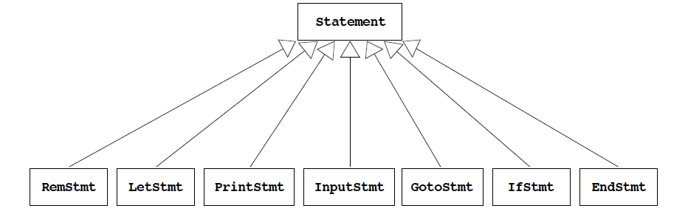
Mini-Basic Interpreter

Slide 28
a := 5 + 3 ; b := (print(a, a-1), 10*a); print (b)
CompoundStm
AssignStm
CompoundStm
a
OpExp
AssignStm
PrintStm
b
LastExpList
EseqExp
NumExp
plus
NumExp
printStm
IdExp
OpExp
5
3
PairExpList
b
NumExp
Times
idExp
a
LastExpList
10
a
OpExp
IdExp
Minus
NumExp
a
1

Slide 29
Tree Languages
Statement
Stm → Stm; Stm (CompoundStm)
| id := Exp (AssignStm)
| print(ExpList) (PrintStm)
CompoundStm
AssignStm
PrintStm
b
LastExpList
EseqExp
printStm
OpExp
PairExpList

Slide 30
Exp → id (IdExp)
| num (NumExp)
| Exp Binop Exp (OpExp)
| (Stm, Exp) (EseqExp)
ExpList → Exp, ExpList (PairExpList)
| Exp (LastExp)
Binop → + (Plus)
| - (Minus)
| * (Times)
| / (Div)
EseqExp
printStm
OpExp
PairExpList
NumExp
Times
IdExp
a
LastExpList
10
a
OpExp
IdExp
Minus
NumExp
a
1

Slide 31
Tree Data Structures
typedef struct A_stm_ *A_stm ;
typedef struct A_exp_ *A_exp ;
typedef struct A_expList_ *A_expList ;
typedef enum {
A_plus, A_minus, A_times, A_div
} A_binop ;

Slide 32
Tree Data Structures
struct A_stm_ {
enum { A_CompoundStm, A_assignStm, A_printStm } kind;
union {
struct {A_stm stm1; A_stm stm2; } compound ;
struct {string id; A_exp exp; } assign ;
struct {A_expList exps; } print ;
} u ;
} ;
C中没有类的概念，使用
union来起相同作用，回忆
ICS中的union，用的是
同一块内存空间。
CompoundStm
AssignStm
PrintStm
b
LastExpList
EseqExp

Slide 33
Tree Data Structures
struct A_stm_ {
enum { A_CompoundStm, A_assignStm, A_printStm } kind;
union {
struct {A_stm stm1; A_stm stm2; } compound ;
struct {string id; A_exp exp; } assign ;
struct {A_expList exps; } print ;
} u ;
} ;
A_stm A_CompoundStm (A_stm, A_stm) ;
A_stm A_AssignStm (string, A_exp);
A_stm A_PrintStmt (A_expList) ;

Slide 34
Tree Data Structures
struct A_exp_ {
enum { A_idExp, A_numExp, A_opExp, A_eseqExp } kind;
union {
string id ;
int num ;
struct {A_exp left; A_binop oper; A_exp right;} op ;
struct {A_stm stm; A_exp exp; } eseq ;
} u ;
} ;
EseqExp
IdExp
NumExp
OpExp
printStm
OpExp
a
10
NumExp
Times
IdExp

Slide 35
Tree Data Structures
struct A_exp_ {
enum { A_idExp, A_numExp, A_opExp, A_eseqExp } kind;
union {
string id ;
int num ;
struct {A_exp left; A_binop oper; A_exp right;} op ;
struct {A_stm stm; A_exp exp; } eseq ;
} u ;
} ;
A_exp A_IdExp (A_stm, A_stm) ;
A_exp A_NumExp (string, A_exp);
A_exp A_OpExp (A_expList);
A_exp A_EseqExp (A_stm, A_exp);

Slide 36
Tree Data Structures
struct A_expList_ {
enum { A_pairExpList, A_lastExp} kind;
union {
struct {A_exp head; A_expList tail; } pair ;
A_exp last ;
} u ;
} ;
A_stm A_CompoundStm (A_stm stm1, A_stm stm2) {
A_stm s = checked_malloc(sizeof(*s)) ;
s->kind = A_compoundStm ;
s->u.compound.stm1=stm1; s->u.compound.stm2=stm2;
return s ;
}
PairExpList
a
LastExpList
OpExp

Slide 37
Assignment
e.g.print((print(1, 2, 3), 3), 4),的maxArgs结果是3，逻辑是：maxArgs=max(exps->maxArgs(),
exps->NumExps()(exp个数)).
1. Write a function int maxargs(A_stm)
Tells the maximum number of arguments of any print statement within any subexpression of a given statement
Remember print statements can contain expressions that contain other statements
2. Write a function void interp(A_stm)
Interprets a program in this language
Make two mutually recursive functions interpStm and interpExp

Slide 38
Environments (symbol tables)
Represent a “table” as a list of id × int pairs
mapping identifiers to the integer values
typedef struct table *Table_;
struct table { string id; int value; Table_ tail};
Table_ Table(string id, int value, struct table *tail) {
Table_ t = malloc(sizeof(*t));
t->id=id; t->value=value; t->tail=tail;
return t;
}
Table_ update(Table_ t, string id, int value);
int lookup(Table_ t, string key);
是一个存储各个变量以及
对应数值的一个map。用
类似于list的格式连接

Slide 39
Straight-line program interpreter
Input
Write hardcoded programs by directly invoking constructors
No side effect
Denotational semantics, attribute grammar
{a |-> 3, c|->4},
Changing c to 7
{a|->3, c|->7}
a | 3
c | 4
c | 7
a | 3
c | 4
当修改变量值时，不会修改原有节点，而是插入新的数值对应的节点，并且每次都是从header开始遍历，所以不会出现数值错误
每次在原链表的头部插入新的节点(偷插)。

Slide 40
Straight-line program interpreter
Execution
Traverse the tree
evaluate each subtrees and then the tree itself
Table_ interpStm(A_stm s, Table_ t)
The result is a table
final values of each identifier
struct IntAndTable {int i; Table_ t};
struct IntAndTable interpExp(A_exp e, Table_ t);
The result is a table
For side effects
and the value of the expression itself

Slide 41
Naming Rules and Modularity Principles
A_stm
A_CompoundStm (A_stm stm1, A_stm stm2)
Each module (header file) shall have a prefix unique to that module
lowercase
uppercase

Slide 42
Outline
How to define source languages?
How to represent programs internally?
Abstract syntax tree and environment (tables)
How to translate sources to internals?
How to translate internals to targets?
Tiger language

Slide 43
Front end
scanner
parser
source
token
IR
errors

Slide 44
Front end
Responsibilities:
recognize legal procedure
report errors
produce IR
preliminary storage map
shape the code for the back end
Much of front end construction can be automated

Slide 45
Scanner(词法分析)
Maps characters into tokens
the basic unit of syntax
a := a - 1 becomes
<id, a>; <:=, >; <id, a>; <-, >; <num, 1>
A lexeme is (an instance of the token)
a value for a token : character string, integer
typical tokens: numb, id, +, -, ……
Eliminates white space (tabs, blanks, comments)
Simplify the parser

Slide 46
Parser
Parser
recognize context-free syntax
guide context-sensitive analysis
construct IR
produce meaningful error messages
attempt error correction
Parser generators mechanize much of the work

Slide 47
Outline
How to define source languages?
How to represent programs internally?
How to translate sources to internals?
Scanner and parser
How to translate internals to targets?
Tiger language

Slide 48
Back End
Responsibilities
translate IR into target machine code
choose instructions for each IR operation
decide what to keep in registers at each point
ensure conformance with system interfaces
Automation has been less successful here

Slide 49
Three pass compilers
target
source
Analysis
HIR
Synthesis
LIR
Code Gen
errors
Analyzes and generates HIR close to source
translates HIR to LIR close to target
Emits target from LIR

Slide 50
Optimizer
Token
Lexical
analysis
Source
Analyzes and changes IR
The goal is to reduce runtime
Optimizer must preserve values
Parsing
IR
Code
Gen.
Optimization
target

Slide 51
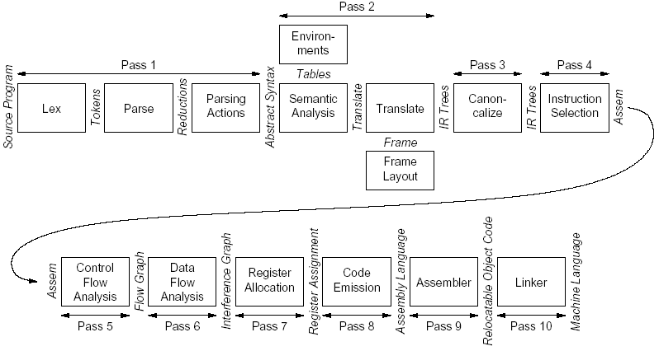

Slide 52
Outline
How to define source languages?
How to represent programs internally?
How to translate sources to internals?
How to translate internals to targets?
Multiple passes (translations)
Tiger language
Appendix (Tiger language reference manual)
P518-527

Slide 53
Tiger Language(queens.tig)
let
var N := 8
type intArray = array of int
var row := intArray [N] of 0
var col := intArray [N] of 0
var diag1 := intArray [N+N-1] of 0
var diag2 := intArray [N+N-1] of 0
function printboard() =
( for i:= 0 to N-1
do (for j:= 0 to N-1
do print (if col[i] = j then “0” else “.”) ;
print(“\n”));
print(“\n”))
Buiding type
array
Standard library

Slide 54
Tiger Language(queens.tig)
function try(c: int) =
if c=N
then printboard()
else for r := 0 to N-1
do if row[r] = 0 & diag1[r+c] = 0 & diag2[r+7-c] = 0
then ( row[r] := 1; diag1[r+c] := 1; diag2[r+7-c] :=1 ;
col[c] :=r ;
try(c+1) ;
row[r] :=0; diag1[r+c] :=0; diag2[r+7-c] :=0)
in try(0)
end

Slide 55
Tiger Language(Merge.tig)
let
type any = {any : int} /*type declaration */
var buffer := getchar() /*variable declaration */
function readint(any: any) : int = /*function declaration */
let
var i := 0
function isdigit(s: string) : int =
ord(buffer)>=ord(“0”) & ord(buffer)<=ord(“9”)
in
while buffer=“ “ | buffer=“\n” do buffer := getchar()
any.any := isdigit(buffer);
while isdigit(buffer)
do ( i := i*10+ord(buffer)-ord(“0”); buffer := getchar() )
i
end
Buiding type
Standard library
Nested function

Slide 56
Tiger Language(Merge.tig)
type list = {first: int, rest: list}
……
function printint(i: int) =
let function f(i: int) = =if i > 0
then (f(i/10); print(chr(i - i/10*10+ord(“0”))))
in if i < 0 then (print(“-”); f(-i))
else if ( i > 0 ) then f(i)
else print(“0”)
end
record
Nested function

Slide 57
Tiger Language(Merge.tig)
function printlist(l: list) =
if l=nil then print(“\n”)
else (pintint((l.first); print(“ “); printlist(l.rest))
/* BODY OF MAIN PROGRAM */
in
printlist(merge(readlist(), readlist()))
end

Slide 58
Tiger Language
Mutually recursive types
declared by a consecutive sequence of type declarations. Each recursion cycle must pass through a record or array type.
type tree = {key: int, chidren: treelist}
type treelist = {hd: tree, tl: treelist}
Mutually recursive functions
declared by a sequence of consecutive function declarations
function treeLeaves(t ：tree) : int =
if t = nil then 1
else treelistLeaves(t.children)
function treelistLeaves(L : treelist) : int =
if L = nil then 0
else treeLeaves(L.hd) + treelistLeaves(L.tl)

