Slide 1
Garbage Collection (II)

Slide 2
Review: mark-sweep and reference counting
Mark-sweep
DFS-based marking (graph traversal)
Whole-heap sweeping (free-list management)
Reference counting
Maintaining in-degree for each object
Problem: cycles and performance

Slide 3
Copying Collection
from-space
to-space
from-space
to-space
root
root
next
next
limit
limit

Slide 4
Copying Collection
Split the heap into two parts
from-space, to-space
Without sweep
Copy the reachable nodes from from-space to to-space with a compact way
All the reachable nodes are around the beginning of to-space
The rest part of the to-space are freed
When next reaches the limit
Switch the roles of from-space and to-space

Slide 5
Cheney’s algorithm
function Forward(p) scan ← next ← beginning of to-space
if p is a pointer to from-space then for each root r
if p.f₁ points to to-space then r ← Forward(r)
return p.f₁ while scan < next
else for each field f_{i} at scan
for each field f_{i} of *p scan.f_{i} ← Forward(scan.f_{i})
next.f_{i} ← p.f_{i} scan ← scan + size of record at scan
p.f₁ ← next
next ← next +size of record p
return p->f₁
else
return p
From
To
scan
next

Slide 6
Cheney’s algorithm
function Forward(p) scan ← next ← beginning of to-space
if p is a pointer to from-space then for each root r
if p.f₁ points to to-space then r ← Forward(r)
return p.f₁ while scan < next
else for each field f_{i} at scan
for each field f_{i} of *p scan.f_{i} ← Forward(scan.f_{i})
next.f_{i} ← p.f_{i} scan ← scan + size of record at scan
p.f₁ ← next
next ← next +size of record p
return p->f₁
else
return p
From
To
scan
next

Slide 7
Cheney’s algorithm
function Forward(p) scan ← next ← beginning of to-space
if p is a pointer to from-space then for each root r
if p.f₁ points to to-space then r ← Forward(r)
return p.f₁ while scan < next
else for each field f_{i} at scan
for each field f_{i} of *p scan.f_{i} ← Forward(scan.f_{i})
next.f_{i} ← p.f_{i} scan ← scan + size of record at scan
p.f₁ ← next
next ← next +size of record p
return p->f₁
else
return p
From
To
scan
next

Slide 8
Cheney’s algorithm
function Forward(p) scan ← next ← beginning of to-space
if p is a pointer to from-space then for each root r
if p.f₁ points to to-space then r ← Forward(r)
return p.f₁ while scan < next
else for each field f_{i} at scan
for each field f_{i} of *p scan.f_{i} ← Forward(scan.f_{i})
next.f_{i} ← p.f_{i} scan ← scan + size of record at scan
p.f₁ ← next
next ← next +size of record p
return p->f₁
else
return p
From
To
scan
next

Slide 9
Cheney’s algorithm
Pro
No external stack
No pointer reverse
Con
Poor locality
Irrelevant records are copied together

Slide 10
An Example for Locality
1
1
2
4
5
3
6
7
DFS
2
3
BFS
1
2
3
4
5
6
7
4
5
6
7

Slide 11
Semi-depth-first algorithm
function Forward(p)
if p points to from-space then
if p.f₁ points to to-space then
return p.f₁
else
chase(p)
return p.f₁
else
return p

Slide 12
Semi-depth-first algorithm
function Chase(p)
repeat
q ← next
next ← next + size of record p
r ← nil
for each field f_{i} of record p
q.f_{i} ← p.f_{i}
if q.f_{i} points to from-space and q.f_{i}.f₁ does not points to to-space then
r ← q.f_{i}
p.f₁ ← q
p ← r
until p = nil

Slide 13
Semi-depth-first algorithm
function Chase(p)
repeat
q ← next
next ← next + size of record p
r ← nil
for each field f_{i} of record p
q.f_{i} ← p.f_{i}
if q.f_{i} points to from-space and q.f_{i}.f₁ does not points to to-space then
r ← q.f_{i}
p.f₁ ← q
p ← r
until p = nil
p
From
To
scan
q
next

Slide 14
Semi-depth-first algorithm
function Chase(p)
repeat
q ← next
next ← next + size of record p
r ← nil
for each field f_{i} of record p
q.f_{i} ← p.f_{i}
if q.f_{i} points to from-space and q.f_{i}.f₁ does not points to to-space then
r ← q.f_{i}
p.f₁ ← q
p ← r
until p = nil
p
r
From
To
scan
q
next

Slide 15
Semi-depth-first algorithm
function Chase(p)
repeat
q ← next
next ← next + size of record p
r ← nil
for each field f_{i} of record p
q.f_{i} ← p.f_{i}
if q.f_{i} points to from-space and q.f_{i}.f₁ does not points to to-space then
r ← q.f_{i}
p.f₁ ← q
p ← r
until p = nil
p
r
From
To
scan
q
next

Slide 16
Semi-depth-first algorithm
function Chase(p)
repeat
q ← next
next ← next + size of record p
r ← nil
for each field f_{i} of record p
q.f_{i} ← p.f_{i}
if q.f_{i} points to from-space and q.f_{i}.f₁ does not points to to-space then
r ← q.f_{i}
p.f₁ ← q
p ← r
until p = nil
p
r
From
To
scan
q
next

Slide 17
Semi-depth-first algorithm
function Chase(p)
repeat
q ← next
next ← next + size of record p
r ← nil
for each field f_{i} of record p
q.f_{i} ← p.f_{i}
if q.f_{i} points to from-space and q.f_{i}.f₁ does not points to to-space then
r ← q.f_{i}
p.f₁ ← q
p ← r
until p = nil
r
p
From
To
scan
q
next

Slide 18
Semi-depth-first algorithm
function Chase(p)
repeat
q ← next
next ← next + size of record p
r ← nil
for each field f_{i} of record p
q.f_{i} ← p.f_{i}
if q.f_{i} points to from-space and q.f_{i}.f₁ does not points to to-space then
r ← q.f_{i}
p.f₁ ← q
p ← r
until p = nil
p
From
To
nil
r
scan
q
next

Slide 19
Semi-depth-first algorithm
function Chase(p)
repeat
q ← next
next ← next + size of record p
r ← nil
for each field f_{i} of record p
q.f_{i} ← p.f_{i}
if q.f_{i} points to from-space and q.f_{i}.f₁ does not points to to-space then
r ← q.f_{i}
p.f₁ ← q
p ← r
until p = nil
From
p
To
nil
r
scan
q
next

Slide 20
What is the Order for Semi-DFS?
1
1
2
4
5
3
6
7
DFS
2
3
BFS
1
2
3
4
5
6
7
4
5
6
7
Semi-DFS

Slide 21
What is the Order for Semi-DFS?
1
1
2
4
5
3
6
7
DFS
2
3
BFS
1
2
3
4
5
6
7
4
5
6
7
Semi-DFS
1
2
5
3
7
4
6

Slide 22
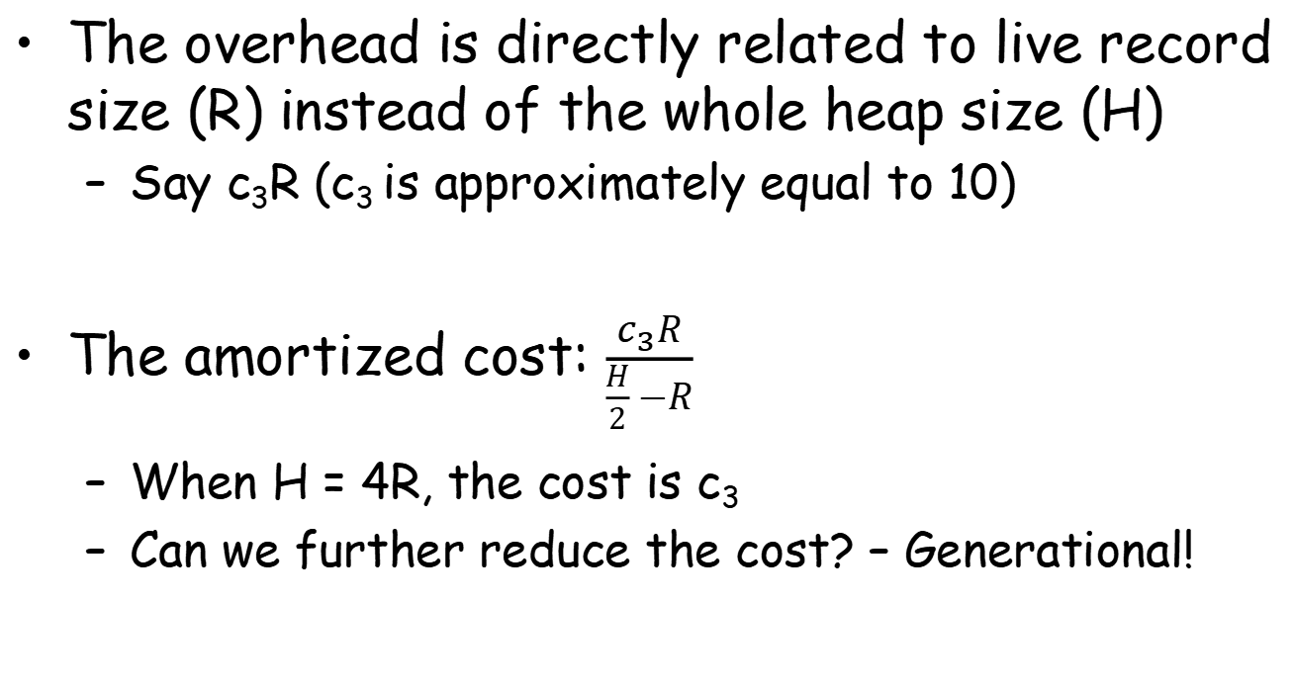
Overhead for Copying Collection
The overhead is directly related to live record size (R) instead of the whole heap size (H)
Say c₃R (c₃ is approximately equal to 10)
The amortized cost: $\frac{c_{3}R}{\frac{H}{2} −R}$
When H = 4R, the cost is c₃
Can we further reduce the cost? – Generational!

Slide 23
Generational Collection
Observations
Newly created objects are likely to die soon
Object will probably survive for more collections if still reachable after many collections
Collector concentrates on “young data”
The heap is divided into generations G₀, G₁, G_{2,} …
The collector just collects G₀
Roots are not just program variables
But also pointers in G₁, G_{2,} … that points to G₀

Slide 24
Generational Collection
It is rare that pointers in G₁, G_{2,} … point to G₀
An object a is created, its fields are created immediately which point to objects b and c which are already created
An object a in old generation whose field points to a younger generation means its field is updated long after it is created (rarely happens)
To avoid all of G₁, G_{2,} … for roots of G₀
Compilers must let the program remember where there are pointers from old objects to new ones

Slide 25
Ways of Remembering
Remembered List
After each update store of the form b.f ← a
Put b into a vector updated objects
Remembered Set
Like remembered lists, but uses a bit within object b to record that b is already in the vector
To avoid duplicate references to b in the vector

Slide 26
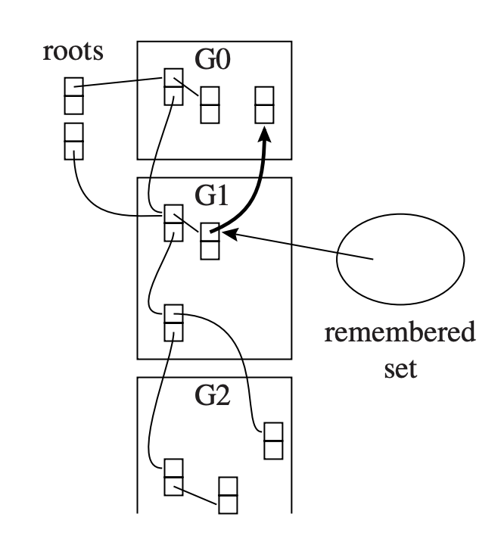
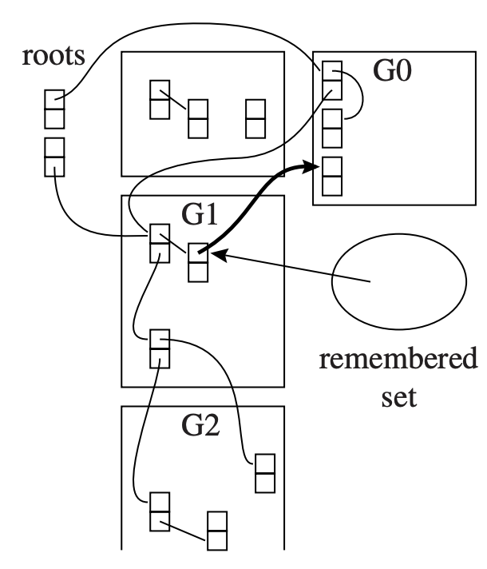
An Example of Remember Set
Remember sets mark all inter-gen references

Slide 27
Ways of Remembering
Card Marking
Divide memory into logical “cards” of size 2^{k} bytes
An object can
occupy part of a card or
start in the middle of one card and continue onto the next
Whenever address b is updated, the card containing that address is marked
There is an array of bytes that serves marks
The byte index can be found by shifting address b right by k bits

Slide 28
Ways of Remembering
Page Marking
Like card marking, but 2^{k} is the page size
Update an object in a page makes the page dirty
User level program can mark each page write-protected after each GC
When a write-protect violation occurs, user-level fault handlers can record the dirtiness and unprotects the page

Slide 29
Generational Collection
When garbage collection begins
The remembered set tells which objects of the old generation can possibly contain pointers in G₀
After several collections of G₀:
Generation G₁ may have accumulated a significant amount of garbage that should be collected
It is better to collect G₀ and G₁ together

Slide 30
Generational Collection
When garbage collection begins
After several collections of G₀:
Each old generation should be exponentially bigger than the previous one
An object should be promoted from G_{i} to G_{i+1}
When it survives two or three collections of G_{i}

Slide 31
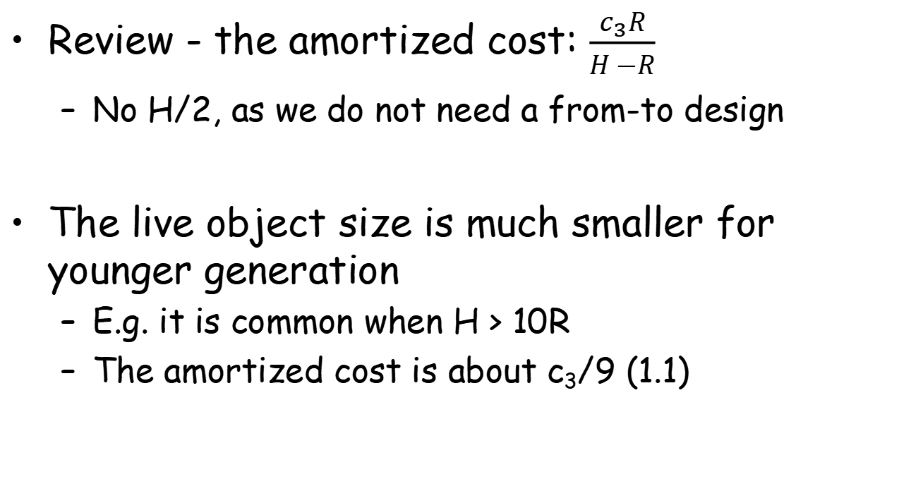
Cost of Generational Collection
Review - the amortized cost: $\frac{c_{3}R}{H −R}$
No H/2, as we do not need a from-to design
The live object size is much smaller for younger generation
E.g. it is common when H > 10R
The amortized cost is about c₃/9 (1.1)

Slide 32
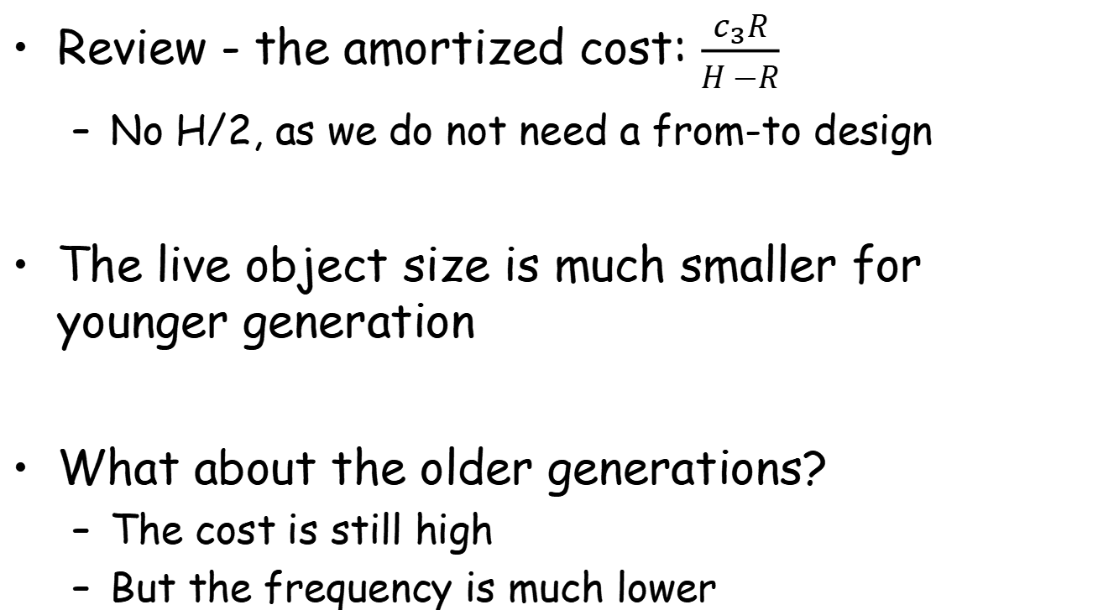
Cost of Generational Collection
Review - the amortized cost: $\frac{c_{3}R}{H −R}$
No H/2, as we do not need a from-to design
The live object size is much smaller for younger generation
What about the older generations?
The cost is still high
But the frequency is much lower

Slide 33
Incremental Collection

Slide 34
Incremental Collection
Prior collection algorithms require applications to pause
So GC threads can move objects correctly
However, the pause time might be long
Especially for a whole-heap collection (G₁ + G₀)
Undesirable for interactive/real-time programs
That‘s why we need an “incremental” collection

Slide 35
Terminology
Two kinds of executors are included:
Collector: collecting the garbage and reclaim memory
Mutator: mutate the graph of reachable data
Incremental and Concurrent collectors
Incremental: the collector operates only when the mutator requests it
Concurrent: the collector operates during any instructions executed by the mutator

Slide 36
Logical Model: Tri-color Records
A record must have one of the following three colors:
White: not visited by GC
Grey: visited by GC, but its children are not
Black: visited by GC, so as its children

Slide 37
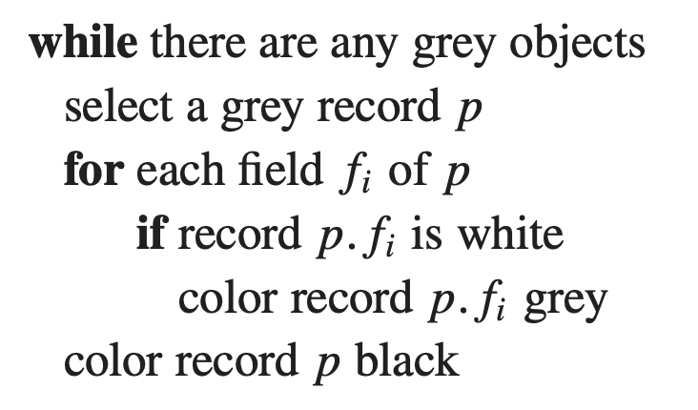
Tricolor Marking: The Basic Model for Marking
Tricolor generalizes the marking phase of GC
All records are white before GC
When a record is visited, marking it grey and examine its (reachable) children
Marking it black, go processing more grey records

Slide 38
Tricolor Marking: The Basic Model for Marking
Tricolor generalizes the marking phase of GC
All records are white before GC
When a record is visited, marking it grey and examine its (reachable) children
Marking it black, go processing more grey records

Slide 39
Tricolor Marking: The Basic Model for Marking
Tricolor generalizes the marking phase of GC
All records are white before GC
When a record is visited, marking it grey and examine its (reachable) children
Marking it black, go processing more grey records

Slide 40
Tricolor Marking: The Basic Model for Marking
Tricolor generalizes the marking phase of GC
All records are white before GC
When a record is visited, marking it grey and examine its (reachable) children
Marking it black, go processing more grey records

Slide 41
Tricolor Marking: The Basic Model for Marking
Tricolor generalizes the marking phase of GC
All records are white before GC
When a record is visited, marking it grey and examine its (reachable) children
Marking it black, go processing more grey records

Slide 42
Tricolor Marking: The Basic Model for Marking
Tricolor generalizes the marking phase of GC
Different algorithms only have different UDFs during marking
inserting into stack
removing from stack

Slide 43
Invariants of Tricolor Marking
Invariant 1: No black object points to white
This suggests black objects are not completely processed
Invariant 2: Every grey is on the collector’s data structure (stack, queue, etc.)
Or an under-processed object is missing

Slide 44
Incremental Ways to Preserve Invariants
Basic idea: instrumenting read or write operations (or known as barriers)
Method 1 (Dijkstra, Lamport et al.)
When storing a white pointer a into a black object b, coloring a grey
b
a
b
a

Slide 45
Incremental Ways to Preserve Invariants
Basic idea: instrumenting read or write operations (or known as barriers)
Method 2 (Steele)
When storing a white pointer a into a black object b, coloring b grey
b
a
b
a

Slide 46
Incremental Ways to Preserve Invariants
Basic idea: instrumenting read or write operations (or known as barriers)
Method 3 (Boehm, Demers, Shenker)
Marking black pages as read-only. Page faults mark objects grey and the page writable
b
a
b
a

Slide 47
Incremental Ways to Preserve Invariants
Basic idea: instrumenting read or write operations (or known as barriers)
Method 4 (Baker)
When reading a pointer b to a white object, coloring b grey
A mutator can never have a pointer to white objects
b
b

Slide 48
Incremental Ways to Preserve Invariants
Basic idea: instrumenting read or write operations (or known as barriers)
Method 5 (Appel, Ellis, Li)
When reading a pointer b to a non-black object, a page fault is triggered
A mutator can never have a pointer to non-black objects
b
b

Slide 49
Baker’s Algorithm
An incremental collection algorithm atop Cheney’s
Review: Cheney’s copying algorithm
Dual spaces (from/to), copy-based, forward pointers
scan ← next ← beginning of to-space
for each root r
r ← Forward(r)
while scan < next
for each field f_{i} at scan
scan.f_{i} ← Forward(scan.f_{i})
scan ← scan + size of record at scan

Slide 50
Baker’s Algorithm
An incremental collection algorithm atop Cheney’s
Single threaded: one thread for both application and GC
Do some GC work when allocation happens
allocation-done
application
collection
allocation

Slide 51
Baker’s Algorithm: Triggering
The heap still contains from/to spaces
From space: served for allocation
To space: served for copy destination
Collection starts when from space is full
Detected by an allocation request
From
root
To

Slide 52
Step 1: Flipping
The role of from/to space switches
The original to-space now accepts new objects
To
root
From
scan/next
limit

Slide 53
Step 1: Flipping
The role of from/to space switches
The original to-space now accepts new objects
Forwarding all roots
Copying the referred object to the new space
Do not forget the forwarding pointer
To
root
From
scan
next
limit

Slide 54
Step 2: Allocation during GC
Objects are allocated from the bottom
Allocating by minus the limit pointer
New objects do not need special handling
They have not created any useful references
Can treat them black
To
root
From
scan
next
limit

Slide 55
Step 3: Incremental Scanning
Still scanning objects, but not all
If allocating N bytes, then scanning at least N bytes to catch up with allocation
To
root
From
scan
next
limit

Slide 56
Step 3: Incremental Scanning
Still scanning objects, but not all
If allocating N bytes, then scanning at least N bytes to catch up with allocation
Copy more objects to the new space
Also: remember the forwarding pointer
To
root
From
scan
next
limit

Slide 57
Step 4: Loading References
Mutators create new roots by loading a reference
Invariant: no reference should be pointed to To-space!
Detected by instrumenting read instructions
To
root
From
scan
next
limit

Slide 58
Step 4: Loading References
Mutators create new roots by loading a reference
Invariant: no reference should be pointed to To-space!
Detected by instrumenting read instructions
Solution: forwarding immediately
To
root
From
scan
next
limit

Slide 59
Step 4: Loading References
Mutators create new roots by loading a reference
Invariant: no reference should be pointed to To-space!
Another case: the reference already has a newer object
To
root
From
scan
next
limit

Slide 60
Step 4: Loading References
Mutators create new roots by loading a reference
Invariant: no reference should be pointed to To-space!
Another case: the reference already has a newer object
Solution: direct forwarding (with the pointer)
To
root
From
scan
next
limit

Slide 61
When does It Finish?
When scan finally reaches next
Triggered again when the from space is full
Can collection catches up with allocation?
Yes when R < H/4
The live size is smaller than the half of from-space
When finished, allocation is also smaller than H/4
To
root
From
scan/next
limit

Slide 62
Pros and Cons for Incremental Collection
Pros: low latency
Avoid a large number of copied objects at a time
Suitable for interactive/real-time applications
Cons: large performance overhead
For Baker’s: adding two operations for each read
One for compare, one for jump
The overhead can be more than 20%
Does not consider issues like locality

Slide 63
Some Words on Concurrent Collection
The algorithms are nearly the same
Read/write instrumentation (barriers)
But synchronizations are required
A simple example to violate the invariant
Collector: finish scanning all references of a
Mutator: add a reference to white object b
Collector: color a black
A black -> white reference occurs!
collector
mutator

Slide 64
Some Words on Concurrent Collection
The algorithms are nearly the same
Read/write instrumentation (barriers)
But synchronizations are required
Many methods can be used
Locks/atomic instructions
Virtual memory (page fault)
Other hardware-supported features

