Slide 1
Interface to Compiler (Lab7)

Slide 2
Derived Pointers
Detecting roots might not be enough
We may have pointers to internal structures of record/array
An example: load a[i-2000]
Can be represented as M[a-2000+i]
t₁ is not a pointer to an object
It may point to an integer (for array of int)
GC cannot start from it for traversal
t₁ <- a – 2000
t₂ <- t₁ + i
t₃ <- M[t₂]

Slide 3
Derived Pointers
Detecting roots might not be enough
We may have pointers to internal structures of record/array
An example: load a[i-2000]
Can be represented as M[a-2000+i]
t₁ is not a pointer to an object
But a is (t₁ is derived from a)
t₁ <- a – 2000
t₂ <- t₁ + i
t₃ <- M[t₂]

Slide 4
Handling Derived Pointers
Derived pointers should keep its base alive
Even though its base is no longer reachable
Implementation in Tiger
Marking pointers as “derived” in pointer maps
Maintaining the base for each pointer
rax <- a
rax <- rax – 2000
rcx <- rax + i
rdx <- M[rcx]
a is dead!

Slide 5
Putting It All Together: Lab7
The most difficult part is root marking
Metadata
GC
gc triggering
typeinfo passing
stack scanning
map generation
map searching
root marking

Slide 6
A Little Words on Collection
We do not restrict the algorithm for collection
Sweep and copying are both OK
Marking is a must (no reference counting!)
The result should be exact
i.e., all unreachable objects should be reclaimed

Slide 7
Modern GC in Java: Examples

Slide 8
Parallel Scavenge (PS)
Generation GC
Stop-Copy-Compact
Different algorithms for old/young
Minor GC: From-to copy
Major GC: In-place copy

Slide 9
Heap Layout Overview
Allocation
Young
From
Old
Eden
To

Slide 10
Minor GC
To
Eden
From

Slide 11
Minor GC
To
Eden
Copy!
From

Slide 12
Minor GC
To
Eden
Copy!
From

Slide 13
Minor GC
To
Eden
From

Slide 14
Minor GC
To
Eden
From

Slide 15
Minor GC
Promote (Age > K)
To
Eden
Copy!
Copy!
From

Slide 16
Minor GC
To
Eden
From

Slide 17
Minor GC
To
Eden
swap
From

Slide 18
Minor GC in parallel
Root assignment to GC threads
Copy race
Work-stealing

Slide 19
References tracking
MetaData
T1 stack
T2 stack
Dirty card table (512 bytes)
int a
pointer
obj a
obj b
pointer
pointer
int b
int v
double
double
Worker 1
Worker 2

Slide 20
Concurrent copying
Header
pointer
int
pointer
From
Worker 1
Worker 2
To

Slide 21
Concurrent copying
Step 1: Copy
Header
pointer
int
pointer
From
Worker 1
Worker 2
To

Slide 22
Concurrent copying
Header
pointer
int
pointer
Step 2: Push into queues
From
Worker 1
Worker 2
To

Slide 23
Concurrent copying
Header
pointer
int
pointer
Step 3: Dequeue
From
Worker 1
Worker 2
To

Slide 24
Copy race
Step 1: Copy
Header
pointer
int
pointer
From
Worker 1
Worker 2
To

Slide 25
Copy race
Header
pointer
int
pointer
Step 2: CAS
From
Worker 1
Worker 2
To

Slide 26
Copy race
NewAddr1
pointer
int
pointer
From
Step 3: Clean-up
Worker 1
Worker 2
To

Slide 27
Copy race
NewAddr1
pointer
int
pointer
From
Step 3: Clean-up
Worker 1
Worker 2
To

Slide 28
Work stealing
Worker 1
Worker 2

Slide 29
Work stealing
Worker 1
Worker 2
What if we have many workers?

Slide 30
Full (Major) GC
Marking
Mark all live objects
Summary
Calculate new address for live objects
Compact
Move objects and update references

Slide 31
Marking
Bitmap
Source
A
B
C

Slide 32
Summary
Bitmap
Source
A
B
C
dest
Destination

Slide 33
Summary & compact
Bitmap
Source
A
B
C
dest
Destination

Slide 34
Summary & compact
Bitmap
Source
A
B
C
dest
Destination
A

Slide 35
Summary & compact
Bitmap
Source
A
B
C
dest
Destination
A
B

Slide 36
Summary & compact
Bitmap
Source
A
B
C
dest
Destination
A
B
C
In-place compact: what if the destination is also source?

Slide 37
A Problem of PS: Inflexible
Spaces are contiguous
Hard to split/adjust/reorganize
The time difference between old/young GC is too large
Minor GC (4GB): ~100ms
Major GC (16GB): >1s
Young
Old

Slide 38
Heap Structure: from Spaces to Regions
Using smaller, segregated regions to form spaces
Also including young and old spaces

Slide 39
Heap Structure: from Spaces to Regions
Using smaller, segregated regions to form spaces
Also including young and old spaces
Easy to enlarge/shrink

Slide 40
Heap Structure: from Spaces to Regions
Using smaller, segregated regions to form spaces
Also including young and old spaces
Easy to enlarge/shrink
Collection set: including all regions to be collected

Slide 41
Fixing the Time Difference
Adding a middleground between old and young
Named mixed GC
Collecting young space and a part of old space
Young space
Young + a part of old
Young + Old
Minor GC (10ms)
Mixed GC (50ms)
Major GC (200ms)

Slide 42
Fixing the Time Difference
Adding a middleground between old and young
Named mixed GC
Mixed GC is highly adjustable to meet demands
Soft Limit (30ms)
Young space
Young + a small part of old
Young + Old
Minor GC (10ms)
Mixed GC (30ms)
Major GC (200ms)

Slide 43
How to Adjust the Pause Time?
Adjusting the collection set!
Including less regions for each collection
Adding old regions according to their estimated collection time
Until reaching the preset limit
10ms to collect
20ms
to collect
Problem: which regions to collect?
15 ms
to collect

Slide 44
Solution: Concurrent Marking
Before pausing for collection, mark live objects concurrently
How to handle concurrent update?
Mutators: writing into logs
Marking threads: periodically consuming the logs

Slide 45
Live Data Profiling
After marking, count per-region live data size
Choose regions with the least live data for collection
live data: 0%
live data: 2%
live data: 3%

Slide 46
How to Collect Selected Regions Only?
Young regions: card tables
Memorizing old-to-young references
Old regions: remembered sets
Memorizing all inter-region references
Maintained by write barriers
region
RSet

Slide 47
Putting it All Together: Garbage First (G1)
The default collector in OpenJDK (LTS)
Region-based heap organization
Soft limit (MaxGCPauseMillis)
Concurrent marking for mixed GC
Choosing regions with the most garbage
Namely Garbage First (G1)
G1’s problem: adjustable but has limit
The collection part still causes 10-100ms pauses

Slide 48
Functional Programming Languages

Slide 49
INTRO TO FUNCTIONAL PL

Slide 50
Functions: Back to Mathematics
A function is a fixed mapping from one element to another
If f(x) = a, then f(x) is always a
Also named “equational reasoning”
However, functions in imperative programming is not like this
If f(x) = a this time, f(x) can be b next time
The function can have so-called “side-effect”

Slide 51
Higher-order functions: function-as-a-argument
Functional languages allow passing functions as arguments or return values
Functions taking functional arguments are called higher-order functions
Higher-order functions are more interesting if a language supports nested functions (like Tiger)
A higher-order functional language supports those features

Slide 52
What is the essence of functional programming?
Equational reasoning or higher-order functions?
No clear agreement about the answer
Functional programming can be in different flavors
Fun-Tiger: Tiger + higher-order functions
PureFun-Tiger: Fun-Tiger + no-side-effect
Lazy-Tiger: Fun-Tiger + lazy evaluation

Slide 53
Grammar rules for Fun-Tiger
First add function types to Tiger
“arrows” are markers for function types
Left: parameters; right: return value
The arrow operator is right-associative
What do the following types mean?
int -> int
int -> int -> int
(int -> int) -> int -> int
ty ty->ty (single parameter)
(ty {, ty}) -> ty (multiple parameters)
() -> ty (no parameter)

Slide 54
Grammar rules for Fun-Tiger
The CALL expression should also be extended
Original: only ID (name) can be used for calling
Now: arbitrary expressions (examples later)
What if expressions are not functions? (solved by semantic analysis)
originally ID
exp -> exp (exp {, exp})
exp -> exp ()

Slide 55
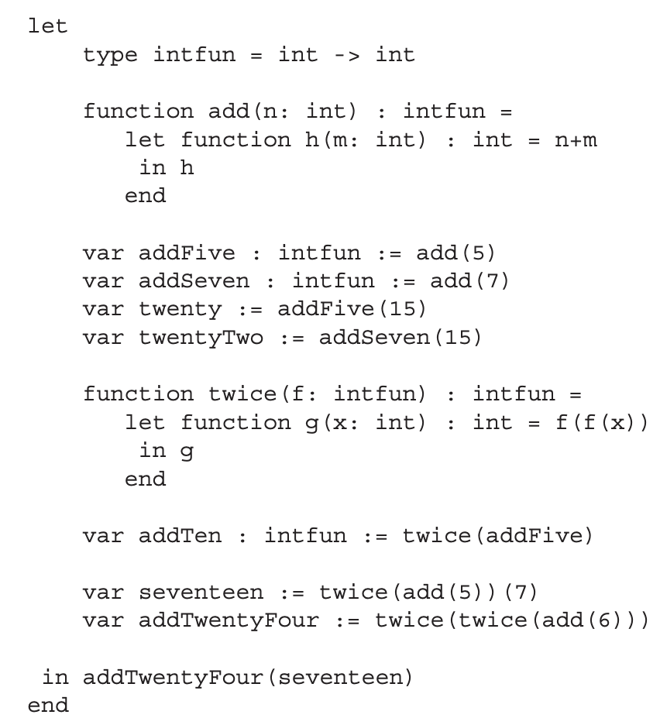
An example for Fun-Tiger
Type declaration:
accept int, return int

Slide 56
An example for Fun-Tiger
Func declaration:
accept int, return an intfun (h)

Slide 57
An example for Fun-Tiger
Defining two intfun instances

Slide 58
An example for Fun-Tiger
Using intfun instances to get int

Slide 59
An example for Fun-Tiger
Get an intfun, return an intfun

Slide 60
An example for Fun-Tiger
Type analysis:
f: intfun (int -> int)
f(x): return int
f(f(x): accept int (f(x)), return int

Slide 61
An example for Fun-Tiger
Using the intfun:
actually invoking addFive twice

Slide 62
An example for Fun-Tiger
Using the returned intfun
(5 + 5 + 7)

Slide 63
An example for Fun-Tiger
More complicated…
seventeen: an int value
AddTwentyFour: an intfun
in: an int value

Slide 64
CLOSURES

Slide 65
Why higher-order is more interesting with nested?
Consider a language without nested functions
We can use function pointers
Like C: void (*fun)()
Invocation is achieved by calling to the address
X86: call *%rax
However, it doesn’t work for nested functions
A child function can live beyond the outer ones
How can it access the variables in outer frames?

Slide 66
Back to the previous example
invoking add
Stack frames
main
SL
add
5

Slide 67
Back to the previous example
Stack frames
return from add
main
code for h
h
SL
add
5
The function (h) cannot access the frame anymore

Slide 68
Solution: closure
A closure is a combination including
A pointer to the function code
A way to access the necessary nonlocal variables (also called environment)
In one word: code + data
Closures can be implemented with multiple ways
We still use static link, but with refinements

Slide 69
Heap-allocated activation records
Allocating records to heap, instead of stack
Back to the previous example:
Stack frames
Heap frames
SL
main
add
5
let
type intfun = int -> int
function add(n: int): intfun =
let function h(m: int): int = n+m
in h
end
var addFive: intfun := add(5)
var twenty := addFive(15)
…
in addTwentyFour(seventeen)
add is not destroyed

Slide 70
Heap-allocated activation records
Allocating records to heap, instead of stack
Back to the previous example:
Stack frames
Heap frames
SL
main
add
5
let
type intfun = int -> int
function add(n: int): intfun =
let function h(m: int): int = n+m
in h
end
var addFive: intfun := add(5)
var twenty := addFive(15)
…
in addTwentyFour(seventeen)
SL
addFive
the static link in addFive points to add

Slide 71
Activation record reclamation
Heap-allocated records are not auto-reclaimed
A collector must explicitly reclaim them
But: when to properly reclaim them?
Key insight: the record lives with the function instance
Recall its alias: environment (an empty env is useless)
Stack frames
Heap frames
SL
main
add
5
h

Slide 72
Activation record reclamation
Heap-allocated records are not auto-reclaimed
A collector must explicitly reclaim them
But: when to properly reclaim them?
For addFive: dead after addTen (reclaimable then)
let
type intfun = int -> int
function add(n: int): intfun =
let function h(m: int): int = n+m
in h
end
var addFive: intfun := add(5)
var twenty := addFive(15)
…
var addTen: intfun := twice(addFive)
… // no longer used
in addTwentyFour(seventeen)

Slide 73
Refinement to the heap-allocated technique
The whole stack frame is large
Can we only store necessary information
Question: which variables are necessary?
Answer: escaped variables!
Solution: adding a escaping-variable record for stack frames
The record stores all escaped variables on the heap

Slide 74
An example for refined closures
EP -> escape pointer
Stack frames
Heap records
SL
main’s escape
main
EP
add
SL
add’s escape
5
EP

Slide 75
An example for refined closures
EP -> escape pointer
MC -> machine code
Stack frames
Heap records
SL
main’s escape
main
h
EP
SL
add’s escape
5
EP
h’s closure
MC
h’s machine code

Slide 76
An example for refined closures
EP -> escape pointer
MC -> machine code
Stack frames
Heap records
SL
main’s escape
main
EP
twice
SL
add’s escape
5
EP
SL
twice’s escape
f (h)
EP
h’s closure
MC
h’s machine code

Slide 77
Modifications to the Tiger compiler
Adding EP to the frame structure
All static-link-related operations now rely on EP (not FP)
EP itself is a non-escaping local temporary
Other frames do not directly access it
Formals/locals creation should be modified
Offsets should be based on EP
Escaped variables should be allocated on heap
In procEntryExit1

