Slide 1
Functional Programming Languages

Slide 2
Grammar rules for Fun-Tiger
First add function types to Tiger
“arrows” are markers for function types
Left: parameters; right: return value
The arrow operator is right-associative
What is the following type means?
(int -> int) -> int -> int
ty -> ty->ty (single parameter)
-> (ty {, ty}) -> ty (multiple parameters)
-> () -> ty (no parameter)
含义：指的是一个接收int返回int的函数，接受一个接收int返回int的函数作为最终的参数。

Slide 3
Grammar rules for Fun-Tiger
The CALL expression should also be extended
Original: only ID (name) can be used for calling
Now: arbitrary expressions (examples later)
What if expressions are not functions? (solved by semantic analysis)
originally ID
exp -> exp (exp {, exp})
exp -> exp ()

Slide 4
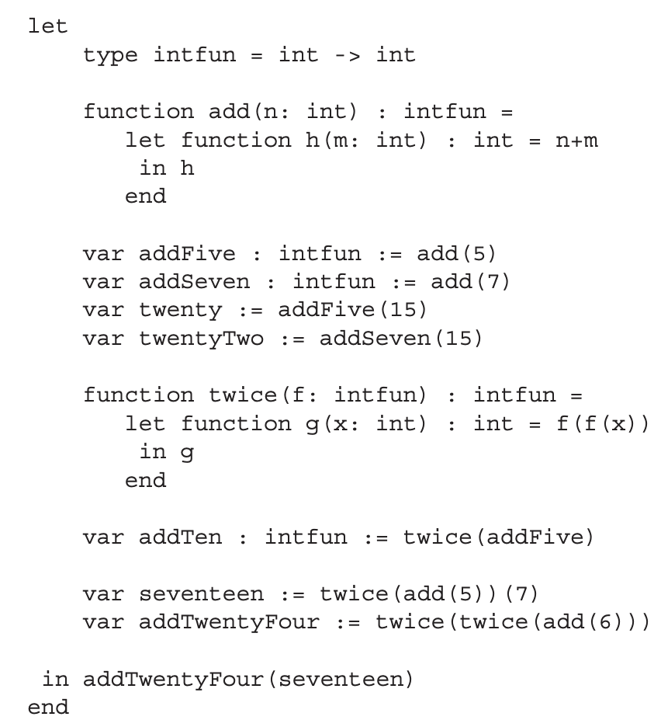
An example for Fun-Tiger
Type declaration:
accept int, return int

Slide 5
An example for Fun-Tiger
Func declaration:
accept int, return h，
h是一个intfun。

Slide 6
An example for Fun-Tiger
Defining two intfun instances
add(5)=m+5
add(7)=m+7

Slide 7
An example for Fun-Tiger
Using intfun instances to get int

Slide 8
An example for Fun-Tiger
Get an intfun, return an intfun

Slide 9
An example for Fun-Tiger
Type analysis:
f: intfun (int -> int)
f(x): return int
f(f(x): accept int (f(x)), return int

Slide 10
An example for Fun-Tiger
Using the intfun:
actually invoking addFive twice
addTen=m+10

Slide 11
An example for Fun-Tiger
Using the returned intfun
(5 + 5 + 7)
twice(add(5))=m+10
m=7,所以结果是17.

Slide 12
An example for Fun-Tiger
twice(twice(add(6)))=m+12+12=m+24
More complicated…
seventeen: an int value
AddTwentyFour: an intfun
in: an int value

Slide 13
CLOSURES(闭包)

Slide 14
Why higher-order is more interesting with nested?
Consider a language without nested functions
We can use function pointers
Like C: void (*fun)()
Invocation is achieved by calling to the address
X86: call *%rax
However, it doesn’t work for nested functions
A child function can live beyond the outer ones
How can it access the variables in outer frames?

Slide 15
Back to the previous example
invoking add
Stack frames
main
SL
add
5

Slide 16
Back to the previous example
Stack frames
return from add
main
code for h
h
SL
add
5
The function (h) cannot access the frame anymore
(也就是说拿不到5这个参数了)

Slide 17
Solution: closure
A closure is a combination including
A pointer to the function code(指向的是分配在heap上面的frame)
A way to access the necessary non-local variables(指的是获取那些被存储在heap frame的非local变量) (also called environment)
In one word: code + data
Closures can be implemented with multiple ways
We still use static link, but with refinements

Slide 18
Heap-allocated activation records
Allocating records to heap, instead of stack
Back to the previous example:
Stack frames
Heap frames
SL
main
add
5
let
type intfun = int -> int
function add(n: int): intfun =
let function h(m: int): int = n+m
in h
end
var addFive: intfun := add(5)
var twenty := addFive(15)
…
in addTwentyFour(seventeen)
add is not destroyed

Slide 19
Heap-allocated activation records
Allocating records to heap, instead of stack
Back to the previous example:
Stack frames
Heap frames
SL
main
add
5
let
type intfun = int -> int
function add(n: int): intfun =
let function h(m: int): int = n+m
in h
end
var addFive: intfun := add(5)
var twenty := addFive(15)
…
in addTwentyFour(seventeen)
SL
addFive
the static link in addFive points to add

Slide 20
Activation record reclamation
Heap-allocated records are not auto-reclaimed
A collector must explicit reclaim them
But: when to properly reclaim them?
Key insight: the record lives with the function instance
Recall its alias: environment (together with an item)
Stack frames
Heap frames
SL
main
add
5
h

Slide 21
Activation record reclamation
Heap-allocated records are not auto-reclaimed
A collector must explicit reclaim(回收) them
But: when to properly reclaim them?
For addFive: dead after addTen (reclaimable then)
let
type intfun = int -> int
function add(n: int): intfun =
let function h(m: int): int = n+m
in h
end
var addFive: intfun := add(5)
var twenty := addFive(15)
…
var addTen: intfun := twice(addFive)
… // no longer used
in addTwentyFour(seventeen)

Slide 22
Refinement to the heap-allocated technique
The whole stack frame is large
Can we only store necessary information?
Question: which variables are necessary?
Answer: escaped variables!
Solution: adding a escaping-variable record for stack frames
The record stores all escaped variables on the heap
只存储escaped var在heap上面，这样可以节省heap空间，同时，在heap上存储frame的主要目的就是为了解决nested func在内层函数ret之后仍然能访问这个内部函数变量的问题，所以只存储escaped var并不影响正确性。

Slide 23
An example for refined closures
EP -> escape pointer
Stack frames
Heap records
SL
main’s escape
main
EP
add
SL
add’s escape
5
EP

Slide 24
An example for refined closures
EP -> escape pointer
MC -> machine code
Stack frames
Heap records
SL
main’s escape
main
h
EP
SL
add’s escape
5
EP
h’s closure
MC
h’s machine code

Slide 25
An example for refined closures
EP -> escape pointer
MC -> machine code
Stack frames
Heap records
SL
main’s escape
main
EP
twice
SL
add’s escape
5
EP
SL
twice’s escape
f
EP
h’s closure
MC
h’s machine code

Slide 26
Modifications to the Tiger compiler
Adding EP to the frame structure
All static-link-related operations now rely on EP (not FP)
EP itself is a non-escaping local temporary
Other frames do not directly access it
Formals/locals creation should be modified
Offsets should be based on EP
Escaped variables should be allocated on heap
In procEntryExit1

Slide 27
IMMUTABLE VARIABLES

Slide 28
FunTiger is not pure enough
Side effects still exist
A function may return a different value each time
We pursue a pure functional language
A function must return a result WITHOUT changing the “world” in any observable way

Slide 29
FunTiger is not pure enough
In a pure functional PL, the following is prohibited:
Assignments to variables (except for initializations)
Assignments to heap-allocated records
Calls to external functions having visible effects
print, flush, getchar, exit (discussed later)
Isn’t it too restrictive?
What can we do with such a language?

Slide 30
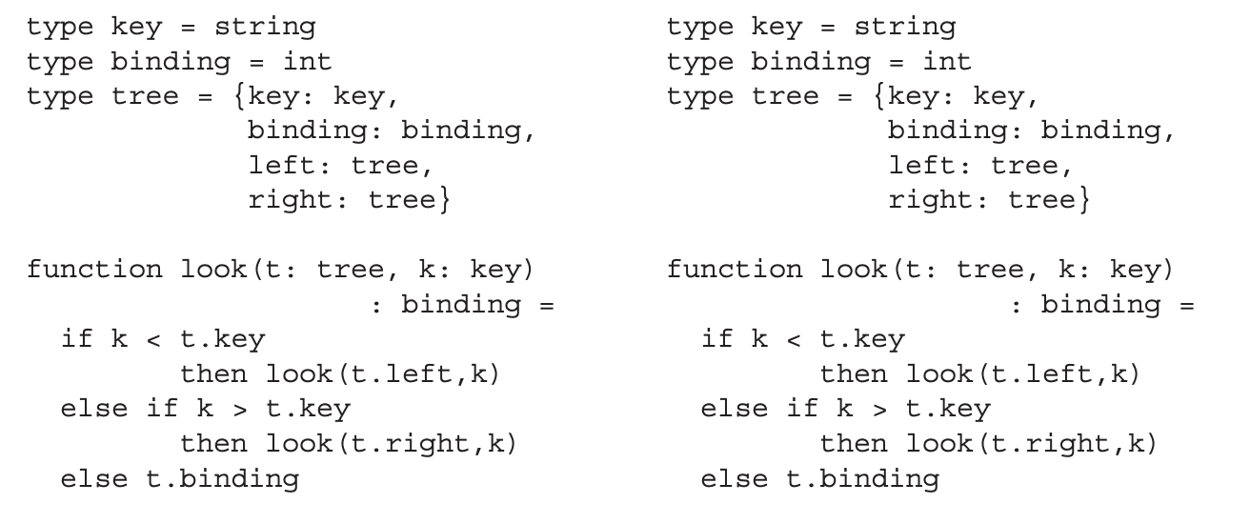
An example: binary search trees (BST)
imperative
functional
This part is the same!

Slide 31
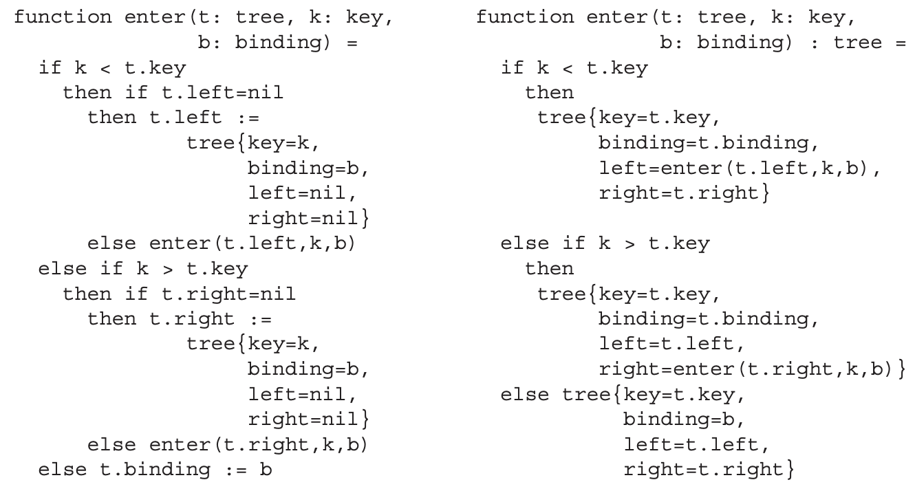
An example: binary search trees (BST)
imperative
functional
direct assignment
reconstruction

Slide 32
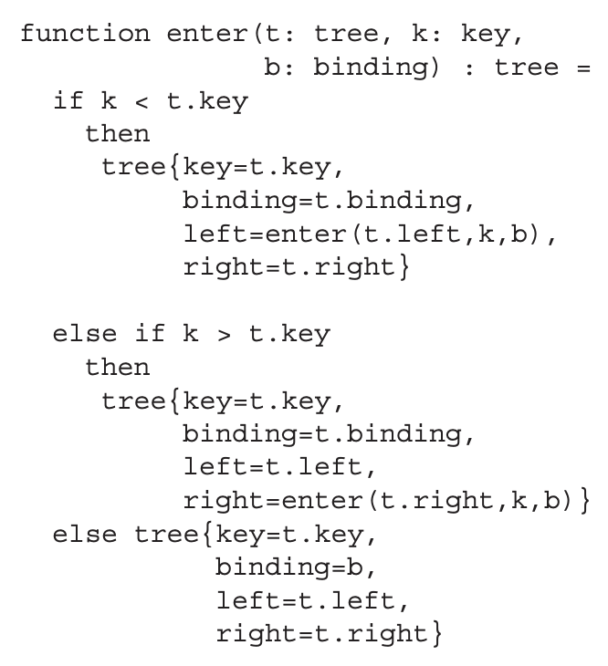
An example for enter in a functional style
enter(t, 11, 0)
origin
returned
12
7
31
3
10

Slide 33
An example for enter in a functional style
enter(t, 11, 0)
11 < 12
origin
returned
12
12
7
31
31
3
10

Slide 34
An example for enter in a functional style
enter(t, 11, 0)
11 > 7
origin
returned
12
12
7
31
7
31
3
10
3

Slide 35
An example for enter in a functional style
enter(t, 11, 0)
11 > 10
origin
returned
12
12
7
31
7
31
3
10
3
10

Slide 36
An example for enter in a functional style
enter(t, 11, 0)
Null
origin
returned
12
12
7
31
7
31
3
10
3
10
11

Slide 37
When enter is returned
origin
returned
12
12
7
31
7
31
3
10
3
10
11
Unused nodes can be deleted
Shared nodes are kept

Slide 38
Recap: the prohibited behaviors
Assignments to vars
Assignments to heap records
Calls to external functions
External functions are usually I/O related
E.g. print, getchar
How to make them ‘functional’?
Solution: continuation-based I/O
reconstruction
?

Slide 39
What is a continuation?
Formally: an abstract representation of the control state of a computer program
Similar to “context”(上下文) in process/thread
Coroutines(协同程序,协程) can be implemented with continuations
In functional I/O, continuations are used to:
Generate a fixed return value (answer(与C中main的return 0类似))
So a function always returns the same value

Slide 40
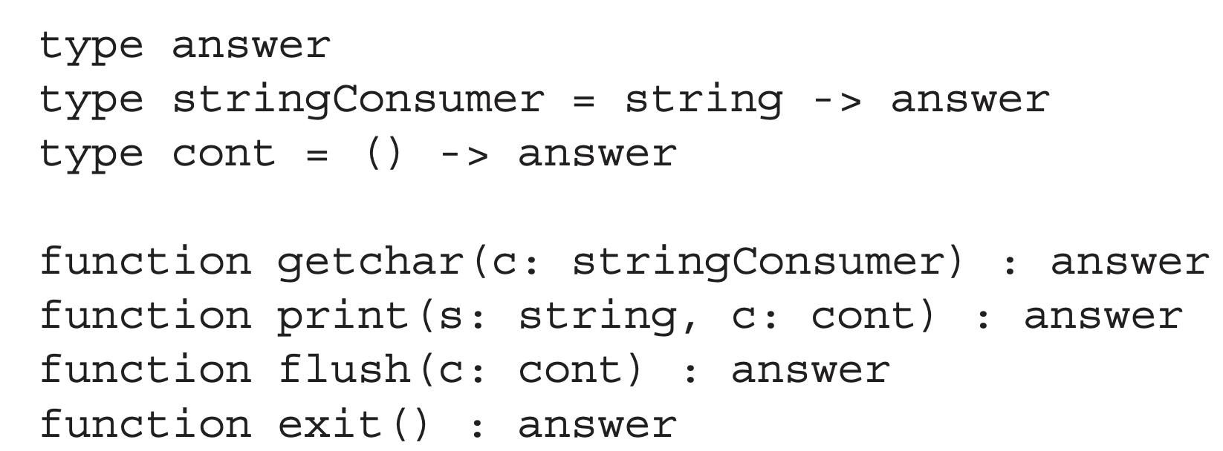
Types and functions for PureFun-Tiger
Adding the answer type
An abstract type for the return value of I/O
Denoting the “result” for the entire program

Slide 41
Types and functions for PureFun-Tiger
Adding the answer type
The consumer type
Containing the logic to handle input
Now the I/O related logic is explicitly passed in

Slide 42
Types and functions for PureFun-Tiger
Adding the answer type
The consumer type
The continuation type
Generate the return value in answer
cont()类型不接受任何参数，而直接返回一个answer，调用一个cont函数的时候实际上就是跳转到某一个控制流并执行。

Slide 43
Types and functions for PureFun-Tiger
Adding the answer type
The consumer type
The continuation type
External functions
All functions return answer now
Invoking the continuation to get answer

Slide 44
Types and functions for PureFun-Tiger
Adding the answer type
The consumer type
The continuation type
External functions
getchar: passing the read char to the consumer

Slide 45
Types and functions for PureFun-Tiger
Adding the answer type
The consumer type
The continuation type
External functions
print/flush: invoke the continuation (c) to produce an answer

Slide 46
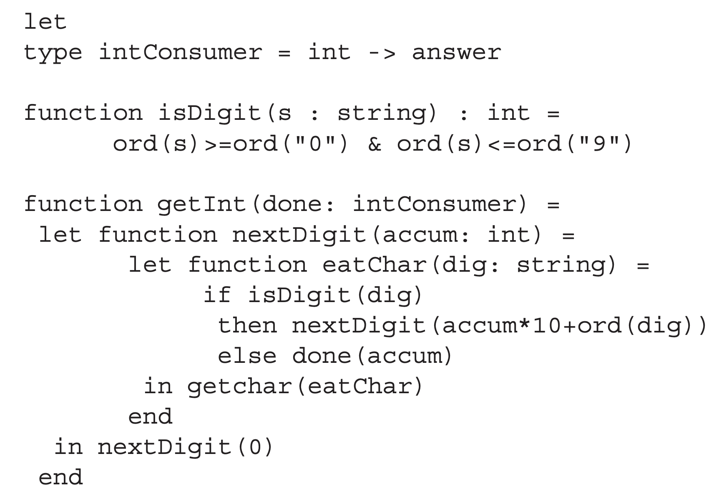
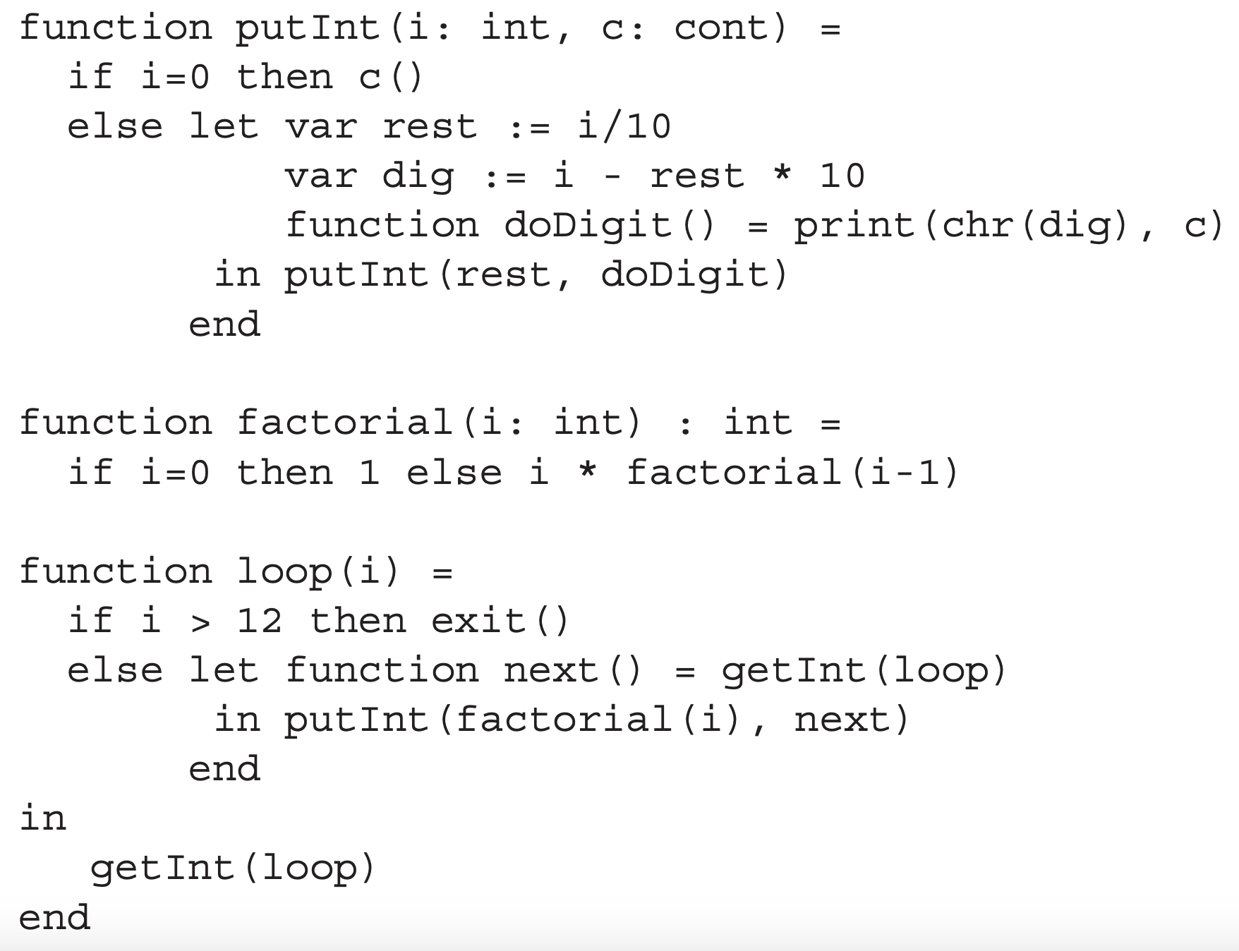
An example for PureFun-Tiger
Two I/O-related functions: getInt/putInt
getInt是读取一个输入的数字字符串并将其转化为十进制，并在遇到一个分隔符的时候一次读取完成。
done会读取最终的int并返回一个answer，从而结束这个nextDigit函数。

Slide 47
An example for PureFun-Tiger
getInt: invoke getchar
stringConsumer -> answer
Passing the input character to eatChar

Slide 48
An example for PureFun-Tiger
getInt: invoke getchar
eatChar recursively read characters
When inputting non-digit, go to done (loop)

Slide 49
An example for PureFun-Tiger
loop: a dead loop to read numbers
A number larger than 12 exits the program
Otherwise passing next (continuation) to putInt

Slide 50
An example for PureFun-Tiger
putInt: output the integer
i is 0 (output is done): call cont and go back to loop
Otherwise recursively print the characters

Slide 51
An example for PureFun-Tiger
The control flow of putInt (suppose i is 24)
factorial(4)=24
putInt(24, getInt(loop)
print invocations are stringed by continuation
putInt(2, print(chr(4), getInt(loop)))
putInt(0, print(chr(2), print(chr(4), getInt(loop))))
c()
print(chr(2), print(chr(4), getInt(loop)))
c()
print(chr(4), getInt(loop))
c()
getInt(loop)

Slide 52
Language changes for Pure-Tiger
Predefined types and functions
answer, stringConsumer, cont
getchar, print, flush, exit
A procedure is considered to return answer
Assignments, for/while loops, compound statements (seqExp) are deleted

Slide 53
Pure functional language optimizations
PureFun-Tiger does not change much compared with Tiger
Similar optimizations (e.g., register allocation) can apply
However, the control flow is more complex…
Expressed through function calls
Some calls are function variables instead of static functions

Slide 54
Pure functional language optimizations
Are there any specific languages for pure functional languages?
The answer is YES, by using equational reasoning

Slide 55
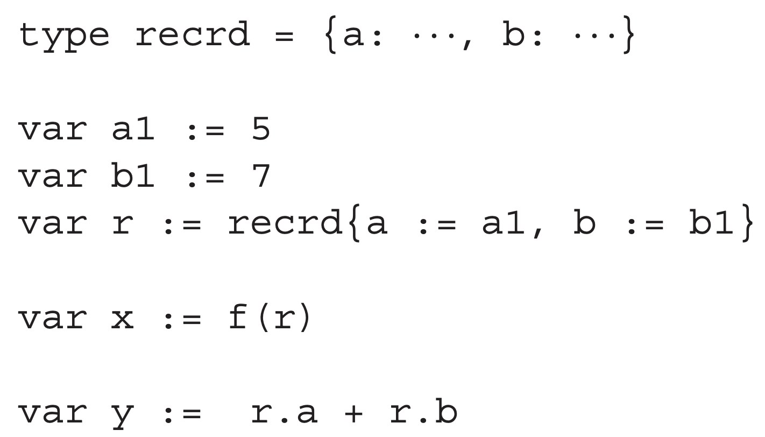
Pure functional language optimizations
Are there any specific optimizations for pure functional languages?
The answer is YES, by using equational reasoning
Consider the following example:
a1 (immutable) -> 5
b1 (immutable) -> 7

Slide 56
Pure functional language optimizations
Are there any specific languages for pure functional languages?
The answer is YES, by using equational reasoning
Consider the following example:
a1 (immutable) -> 5
b1 (immutable) -> 7
r (immutable) -> {a=5, b=7}

Slide 57
Pure functional language optimizations
Are there any specific languages for pure functional languages?
The answer is YES, by using equational reasoning
Consider the following example:
a1 (immutable) -> 5
b1 (immutable) -> 7
r (immutable) -> {a=5, b=7}
all data is immutable!

Slide 58
Pure functional language optimizations
Are there any specific languages for pure functional languages?
The answer is YES, by using equational reasoning
Consider the following example:
a1 (immutable) -> 5
b1 (immutable) -> 7
r (immutable) -> {a=5, b=7}
y <- 5+7 = 12 (constant propagation)

Slide 59
Pure functional language optimizations
Are there any specific languages for pure functional languages?
The answer is YES, by using equational reasoning
Constant propagation is also used in imperative languages
But more complex: fields can be changed
Inter-function analysis is usually difficult

Slide 60
INLINE EXPANSION

Slide 61
Yet another important optimization
Observation: functional programs tend to use many small functions
Loops are not used; replaced by recursive functions
Too many invocations cause performance overhead
Solution: inlining function invocations
Replacing a function call with a copy of a function body
The resulting program can be as efficient as a imperative one

Slide 62
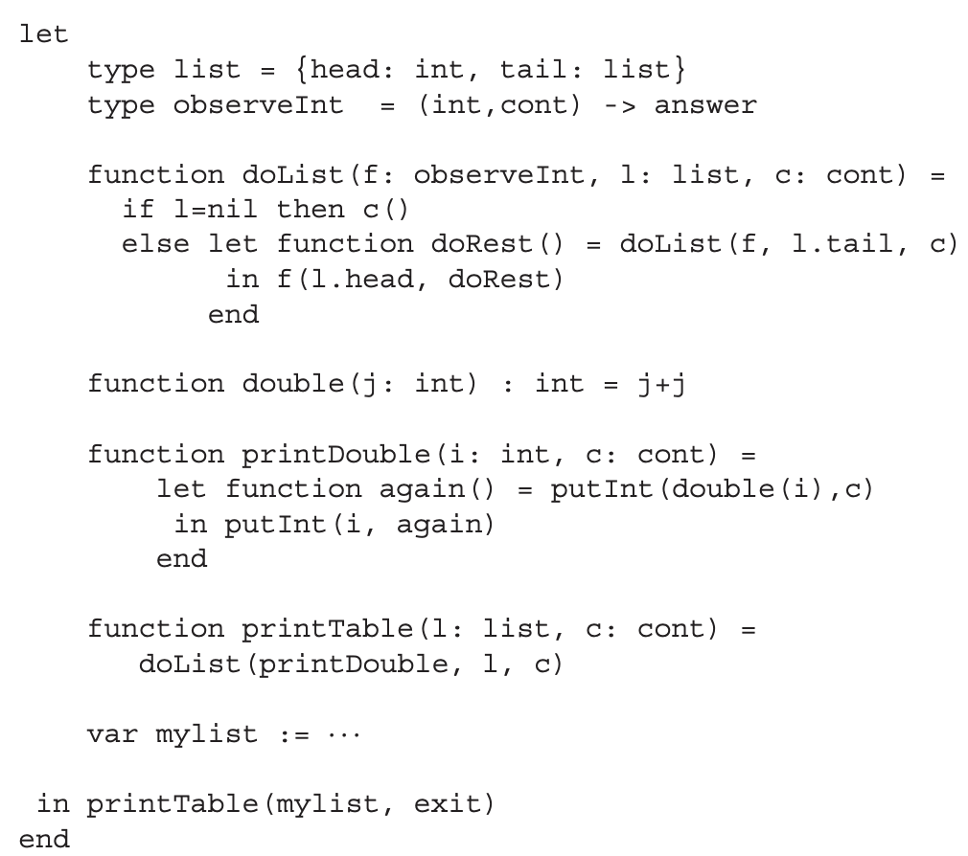
The example used in this part
print elements in a table/list

Slide 63
The example used in this part
print twice: i, i+i
suppose list = {1,2}
output: 1,2,2,4

Slide 64
Note: avoiding variable capture
Outer variables can have the same name with inners
let var x := 5
function g(y: int): int =
y+x
function f(x: int): int =
g(1)+x
in f(2)+x
end

Slide 65
Note: avoiding variable capture
Outer variables can have the same name with inners
Suppose we want to inline g(1) in f
let var x := 5
function g(y: int): int =
y+x
function f(x: int): int =
g(1)+x
in f(2)+x
end
1

Slide 66
Note: avoiding variable capture
Outer variables can have the same name with inners
Suppose we want to inline g(1) in f
The result is 1+x+x
let var x := 5
function g(y: int): int =
y+x
function f(x: int): int =
1+x+x
in f(2)+x
end

Slide 67
Note: avoiding variable capture
Outer variables can have the same name with inners
Suppose we want to inline g(1) in f
The result is 1+x+x
After inlining: f(2) = 1+2+2=5 (before is 1+5+2=8!)
Key reason: two “x”s are different!
let var x := 5
function g(y: int): int =
y+x
function f(x: int): int =
1+x+x
in f(2)+x
end

Slide 68
Note: avoiding variable capture
Solution: renaming the parameters of f
Now the synonym problem is gone
let var x := 5
function g(y: int): int =
y+x
function f(a: int): int =
g(1)+a -> (1+x)+a
in f(2)+x
end

Slide 69
Note: avoiding variable capture
Solution: renaming the parameters of f
Now the synonym problem is gone
A more general solution: adding an earlier pass
Renaming all variables so they never declare twice
let var t0 := 5
function g(t1: int): int =
t1+t0
function f(t2: int): int =
g(1)+t2
in f(2)+t0
end

Slide 70
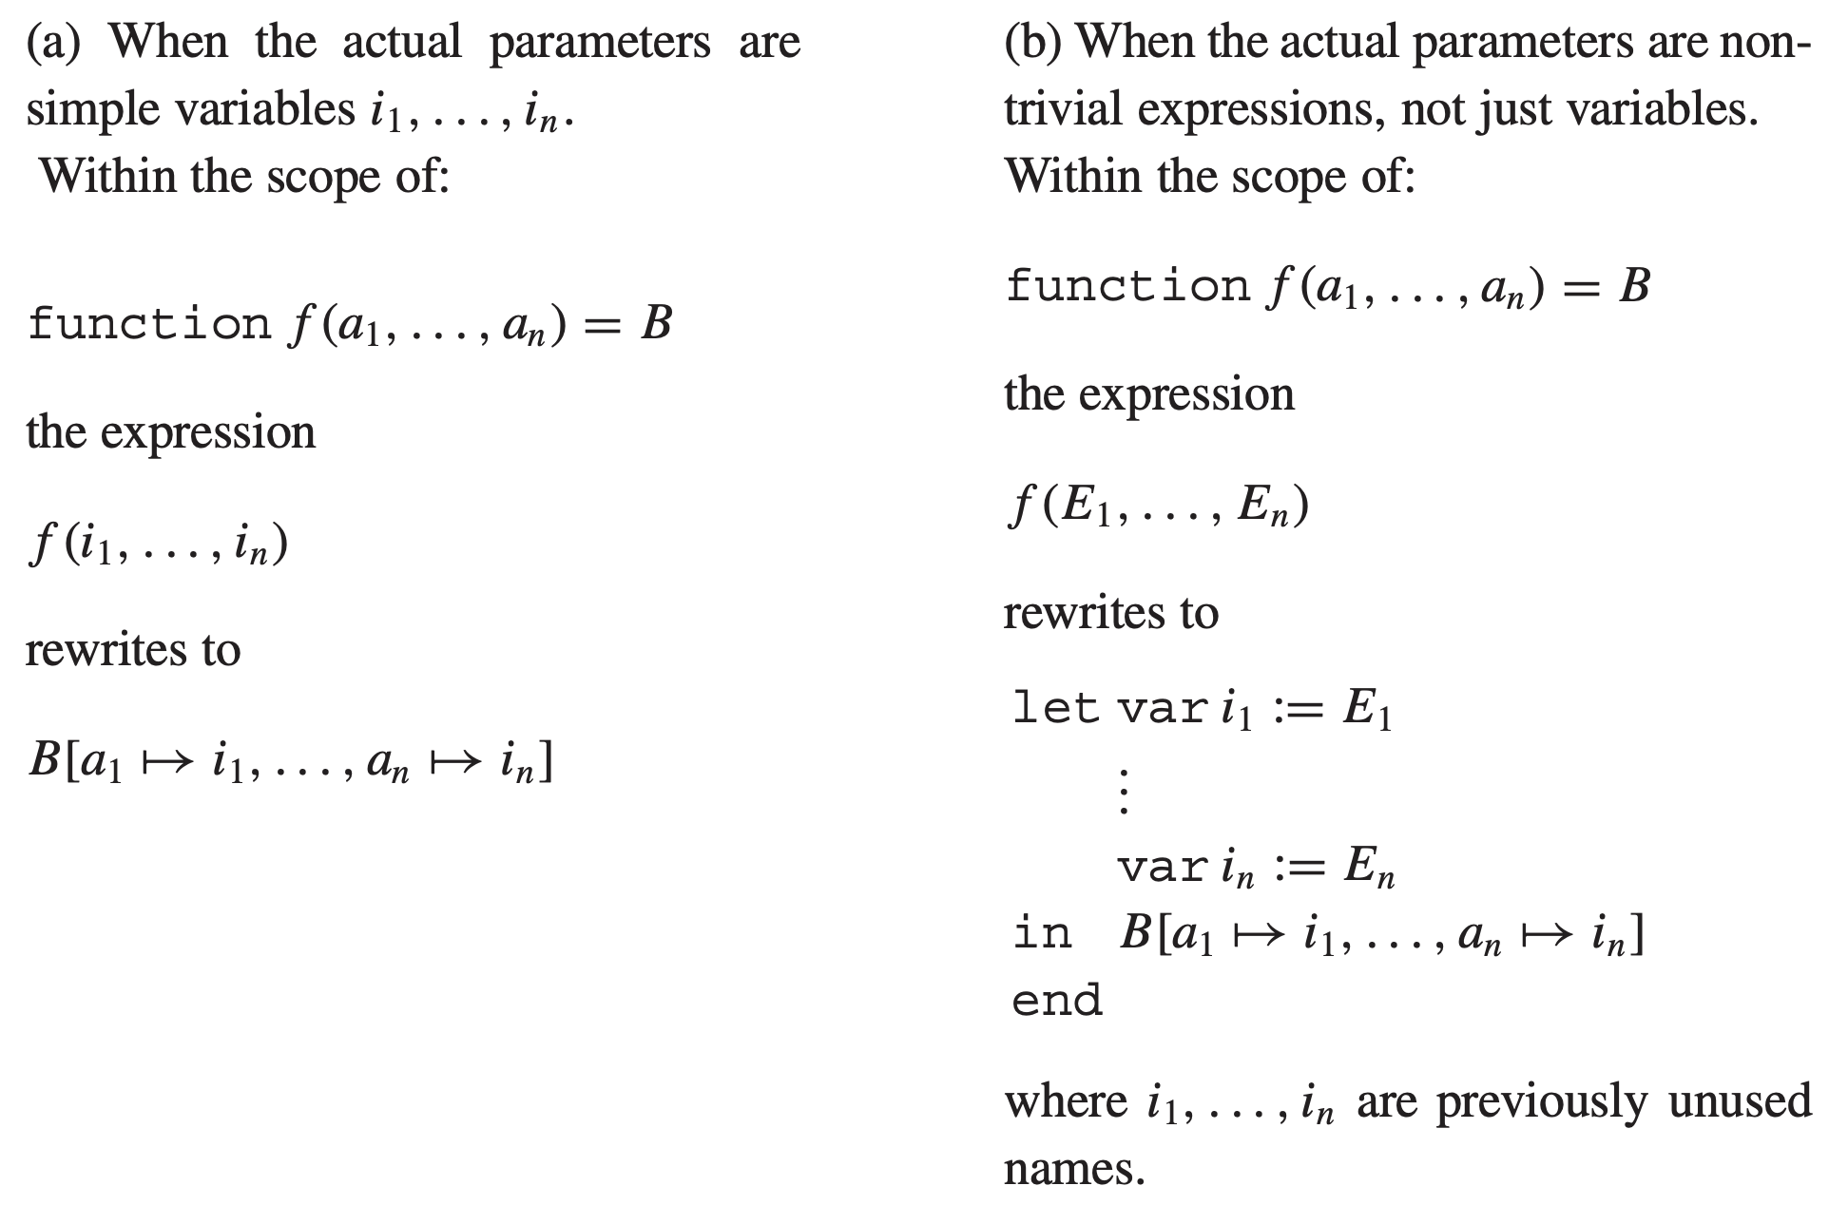
Algorithm for inline expansion
function body

Slide 71
Back to the original example
Suppose we want to inline the double(i) invocation
…
function double(j: int): int = j+j
function printDouble(i: int, c:cont) =
let function again() = putInt(double(i), c))
in putInt(i, again)
end
…

Slide 72
Back to the original example
Suppose we want to inline the double(i) invocation
Following (a): replace i in j+j -> i+i
…
function double(j: int): int = j+j
function printDouble(i: int, c:cont) =
let function again() = putInt(i+i, c))
in putInt(i, again)
end
…

Slide 73
A slightly different example
The invocation now becomes double(g(i))
We do not want to inline the g function
…
function double(j: int): int = j+j
function printDouble(i: int, c:cont) =
let function again() = putInt(double(g(i)), c))
in putInt(i, again)
end
function g(x: Int) = …
…

Slide 74
A slightly different example
The invocation now becomes double(g(i))
We do not want to inline the g function
Following (a): replace g(i) in j+j
…
function double(j: int): int = j+j
function printDouble(i: int, c:cont) =
let function again() = putInt((g(i)+g(i), c))
in putInt(i, again)
end
function g(x: Int) = …
…

Slide 75
A slightly different example
This inline expansion is not good enough
Efficiency: call g twice
Correctness: two calls can have different results for imperative programs
…
function double(j: int): int = j+j
function printDouble(i: int, c:cont) =
let function again() = putInt((g(i)+g(i), c))
in putInt(i, again)
end
function g(x: Int) = …
…

Slide 76
A slightly different example
Solution: following algorithm (b)
Using let-expression to catch the value of g(i)
Then using the new variable to replace j+j
…
function double(j: int): int = j+j
function printDouble(i: int, c:cont) =
let function again() = putInt(
let k:= g(i)
in k+k
end, c))
in putInt(i, again)
end
function g(x: Int) = …
…

Slide 77
Dead function elimination
Similar to dead code elimination (DCE)
Useless functions can be removed
The previous example: double() can be removed
…
function double(j: int): int = j+j
function printDouble(i: int, c:cont) =
let function again() = putInt(i+i, c))
in putInt(i, again)
end
…

Slide 78
Inlining recursive functions
Following (a), we can inline doList in printTable
…
function doList(f: observeInt, l: list, c: cont) =
if l = nil then c()
else let function doRest() = doList(f, l.tail, c)
in f(l.head, doRest)
end
function printTable(l: list, c: cont) =
doList(printDouble, l, c)
…

Slide 79
Inlining recursive functions
Following (a), we can inline doList in printTable
But invocations to doList still exist
We only inline “the first iteration”
…
function printTable(l: list, c: cont) =
if l = nil then c()
else let function doRest() =
doList(printDouble, l.tail, c)
in printDouble(l.head, doRest)
end
…

Slide 80
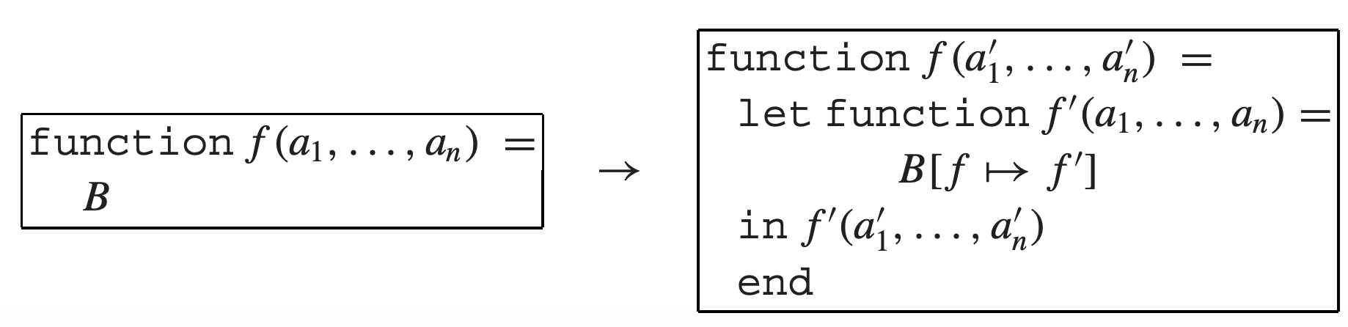
How to entirely inline recursive functions?
Simply inline them does not work
They can have infinite iterations
We need to refactor/customize them
Algorithm: loop-preheader transformation
Key idea: split the function into nested two
The outer one serves as a “hook” (or prelude)

Slide 81
How does this algorithm work?
Still use doList as an example
function doList(f: observeInt, l: list, c: cont) =
if l = nil then c()
else let function doRest() = doList(f, l.tail, c)
in f(l.head, doRest)
end
function doList(fX: observeInt, lX: list, cX: cont) =
let function doListX(f: observeInt, l: list, c: cont) =
if l = nil then c()
else let function doRest() = doListX(f, l.tail, c)
in f(l.head, doRest)
end
in doListX(fX, lX, cX)
end

Slide 82
How does this algorithm work?
Now doList is not calling itself (doListX is)
function doList(f: observeInt, l: list, c: cont) =
if l = nil then c()
else let function doRest() = doList(f, l.tail, c)
in f(l.head, doRest)
end
function doList(fX: observeInt, lX: list, cX: cont) =
let function doListX(f: observeInt, l: list, c: cont) =
if l = nil then c()
else let function doRest() = doListX(f, l.tail, c)
in f(l.head, doRest)
end
in doListX(fX, lX, cX)
end

Slide 83
Inline expand after transformation
Now if printTable inlines doList:
Following (a)
Note: the formal parameters do not need to change
…
function printTable(l: list, c: cont) =
let function doListX(f: observeInt, l: list, c: cont) =
if l = nil then c()
else let function doRest() = doListX(f, l.tail, c)
in f(l.head, doRest)
end
in doListX(printDouble, l, c)
…

Slide 84
Inline expand after transformation
Is it good enough?
Perhaps more potential optimizations
E.g., f is always printDouble in doListX
…
function printTable(l: list, c: cont) =
let function doListX(f: observeInt, l: list, c: cont) =
if l = nil then c()
else let function doRest() = doListX(f, l.tail, c)
in f(l.head, doRest)
end
in doListX(printDouble, l, c)
…

Slide 85
Loop-invariant arguments
doListX has two unchanged arguments in every calls
f (always fX); c (always cX)
They are invariants during recursive invocations
function doList(fX: observeInt, lX: list, cX: cont) =
let function doListX(f: observeInt, l: list, c: cont) =
if l = nil then c()
else let function doRest() = doListX(f, l.tail, c)
in f(l.head, doRest)
end
in doListX(fX, lX, cX)
end

Slide 86
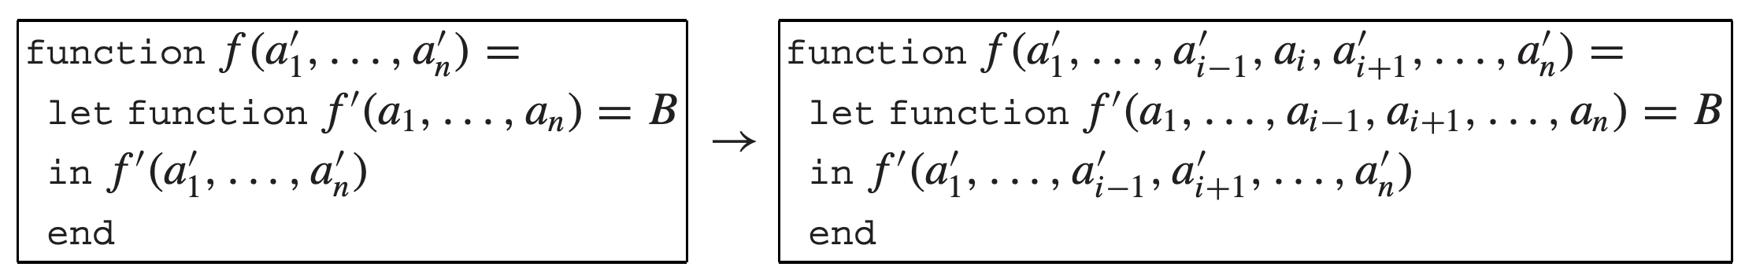
Loop-invariant hoisting
Algorithm: if every use of f’ within B is of the form f’(E₁, …, E_{i-1}, a_{i}, E_{i+1}, …, E_{n}) such that the ith argument is always a_{i}, then rewrite
where every call f’(E₁, …, E_{i-1}, a_{i}, E_{i+1}, …, E_{n}) within B is rewritten as f’(E₁, …, E_{i-1}, E_{i+1}, …, E_{n})
moved out

Slide 87
Loop-invariant hoisting in our example
Moving f and c out
Replacing the original name: fX and cX
function doList(fX: observeInt, lX: list, cX: cont) =
let function doListX(f: observeInt, l: list, c: cont) =
if l = nil then c()
else let function doRest() = doListX(f, l.tail, c)
in f(l.head, doRest)
end
in doListX(fX, lX, cX)
end

Slide 88
Loop-invariant hoisting in our example
Moving f and c out
Replacing the original name: fX and cX
Now doListX has only one parameter (l)
function doList(f: observeInt, lX: list, c: cont) =
let function doListX(l: list) =
if l = nil then c()
else let function doRest() = doListX(l.tail)
in f(l.head, doRest)
end
in doListX(lX)
end

Slide 89
Loop-invariant hoisting in our example
Moving f and c out
Replacing the original name: fX and cX
Now doListX has only one parameter (l)
The inlined result also changes
…
function printTable(l: list, c: cont) =
let function doListX(l: list) =
if l = nil then c()
else let function doRest() = doListX(l.tail)
in printDouble(l.head, doRest)
end
in doListX(l)
…

Slide 90
Cascading inlining
Formal inline expands enable more opportunities
Now it is clear that printDouble can be inlined
Following (b)
…
function printTable(l: list, c: cont) =
let function doListX(l: list) =
if l = nil then c()
else let function doRest() = doListX(l.tail)
in printDouble(l.head, doRest)
end
in doListX(l)
…

Slide 91
Cascading inlining
The result for inline expanding
Can we do more inlining? (sure, consider putInt)
…
function printTable(l: list, c: cont) =
let function doListX(l: list) =
if l = nil then c()
else let function doRest() = doListX(l.tail)
in let var i:= l.head
in let function again() = putInt(i+i,doRest)
in putInt(i,again)
end
end
end
in doListX(l)
…

Slide 92
Another opportunity: unnesting lets
Nested lets can be simplified
In our example: three nested lets
let dec1 in let dec2 in exp end end = let dec1 dec2 in exp end
function printTable(l: list, c: cont) =
let function doListX(l: list) =
if l = nil then c()
else let function doRest() = doListX(l.tail)
in let var i:= l.head
in let function again() = putInt(i+i,doRest)
in putInt(i,again)
end
end
end
in doListX(l)
end

Slide 93
Another opportunity: unnesting lets
Nested lets can be simplified
The optimized version (neat in source code)
let dec1 in let dec2 in exp end end = let dec1 dec2 in exp end
function printTable(l: list, c: cont) =
let function doListX(l: list) =
if l = nil then c()
else let function doRest() = doListX(l.tail)
var i:= l.head
function again() = putInt(i+i,doRest)
in putInt(i,again)
end
in doListX(l)
end

Slide 94
Tradeoff for inline expansion
Inline expansion can improve the performance
Call instructions are removed
Less register saving/restoring
However, it makes the program bigger
A function body might be copied in multiple callers
Can cause code explosion if handled incorrectly

Slide 95
Heuristics to control inlining
Expand only call sites frequently executed
The most cost-effective
Frequency can be determined by static analysis or dynamic profiling
Expand functions with small bodies
Some functions (getter/setter) are even smaller than the call-related instruction sequence
A smart compiler automatic inlines them

Slide 96
Heuristics to control inlining
Expand only call sites frequently executed
Expand functions with small bodies
Expand functions called only once
The original body can be removed by DFE
The program size may not increase

